Slide 1
Strategy
Chapter Two
McGraw-Hill/Irwin
Copyright © 2014 by The McGraw-Hill Companies, Inc. All rights reserved.

Slide 2
Company Aspirations Beyond Making a Profit
Cliff Bar’s Aspirations (an example)
1. Sustaining our Planet—Keep our impact on the planet small, even as we grow.
2. Sustaining our Community—Be good neighbors. Give back to the community.
3. Sustaining our People— Create an environment where people can live life to the fullest, even from 9 to 5.
4. Sustaining our Business—Grow slower, grow better, and stick around longer.
5. Sustaining our Brands—Make what people actually need. Never compromise quality.

Slide 3
Sustainable Strategy
The firm’s strategy describes how it will create and sustain value for its current shareholders
Shareholders – individuals or companies that legally own one or more shares of stock in the company
Stakeholders – individuals or organizations who are directly or indirectly influenced by the actions of the firm
Adding a sustainability requirement means meeting value goals without compromising the ability of future generations to meet their own needs
Triple bottom line – evaluating the firm against social, economic, and environmental criteria

Slide 4
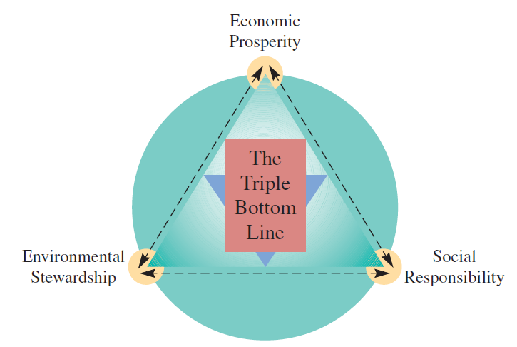
Triple Bottom Line

Slide 5
Operations and Supply Chain Strategy
Setting broad policies and plans for using the resources of a firm – must be integrated with corporate strategy
Corporate strategy provides overall direction and coordinates operational goals with those of the larger organization
Operations effectiveness – performing activities in a manner that best implements strategic priorities at a minimum cost

Slide 6
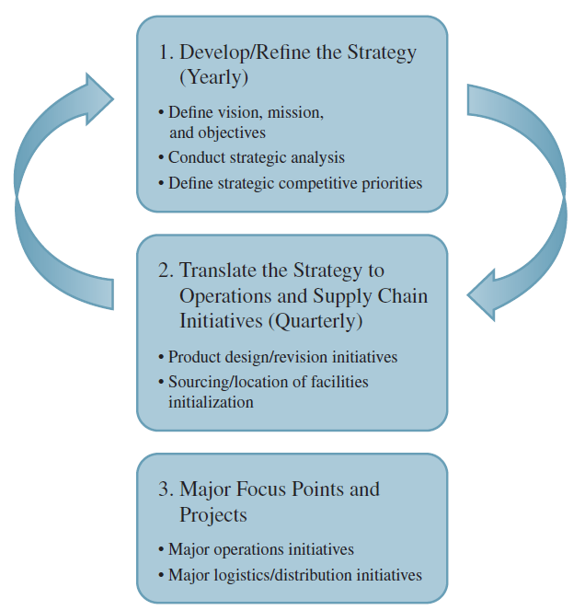
Formulating an Operations and Supply Chain Strategy

Slide 7
Competitive Dimensions
Price
Quality
Delivery Speed
Make the product or deliver the service cheap
Make a great product or delivery a great service
Make the product or deliver the service quickly
Delivery Reliability
Deliver it when promised
Coping with Changes in Demand
Change its volume
Flexibility and New-Product Introduction Speed
Change it

Slide 8
Trade-Offs
Management must decide which parameters of performance are critical and concentrate resources on those characteristics
For example, a firm that is focused on low-cost production may not be capable of quickly introducing new products
Straddling – seeking to match a successful competitor by adding features, services, or technology to existing activities
Often a risky strategy

Slide 9
Order Winners and Order Qualifiers
Order qualifiers are those dimensions that are necessary for a firm’s products to be considered for purchase by customers
Features customers will not forego
Order winners are criteria used by customers to differentiate the products and services of one firm from those of other firms
Features that customers use to determine which product to ultimately purchase

Slide 10
SC Risk Examples
Japanese Tsunami (March 2011).
In 1996 General Motors experienced an 18-day labor strike at a brake supplier factory.
This strike idled workers at 26 assembly plants and led to an estimated $900 million reduction in earnings.
In 1997 a Boeing supplier’s failure to deliver two critical parts led to a loss of $2.6 billion.

Slide 11
Assessing Risk Associated with OSCM Strategy
All strategies have an inherent level of risk
Uncertainty in the environment causes supply chain planners to evaluate the relative riskiness of their strategies
Supply chain risk is the likelihood of a disruption that would impact the ability of a company to continuously supply products or services
Supply chain coordination risks are associated with the day-to-day management of the supply chain
Disruption risks are caused by natural or manmade disasters

Slide 12
Risk Mitigation Framework
1. Identify the sources of potential disruptions and assess a type of vulnerability.
Focus on highly unlikely events that would cause a significant disruption to normal operations.
2. Assess the potential impact of the risk. Here the goal is to quantify the probability and the potential impact of the risk.
Could be based on financial impact, environmental impact, ongoing business viability,
Brand image/reputation, potential human lives, and so on.
3. Develop plans to mitigate the risk. A detailed strategy for minimizing the impact of the risk could take many different forms, depending on the nature of the problem.

Slide 13
Productivity Measurement
Productivity is a measure of how well resources are used
Productivity =
Productivity is a relative measure
Must be compared to something else to be meaningful
Operations can be compared to each other
Firms can be compared to other firms
Partial productivity measures compare output to a single input
Multifactor productivity measures compare output to a group of inputs
Total productivity measures compare output to all inputs

