Slide 1
DESIGN OF PRODUCTS AND SERVICES
Chapter Three
McGraw-Hill/Irwin
Copyright © 2014 by The McGraw-Hill Companies, Inc. All rights reserved.

Slide 2
The Product Design Process
Companies continuously bring new products to market
Product design is integral to success
Product design differs significantly depending on the industry
Companies often outsource major functions
Contract manufacturer: an organization capable of manufacturing and/or purchasing all the components needed to produce a finished product

Slide 3
Core Competency
Core competency: the one thing a company can do better than its competitors
A core competency has three characteristics:
It provides potential access to a wide variety of markets
It increases perceived customer benefits
It is hard for competitors to imitate

Slide 4
Brainstorming: A General Method for Problem Solving
Defer judgment
Build on the ideas of others
Stay focused on the topic
One person at a time
Go for quantity
Encourage wild ideas
Be visual

Slide 5
Six Phases of the Generic Development Process (Formal Process)
Phase 0: Planning
Phase 1: Concept development
Phase 2: System-level design
Phase 3: Design detail
Phase 4: Testing and refinement
Phase 5: Production ramp-up

Slide 6
Phase 0: Planning
Precedes project approval
Begins with corporate strategy
Includes assessment of technology developments and market objectives
Output is the project mission statement

Slide 7
Phase 1: Concept Development
Needs of the target market are identified
Alternative product concepts are generated and evaluated
One or more concepts are selected for further development and testing
Concept: a description of the form, function, and features of a product

Slide 8
Phase 2: System-Level Design
Definition of the product architecture
Decomposition of the product into subsystems and components
Final assembly scheme for the production system is usually defined
Output:
Geometric layout of the product
Functional specifications for each subsystem
Preliminary process flow diagram

Slide 9
Phase 3: Design Detail
Complete specification of the geometry, materials, and tolerances for all parts
Identification of all the standard parts to be purchased from suppliers
Process plan is established
Tooling is designed
Output:
Drawings describing the geometry of each part and its tooling
Specifications of purchased parts
Process plan

Slide 10
Phase 4: Testing and Refinement
Construction and evaluation of multiple preproduction versions of product
Same geometry and material as production version
Not necessarily fabricated with the actual production processes
Prototypes tested to determine if the product will work as designed

Slide 11
Phase 5: Production Ramp-Up
Product is made using the intended production system
Need to train workers and resolve any remaining problems
Products may be supplied to preferred customers for evaluation
Transition to ongoing production is gradual

Slide 12
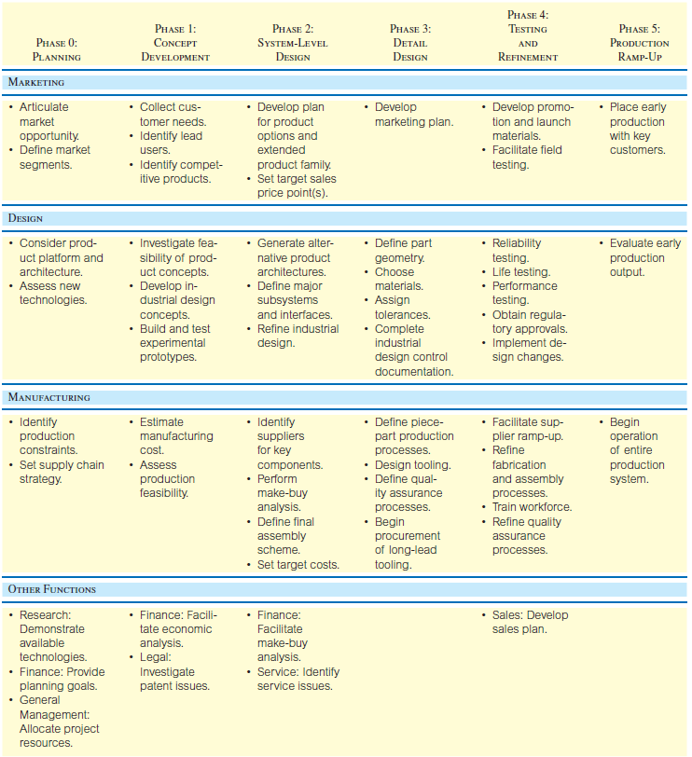
The Generic Product Development Process

Slide 13
Generic Product Development Process
Technology-push products: firm begins with new technology and looks for a market
Platform products: built around a preexisting technological subsystem
Process-intensive products: production process has an impact on the properties of the product
Product design cannot be separated from process design

Slide 14
Generic Product Development Process Continued
Customized products: new products are slight variations of existing configurations
High-risk products: technical or market uncertainties create high risks of failure
Quick-build products: rapid modeling and prototyping enables many design-build-test cycles

Slide 15
Generic Product Development Process Continued
Complex systems: systems must be decomposed into several subsystems and many components
Generic: begins with a market opportunity and team selects appropriate technologies to meet customer needs

Slide 16
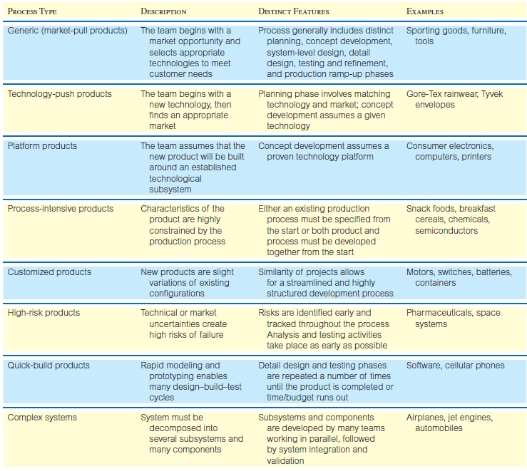
Summary of Variants of Generic Product Development Process

Slide 17
Designing for the Customer
House of Quality
Ideal Customer Product
Quality Function
Deployment
Value Analysis/
Value Engineering

Slide 18
Quality Function Deployment
Interfunctional teams from marketing, design engineering, and manufacturing
Begins with listening to the customer
Uses market research
Customer preferences are defined and broken down into customer requirements
House of quality
Notes:
6

Slide 19
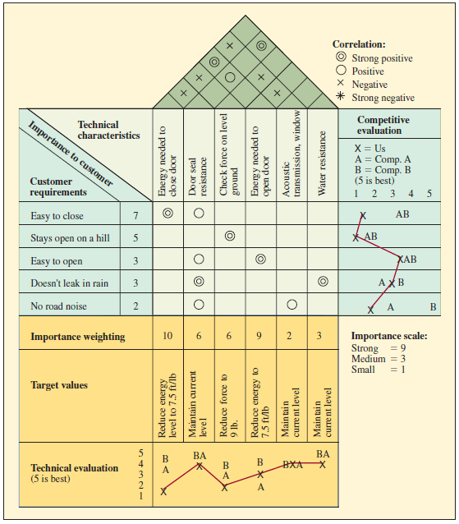
Completed House of Quality Matrix for a Car Door
Customer requirements information forms the basis for this matrix, used to translate them into operating or engineering goals

Slide 20
Value Analysis/Value Engineering (VA/VE)
Purpose is to simplify products and processes
Objective is to achieve better performance at a lower cost while maintaining all functional requirements defined by the customer
Does the item have any design features that are not necessary?
Can two or more parts be combined into one?
How can we cut down the weight?
Are there nonstandard parts that can be eliminated?
Notes:
8

Slide 21
Designing Products for Manufacture and Assembly
Traditional approach
“We design it, you build it” or “over the wall”
Concurrent engineering
“Let’s work together simultaneously”
Notes:
9

Slide 22
Design for Manufacturing and Assembly
Greatest improvements related to DFMA arise from simplification of the product by reducing the number of separate parts:
During the operation of the product, does the part move relative to all other parts already assembled?
Must the part be of a different material or be isolated from other parts already assembled?
Must the part be separate from all other parts to allow the disassembly of the product for adjustment or maintenance?
Notes:
10

Slide 23
Ecodesign
Ecodesign: the incorporation of environmental considerations in the design and development of products or services
The whole life cycle is considered
The product is considered as a system
A multi-criteria approach is used
Application of ecodesign can benefit business

Slide 24
Designing Service Products
Service products are very different
Direct customer involvement introduces significant variability in the process
Questions to address:
How will this variability be addressed?
What are the implications for operational cost and the customer service experience?

Slide 25
Three General Factors for Determining Fit
Service experience fit
The new service should fit into the current service experience for the customer
Operational fit
Existing processes should be able to support the operation of the new service
Financial impact
Introducing a new service should be financially justified

Slide 26
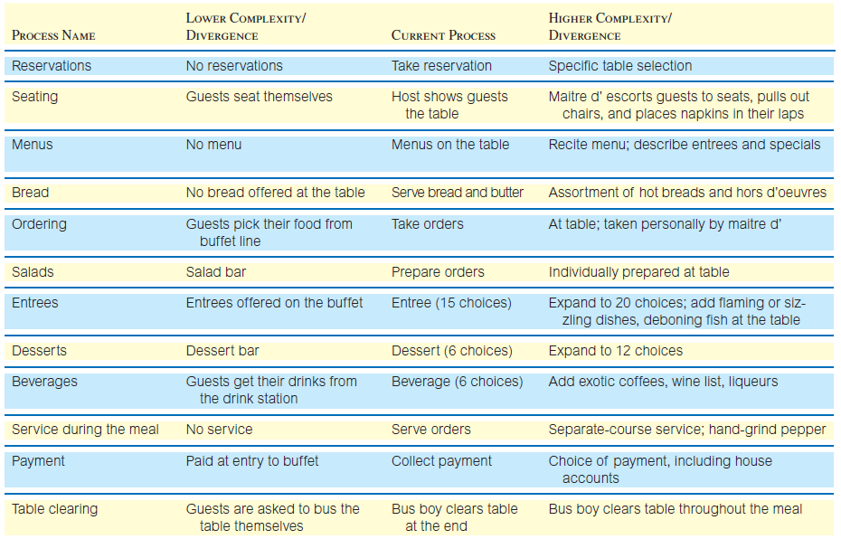
Structural Alternatives for a Family Restaurant

Slide 27
Economic Analysis of Project Development Costs
Using measurable factors to help determine:
Go/no-go milestones
Operational design and development decisions
Building a base-case financial model
A financial model consisting of major cash flows
Sensitivity analysis for “what if” questions

Slide 28
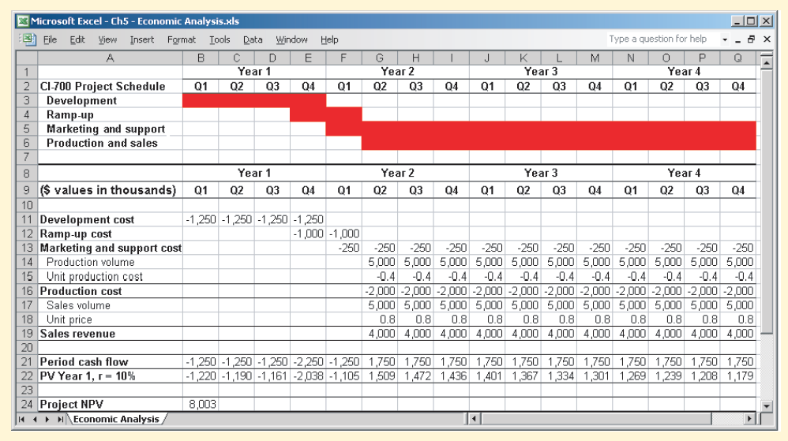
Merging the Project Financials and Schedule into a Cash Flow Report

Slide 29
Possible Sensitivity Analysis Scenarios
Longer product development time
Higher/lower sales volume
Higher/lower sales price
Higher/lower development costs

Slide 30
Measuring Product Development Performance
A steady stream of new products is important to competitiveness
Firms must respond to changing customer needs and competitor moves
Ability to identify opportunities and bring new products to market is critical
Must also be efficient

Slide 31
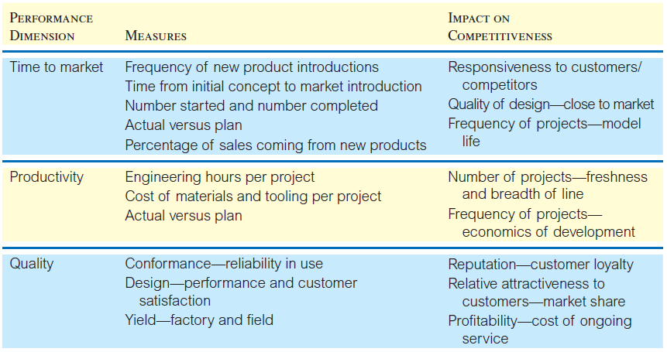
Performance Measures for Development Projects

