Slide 1
STORIA GLOBALE
Guido Abbattista
Laurea Magistrale Interateneo in Studi Storici dal Medioevo all’età contemporanea
Moodle enrolment key: GLOBHIST

Slide 2
Lezione 3
Geografia e cronologia della Cina

Slide 5
La province della Cina

Slide 6
Province della Cina

Slide 7
Dimensioni comparate
1 | Russia | 17,098,242
2 | Canada | 9,984,670
3 | United States | 9,826,675
4 | China | 9,596,960
5 | Brazil | 8,514,877
6 | Australia | 7,741,220
7 | India | 3,287,263
8 | Argentina | 2,780,400
9 | Kazakhstan | 2,724,900

Slide 8
Huang Ho River

Slide 9
Yangtze River

Slide 10
Xun River

Slide 11
Grand canal
The Grand Canal (also known as the Beijing-Hangzhou Grand Canal), a UNESCO World Heritage Site, is the longest canal or artificial river in the world […] Starting at Beijing, it passes through Tianjin and the provinces of Hebei, Shandong, Jiangsu and Zhejiang to the city of Hangzhou, linking the Yellow River and Yangtze River. The oldest parts of the canal date back to the 5th century BC, although the various sections were finally combined during the Sui dynasty (581–618 AD).
The total length of the Grand Canal is 1,776 km (1,104 mi).

Slide 12
Storia della Cina: dinastie imperiali e repubblica
Xia (2100-1600 a.C. circa)
Shang (c. 1600-1046 a.C.)
Zhou (1046-256 a.C.)
Periodo degli Stati Combattenti (453-221 a.C.)
Qin (221-206 a.C.)
Han (202 a.C. - 220 d.C.)
Three Kingdoms (220-280 d. C.)
Jìn (265–420 d.C.)
Dinastie del Nord e del Sud (420-589 d. C.)
Suí (581-618 d. C.)
Tang (618-907 d.C.)
Cinque dinastie e dieci regni (907-979. C.)
Song (979-1279)
Yuan (Mongoli, 1279-1368)
Ming (1368 -1644)
Qing (Manchu, 1644-1911)
Repubblica di Cina (1912-1949)
Repubblica Popolare Cinese (1949-corrente)

Slide 13
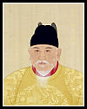
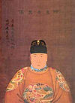
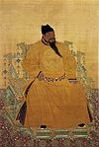
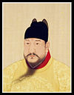
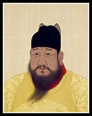
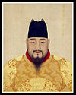
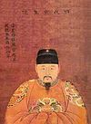
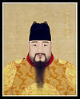
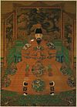
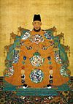
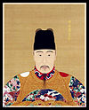
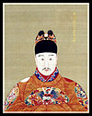
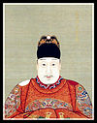
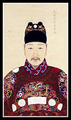
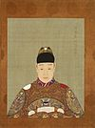
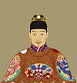
Imperatori della dinastia Ming
Name by which most commonly known | Reign years
Hongwu Emperor | 1368–1398
Jianwen Emperor | 1398–1402
Yongle Emperor | 1402–1424
Hongxi Emperor | 1424–1425
Xuande Emperor | 1425–1435
Zhengtong Emperor | 1435–1449 and 1457–1464
Jingtai Emperor | 1449–1457
Chenghua Emperor | 1464–1487
Hongzhi Emperor | 1487–1505
Zhengde Emperor | 1505–1521
Jiajing Emperor | 1521–1567
Longqing Emperor | 1567–1572
Wanli Emperor | 1572–1620
Taichang Emperor | 1620
Tianqi Emperor | 1620–1627
Chongzhen Emperor | 1627–1644

Slide 14
Imperatori della dinastia Qing
No. | Reign Title | Personal Name | Reign | Lifetime | Relation to Previous Emperor | Comments
--- | Kundulun Khan Tian Ming (1616 - 1626) | Nurhachi | 1583 - 1626 | 1559 - 1626 | None | Unified Manchu tribes and founded the Manchu state. Named state Jin¹ in 1616.
--- | Tian Cong (1627 - 1636) Chong De (1636 - 1643) | Abahai | 1627 - 1643 | 1592 - 1643 | 8th son | Renamed dynasty Qing in 1636.
1 | Shun Zhi | Fu Lin | 1644 - 1661 | 1638 - 1661 | 9th son | Manchu conquest of China proper, 1644.
2 | Kang Xi | Xuan Ye | 1662 - 1722 | 1654 - 1722 | 3rd son | Consolidated Manchu control of China.
3 | Yong Zheng | Yin Zhen | 1723 - 1735 | 1678 - 1735 | 4th son | Concentrated power in Emperor's hands.
4 | Qian Long | Hong Li | 1736 - 1795 | 1711 - 1799 | 5th son | Height of Qing power.
5 | Jia Qing | Yong Yan | 1796 - 1820 | 1760 - 1820 | 5th son | Attempted to restore flagging state of empire.
6 | Dao Guang | Min Ning | 1821 - 1850 | 1782 - 1850 | son | Lost Opium War to Britain
7 | Xian Feng | Yi Zhu | 1851 - 1861 | 1831 - 1861 | son | Signed "unequal treaties," fought against Taiping rebels.
8 | Tong Zhi | Zai Chun | 1862 - 1874 | 1856 - 1875 | son | Weak ruler under his mother, the Empress Dowager Cixi. Revitalized government.
9 | Guang Xu | Zai Tian | 1875 - 1908 | 1871 - 1908 | cousin | Installed and controlled by the Empress Dowager Cixi. Attempts at reform stifled by Cixi.
10 | Xuan Tong | Pu Yi | 1909 - 1912 | 1906 - 1967 | nephew | Abdicated. Installed as Chief Executive (1932 - 1934), then as Emperor (1934 - 1945) of Manchukuo by the Japanese under the reign title Kang De.

