Slide 1
Introduction
Chapter One
McGraw-Hill/Irwin
Copyright © 2014 by The McGraw-Hill Companies, Inc. All rights reserved.

Slide 2
Strategy, Processes, and Analytics
Operations and supply chain management involves
Product design
Purchasing
Manufacturing
Service operations
Logistics
Distribution
Success depends upon
Strategy
Processes to deliver products and services
Analytics to support the decisions needed to manage the firm

Slide 3
What Is Operations and Supply Chain Management?
The design, operation, and improvement of the systems that create and delivery the firm’s primary products and services
Operations and supply chain management (OSCM) is
A functional field of business
Concerned with the management of the entire production/delivery system

Slide 4
Operations and Supply Chain Processes
Operations
Manufacturing and service processes used to transform resources into products
Supply Chain
Processes that move information and material to and from the firm

Slide 5
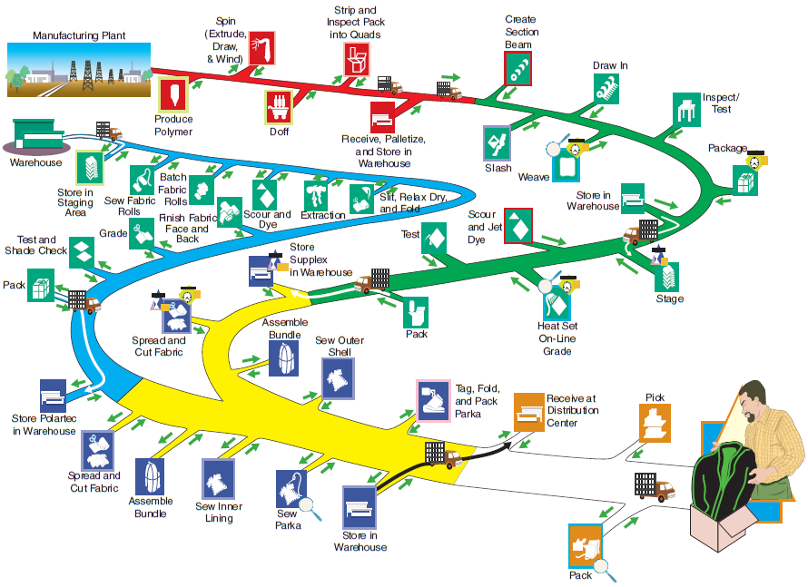
Process Steps for Men’s Nylon Supplex Parkas

Slide 6
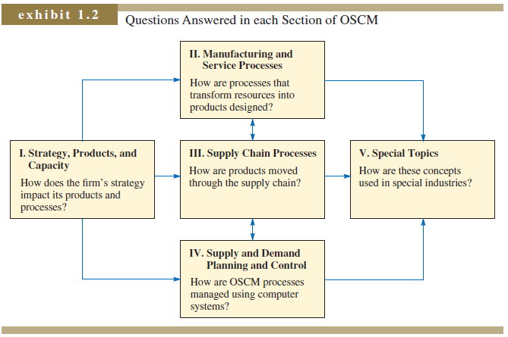
Each Section of OSCM: What Is Accomplished?

Slide 7
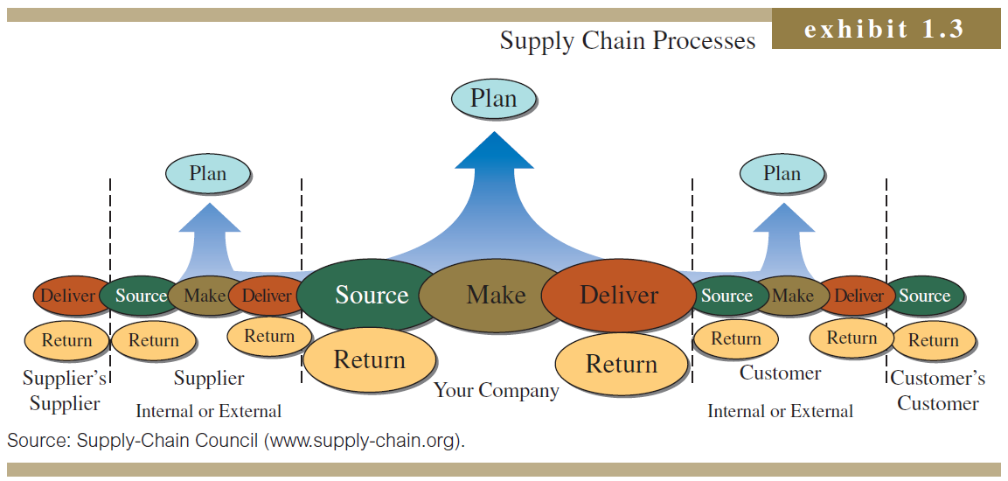
Operations and Supply Chain Processes

Slide 8
Process Activities
Planning – processes needed to operate an existing supply chain
Sourcing – selection of suppliers that will deliver the goods and services needed to create the firm’s product
Making – producing the major product or service
Delivering – logistics processes such as selecting carriers, coordinating the movement of goods and information, and collecting payments from customers
Returning – receiving worn-out, excess, and/or defective products back from customers

Slide 9
Goods versus Services
Goods
Services
Tangible
Less interaction with customers
Often homogeneous
Not perishable – can be inventoried
Pure Goods
Intangible
Interaction with customer required
Inherently heterogeneous
Perishable/time dependent
Defined and evaluated as a package of features
Core Services
Pure Services
Core Goods

Slide 10
Careers in Operations and Supply Chain Management
Plant manager
Hospital administrator
Branch manager
Department store manager
Call center manager
Supply chain manager
Purchasing manager
Business process improvement analyst
Quality control manager
Lean improvement manager
Project manager
Production control analyst
Facilities manager
Chief operating officer

Slide 11
Historical Development of Operations and Supply Chain Management
Late 1970s
Manufacturing strategy developed
Just-in-time (JIT) production pioneered by the Japanese
Early 1980s
Mid 1980s
Service quality and productivity
Total quality management (TQM) and Quality certification programs
Early 1990s
Six-sigma quality
Mid 1990s
Supply chain management (SCM)
Business process reengineering (BPR)
Late 1990s
Electronic commerce
Early 2000s
Service science
Mid 2010s
Business analytics

Slide 12
Current Issues in OSCM
Coordinating relationships between members of SC
Optimizing global network of suppliers, producers, and distributors
Managing customer touch points
Raising awareness of OSCM as a competitive weapon
Sustainability and triple bottom line

Slide 13
Efficiency, Effectiveness, and Value
Efficiency
Effectiveness
Value
Doing something at the lowest possible cost
Doing the right things to create the most value for your customer
The attractiveness of a product relative to its cost

Slide 14
Efficiency and Wall Street

