Slide 1
Lesson One

Slide 2
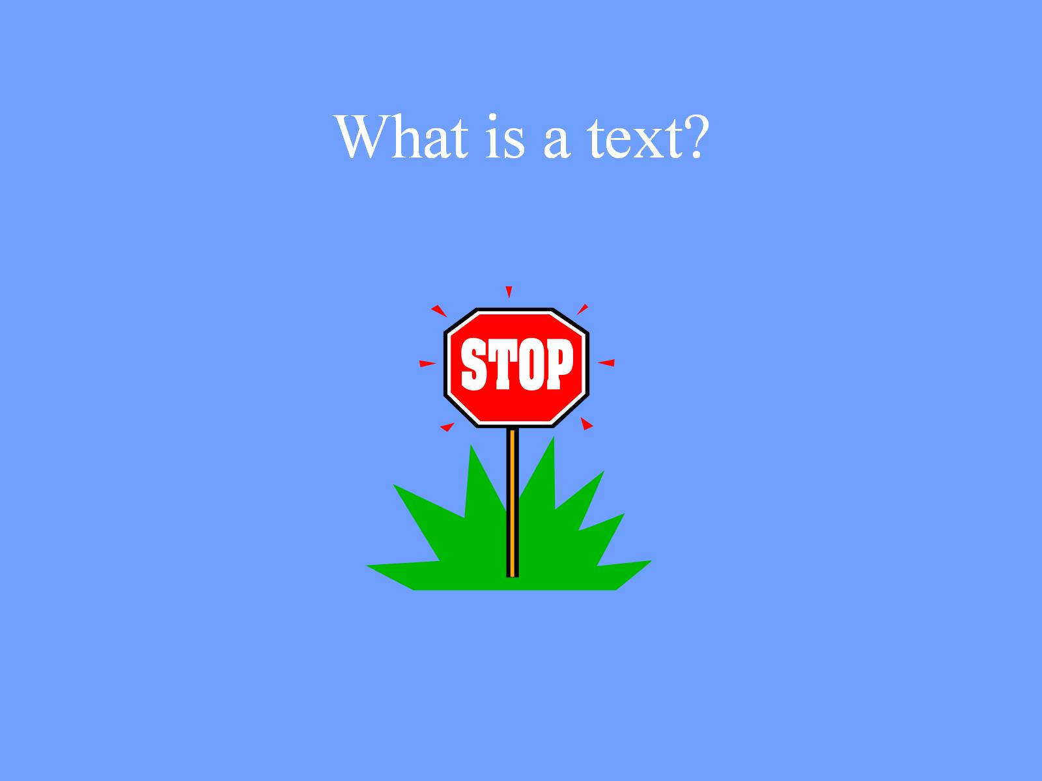
What is a text?

Slide 3
What is a multimodal text?

Slide 5
Semiotic modalities

Slide 6
Written Words

Slide 7
Pictures

Slide 8
Colour

Slide 9
Gesture

Slide 10
Male body language

Slide 11
Hand gesture

Slide 12
Female body language

Slide 13
Movement

Slide 14
Music

Slide 15
The Green Leaves of Summer The Alamo

Slide 16
The Green Leaves of Summer Inglourious Basterds

Slide 17
Perspective

Slide 18
Camera Angles

Slide 19
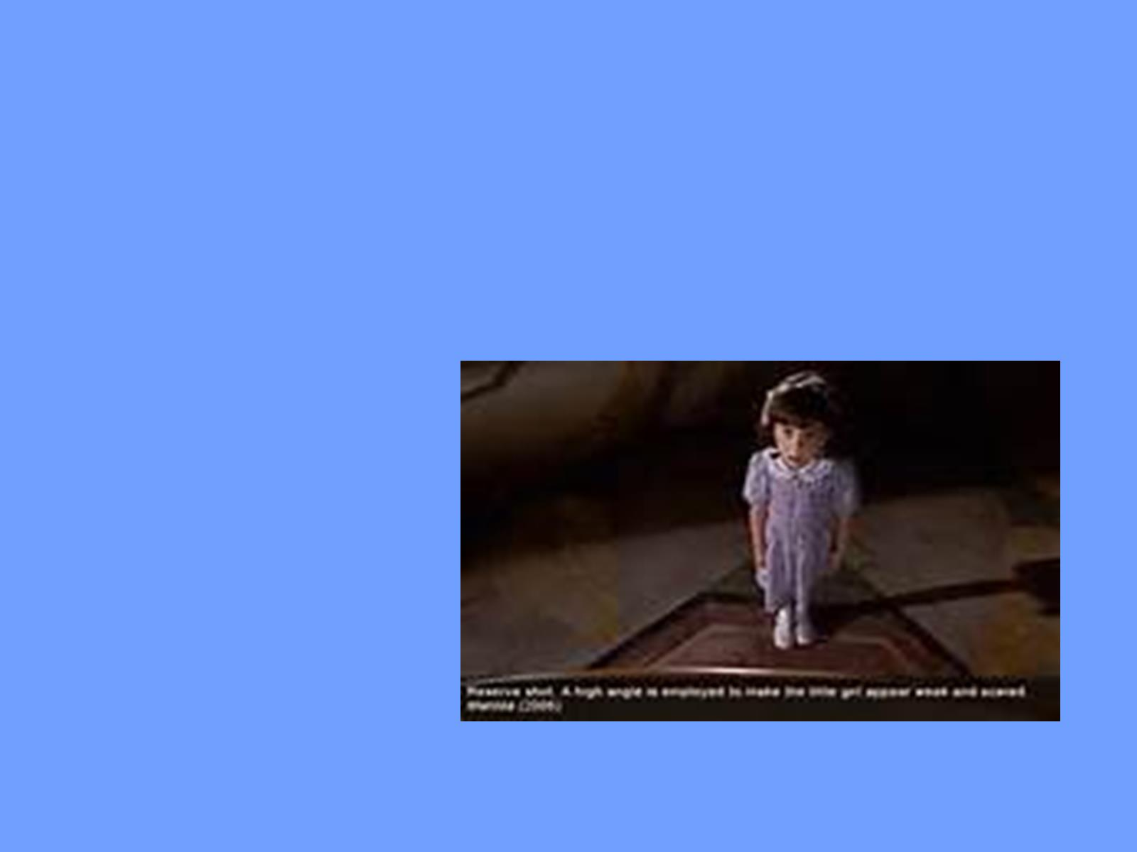

Slide 20
Spoken Words

Slide 21
Sounds

Slide 22
Silence cf. Ingmar Bergman ‘The Silence’ Martin Scorsese ‘Silence’ «it is inscribed inside the register of speech where it deliniates a certain stance» (Dolar)… …and thus inserted by the director

Slide 23
Silence as a narrative element eg. Mission Impossible: Tom Cruise tries to disable a sound-sensitive alarm system

Slide 24
Eg. 2001 A Space Odyssey ‘The dawn of man’ – the camera moves into space and into silence. Then images of landscapes are shown against the sounds of wind and birds … inducing the idea of silence.

Slide 25
The Marx Brothers ‘Duck Soup’ three minutes of silence during the ‘mirror’ scene

Slide 26
Light

Slide 27
Surreal

Slide 28
Sensual lighting

Slide 29
Signs

Slide 30
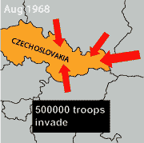
Vectors

Slide 31
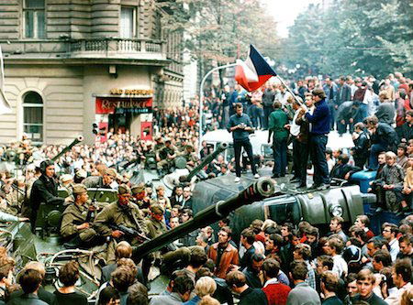

Slide 32
Digital longform journalism SNOWFALL

Slide 33
Reference: A Postgraduate Screen Translation Course IN ‘Readings in Intersemiosis and Multimedia’ ed. Elena Montagna

