Slide 1
AD
Lezione 3

Slide 2
ADLAB. Audio Description – lifelong access for the blind
European Erasmus Multilateral Lifelong Learning project
2011-2014

Slide 3
Partners
University of Trieste
Autonomous University of Barcelona
Polytechnic University of Leiria
Artesis, Antwerp University
University of Poznan (UAM)
BayerischeRundfunk
Vlaamse Radio en Televisie (VRT)
Senza Barriere

Slide 4
PROJECT OBJECTIVES AND VISION
Create authoritative guidelines for the AD profession/industry
in all Europe;
Develop curricula for universities in EuropeTraining of audio describers and audio
describer trainers;
Sensitise and influence decision-makers at a local, national and European level;
Create useful connections with the industry and with the service providers;
Social Inclusion;
Improve the lives of the blind and visually impaired population;
(but also that of immigrants, those with learning difficulties, language learners, etc.)

Slide 5
WORK PACKAGES
WP 1 User Needs Analysis
WP 2 Text Analysis and Development
WP 3 Testing
WP 4 Guidelines

Slide 6
Work Package 1 USER NEEDS
Executive Summary
The issue addressed in the ADLAB WP1 report on user needs is the current situation in Europe regarding the accessibility to audiovisual products on the part of the blind and visually impaired population. The aim was to achieve a ‘photograph’ of the situation in Europe – particularly regarding the project member states – in order to better focus efforts in the succeeding stages of the project.

Slide 7
Questions
How many blind and visually impaired people?
What is the legal situation?
How much audio description is already available? On television, at the theatre, etc.
How much research, teaching and training ?
What is the role of the national blind associations
ANSWERS IN THE REPORT
Website <www.adlabproject.eu>

Slide 8
Legal situation
The survey demonstrates that various government jurisdictions have formulated different and complex definitions of legal blindness and other forms of visual impairment.
As for the specific laws and regulations pertaining to AD, here too there is much variation:
  countries that have no regulations;
  countries where very precise guidelines exist for some sectors (e.g. public television in Flanders);
  countries that are known to have much fuller legislation (e.g. the UK).

Slide 9
Availability of AD
Results show a somewhat comparable situation in all the countries involved in the research in that public television typically offers AD services to some extent while the private market is less interested in making its audio-visual productions accessible.
Television is the key market!

Slide 10
Updating
some DVDs including AD tracks exist in all countries under consideration but often very limited cf. 4 or 5 in Italy;
Germany has gone from 130 to 183, Italy from 4/5 to 20;
some organisations cater for the needs of the target group, e.g. Italy (Senza Barriere Onlus) and Spain (cf. O.N.C.E.);
Senza Barriere’s output has risen to 600 Ads, and they have produced a new trainer dvd,
the situation in museums seems reasonably positive, and in expansion;
This continues but irregularly
theatre, opera and ballet - mostly occasional one-off Ads
Regular AD provision in theatres is increasing in Spain, Germany, Italy and Flanders
almost no cinemas offer AD on a regular basis. Special screenings with AD, are all linked to single initiatives.
But watch for latest developments!

Slide 11
AD research and training
Our surveys show that in most countries research and educational training are closely linked, as both are typically carried out in universities even if there are no specific professorships or chairs for AD experts.
Generally speaking, it is safe to say that AD is only very rarely part of the curriculum at higher education level.
New courses and modules based on ADLAB findings are being introduced in Italy, Poland, Flanders and Spain
Sometimes training is offered in seminars taught by professionals, or available in-house within companies or on-line (Senza Barriere).

Slide 12
User reception studies
investigating the position of national and local blind associations regarding audio description, especially in terms of their lobbying power in promoting the practice.
the report includes a list of organizations for each charted country with very varied and detailed answers provided by each.
the trend seems to confirm the great importance ascribed to AD by each and every organization, even though their involvement and lobbying power varies and more cooperation is called for.

Slide 13
REPORT Conclusions
The general conclusion is that AD is still a media access practice lacking critical mass in terminology, practice, and training
Raising awareness at all levels is the first recommendation made by the ITU Audiovisual Media Focus Group, and ADLAB attempted to take forward this recommendation leading to its work on creating guidelines and curricula, and on promoting the practice of audio description whenever and wherever possible.

Slide 14
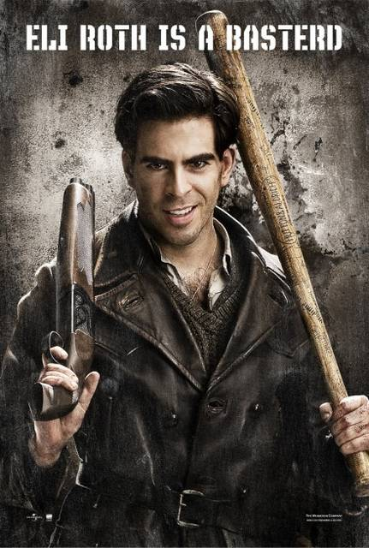
Work package 2
An extensive text analysis was carried out on the film Inglourious Basterds by all partners, and coordinated by UAB.
The film was chosen because ot its myriad varied features, its connections to other films and genres, its use of several languages and basically because of its extreme difficulty for the audiodescriber.

Slide 15
Going beyond…
This WP was to go beyond what had already been investigated, but only partially answered, with regard to
What should be described?
What should not be described?
How objective should the description be?

Slide 16
How?
Eye-tracking technology
Psychological studies
Systemic-functional linguistics
Bottom-up processing

Slide 17
Rationale (Orero)
Most studies on audiovisual translation in general (Perego 2005, Díaz-Cintas & Remael 2007, Franco, Matamala & Orero 2010, Romero-Fresco 2011) were drafted from a top-down approach. While this is the most common and time effective procedure, it tends to yield the information expected from the onset of the experiment and hypothesis drafted.
We have with the EU project a unique and too interesting opportunity to have several countries and experts in the field. We decided to embark on a new and challenging research approach: bottom-up, that is following a user-centric approach, and avoiding a pre-determined outcome. We departed for our research and analysis from one common input: Tarantino’s Inglorious Basterds (2009).

Slide 18
THE MATRIX
Text on screen
Music and sounds
Intertextual relations
Cultural references
Secondary elements (content prioritisation)
Gestures and facial expressions
Cinema tools/camera techniques
Spatio-temporal characteristics
Characters (describing, naming, placing, …)
Audio description wording, language, style

Slide 19
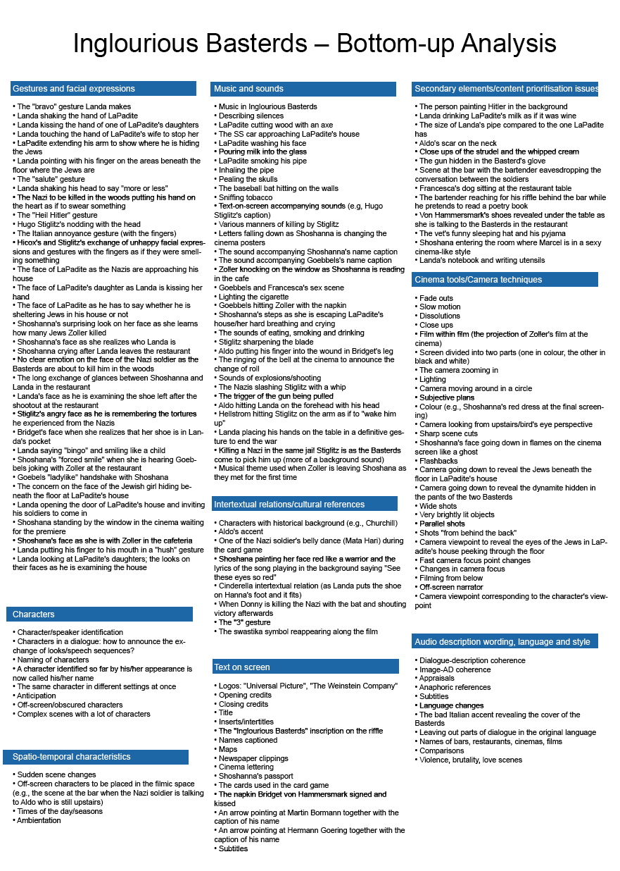

Slide 20
Text-on-screen
Logos: Universal Pictures
            The Weinstein company
            Opening credits/closing credits/TITLE
            Inserts/Intertitles (e.g. Kapitel Eins)
            Inglourious Basterds inscription on the rifle
            Names captioned and arrowed
            Maps
            Newspaper clippings
            Cinema lettering
            Shoshana’s passport
            Cards used in game
            The napkin signed by Bridget
            Subtitles

Slide 21
Work package 2 – the book
Work package 2 also spawned a volume published by Benjamins written by ADLAB members and covering all the aspects alluded to above concerning the difficulties encountered in audio describing Inglourious Basterds and their relevance to the audio description world in general.

Slide 22
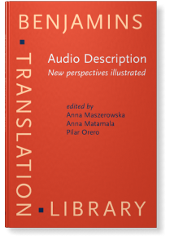

Slide 23
Book chapters
Text on screen
Music and sounds
Textual Cohesion
Intertextual relations
Cultural references
Secondary elements
Gestures and facial expressions
Cinema techniques
Spatial temporal features
Characters
Language

Slide 24
Textual Cohesion
Cohesion is created in a number of ways within a text and indeed refers only to the links within the discourse, within the co-text, that is created by the words themselves.
Eg. by repetition, anaphoric reference, peratining to same semantic field, etc.

Slide 25
But in the case of audio descriptions (ADs) …
… the text is ‘written to be read’ and needs to be both linguistically cohesive within itself and cohesive with the visual content it describes, both in its original form and in its possible translated form.

Slide 26
And …
… constant cross reference to characters, objects and scenes, which give texture to a film, must be reflected in the AD where a parallel linguistic cross reference gives texture to the description.

Slide 27
And what is more …
… what distinguishes the audio description of film from other forms of text is the fact that its written form is discontinuous, in that it is created around the dialogue of the film. The blind audience receive and interpret both ‘texts’ and thus the AD has to be cohesive also with the spoken component.

Slide 28
First scene Inglourious Basterds
It is summer 1941. A small farmhouse stands in the Nazi-occupied French countryside. A man is chopping wood on a block. He is tall and bearded.
A girl is hanging washing on a line.
The girl hears something. She moves a sheet she is hanging to see a car approaching along the untarred road leading to the house.
The man turns to look, apprehensively, as the vehicle approaches. It is military with motor-cycle outriders.

Slide 29
The AD of this scene
There is concision, simple syntax, use of the present tense, third person perspective, objectivity, etc.:
AND cohesion

Slide 30
Phasal analysis
Very simply a film, like a book, is seen as consisting of a number of major phases (macro-phases) which can in turn be divided into minor phases or subphases. But what defines a phase? As Thibault (2000: 320) puts it, phases are…
“continuous and discontinuous stretches of discourse which share ideational, interpersonal and textual consistency and congruity, i.e. consistent selection from the various semiotic systems”.

Slide 31
How does this work?
For example, a scene featuring a particular set of characters, in the same setting, with the same register of dialogue, accompanied by a particular piece of music can be recognised as a phase.
When the scene or sequence changes and different characters in a different setting with a different musical background takes over, another phase can be identified.

Slide 32
Phases
Slight changes in the composition of characters or setting may simply represent a subphase of a macrophase, but are in any case perceivable.
A particular phase may appear only once during a film, but usually phases re-emerge at intervals during the length of the feature.
They can thus be described as continuous or discontinuous, as mentioned above.
This may take place over 50 years cf. Coronation Street

Slide 33
Changes
The changes between phases are signalled by transitions, which may consist of immediate scene changes, fade-outs or obviously repeated actions.

Slide 34
ELEMENT | VISUAL IMAGES | VERBAL COMPONENT | TRANSITION
Title | Logo and lettering | Inglourious Basterds | cut
Chapters | Caption: Chapter One, etc. | Chapter One … | cut
Story theme | Caption: Once upon a time … | Once upon a time … 1941 | cut
SCENE | VISUAL IMAGES | RECCURENT VERBAL COMPONENT | TRANSITION
1a | French farm/arrival of Nazis | Names: Perrier La Padite. Col. Hans Landa | Entering house
2 | Dapite’s living room, glass of milk, living room, pipe smoking, people under floorboards, massacre | Family(ies), dairy farm, Jews, The Jew Hunter, milk, enemies of the state, Shosanna, pipe, Goebbels, Führer | Landa’s hand gesture to be silent.
1b | Farm, Shosanna’s escape | “Au revoir Shosanna” | Runs into woods. Cut to Chapter Two Inglourious Basterds

Slide 35
Conclusion
Following the sequences e.g., 15 a,b,c,d; 22 a,b,c,d,e,f, it can be seen how the film is structured and how the director wants the audience to trace its development. The audio describer should pay attention, consciously or unconsciously, to these cohesive elements in order to provide continuity and cohesion, in both verbal and visual terms, to his or her description.

Slide 36
Intertextuality
The Alamo
Inglourious Basterds

Slide 37
The testing
Impact on the end-users, i.e the blind and sight-impaired community.
Comparison of descriptive and narrative approaches measuring levels of comprehension and enjoyment.

Slide 38
The testing study
In the study the opening scene from Inglourious Basterds (with two alternative ADs) was shown to a group of VIPs (divided into groups A and B), which was followed by a questionnaire-based interview. For the purposes of comparison, the same clip (without AD) was shown to a control group of sighted respondents, also followed by a questionnaire.

Slide 39
What was tested
The tested issues included the opening credits (naming actors with protagonists, AD authors), text-on-screen, naming characters, film terminology and film technique (lighting, camera movement, shots), information sequencing and fragmentation, gestures, describing sounds, intertextual references, explicitation, narration vs. description.

Slide 40
Example
The experimental video includes one very interesting intertextual reference. Colonel Landa’s pipe resembles that of Sherlock Holmes. The descriptions of the pipe in the two ADs were manipulated so that AD-A included a conventional description without the intertextual reference (“an enormous, saxophone shaped pipe”) while AD-B included the reference (“Sherlock-Holmes-Style Calabash). The respondents were to judge on a 5-point scale (1 – definitely not, 5 – definitely yes) to what extent the description helped them imagine the actual pipe.
Results in the report
www.adlabproject.eu

Slide 41
Conclusion
In conclusion, WP3 identified troublesome aspects of AD and highlighted the need to adopt individual strategies instead of general across-the-board guidelines. As in any other type of translation, individual solutions are decided upon in a given context that should be carefully considered by the decision-maker, i.e. the audio describer.

Slide 42
Which brings us the the manual
The guidelines that have been adopted thus far, however valid locally, are rarely based on empirical research, in most cases being the result of experience, common sense and personal preferences
For ADLAB the decision was made, taking into consideration all that had been learnt en route, to formulate strategic guidelines for the manual.

Slide 43
The Innovators from Antwerp
Taking into account the results obtained from both the text analysis and testing phases of the project, all members were provided with tasks coordinated by the University of Antwerp team. After considerable thought and discussion, it was decided to create ‘strategic’ guidelines rather than produce prescriptive rules and these would be presented in the form of a manual and published as an e-book.

Slide 44
… no set solutions
These innovative guidelines suggest strategies for dealing with particular, commonly met situations. In other words, there are no set solutions to AD problems but there are ways of dealing with them in particular circumstances. The guidelines thus take the form of advice, but based on meticulous analysis and testing, and organized under the headings that appear in the report on text analysis and associated book (spatio-temporal issues, film language, textual cohesion, etc.) .

Slide 45
INTERESTED PARTIES
Universities (training/research)
Blind Associations
Media producers
Film distributors
AD service providers
Politicians,undersecretaries, administrators,
International organisations e.g.. ONU, UNESCO
Disseminate the manual e.g., to the more than 70
universities in Italy. Prize given in Calabria.
“Dissemination conference”

Slide 46
DYNAMIC WEB SITE
Open to all and adapted for all users;
Constantly updated;
www.adlabproject.eu

Slide 47
EXPLOITATION and SUSTAINABILITY
Final conference Brussels 19th September
HBB4ALL
MOOC
Knowledge Alliance, etc.
Languages and the media!

Slide 48
MAIN PRODUCTS (deliverables)
Reports on work packages.
Book on AD - Audio Description: new perspectives illustrated
Manual (e-book + hard copies in English and German).
Course curricula.

