Slide 1
Lesson SIX

Slide 2
Audio Description and Museums
At a number of ESFLC events I have spoken about Audio Description (AD) as the description of the visual elements of a film or television product inserted in the gaps available in the dialogue principally for the benefit of the blind and sight-impaired community.
«the visual made verbal»

Slide 3
Intersemiotic, intermodal ‘translation’
Intersemiotic – modes of meaning (images, movement, gesture, etc.);
Inter-modal - from one sense to another;
Interlingual translation eg. English AD to German AD

Slide 4
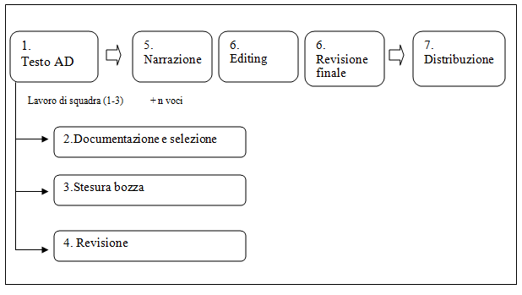

Slide 5
Bleak House

Slide 6
AD as a genre
A number of specific features of the audio description (AD) process have already been posited as justification for the labelling of AD as a genre in its own right (Taylor, 2015).

Slide 7
Linguistic features of AD
Exclusive use of present tenses
Exclusive use of third person
Simple sentences
Lack of subordination
Parataxis
Vivid vocabulary
Concision
Limited use of appraisal
More than usual use of non-finite phrases in theme position
Use of isolated noun phrases

Slide 8
The language of AD (cont.)
It tells a story;
It has a descriptive charge (objects, colours, shapes, gestures). Iconic information in words;
Objective/denotative;
Correspondence between language and image;
High lexical density;
Wording should be appropriate to the public (scientific versus artistic language)

Slide 9
AD on screen
These features, and their relevance to SFL, have been identified particularly in the audio description of films and television programmes (Maszerowska, Matamala and Orero, 2014) where the focus was on linguistic and pragmatic perspectives, questions of cohesion and coherence, and intertextuality.
parameters of the objective/subjective spectrum
cf. interpreter’s neutrality
source of fierce debate on appraisal

Slide 10
In the wake of O’Toole, Kress, van Leuwen
Current research related to this paper has extended the study of the AD genre to museums and art galleries, thus wedding AD to the early multimodal work of O’Toole, Kress and van Leeuwen, etc.
«Visual output has clearly become the priority» (Kress)

Slide 11
The story so far …
The limited amount of work conducted so far on the audio description of art and the three-dimensional world of museums show first of all how the old formulae of traditional museum presentations have mutated as such institutions become more ’hands-on’, and how audio description has produced further manipulation of the texts associated with presentation.

Slide 12
Government policy
European Strategy on Disability 2010-2020
designed to improve social inclusion and the exercise of human rights at national and European level
Cf. Americans with Disabilities Act
«cultural inclusion»

Slide 13
Museum
From Greek museion – a place sacred to the daughters of Zeus and Mnemosine
16° century – a more modern sense
19° century – specialisation
“a product of Renaissance humanism, 18° century enlightenment and 19° century democracy”
(Mordaunt Crook)

Slide 14
The contemporary Museum
Communication with the public
“an exposition illustrating not only the artefacts it contains … but rather a series of ideas, situations, relations, questions and solved and unsplved problems”.
Part of an inexorable rise in hybridity and complexity.

Slide 15
Hybridity
Store of artefacts and collections
Site for tourism
Place of research
Place of entertainment
Place of education (edutainment)
Place of promotion
Place of merchandising
Place of SERVICE – access for disabled

Slide 16
Complexity
Artefacts – illustrative cards to guidebooks to audioguides to guided tours
3D productions
Technological advance
Lighting effects
Special effects (eg Tate Modern)
Educational programmes/lectures/courses
Club activities
Publications
Access - Audio Description/touch tours/multisensory approach

Slide 17
Leisure venues
People have working models of what the museum experience affords.
These affordances match public expectations and needs.
Social aggregation, civil awareness, interaction

Slide 18
Museum Discourse
Museum discourse is under-researched, notably in terms of its dynamic meaning production.
… where verbal and visual language are on display constructing specific socio-cultural mind frames and construing community involvement.

Slide 19
The Language of Museums
Construction of a narrative
Cultural model of commmunication
The visitor plays an active part in the construction of meaning
A reconceptualisation of the relation between museums and the public (adults, children, students, families, elderly, residents, members, tourists, foreigners, handicapped)

Slide 20
Captioning
Traditional captions (often classical terminology, technical language, etc.) … “able to put off any visitor” (Broccoli, 2010)
New modes differentiated for type of visitor in terms of knowledge, status, identity.
Wedded to technology
audioguides, smartphones, audioguides with AD (and gps?)

Slide 21
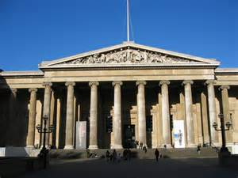
The British Museum

Slide 22
The British
Audioguide for sighted
Audioguide for blind and sight impaired (also available online)
20 artefacts
introductions to rooms
male and female voices
2-3 minute descriptions
NO directions and need to see EYE

Slide 23
What’s the difference between an Audio Guide and an Audio Descriptive Guide?
A standard audio guide combines contextual and curatorial information about exhibits for the benefit of sighted visitors, but it rarely includes the necessary degree of descriptive detail that blind and partially sighted visitors require. An audio descriptive guide begins with basic information, such as the size of an exhibit, the materials it is made from, how it is labelled and displayed, before going to provide a vivid verbal picture of the exhibit itself.

Slide 24
Audio Description Project
Audio description at a museum, park, or exhibit is not the same as an audio tour or a docent-lead tour. Audio description has a different focus: describing the actual object, rather than addressing its creator or history, for example. A true audio description tour of a museum would actually assist in leading you from exhibit to exhibit, and the emphasis would be on size, shape, color, texture, detail. If you are lucky, you will be allowed to touch some of the objects on display, but you should not expect this accommodation.

Slide 25
An Audio Descriptive Guide may also include directions to help blind and partially sighted visitors navigate from one part of the gallery to the next:
If you’re ready, make your way to the first
display case, directly ahead of you. It straddles
an ornate ironwork vent that’s set into the floor
and runs the length of the exhibition space.
Please take care as you cross it.

Slide 26
Here’s an example from an Exhibition at Colchester Museum.
“All the figures in this Exhibition date from the first part of the Han Dynasty, known as the Western Han Dynasty, from 206BC to 8AD – a period when human sacrifice almost disappeared and instead various lifelike figures, made of wood or terracotta, were placed in the tombs.

Slide 27
And it puts individual exhibits in context:
After the formal poses of the figures we’ve met so far, the ones in this case are strikingly different. Music and dance had an important role in Chinese ritual. Here 3 dancers are accompanied by 4 musicians kneeling in a row behind them. All the figures are female.

Slide 28
Textuality of exhibits
General presentation
Importance
Dimensions
Origins
Dates
State of consrvation
Materials
Light effect
Shape
Colour
Decoration
Anecdote
Practical information

Slide 29
Language of descriptions
Parataxis
Longer sentences
Simple present (continuous for actions)
Modals “It may be …” «it is said to have»
Lexis – expressive, accurate, precise. Numerous adjectives and pre-modifiers
Static verbs – be, stand, represent, show
Art history terminology – frieze, reliefs, peplo
But beware of wpm!

Slide 30
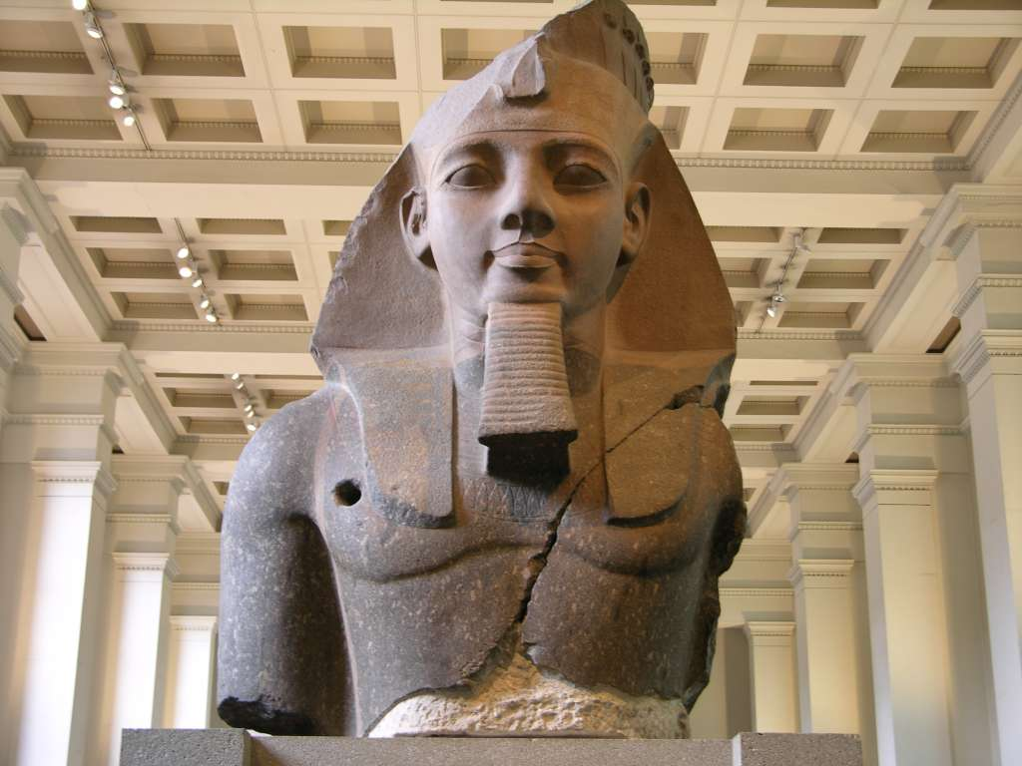

Slide 31
Example Rameses II
Ramesses II succeeded his father Sety I as ruler of Egypt in around 1279 BC and ruled for 67 years. This bust of Ramesses is from the Ramesseum, his mortuary temple at Thebes in Egypt, and dates from the 19th Dynasty, about 1250 BC. It is one of the largest pieces of Egyptian sculpture in the British Museum. It weighs 7.25 tons and measures just over two and a half metres from the top of his headdress to the base of his ribs and just over 2 metres across his shoulders.

Slide 32
…
This mammoth fragment is the upper part of a seated statue which was located in the second court of the temple. It is cut from a block of two-coloured granite - dark grey and rose pink.
The bust shows an idealised image of Ramesses as a young man, with high cheek-bones and smooth skin.

Slide 33
Ramesses also wears the nemes or royal head-dress. The stone head-dress of the statue is surmounted by a diadem or headband in the shape of auraeus - a rearing cobra. And on top of his head Ramesses wears a modius crown encircled with cobra heads set side by side, each surmounted by a sun-disc.

Slide 34
…
… in his bare torso there is a hole - approximately 5 centimetres in diameter - bored out of the granite just above his right breast. This hole is said to have been made by members of Napoleon's expedition to Egypt at the end of the eighteenth century, in an unsuccessful attempt to remove the statue. The statue was eventually retrieved from the Ramesseum by Giovanni Belzoni in 1816.

Slide 35
Textuality of exhibits: Rameses II
General presentation
Importance
Dimensions
Origins
Dates
State of conservation
Materials
Light effect
Shape
Colour
Decoration
Anecdote
Practical information

Slide 36
Language of descriptions: Rameses II
Parataxis
Longer sentences
Simple present (continuous for actions)
Modals “It may be …” «it is said to have»
Lexis – expressive, accurate, precise. Numerous adjectives and pre-modifiers
Static verbs – be, stand, represent, show
Art history terminology – frieze, reliefs, peplo
But beware of wpm!

Slide 37
Audio description of bi-dimensional art
Any time a sighted person assists a blind person in visualising pictures in an art gallery a type of audio description is taking place.
But the need to convey explicit/implicit, objective/subjective messages through non-visual forms requires extensive pre-planning.
Enter ‘talk and touch’

Slide 38
National Museum of Ethnology, Osaka
‘Look at’ = ‘touch widely, conscious of the direction your hands reach out’.
‘Watch’ = ‘touch closely with your fingertips concentrating at one point’
‘See’ = ‘keep your skin sensation sharp and feel with your whole body’

Slide 39
Visual sense and Tactile sense
English (like Japanese) has an abundant vocabulary for ‘see’ but not for ‘touch’.
It has been said that life depends on eyesight, but by applying the three elements of the sense of sight to the sense of touch, we can establish a method of approach to tactile culture.
(Hirose, 2016)

Slide 40
The Goldfinch
«it was harder to deceive the sense of touch than sight» (p. 754)
It is even harder to deceive the sense of touch and talk.
Which brings us to …

Slide 41
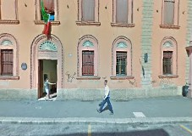
The Anteros Museum

Slide 42
The Anteros Museum
Multi-sensory approach:
Touch and Words.
The website tells us how
«to know how to see with the hands and touch with the eyes … and how to convey the ambivalent/hidden/connotative/implicit elements to a blind audience».
Rare personal treatment

Slide 43
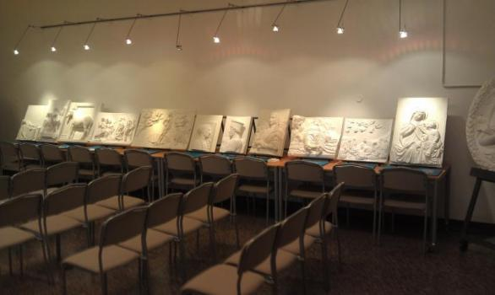

Slide 44
Elena’s visit
Neves (2012) describes the visit of Elena who was personally taken through Mantegna’s ‘The Lamentation over the Dead Christ’.
After an initial tactile exploration on her own, which elicited little understanding, Elena was guided through the touch tour. Her hands were taken and guided to explore the painting and ‘her face lit up’. But the whole thing was performed TO THE SOUND OF WORDS.

Slide 45
Elena …
The picture only really came to life through language. Words were used in profusion:
denotative: size, shape, location
technical: style, perspective
descriptive: colour, texture
emotive: culture, stories

Slide 46
Multimodal approach
This is where AD for museums differs greatly from AD for films, etc.
The describer has to interpret, explicitate, be subjective. Appraisal comes to the fore.
Art is creative and needs treating accordingly.
The voice talent needs to use tone of voice, rhythm, etc. and may be accompanied by carefully chosen musical extracts.

Slide 47
Linguistic compensation
In the absence of sight, speech is essential to the integration of sensory input and therefore to perception.
Speech is an effective replacement for directly experienced visual input.
(Fryer, 2016)

Slide 48
Personal experience
Clara and Dwight at the British Museum.

Slide 49
Presence
AD users report a strong sense of ‘presence’, even through a single auditory channel
Language can convey all necessary meaning
(Milligan, 1995)

Slide 50
Paintings
Neves asks the question:
Why would a blind person want to visit an art gallery? Are they interested? What do they cost?
« a visually impaired person hopes to leave the museum fully enriched by the experience.
By using vivid description … they are able to give me a greater level of access than they would to many researchers with sight»
(Smith, 2003)
BUT ‘Nothing about us without us’

Slide 51
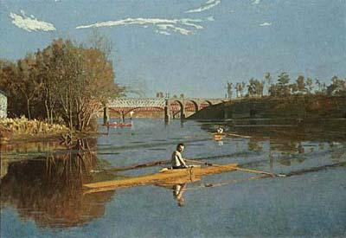

Slide 52
Audio descriptions of paintings
Robert Sutter used to offer his unique descriptions via a local Radio Reading Service, which go beyond commentary and facts.

Slide 53
Max Schmitt In a Single Scull
In this painting a warm russet light suffuses the Autumn scene and tells us that it is late afternoon. The low angle of the afternoon sun makes the ripples on the water from the barely moving shell, large in the foreground, contrast with the mirror-like surface of the river. A few trees clothed in their fall colors grow out of a jut of land on the left bank of the river downstream behind Schmitt's boat and cast their reflections in perfect symmetry on the mirror of the river's still surface.

Slide 54
Describing art
Visual intensity
Narrative of the work of art
Clear signs (Rembrandt)
Ambivalent signs (Dalì)

Slide 55
What can be translated into words?
De Coster
Dimensions, spatial structure, narrative of clear signs, ‘meanings’ of ambivalent signs.
What can be successfully accompanied by touch
What needs visual imagination to explore intersensorial possibilities eg. surreal effects (helped by guide?)

Slide 56


Slide 57
Piet Mondrian
Composition
Piet Mondrian
Solomon R. Guggenheim Museum, New York,
Produced by Art Education for the Blind, New York
Composition is the title of a painting by the Dutch artist Piet Mondrian.
He painted it in 1929. It's an oil painting on canvas.
The dimensions of the painting are 17 and 3/4 inches by 17and 7/8 inches

Slide 58
Composition (description)
The simplest way to describe Composition is to say that it is a large square, and within the large square are a smaller square and 7 rectangles of various sizes. The square is white, and the rectangles are white, red, blue, yellow, and black. These areas are separated by straight, black, thick lines about ½ inch wide.

Slide 59
Composition (explanation)
Composition is a good example of Mondrian's ideas about what makes a good painting. First of all, he maintained that art should not concern itself with reproducing images of real objects in the world. He thought art should express only the universal absolutes that underlie reality. So he rejected all sensuous qualities like texture, and the illusion of depth, and a wide palette of colors. Besides black and white, he used only the primary colors-red, blue, and yellow.

Slide 60
Composition
Mondrian's compositions are so precise that if any single element is changed, then every other element in the painting must be adjusted to reorder the balance. To Mondrian, a painting like Composition represents the dynamic equilibrium of the world of the spirit, which transcends the material world.

Slide 61
Other examples
More recent examples include those relating outside attractions (eg. Disneyland), city tours (eg. Washington) or nature reserves (eg. Golden Gate Park)

Slide 62
Miur Woods
Golden Gate Park

Slide 63
Andrew Sachs on London Zoo
My name is Andrew Sachs, and I’m an actor and writer.
I first visited the London Zoo in Regent’s Park not long after our family had arrived in England in 1938 as refugees from Nazi Germany.

Slide 64
The Okapi
As I grew older I read about the Okapi - although I never actually met one. Then, after many years travelling the world as an actor, I revisited the London Zoo. And there they were, right in front of me. It had taken me nearly thirty years to find them here in London, almost in my own backyard.
Their body shape resembles that of a giraffe – sloping down gently from the shoulders to the hindquarters. But they’re smaller – about the size of a horse – and with a neck not nearly as long as a giraffe’s. Like a giraffe they have large eyes and ears and the males have little horns. And they’re really rather attractive. They have a reddish-brown short, velvety coat – oily to keep off the rain - white legs from ankle to knee and horizontal black and white stripes on their upper legs and all the way up their backside, almost like a zebra. Like giraffes okapis have thick long tongues to strip leaves from the trees – nearly a foot long in fact – and they have the ability to wash their own ears with it – inside and out. Fantastic!
If you too would like to experience them at the Zoo they’re near the main entrance, in an area with giraffes and zebras called ‘Into Africa’, next to the Regent’s Canal. It’s between the road known as the Outer Circle and the one which encircles that – Prince Albert Road. The quickest way to get there is behind the main entrance through a short tunnel under the Outer Circle. The path around ‘Into Africa’ is a loop, and the okapis are at the far end, next to the Outer Circle. They have an outside enclosure with trees and an indoor house for them and their visitors if it’s raining. And if that’s all too complicated ask any of the staff!

