Slide 1
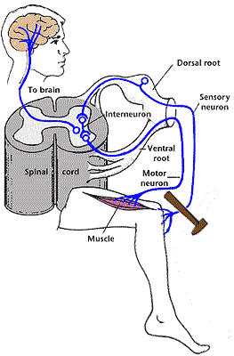
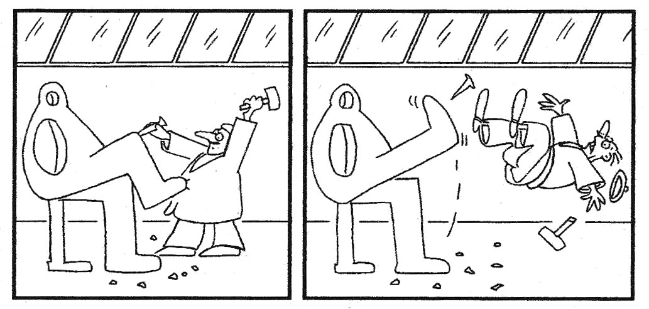
SPINAL REFLEXES
V 3.5
Main figures sources:
Purves et al., NEUROSCIENZE, Zanichelli
Kandel et al., PRINCIPLES OF NEUROSCIENCE, Mc Graw Hill

Slide 2
OVERVIEW
General organization of the spinal cord
Classification of peripheral fibers
Classification of spinal reflexes
Monosynaptic reflex
Muscle spindle
H Reflex
Reciprocal inhibition
Di-synaptic reflex
Polisynaptic reflexes
Flexion reflex
Synaptic organization of the spinal cord
Synaptic integration
General organization of the motor system

Slide 3
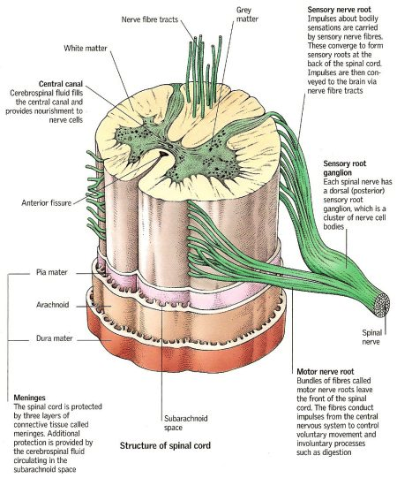

Slide 4
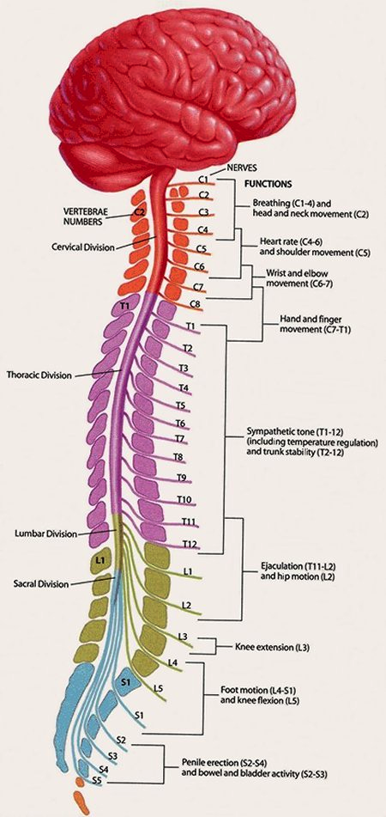
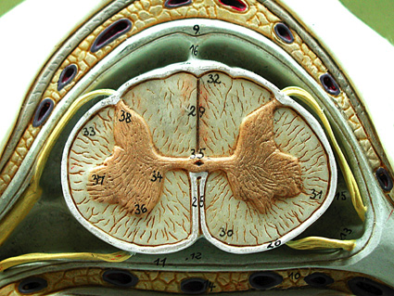
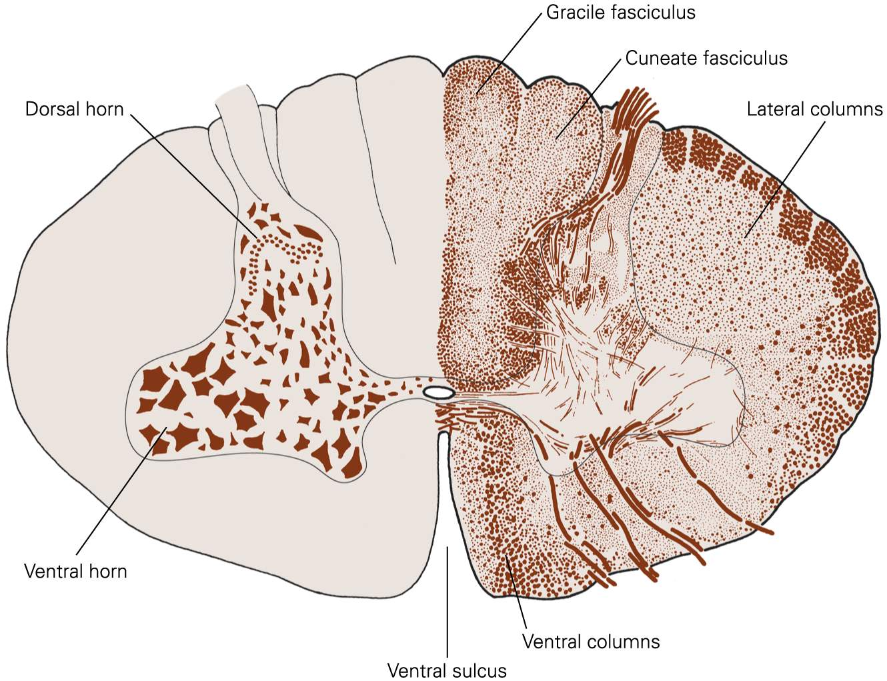

Slide 5
CLASSIFICATION OF NERVE FIBERS
Nerve | Function | Diameter (μm) | Velocity of conduction (m/sec) | Dorsal root
A-alfa | Proprioception: spindles (muscle contraction) and Golgi tendon organs (muscle tension) Motors for skeletal muscles | 12-20 | 70-120 | IA, IB
A-beta | Touch, pressure, vibration | 6-12 | 40-70 | II
A-gamma | Motors for spindles | 3-6
A-delta | Pain (mechanic and thermic stimuli) | 2-3 | 12-36 | III
B | Preganglionic (Autonomic Nervous System) | <3 | 2-12 | III
C | Pain (polymodal/chemoceptive), postganglionic of the Autonomic Nervous System | 0,3-1,3 | 0,5-2 | IV
Notes:
5

Slide 6
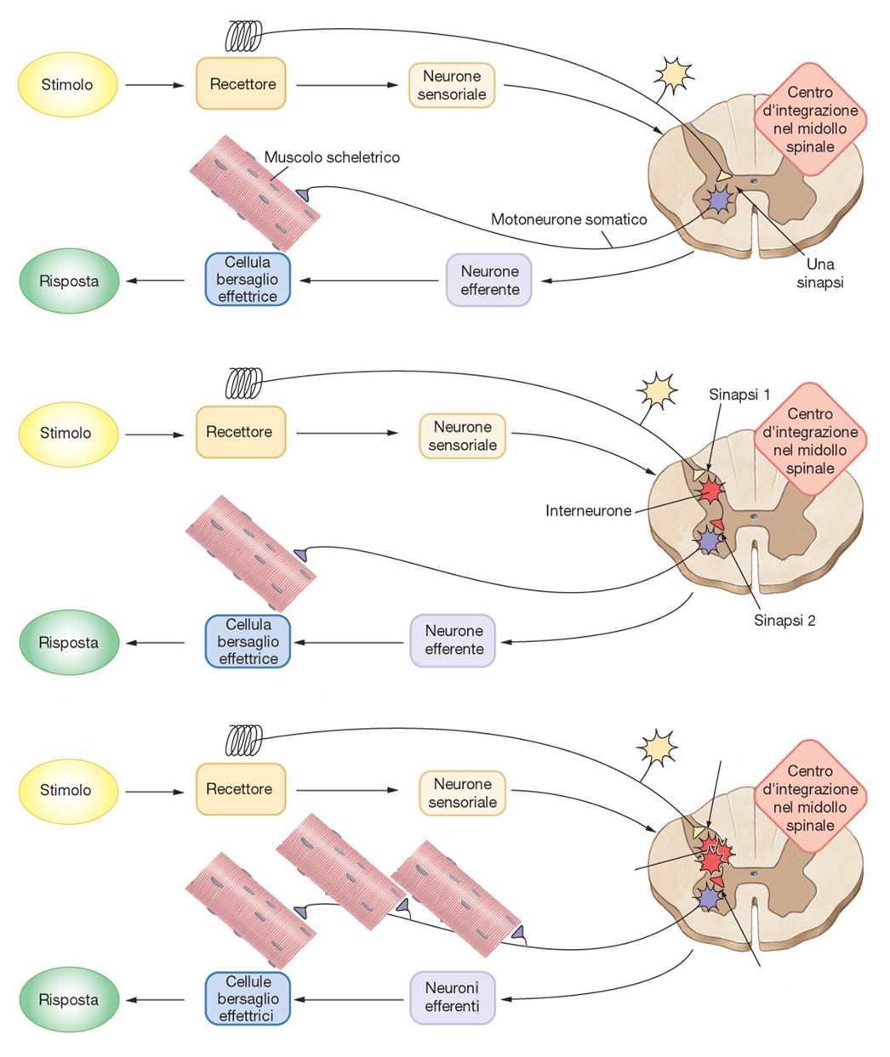
CLASSIFICATION OF REFLEXES
monosynaptic reflex
disynaptic reflex
n sinapsi
polysynaptic reflexes
n interneuroni
n muscoli scheletrici
n motoneuroni
Modificata da Silverthorn, fisiologia umana, Ambrosiana

Slide 7
REFLEX CIRCUITRY: THE MONOSYNAPTIC REFLEX

Slide 8
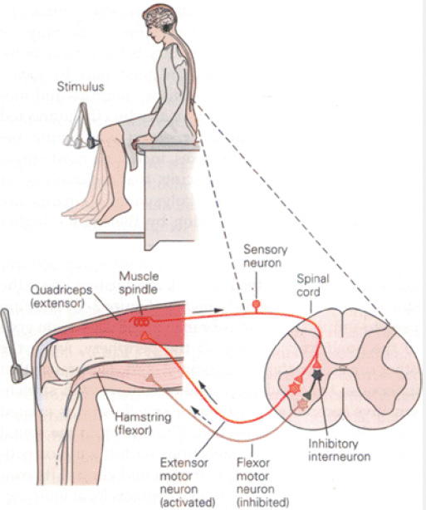
MONOSYNAPTIC REFLEX, MIOTACTIC, STRETCH REFLEX
Kandel et al., Principi di Neuroscienze, Ambrosiana.

Slide 9
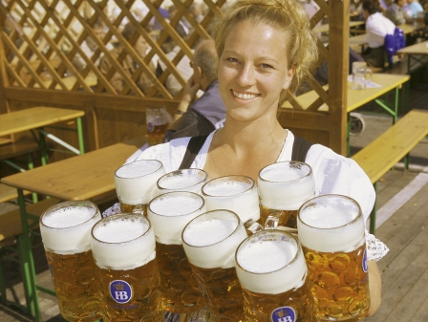

Slide 10
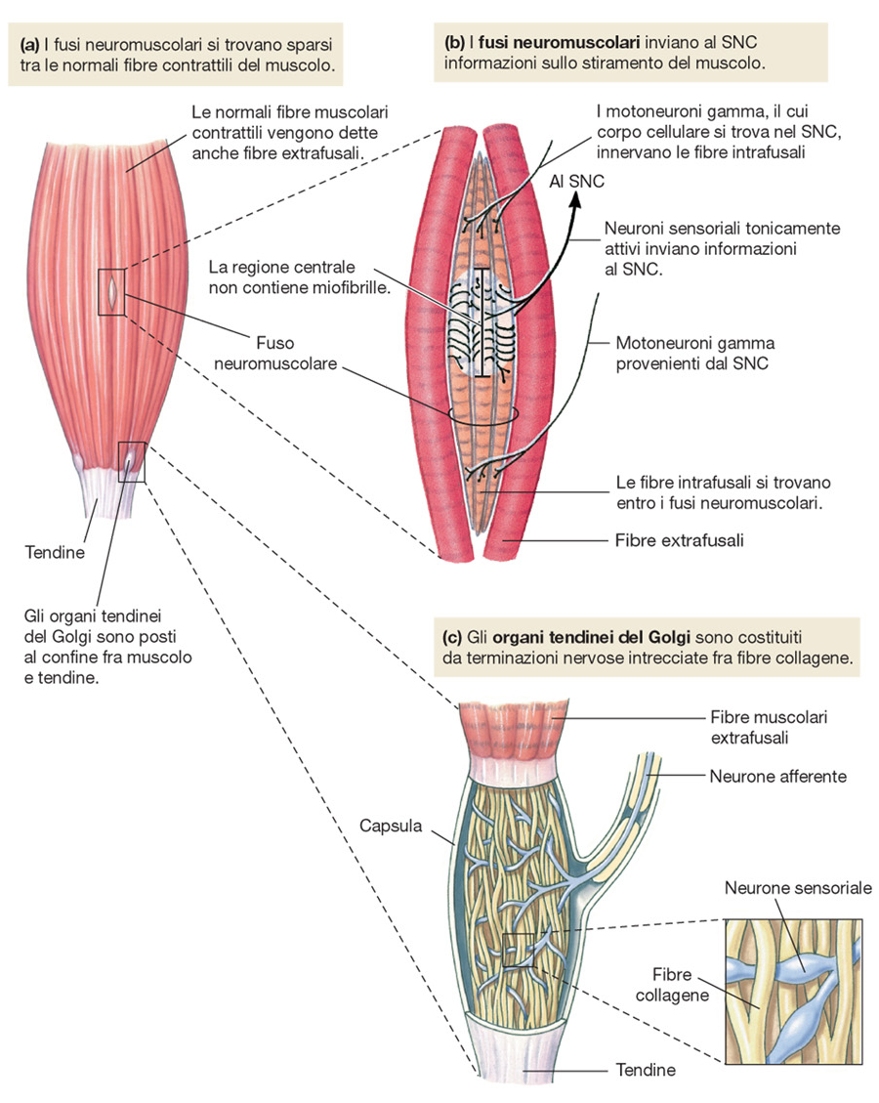
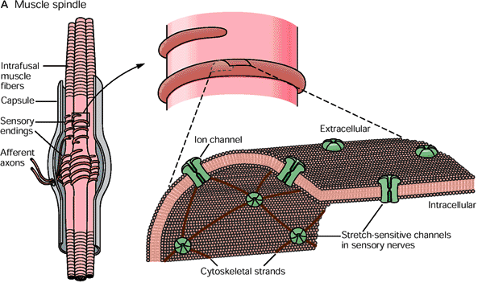
PROPRIOCETTORI MUSCOLARI
Da Silverthorn, fisiologia umana, Ambrosiana

Slide 11
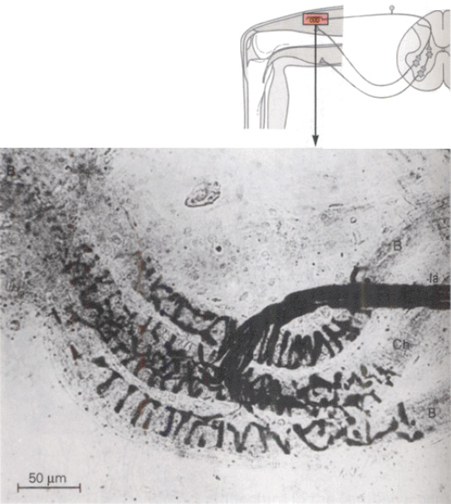
MUSCLE SPINDLE
from Kandel, McGraw-Hill

Slide 12
MUSCLE SPINDLE
stiramento lento
(risposta statica)
stiramento rapido
(risposta dinamica)
FIBRA A SACCO NUCLEARE
FIBRA A CATENA NUCLEARE

Slide 13
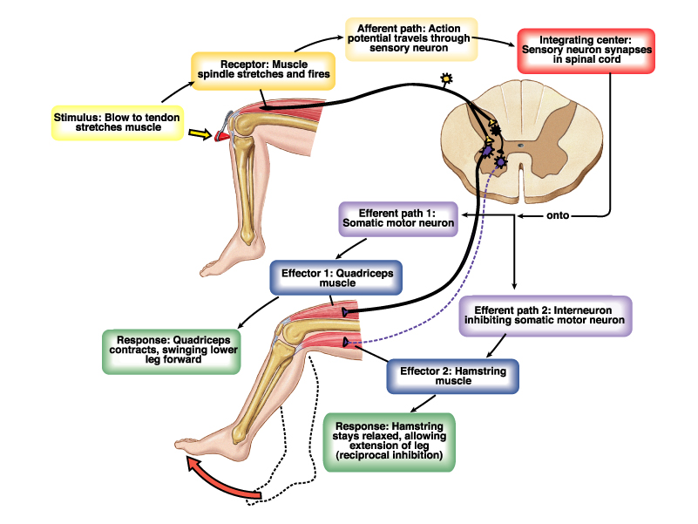
RECIPROCAL INHIBITION

Slide 14
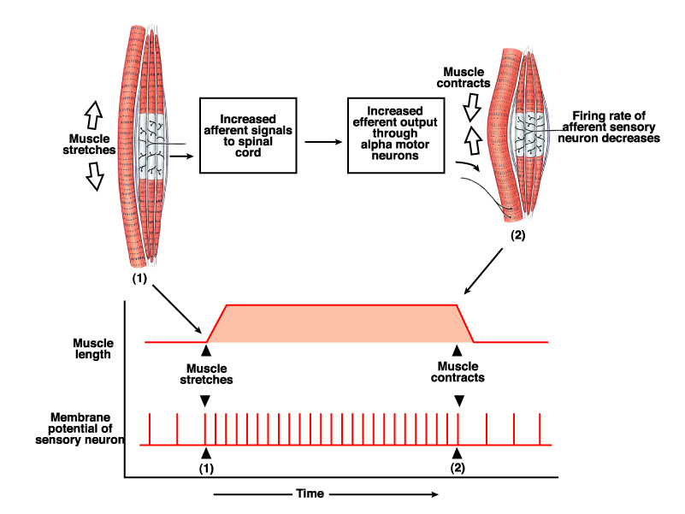
MUSCLE SPINDLE: IA DISCHARGE

Slide 15
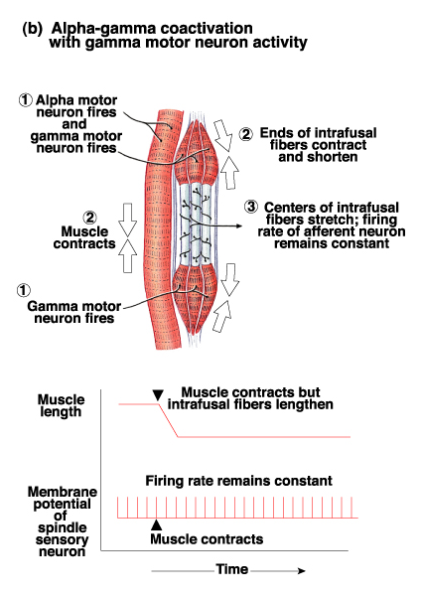
γ ACTIVITY
IA discharge with only α activity
IA discharge with α−γ co-activation

Slide 16
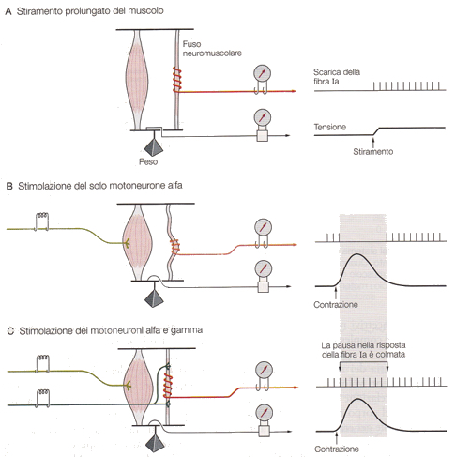
REGULATION OF SPINDLE SENSITIVITY
Da Kandel et al., Principi di Neuroscienze, Ambrosiana

Slide 17
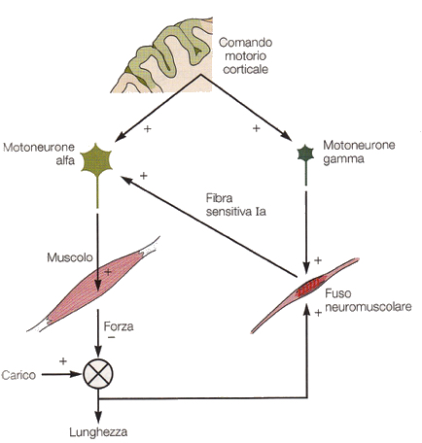
REFLEX REGULATION OF MUSCLE FORCE
same commands
TOO MUCH LOAD
Muscle do not short as much as they should. Spindle increase their tension in excess. This increases IA discharge so as to increase α-motoneurons activity
TOO MUCH POWER
Muscles shorten too much. Spindles decrease their tension. This decreases IA discharge, hence α-motoneurons discharge is reduced as well.
Da Kandel et al., Principi di Neuroscienze, Ambrosiana

Slide 18
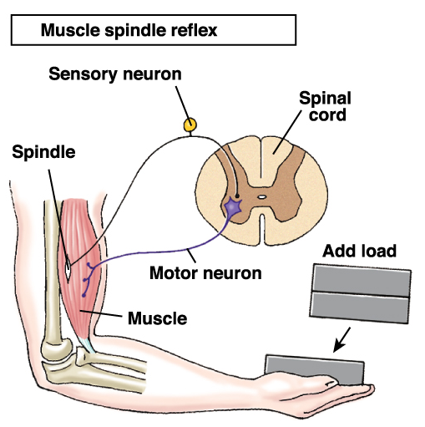
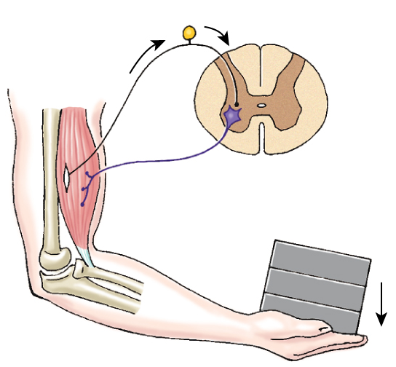
MUSCLE SPINDLE: IA DISCHARGE
2
1
3

Slide 19
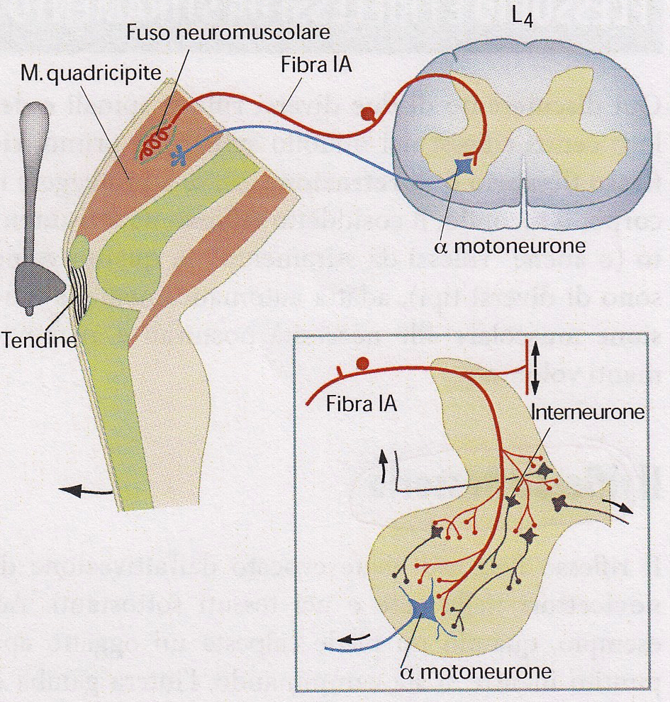
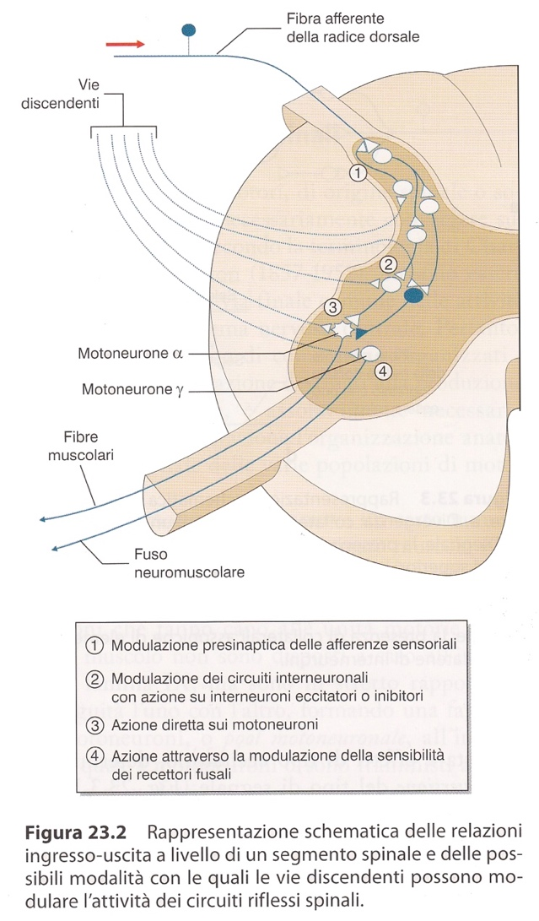
INFLUENZE DISCENDENTI SUL RIFLESSO DA STIRAMENTO
Manovra di Jendràssik
Brodal, Il Sistema Nervoso Centrale, Piccin
Conti et al., Fisiologia Medica, Edi-Ermes.

Slide 20
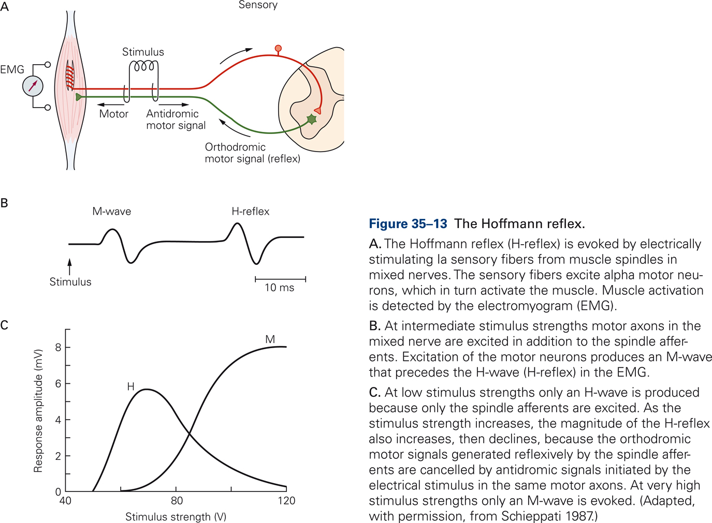
H-REFLEX
from Kandel, McGraw-Hill

Slide 21
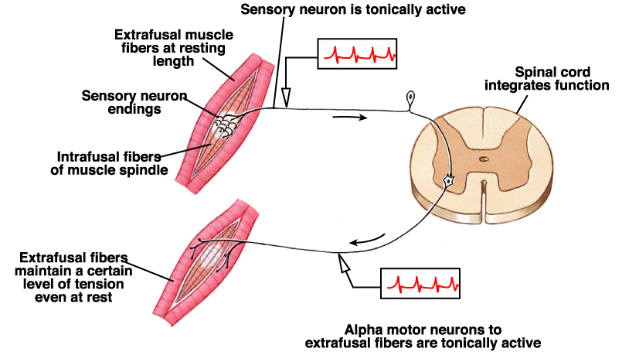
MUSCLE TONE

Slide 22
RIFLESSI TENDINEI

Slide 23
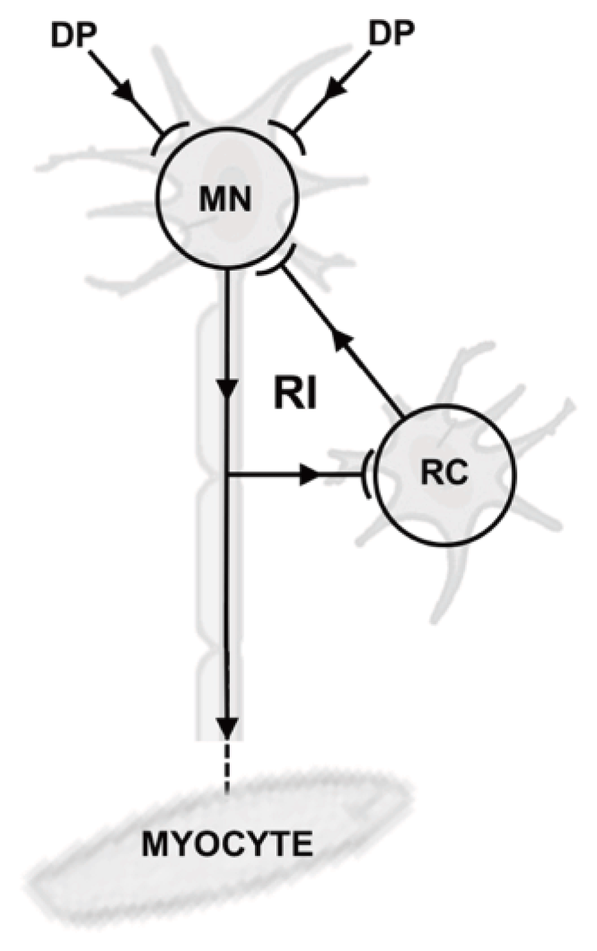
INIBIZIONE RICORRENTE
_
+
+
DP: descending pathway
MN: motoneurone
RC: cellula di Renshaw
Notes:
Figure 1. Schematic overview of recurrent inhibition. With recurrent inhibition (RI), input from descending pathways (DP) reaches the motor neuron (MN). In response, the MN activates the target myocyte; in addition, the MN also activates Renshaw cells (RC), which then inhibit the motor neuron through a negative feedback loop.
Tuk B. Inhibitory system overstimulation plays a role in the pathogenesis of neuromuscular and neurological diseases: a novel hypothesis [version 1]. F1000Research 2016, 5:1435 (doi: 10.12688/f1000research.8774.1)

Slide 24
DI-SYNAPTIC REFLEX

Slide 25
DI-SYNAPTIC REFLEX

Slide 26
RIFLESSI POLISINAPTICI: RIFLESSO FLESSORIO

Slide 27
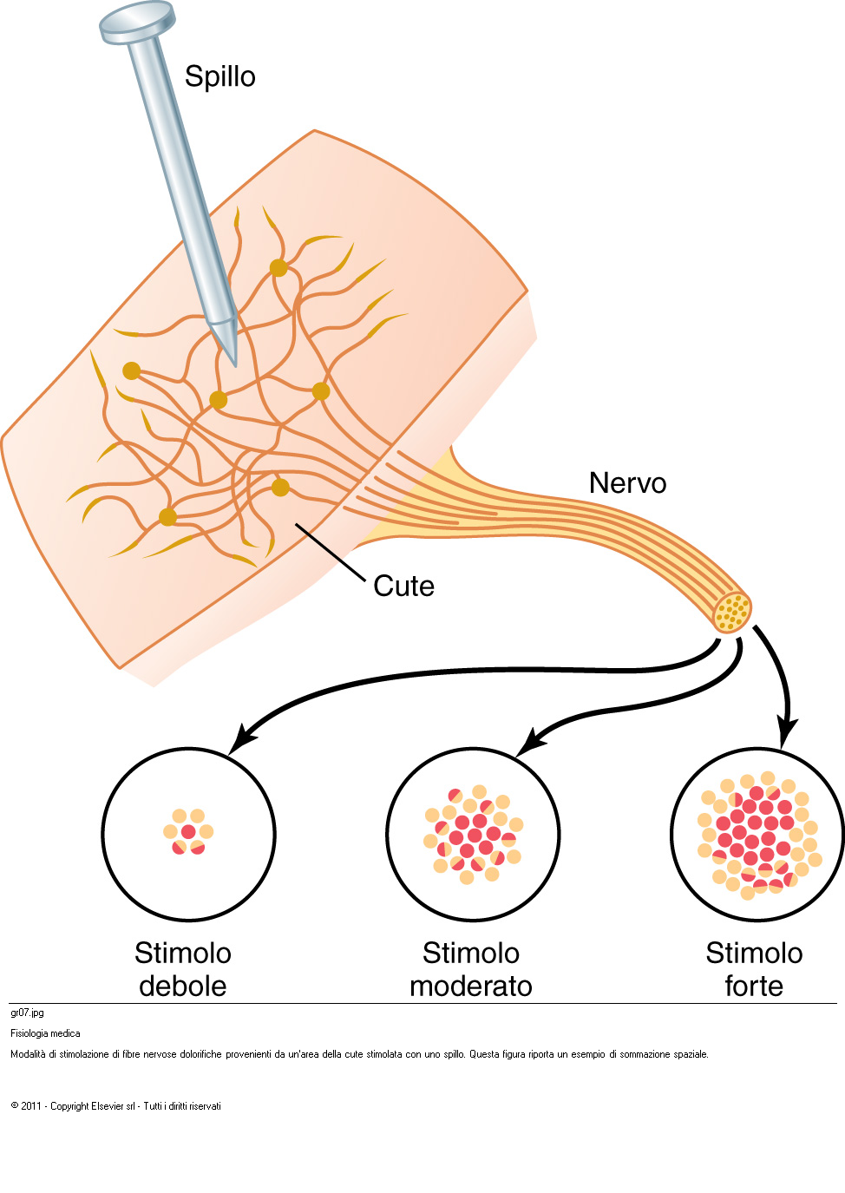
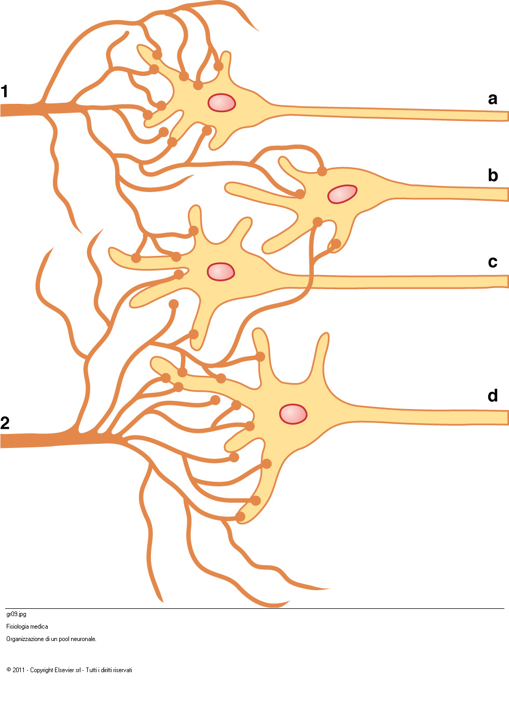
SYNAPTIC ORGANIZATION OF THE SPINAL CORD
(Coding of intensity):
Population effect,
Spatial summation,
Divergence and convergence,
Subliminar zone,
Facilitation zone
Da Guyton, Elsevier

Slide 28
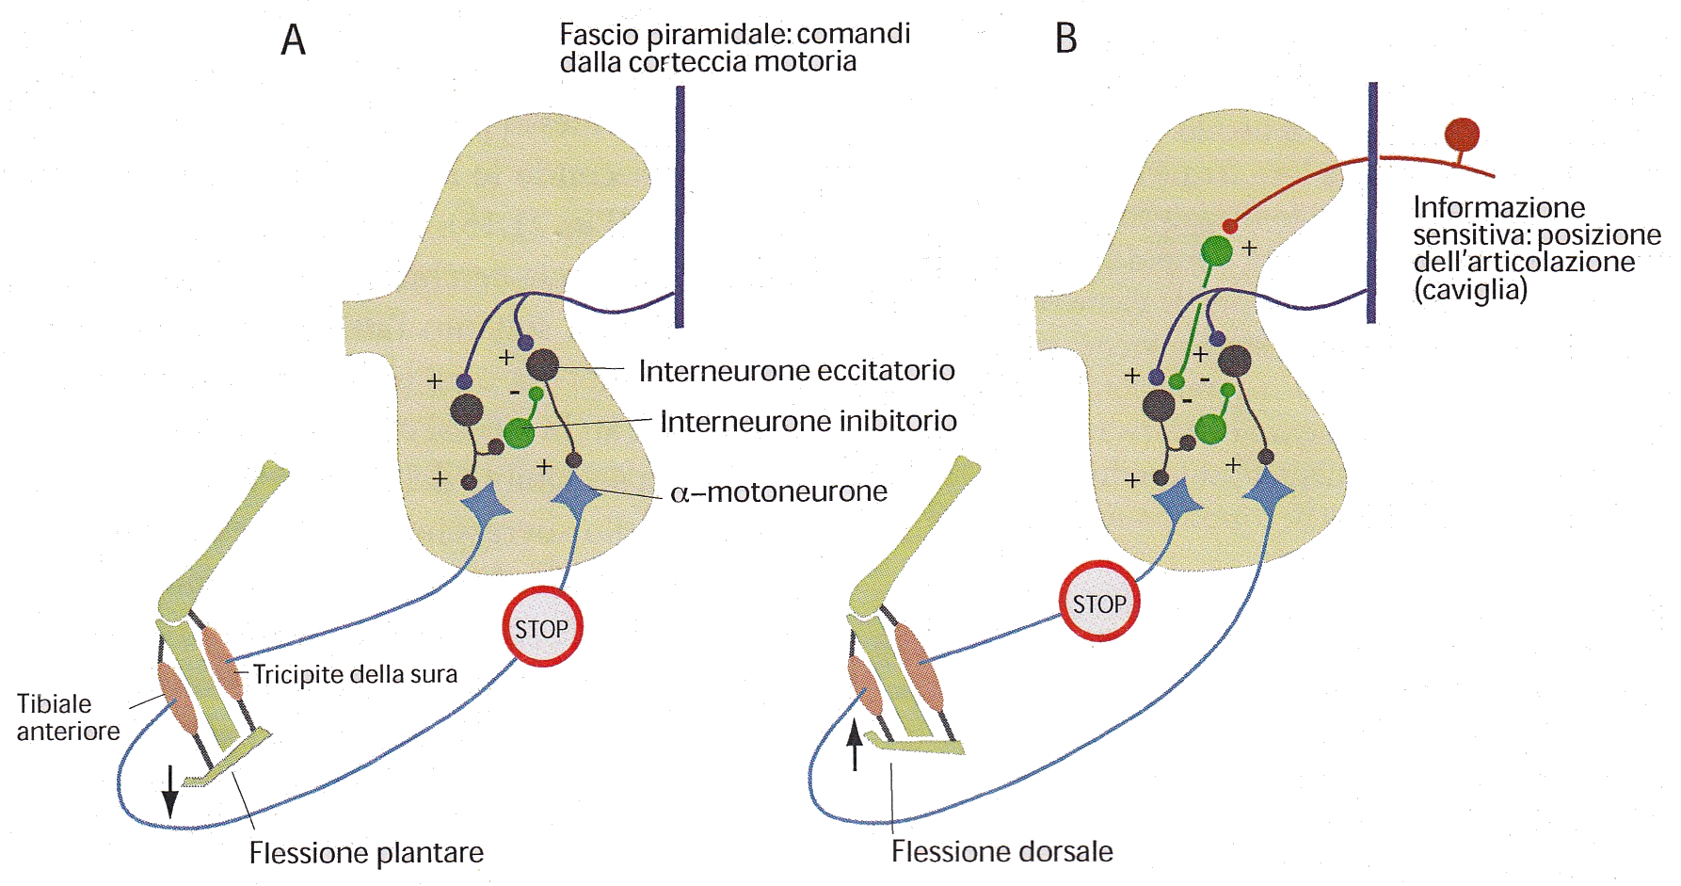
CONTESTO MOTORIO (PERIFERIA)
Inibizione reciproca
Diversa azione dei comandi motori (fascio piramidale) a seconda della posizione del piede
Brodal, Il Sistema Nervoso Centrale, Piccin

Slide 29
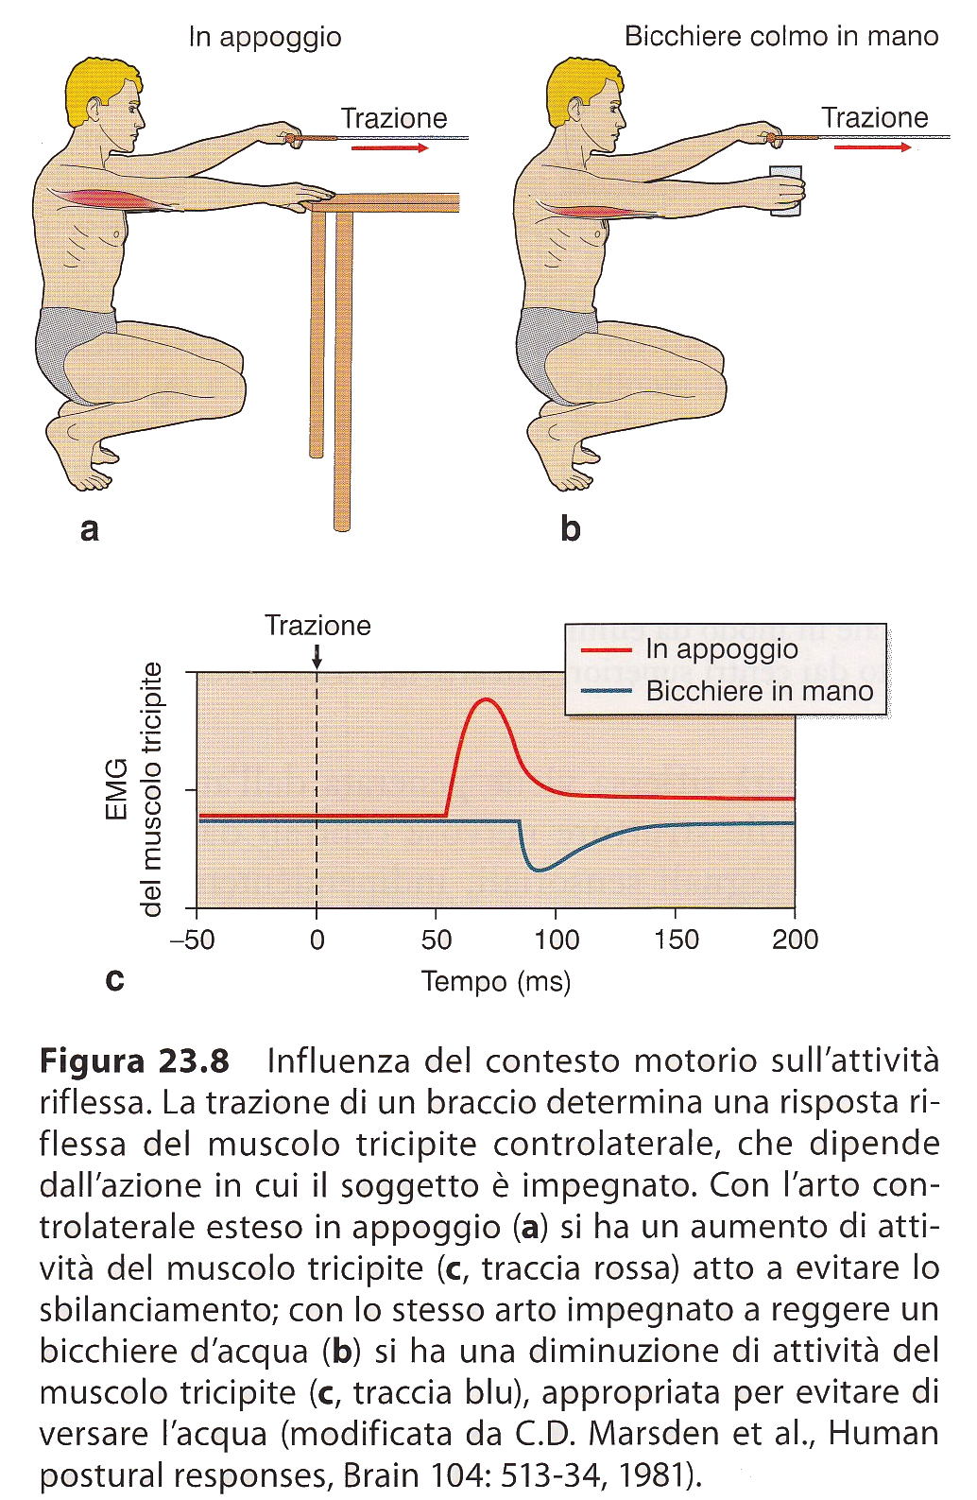
CONTESTO MOTORIO
(CENTRO)
Da Conti et al., Fisiologia Medica, edi-ermes

Slide 30
DEAMBULAZIONE
n. peduncolopontino,
regione locomotoria mesencefalica
CPG (central pattern generator)
CENTRI PER I MOVIMENTI RITMICI

Slide 31
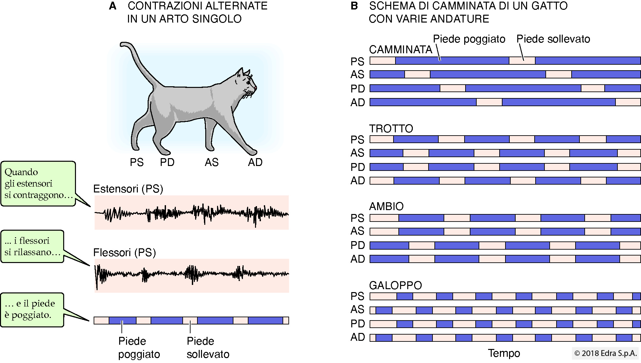
attività ritmica
Da Boron e Boulpapep, fisiologia medica, Edra

Slide 32
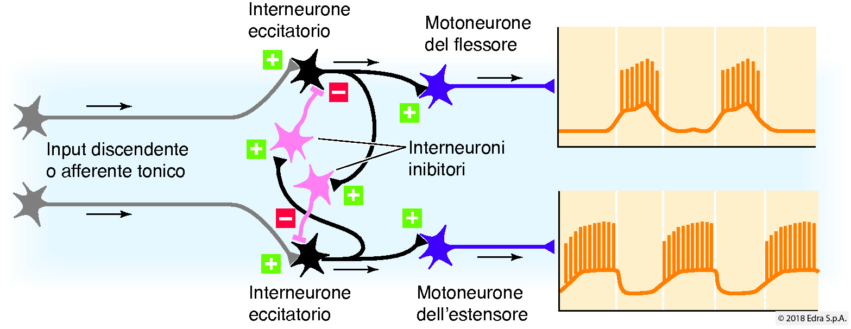
attività ritmica
I neuroni discendenti (in grigio) hanno una scarica tonica, che divente fasica sui motoneuroni antagonisti grazie alla inibizione reciproca di questi ultimi. Analogo principio si può applicare agli estensori di un arto nei confronti di quello dell’altro, come pure ai flessori.
Da Boron e Boulpapep, fisiologia medica, Edra

Slide 33
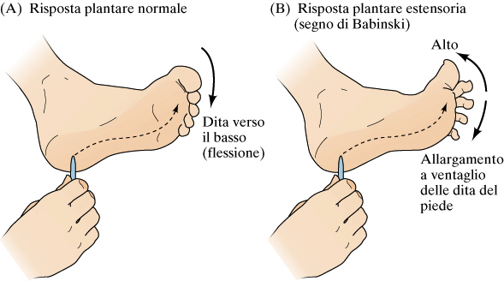
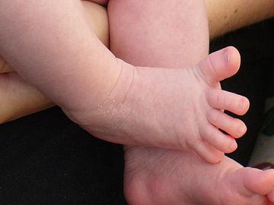
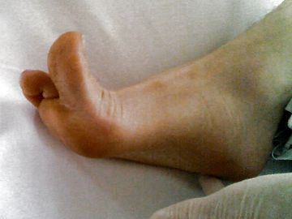
BABINSKI REFLEX
Absent (newborn) or lost (pyramidal lesion) control of avoidance (nociceptive) reflex
Da: Purves et al NEUROSCIENZE Zanichelli

Slide 34
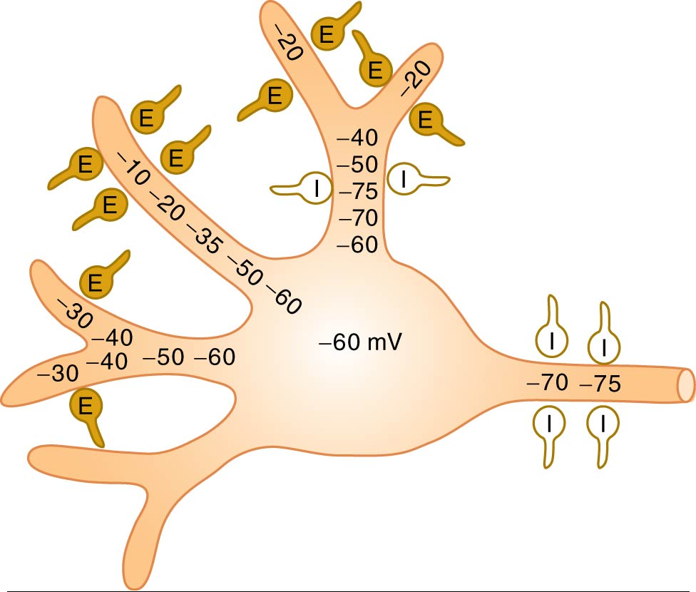
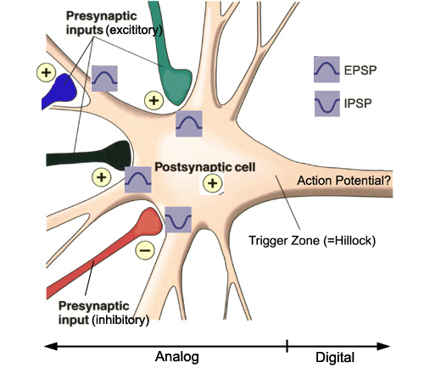
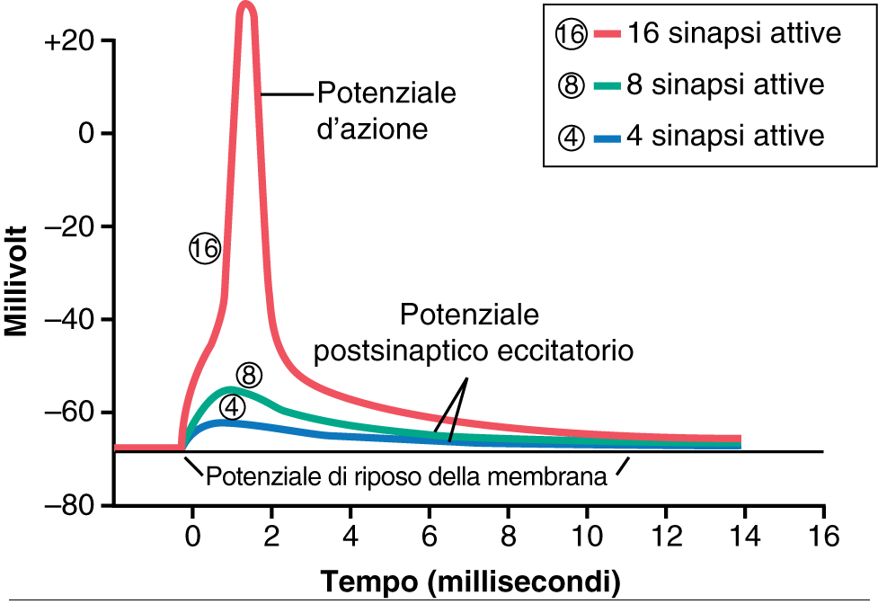
SYNAPTIC INTEGRATION
Propagazione con decremento
Potenziale di riposo

Slide 35
GENERAL ORGANIZATION OF THE MOTOR SYSTEM

