Slide 1
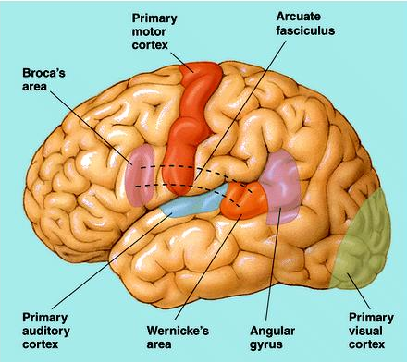
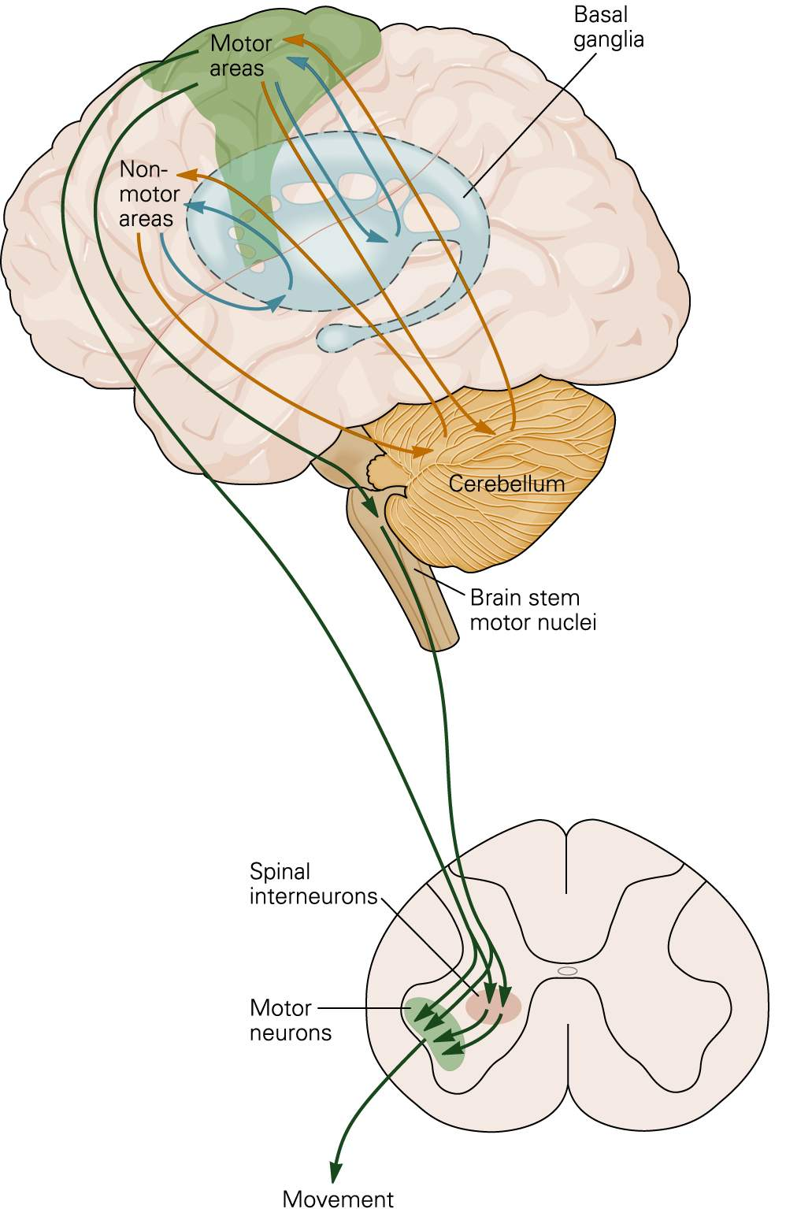
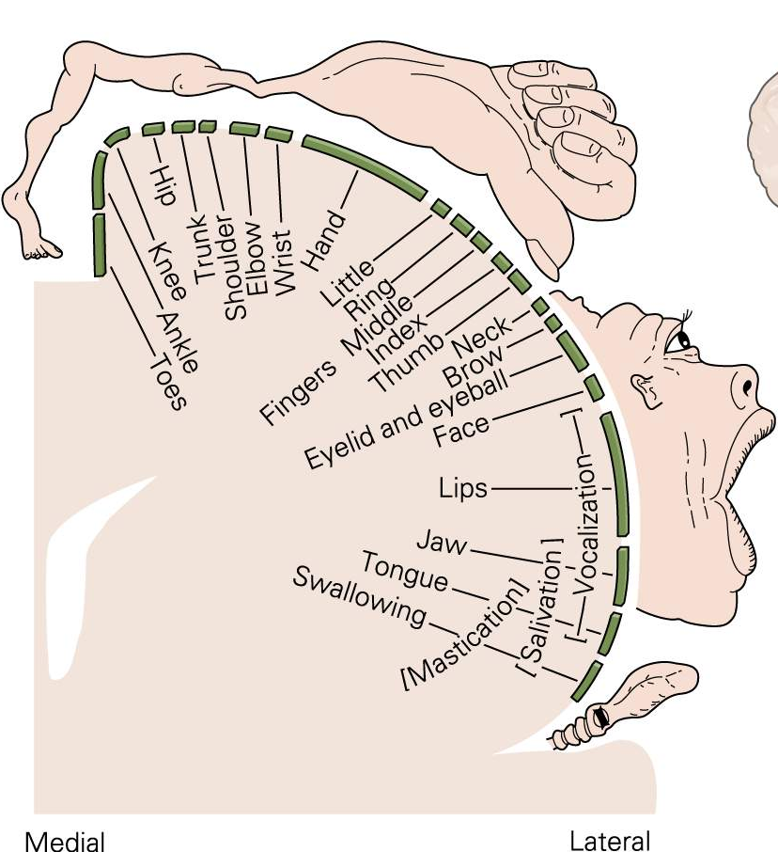
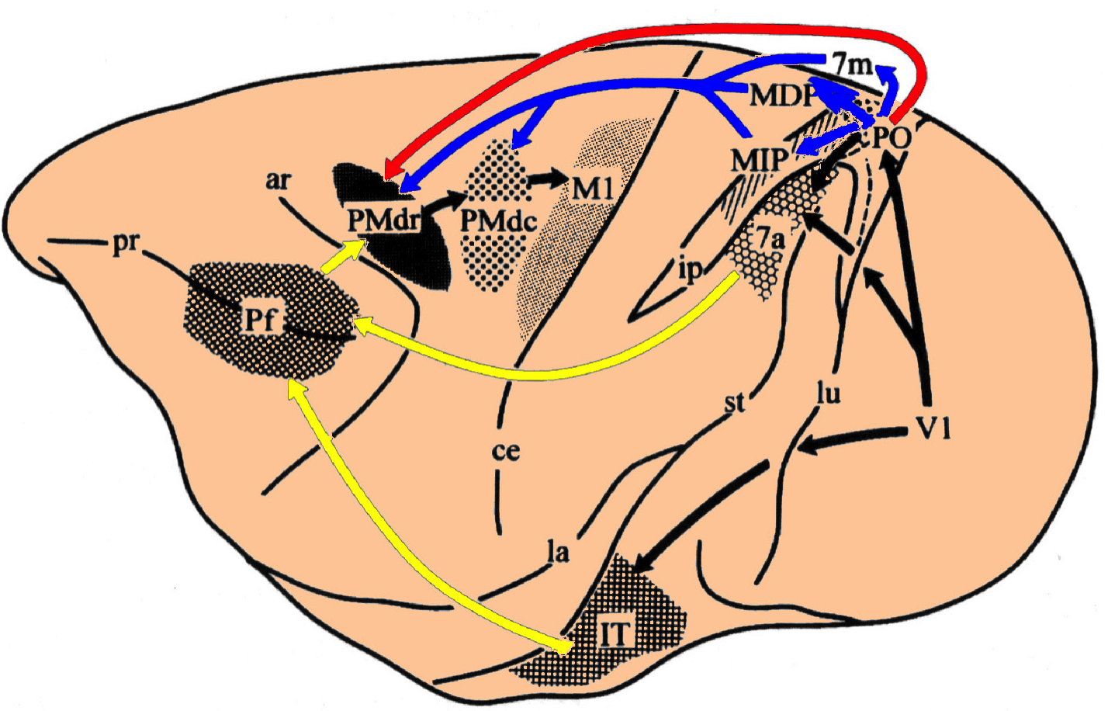
Neuroscience: Voluntary movement
prof. P.P. Battaglini
Notes on

Slide 2
Dichiarazione
Le immagini presenti in questo file sono state reperite in rete o modificate da testi cartacei.
Queste immagini vengono utilizzate per l’elevato contenuto didattico e per promuovere la conoscenza delle opere da cui sono tratte, la cui consultazione è consigliata e certamente utile allo studio degli argomenti qui trattati.
Il materiale presentato non è sufficiente a superare adeguatamente l’esame.
E’ necessario, quindi, completare lo studio su testi reperibili in commercio, fra cui:
Guyton e Hall: Fisiologia Medica. Elsevier
Autori vari (a cura di F. Conti); Fisiologia medica. EdiErmes
Silverthorn; Fisiologia umana: un approccio integrato. Pearson
W. F. Ganong; Fisiologia Medica. Piccin
Nessun diritto di copyright è invocato per il materiale originale presente in questo file. Chi desideri utilizzarlo è solo invitato a citarne la fonte

Slide 3
Kind of movements
Motor systems generate different kinds of movements:
reflex
saccadic
postural
rhytmic
voluntary
Reflex movements: quick and stereotyped responses, typically graduated by the intensity of the stimulation that evokes them
Saccadic movements: typical of the eye. The organization is complex and subcortical
Postural movements: require activation of many muscles and depends on sensory information. The organization is mainly reflex
Rhythmic movements: a combination of voluntary and reflex movements. Typically, the onset is voluntary and the prosecution is reflex
Voluntary movements: directed to a purpose and learned. Improve with practice

Slide 4
Movements undergo two kinds of control:
Phasic
Tonic
Phasic control: temporary activation to perform discrete movements
Tonic control: activation maintained over time, in order to stabilize joints
Notes:
4

Slide 5
Motor control needs sensory information (1)
All levels of motor hierarchy require sensory information to function properly
Sensory information is as more critical as the lower the hierarchical level is (reflexes)
There are at least three models that illustrate the role of sensory information in motor control:
Open loop
Feedback (closed loop)
Feedforward

Slide 6
Motor control needs sensory information (2)
Feedback (closed loop)
Comparator
Error
signal
Desired movement Effector Movement
+
-
Feedback
signal
Sensor
The Comparator calculates the difference between the desired movement and the one produced. If the two values are not equal, it generates a signal that changes the Effector activity.
These systems are accurate and efficient. They are particularly useful to maintain a variable, as it is the case of the control of posture. They have the defect of being slow, because the efficiency depends on feedback from the periphery (a sudden postural change may not be adequately compensated)

Slide 7
Motor control needs sensory information (3)
Open loop
Desired movement Controller Effector Movement
The sensory input is completely ignored: the motor commands are structured from the beginning and do not take into account the effects they can have. It is a system which privileges speed over efficiency.
ballistic (saccadic) movements: cannot be modified on the basis of sensory information (catch a fly, catch a fast ball)

Slide 8
Motor control needs sensory information (4)
Feedforward (a priori control)
Information in advance
Sensor
Desired movement Controller
Effector Movement
Sensory information is used before execution of the movement. It is quicker than feedback (because it has not a comparator and does not depend on sensory information) but needs time to learn to be effective. Available sensory information has to be valuated as well as the consequences, on it, of the movements that will be performed.
Free climbing, taking a curve at high speed (better in a video game).

Slide 9
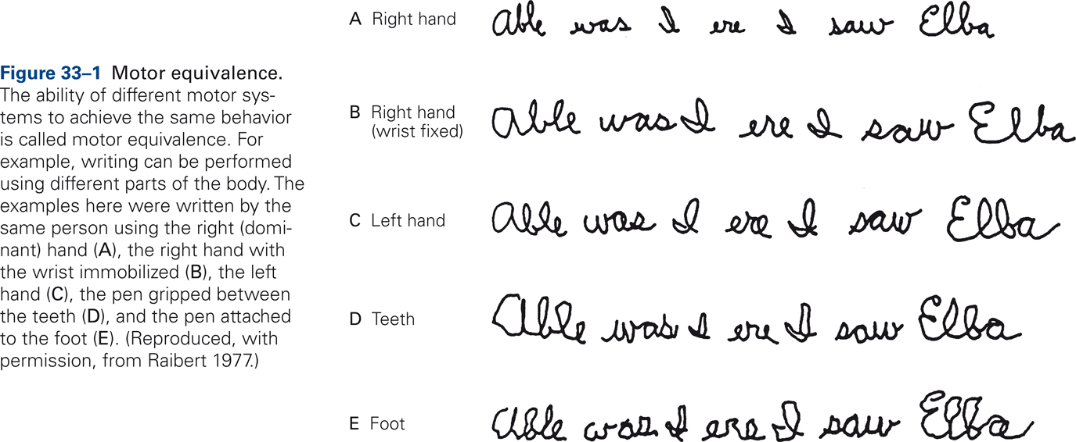
Motor equivalence
While the final product of sensory systems is to create an internal representation of outer space or of one's own body, the activity of motor systems begins with an internal representation: the image of the result of the movement that is intend to make.
From Kandel et al., Principles of Neural Sciences

Slide 10
Overall organization of motor systems
3°
Motor systems are organized both hierarchically (three levels) and in parallel. The motor areas of the cerebral cortex may affect the spinal cord both directly and through the brainstem. The three levels receive sensory information and are under the influence of two independent subcortical systems: the basal ganglia and cerebellum, which both act on the cerebral cortex via the thalamus.
2°
The motor cortex determines which motor groups are activated and the amount of force to exert. Based on input from the motor cortex, the basal ganglia, cerebellum, brainstem nuclei and spinal cord initiate appropriate muscle contraction to accomplish appropriate purposeful movements.
I°

Slide 11
Pyramidal tract
Motor programs are processed in the premotor areas based on the properties of objects (Visual areas) and their position in space (parietal areas) and are then performed by the primary motor cortex.
Movement of each part of the body depends on the activation of neuronal populations in the motor cortex and, on the the basis of the context, the parieto-frontal premotor and parietal system.
Da Silverthorn, fisiologia umana, Ambrosiana

Slide 12
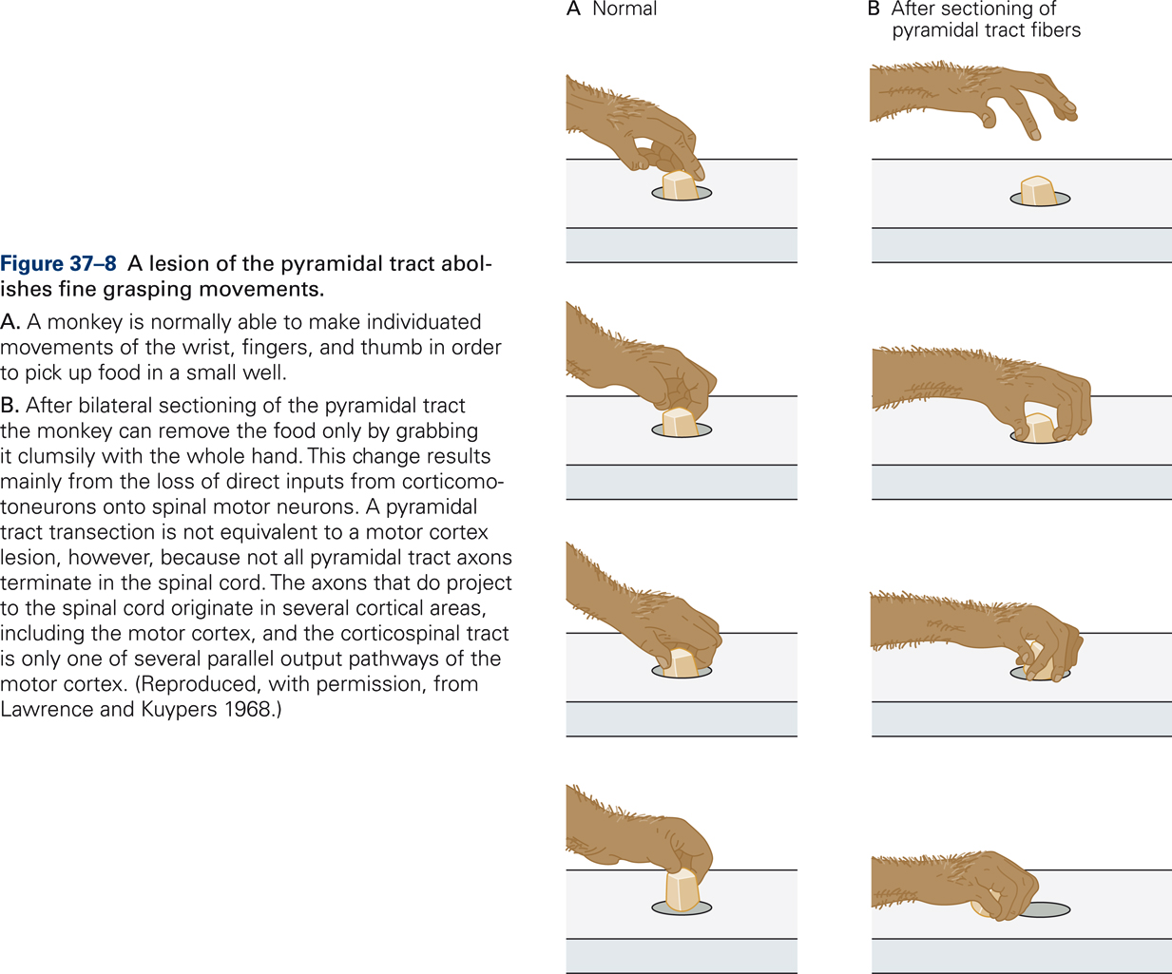
Pyramidal tract
From Kandel et al., Principles of Neural Sciences

Slide 13
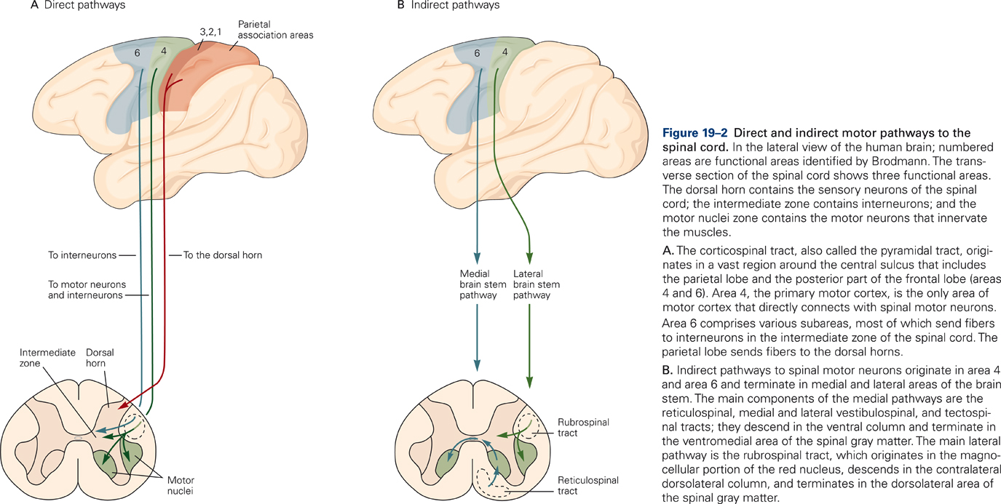
Pathways to motoneurons
From Kandel et al., Principles of Neural Sciences

Slide 14
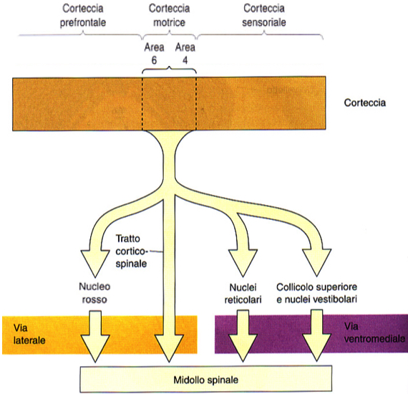
Pathways to motoneurons
At the beginning of voluntary movement, motor cortex activates the spinal motor neurons directly involved and promotes changes of postural tone through an action on the ventromedial pathway
The lateral pathway is involved in voluntary movement of distal muscles (independence of the fingers) and depends on the direct control of the cortex. Rubro-spinal tract, in humans, is underdeveloped but can substitute the functions of the direct cortico-spinal tract
The ventromedial pathway uses sensory information on balance, body position and Visual environment to maintain balance and posture

Slide 15
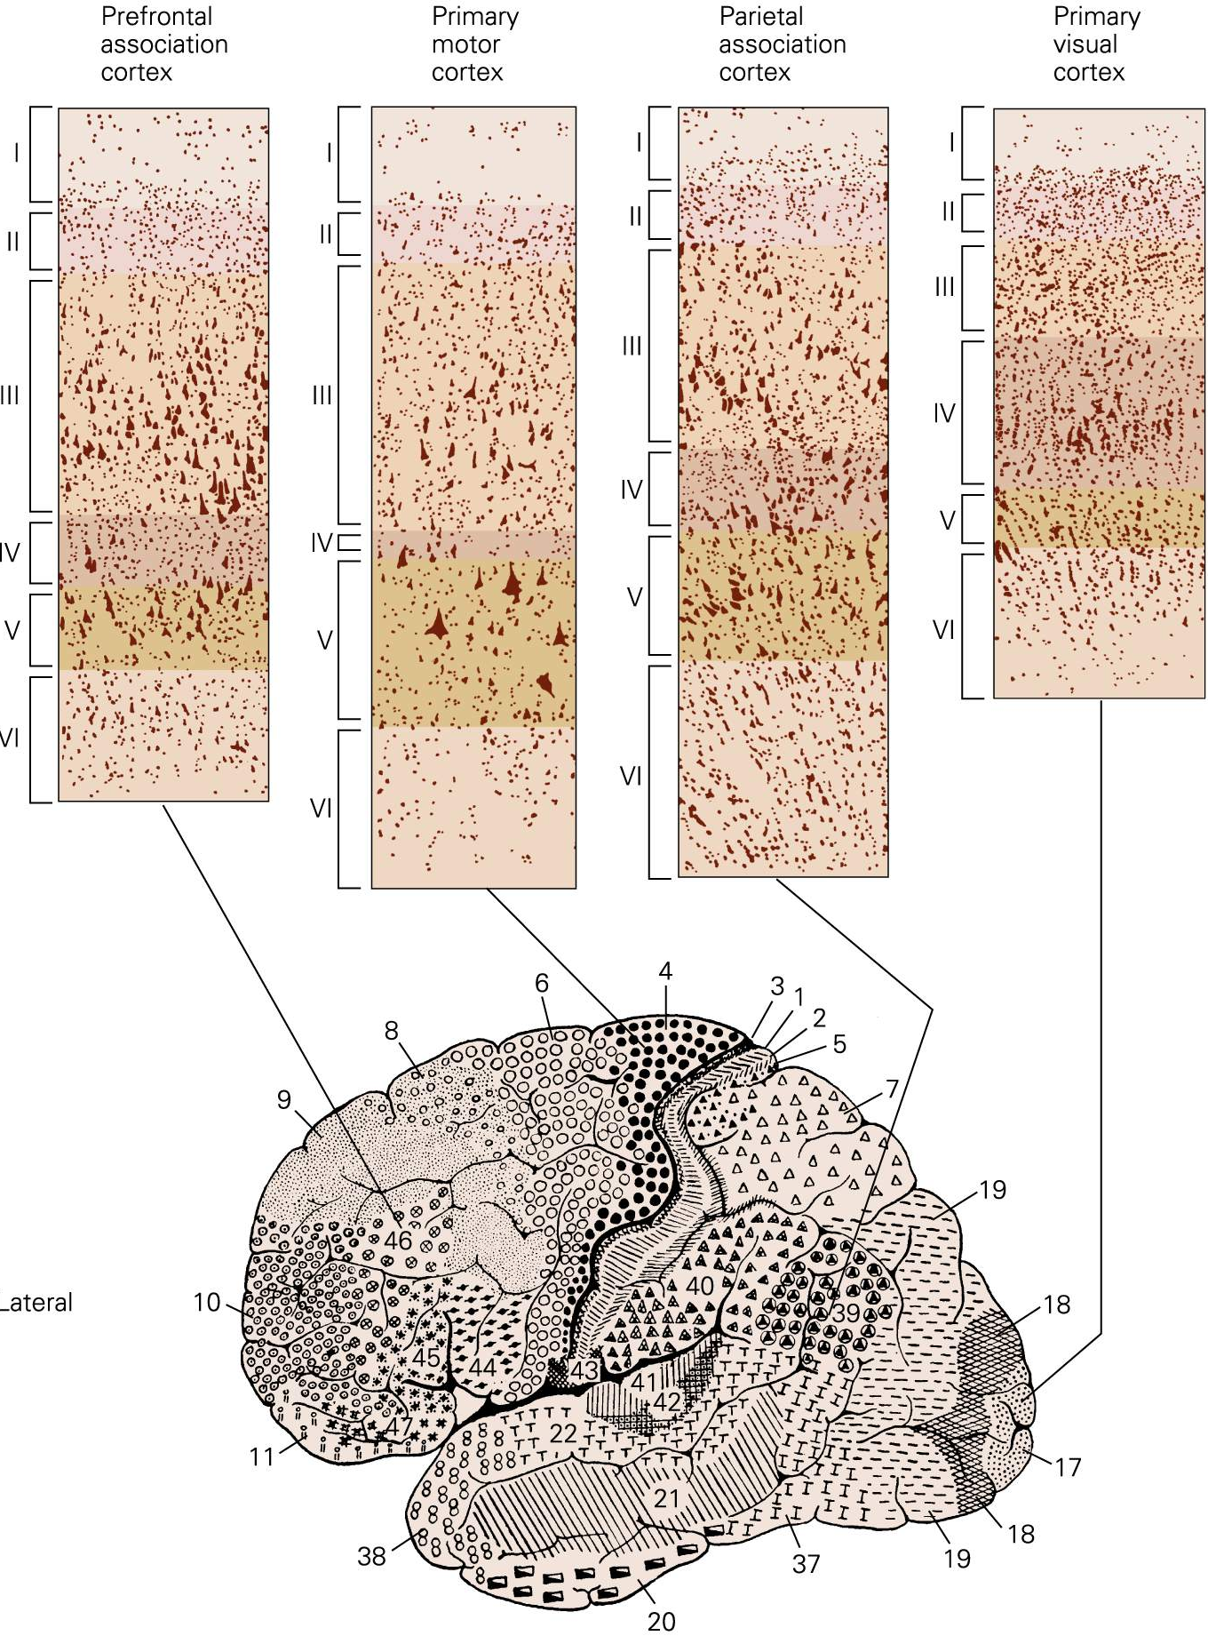
The primary motor cortex is highly specialized
MOTOR SOMATOTOPY: The primary motor cortex is a cortical region whose stimulation evokes movements with the lowest intensity. Electrical stimulation of the motor cortex causes muscle contractions and areas responsible for fine movements have an extension greater than the others.

Slide 16
Organization of primary motor cortex
Wilder Panfield (~1950)
- Much of the M1 is active for each movement
-The direction of movement is the mean value of the activity of a large population of neurons
- The accuracy of the movement depends on the size of the population involved

Slide 17
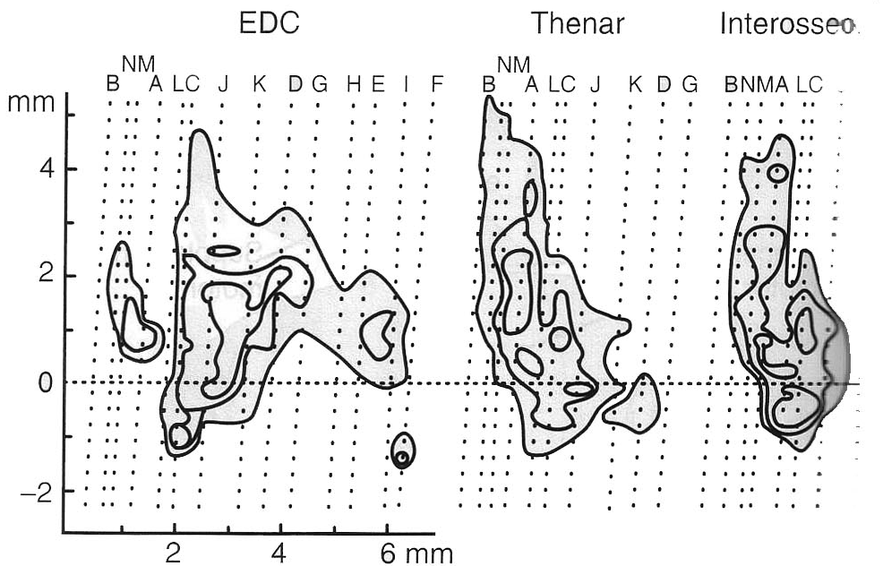
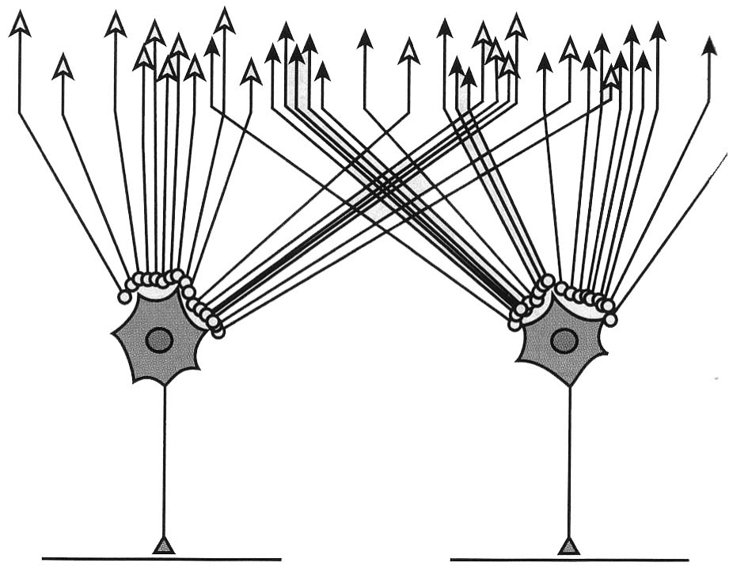
Overlapped representations in M1
Overlap of the edges of electromyographic isoreactivity in the same region of M1 for the activation of three different muscles (common extensor digitorum, thenar and first dorsal interosseous) through microstimulation.
The cortical inputs to motoneurons of each muscle originates from vast territories in M1. Cortical areas that provide input to the motor neurons of different muscles overlap widely among them. In addition, individual cortical neurons project to different motoneuron pools
Modified from Squire et al, Fundamental Neuroscience, Elsevier

Slide 18
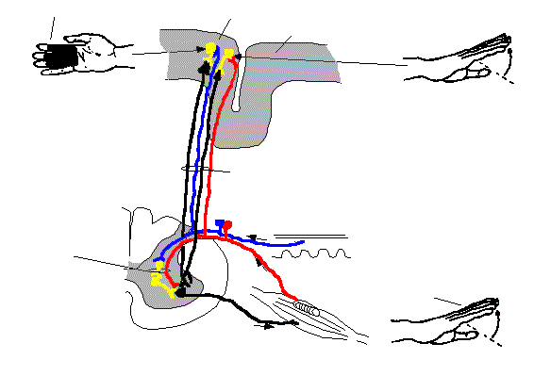
Corticalization of spinal circuitry
Some neurons in the primary motor cortex receive proprioceptive input from the same muscles upon which they act, while others receive information from the areas of skin that are stimulated by the contraction of these muscles.
Campo recettivo cutaneo
Corteccia motoria
Corteccia sensitiva
Informazione propriocettiva: estenxione delle dita
Loop corticale
Pelle
Loop
spinale
Movimento: estensione delle dita
Muscolo

Slide 19
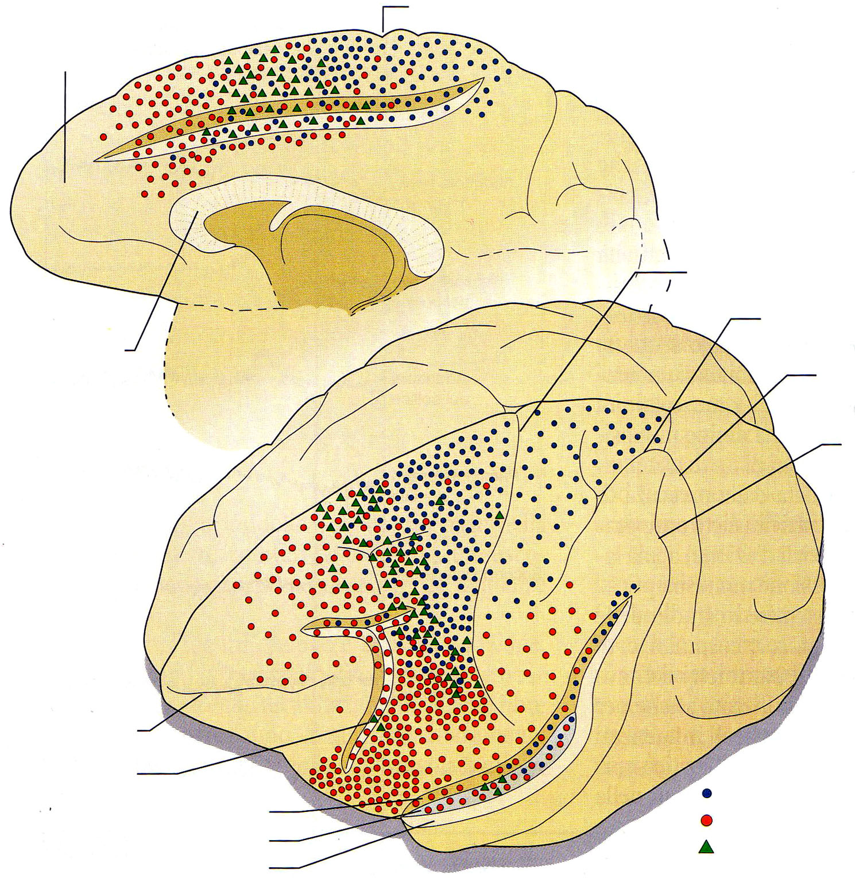
Origin of corticofugal fibres (Macaca fascicularis)
Central sulcus
Cingulate sulcus
Central sulcus
Intraparietal sulcus
Corpus callosum
Lunate sulcus
Superior temporal sulcus
MAINLY TO POSTERIOR HORNS
MAINLY TO ANTERIOR ORNS
Principal sulcus
Arcuate sulcus
Superior wall of lateral sulcus
Corticospinal neurons
Insula
Corticobulbar neurons
Inferior wall of lateral sulcus
Both
Modified from Keizer & Kuypers, Exp. Brain Res., 1989

Slide 20
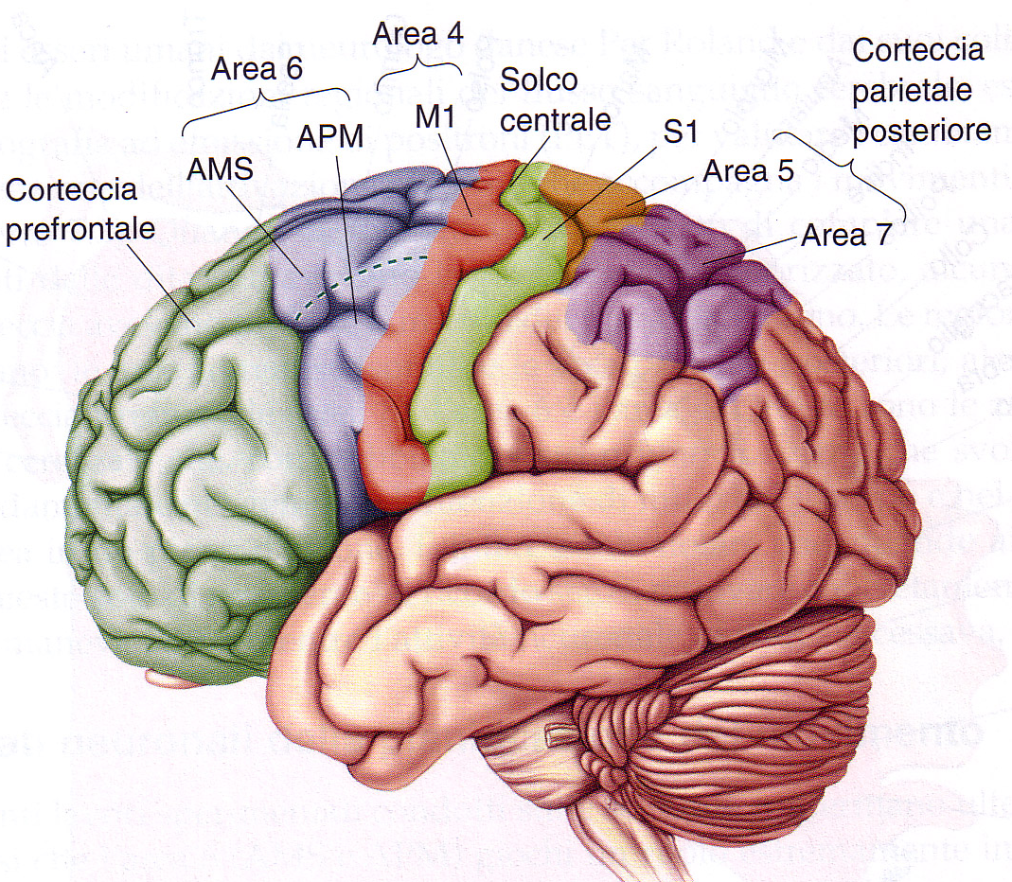
Peri-rolandic areas of the cerebral cortex
Representations of the motor periphery are also present in numerous areas of parietal and frontal cortex and each has a different degree of accuracy.
In addition, their topographical representations are dynamic, as may be modified by several factors, such as learning, training, and lesions of the periphery.
APM: area premotoria
AMS: area supplementare motoria
M1: area motoria primaria

Slide 21
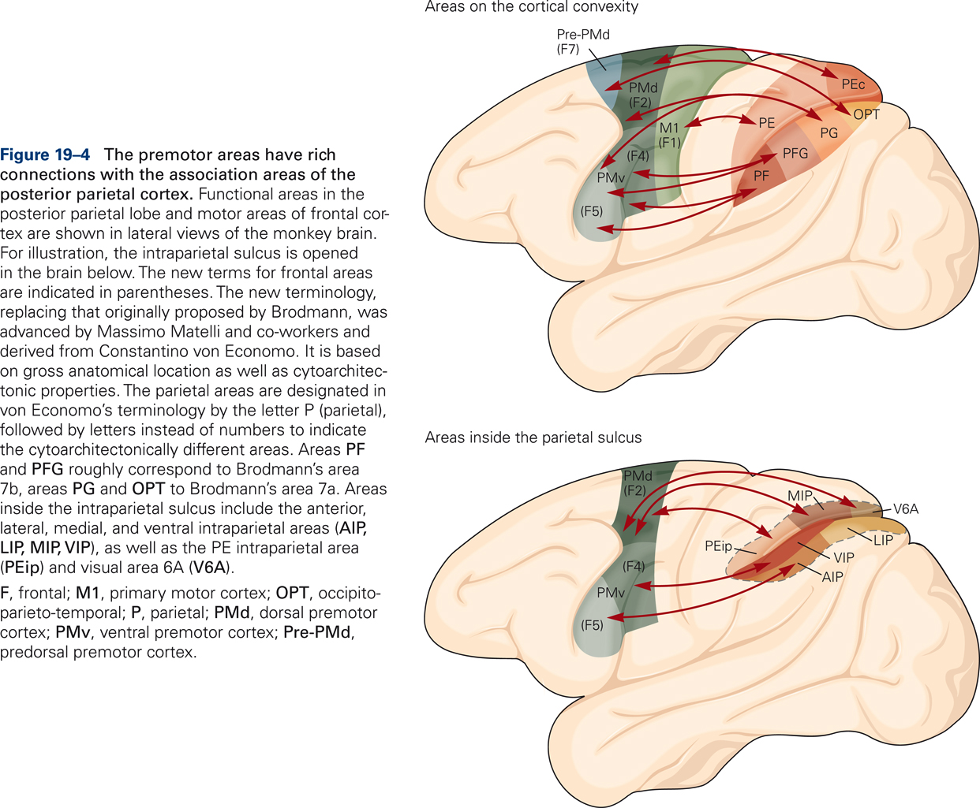
From Kandel et al., Principles of Neural Sciences

Slide 22
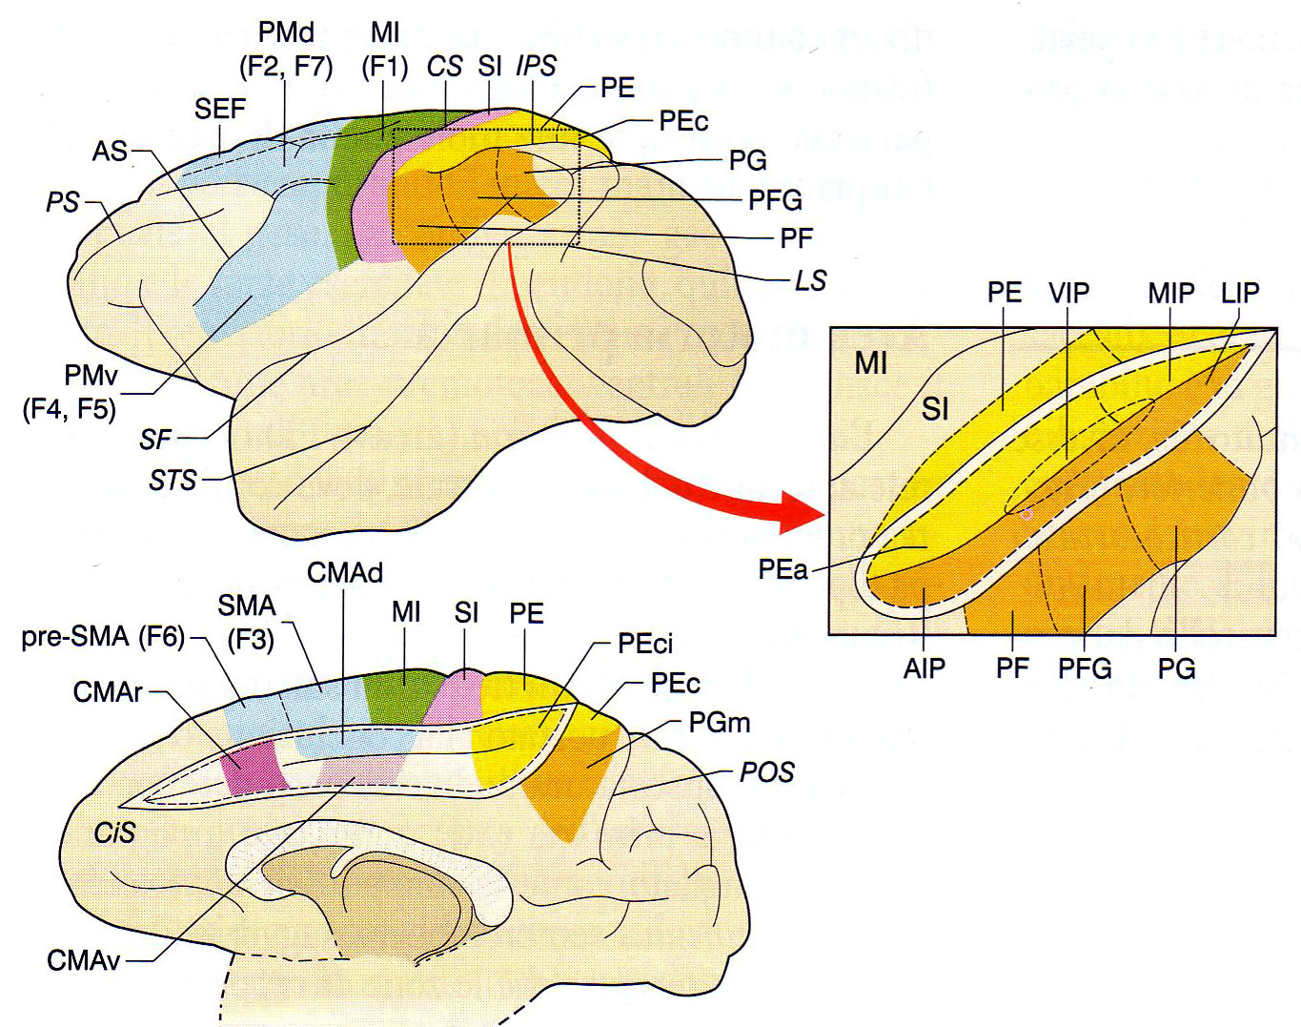
Motor cortex and the fronto-parietal system
Many researchers divide the motor cortex into 7 areas: primary motor area (M1, F1), premotor dorso-rostral area (PMdr, F2), supplementary motor area (SMA, F3), premotor ventro-rostral area (PMvr, F4), premotor ventro-caudal area (PMvc, F5), pre-supplementary motor area (pre-SMA, F6), premotor dorso-caudal area (PMdc, F7)

Slide 23
Motor cortex and the fronto-parietal system
Primary motor area (F1, M1)
Somatotopic; simple, single joint movements.
Movements are encoded by populations of neurons.
Main parietal connections: PE, for the localization of limbs in space, in a coordinate system referred to the body

Slide 24
Motor cortex and the fronto-parietal system
Supplementary motor area (SMA, F3) and pre-SMA (F6)
Somatotopic.
F3: main parietal connections with Peci (secondary sensory area): postural information.
F6: poor parietal connections. Prevalent connections with prefrontal cortex for spatial and temporal aspects of motion planning

Slide 25
Motor cortex and the fronto-parietal system
Dorsal premotor area (F2 and F7) further divided into:
dorsal F2: (somatotopic). Parietal connections: PEip and PEc for limb movements
ventral F2. Parietal connections: MIP and V6A for limb position during reaching movements
medial F7. Parietal connection: PGm for Visual localization of objects during reaching movements lateral F7 (supplementary eye fields). Parietal connections: LIP for exploratory eye movements
V6A

Slide 26
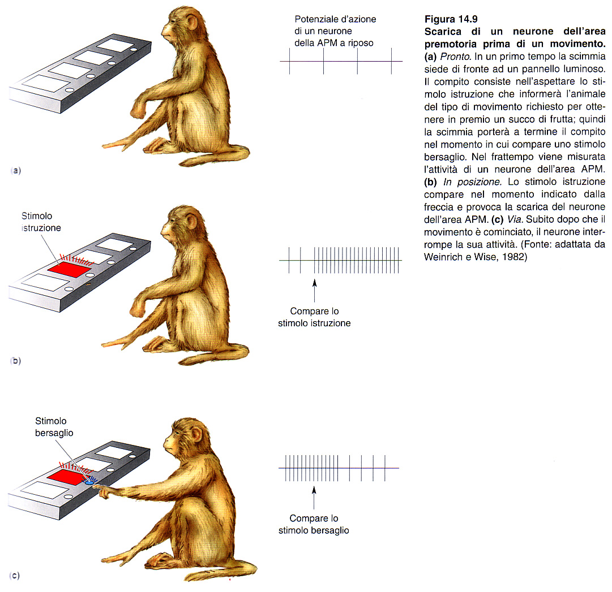
Premotor dorsal cortex

Slide 27
Motor cortex and the fronto-parietal system
Ventral premotor area (PMv; F4, F5).
F4: somatotopic. Complex and multi-joint movements. Parietal connections: VIP for the transformation of position of objects in space in movements to reach them.
F5: somatotopic. Mirror neurons. Parietal connections: AIP for purposeful motions and PF for the internal representation of actions (mimics and recognition).

Slide 28
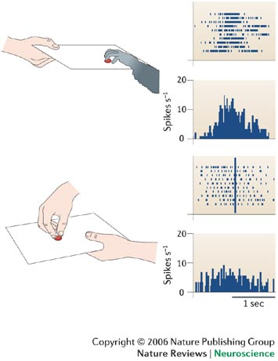
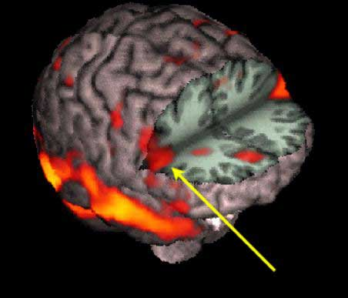
Premotor ventral cortex
MIRROR NEURONS
Area di Broca
45, 44

Slide 29
Motor cortex and the fronto-parietal system: all together
The involvement of each of these areas in the planning and execution of movement depends not only on the properties of its neurons, but also on the context in which the movement itself is carried out. From this point of view, the cerebral cortex seems to be involved more in the cognitive aspects of movement that in its real generation.

Slide 30
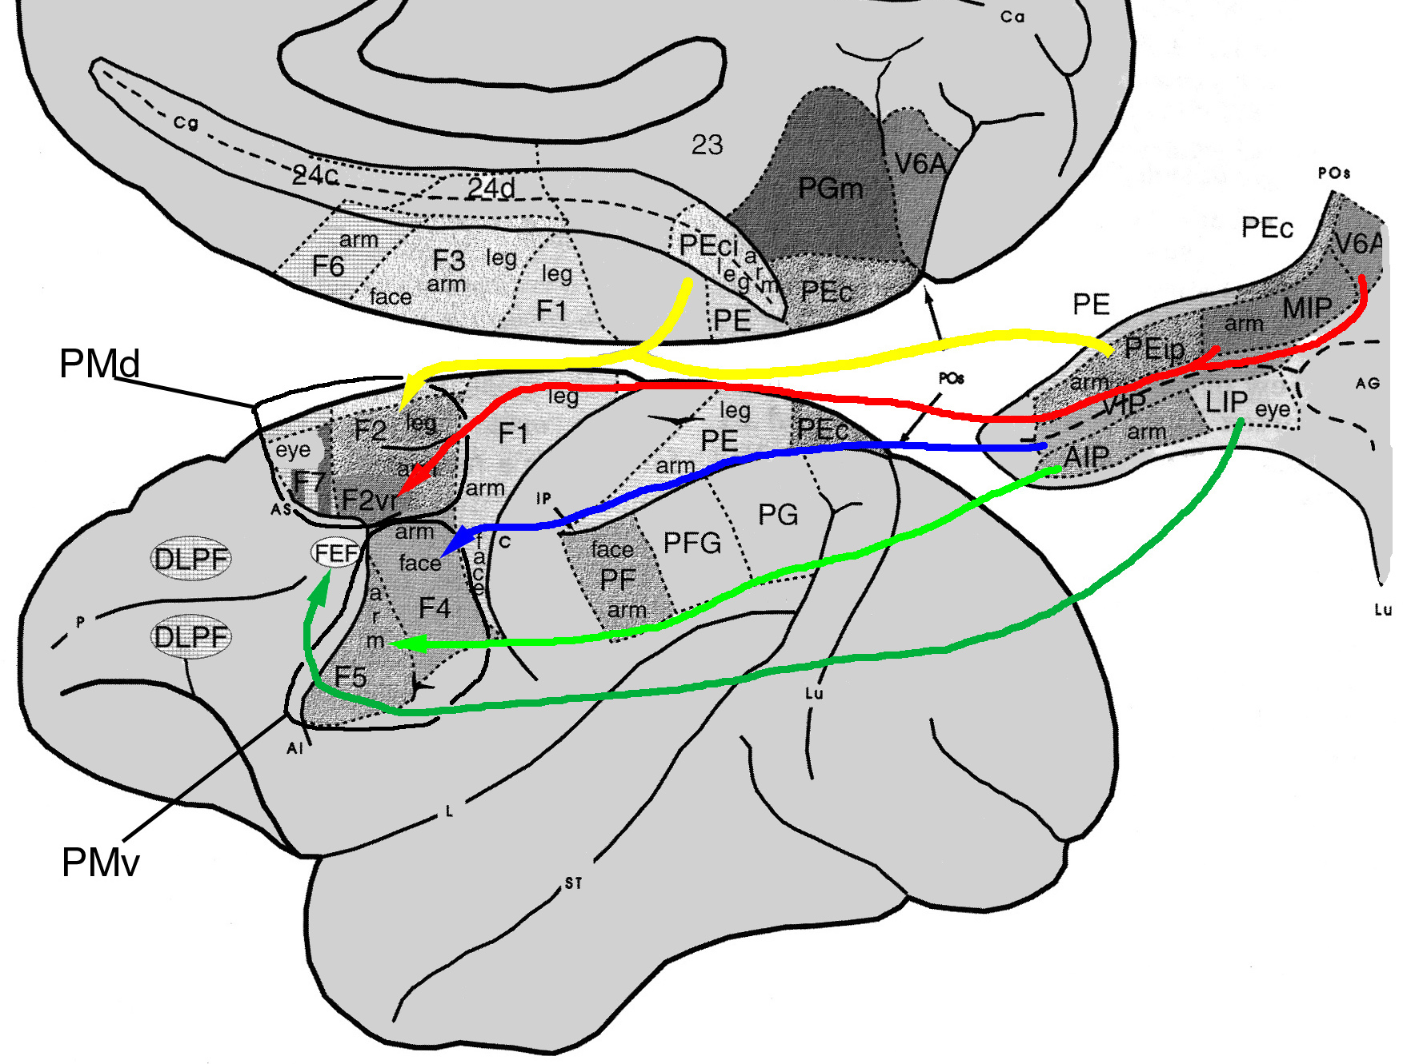
Functional streams: the parieto-frontal system
This parieto-frontal system plays a crucial role in the composition of motor commands, in the control of coherence between planning and execution, in the selection of conflicting motor plans and in the change of motor trajectory, when it is requested by the context.
Limb movements
Limb position
Saccades, eye-arm coordination
Representation of action
Movement in peripersonal space
Matelli & Luppino, Neuroimage, 2001

Slide 31
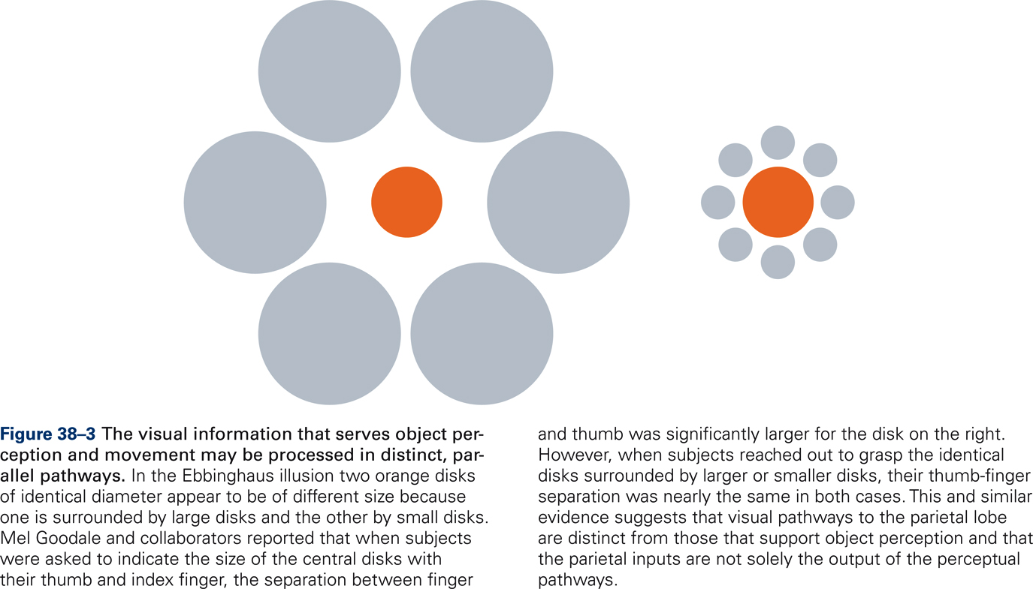
Different analysis for action and perception
From Kandel et al., Principles of Neural Sciences

Slide 32
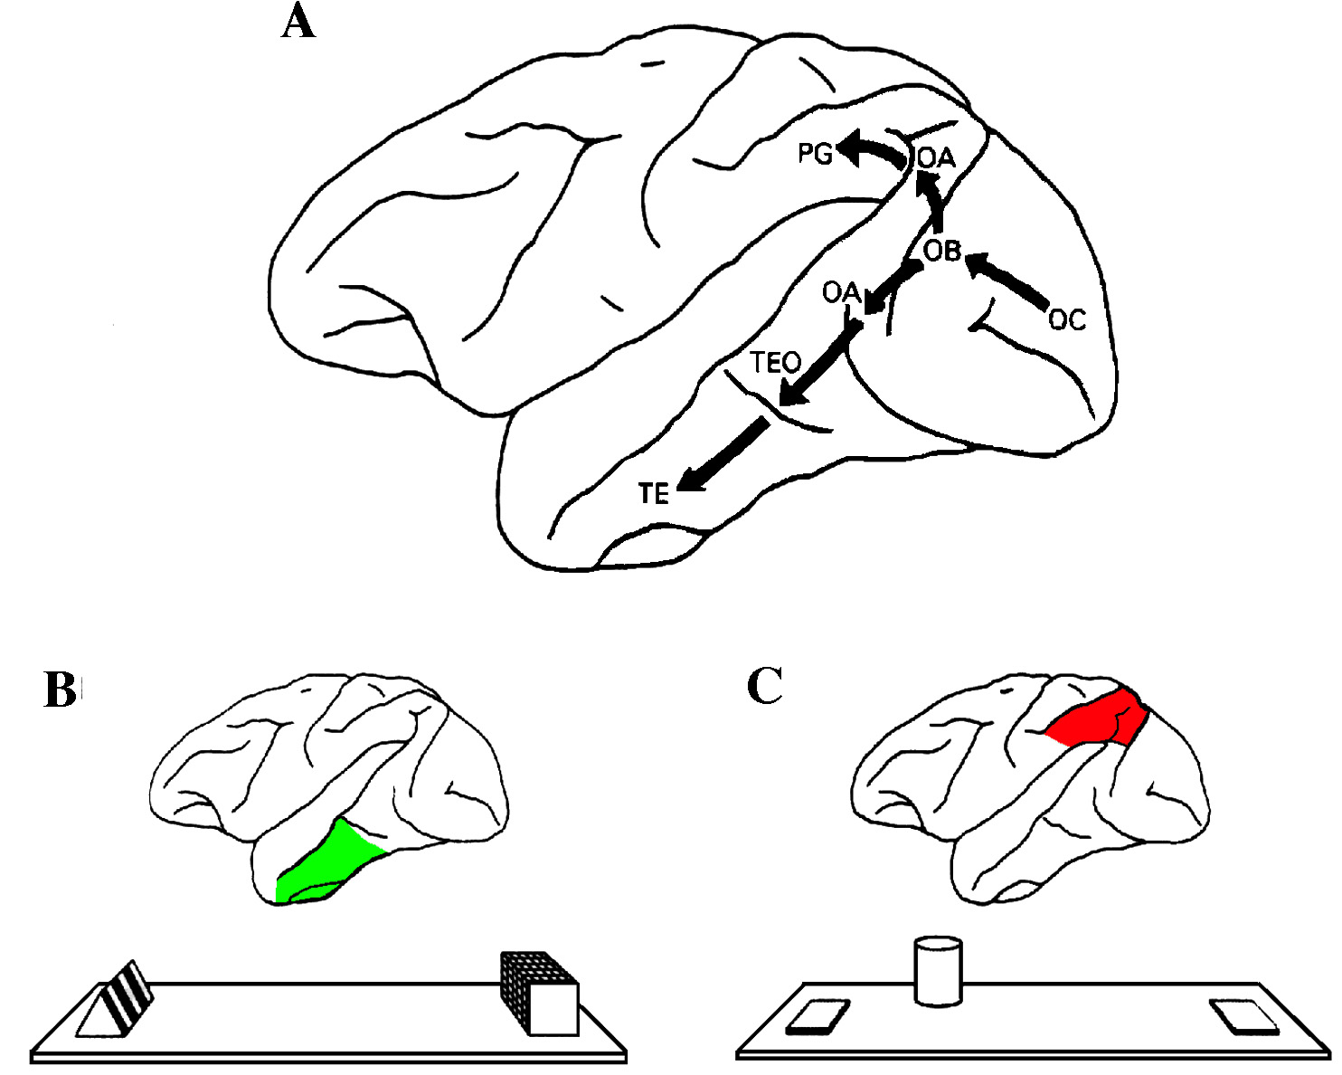
Dorsal and ventral channels for action and perception

Slide 33
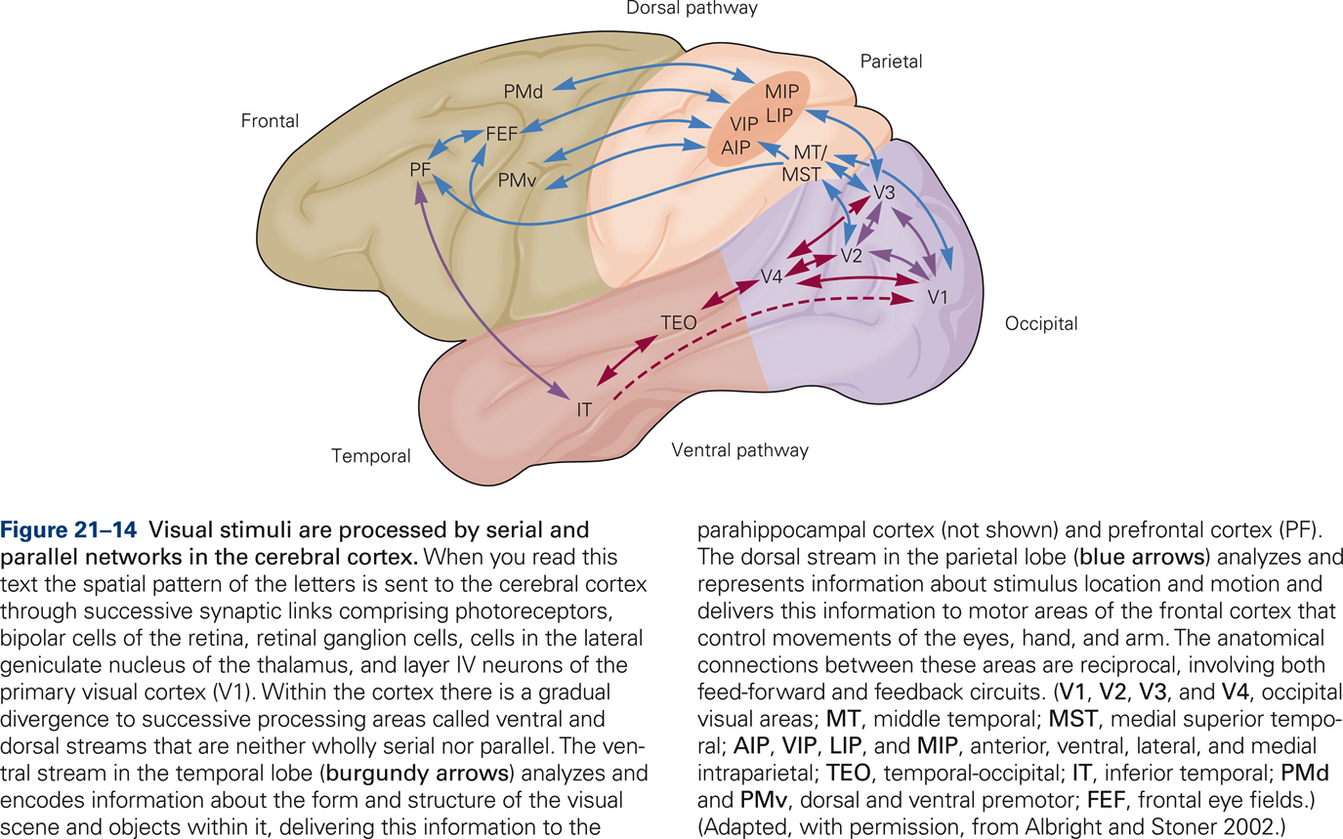
Functional streams: the parieto-frontal system
From Kandel et al., Principles of Neural Sciences

Slide 34
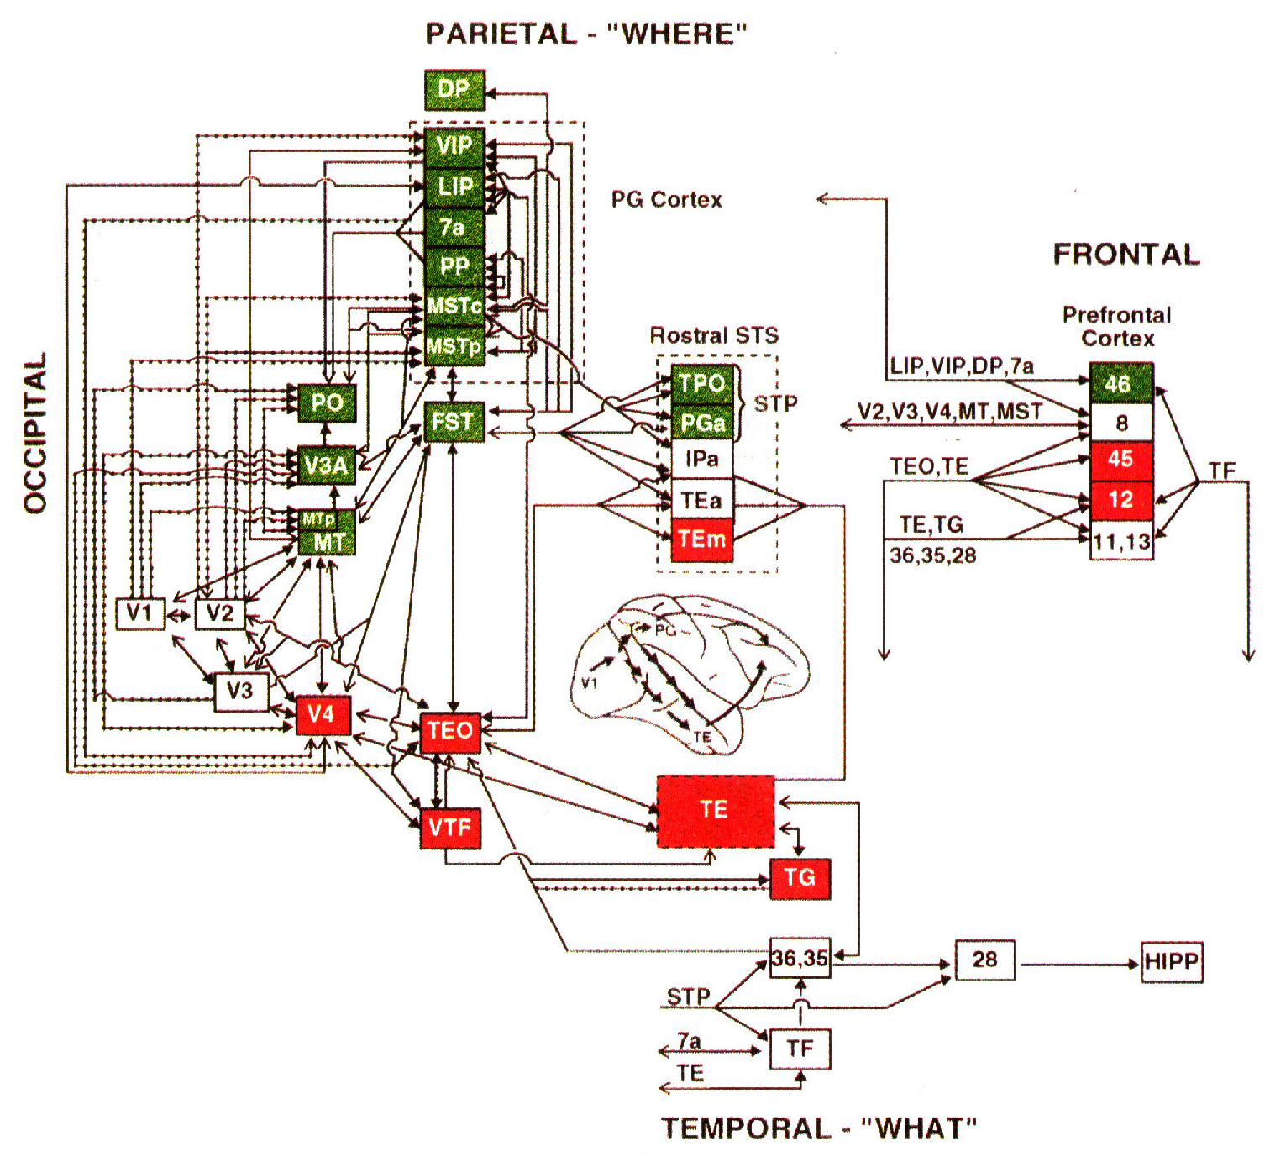
Parallel distribution to parietal and frontal areas

Slide 35
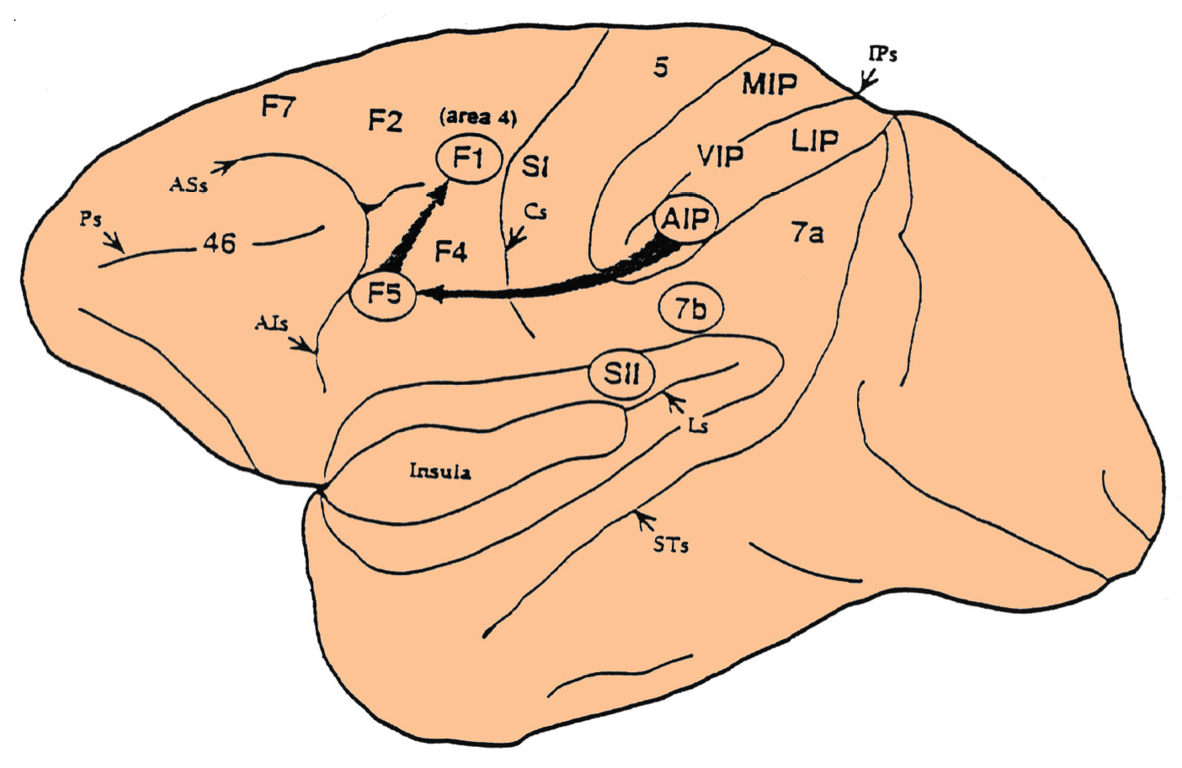
Functional streams: the parieto-frontal system
The cortical control of voluntary movement is based upon the activity of a system of parietal and frontal regions which are linked by reciprocal connections.
REACHING
GRASPING
Tannè et al., Neuroreport, 1995
Cortical regions involved in these processes differ on the basis of their cortico-cortical and cortico-subcortical connections as well as for the different functional properties of their neurons.

Slide 36
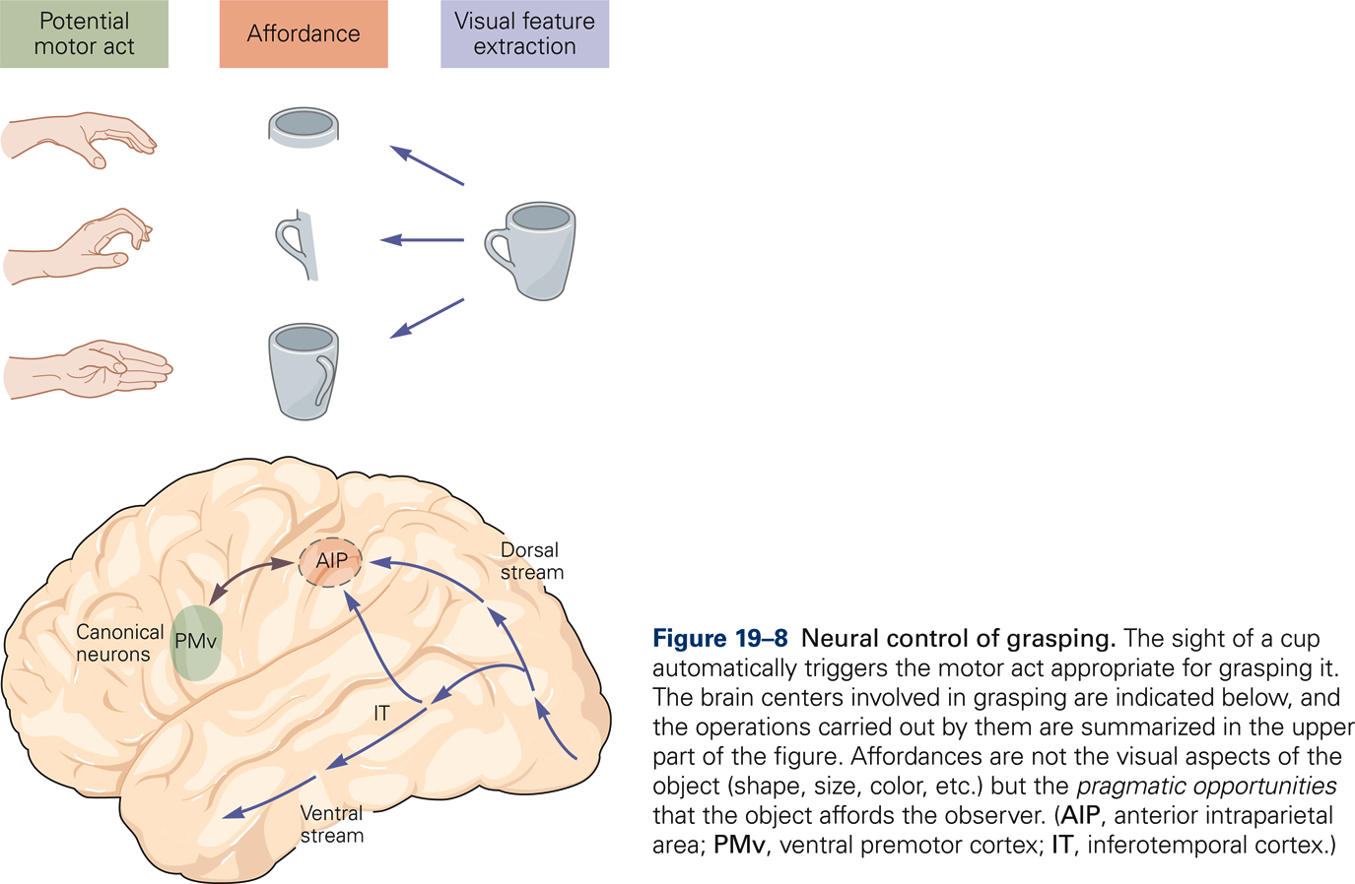
Functional streams: the parieto-frontal system (grasping)
From Kandel et al., Principles of Neural Sciences

Slide 37
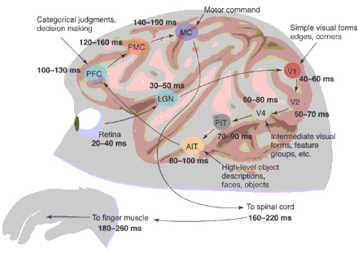
Timing from sensory signal to motor output
From Thorpe and Fabre-Thorpe, Science, 2001

Slide 38
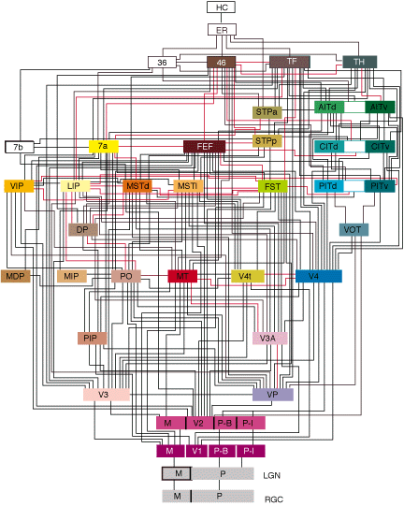
Cortico-cortical flow of information
Felleman and Van Essen

