Slide 1
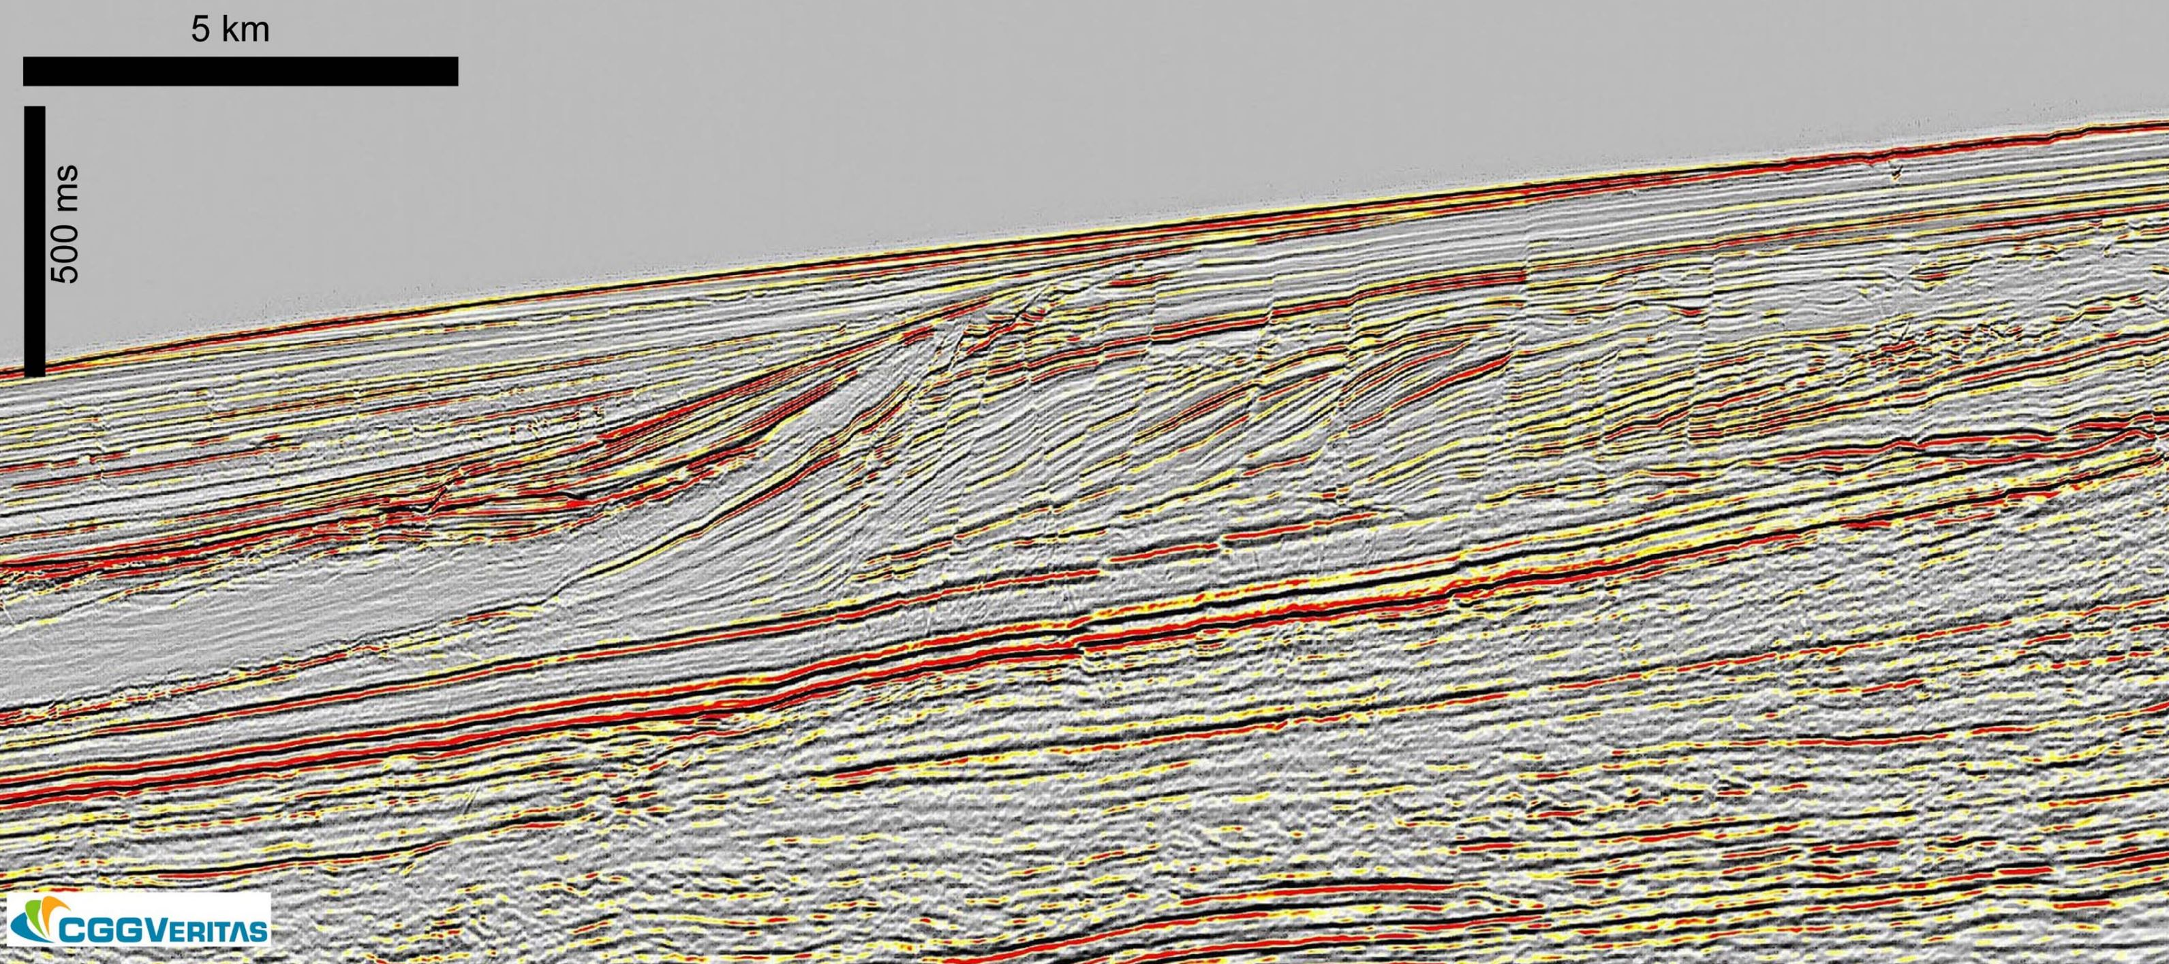
By VSA
http://www.seismicatlas.org/entity?id=cba7ba45-6c87-418d-8295-c8180b3b0c38

Slide 2
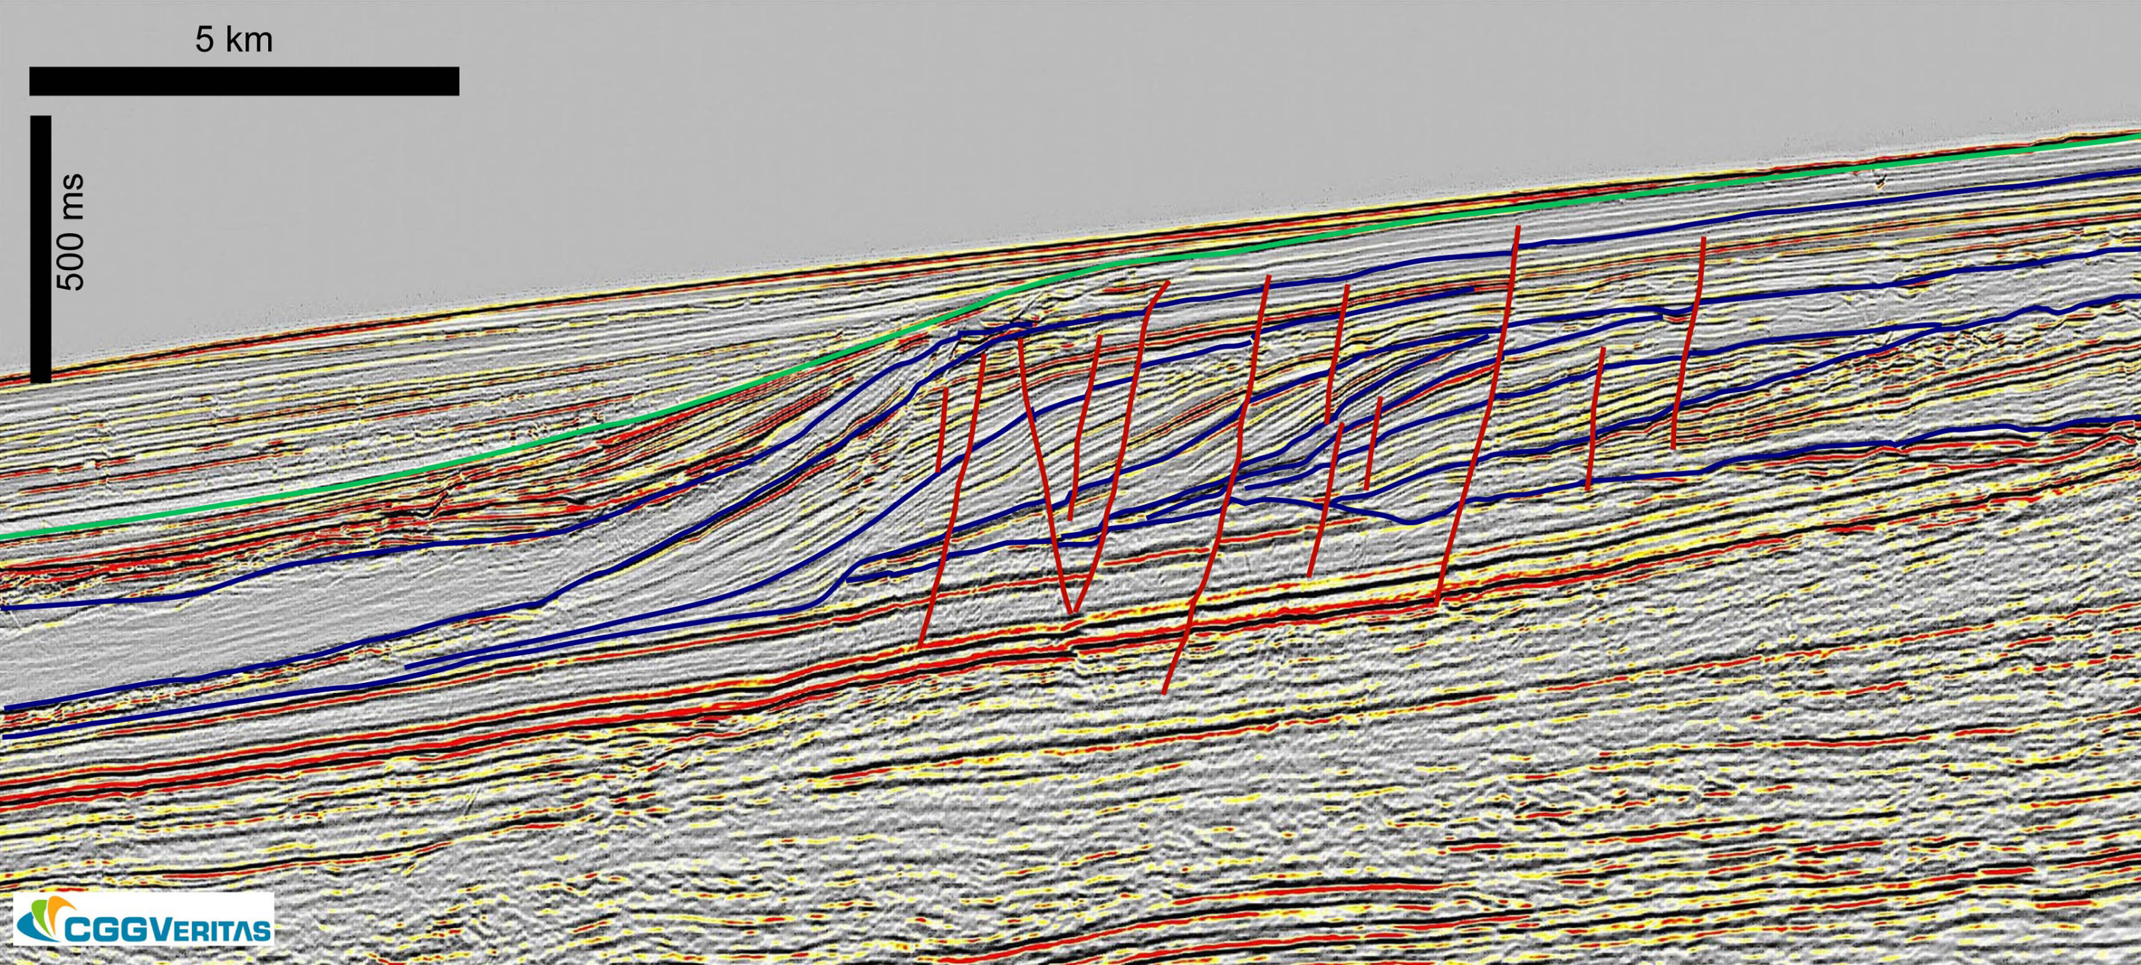
By VSA

Slide 3
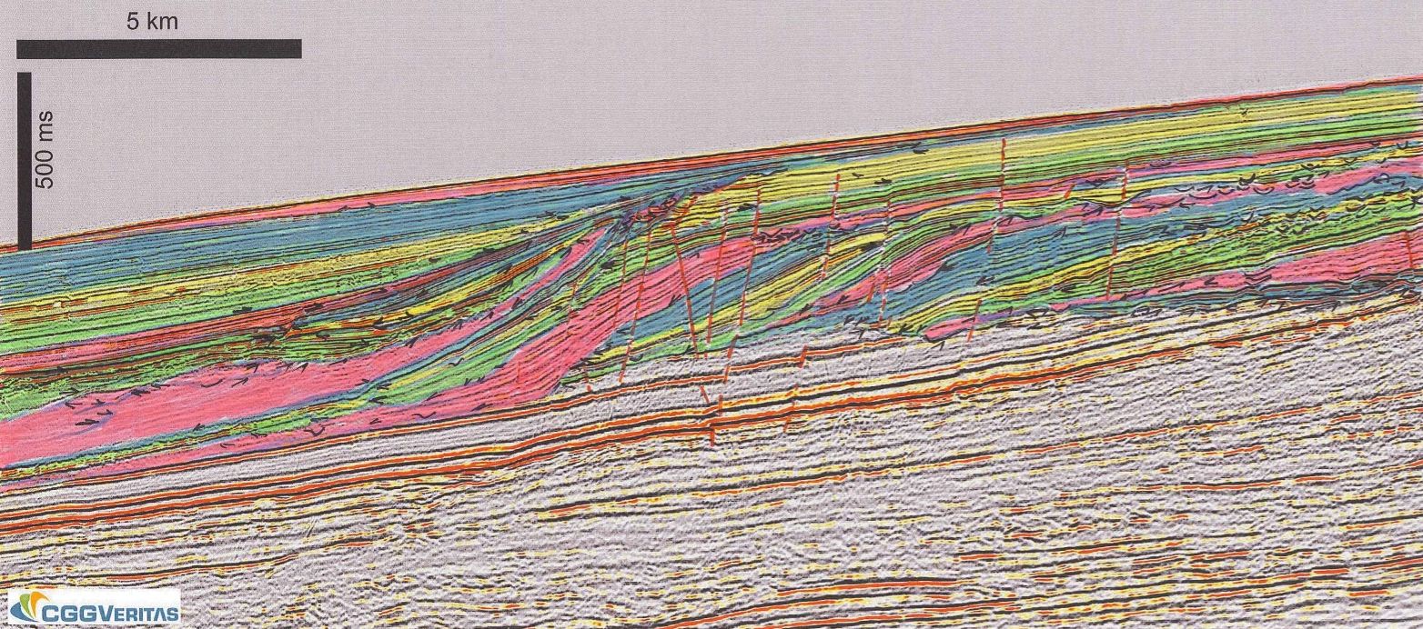
By VSA

Slide 4
