Slide 1

OpenMRS: OVERVIEW
Corso di Informatica Medica
Docente Sara Renata Francesca MARCEGLIA

Slide 2
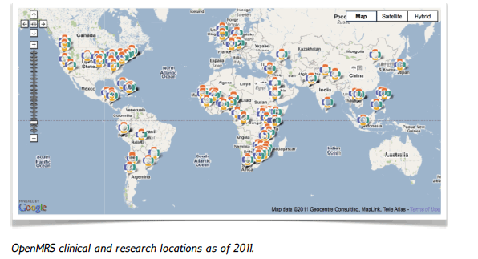
OPENMRS: LOCATIONS AROUND THE WORLD

Slide 3
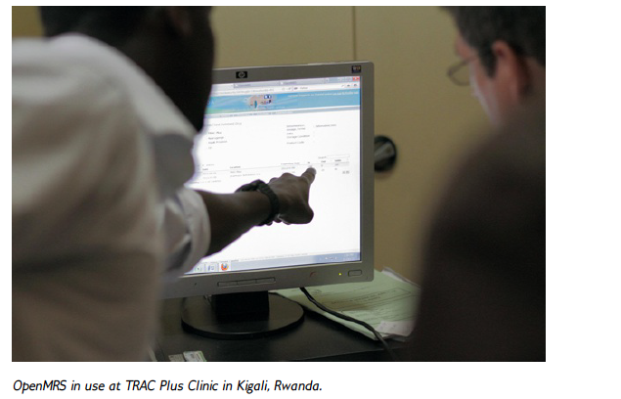
OPENMRS WAS CREATED FOR THE DEVELOPING COUNTRIES

Slide 4
OPEN SOURCE: IMPLEMENTATION VS DEVELOPMENT
IMPLEMENTERS
Clinics/Hospitals in need of the EHR system
Install OpenMRS and Use it
DEVELOPERS
Information scientists who develop the source code
Rely on the development community for new features → use modules
Create the dictionary and the forms useful for their implementation
Work independently or after being committed to a project
The source code is available
There is a large developer community around the world
Develop modules

Slide 5
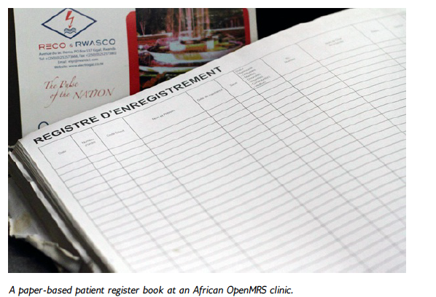
FROM PAPER-BASED RECORDS… TO THE EHR

Slide 6
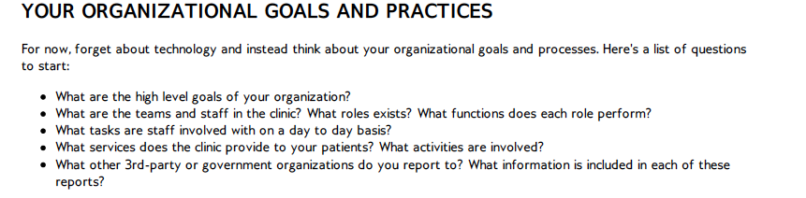
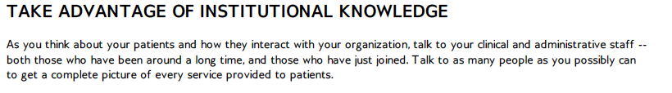

THE DEVELOPMENT PROCESS: IDENTIFYING YOUR NEEDS

Slide 7
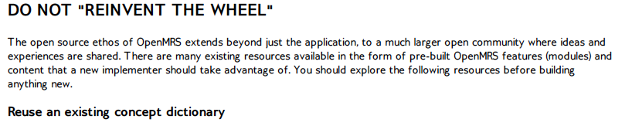


THE OPEN SOURCE COMMUNITY

Slide 8
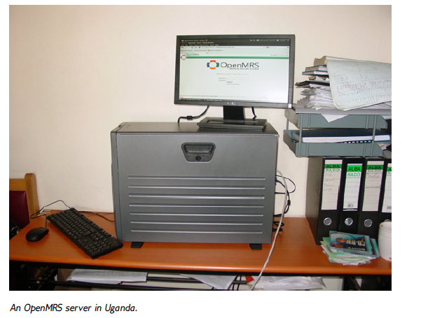
…AND THEN IMPLEMENT…

Slide 9
THE INFORMATION MODEL
DATA
  Person
  Encounter
  Visit
  Observation
  Order
  Workflow
METADATA
  Locations
  Concept Dictionary
FORMS

Slide 10
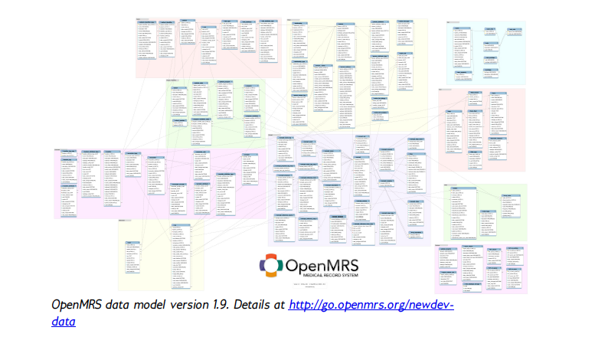
THE DATA MODEL

Slide 11
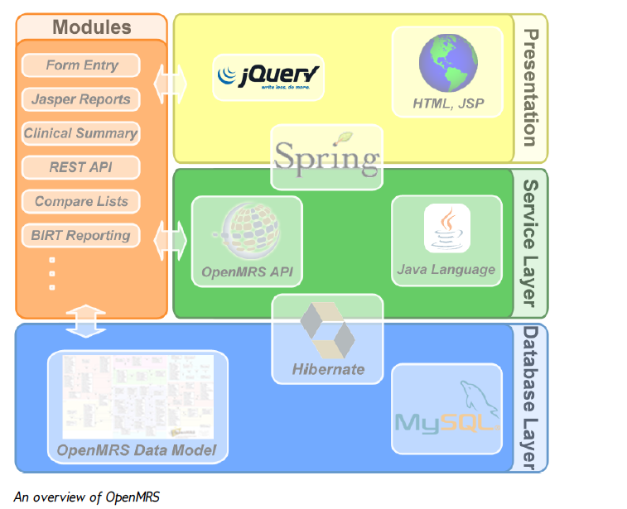
ARCHITECTURE

Slide 12
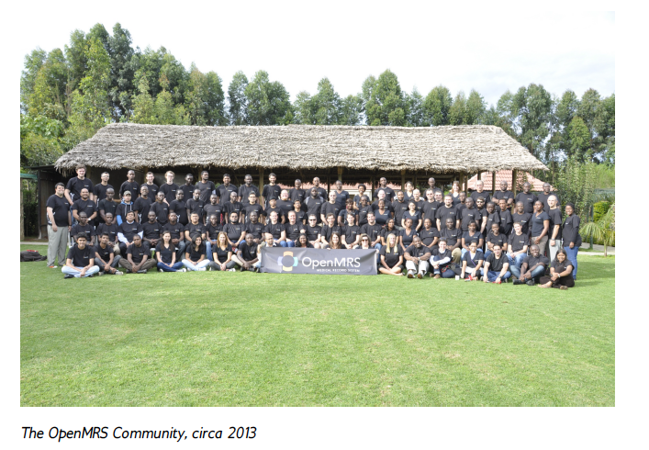
GET INVOLVED

Slide 13
DOWNLOAD OpenMRS
http://openmrs.org/download/

Slide 14
THE DEMO ENVIRONMENT

Slide 15
THE STANDALONE EDITION
Choose the location for the session
Username: admin
Password: Admin123

Slide 19
START VISIT

Slide 20
CAPTURE VITALS

Slide 21
VISIT REPORT
The diagnosis is chosen from the dictionary

Slide 22
ADMINISTRATION SECTION

Slide 23
CONCEPT DICTIONARY

Slide 24
CREATE NEW CONCEPT

Slide 25
QUESTION&ANSWER CONCEPTS

Slide 26
CREATE A NEW FORM
We want to create a form that contains:
CASE DETAILS
Age:___________________________________
Gender:
□ Male
□ Female
Diagnosis:______________________________
Years of disease history:__________________
Predominant side:
□ Left
□ Right
Date of implant:_________________________
Target structure:________________________

Slide 27
CREATE THE CONCEPTS
Age →
  question with numeric answer
  Equivalent to SNOMED CT “current chronological age “ code: 424144002
Gender →
  Question with answers “male” and “female”
  First you have to create the concepts for the answers
Diagnosis →
  Question with either open answer or coded answer (set of diagnoses)
Years of disease history →
  question with numeric answer

Slide 28
CREATE THE NEW FORM

Slide 29
EDIT THE NEW FORM

Slide 30
CREATE THE CODE
<tr>
  <td>Diagnosi neurologica:</td>
  <td>
  <obs conceptId="163140" labelText="" style="radio"/>
  </td>
</tr>
<tr>
  <td>Genere:</td>
  <td>
  <obs conceptId=“163143” labelText="" answerConceptIds="163141,163142”
  answerLabels=“Maschio, Femmina” /></td>
</tr>

Slide 31
PREVIEW THE NEW FORM

