Slide 1
Identification of new drugs
Anti-PCSK9 (evolocumab) for hypercolesteolemia
Use of drugs in rare diseases
Riboflavin to treat pathologies due to SLC52A2 deficiencies
Dose adjustments
TPMT polymorphysms and thiopurine dosing
Predisposition to dose independent adverse effects
HLA and predisposition to adverse effects
Genomic and therapy

Slide 2
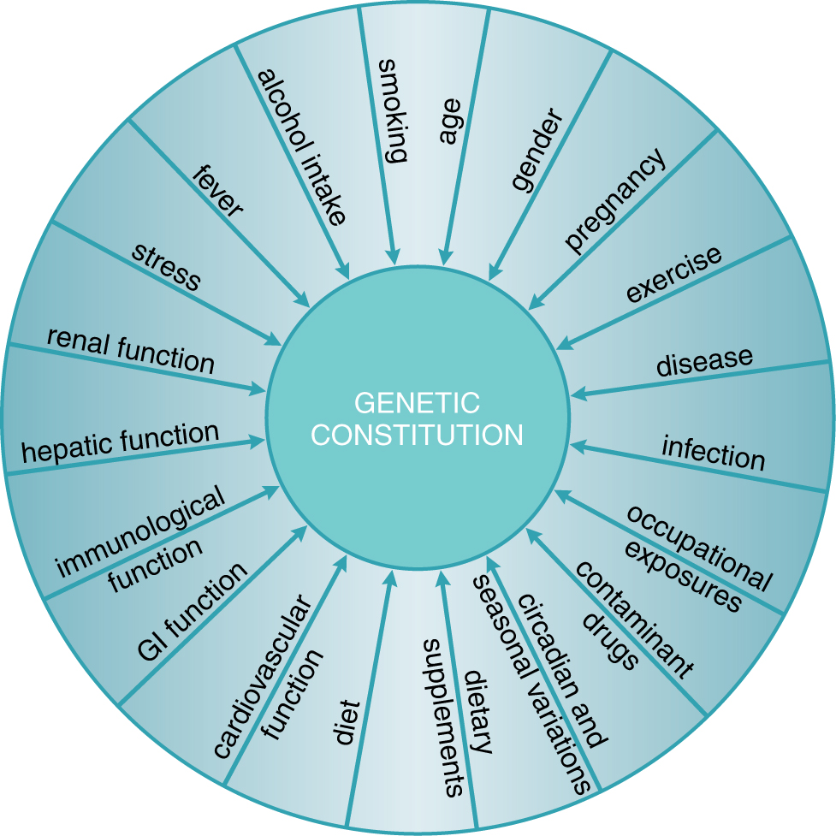
Endogenous and exogenous factors contribute to variability in drug effects
physiological
pathological
genetic
Goodman and Gilman, 2011

Slide 3
Variability can be defined as:
pharmacokinetic
pharmacodynamic
idyosyncratic

Slide 4
Factors affecting variability in drug response
Ethnic differences
Age
Pregnancy
Diseases
Drug interactions
Genetic factors

Slide 5
Ethnic differences
Ethnic means «belonging to a race». However many anthropologists are sceptical on the relevance of this concept.
Afroamericans affected from cardiac insufficiency differently from Caucasians benefit from hydralizin and nitrate.
Asiatics are more sensitive to the effects of propanolol and gefitinib, because of polymorphisms in drug targets.

Slide 7
Ethnic differences: drug metabolism

Slide 8
Ethnic differences: drug metabolism

Slide 9
Ethnic differences
Ethnic group can be considered a surrogate of typing particular variants, also involved in drug pharmacokinetics and pharmacodynamics.
However it is an approximation, therefore it is better to type directly the polymorphisms, because diversity in each ethnic group is ample.

Slide 10
Age
Age is one of the main factors affecting response to pharmacological therapy.
Children and elders present reduced drug elimination and are therefore more sensitive to drugs.
For elders also physiological (alteration of cardiovascular reflexes, increase in body fat) and pathological (hypothermia, polytherapy) factors are relevant for drug response.

Slide 11
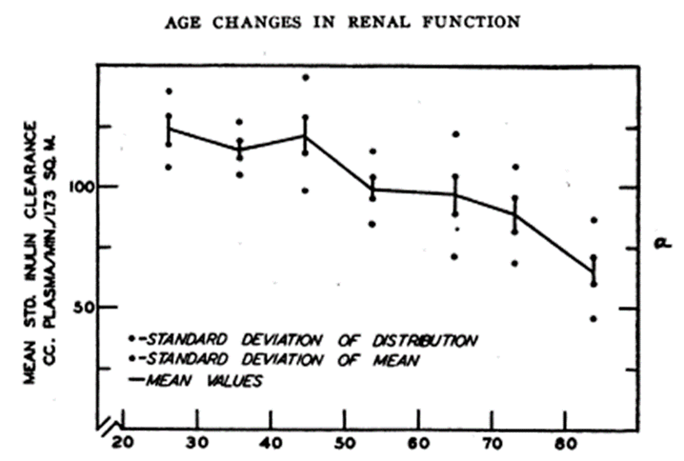
Age and drug excrection

Slide 12
Age and pharmacotherapy: pediatric patients
Pediatrics does not deal with miniature men and women, with reduced doses and the same class of disease in smaller bodies, but has its own independent range and horizon.
Dr. Abraham Jacobi

Slide 13
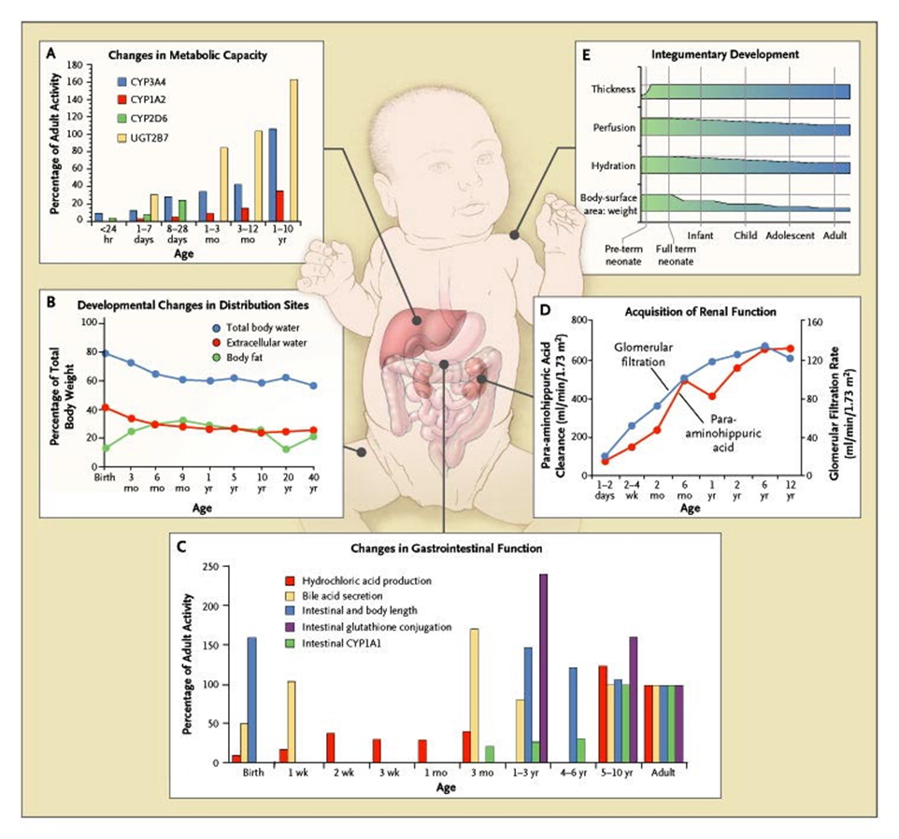
Age and pharmacotherapy: pediatric patients
Kearns GL et al. N Engl J Med 2003;349:1157-1167.

Slide 15
Epigenetic (promoter methylation) can explain age-related changes in gene expression
Kacevska et al., Biochimie 2012

Slide 16
Examples
Cloramphenicol and sulphamidic intolerance in children due to reduced glucuronidation
Morphine is not used among analgesis during delivery.
«Gasping syndrome» in newborns due to benzylic alchool.

Slide 17
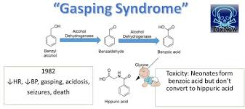

Slide 18
Pregnancy

Slide 19
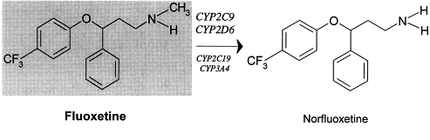
Pregnacy and cytochromes

Slide 20
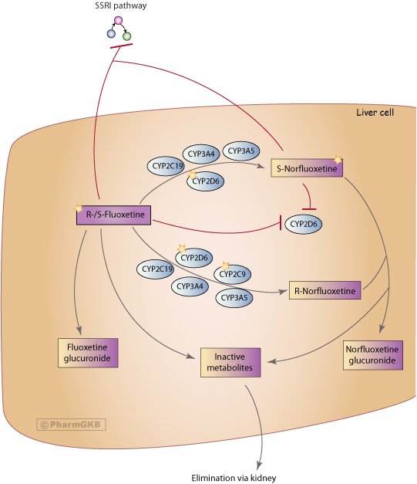
Fluoxethine biotransformation

Slide 22
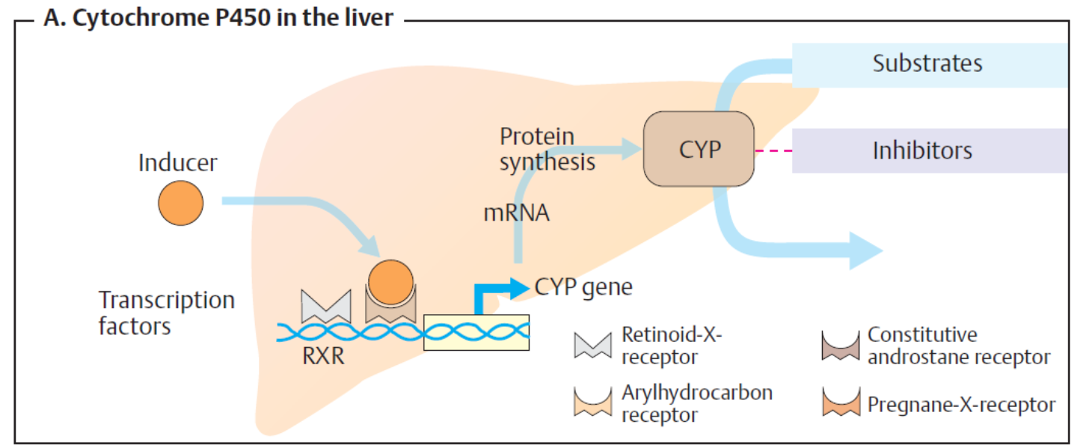
Drugs can induce expression of metabolizing enzymes

Slide 23
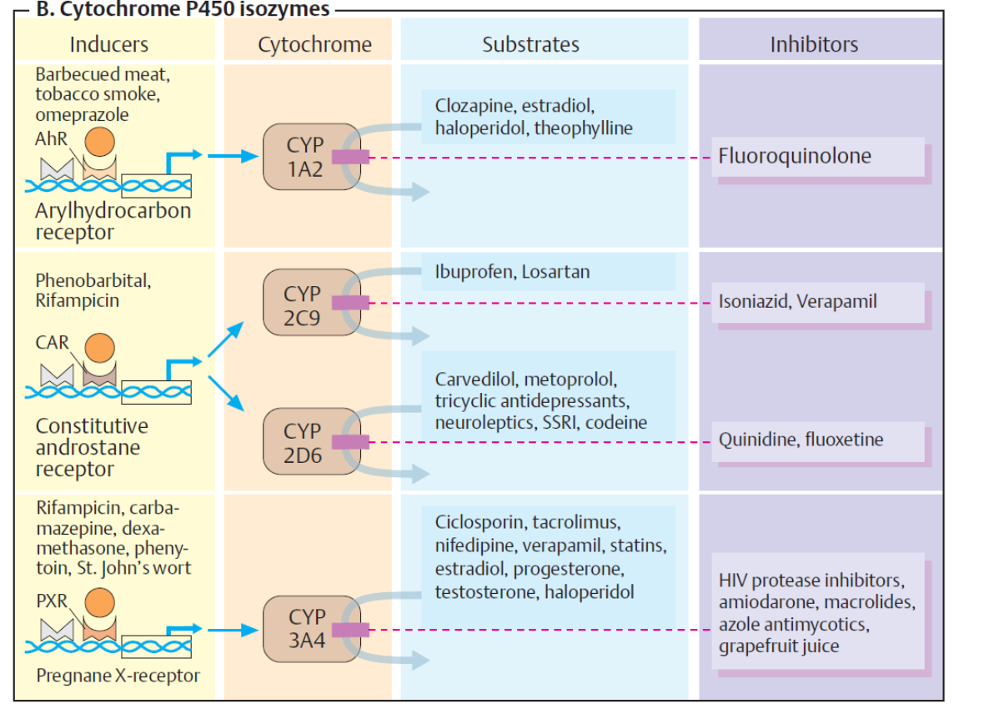

Slide 24
Personalized therapy
Treatment Outcome (same dose)
Responder
No effect
Adverse event

























Slide 25
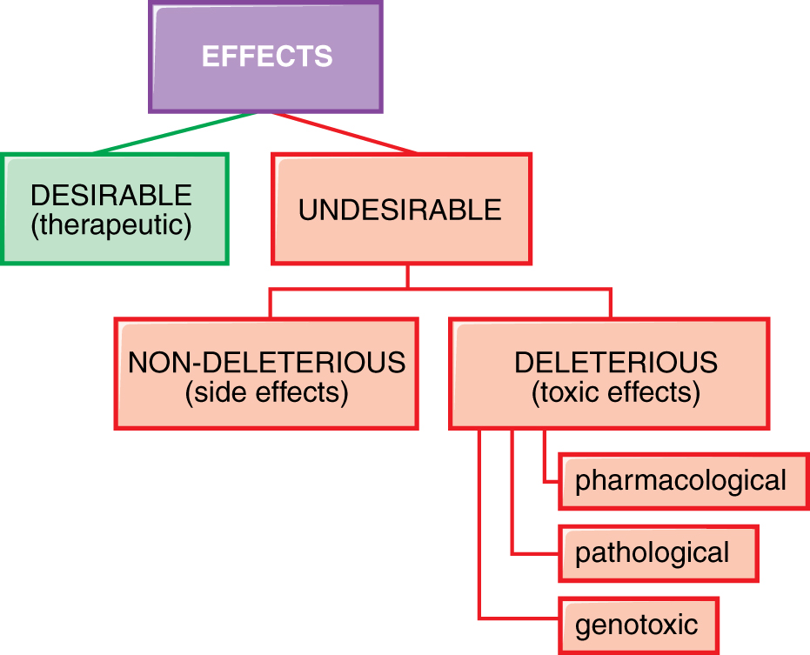
Drug effects
Goodman and Gilman, 2011

Slide 26
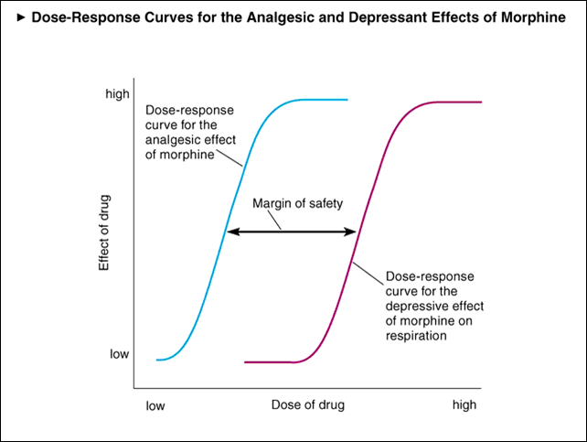
Dose dependent side effects: morphine

Slide 27
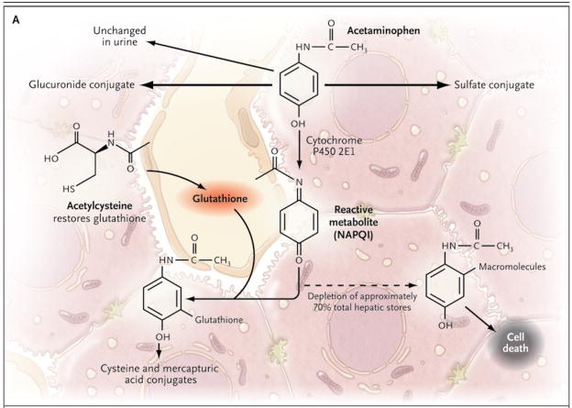
Dose dependent «off target» adverse events: paracetamol

Slide 28
Drugs that can give hypersensitivity reactions in humans

Slide 29
Hypersensitivity reactions

Slide 30
Ipotesi del meccanismo delle reazioni di ipersensibilità
"Hapten"
"Pharmacological interaction"
"Danger"

Slide 31
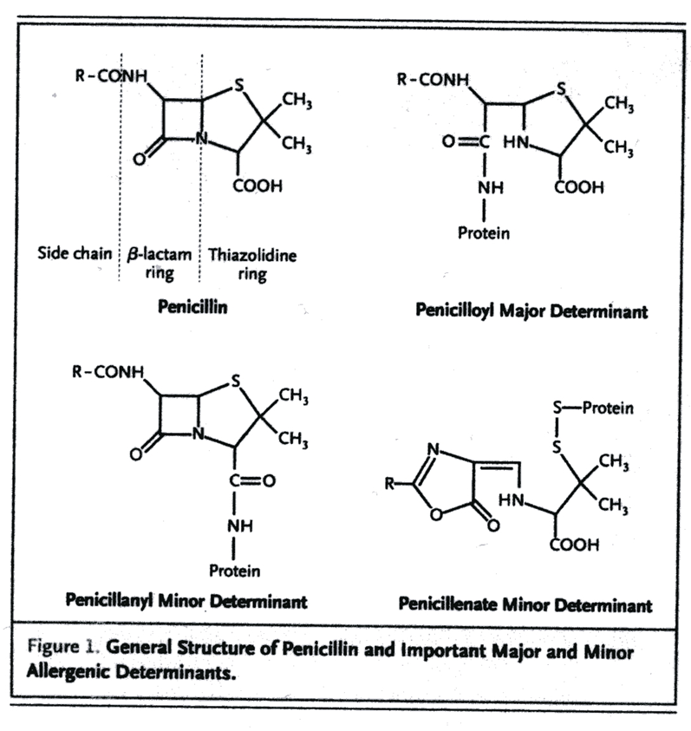
Hapten hypothesis

Slide 32
Pharmacological interaction

Slide 33
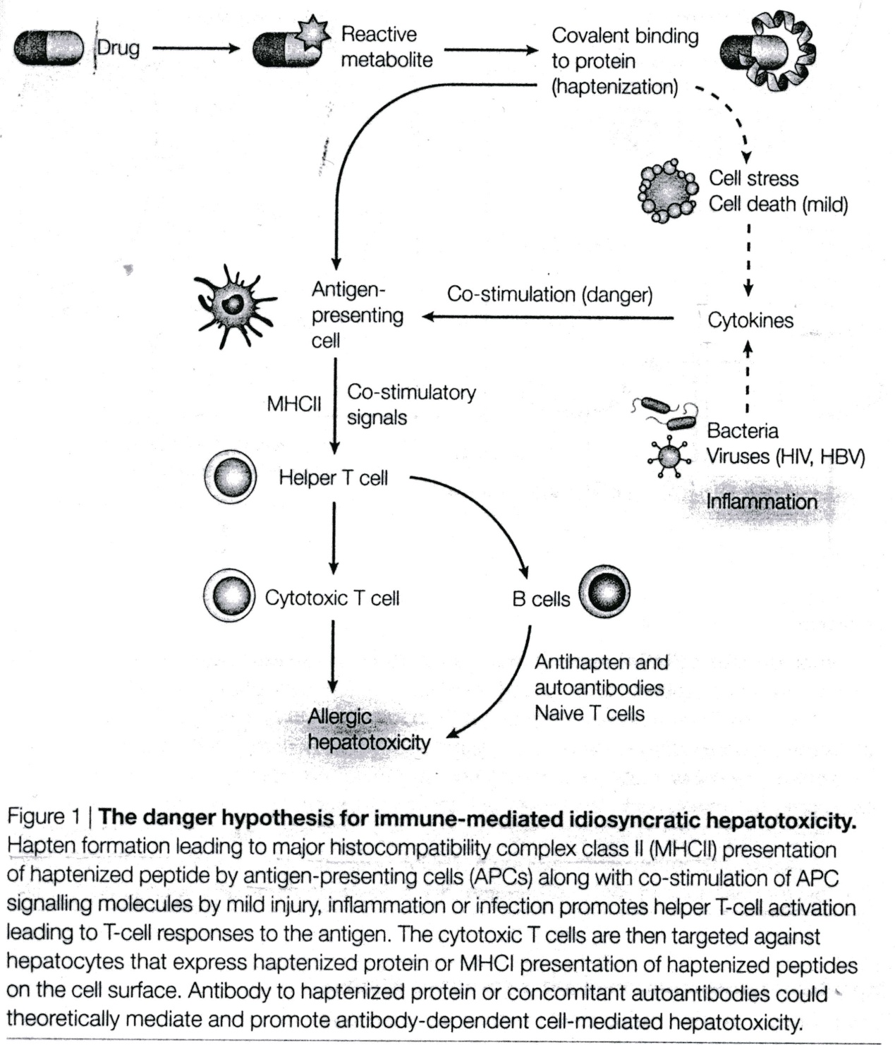
Danger hypothesis

