Slide 1
UNIFIED MODELING LANGAUGE BASICS
Corso di Informatica Medica
Docente Sara Renata Francesca MARCEGLIA

Slide 2
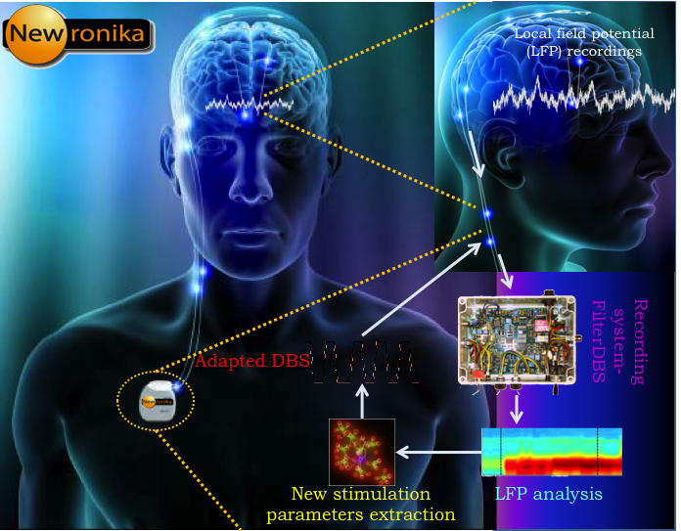
SCENARIO

Slide 3
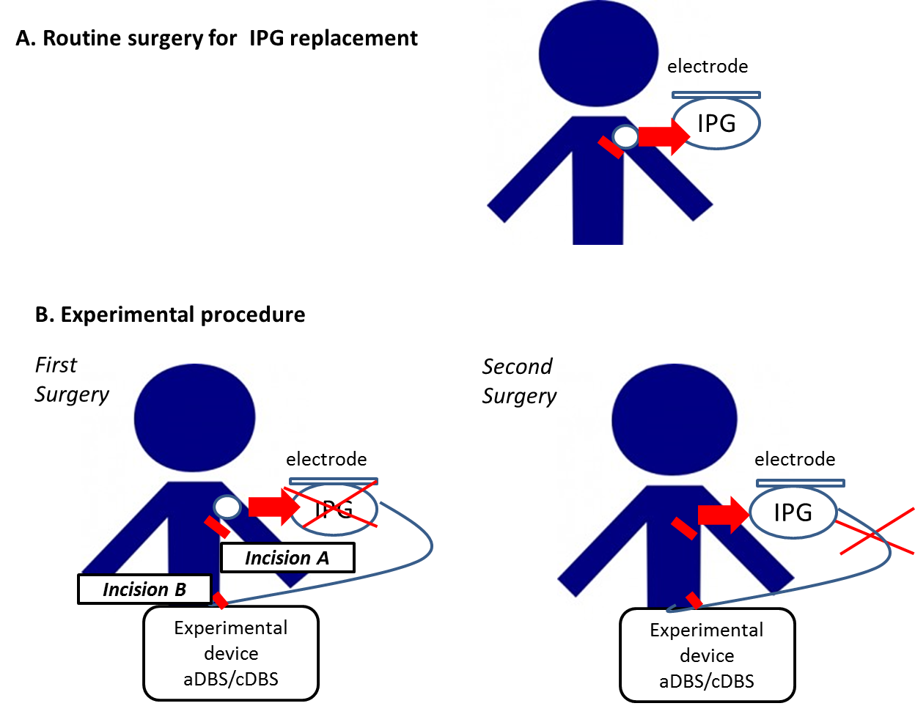
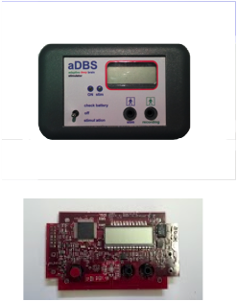
SCENARIO
Si vuole studiare la aDBS mediante un prototipo esterno in pazienti che stanno cambiando lo stimolatore a causa dell’esaurimento della batteria

Slide 4
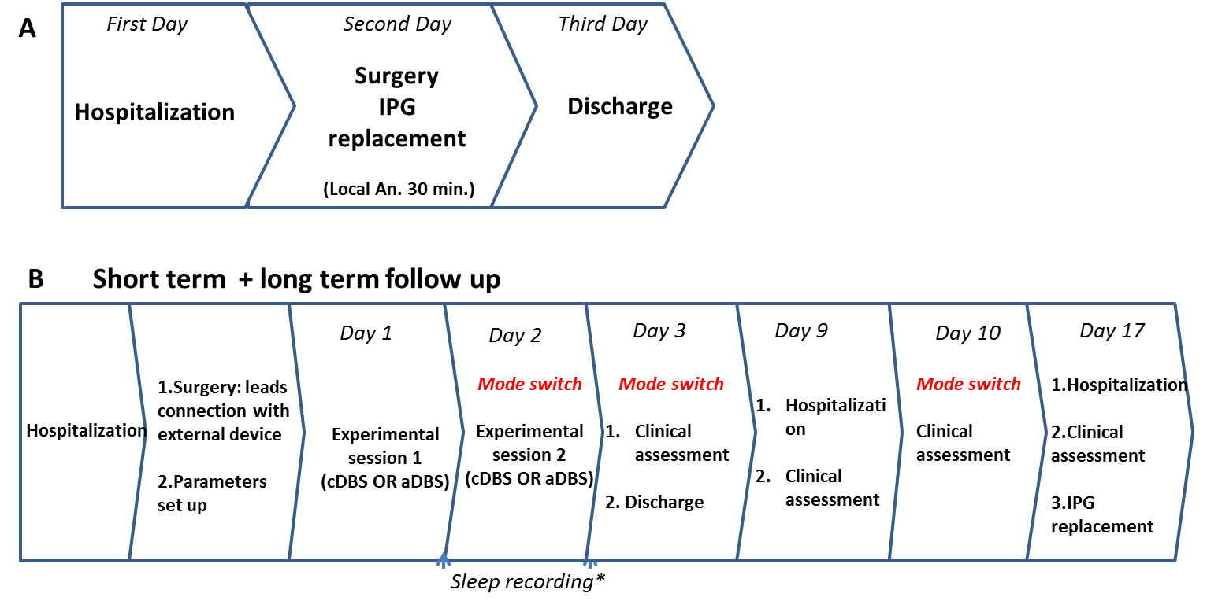
SCENARIO
PROTOCOLLO SPERIMENTALE

Slide 5
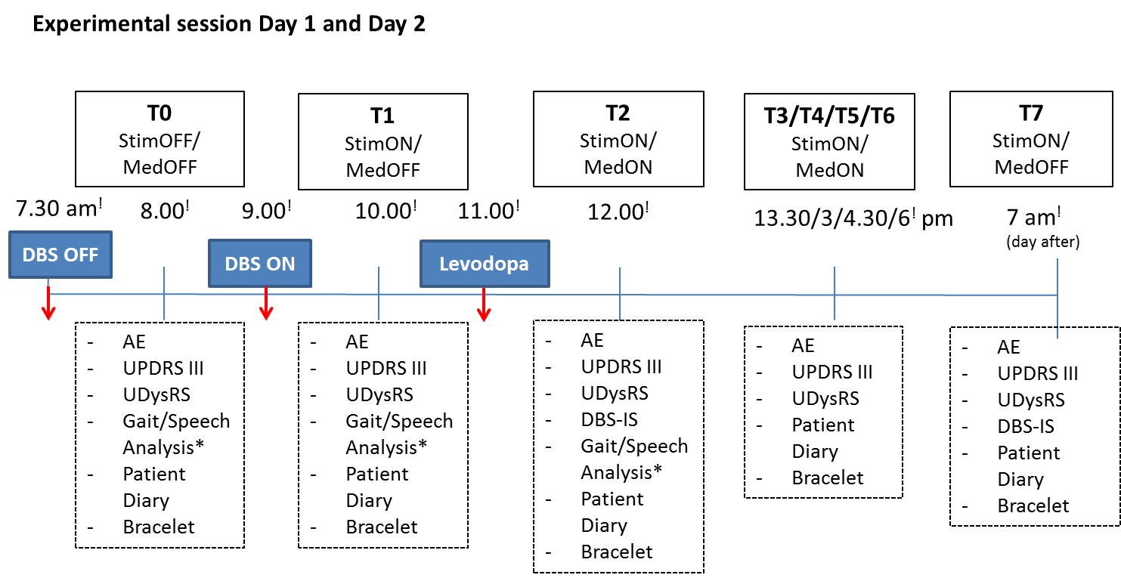
SCENARIO
SHORT-TERM FOLLOW UP

Slide 6
SCENARIO
Day 9 and Day 10: B. Monitoring of motor symptoms fluctuations
  The patient will wear a bracelet equipped with a three-axial accelerometer and will fill in his/her Patient’s Diary every 90 minutes (night excluded) and the DBS-IS (daily).
Day 10: Discharge
  At Day 10, at the end of the experimental session (late in the morning), if symptoms will be well controlled by the combined effect of DBS and dopaminergic therapy, if the patient can tolerate an interruption of DBS stimulation for 24 hours and if the neurologist will deem the patient suitable to continue the trial the patient will be discharged.
Days 4 to 9 and Days 11 to 16: Remote monitoring
  The patient will wear a bracelet equipped with a three-axial accelerometer, possibly all day long, and will fill in his/her Patient’s Diary, every 90 minutes (night excluded) and the DBS-IS (daily) .

Slide 7
SCENARIO
Day 17: Clinical assessment and second surgery
  At Day 17, after 2 weeks of follow-up, the patient will be re-hospitalized in the morning and will undergo a clinical assessment will be hospitalized in the morning and will undergo a clinical assessment including UPDRS III, UDysRS, DBS-IS and examining for possible side effects, in stim-ON/med-OFF condition, and including automatic collection of the parameters needed to calculate the TEED from the «AlphaDBS» device. On the same day or on Day 18, patient will undergo the second surgery, according to medical advice.
  During the second surgery, in local anesthesia, the surgeon will place the new IPG, as foreseen in normal practice (Incision A, Fig. 2B).
  The same surgery will be performed on any patient discontinuing the study at any time.

Slide 8
SCENARIO

Slide 9
SCENARIO

Slide 10
SCENARIO

Slide 11
SCENARIO

Slide 12
ATTORI
ATTORI SOGGETTO
Dispositivo
Neurologo (fa la valutazione – blind)
Bioingegnere
Infermiere
Paziente (compila il diario – blind)
Braccialetto
Dizionari (farmaci, concetti clinici)
Chirurgo
Principal Investigator (PI)
ATTORI OGGETTO
CRF
Scale cliniche da compilare (domande)
Scala clinica compilata (risposta)
Patient diary
Adverse Event report
Farmaco assunto

Slide 13
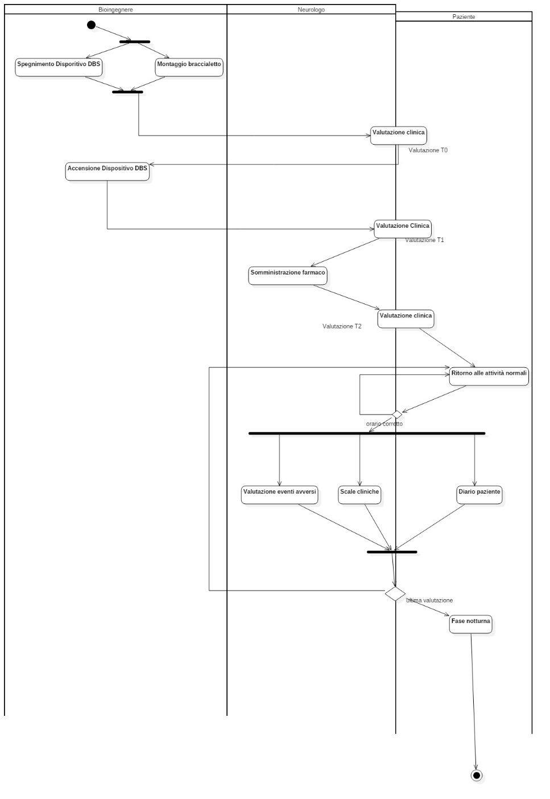
SHORT-TERM EVALUATION

Slide 14
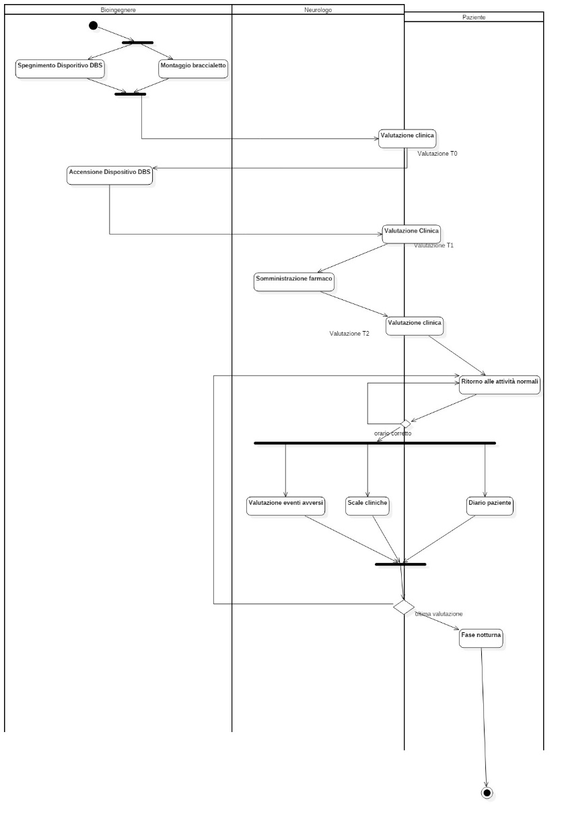
SHORT-TERM EVALUATION

Slide 15
SHORT-TERM EVALUATION

Slide 16
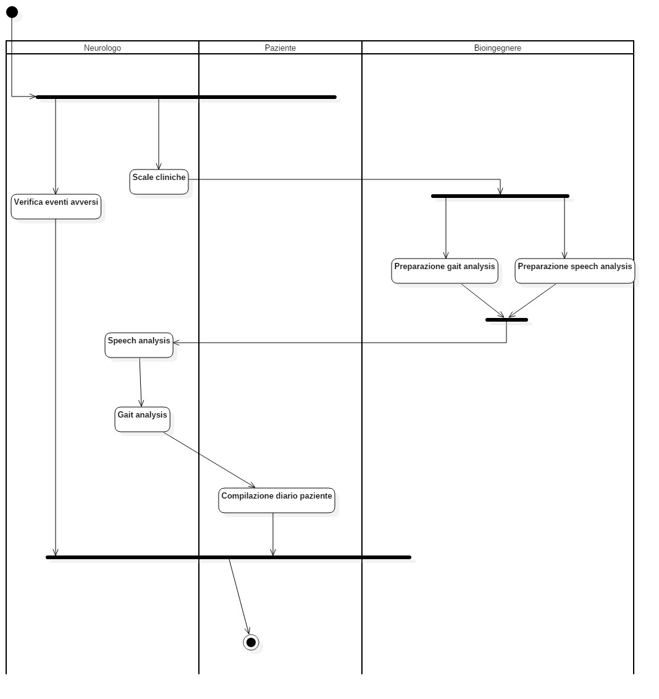
VALUTAZIONE CLINICA

