Slide 1
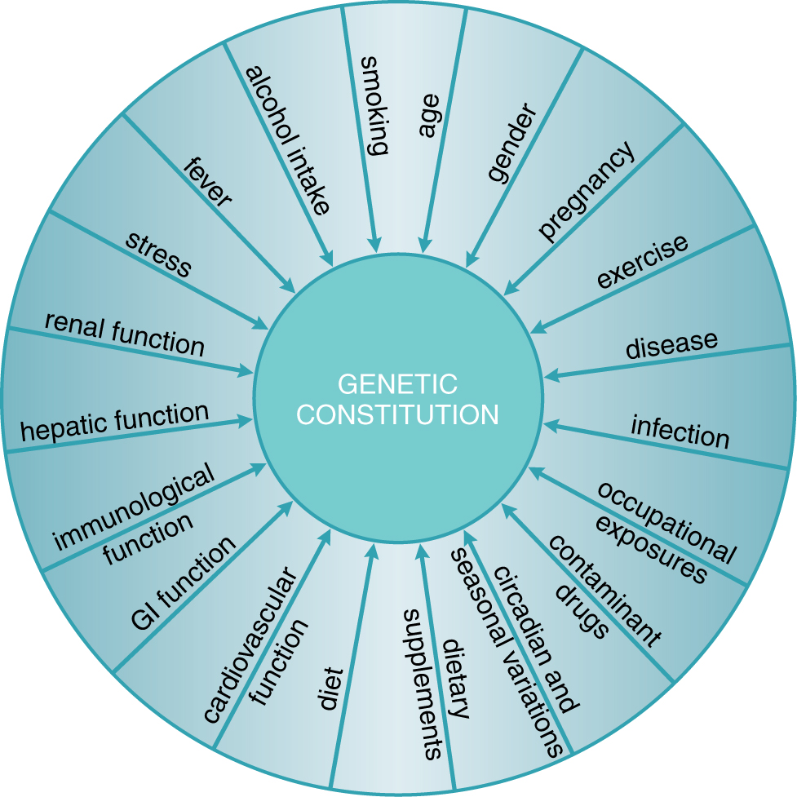
Endogenous and exogenous factors contribute to variability in drug effects
physiological
pathological
genetic
Goodman and Gilman, 2011

Slide 2
Variability can be defined as:
pharmacokinetic
pharmacodynamic
idyosyncratic

Slide 3
Factors affecting variability in drug response
Ethnic differences
Age
Pregnancy
Diseases
Drug interactions
Genetic factors

Slide 4
Ethnic differences
Ethnic means «belonging to a race». However many anthropologists are sceptical on the relevance of this concept.
Afroamericans affected from cardiac insufficiency differently from Caucasians benefit from hydralizin and nitrate.
Asiatics are more sensitive to the effects of propanolol and gefitinib, because of polymorphisms in drug targets.

Slide 6
Ethnic differences: drug metabolism

Slide 7
Ethnic differences: drug metabolism

Slide 8
Ethnic differences
Ethnic group can be considered a surrogate of typing particular variants, also involved in drug pharmacokinetics and pharmacodynamics.
However it is an approximation, therefore it is better to type directly the polymorphisms, because diversity in each ethnic group is ample.

Slide 9
Age
Age is one of the main factors affecting response to pharmacological therapy.
Children and elders present reduced drug elimination and are therefore more sensitive to drugs.
For elders also physiological (alteration of cardiovascular reflexes, increase in body fat) and pathological (hypothermia, polytherapy) factors are relevant for drug response.

Slide 10
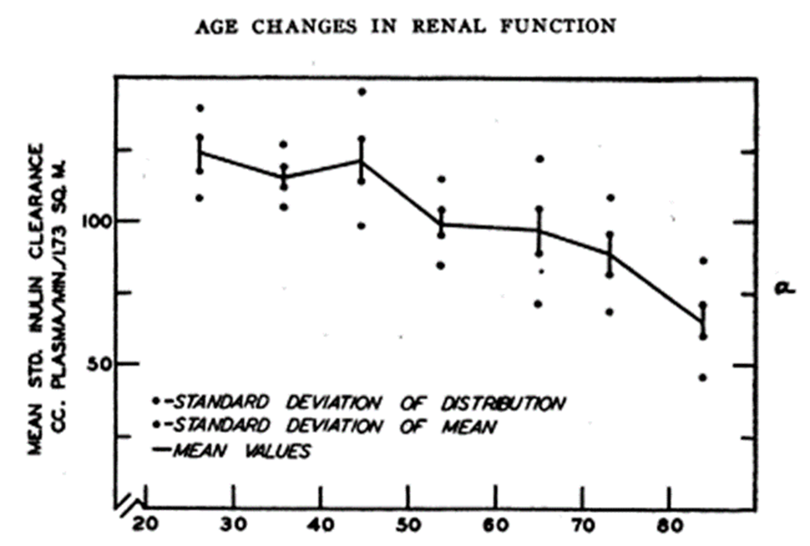
Age and drug excrection

Slide 11
Age and pharmacotherapy: pediatric patients
Pediatrics does not deal with miniature men and women, with reduced doses and the same class of disease in smaller bodies, but has its own independent range and horizon.
Dr. Abraham Jacobi

Slide 12
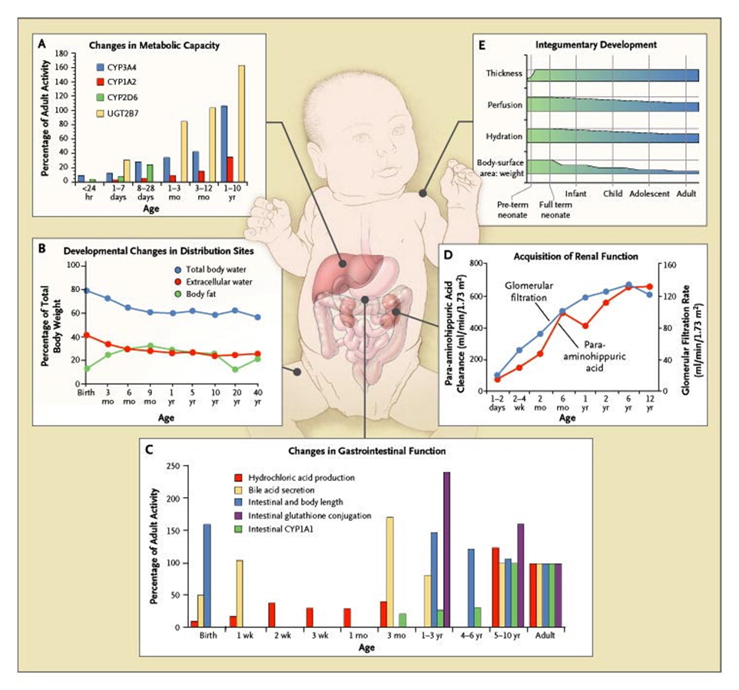
Age and pharmacotherapy: pediatric patients
Kearns GL et al. N Engl J Med 2003;349:1157-1167.

Slide 14
Epigenetic (promoter methylation) can explain age-related changes in gene expression
Kacevska et al., Biochimie 2012

Slide 15
Examples
Cloramphenicol and sulphamidic intolerance in children due to reduced glucuronidation
Morphine is not used among analgesis during delivery.
«Gasping syndrome» in newborns due to benzylic alchool.

Slide 16
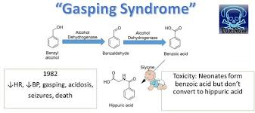

Slide 17
Pregnancy

Slide 18
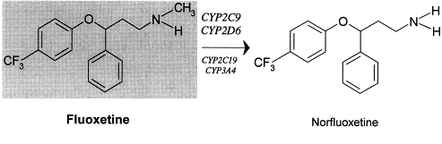
Pregnacy and cytochromes

Slide 19
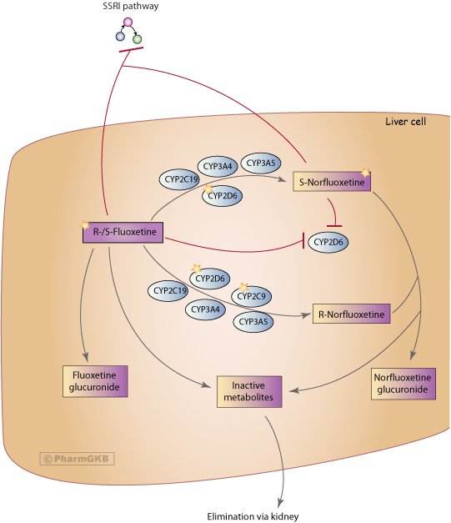
Fluoxethine biotransformation

Slide 21
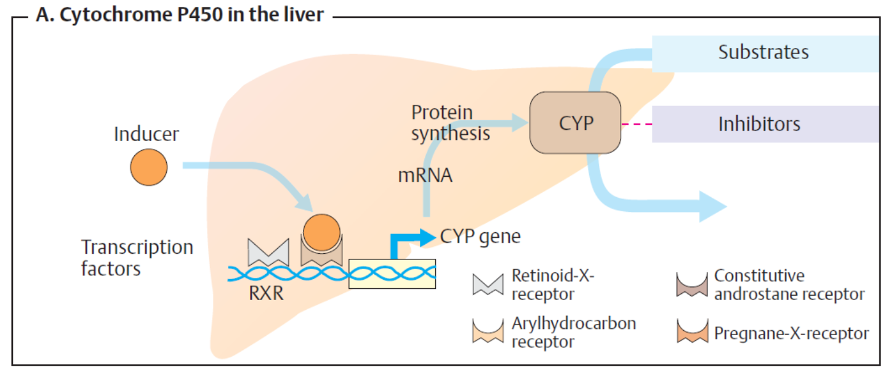
Drugs can induce expression of metabolizing enzymes

Slide 22
