Slide 1

Pharmacogenetic effects on pharmacokinetics and pharmacodynamics
Evans & McLeod, NEJM 2003

Slide 2
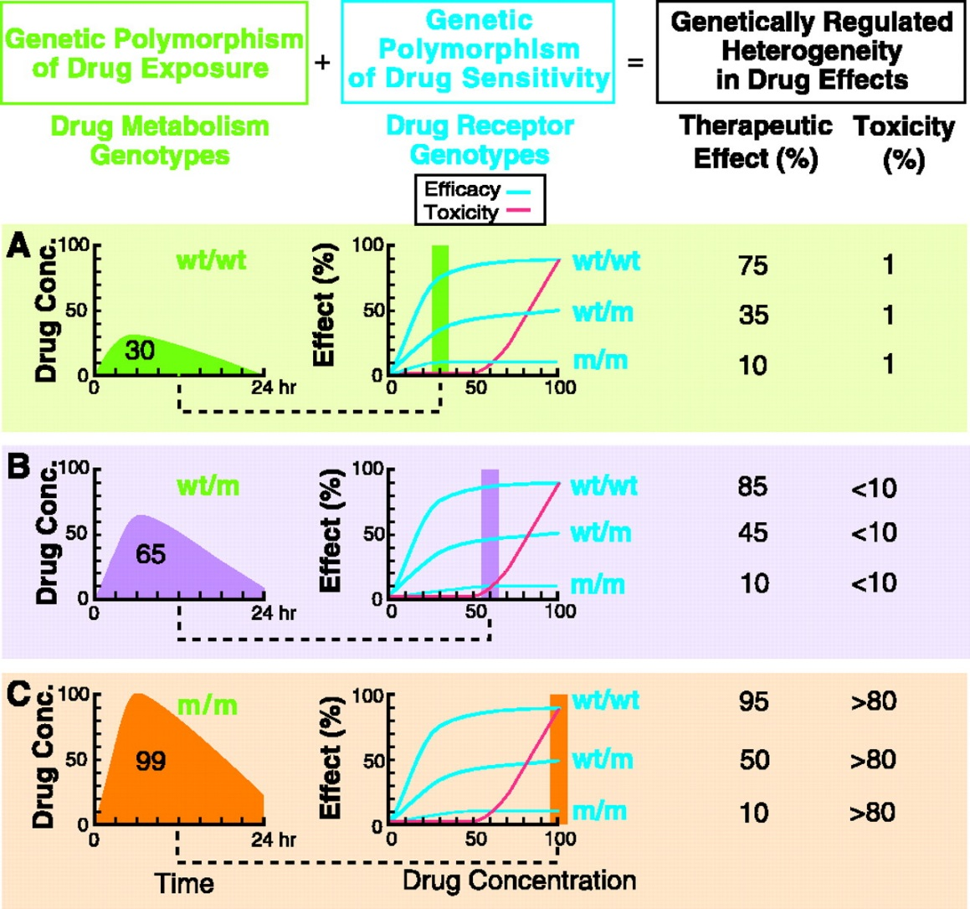
Genetic polymorphisms of enzymes involved in drugs’ metabolic inactivation or drug receptors influence treatment bioavailability and efficacy
Relling & Evans, Science 1999

Slide 3
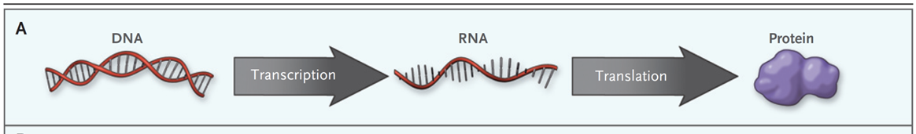
DNA polymorphisms can influences protein function
Feero et al., NEJM 2010

Slide 4

Epigenetic effects modulate the association of DNA variants with protein function
Feero et al., NEJM 2010

Slide 5
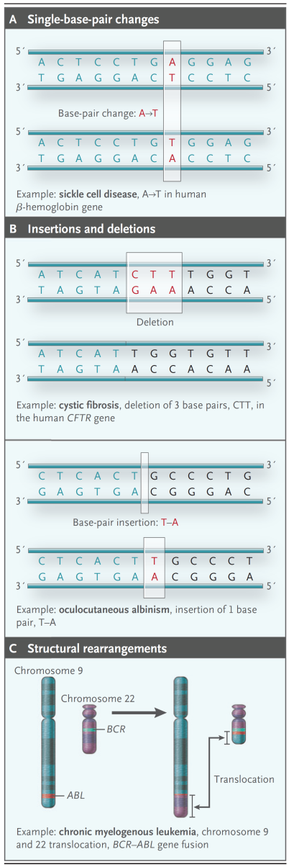
Elements of human genetic variation
Feero et al., NEJM 2010

Slide 6
Relevance of germline and somatic variants in oncology
Paugh et al., Clin Pharm Ther 2011

Slide 7
In infectious diseases, genetic variation can affect a pathogen's sensitivity to antimicrobial drugs
Huges and Andresson Nat Rev Genet 2015

Slide 8
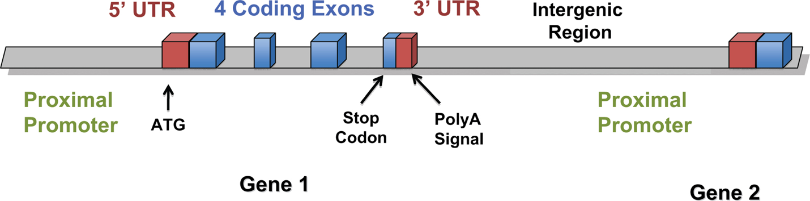
Nomenclatura delle regioni genomiche
Goodman and Gilman, 2011

Slide 9
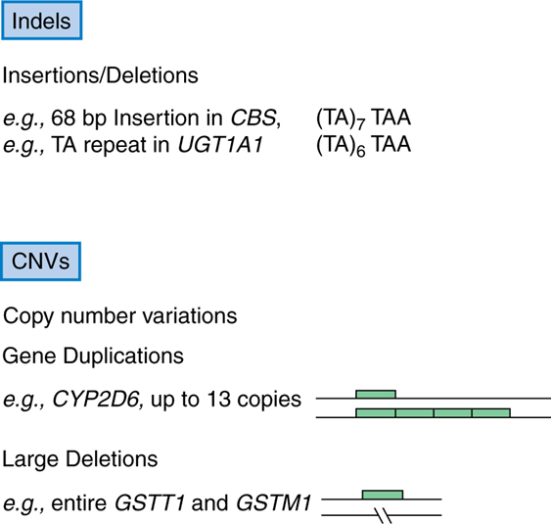

Meccanismi molecolari di polimorfismi genetici
Goodman and Gilman, 2011

Slide 10
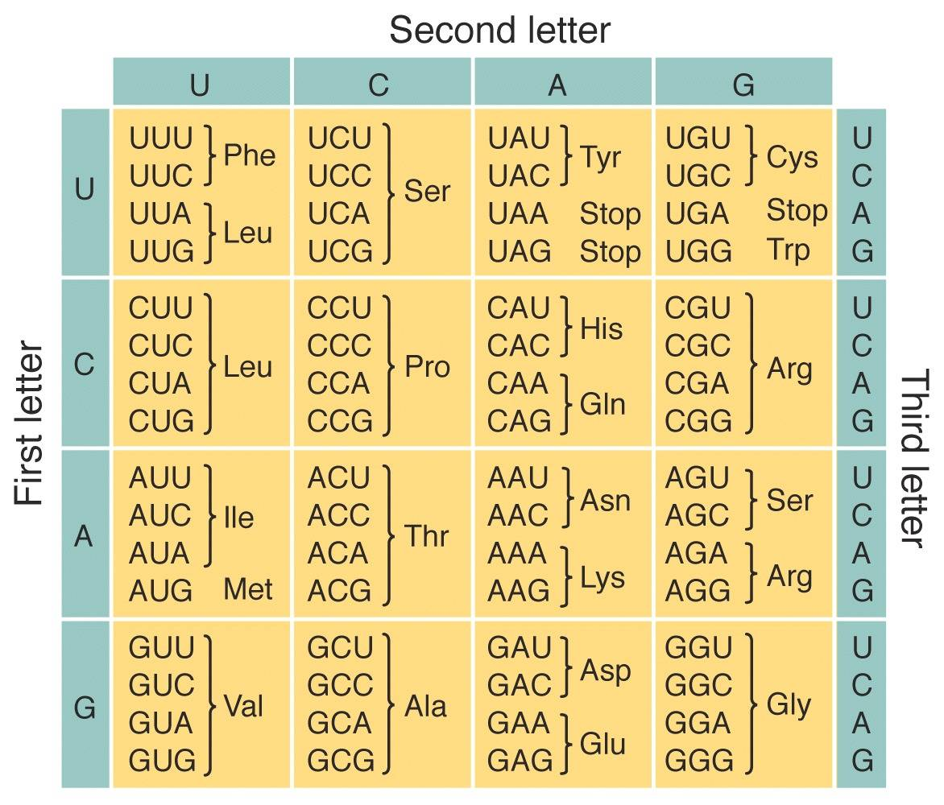
Codice genetico
Codice genetico

Slide 11
Nomenclatura delle regioni genomiche
Goodman and Gilman, 2011

Slide 12

How different is the genome (DNA) between individuals?
~ 1 nucleotide every 150-1000 nucleotides
For a total of:
~ 60 million small elements of varitiation
~ 17 million SNPs
~ 8000 copy number variations
Chakravarti et al Nature 409, 822 – 823, 2001
The International HapMap Consortium Nature 449, 851-861. 2007
The International HapMap Consortium Nature 437, 1299-1320. 2005
Conrad et al Nature 2009

Slide 13
How many genes contain variations in each individual
DNA genomic studies by exome sequencing and copy number variation interrogation show:
46 non-sense coding SNPs/person
52 frameshift indel/person
274 geni alterati by CNV
Therefore ~372 genes/person have substantial defects
Nature. 2009; 461:272-6. Ng ….Nickerson DA, Shendure J.
Nature. 2009. WTCC CNV Conrad DF et al

Slide 14
What is the importance of inherited genomic variability?
Common vs rare variants—still unclear if variability is so diverse that it’s not tenable to discover or utilize
What proportion of variability in clinical phenotypes (e.g. cancer risk, response to medications) is inherited?

Slide 15
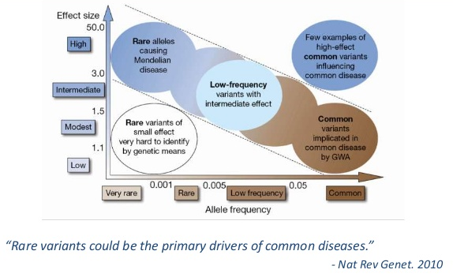
Common variants vs Rare variants

