Slide 1
BRETTON WOODS

Slide 2
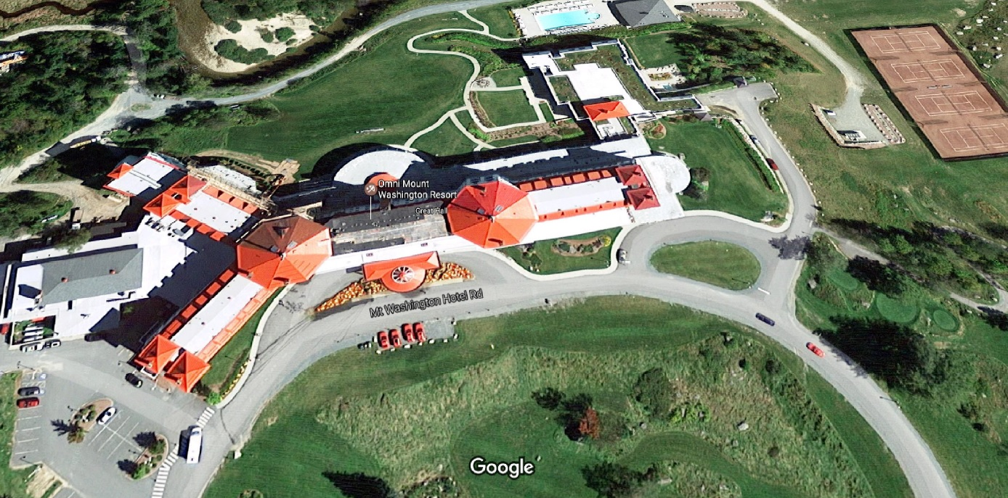
Bretton Woods, Carroll, New Hampshire 03575 USA

Slide 3
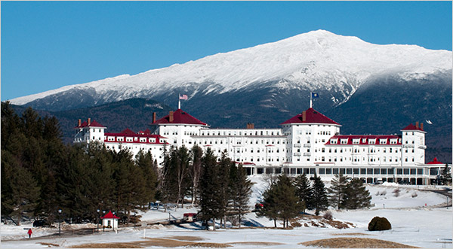

Slide 4
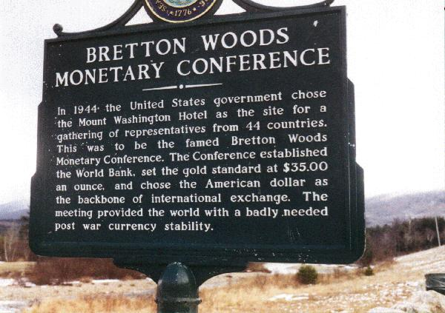

Slide 5
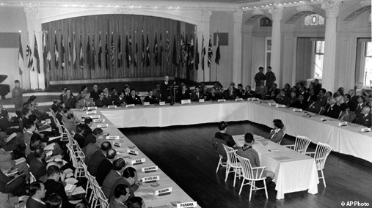

Slide 6
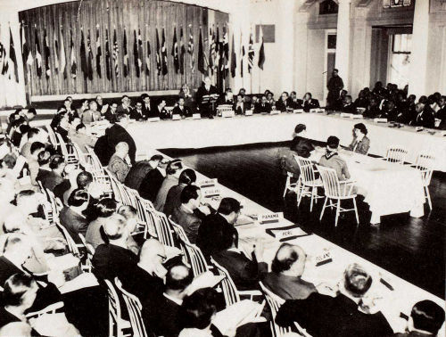

Slide 7
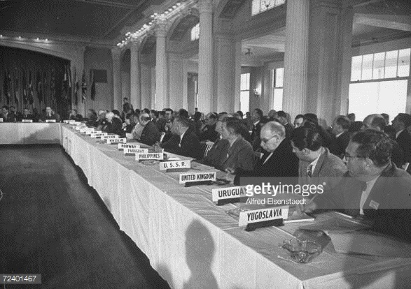

Slide 8
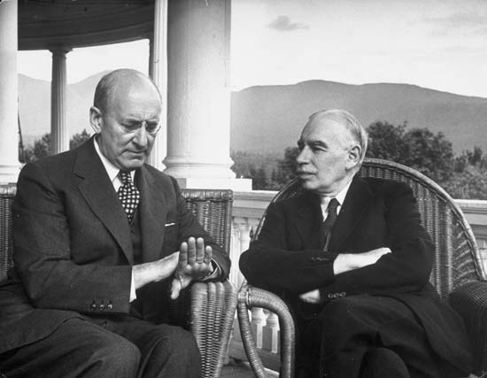

Slide 9
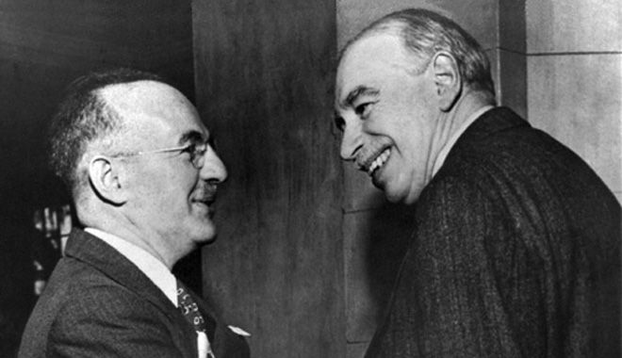

Slide 10
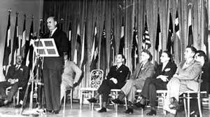

Slide 11
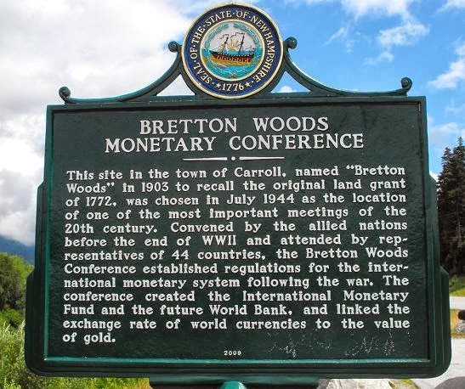

Slide 12
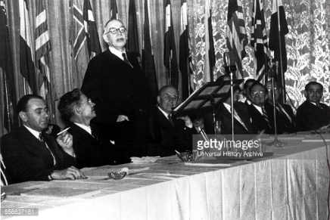

Slide 13
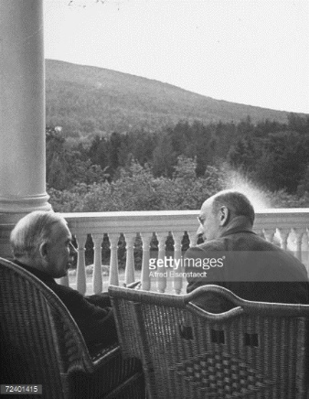

Slide 14
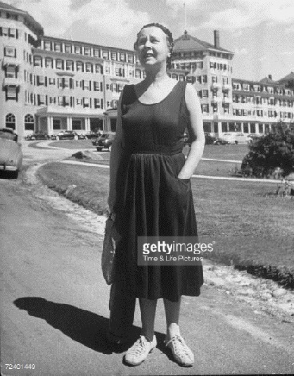

Slide 15
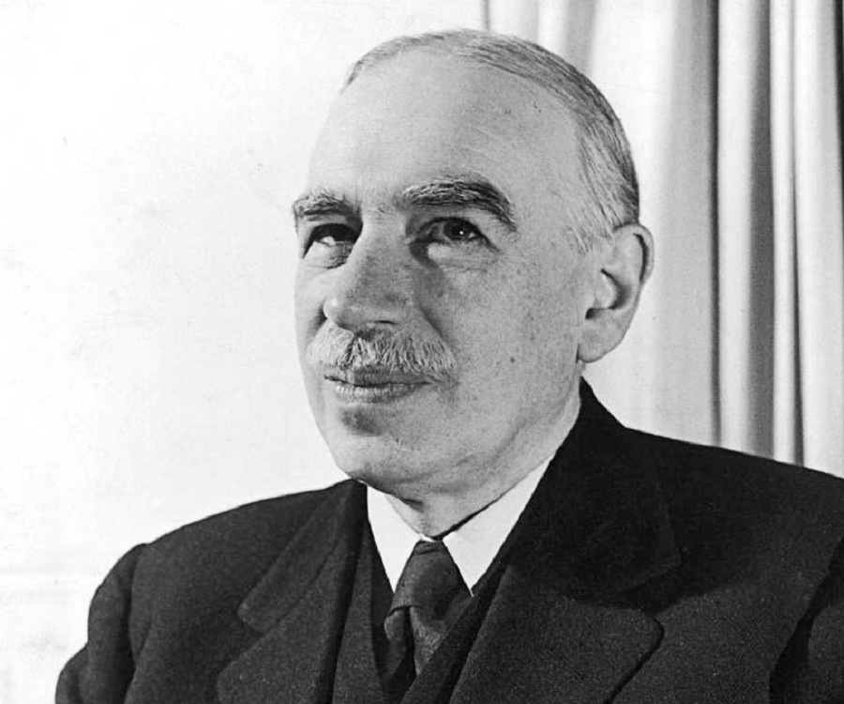

Slide 16
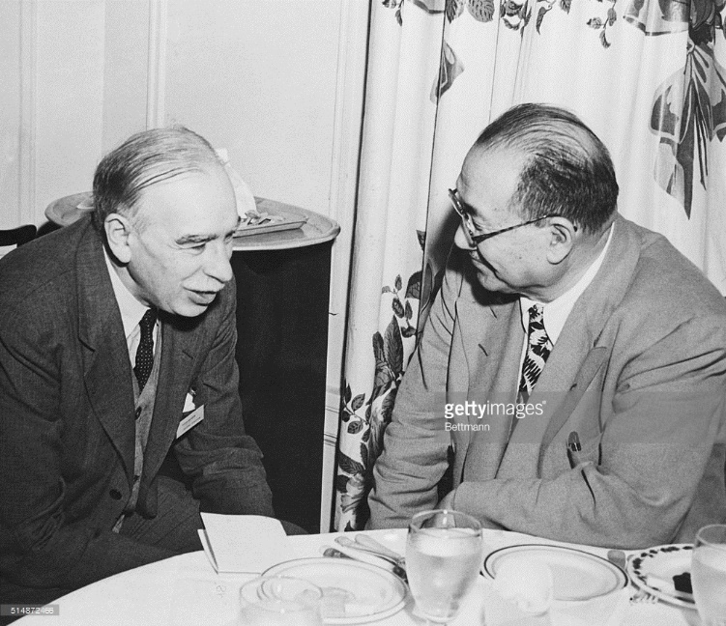

Slide 17
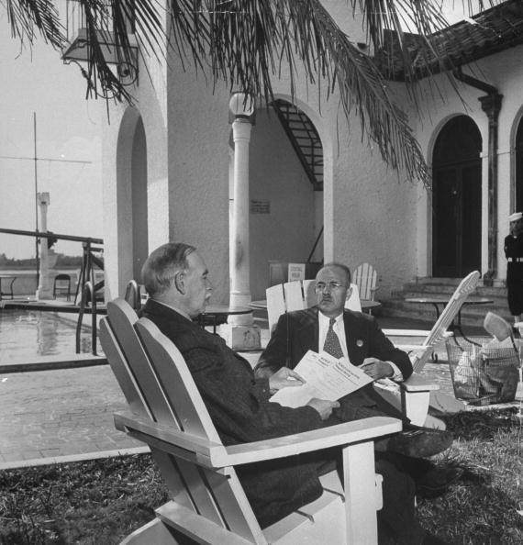

Slide 19
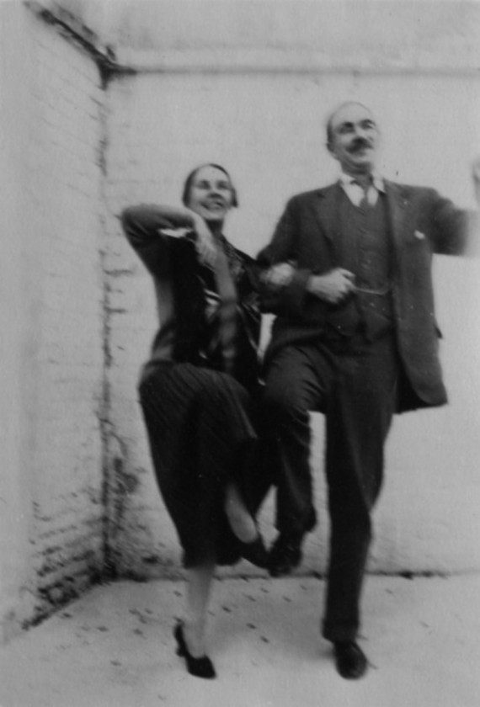

Slide 20
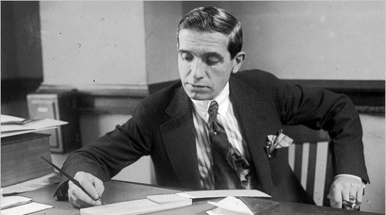
Charles Ponzi

Slide 21
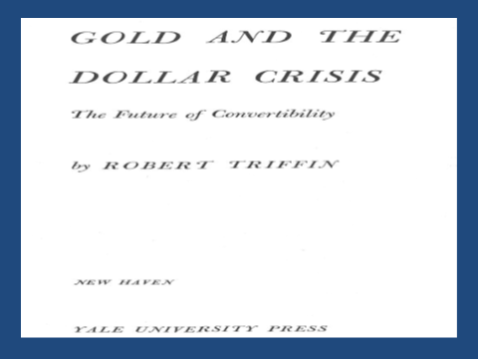

Slide 23
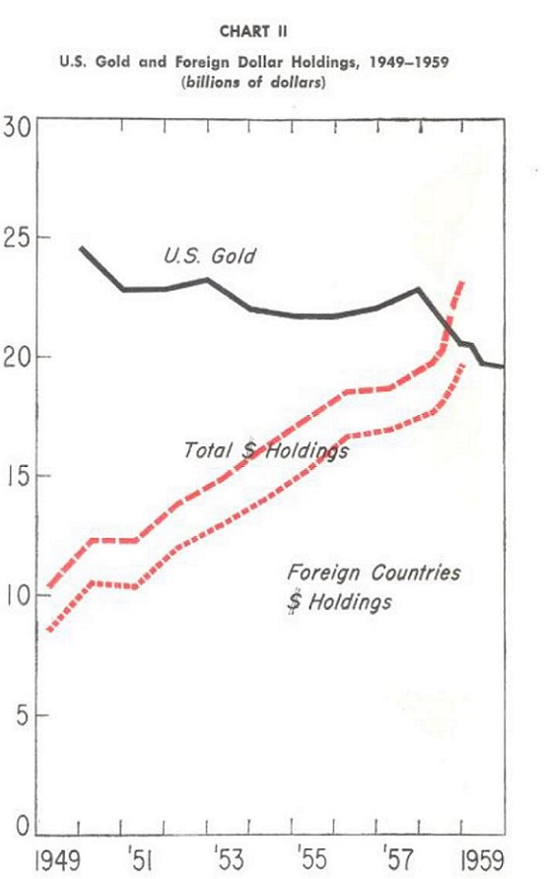
From Gold and the Dollar Crisis, R. Triffin NH 1960

Slide 24
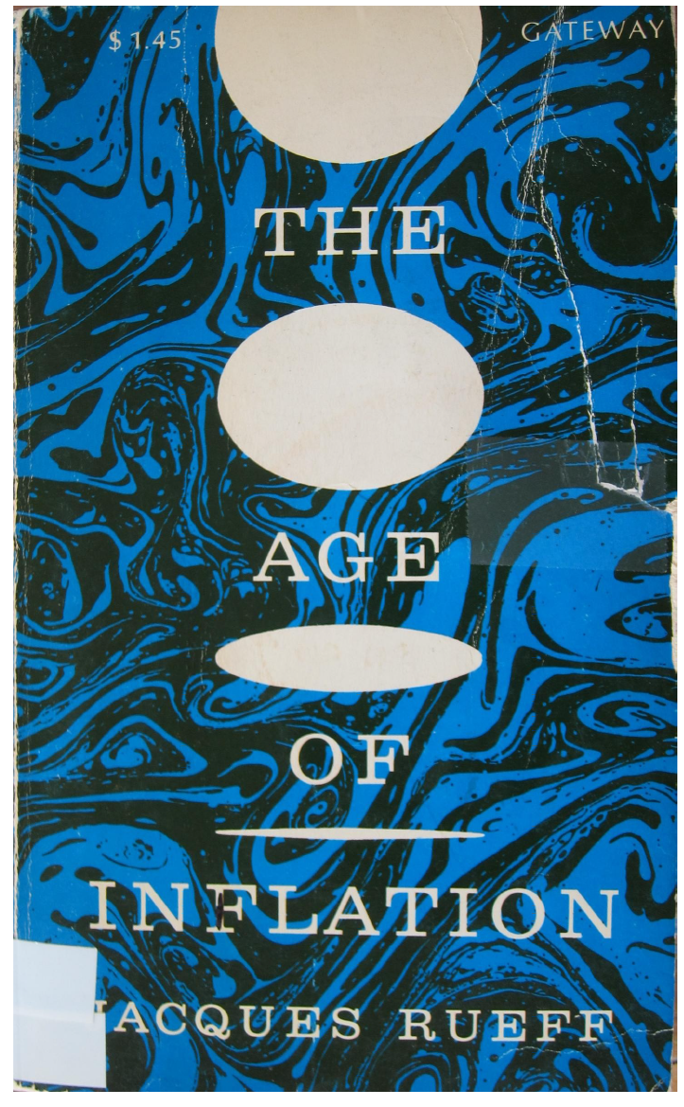

Slide 25
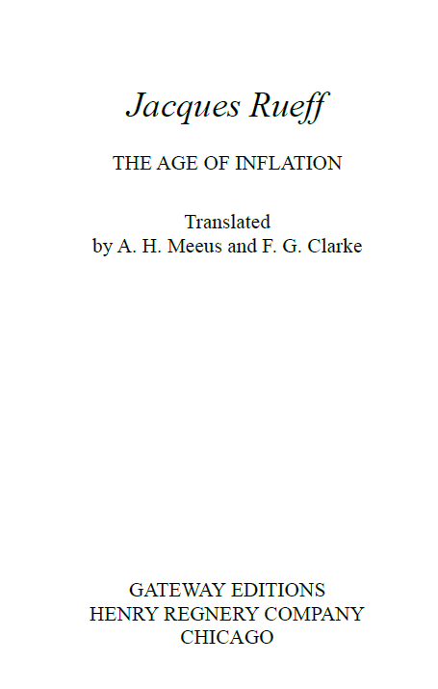

Slide 26
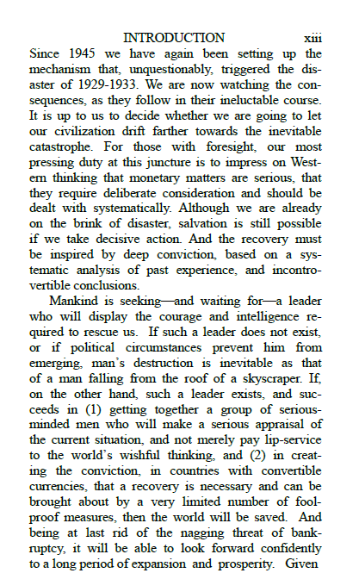
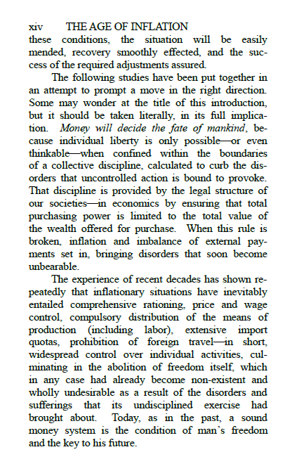

Slide 27
Jacques Rueff,
The Age of Inflation, and the True Gold Standard

Slide 28
ON THE OCCASION OF THE 100TH ANNIVERSARYOF THE BIRTH OF JACQUES RUEFF Address byLEWIS E. LEHRMAN at the PARLIAMENT OF FRANCE(Assemble Nationale) November 7, 1996

Slide 29
The overthrow of the historic money of commercial civilization, the gold standard, led, during the next decade, to the great inflations in France, Germany, and Russia. The ensuing convulsions of the social order, the rise of the speculator class, the obliteration of the savings of the laboringand middle classes on fixed incomes, led directly to the rise of Bolshevism, Fascism, and Nazism – linked, as they were, to floating European currencies, perennial budgetary and balance of payments deficits, central bank money printing, currency wars and the neo mercantilism they engendered.

Slide 30
The overthrow of the historic money of commercial civilization, the gold standard, led, during the next decade, to the great inflations in France, Germany, and Russia. The ensuing convulsions of the social order, the rise of the speculator class, the obliteration of the savings of the laboringand middle classes on fixed incomes, led directly to the rise of Bolshevism, Fascism, and Nazism – linked, as they were, to floating European currencies, perennial budgetary and balance of payments deficits, central bank money printing, currency wars and the neo mercantilism they engendered.

Slide 32
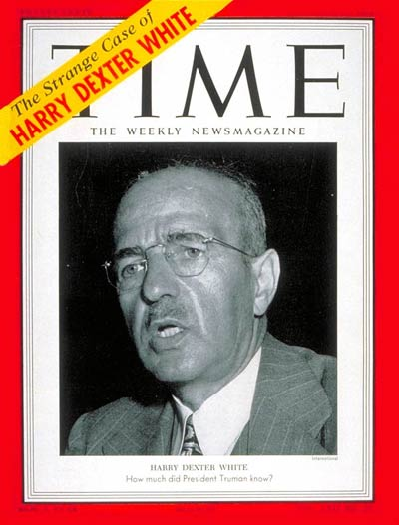
Monday, Nov. 23, 1953

Slide 33
The “infamy” of December 7, 1941, is deeper than most Americans have ever imagined. The Japanese attack on Pearl Harbor was almost certainly the result of a Soviet plot—“Operation Snow”—carried out by Harry Dexter White, a figure of enormous influence in the Roosevelt administration and a known Soviet...

Slide 34
Without question, Harry Dexter White was one of the two great intellectual founders of the IMF and the World Bank. As the chief international economist at the U.S. Treasury in 1942–44, he drafted the U.S. blueprint for the IMF that competed with the plan drafted for the British Treasury by Keynes. The final compromise adopted at Bretton Woods, New Hampshire in July 1944 retained much of the flavor of the White Plan: it defined the IMF not as a world central bank but as a promoter of economic growth through international trade and financial stability. When the IMF began operations in 1946, President Harry S. Truman named White as its first U.S. Executive Director. Since no Deputy Managing Director post had yet been created, White served occasionally as Acting Managing Director and generally played a highly influential role during the IMF's first year. His health deteriorated, however, and he resigned in March 1947 and died of heart failure the following year.

Slide 35
" Despite some resistance from Keynes and others, White succeeded in getting the Soviet Union to participate in the Bretton Woods conference in 1944, but his goal was frustrated when Joseph Stalin decided a year later that the country would not join the IMF. In a paper that White was writing at the time of his death, he lamented the "tensions between certain of the major powers" that had brought "almost catastrophic" consequences, including an "acute lack of confidence in continued political stability and the crippling fear of war on a scale unprecedented and almost unimaginable in its destructive potentialities."
White's intensely personal internationalism came under heavy criticism in the United States once the wartime military alliance with the Soviet Union against the Axis countries was no longer in force. During the investigations of the McCarthy era, attacks on his motives ranged from the questionable to the bizarre. His meetings with Soviet officials around the time of Bretton Woods were interpreted as espionage. His efforts during the war to hold the Nationalist government in China accountable for hundreds of millions of dollars in U.S. financial aid were interpreted as an effort to undermine Chiang Kai-shek in favor of Mao Tse-tung. His assistance in drafting a plan to limit the reindustrialization of Germany after the war was interpreted as part of a grand design to create an economic vacuum in Europe to be exploited by the Soviet Union.

Slide 36
Whatever mistakes White may have made in these and other projects seem trivial today when set next to the excesses of his enemies and to the personal price that he was made to pay. His spirited defense of his loyalty to the United States and its values, made at hearings before the Committee on Un-American Activities of the U.S. House of Representatives in August 1948, left him exhausted. He died three days afterwards. Five years later, at the height of the loyalty investigations led by Wisconsin Senator Joseph McCarthy, President Eisenhower's Attorney General accused former President Truman of knowing that White was a Soviet spy before appointing him to the Executive Board of the IMF. Although Truman successfully fought off both that charge and a subpoena compelling him to testify on the matter, White was vilified in Congress and in the press. The exposure irreparably damaged his personal reputation. What remains of his legacy is the International Monetary Fund, which still bears his imprint more than any other’s.

Slide 37
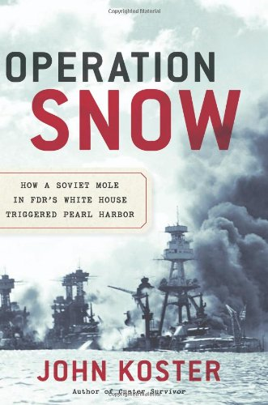

Slide 38
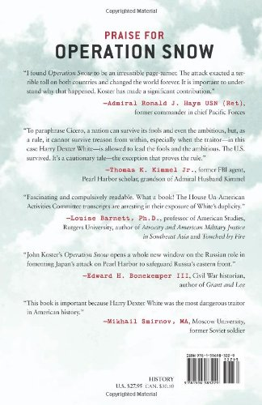

Slide 39
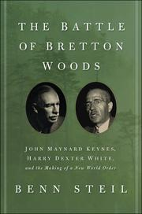

Slide 40
On the eve of the First World War, the ratio of Britain debt to gross domestic product was a mere 29 percent, by the end of the Second World War it had soared to 240 percent- A nation that had in the 1920s controlled a quarter of the earth’s territory and its population was, in Keynes words, facing a “financial Dunkirk”. The story of the Faustian bargain Britain struck with the United States in order to survive, the war would become an essential element in the Bretton Woods drama” Benn Steil, The Battle of Bretton Woods, Princeton, 2013 pag 2.

Slide 41
“The next morning, 9:30 a.m. on July 14. Morghenthau began a meeting of the full American team by reporting cheerily that White had “worked up until three o’clock this morning with the Drafting Committee on the Fund and he feels [the text] is in excellent shape. Morghenthau had no idea what exactly that meant, and likely no interest. But among the achievements of the committee, composed entirely of White’s technicians, was strategically replacing “gold” with “gold and U.S, dollars” through the 96-page Final Act. White never submitted the changes for consideration in Commission I, yet they would become an important part of the IMF Articles of Agreement. Keynes would only discover them after his departure from Bretton Woods.” Morghenthau, Diaries, Vol. 754, July 14, 1944, p.3. Benn Steil, The Battle of Bretton Woods, Princeton, 2013, pag. 216.

Slide 42

No sooner had the delegations departed Bretton Woods than controversy erupted between the British and the Americans over the meaning of what had been signed. “We, all of us, had to sign, of course, before we had had a chance of reading through a clean and consecutive copy of the document,” Keynes offered by way of explanation five months later. “All we had seen of it was the dotted line.
Our only excuse,” he added, lifting some prose from Shakespeare, “is the knowledge that our hosts had made final arrangements to throw us out of the hotel, unhouselled, disappointed, unaneled, within a few hours.”¹
¹ Foreign Office (Dec. 29, 1944) FO371/45662, Keynes Memorandum. (Chap. 9, pag. 251)

Slide 43
1. Foreign Office (Dec. 29,1944)
Ghost:
Thus was I, sleeping, by a brother’s hand
of life, of crown, of queen, at once dispatch’d
cut off even in the blossoms of my sin,
unhousel’d, disappointed, unaneled;
no reckoning made, but sent to my account
with all my imperfections on my head
(Hamlet, Act 1, Scene 5, Lines 74-79)
Note to pag. 397 n. 1
Five more hours of debate ensued, whereafter the vote was taken. In a mark of disgruntled resignation, half the peers abstained. The resolution to approve the financial agreement was carried by a margin of 90 to 8. The British debt to the United States was ultimately repaid with a final installment of $83.25 million in December 2006, under the government of Prime Minister Tony Blair. (Pag- 287)
The Battle of Bretton Woods by Benn Steil, Princeton, 2013, pag. 287

Slide 44
Keynes himself was “more than normally” partial to speculation, which would cost him dearly that year. Long on commodities such as rubber, corn, cotton, and tin, he was forced to sell securities to cover margin calls when the market turned against him. His net worth plummeted from £44,000 at the end of 1927 (about $3,5 million in current dollars) to £7,815 at the end of 1929, following the Wall Street crash in October, in spite of his having no holdings of U.S. stocks⁵⁷." - The Battle of Bretton Woods by Benn Steil, pag. 79.
Keynes would in 1930 insist that falling commodity prices were the result of policy-induced nsufficient demand rather than overinvestment - a perhaps not altogheter surprising view from one whose commodities punts had turned out so disastrousley.⁵⁸ ibidem,
57 Keynes (1983) XI, p. 11.
58 Keynes (1981) XX, Mr. 7, 1930, p. 153.

Slide 45
Thus was I, sleeping, by a brother's hand
Of life, of crown, of queen, at once dispatch‘ d:
Cut off even in the blossoms of my sin,
unhousel‘ d, disappointed, unanel‘ d,
No reckoning made, but sent to my account
With all my imperfections on my head:
O, horrible! O, horrible! most horrible!
(Hamlet, Act 1, Scene 5, Lines 74-79)
Note to p. 397 n. 1

Slide 46

27° February 2016 G20 Shangai - Zhou Xiaochuan

Slide 47
Zhou Xiaochuan: Reform the international monetary system
Essay by Dr Zhou Xiaochuan, Governor of the People’s Bank of China, 23 March 2009.
* * *
The outbreak of the current crisis and its spillover in the world have confronted us with a
long-existing but still unanswered question, i.e., what kind of international reserve currency
do we need to secure global financial stability and facilitate world economic growth, which
was one of the purposes for establishing the IMF? There were various institutional
arrangements in an attempt to find a solution, including the Silver Standard, the Gold
Standard, the Gold Exchange Standard and the Bretton Woods system. The above question,
however, as the ongoing financial crisis demonstrates, is far from being solved, and has
become even more severe due to the inherent weaknesses of the current international
monetary system.

Slide 48
Theoretically, an international reserve currency should:
first be anchored to a stable benchmark and issued according to a clear set of rules, therefore to ensure orderly supply;
second, its supply should be flexible enough to allow timely adjustment according to thechanging demand;
third, such adjustments should be disconnected from economic conditions and sovereign interests of any single country

Slide 49
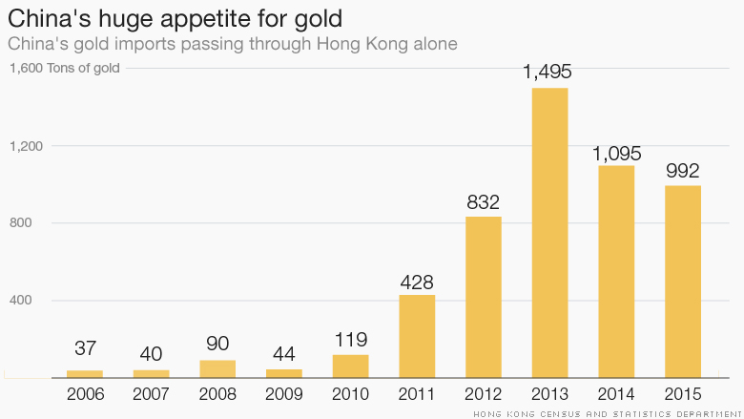

Slide 50
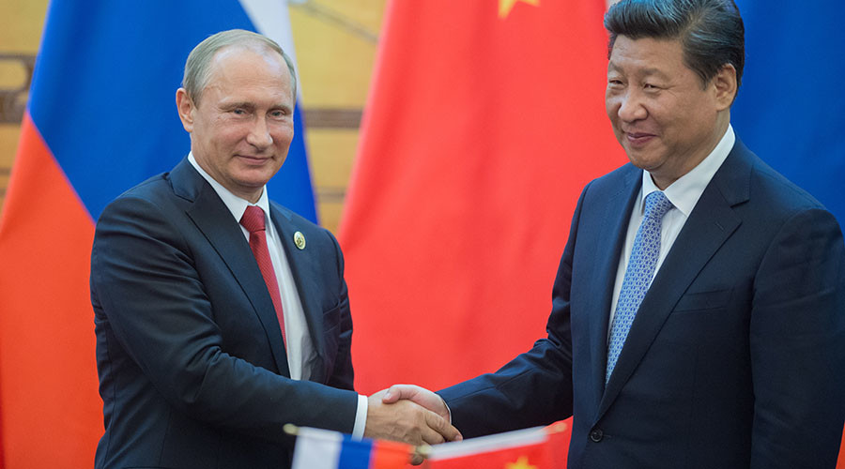
Putin – Xi Jinping in March 2015 Zijingping agreement about bilateral yuan clearing

Slide 51
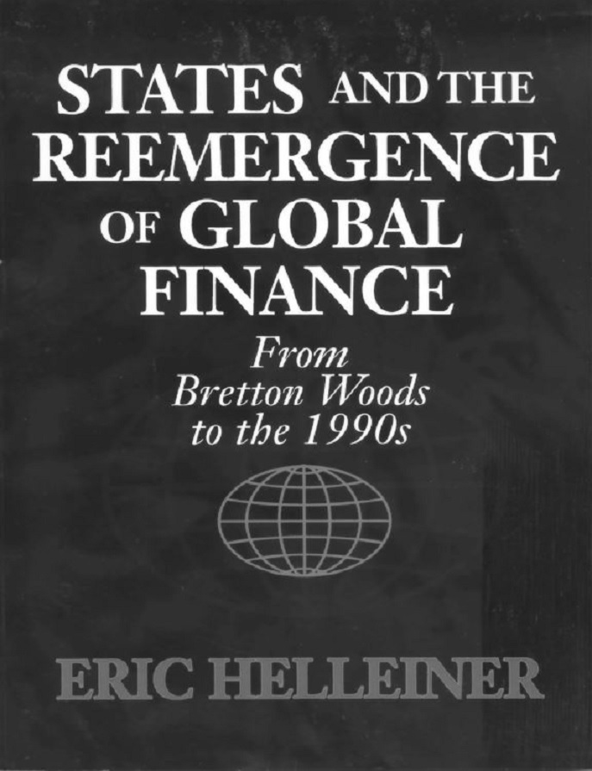

Slide 52
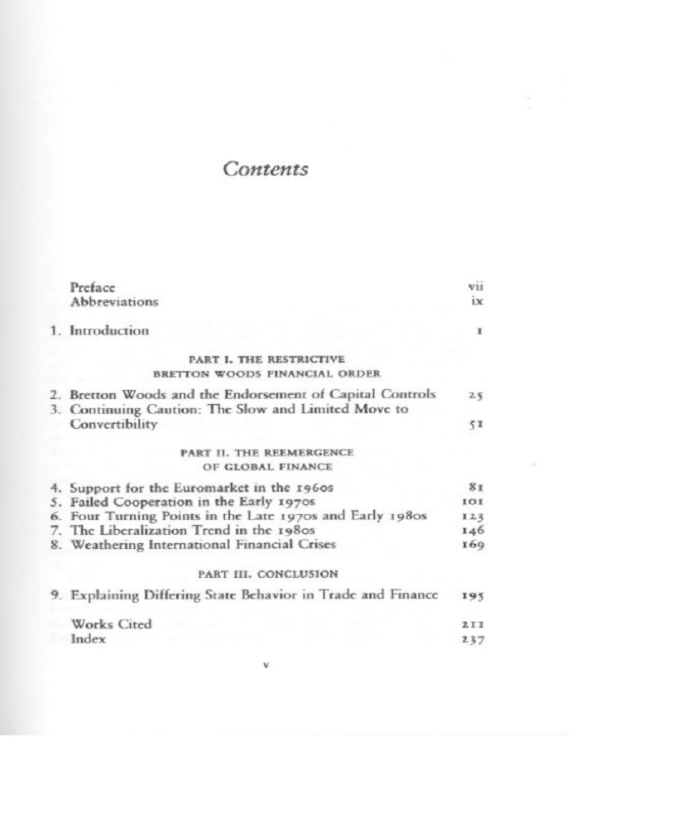

Slide 53
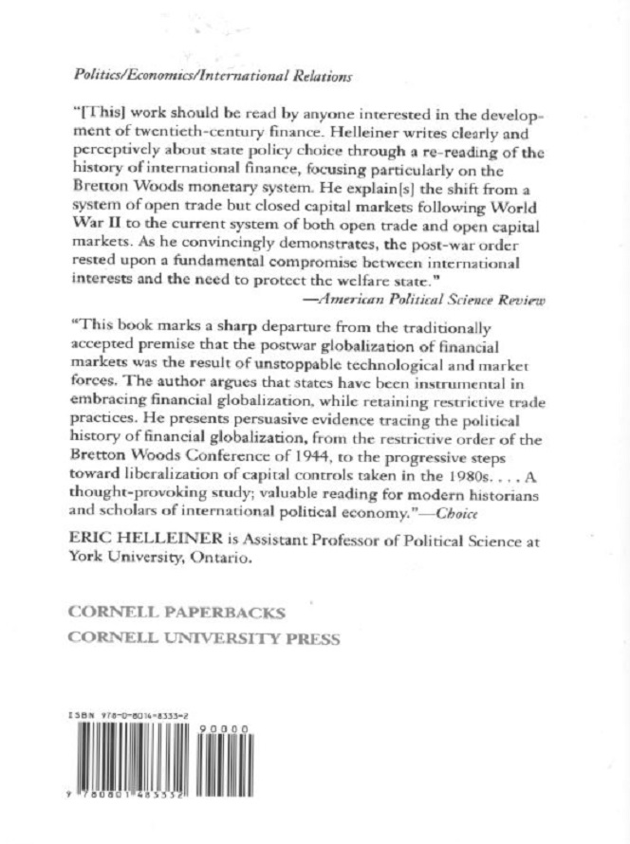

Slide 54
Bank of England Governor King Calls For End of ‘Too
Big To Fail’
By Valentin Schmid On December 11, 2012 @ 12:50 am In Companies | No Comments
Outgoing Bank of England Gov. Sir Mervin King said economic problems are manageable in a New York speech Dec. 10 . He also called for an end of “Too Big to Fail” banks and special interest policies.
“These problems are all manageable. Manageable though they are, they have to be done,” said Sir Mervin King at a luncheon speech before the Economic C lub of New York Dec. 10. He referred to the standard economic problems that a re often addressed by central bank ers: A slow economic recovery, banks that are unwilling to lend and structural im balances in world trade.
Governor of the Bank of England Mervyn King
leaves Downing Street in London in this file
photo. King spoke on Dec. 10 at the Economic
Club of New York and called for an end to ‘Too
Big to Fail’ and special interest politics. (Peter
Macdiarmid/Getty Images)

Slide 55
Having joined t he Bank of England in 1991, King became governor of the
world’s oldest central bank in 2003. He will retire from the post in July 2013
and Mark Carney of the Bank of Canada is the designated successor. In one
of his last speeches, the outgoing governor certainly did not disappoint the
New York audience, with William Dudley of the New York Fed and Glenn
Hubbard of Columbia University in attendance.
Often when public officials and politicians have little time of service left, they
start to become more outspoken. King, having little to lose with a fully
accrued annual pension benefit of $3 18,467, also went beyond the common
central banker script. The Fed’s Ben Bernanke or the European Central
Bank’s Mario Draghi often dwell on topics such as banks’ unwillingness to
lend or the slow recovery, not so King.

Slide 56
King Says Need to ‘Stop Too Big To Fail’
Although other central ban kers have spoken about the topic before, King was vocal in say ing that is it pertinent “to rid the world of the pro blem of ‘too important to fail.’” This concept describe s multination al financial institutions that are so big and so complicated tha t their bankruptcies wou ld threaten the whole financial system.
The prime eample of ‘Too Big to Fail’ would be the investment bank Lehman Brothers, which went bankrupt in Septemb er 2008, br inging the global financia l system to the brink of co llapse.
“We are intent o n putting in place a ringfence around those banking activities that ar e absolutely crucial for th e operation of the dom estic economy: etail deposits, th e payment system and financing sm all businesses, “ he said, not m entioning investment b anking and financial speculation.
On the other hand, he say s that the U .K. is developing a process through which large ban ks can be liuidated in an orderly fashion. “We need a framework where by these banks can be resolved,” King said. He added that lenders and inv estors need to underst and that the re are risks involved wh en lending to finan cial institutio ns. “They are not lendi ng to the government with a guaranteed return, they are actually taking a ge nuine financial risk,” he says.
He added that the commun ity of intern ational regulators is takin g this issue seriously. egulators would have to wo rk together in order to in sure the orderly runoff of large bank s. King belie ves that there won’t be a standard international framework but that each n ational regulator will ma ke sure they have a procedu re in place to deal with such an event.
Legitimacy of Market Economy Needs to Be Defended
Another interes ting point th at has not been prominent among central bankers is the t opic of spec ial interests and lobbying. “We face a broa der challen ge, a challe nge to defe nd the market economy in the face of concerns among those who suffered d uring the economic crisis ,” says King and notes that t he legitimacy of the market economy has suffered as a conseuence of spec ial interest a nd lobbying .

Slide 57
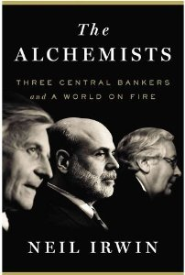
In May 2010, the world's most powerful central bankers met in Basel, Switzerland: the European Central Bank's Jean-Claude Trichet, the Bank of England's Mervyn King and the Federal Reserve's Ben Bernanke. The Washington Post's Neil Irwin explores the role this meeting played in safeguarding the global economy.

Slide 58
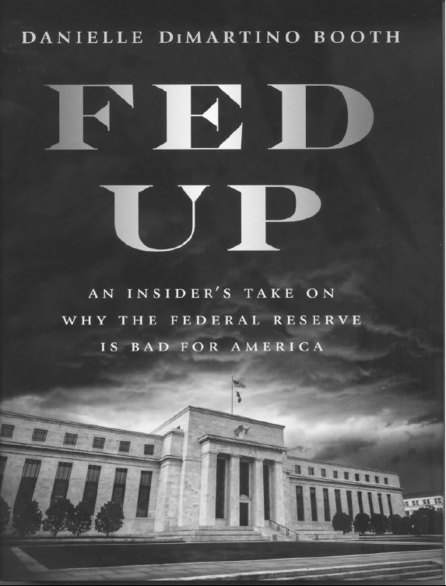

Slide 59
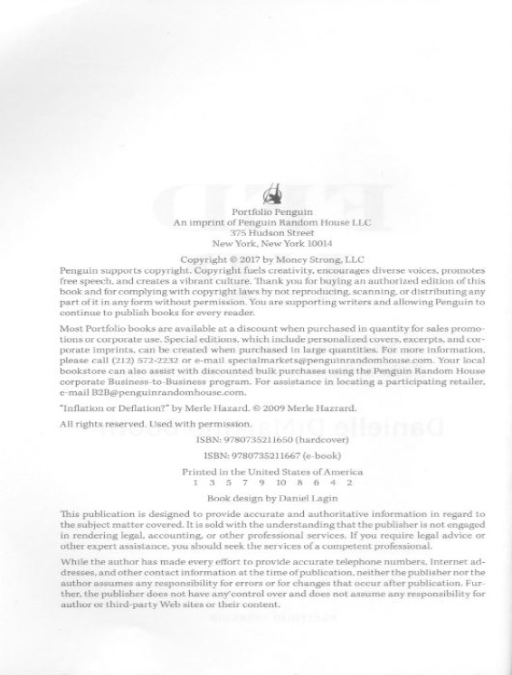

Slide 60
“Never in the field of monetary policy was so much gained by so few at the expenses of so many.” (DiMartino, 2017, 1)

Slide 65
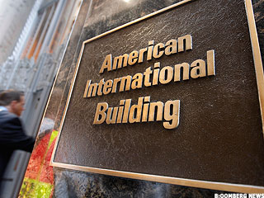
A potentially market-rattling bankruptcy filing by American International Group AIG forced federal officials to reverse course and pursue a costly bailout of the insurance giant late Tuesday.
Sep 17, 2008 4:59 AM EDT
AIG Bankruptcy Threat Forced Fed's Hand

Slide 66
AIG will receive an $85 billion bridge loan from the Federal Reserve aimed at keeping the giant insurer out of bankruptcy and preventing the acceleration of a world credit crisis.
AIG shares fell to as low as $2.42 in extended trading after reports spread of the agreement, which calls for the government to take an 80% stake in the company.
"The Federal Reserve Board determined that, in current circumstances, a disorderly failure of AIG could add to already significant levels of financial market fragility and lead to substantially higher borrowing costs, reduced household wealth, and materially weaker economic performance," the central bank said in statement posted on its Web site at 9 p.m. EDT Tuesday.

Slide 67
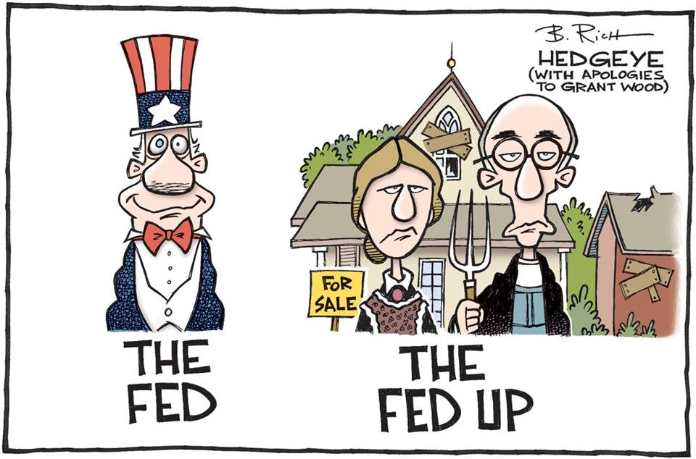

Slide 68

Q.E. Quantitative Easing

Slide 69
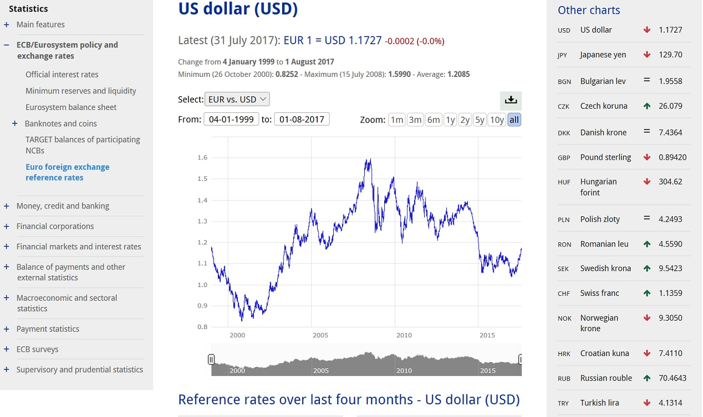

Slide 70
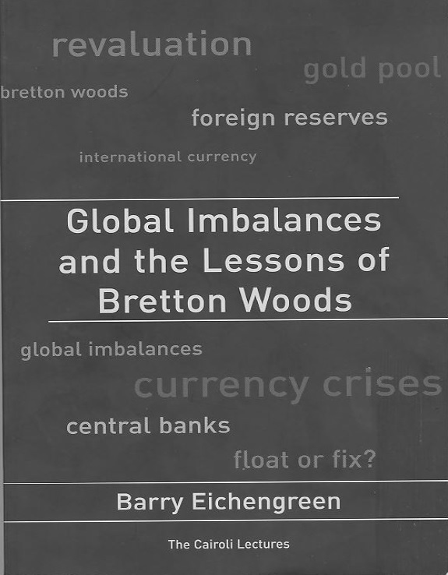

Slide 71
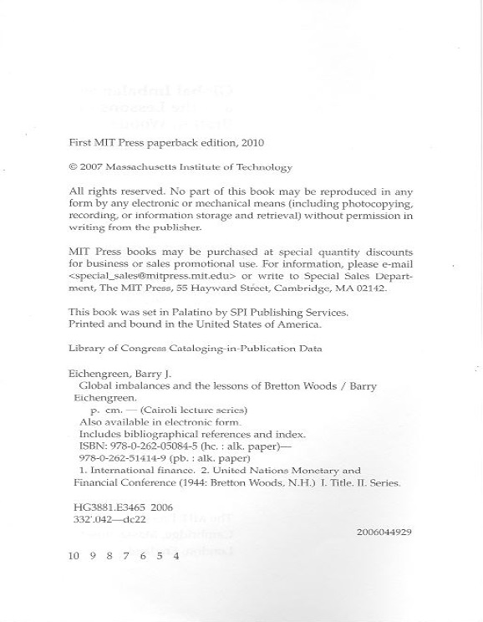

Slide 72
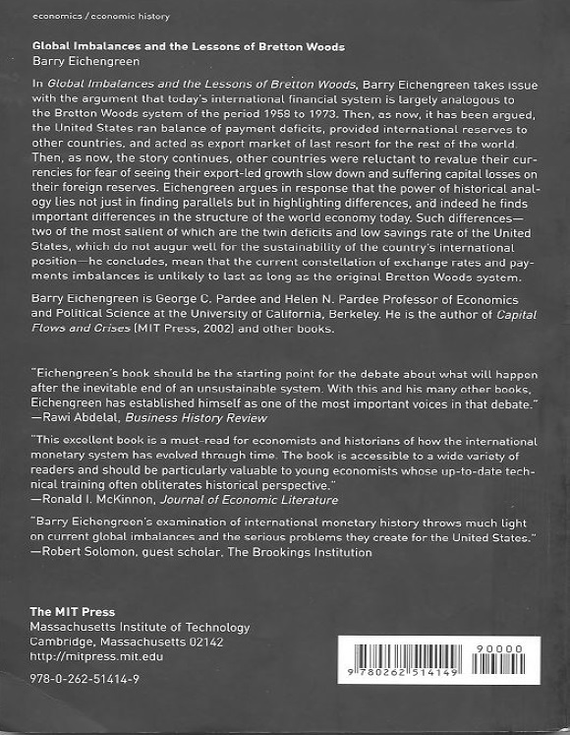

Slide 73
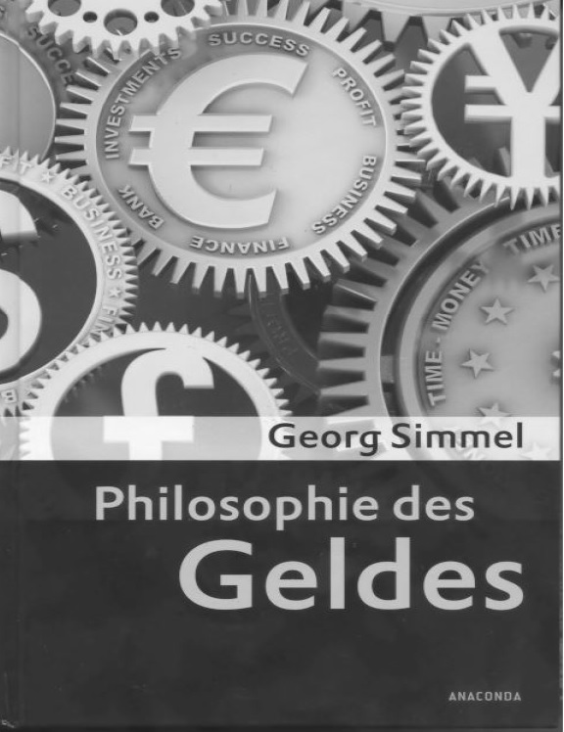

Slide 74
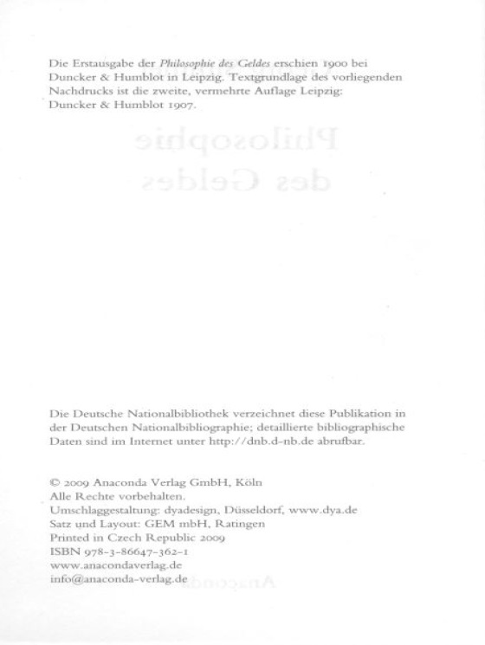

Slide 75
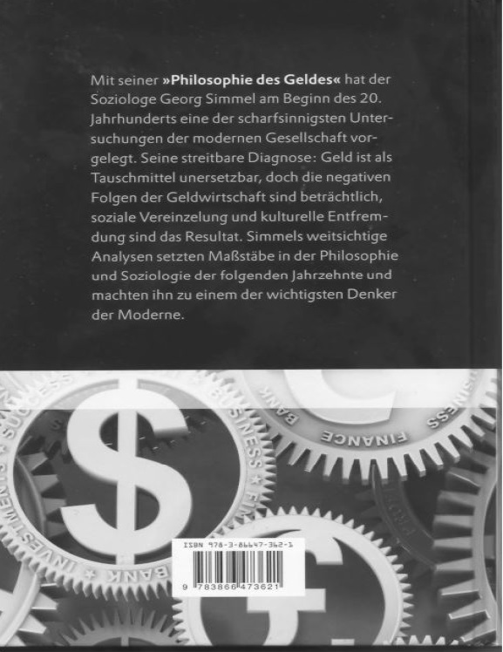

Slide 76
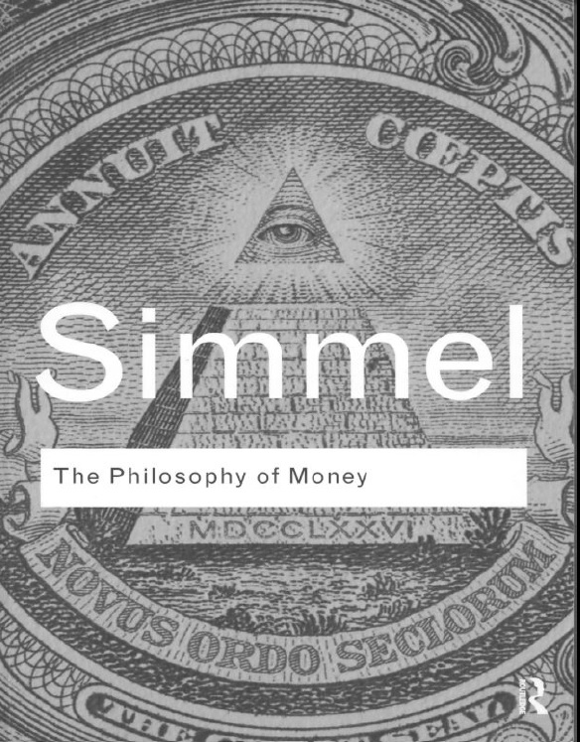

Slide 77
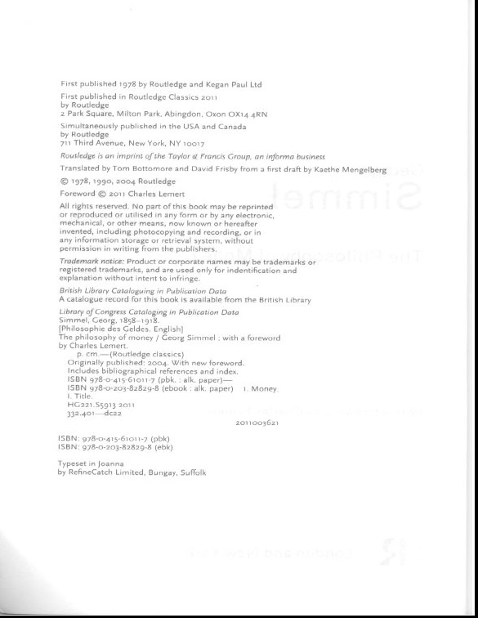

Slide 78
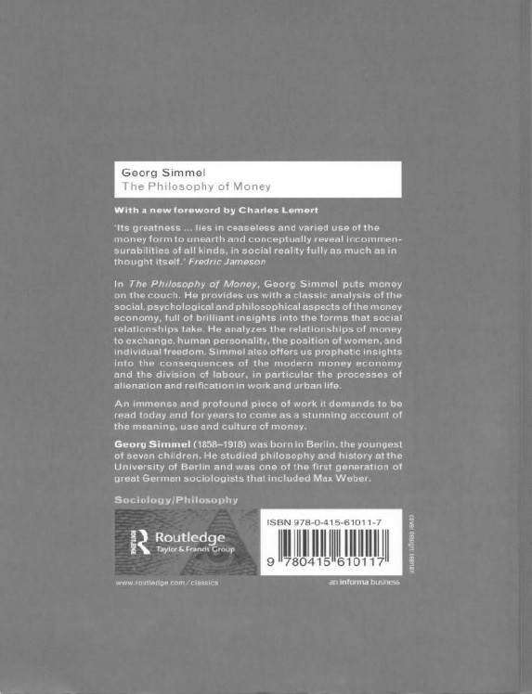

Slide 79
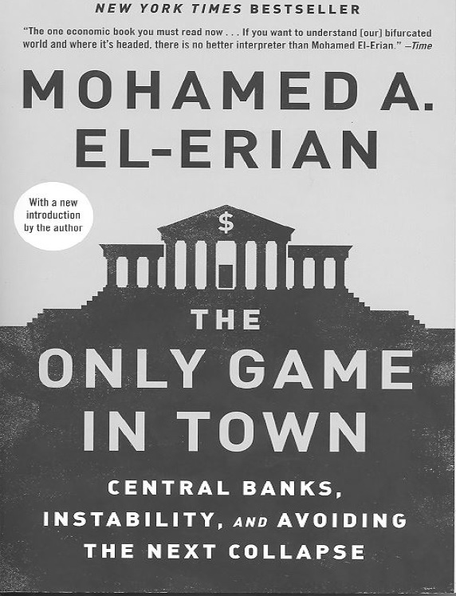

Slide 80
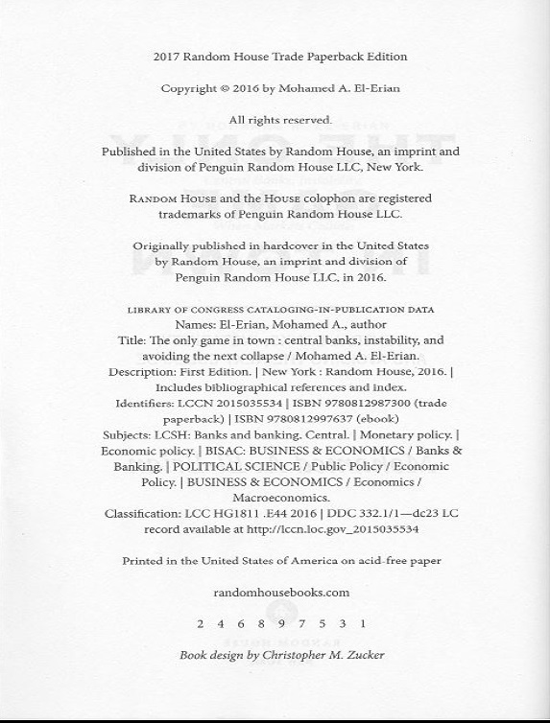

Slide 81


Slide 82


Slide 90


Slide 92


Slide 104


Slide 105


Slide 106


Slide 107


