Slide 1
1971 – 1979
CAMP DAVID

Slide 2

CAMP DAVID

Slide 3


Slide 4
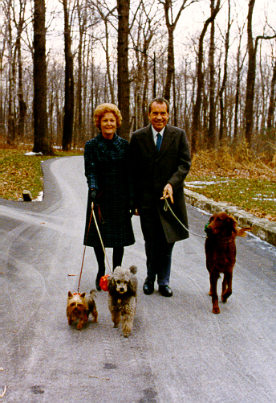
Nixon wife & dogs - Camp David

Slide 5


Slide 6


Slide 7


Slide 8
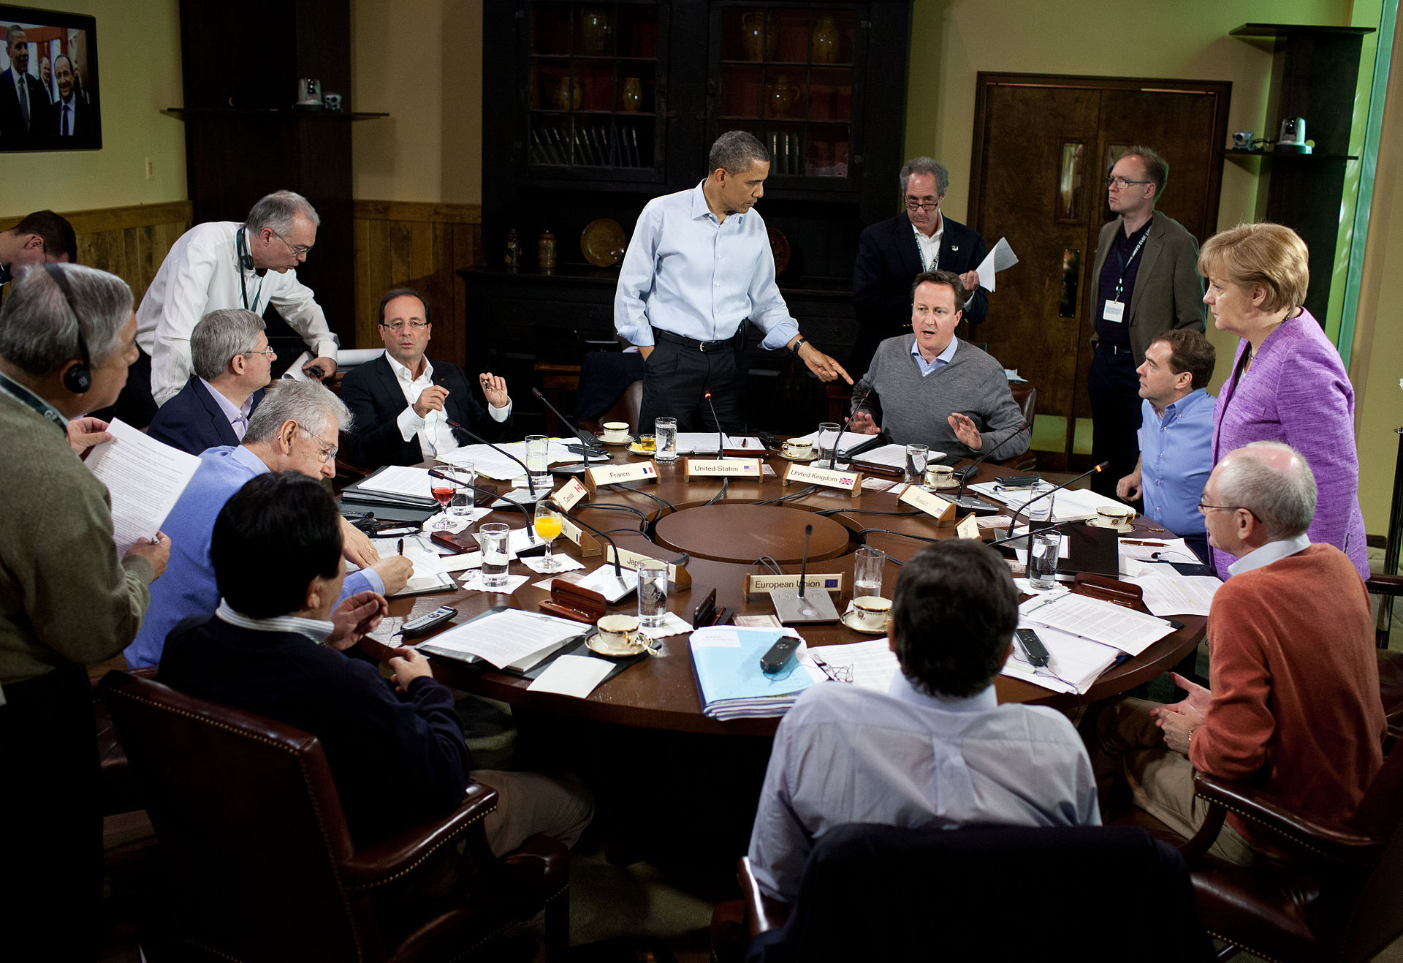
G8_Summit_working_session_on_global_and_economic_issues_May_19,_2012_Camp David

Slide 9
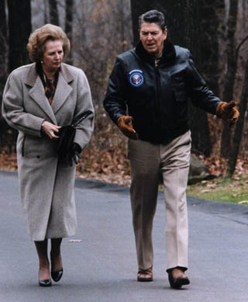

Slide 10
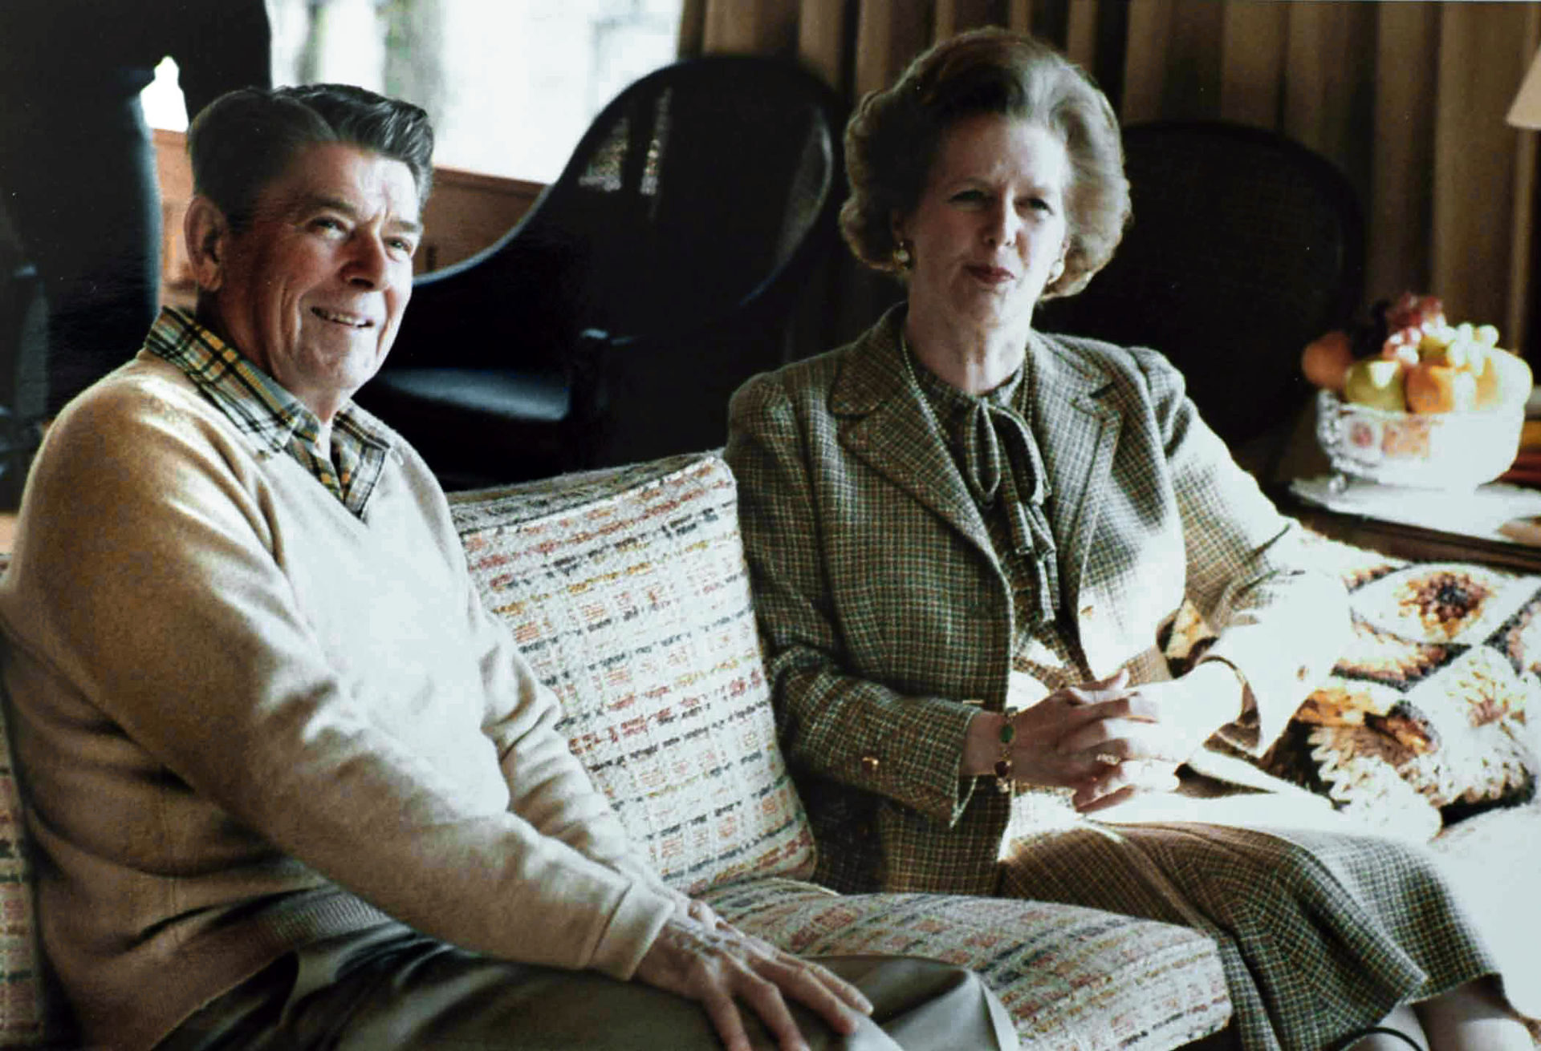

Slide 11
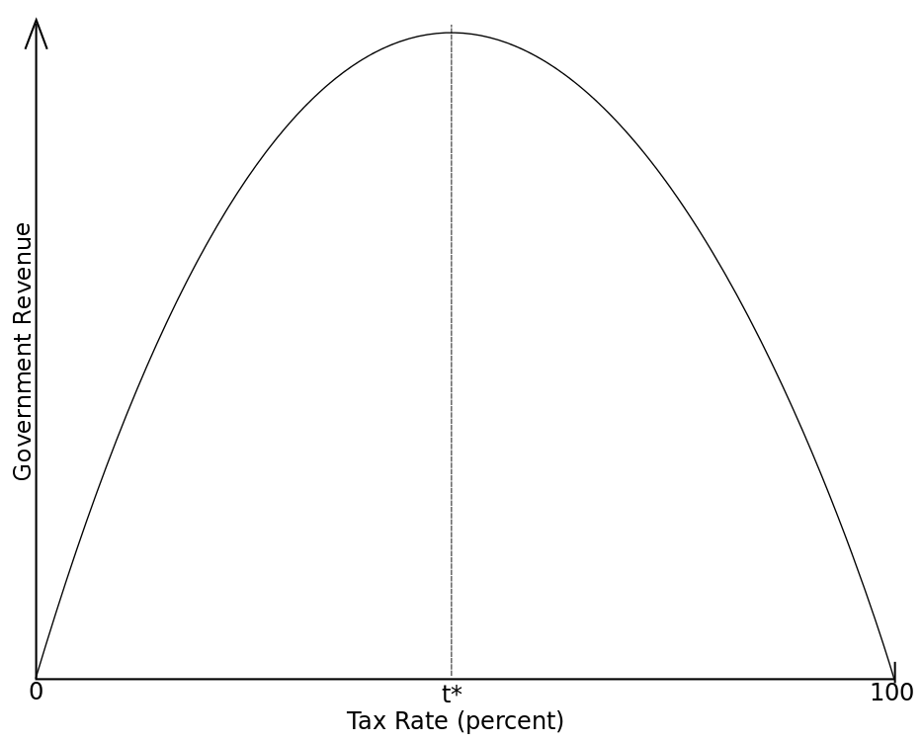

Slide 12
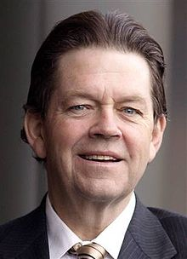
ARTHUR LAFFER

Slide 13
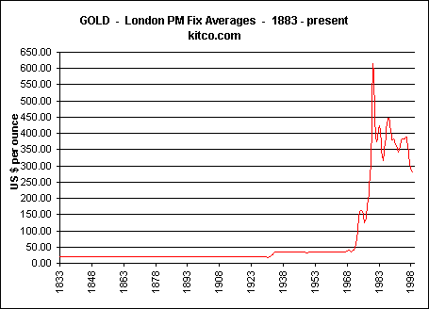

Slide 14
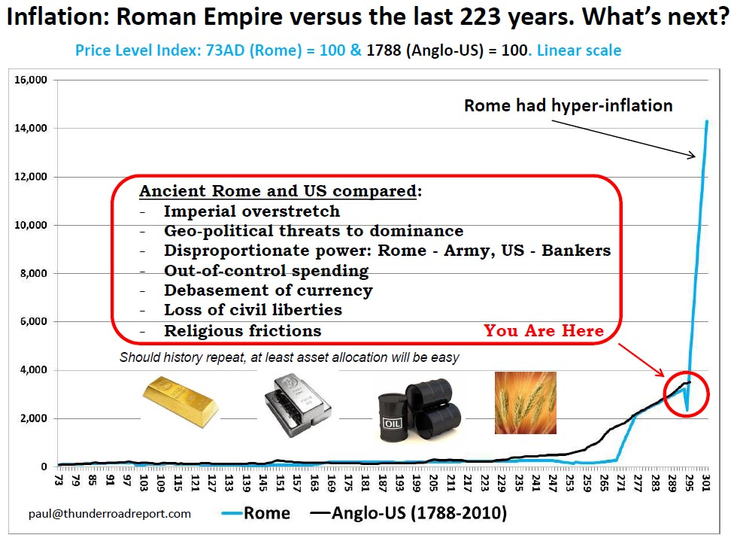

Slide 15
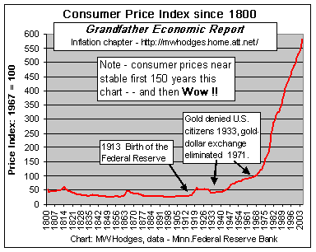

Slide 16
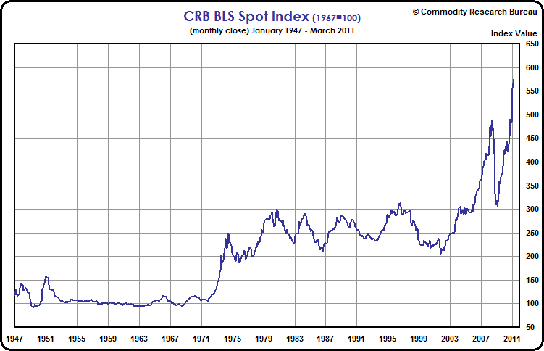
http://www.crbtrader.com/crbindex/images/crb-b7.gif

Slide 17
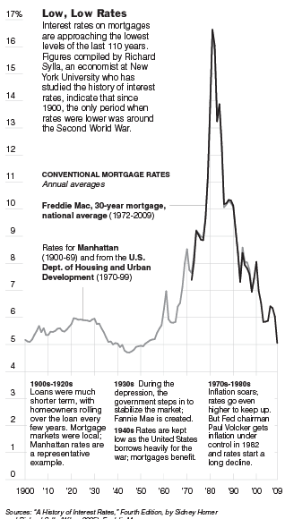
Source A history of interest rets by Sichey Horner and Sylla Wiley, 2005

Slide 18
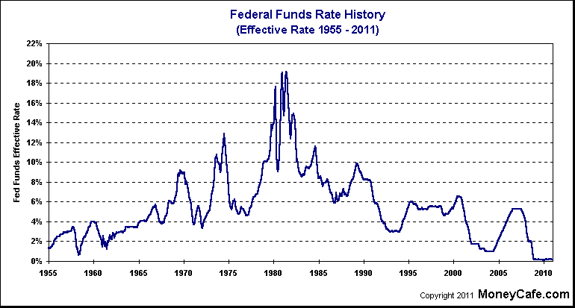

Slide 19
1979

Slide 20
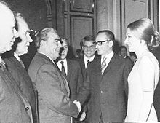
Mohammad Reza Shah Pahlavi and Empress Farah meeting with general
secretary Leonid Brezhnev in Moscow in 1970

Slide 21
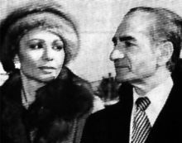
Shah Mohammad Reza Pahlavi and Shahbanu Farah shortly before leaving Iran in 1979 during the height of the Iranian revolution

Slide 22
. "We used to think," James Callaghan told the Labour party conference since 1976, "you could spend your way out of a recession and increase employment by cutting taxes and boosting spending. I tell you in all candour that this option no longer exists.......”. James Callaghan quote – British Political Speech, Blackpool 1976, 28 September 1976 .New statesman: Volume 139, Ed. 4995-5007;

Slide 23
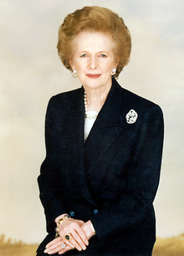
In Office 4 May 1979 – 28 November 1990

Slide 24
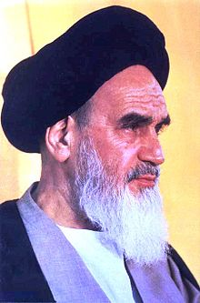
In office 3 December 1979 – 3 June 1989

Slide 25
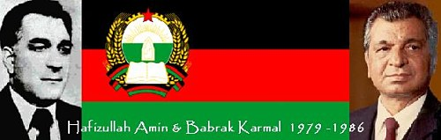

Slide 26
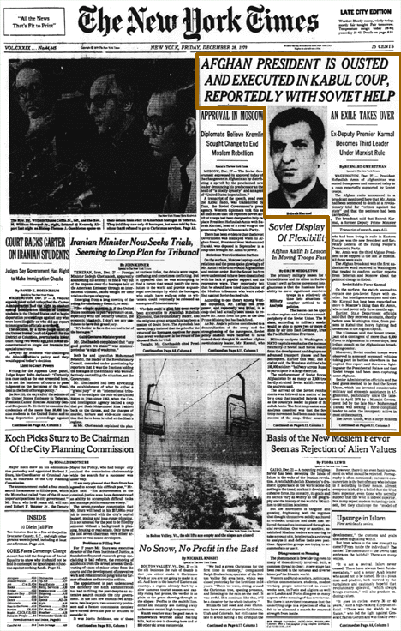

Slide 27
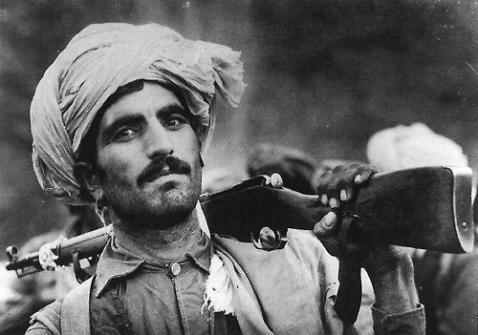

Slide 28
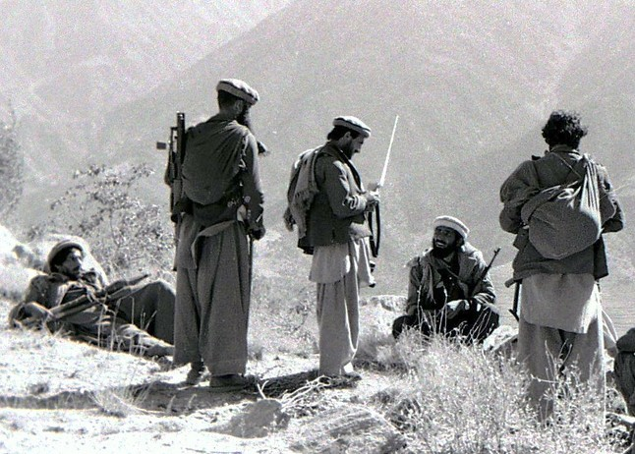

Slide 29
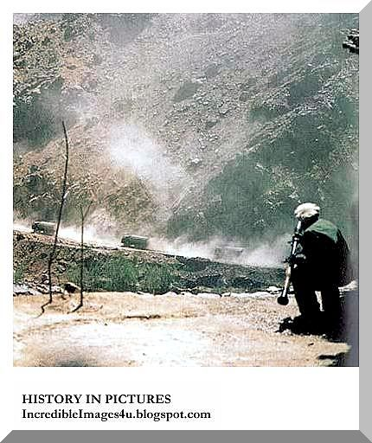
The Mujahideen fighter lurks with a US supplied bazooka to hit a Soviet convoy

Slide 30
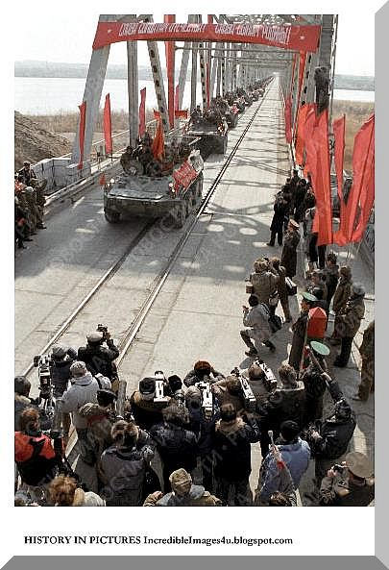

Slide 31

Mikhail Gorbachev took Russia out of the Afghanistan fiasco when he realised what many Russian leaders had been too scared to admit in public - that Russia could not win the war and the cost of maintaining such a vast force in Afghanistan was crippling Russia's already weak economy.

Slide 32
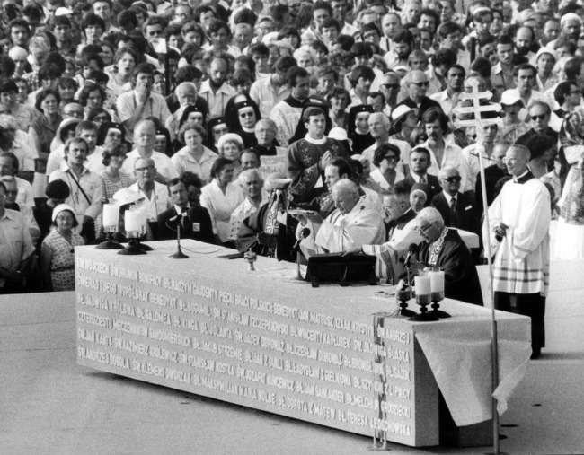
Freedom Square Warsaw June 1979

Slide 33
At the end of 1978, the septuagenarian Chinese, Communist Party leader Deng Xiaoping, after stabilizing the relations with the US, heaved himself to the top job
“The Unite States of America and the People’s Republic of china have agreed to recognize each other and establish diplomatic relations as from January 1, 1979.” (EZRA F. VOGLEI, 2011, 333)
introducing a series of economic reforms that ultimately changed the country beyond all recognition. Emulating closer reforms, he applied the successful free or special zones regimes of Singapore, Hong Kong, Taiwan and similar Special Economic Zones, to mainland and continental China. Adopting the Wealth of Nations principles’ Voglej, F, Ezra, Deng Xiaoping and the Transformation of China, London 2011.

Slide 34
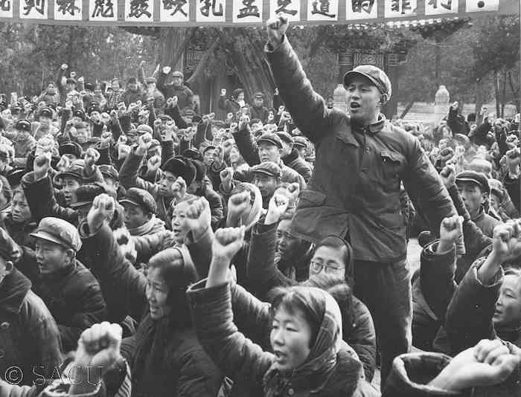
People in Chufu County, Shandong denounce Lin Biao's crimes in preaching the doctrine of Confucius and Mencius at a meeting

Slide 35
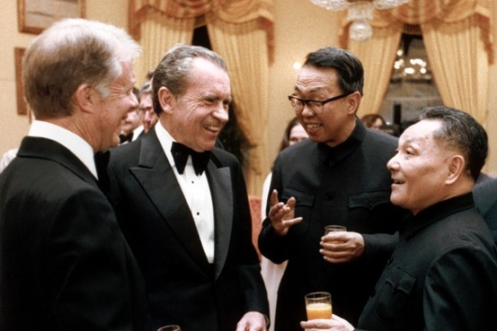
Washington January 1979

Slide 36
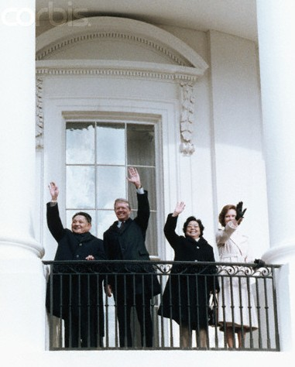
Washington January 1979

Slide 37
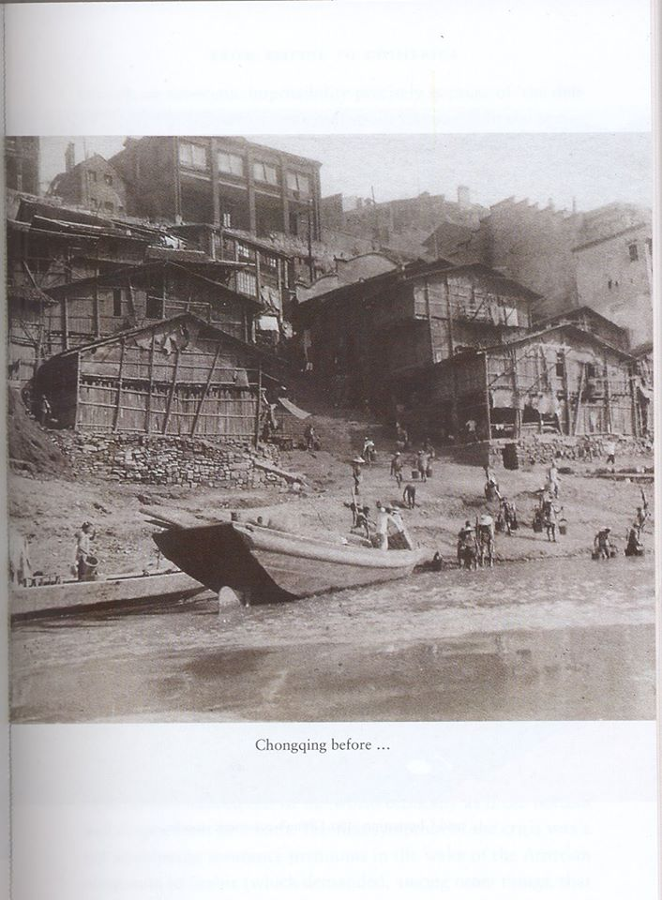

Slide 38
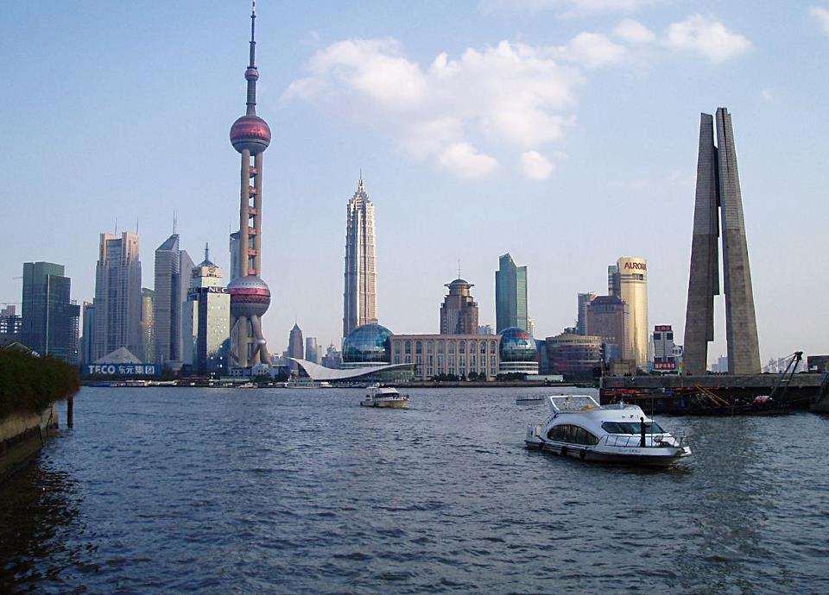

Slide 39


Slide 40
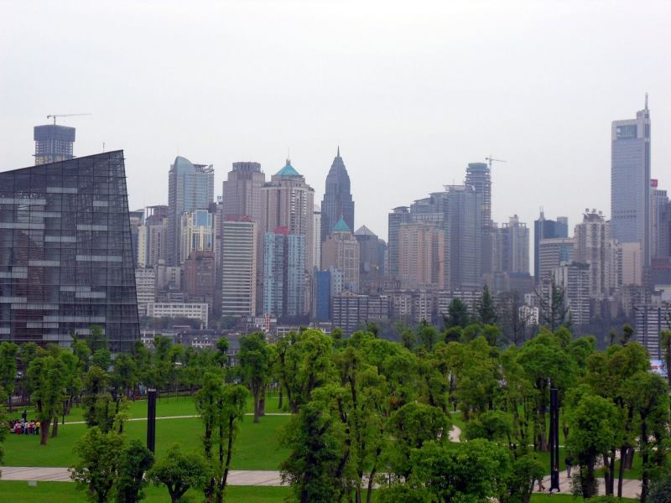

Slide 41


Slide 42


Slide 43


Slide 44


Slide 45


Slide 46


Slide 47


Slide 48
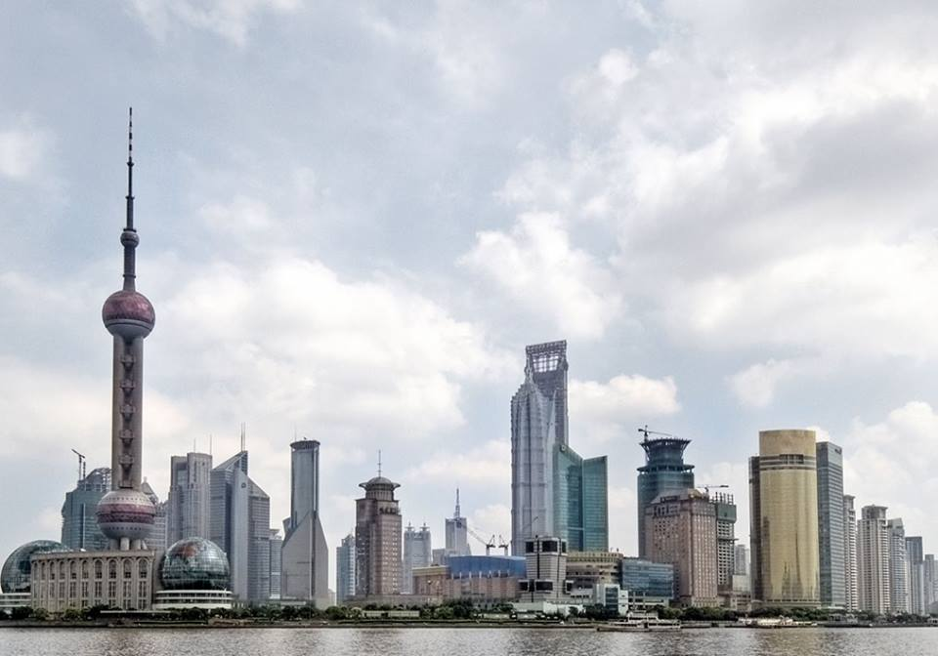

Slide 49
Trade Deficit
IThe Sole24Ore 16 otober 2010 P. 6

