Slide 1
Nixon’s announcement on the 15° August 1971:
"I have directed Secretary Connally to suspend temporarily the convertibility of the American dollar except in amounts and conditions determined to be in the interest of monetary stability and in the best interests of the United States”.

Slide 2
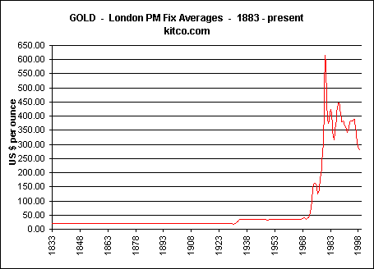

Slide 3
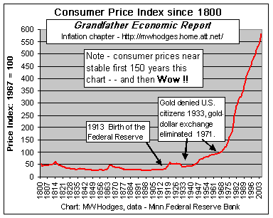

Slide 4
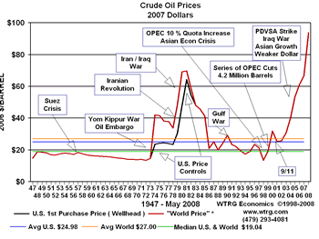
<http://www.wtrg.com/prices.htm>

Slide 5
John Maynard Keynes
The General Theory of Employment, Interest and Money
Chapter 24. Concluding Notes on the Social Philosophy towards which the General Theory might Lead
…….. some academic scribbler of a few years back …….

Slide 6
THE outstanding faults of the economic society in which we live are its failure to provide for full employment and its arbitrary and inequitable distribution of wealth and incomes. The bearing of the foregoing theory on the first of these is obvious. But there are also two important respects in which it is relevant to the second.
……………………………………………………
Madmen in authority, who hear voices in the air, are distilling their frenzy from some academic scribbler of a few years back. I am sure that the power of vested interests is vastly exaggerated compared with the gradual encroachment of ideas. Not, indeed, immediately, but after a certain interval; for in the field of economic and political philosophy there are not many who are influenced by new theories after they are twenty-five or thirty years of age, so that the ideas which civil servants and politicians and even agitators apply to current events are not likely to be the newest. But, soon or late, it is ideas, not vested interests, which are dangerous for good or evil.

Slide 7


Slide 8
Edited by Rudiger Dornbusch and Sebastian Edwards
412 pages | 32 figures, 85 tables | 6 x 9 | © 1991
National Bureau of Economic Research Conference Report
Paper $37.50ISBN: 9780226158440 Published February 1992
E-book $7.00 to $37.50
ISBN: 9780226158488 Published December 2007
Again and again, Latin America has seen the populist scenario played to an unfortunate end. Upon gaining power, populist governments attempt to revive the economy through massive spending. After an initial recovery, inflation reemerges and the government responds with wage an price controls. Shortages, overvaluation, burgeoning deficits, and capital flight soon precipitate economic crisis, with a subsequent collapse of the populist regime. The lessons of this experience are especially valuable for countries in Eastern Europe, as they face major political and economic decisions.

Slide 9
Table 1. US Internal deficit according to the presidencies
1970 – 2014
^{[1]}
Ford, $0.654 trillion
Carter, $0.930 trillion, 42%
Reagan, $2.68 trillion, 189%
Bush, $4.18 trillion, 55.6%
Clinton, $5.7 trillion, 36%
Bush, $10.7 trillion, 75%
Obama $17.00 current.
^{[1]} <http://www.presidentialdebt.org>

Slide 11
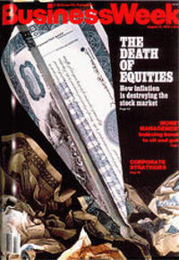
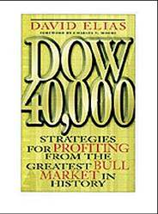
Business Week 13 August 1979 Dj 875
Business Week Online September 27, 1999 DJ 10.395

Slide 12
"I am not worried about the deficit. It is big enough to take care of itself."
-- Ronald Reagan
"Reagan proved deficits don't matter." -- Dick Cheney, Nov. 15, 2002"

Slide 13
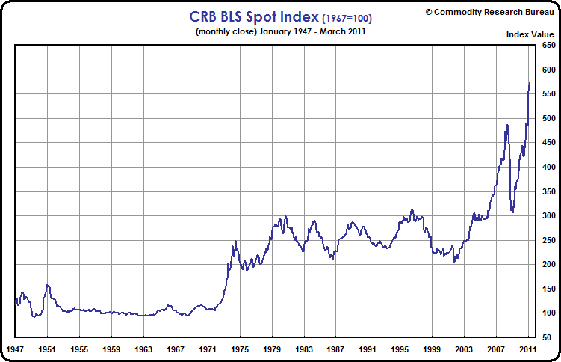
http://www.crbtrader.com/crbindex/images/crb-b7.gif

Slide 14
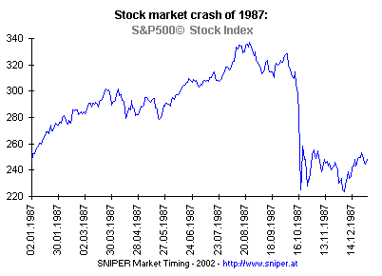

Slide 15
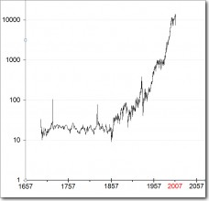
http://www.gamingthemarket.com/where-the-new-ppt-hides.html

Slide 16
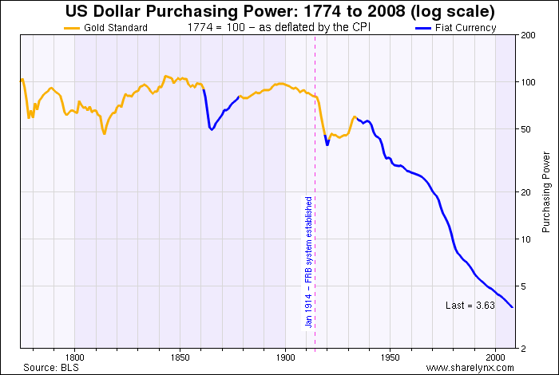

Slide 17
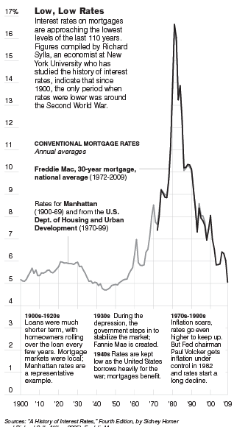
Source A history of interest rets by Sichey Horner and Sylla Wiley, 2005

Slide 18
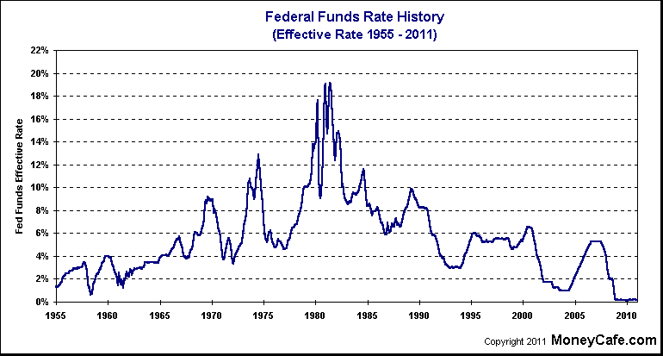

Slide 19
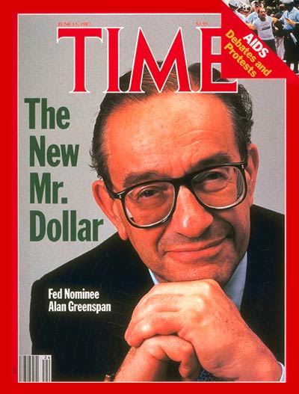

Slide 20
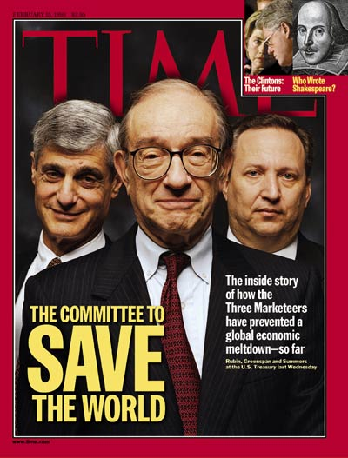
15 February 1991

Slide 21
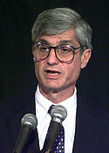
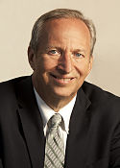
Robert E. Rubin
Lawrence H. Summer

Slide 22
Global Economy Meeting
The Global Economy Meeting (GEM) comprises the Governors from 30 BIS member central banks in major advanced and emerging market economies that account for about four fifths of global GDP. The members of the GEM are the central bank Governors of Argentina, Australia, Belgium, Brazil, Canada, China, France, Germany, Hong Kong SAR, India, Indonesia, Italy, Japan, Korea, Malaysia, Mexico, the Netherlands, Poland, Russia, Saudi Arabia, Singapore, South Africa, Spain, Sweden, Switzerland, Thailand, Turkey, the United Kingdom and the United States and also the President of the European Central Bank and the President of the Federal Reserve Bank of New York. Governors from several other central banks attend the GEM as observers.
The GEM has two main roles: (i) monitoring and assessing developments, risks and opportunities in the world economy and the global financial system; and (ii) providing guidance to the Basel-based central bank committees, especially the main three - the Committee on the Global Financial System, the Committee on Payment and Settlement Systems and the Markets Committee. The GEM also receives reports from the chairs of those committees and decides on publication.
The Global Economy Meeting is one of the principal bimonthly meetings held at the BIS.

Slide 23
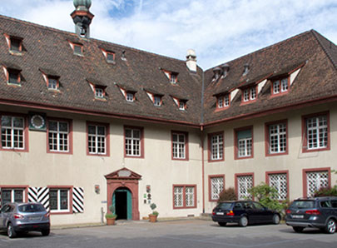



Slide 25
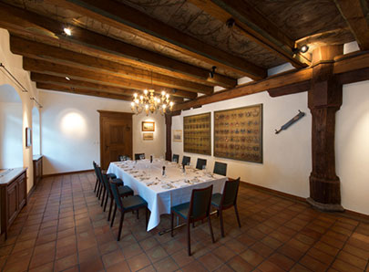

Slide 26
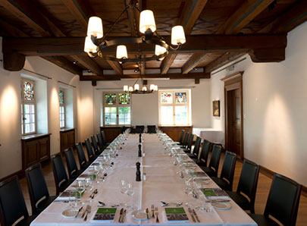

Slide 27
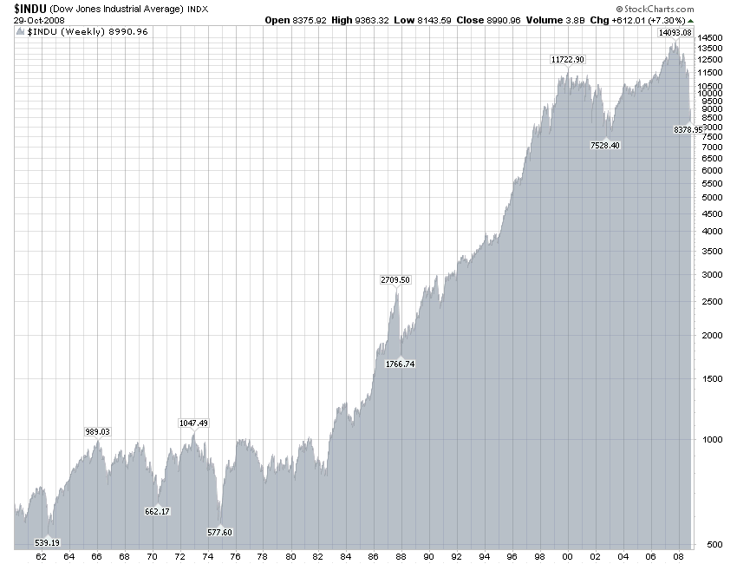

Slide 28
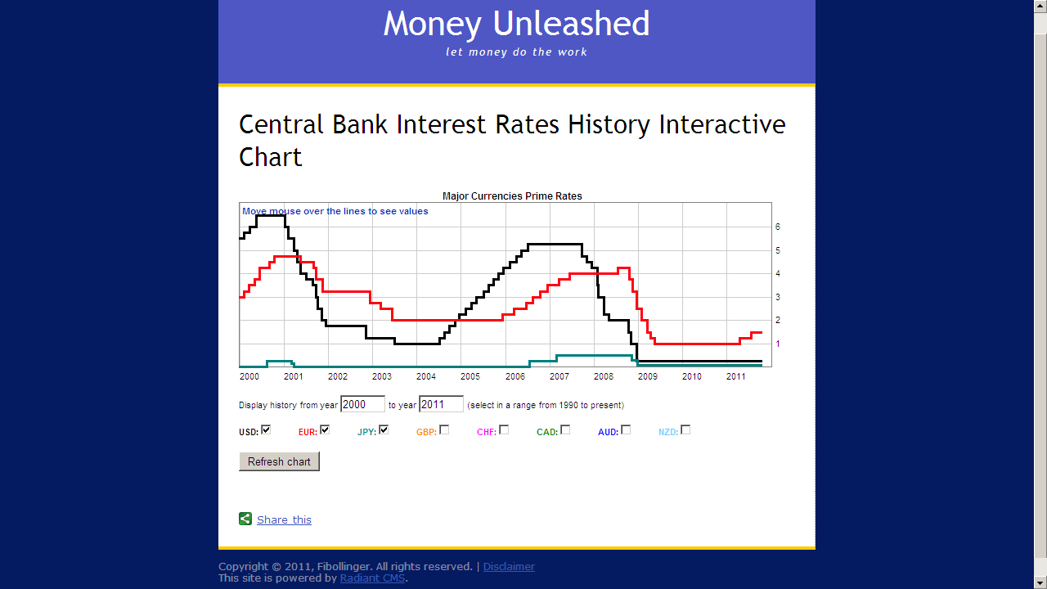

Slide 29
Since the collapse of fixed exchange rate
August 1971
Banca Privata e Finambro 1974
Bankhaus Herstatt in Cologne. 1974
Franklin Square National Bank – Long Island, New York - 1974
Penn Central Corporation – Pennsylvania 1978
Banco Ambrosiano 1982
Continental Illinois National Bank and Trust Company (CINB) in May 1984,
Drexel Burnham Lambert Group (DBLG) 1989
Bank for Credit and Commerce International (BCCI) 1991
Long-Term Capital Management (LTCM) 1994
Barings PLC 1995
Crédit Lyonnais' Paris 1996
Bipop-Carire 2001
Enron Corporation is an energy company based in Houston, Texas. 2001
WorldCom (known as LDDS) and MCI Communications, MCI WorldCom WorldCom taking its final name on April 14, 2003 as part of the corporation's emergence from bankruptcy 2003

Slide 30
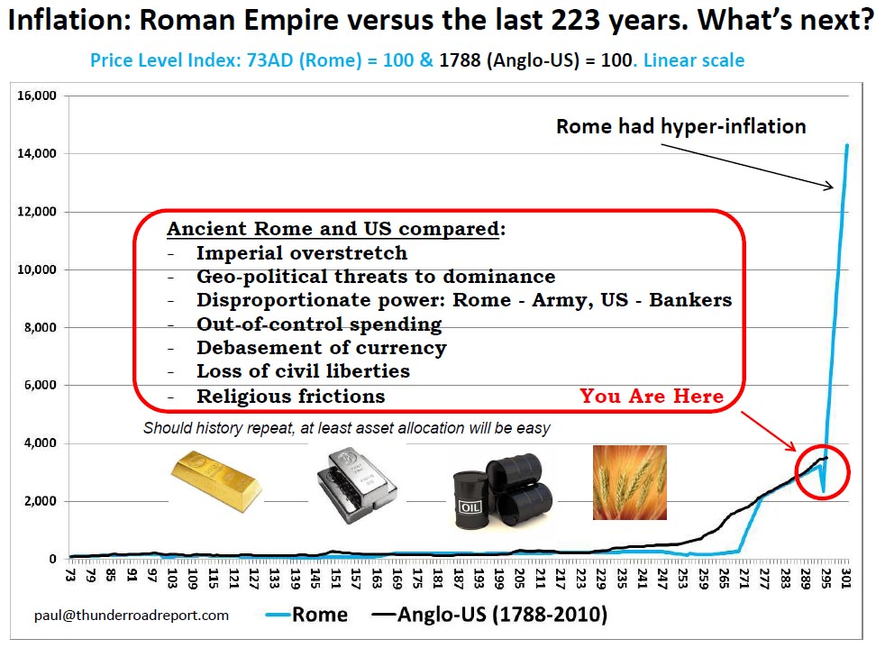

Slide 31
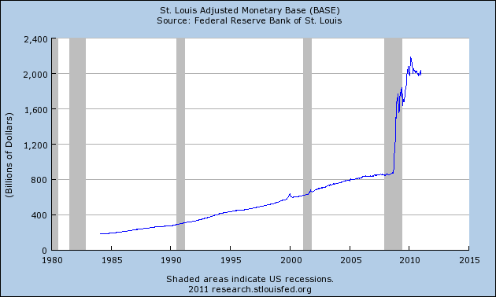
http://research.stlouisfed.org/fred2/series/BASE

Slide 32
Federal Reserve Act
Section 13. Powers of Federal Reserve Banks
Omissis …………………………….
3. Discounts for individuals, partnerships, and corporations
In unusual and exigent circumstances, the Board of Governors of the Federal Reserve System, by the affirmative vote of not less than five members, may authorize any Federal reserve bank, during such periods as the said board may determine, at rates established in accordance with the provisions of section 14, subdivision (d), of this Act, to discount for any participant in any program or facility with broad-based eligibility, notes, drafts, and bills of exchange when such notes, drafts, and bills of exchange are indorsed or otherwise secured to the satisfaction of the Federal Reserve bank: Provided, That before discounting any such note, draft, or bill of exchange, the Federal reserve bank shall obtain evidence that such participant in any program or facility with broad-based eligibility is unable to secure adequate credit accommodations from other banking institutions. All such discounts for any participant in any program or facility with broad-based eligibility shall be subject to such limitations, restrictions, and regulations as the Board of Governors of the Federal Reserve System may prescribe.

Slide 33
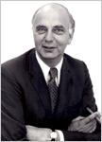
Paul Volker - He was named chairman of the Board of Governors of the Federal Reserve System by President Carter, and was sworn in on August 6, 1979. He served until August 11, 1987

Slide 34
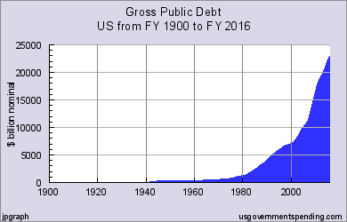

Slide 35
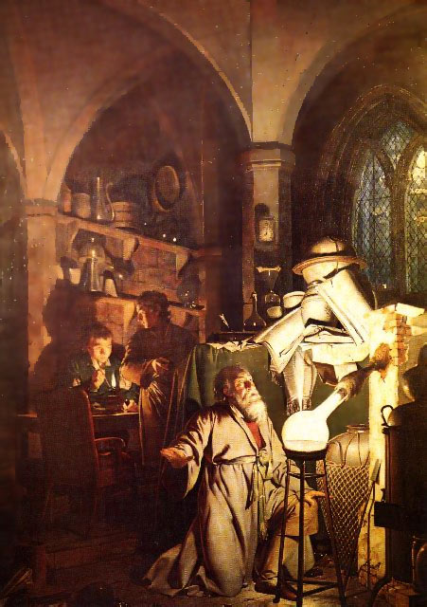
Joseph Wright The Alchemist 1771

Slide 36


Slide 37
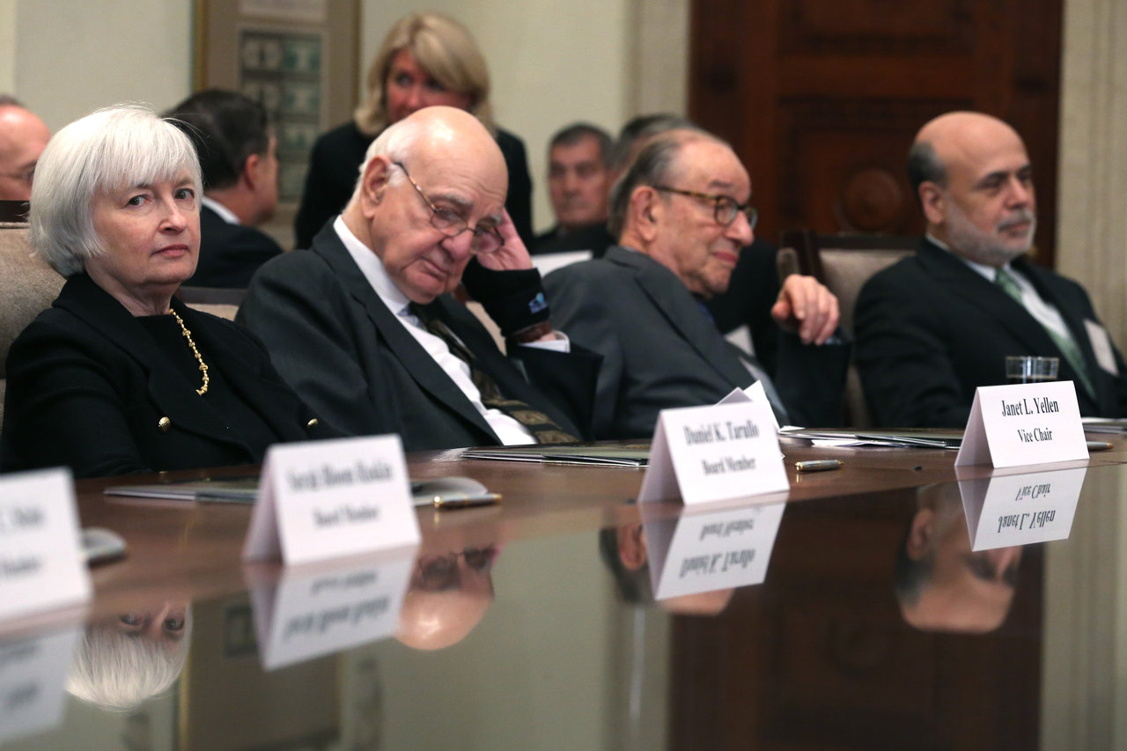

Slide 38
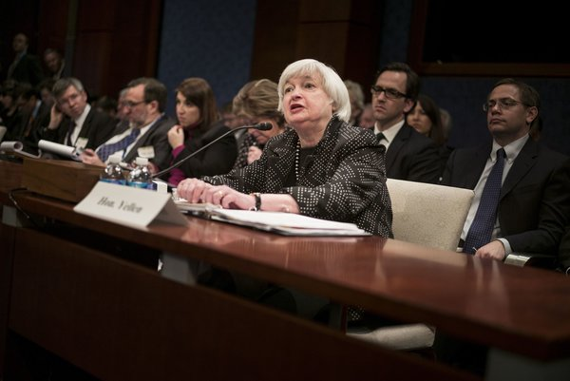
Janet Yellen denied accusations on Wednesday that she had used her office to advance liberal policy goals and warned against attempts to limit Fed independence. Credit Brendan Smialowski/Agence France-Presse — Getty Images

Slide 39
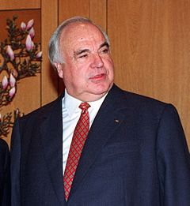

Slide 40
http://www.pines.it/Fallout1998.pdf

Slide 41
Year 2015 European monetary and fiscal policys instruments
European Financial Stability Facility (EFSF),
European Stability Mechanism (ESM),
European Fiscal Compact (EFC),
Emergency Liquidity Assistance (ELA),
Long-term refinancing operation (LTRO),
Quantitative easing operations
European Banking Authority (EBA),
Single Supervisory Mechanism (SSM),
Economic and Financial Affairs Council (ECOFIN),

Slide 44
1979

Slide 45
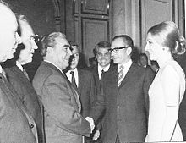
Mohammad Reza Shah Pahlavi and Empress Farah meeting with general
secretary Leonid Brezhnev in Moscow in 1970

Slide 46
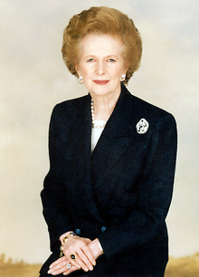
In Office 4 May 1979 – 28 November 1990

Slide 47
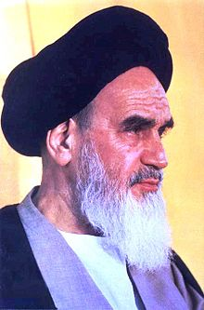
In office 3 December 1979 – 3 June 1989

Slide 48
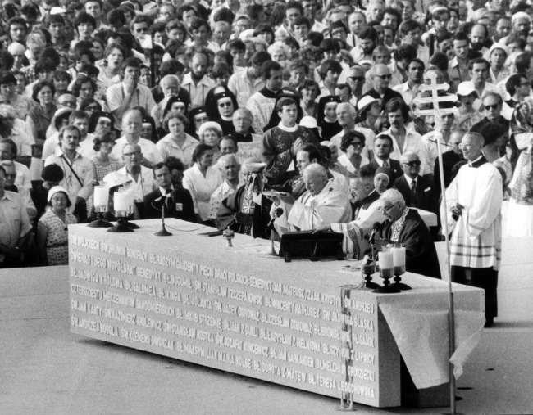
Freedom Square Warsaw June 1979

Slide 49
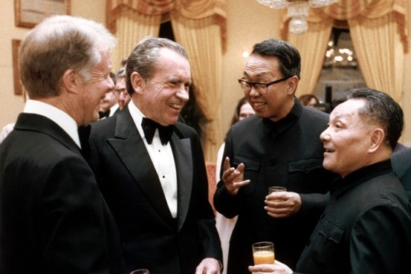
Washington January 1979

Slide 50
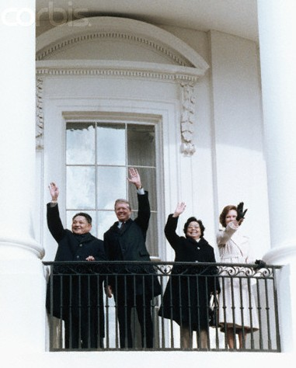
Washington January 1979

Slide 51
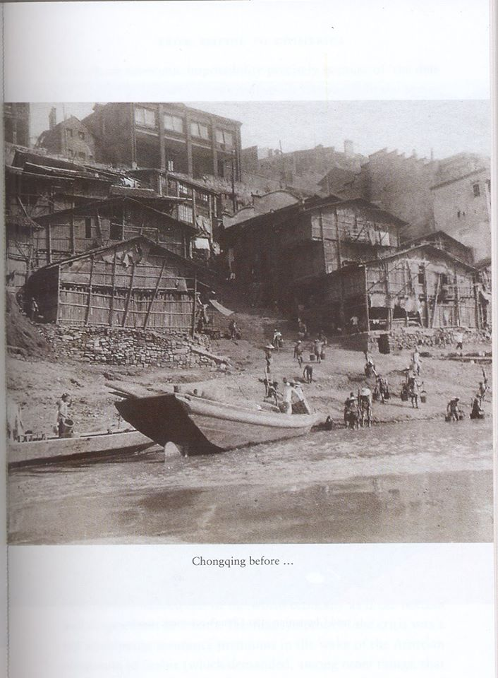

Slide 52


Slide 53


Slide 54


Slide 55


Slide 56


Slide 57


Slide 58


Slide 59


Slide 60


Slide 61


Slide 62
Trade Deficit
IThe Sole24Ore 16 otober 2010 P. 6

Slide 63
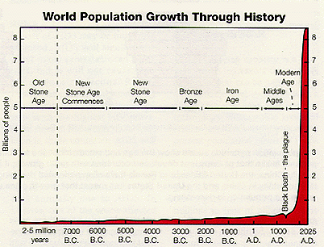
A
B
C
X
1 cm = 100 anni 1 m = 10.000 anni 100 m = 1.000.000 anni <<http://www.nber.org/papers/w7375>>

Slide 64
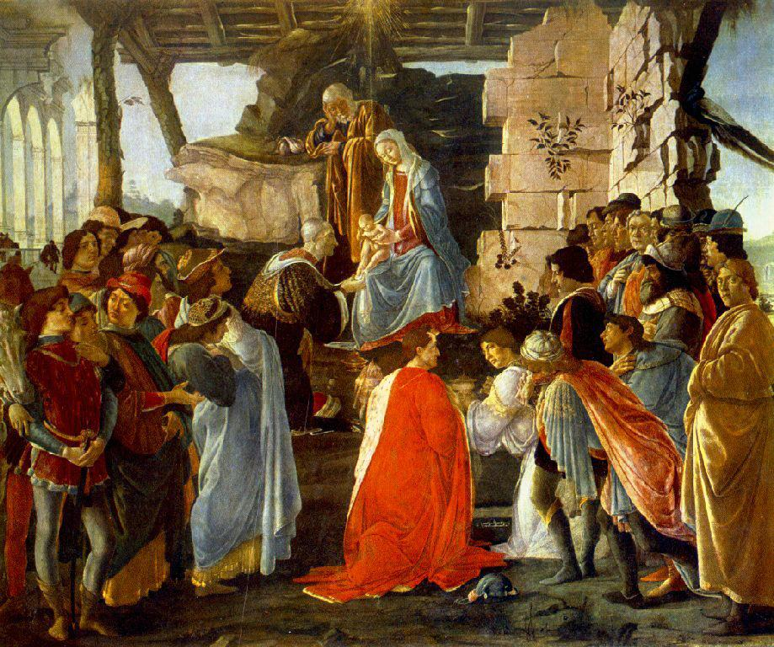

Slide 65

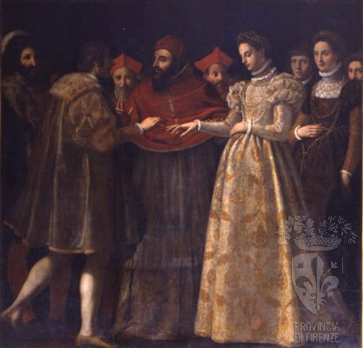
Leone X
Clemente VII
http://www.ilpalio.org/gabrielli_clementeVII.htm
http://cronologia.leonardo.it/biogra2/leonex.htm

Slide 66
 | 2000 | 2005 | 2007 | 2008 | 2014
GDP (current US$) (billions) | 32,001.93 | 45,232.14 | 54,891.06 | 60,587.02 | 87.180
GDP growth (annual %) | 4.1 | 3.5 | 3.8 | 2.0
Inflation, GDP deflator (annual %) | 4.7 | 4.9 | 5.4 | 8.1
http://www.worldbank.org/

