Slide 1

Economic Geography
Introduction
121EC
A.Y. 2017/2018
Prof. Giuseppe Borruso
Department of Economics, Business, Mathematics and Statistics
University of Trieste
E-mail. giuseppe.borruso@econ.units.it
Ph. +39 040 558 7008
Skype: giuseppe.borruso
Notes:
Geografia delle Reti EC 503
I Modulo
Giuseppe Borruso
1
Slides with (*) in footnotes have been modified by Jean-Paul Rodrigue materials. (v. riferimenti copyright a seguire). I have modified and elaborated materials in order to be suitable for the current course.
Copyright © 1998-2010, Dr. Jean-Paul Rodrigue, Dept. of Global Studies & Geography, Hofstra University. For personal or classroom use ONLY.

Slide 2
Instructor information
Prof. Giuseppe Borruso
  University of Trieste
  Via Tigor, 22
  Department of Economics, Business, Mathematics and Statistics (DEAMS)
  Room 312
  3rd Floor
  Office hours: Wednesday 11.00 – 13.00 and/or by app.
  E-mail. giuseppe.borruso@deams.units.it
  Ph. +39 040 558 7008
  Skype: giuseppe.borruso
  Twitter: @gborruso

Slide 3
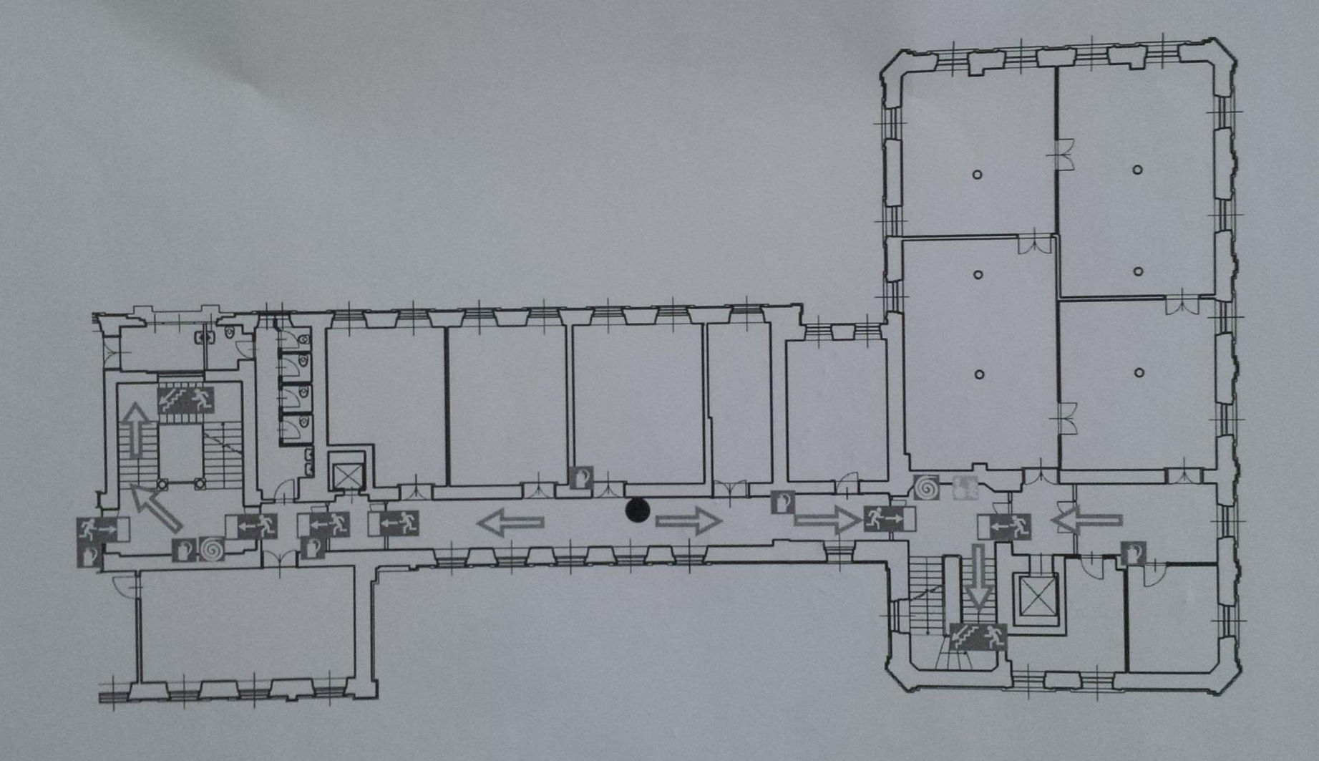
Office – Room 312, 3rd floor

Slide 4
Course content (1/2)
Economic Geography represents the study of the location, distribution and spatial organization of economic activities across the Earth.
In today’s highly competitive economy, many companies, firms and organizations are aware that understanding geography, possibly through mapping, can represent a competitive strategic advantage. Significant cost savings and profit opportunities can result from the understanding of the geographic context of activities such as sales and marketing, distribution and logistics, as well as competitor activity.
The course examines the way in which individuals and enterprises organize their economic activities in space and the extent to which society recognizes the socio-economic impacts of such activities across space and uses its institutions to influence these interdependencies and impacts.
The course is focused on how geographic and economic conditions affect the products, industries, commerce and resources in a variety of regions. The course tackles the concepts, theories, and methodologies used by geographers to analyze economic change.

Slide 5
Course contents (2/2)
The course provides an introduction Economic and Human Geography, particularly in terms of the geographical pattern of residentiality, production and consumption, as well as the consumer’s behaviour.
These topics include theories and basic economic geography models as, for instance, location theories, gravity and spatial interaction models.
  the perspective of location and spatial distribution of economic activities, including questions of "place", "locality", "site and situation" and land use;
  the perspective of spatial interaction and economic dependence and interdependence (exchange, trade, transportation, migration, information and capital flows, communication networks and the economic geography of the Internet); and
  the perspective of economic change in a spatial context (regional growth or decline, technological innovation, processes of structural change [i.e. long-run compositional and interdependence changes in the economy] regional economic development etc.).

Slide 6
Topics covered (1/2)
Geography, economy and business
Human and Economic Geography;
Population Distribution and Structure; Demographic Theory; Migration
The foundations of spatial economics;
Central Place Theory - The System of Cities;
Urban retail – Trade Area Analysis;
Gravitation and spatial interaction models;
Markets and locations of services;
Real estate, retail, transport and space;
Transport Networks; Transport Costs; Telecommunications

Slide 7
Topics covered (2/2)
GIS and spatial models:
  Geographic Information Technologies: GIS, GPS, Remote Sensing and their applications in business, economics and planning;
  Geodemographics
  Geographies of consumption, behaviour, attitude, deprivation;
  Neogeography and the geospatial revolution: how geography meets new technologies and everyday life

Slide 8
Resources
https://moodle2.units.it/course/view.php?id=2572
(work in progress! Documents being uploaded)
To access the course key in: econgeog1 [disabled, at present]
  Resources available (work in progress):
    Powerpoint presentations
    Articles and papers
    Data and documents
    Videos and other materials
  Updates uploaded regularly – at least once a week
Internet – Keywords for searches communicated in class
Students will be provided with copies of key articles during the course.

Slide 9
Text materials
Materials – Powerpoint presentations, key articles, case studies materials - will be made available throughout the course and represent the main references for passing the exam.
The textbook is the book by Anderson W. P., Economic Geography, Routdledge, Oxon, 2012
http://www.routledge.com/books/details/9780415701211/
Part I Fundamental Concepts 1. Introduction 2. The Friction of Distance 3. Agglomeration 5. Spatial Interaction 6. Resources and the Environment
Part III: Location Theory 13. Transportation and Location 14. Scale Economies and Input Substitution 15. Labor, Rent, Taxes and Subsidies 16. Interrelated Location Choices
Part IV: Markets for Space 17. Agricultural Land Use 18 Urban Land Use: The Monocentric City 19. Urban Sprawl and the Polycentric City
Part V: Systems of Cities 20. Urbanization 21 City Size Distribution and Urban Hierarchies 22. Central Place Theory 23. Network Urban Systems
Part VI: Globalization and the Knowledge Economy 25. The Globalization of Production Systems (reading)
No appendixes and boxes

Slide 10
Text materials
Materials presented in class represent the main materials for students attending the course.
Textbook (see previous slide) and key articles on Moodle platform represent part of the materials integrating lecture notes and presentations.
Frequency of the course is recommended.
Students not attending the course should prepare class materials and the selected chapters of the textbook.
The following books can be used as supplemental material (not compulsory):
  Jean-Paul Rodrigue, Claude Comtois and Brian Slack (2009) The Geography of Transport Systems, Second Edition, New York: Routledge, 284 pages.
  Frederick P. Stutz and Barney Warf (2012) The World Economy: Resources, Location, Trade, and Development, 6th Edition. Prentice Hall, Saddle River, NJ.

Slide 11
Classes
Tuesday 13.00 – 15.00
Wednesday: 13.00 – 15.00
Thursday 11.00 – 13.00
AULA MAPPE ANTICHE Via Tigor, 22
OLD MAPS ROOM

Slide 12
Assessment and Grades
There will be a final exam that may test all material included in the assigned readings and all the material covered in class.
The final will be based on a written test, followed by an oral examination.
Marks will be expressed in /30 as in the Italian system, with the maximum mark being 30/30 cum laude
People attending classes, Erasmus and exchange students could be allowed a pre-exam before Christmas, to be agreed.

Slide 13
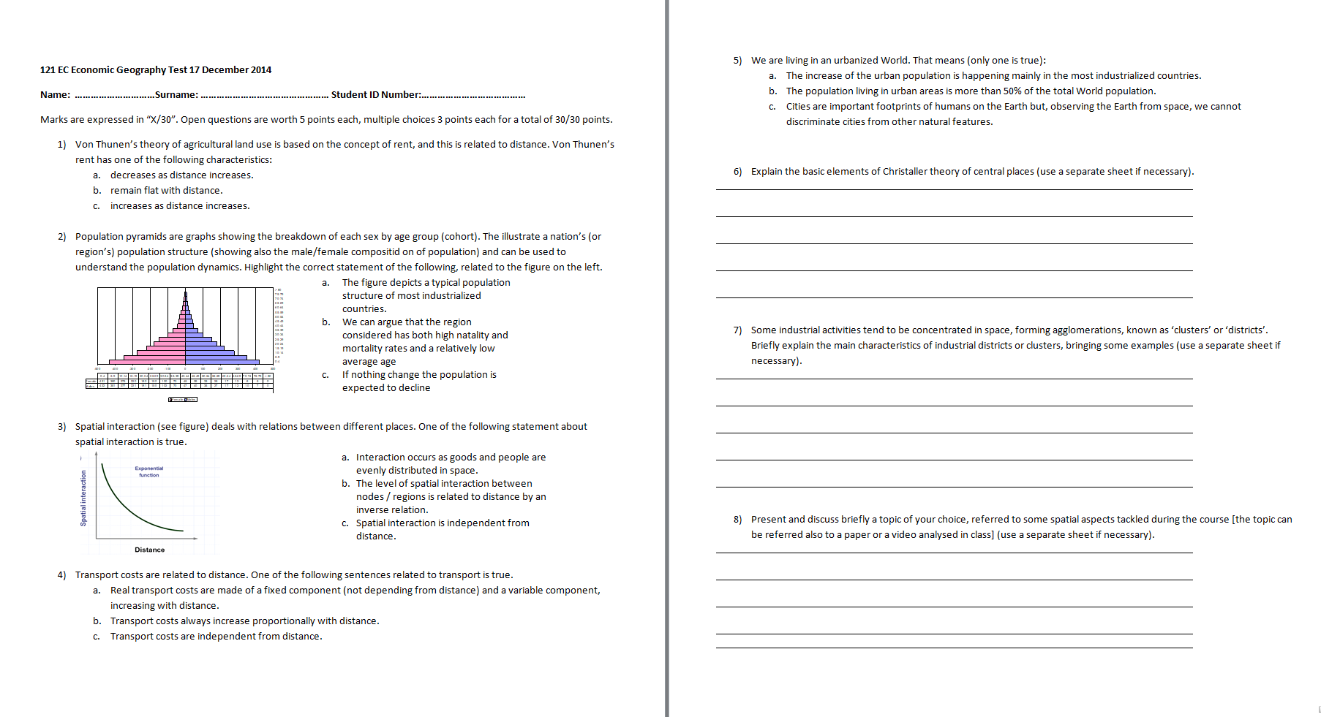
Test sample

Slide 14
Let’s play a geographical game!
https://enketo.ona.io/x/#YpGv

Slide 15
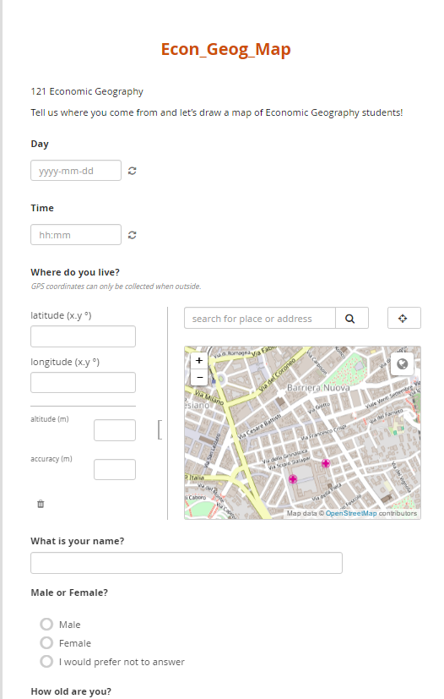
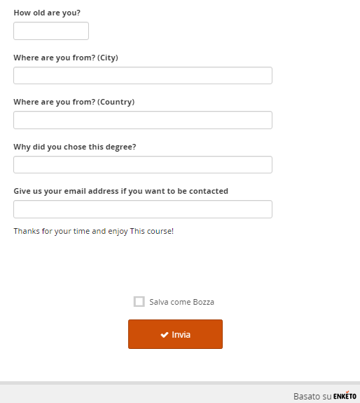

Slide 16
