Slide 2
La proposta di Schacter et al. ha 3 punti chiave:
l’online learning è una forma di apprendimento auto-regolato
il mind wandering è una forma di fallimento del controllo esecutivo che può interferire con l’apprendimento
fornire quiz intermittenti migliora l’apprendimento

Slide 3
Monitoring
Control
Calibration
Much research has focused on the concept of calibration, or the fit between individuals’ judgments about their performance and their actual performance (Keren, 1991).

Slide 4
Calibration scores typically reveal that students are overconfident about their initial levels of learning (Hacker et al., 2008).
This finding has important implications for executive control of study behavior: if students feel as though they have mastered a particular topic, when in fact they have not, then they are likely to proceed to other lessons instead of devoting the additional study time needed to master that topic.
Consistent with this idea, research has shown that when students make overconfident judgments of learning, they are less likely to take advantage of subsequent opportunities to restudy target material (e.g., Dunlosky & Rawson, 2012).

Slide 5
Nello studio si dovrebbe evitare la distrazione interna o esterna, ed invece entrambe possono ridurre il livello dell’apprendimento.

Slide 6
3. recuperare le informazioni dalla memoria (testing effect) migliora la ritenzione.

Slide 7
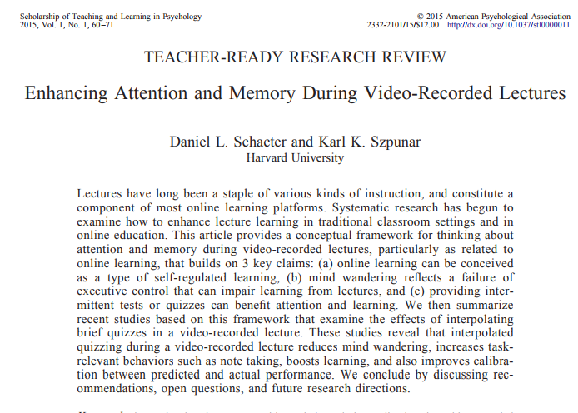

Slide 8
Video di statistica, 4 segmenti, ad un gruppo domande.
Ricordano di più, fanno meno mind-wandering, prendono più note

Slide 9
E I giudizi?
Students in the 4-test group predicted that they would perform at a high level on the final test (77%), and their actual performance (75%) closely matched their predicted performance.
By contrast, students in the 0-test group also predicted that they would perform well on the final test (78%), but their actual performance (48%) was significantly and dramatically lower than their predicted performance.
Students in the 1-test group fell in between the other two groups: their predicted performance (60%) was considerably lower than students in the other two groups.
Migliore calibrazione.

