Slide 1
Lesson One

Slide 2
What is a text?

Slide 3
What is a multimodal text?

Slide 5
Semiotic modalities

Slide 6
Written Words

Slide 7
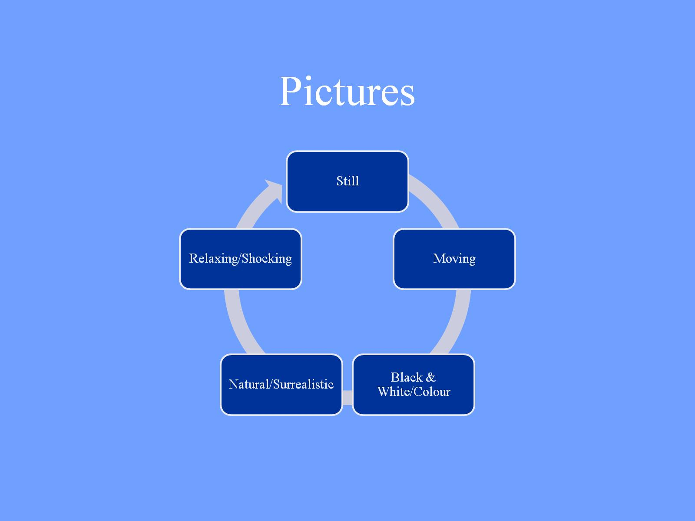
Pictures

Slide 8
Colour

Slide 9
Gesture

Slide 10
Gesture
Co-speech
Pantomime
Emblems
Sign language

Slide 11
Eg a bowl
Drawing
Modelling
Acting
Representing

Slide 12
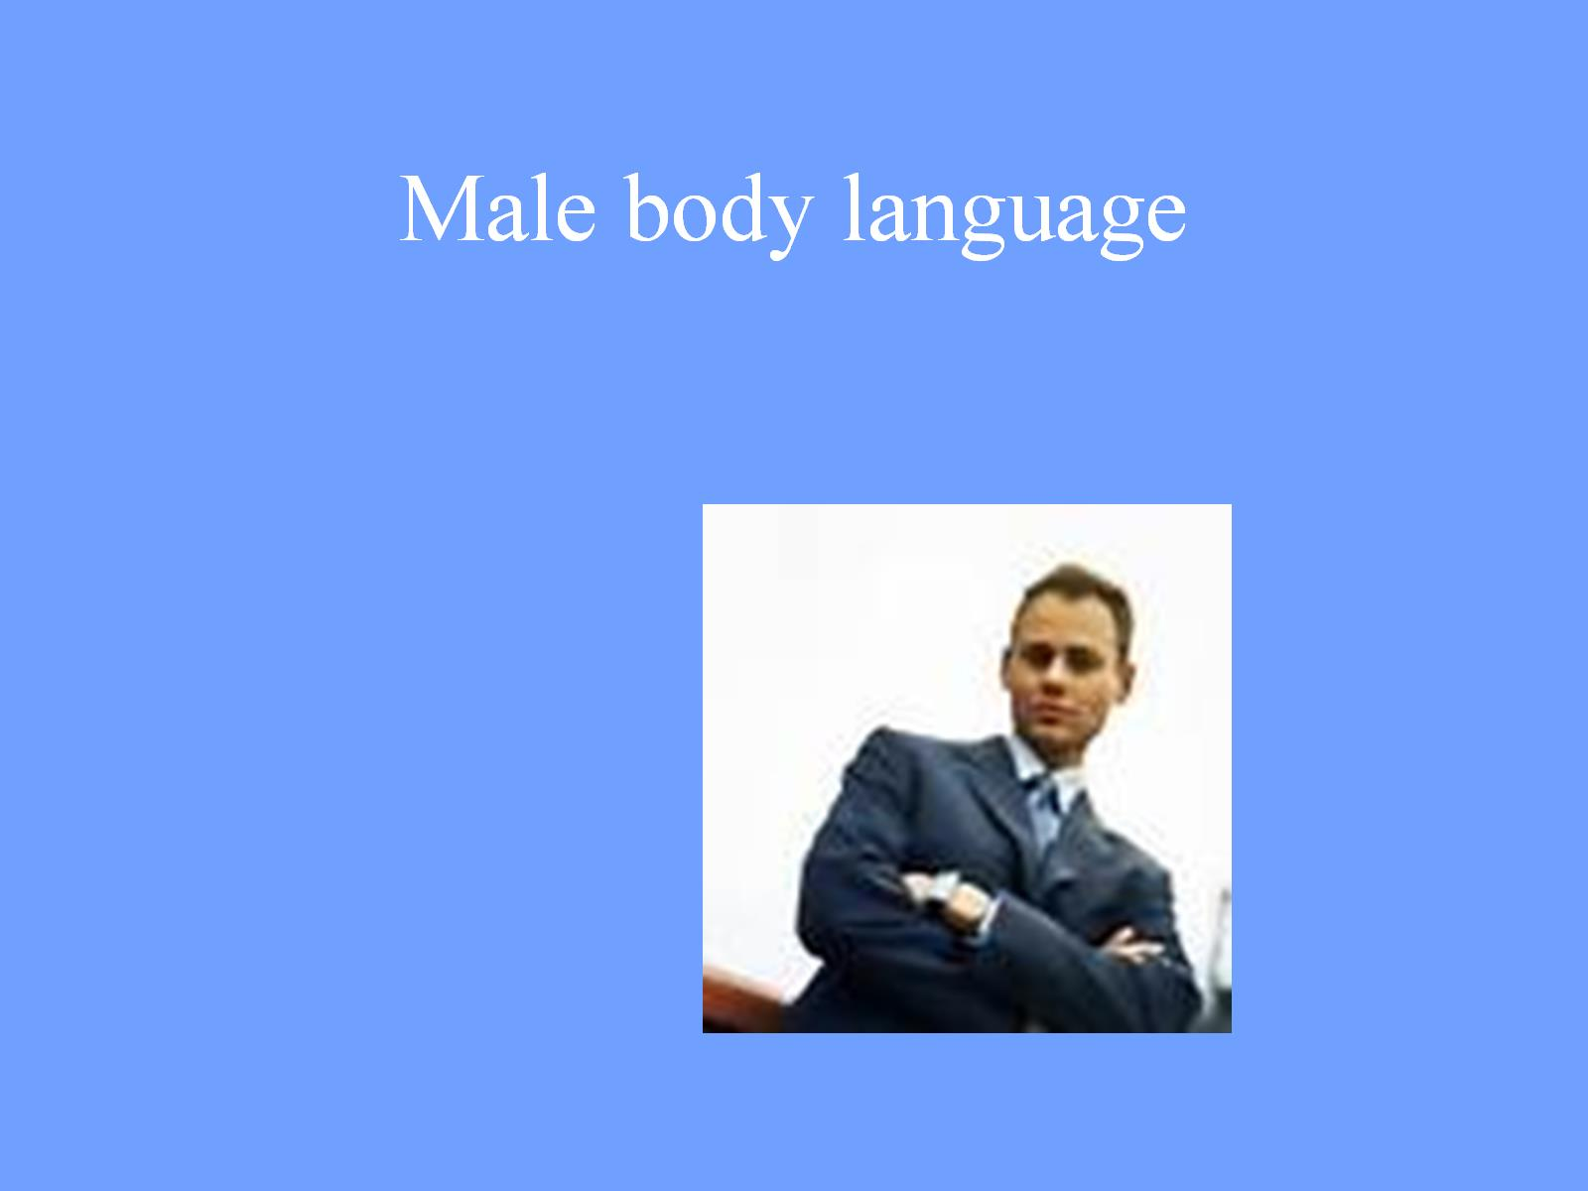
Male body language

Slide 13
Hand gesture

Slide 14
Female body language

Slide 15
Movement

Slide 16
Music

Slide 17
The Green Leaves of Summer The Alamo

Slide 18
The Green Leaves of Summer Inglourious Basterds

Slide 19
Perspective

Slide 20
Camera Angles

Slide 21
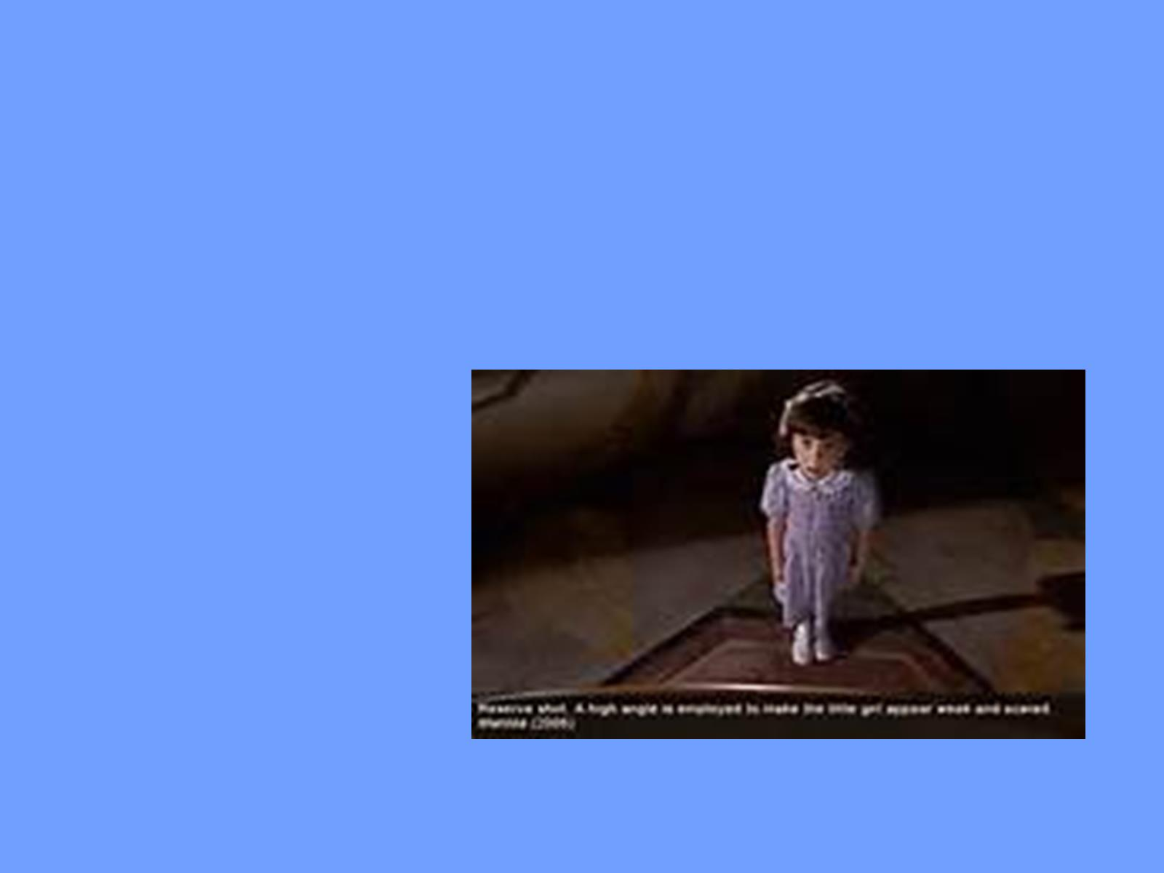

Slide 22
Spoken Words

Slide 23
Sounds

Slide 24
Silence
How to deal with silence in AD.
Silent films? – a constant AD?

Slide 25
Silence cf. Ingmar Bergman ‘The Silence’ «it is inscribed inside the register of speech where it deliniates a certain stance» (Dolar)… …and thus inserted by the director

Slide 26
Silence as a narrative element eg. Mission Impossible: Tom Cruise tries to disable a sound-sensitive alarm system

Slide 27
Eg. 2001 A Space Odyssey ‘The dawn of man’ – the camera moves into space and into silence. Then images of landscapes are shown against the sounds of wind and birds … inducing the idea of silence. Breaking the silence would destroy the effect.

Slide 28
The Marx Brothers ‘Duck Soup’ three minutes of silence during the ‘mirror’ scene Here AD is necessary as there is so much action.

Slide 29
Option 1
Omission
sometimes but aural silence is often accompanied by action. The dilemma is «how to make the silence speak, without making it sound too loud» (Orero).

Slide 30
Option 2
Announce the silence
The silence could be meaningful.
But leaving the silence could be considered a mistake or a breakdown.

Slide 31
Option 3
Audiodescriber decides on function of silence
Could lead to highly subjective interpretations.
But in cases like ‘Duck Soup’ where the Marx Brothers’ sketch is composed of actions, it is clearly necessary to describe.
Whereas the typical silence following a bomb explosion or a gunshot may not need any explanation.

Slide 32
Light

Slide 33
Surreal

Slide 34
Sensual lighting

Slide 35
Signs

Slide 36
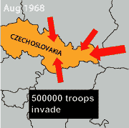
Vectors

Slide 37
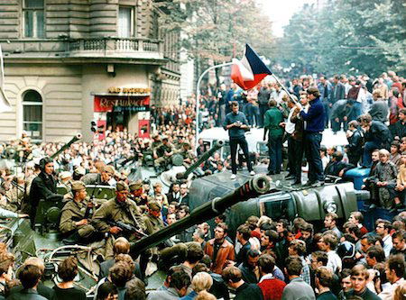

Slide 38
Digital longform journalism SNOWFALL

Slide 39
Reference: A Postgraduate Screen Translation Course IN ‘Readings in Intersemiosis and Multimedia’ ed. Elena Montagna

