Slide 1
Lesson 1a
Audio Description

Slide 2
Beginnings…
1978 Gregory Frazier Masters thesis (after watching ‘High Noon’ with a friend)
1981 the Pfanstiehls – performance of ‘Major Barbara’
By end of 1980s, 50 theatres offered AD

Slide 3
…continued…
1986 first exhibition AD – Statue of Liberty
1988 first TV AD ‘Strange Interlude’
1997 first film AD ‘The Jackal’

Slide 4
…continued
1991 UK – Independent Television Commission resulted in quotas for TV and many DVDs with AD
2010 USA - 21st Century Communication and Video Accessibility Act (Obama)

Slide 5
Who are the blind?
Individuals
Disability is indiscriminate
What are you doing in a museum?

Slide 6
Definition
Audio description (AD) makes the usual images of theatre, media and visual arts accessible for people who are blind or have low vision (myopia, hyperopia, macula degeneration, glaucoma, astigmation, cataracts)
The visual made verbal (J. Snyder)
A verbal camera lens

Slide 7
AD
AD has always existed for the blind
And is useful for others:
children
immigrants
the distracted
all

Slide 8
Who is involved?
Describer
Voice talent
Consumer

Slide 9
What is involved?
OBSERVATION
EDITING
LANGUAGE
VOCAL SKILLS

Slide 10
OBSERVATION
«You can see a lot just by looking» Yogi Berra
eg, Sherlock Holmes
«Those who have never suffered impairment of sight or hearing seldom make the fullest use of these blessed faculties» Helen Keller

Slide 12
Face-to-face game
Mirror actions

Slide 13
EDITING
What to say and what not to say
Editing is essential, choices must be made
General to specific
Use colour
Include directional information
Describe what is essential

Slide 14
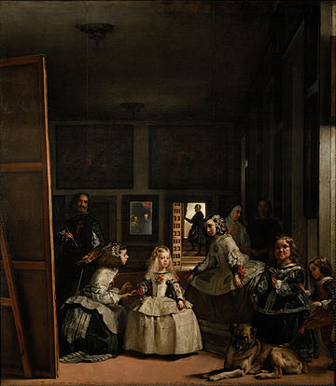

Slide 15
LANGUAGE
Objective (?), vivid, imaginative
When and where
Who – age, clothing, hair, build, ethnicity if necessary
What is happening – gestures, sounds, size (eg. like a football field), detail as necessary
«I have only made this letter long because I didn’t have time to make it short» Pacal

Slide 17
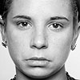
Objectivity (SAD?)
“the eyelids droop as the inner corners of the
brows rise, the corners of the lips pull down, and
the lower lip pushes up in a pout”
Notes:
100% objective

Slide 18
What you see is what you say (WYSIWYS)
Clear, no jargon eg. The creature … with segmented spiracles… (British Museum)
Concise
Present tense, 3° person, non-finite clauses
Know your audience eg. Kids
Use alternatives - Walk, stroll, saunter, stride, etc.
Don’t censor

Slide 19
Imagination
The Book Thief
«What does the sun look like?»
«Like a silver oyster»
«Thankyou, I saw that».

Slide 20
Sight ≠ Vision
Man in hospital

Slide 21
VOCAL SKILLS
Pronunciation
Enunciation 160 wpm
Delivery cf. fight scene or love scene
Oral interpretation
WOMAN WITHOUT HER MAN IS A SAVAGE.

Slide 22
White House
What is missing?

