Slide 1
Using the SRAdb Package to Query the Sequence Read Archive
High throughput sequencing technologies have very rapidly become standard tools in biology. The data that these machines generate are large, extremely rich.
As such, the Sequence Read Archives (SRA) have been set up at NCBI in the United States, EMBL in Europe, and DDBJ in Japan to capture these data in public repositories in much the same spirit as MIAME-compliant microarray databases like NCBI GEO and EBI ArrayExpress.
Since SRA is a continuously growing repository, the SRAdb SQLite file is updated regularly. The first step, then, is to get the SRAdb SQLite file from the online location.
library(SRAdb) sqlfile <- 'SRAmetadb.sqlite’ if(!file.exists('SRAmetadb.sqlite')) sqlfile <<- getSRAdbFile()

Slide 2
Using the SRAdb Package to Query the Sequence Read Archive
High throughput sequencing technologies have very rapidly become standard tools in biology. The data that these machines generate are large, extremely rich.
As such, the Sequence Read Archives (SRA) have been set up at NCBI in the United States, EMBL in Europe, and DDBJ in Japan to capture these data in public repositories in much the same spirit as MIAME-compliant microarray databases like NCBI GEO and EBI ArrayExpress.
Since SRA is a continuously growing repository, the SRAdb SQLite file is updated regularly. The first step, then, is to get the SRAdb SQLite file from the online location.
library(SRAdb) sqlfile <- 'SRAmetadb.sqlite’ if(!file.exists('SRAmetadb.sqlite')) sqlfile <<- getSRAdbFile()

Slide 3
Using the SRAdb Package to Query the Sequence Read Archive
The function dbConnect {DBI} Connect to a DBMS going through the appropriate authorization procedure.
sra_con <- dbConnect(SQLite(),sqlfile)
The dbListTables function lists all the tables in the SQLite database handled by the connection object sra_con created in the previous section.
sra_tables <- dbListTables(sra_con)
There is also the dbListFields function that can list database fields associated with a table.
> dbListFields(sra_con,"study")

Slide 4
Using the SRAdb Package to Query the Sequence Read Archive
Sometimes it is useful to get the actual SQL schema associated with a table. Here, we get the table schema for the study table:
> dbGetQuery(sra_con,'PRAGMA TABLE_INFO(study)')
The table ”col desc” contains information of filed name, type, descritption and default values:
> colDesc <- colDescriptions(sra_con=sra_con)

Slide 5
Send query, retrieve results and then clear result set.
dbGetQuery comes with a default implementation that calls:
dbSendQuery {DBI}
dbHasCompleted {DBI}
dbFetch {DBI}
dbClearResult {DBI}
Requires a DBIConnection object, as produced by dbConnect and a character vector of length 1 containing SQL statement.
rs <- dbGetQuery(sra_con,"select * from study limit 3")
Get some high-level statistics could be to helpful to get overall idea about what data are availble in the SRA database. List all study types and number of studies contained for each of the type:
rs <- dbGetQuery(sra_con, paste( "SELECT study_type AS StudyType, count( * ) AS Number FROM `study` GROUP BY study_type order by Number DESC ", sep=""))

Slide 6
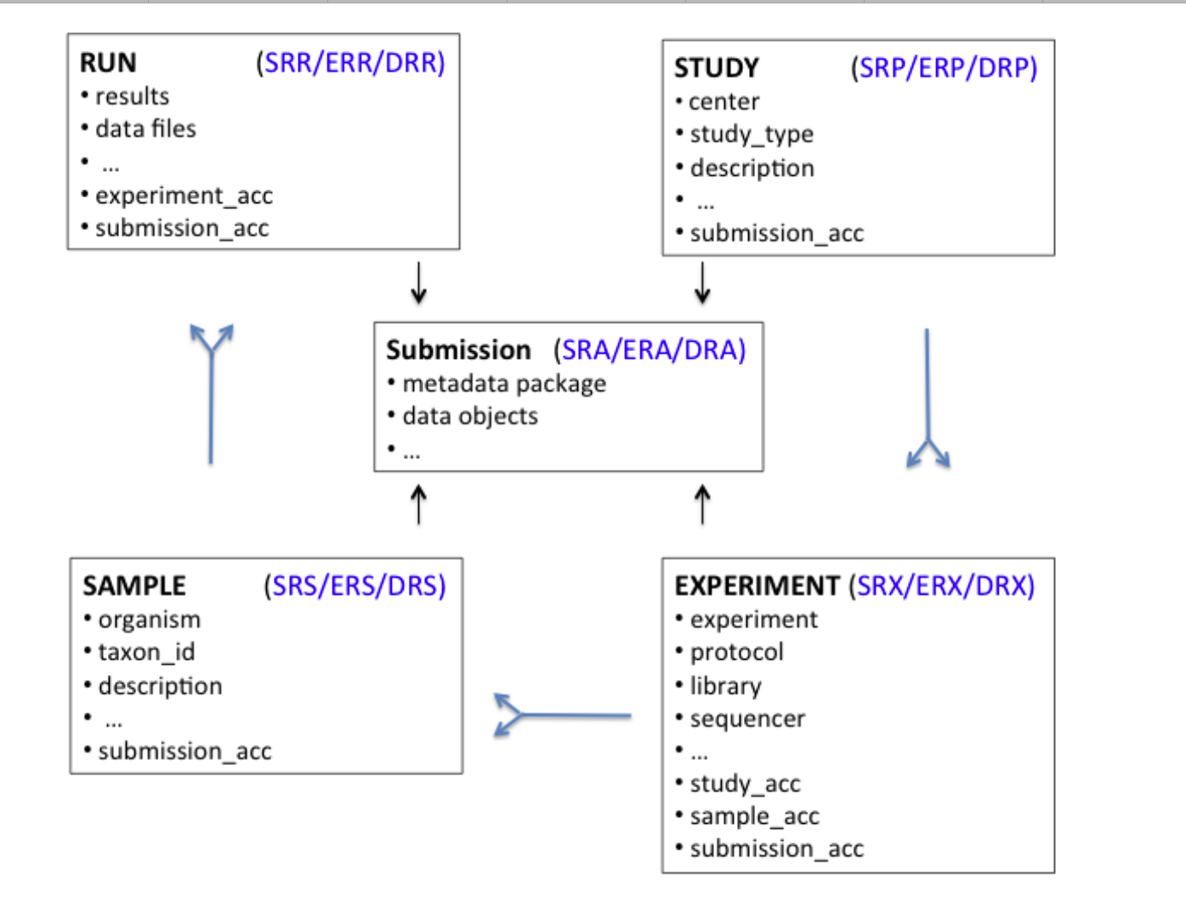
Conversion of SRA entity types
A graphical representation (sometimes called an Entity-Relationship Diagram) of the relationships between the main tables in the SRAdb package.
Function sraConvert does the conversion with a very fast mapping between entity types.

