Slide 1
Lesson Two
Audiovisual Texts:

Slide 2
Ivory Soap (1882 ) cf. 2000
The ‘IVORY’ is a laundry soap, with all the fine qualities of a choice toilet soap, and is 99 44/100 per cent pure.
Ladies will find this soap especially adapted for washing laces, infants’ clothing, silk hose, cleaning gloves and all articles of fine texture and delicate colour, and for the varied uses about the house that daily arise, requiring the use of soap that is above the ordinary in quality.
For the Bath, Toilet or Nursery it is preferred to most of the soaps sold for toilet use, being purer and much more pleasant and effective and possessing all the desirable properties of the finest unadulterated White Castile Soap. The Ivory Soap will ‘float’.

Slide 3
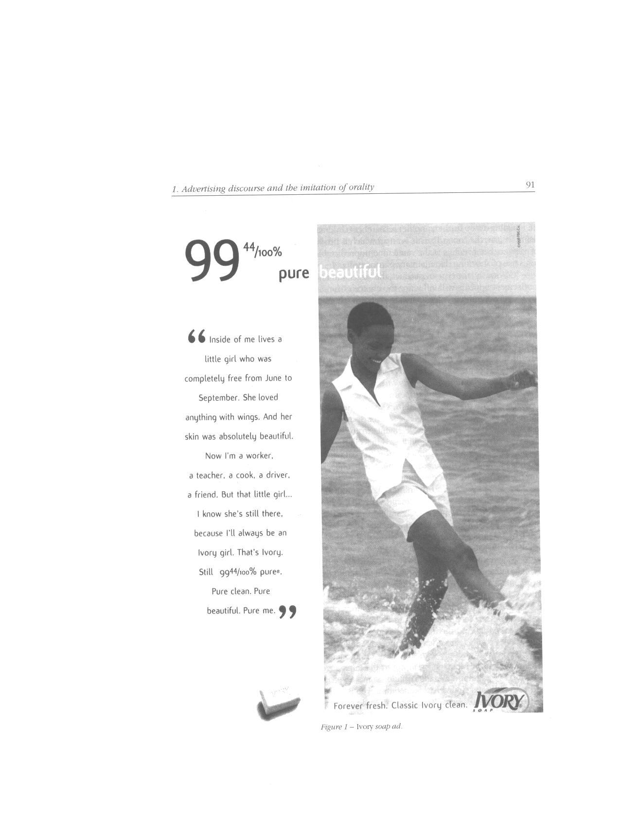

Slide 6
What is a multimodal text?
Several semiotic modalities
  dialogue
  pictures/design
  background noise
  gesture
  music
  colour & light

Slide 7
“Multimodal texts are texts which combine and integrate the meaning-making resources of more than one semiotic modality – for example, language, gesture, movement, visual images, sound, and so on – in order to produce a text specific meaning.”
Thibault 2000)

Slide 8
Multimodality versus Multimediality
Radio is multimodal because it involves speech, music, other sounds, etc. but it is monomedial since it can only be heard, not seen, smelled, touched or tasted,

Slide 9
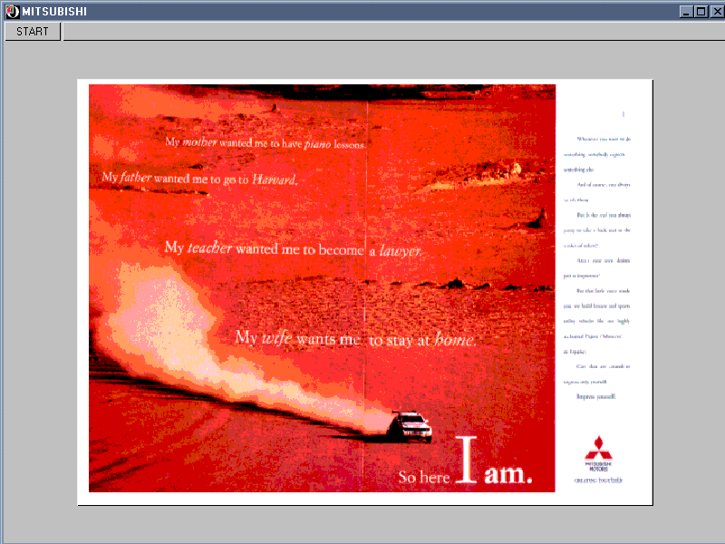
ANALYSIS OF AN AD. (link)

Slide 10
Linguistic Analysis
Theme and Rheme
Information Structure
Cohesion

Slide 11
Analysis of an ad.
Analysis of an advertisement
There are a number of approaches to analysing any text;
(a) The ‘Mitsubishi’ text is analysed both in terms of its written text and its non-verbal features:

Slide 12
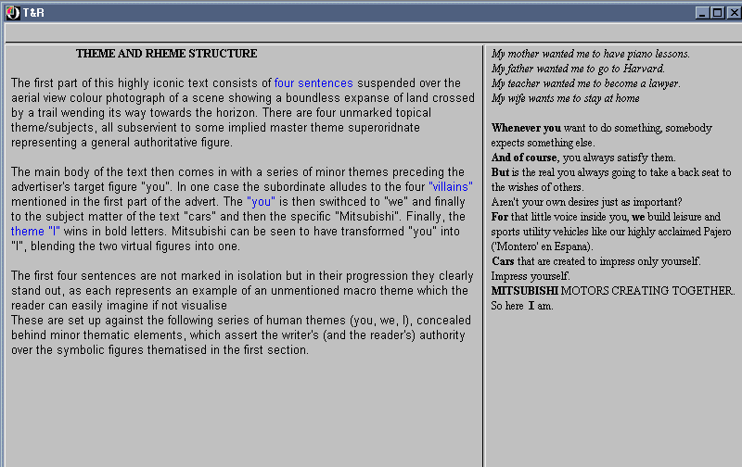

Slide 13
Analysis of a ad.
The grammar of visual design:
• in this case the superimposed verbal text blends in with the background;
• the four lines add to the sense of perspective, the punchline being foregrounded – semantic hierarchy;
• the (interested) reader gets the impression of being in the vehicle;
• the promise – “get away from it all” with the letters of ‘So here I am’ of an exaggerated size;
• a semiotic construct - the background is surreal (and therefore tempting) while the product is real (and therefore attainable);
• two unequal halves – the picture and product are salient;
sharp division of two parts of text – promise/information (two different kinds of meaning)

Slide 14
Analysis of an ad.
So this ‘ad’ is a semiotic unit, structured, not linguistically, but by principles of visual composition... verbal text becomes just one of the elements integrated by the codes of information value, salience and framing... reading is not necessarily linear, wholly or in part, but may go from centre to margin, or in circular fashion, or vertically,... (p 185)

Slide 15
Insert video Citroen

Slide 17
Multimodal transcription
analyse the various semiotic modalities
presentation in table form
assess how each modality works to give meaning and how they work together
(see next lesson for detailed explanation)

Slide 18
Practical applications
analysis of advertisements to check most effective modalities
use in deciding translation strategies for subtitling film, if (some of) the meaning is provided by the other semiotic modalities.

Slide 19
Application of multimodal transcription to film translation
BY
- simplifying the descriptions
- doubling up some columns
- eliminating other columns
- adding a translation column
the MT proved useful in deciding translation strategies for subtitling film…. and not missing anything!

Slide 20
Notting Hill

Slide 21
Notting Hill

Slide 22
Notting Hill
Some statistics

Slide 23
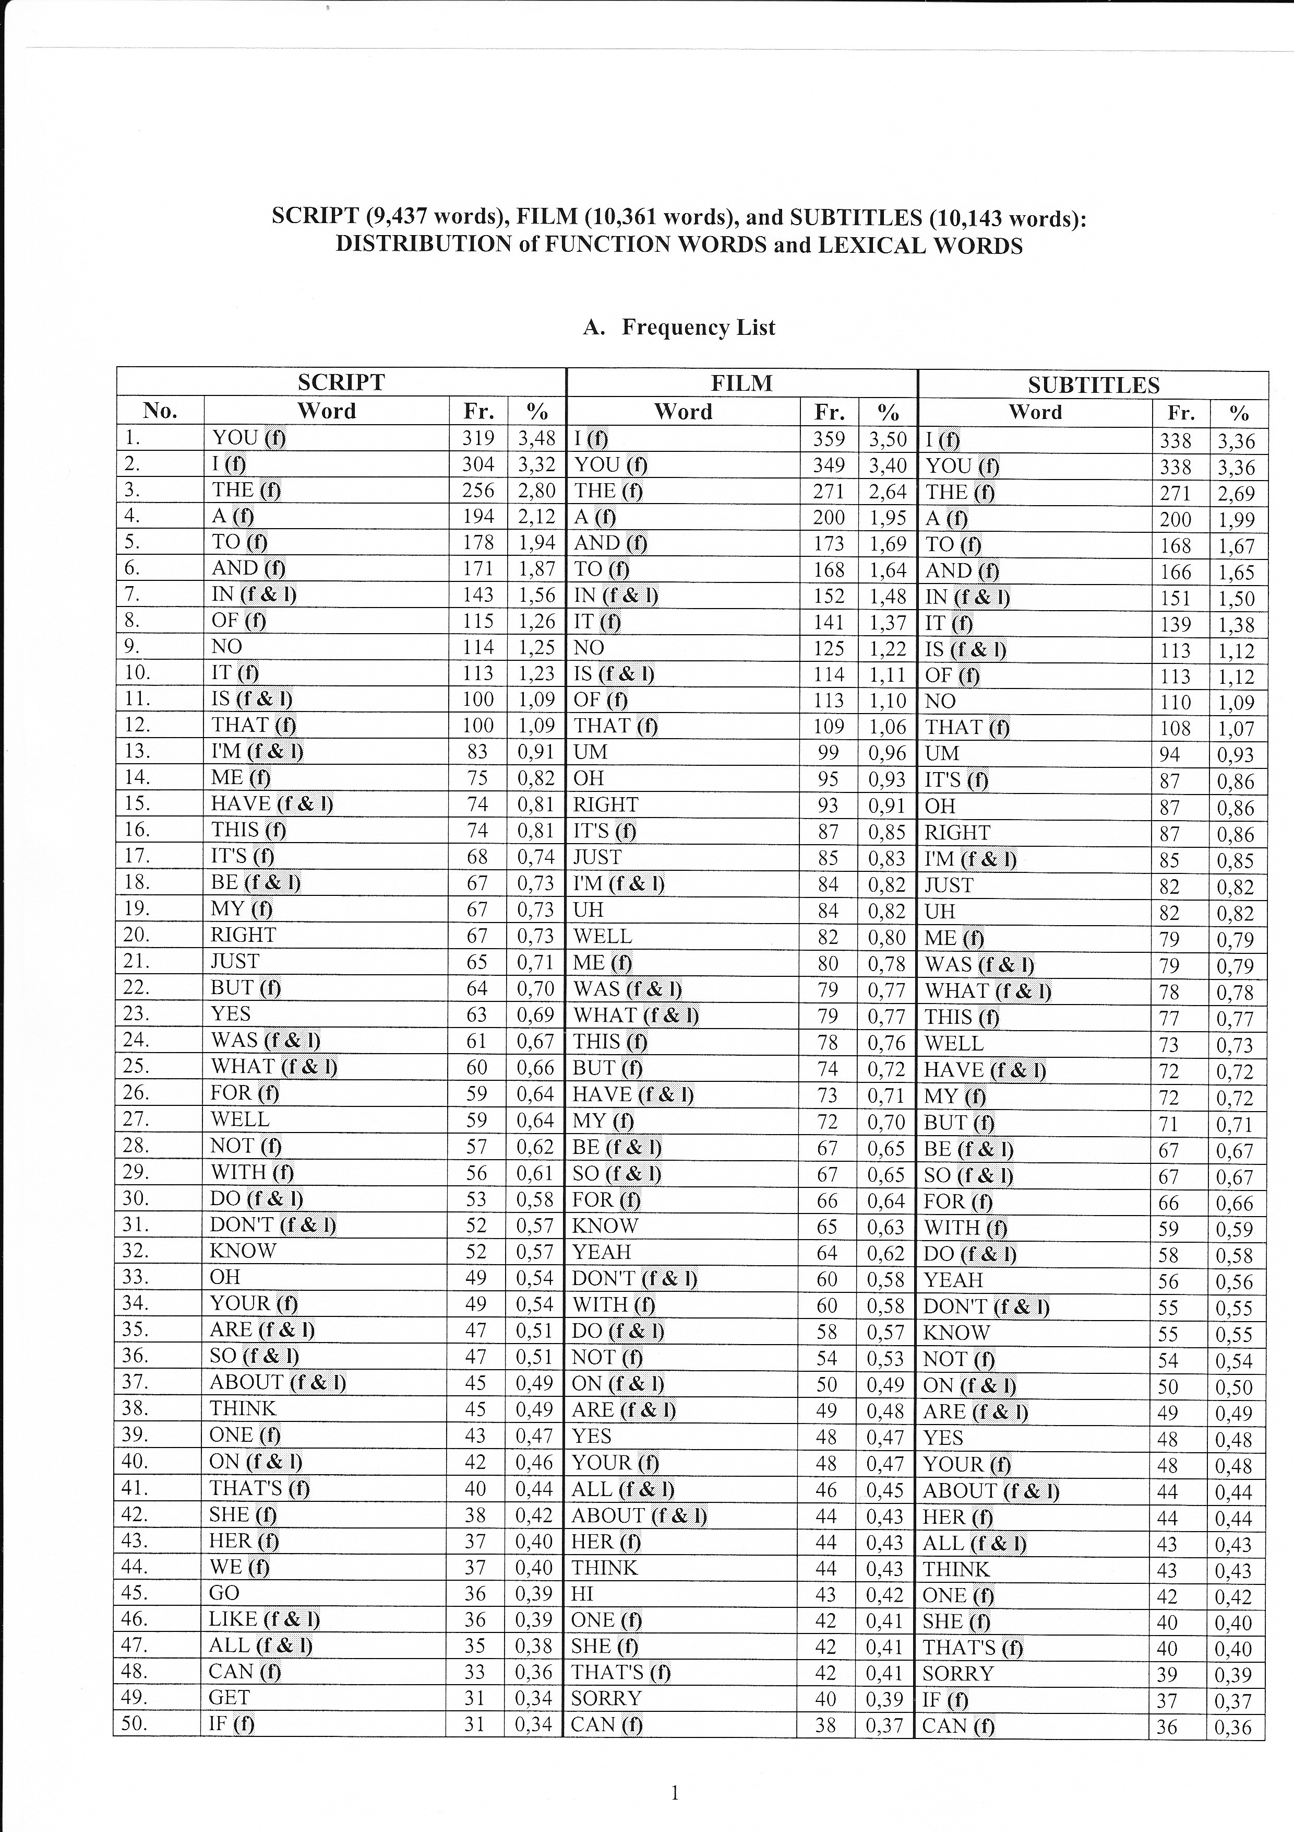

Slide 24
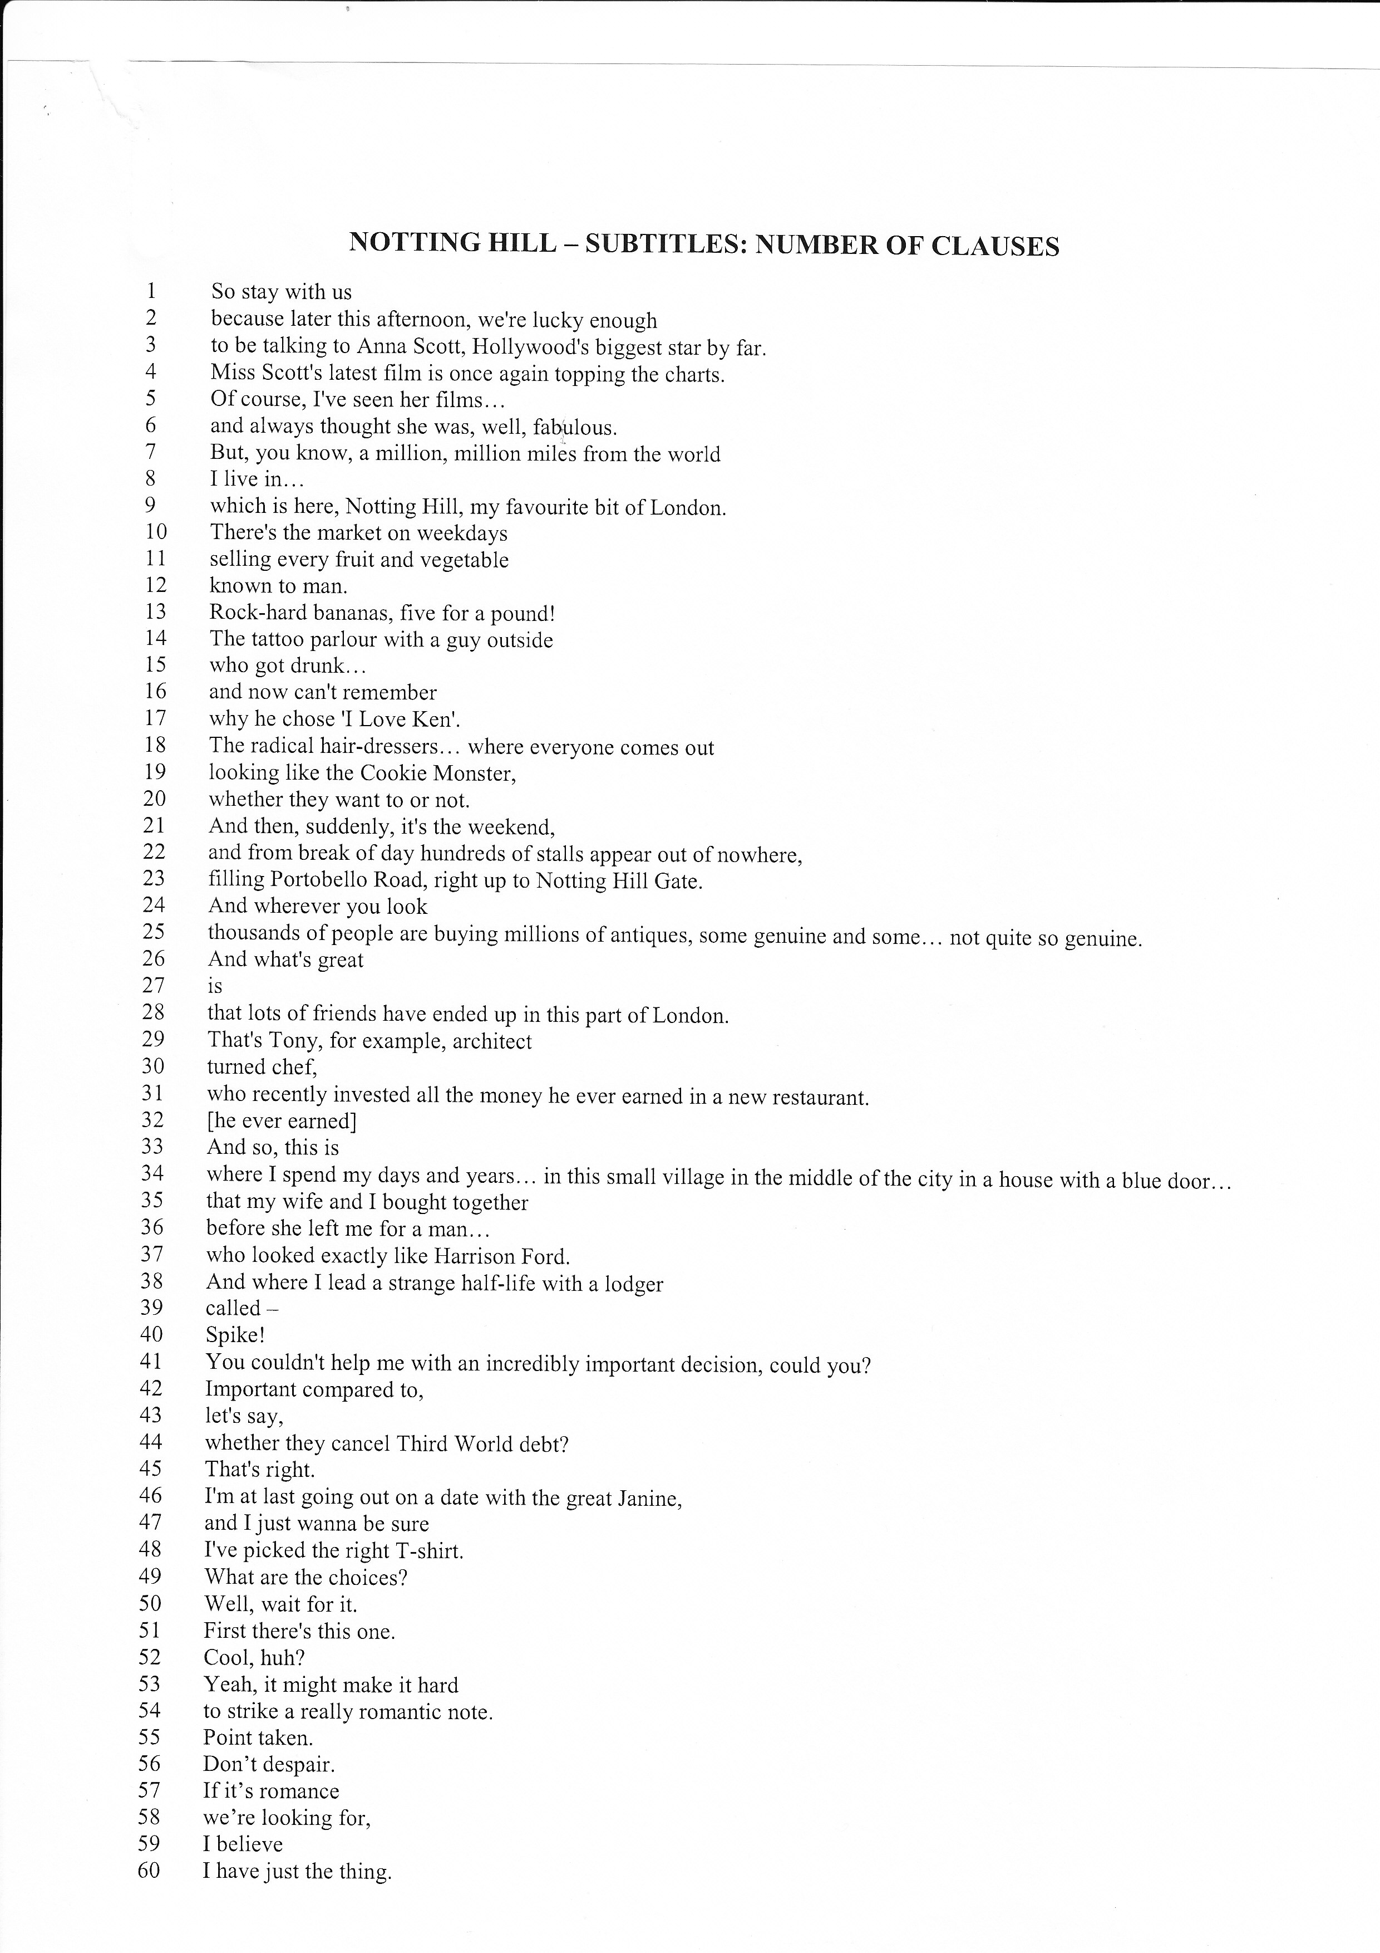

Slide 25
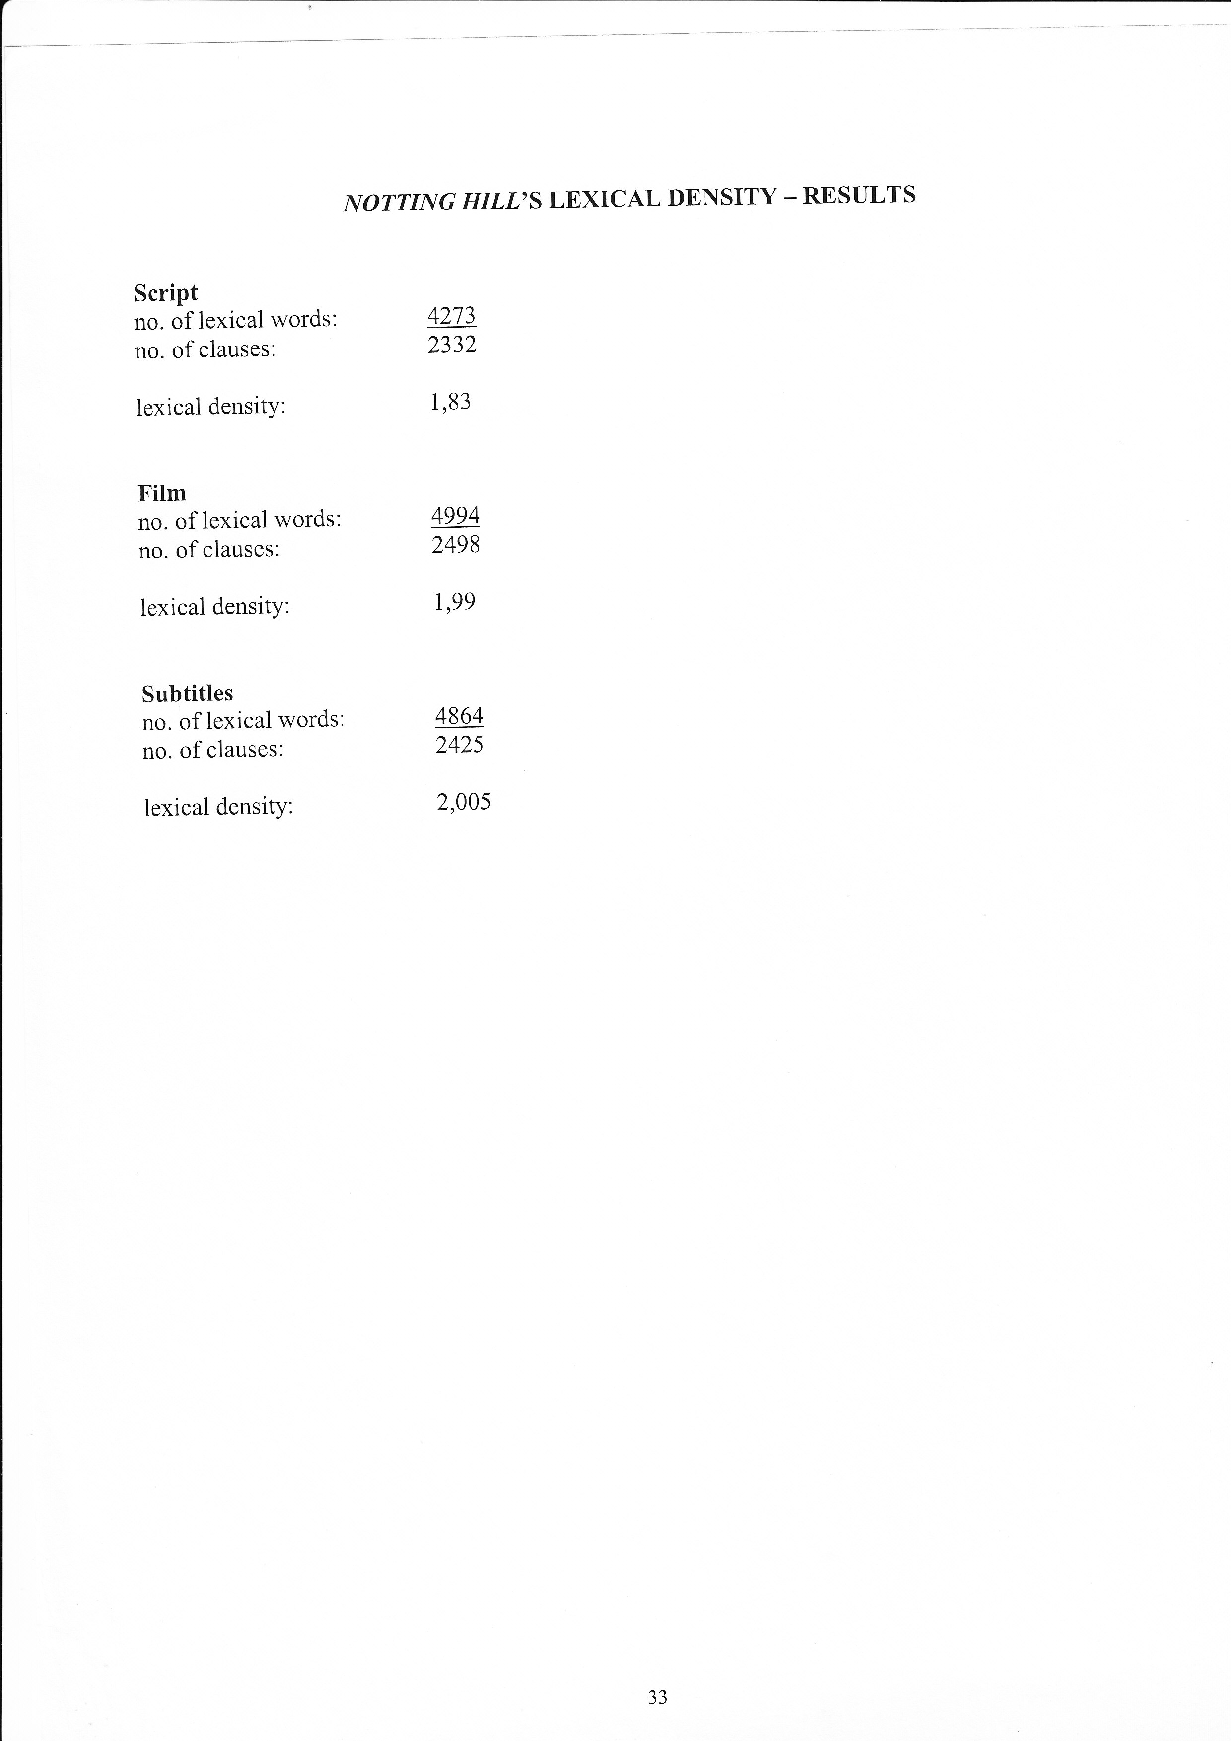

Slide 26
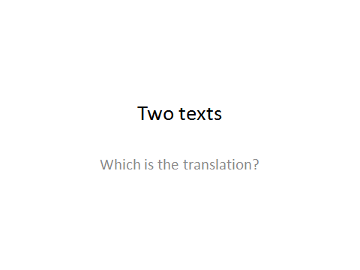

Slide 27
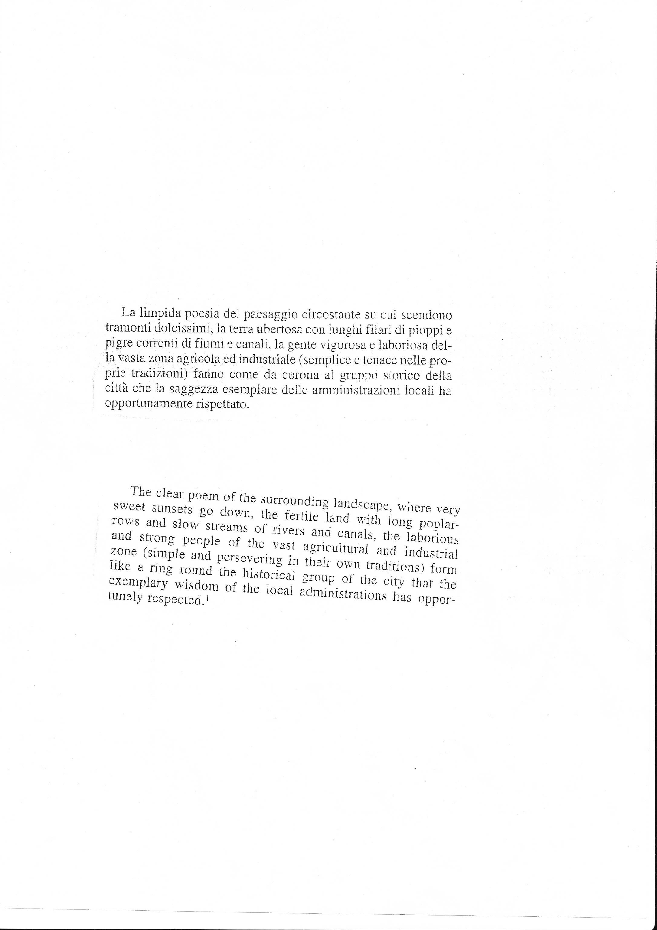

Slide 28
Last exam

