Slide 1
Mechanical interaction

Slide 2
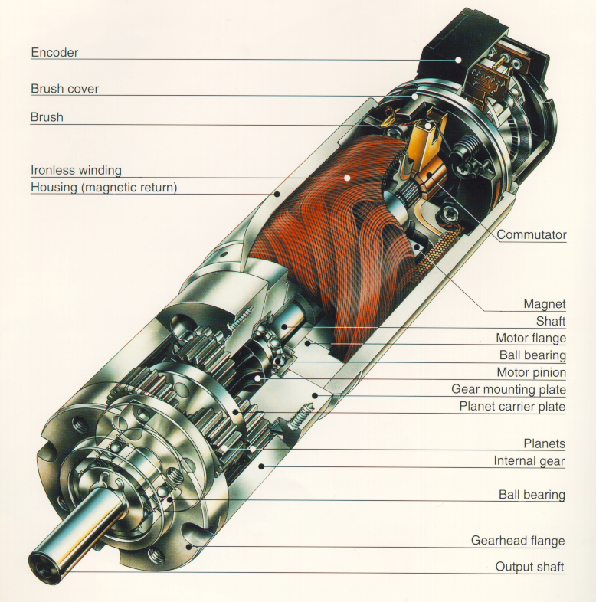
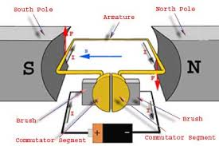
DC-Motors
simple, cheap
easy to control
1W - 1kW
can be overloaded
brushes wear

Slide 3
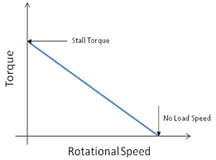
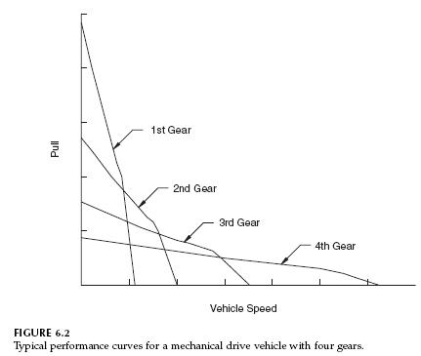


Effect of gearbox
Load curve
$$\frac{ω2}{ω1}=τ=gear ratio<1$$
$$\frac{Torque2}{Torque1}=\frac{1}{τ}=1/gear ratio>1$$

Slide 4
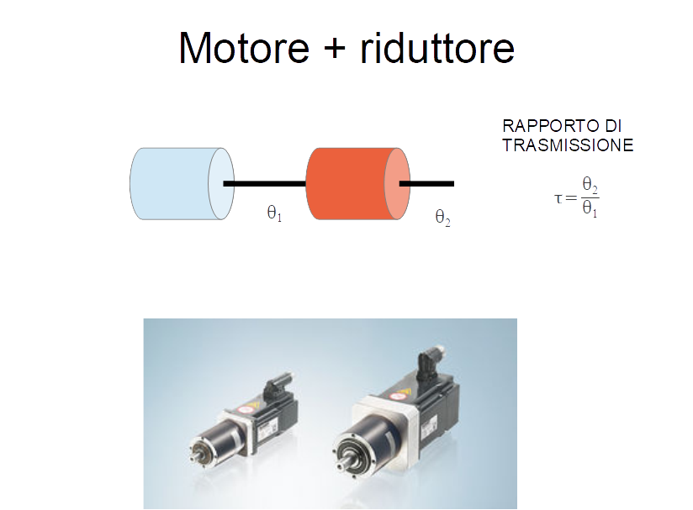

Slide 5
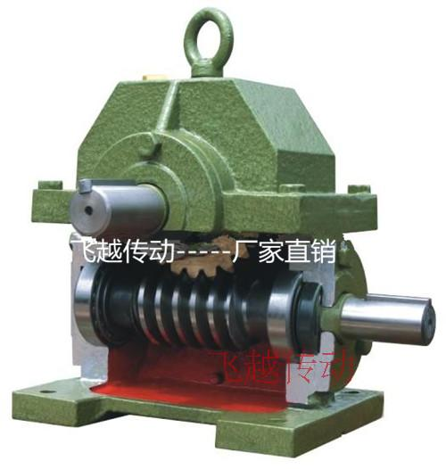




$$\frac{ω2}{ω1}=τ=gear ratio$$
$$\frac{Torque1}{Torque2}=τ=gear ratio$$
$$ω2$$
$$ω1$$

Slide 6
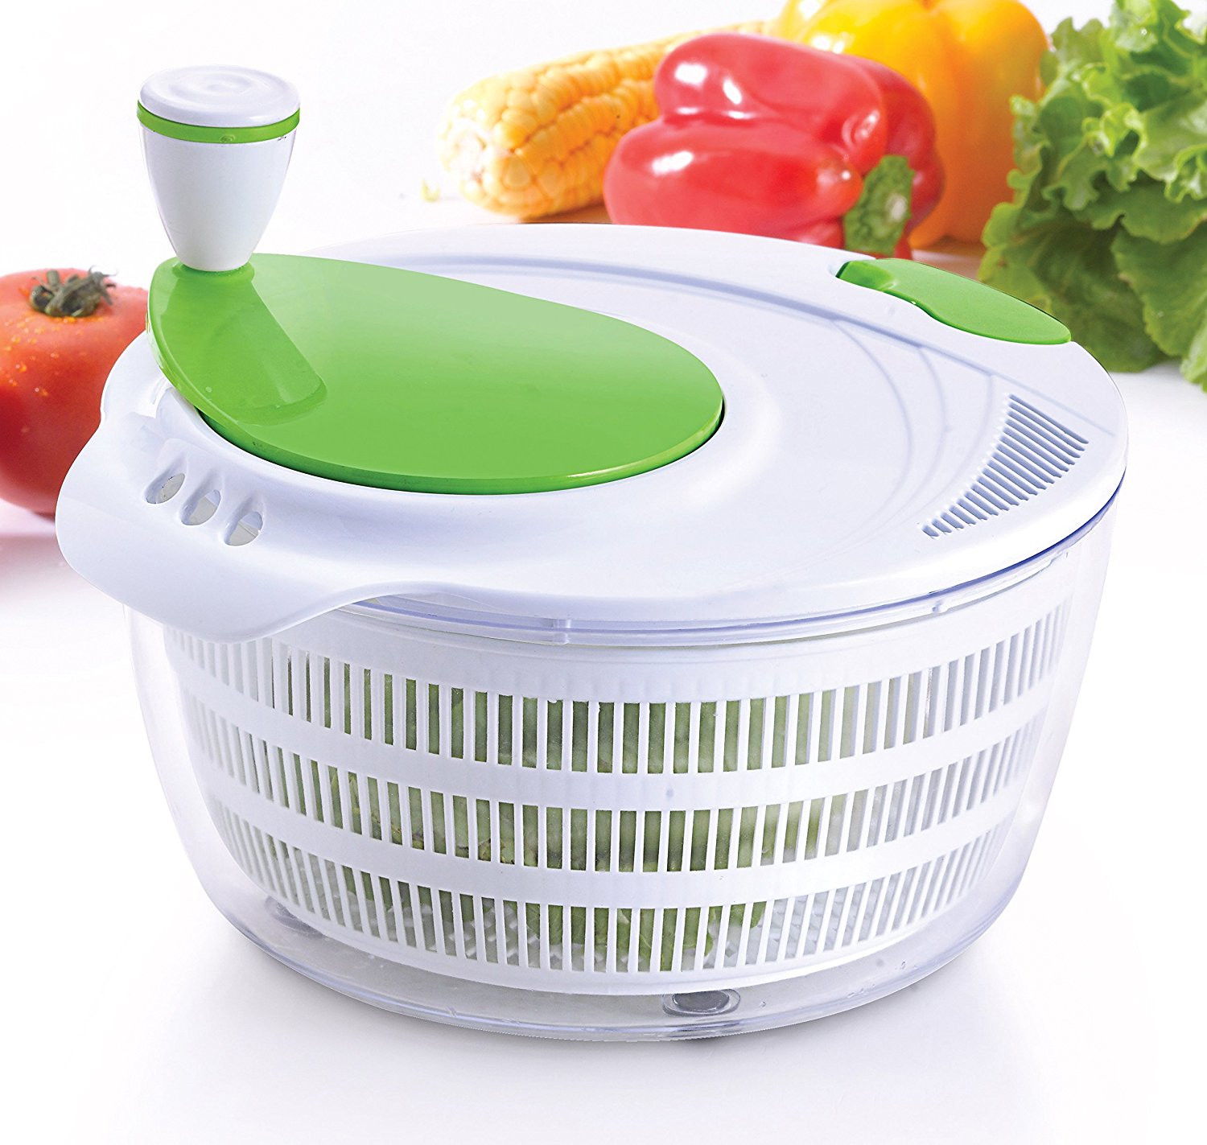
Example of a gear unit operating in reverse mode

Slide 7
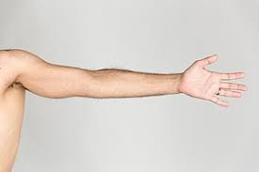
Class exercise: calculate the torque that must have an electric motor to lift a person's arm through a cable wrapped around a drum.

Slide 8
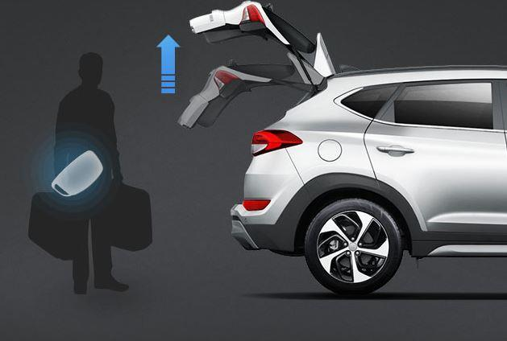
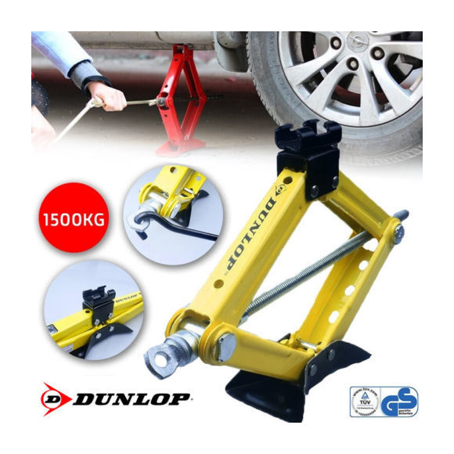

Reversible and not reversible
$$\frac{Torque2}{Friction Torque}=τ≫1$$

Slide 9
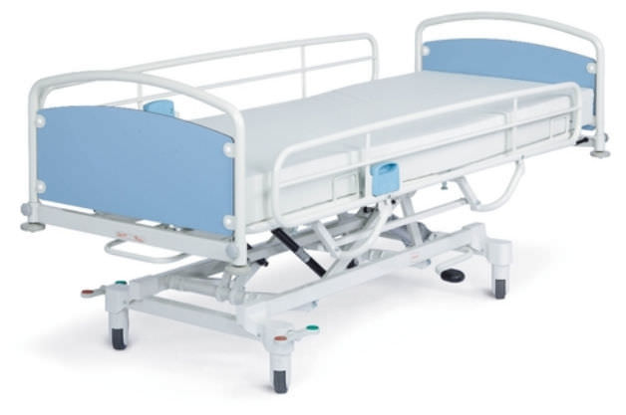
Class exercise: Assuming that the operating crank of a hospital bed has a friction torque of 0.3 Nm, and that the patient + bed weight is 100 kg, what should be the reduction ratio for the bed to be irreversible?

Slide 10
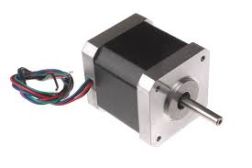
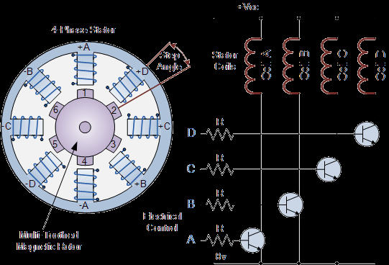
Step motor

Slide 11
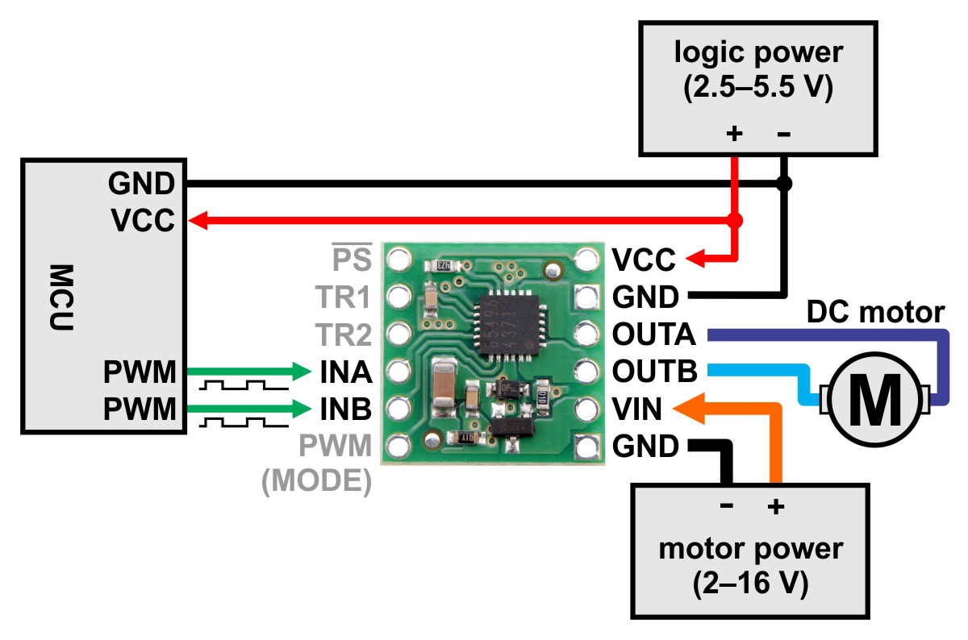
driver

Slide 12
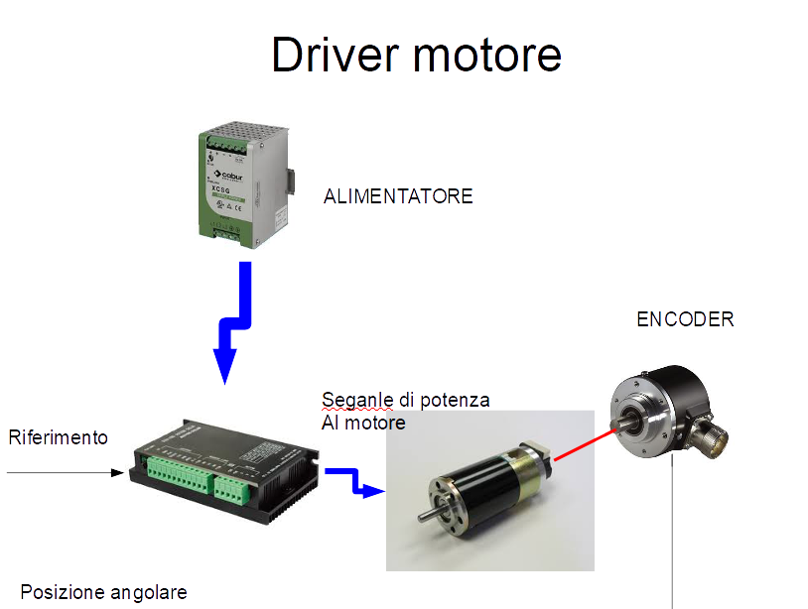

Slide 13
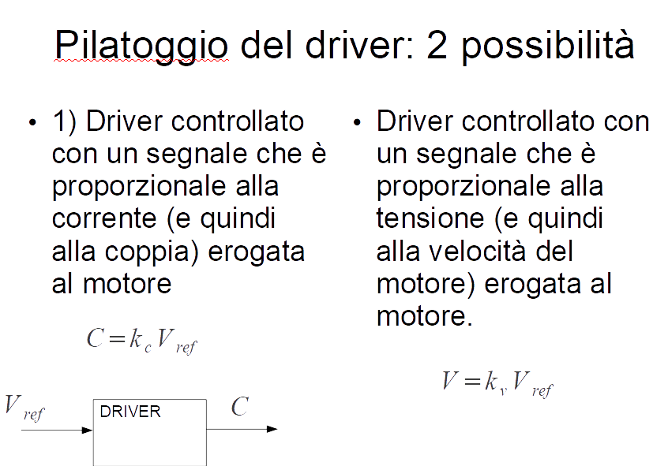

Slide 14
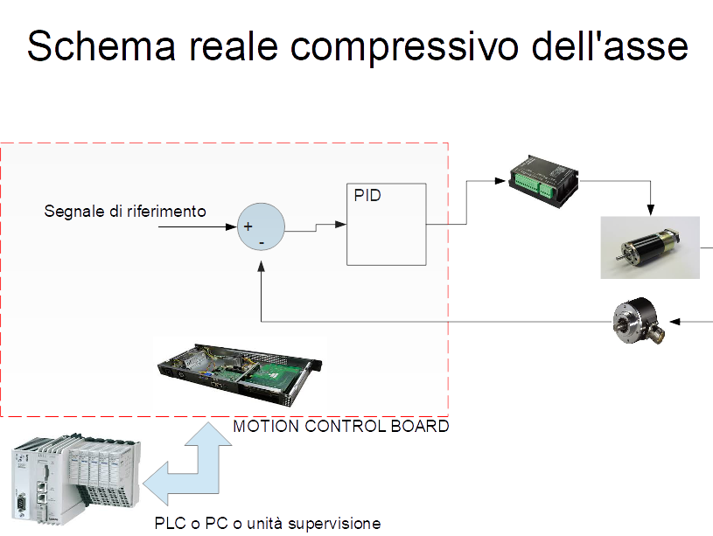

Slide 15
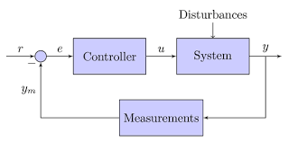

Control and feedback

Slide 16
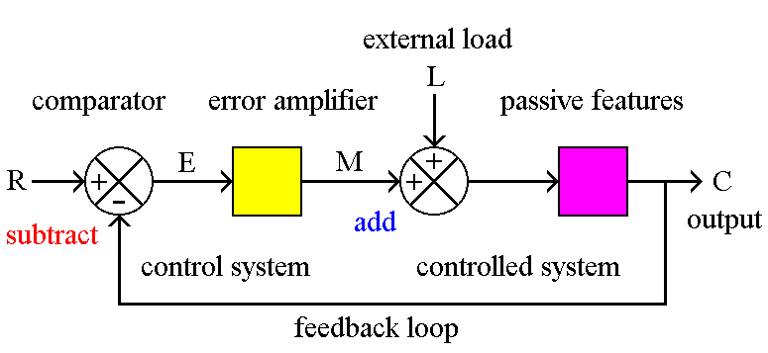
Error and other details

Slide 17
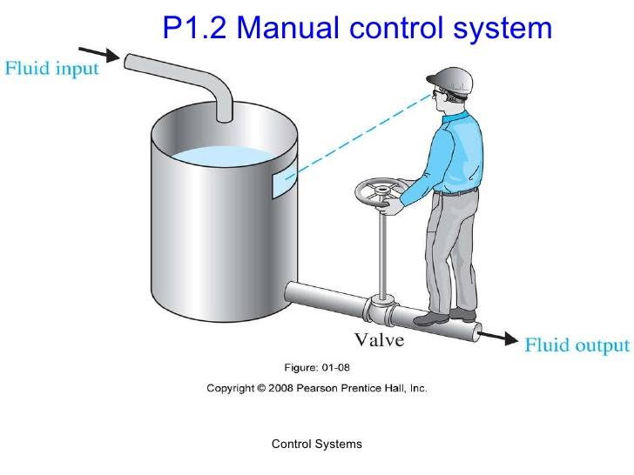
Example of a control system that replace a human operator

Slide 18
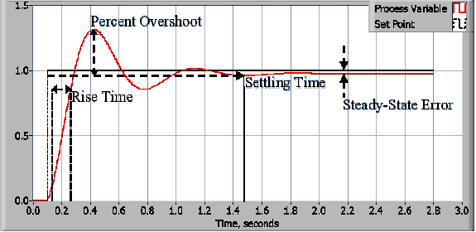

Slide 19
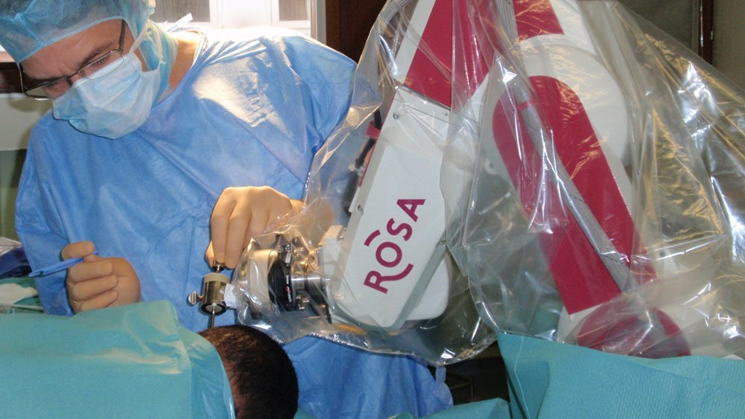
Overshoot problem :example of neurosurgical robot

Slide 20
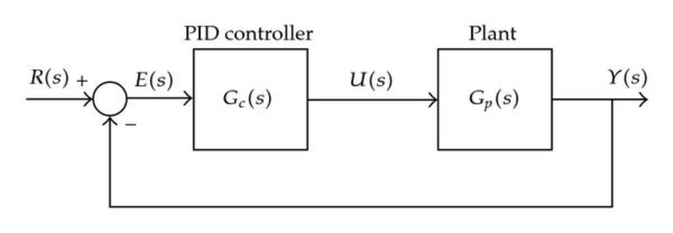
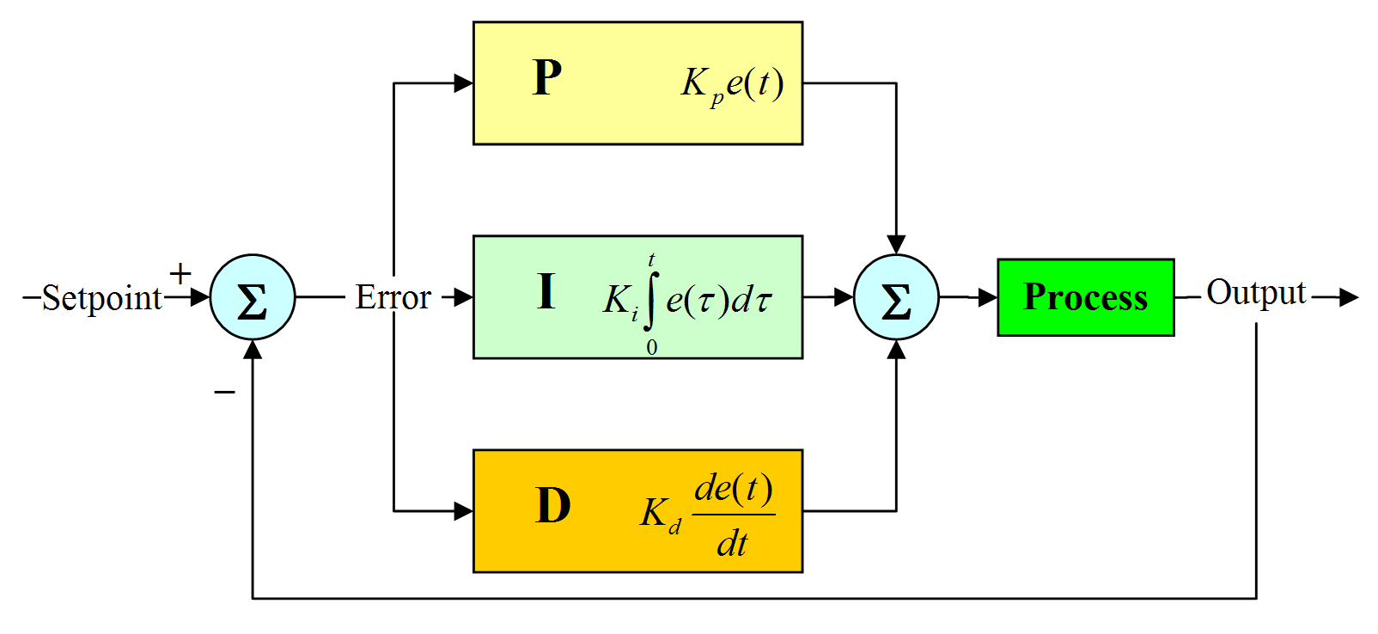
PID

Slide 21
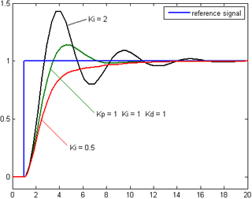

Slide 22
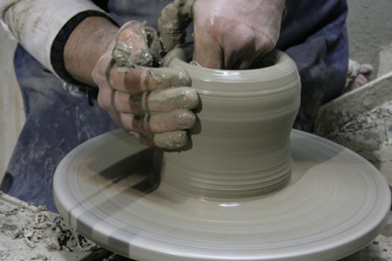
Stability
Example of instability in human-in-the-loop system

Slide 23
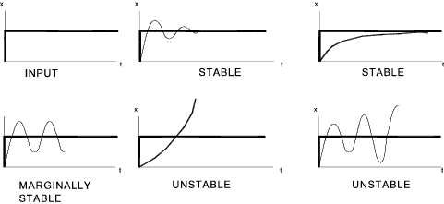
Stability
Trend and video

Slide 24
Show video on stability
Different behaviour of stability
https://www.youtube.com/watch?v=fusr9eTceEo

Slide 25
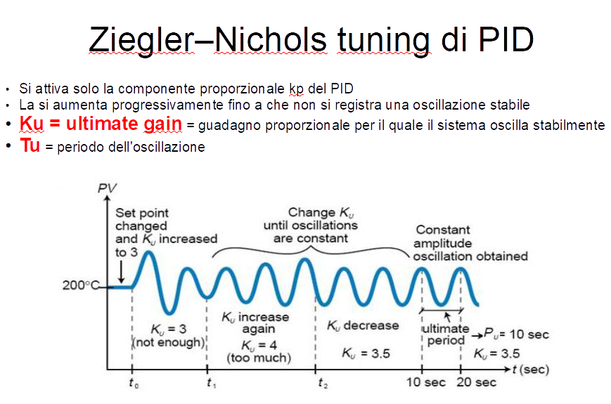

Slide 26
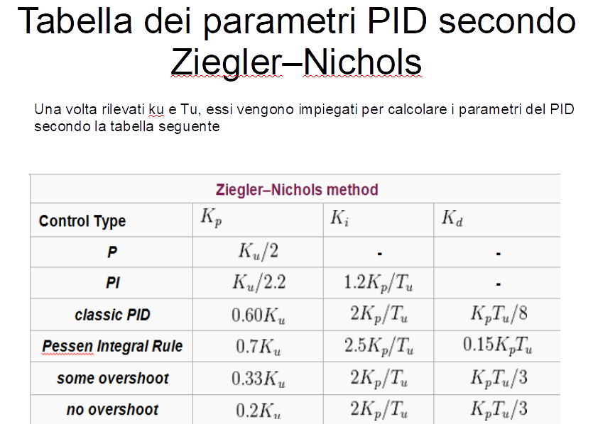

Slide 27
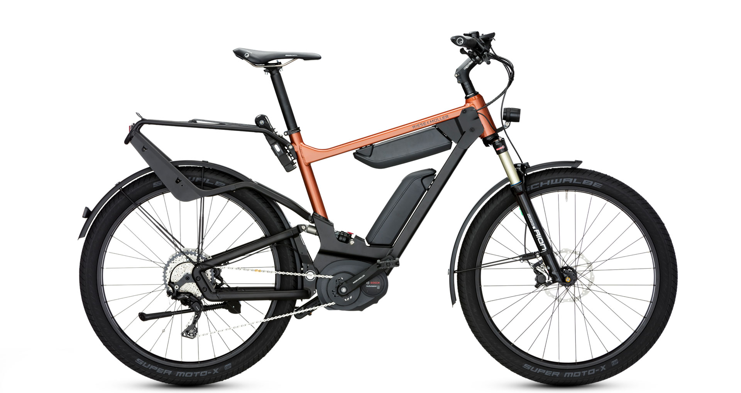
Force sensor (application: electric bike)
How is recorded the activity of the user?

Slide 28
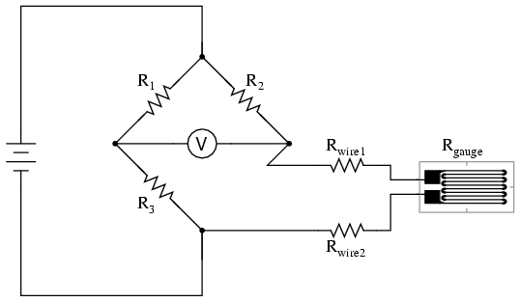
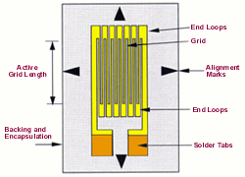
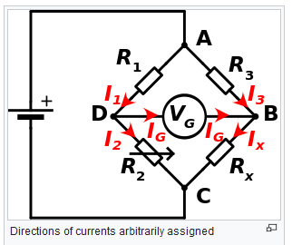
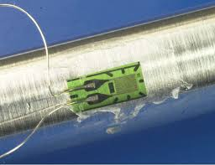
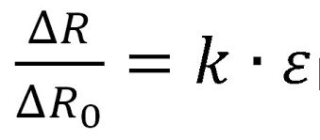
Strain gauge

Slide 29
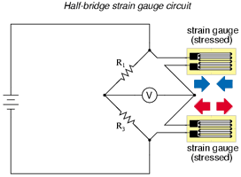
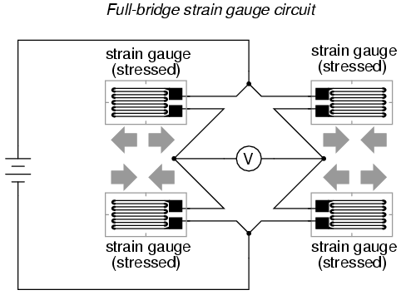
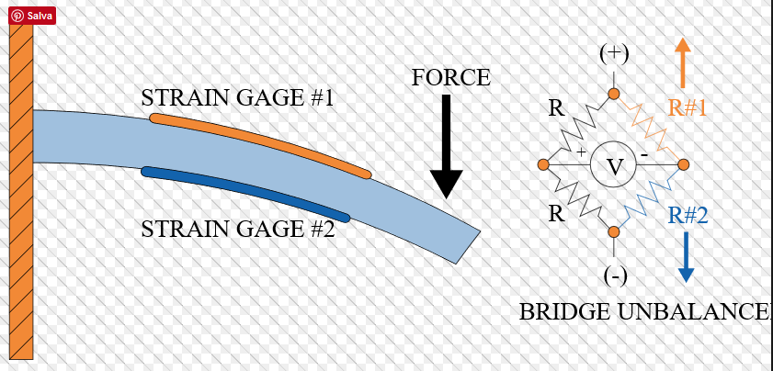
Half Bridge / full bridge

Slide 30
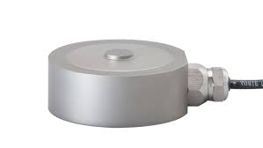
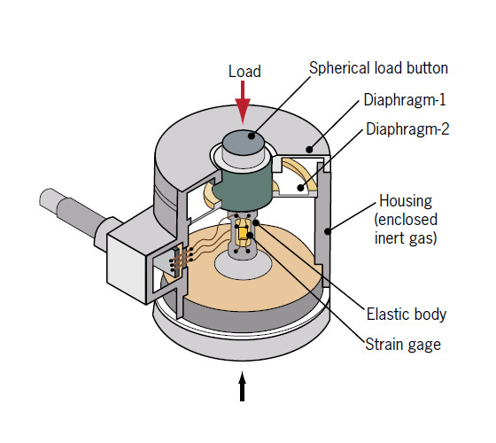
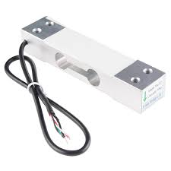
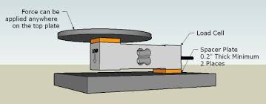
LOAD CELL

Slide 31
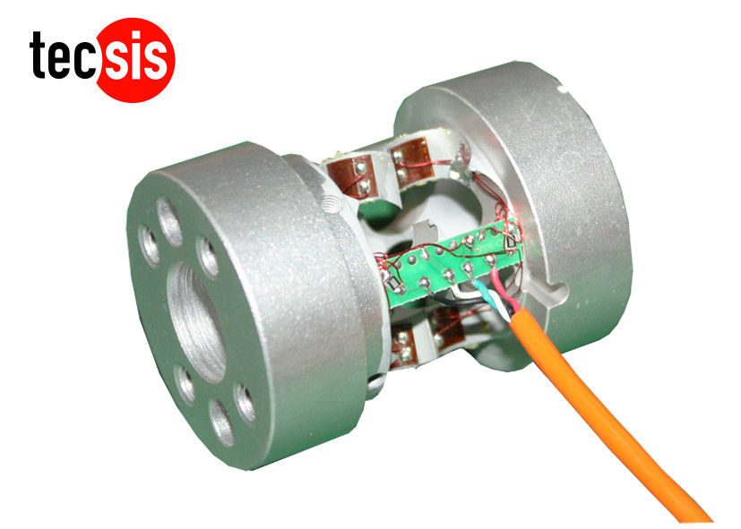
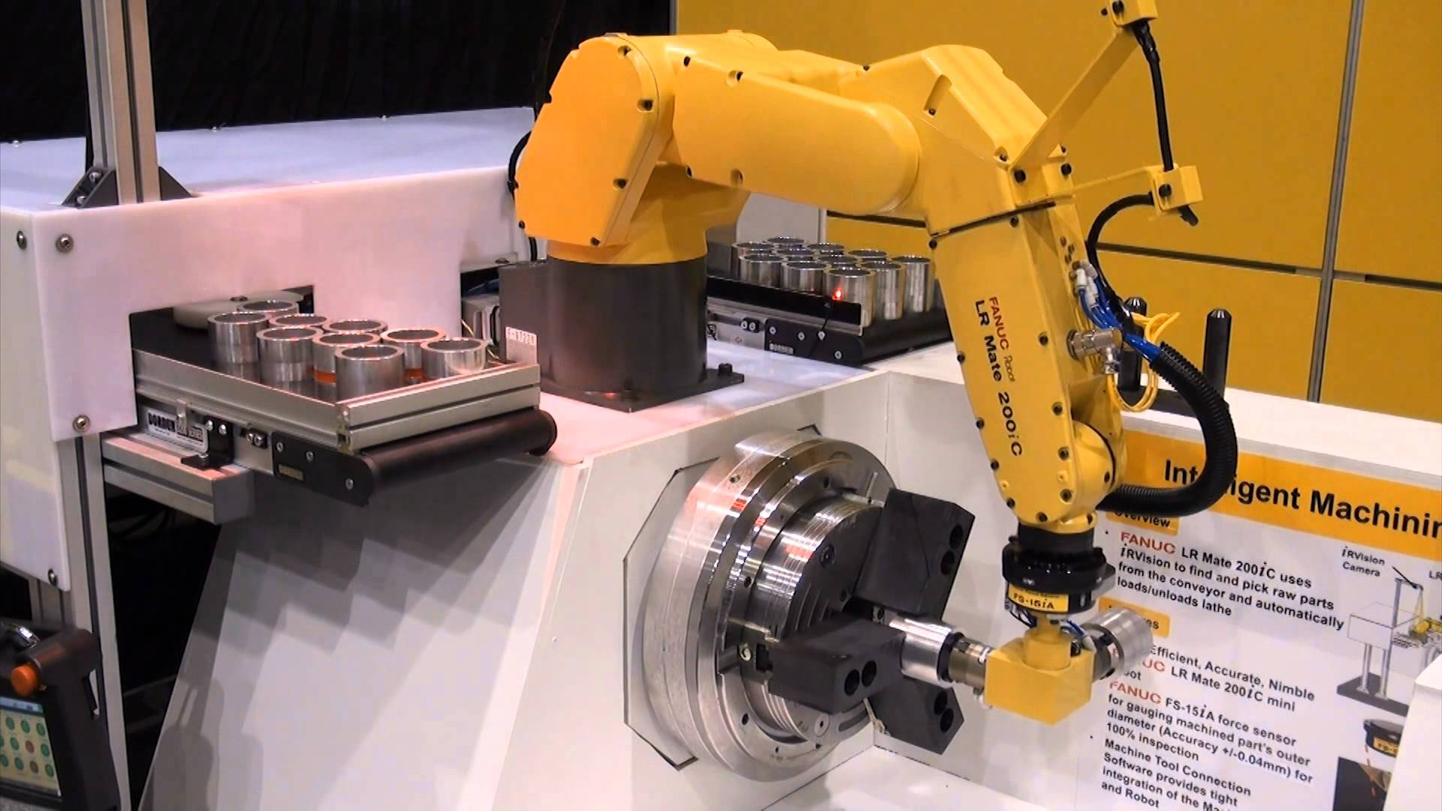
Robotic load cell
Example kuka: https://www.youtube.com/watch?v=Rvqq-OOtUkA

Slide 32
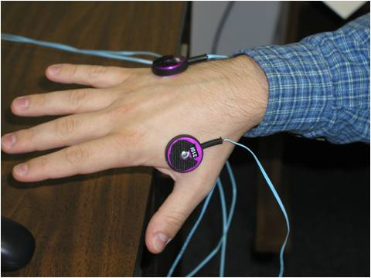
Vibrotactile

Slide 33
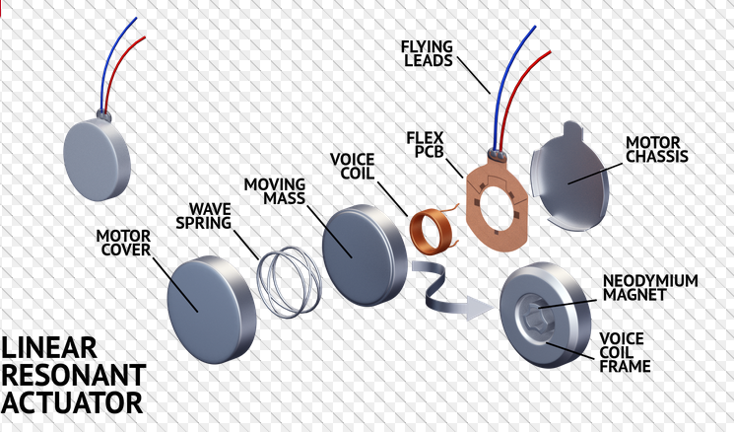
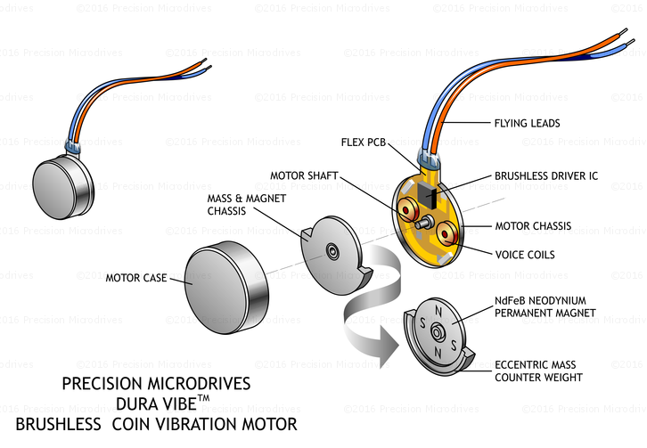
How they work

Slide 34
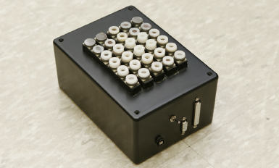
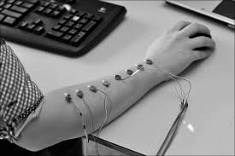
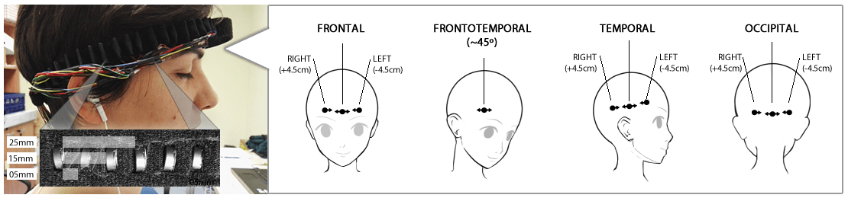
Application and configuration

Slide 35


Joystick training by means of vibration prompts
Study and analysis of reaction times and accuracy during a training session
Development of a pratical training protocol for telemanipulation tasks

