Slide 1
Flipping

Slide 4
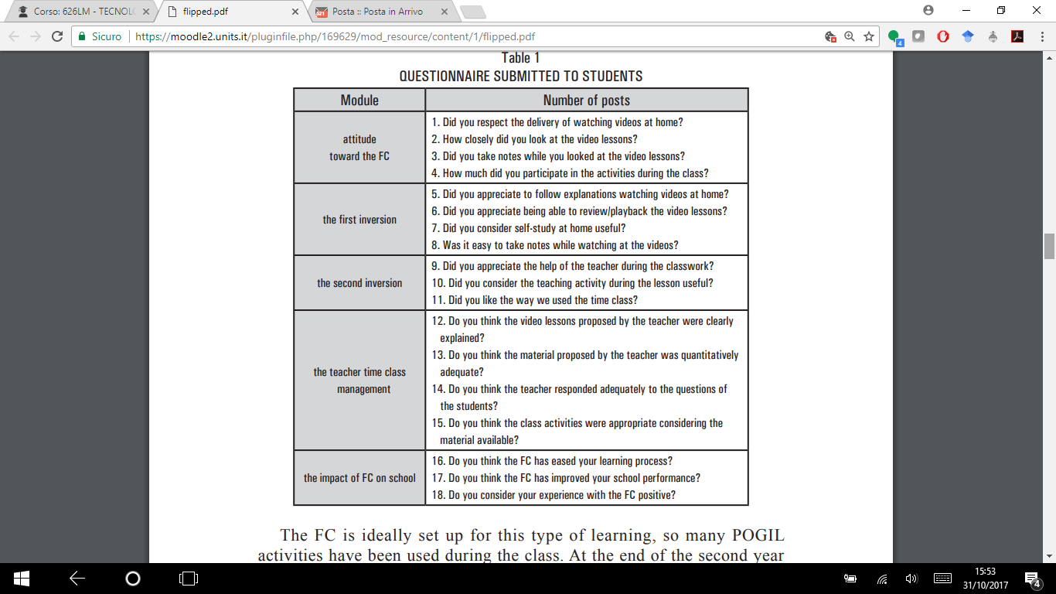

Slide 5
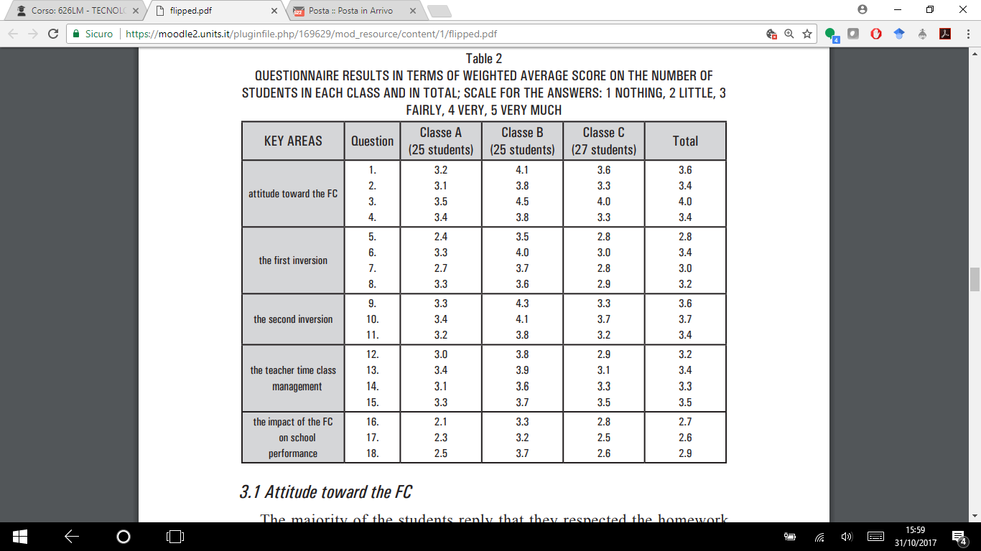

Slide 7
Abstract
An increasing number of teachers are using flipped classroom approach in their teaching. This instructional approach combines video-based learning outside the classroom and interactive group learning activities inside the classroom. The purpose of the present review is to provide an overview of flipped classroom studies in K-12 education. Particularly, we put emphasis on revealing and addressing the potential challenges of flipped classroom approach. Fifteen journal publications of K-12 flipped classrooms were analyzed in terms of their flipped learning activities, student achievement, student attitude, and challenges encountered. The results suggested that a variety of pre-class (e.g., online exercises) and in-class (e.g., brief review, individual practices) activities were provided in addition to instructional videos and small-group activities respectively. The use of flipped classroom approach in K-12 education yielded a neutral or positive impact on student achievement when compared to traditional classroom. Mixed results of student attitude toward flipped classroom approach were discovered. Challenges of implementing flipped classrooms were identified and categorized into student-related challenges, faculty challenges, and operational challenges. Based on the suggestions of previous studies together with relevant empirical supports, we propose a rudimentary flipped classroom model and a set of 10 guidelines to address these challenges. Finally, several recommendations of future research are provided.

Slide 8
FliThe basic notion of flipped classroom approach is to deliver the teacher’s lectures before class through online videos, in order to free-up the in-class time for active learning and problem solving activities.
merely a re-ordering of the teaching and learning activities is insufficient
Bishop and Verleger (2013) :a technology-supported pedagogy that consists of two components: (1) direct computer-based individual instruction outside the classroom through video lectures and (2) interactive group learning activities inside the classroom.
- requirement of using instructional videos in the out-of-class learning component.
asking students to read text-based materials on their own does not involve the elements of lecturing such as teachers’ explanation and elaboration of concepts.

Slide 9
Molto studiato
Può migliorare la performance (ma anche causare un disengagement, scarsa soddisfazione)
Chiede molto lavoro al docente

Slide 10
De Bono Six thinking hats model
Cappello bianco, rosso, blu..
Per identificare tipi e funzioni

Slide 11
review
Cercano ricerche almeno quasi sperimentali, dal 1994 al 2016
K-12
Trovano 15 articoli
La maggior parte high school, stem

Slide 12
Effetti
Opinioni degli studenti:
- guardare i video prima della clase è più facile che leggere, si può anche rivedere
Maggiori interazioni con i compagni e l’insegnante (che assiste megio)
Fare esperienza in classe è meglio che ascoltare le lezioni
Ci sono delle sfide /challenge, per insegnanti, studenti, istituzioni..

