Slide 1
Lesson Three
Chris Taylor
University of Trieste

Slide 2
Audio Description (AD)
the insertion of short verbal descriptions illustrating the essential visual elements of an audiovisual product (including films, television programmes, etc.) principally for the blind and visually impaired community.

Slide 3
Snyder
“the visual made verbal”
In this provision of a verbal version of a visual text for the blind and sight-impaired, the principal focus of the audio describer is clearly on the non-verbal features of an audiovisual text.

Slide 4
Multimodality
Faced with numerous temporal and spatial constraints, the describer generally has to identify the most salient items for the description. This task would clearly seem to require a certain knowledge of and a sensitivity towards what is now known as multimodal studies.

Slide 5
New genre
For a number of reasons, audio description represents a new language type eg.
- exclusive use of present tenses
- exclusive use of third person pronouns
- exclusive use of declarative sentences
- more than usual use of non-finite clauses in theme position (point of departure)
“Seated behind the pilot, …”
“Forcing open a door, …”
“Wearing a simple skirt, …”
- etc.

Slide 6
and the film genre
and film is a complex semiotic mode making meaning in various ways … which need to be captured also in audio description in spite of its rather restricted genre structure.

Slide 7
ADLAB
A European Lifelong Learning project (ADLAB: Audio Description - lifelong access for the blind - 2011-2014) coordinated by the University of Trieste, studied AD in depth and produced a set of strategic guidelines for the profession.

Slide 8
ADLAB premiss
Audio description involves the study of all the semiotic resources in a text and how they interact, providing a vehicle that, in addition to providing an essential tool in promoting the social inclusion of the blind community, makes a contribution to harnessing our understanding of how multimodality impacts on the analysis of texts such as film and television products.

Slide 9
the film genre
All films are to some extent dependent on an (undefined) number of structures/conventions/frames, even to the point of cliché.
There is often a more or less explicit intertextuality present, both verbal and visual.
These aspects also need to be handled (or not) by the audio describer, as they may be important to the understanding of the text. There is a fine line between judicious intervention and unwanted interpretation. This is a controversial issue among different AD schools.

Slide 10
So what to describe?
Where to focus among the semiotic modalities of a multimodal text?
Which are the salient images/sounds/symbols?
What lies behind the immediate visuals?
A good stab…

Slide 11
Little Dorrit by Charles Dickens
SERIAL - 1855-57
NOVEL - 1857
BBC SERIES – 2008
DVD with audio description - 2009

Slide 12
Adaptation (Andrew Davies, BBC)
Whilst adapting the story, one image was dominant in my mind: Little Dorrit going out in the early morning, emerging from the gates of the Marshalsea … hurrying through the mean streets, with the dark, gloomy buildings looming over her.

Slide 13
from the novel
An oblong pile of barrack building, partitioned into squallid houses standing back to back … hemmed in by the high walls duly spiked at top.
She had begun to work beyond the walls … to come and go as secretly as she could between the free city and the iron gates. Her original timidity had grown… and her light step and her little figure shunned the thronged streets while they passed along them.
This was the life of Little Dorrit, turning at the end of London Bridge …

Slide 14
Video Little Dorrit

Slide 15
Little Dorrit
1808 Marshalsea Debtors Prison (+ subtitle)
The doctor shows the baby to a boy and girl
Old discs spinning on lengths of thread in the darkness – (list of names) BBC Little Dorrit by Charles Dickens
21 years later

Slide 16
Little Dorrit (cont.)
A neatly dressed man in his 20s with short brown hair unlocks a small wooden door.
Wearing a smart grey dress and white pinafore, a straw bonnet and light blue cape, Amy climbs through the door carrying a wicker basket and walks into the busy streets outside.
She passes a horse-drawn carriage and two men in top hats on their way across a bridge.
A tiny figure dwarfed by its enormity.

Slide 17
A functional unit of discourse (Bateman, 2013)
«A neatly dressed man in his 20s with short brown hair unlocks a small wooden door».
The image has gone from the verbal (this was scripted) to the visual, back to the verbal as a sentence.
Specific kinds of relations must be present to create ‘intersemiotic texture’. This gives us the basic visual message without unnecessary detail.
Is this always enough? What about the fact that it is clear from the body language that he fancies Amy.

Slide 18
The Shining video

Slide 19
The Shining
A classic threatening confrontation scene, easily imaginable, «visualisable» by a blind audience.
The visuals are accompanied by gestures, facial expressions, sounds/music which sometimes also need explaining. In this case they augment the sense of irrational madness.
This again is part of that broader controversial issue.

Slide 20
So how do we know what to describe? How do we handle a multimodal text?
1. Multimodal transcription
The multimodal transcription, as devised by Thibault and adapted by Taylor, can assist in identifying relevant elements to describe.

Slide 22
Notation
RG = rhythm group
(p) = soft
SI = simultaneous
R = respond
NA = nuclear accent
Vol n = normal
Tempo M = medium

Slide 23
2. Eye-tracking
The practice of eye-tracking has been seen to identify the seemingly most salient visible elements in a video.
Fixations and saccades respectively track the eyes’ route up and down and around the image…
… and the saccades indicate what appears to arouse most interest.

Slide 24
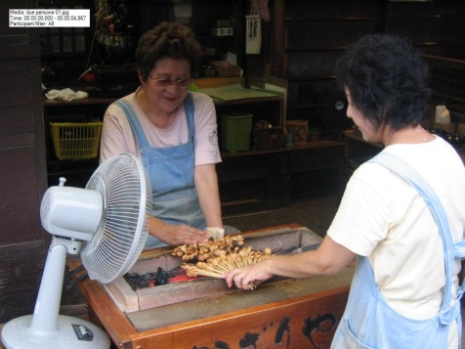

Slide 25
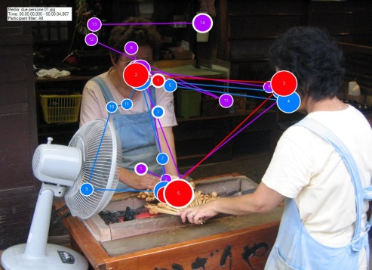

Slide 26
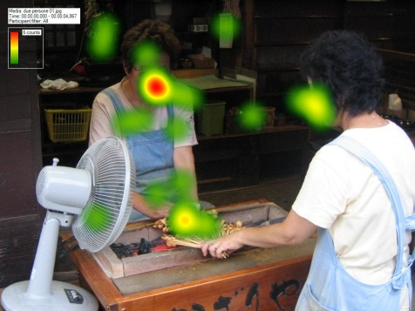

Slide 27
3. The time factor
Student test:
Audio describe an advertisement for Martini

Slide 28
Martini video
A student in Trieste audiodescribed a short advertisement for Martini.

Slide 29
Version 1: reading time 60 seconds
Gwyneth Paltrow è seduta su un letto, di spalle, nuda. Si infila una camicia bianca maschile.
(Where are you going?)
Si gira verso l’uomo che giace sul letto, e gli lancia uno sguardo complice e un sorriso ammiccante.
Si affaccia sul corridoio, è in un albergo.
Percorre il corridoio di soppiatto, con addosso solo la camicia bianca.
Si trova al bar dell’albergo. Scende tre scalini.
Scavalca il bancone del bar. Ha ai piedi un paio di sandali neri con il tacco alto.
Appoggia due bicchieri vuoti sopra il bancone.
Prende la bottiglia di Martini da dietro le sue spalle.
I bicchieri sono ora pieni di ghiaccio. Versa il Martini nei bicchieri.
Aggiunge uno spicchio di limone in ciascun bicchiere.
Afferra la bottiglia e si volta per rimetterla al suo posto.
Un uomo e una donna, giovani ed eleganti, si avvicinano al bancone.
Gwyneth Paltrow si gira verso di loro.
I due giovani hanno preso i due bicchieri che erano sul banco, si voltano e fanno per andarsene.
(Good night!)
Gwyneth Paltrow abbassa lo sguardo con un’aria di ironica rassegnazione.
I due giovani si voltano verso di lei e l’uomo si avvicina di nuovo al bancone. Gwyneth ha un’aria interrogativa.
Lui porge una banconota.
Gwyneth Paltrow sorride stupita.
Bottiglia di Martini in primo piano, logo in sovraimpressione. La mano di Gwyneth afferra un bicchiere e lo solleva.
(My Martini, please)
Sorride, guarda avanti a sé e si avvicina il bicchiere alle labbra. Beve.

Slide 30
Version 2: reading time 45 seconds.
Gwyneth Paltrow è seduta su un letto, di spalle, nuda. Si infila una camicia bianca.
(Where are you going?)
Si volta verso l’uomo che giace sul letto, sorride.
Si affaccia sul corridoio dell’albergo, lo percorre di soppiatto.
E’ al bar dell’albergo, l’arredamento è molto ricercato.
Scavalca il bancone del bar. Ha ai piedi una paio di sandali neri con il tacco alto.
Appoggia due bicchieri sul bancone. Si volta e prende una bottiglia di Martini.
Riempie i bicchieri. Aggiunge una fetta di limone in ciascun bicchiere. Si volta per rimettere a posto la bottiglia.
Un uomo e una donna, giovani ed eleganti, si avvicinano al bancone e afferrano i due bicchieri. Si voltano per andarsene.
(Good night!)
Gwyneth ha un’aria di ironica rassegnazione.
L’uomo torna al bancone, e le porge una banconota.
Gwyneth sorride stupita.
Bottiglia in primo piano e logo del Martini. Una mano in secondo piano afferra un bicchiere.
(My Martini, please)
Gwyneth sorride, e beve.

Slide 31
Version 3: reading time 35 seconds
Gwyneth Paltrow è seduta su un letto, di spalle, nuda. Si infila una camicia bianca.
(Where are you going?)
Si volta verso l’uomo che giace sul letto, sorride.
Esce di soppiatto dalla stanza.
E’ al bar dell’albergo.
Scavalca il bancone.
Appoggia due bicchieri sul bancone. Si volta e prende una bottiglia di Martini.
Riempie i bicchieri. Si volta per rimettere a posto la bottiglia.
Un uomo e una donna, giovani ed eleganti, si avvicinano al bancone e afferrano i due bicchieri. Si allontanano.
(Good night!)
Gwyneth ha un’aria di ironica rassegnazione.
L’uomo torna al bancone, e le porge una banconota.
Gwyneth sorride stupita.
Bottiglia e logo del Martini. Una mano afferra un bicchiere.
(My Martini, please)
Gwyneth sorride, e beve.

Slide 32
Version 4: reading time 30 seconds
(DEFINITIVE VERSION)
Gwyneth Paltrow è seduta su un letto di albergo, di spalle, nuda. Si infila una camicia bianca.
(Where are you going?)
Sorride complice all’uomo che giace accanto a lei.
Esce di soppiatto dalla stanza.
E’ al bar.
Scavalca il bancone.
Appoggia due bicchieri sul bancone. Prende una bottiglia di Martini e li riempie.
Si volta per rimettere a posto la bottiglia.
Una coppia giovane ed elegante si avvicina, afferra i due bicchieri e si allontana.
(Good night!)
Gwyneth ha un’aria seccata, ma ironica.
L’uomo torna al bancone, e le porge una banconota.
Gwyneth sorride stupita.
Bottiglia e logo del Martini. Una mano afferra un bicchiere.
(My Martini, please)
Gwyneth sorride, e beve.

Slide 34
An ADLAB case study
Taking all these factors, and many others, into consideration the ADLAB project produced a book and a manual on how to create valid audio descriptions in any European context.
To this end it was decided to use a single film vehicle for the various stages of analysis, testing and describing.

Slide 35
Inglourious Bsterds
The choice fell on ‘Inglourious Basterds’ because of its extreme difficulty for a host of reasons.
The individual members of the project worked on creating a matrix of all the critical points encountered in writing an audio description of this film, and this led to the structuring of a volume conssiting of the following chapters:

Slide 36
WP2 principal features emerging from the matrix
Audio Introductions
Text-on Screen
Sound in audio description
Textual Cohesion
Intertextual Relations
Cultural References
Secondary Elements
Gestures and facial expressions
Film Language and Tools
Character Fixation and Character Description
Spatio-temporal features
Audio subtitles

Slide 37
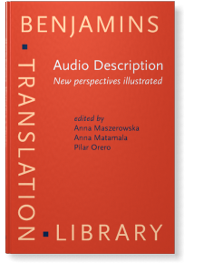

Slide 38
Multimodal and multilingual
Apart from all the other difficulties, in the multilingual production of Tarantino’s film ‘Inglourious Basterds’ French, German and Italian are used as well as English. For the various foreign audiences subtitles are used. Normally subtitles form part of the audio description, read by a second voice talent. These are known as audiosubtitles.
However in the Italian audio description of IB a different approach is used.

Slide 39
Inglourious Basterds video

Slide 40
… and finally, the Manual
The manual, coordinated by the University of Antwerp colleagues, consists of 100 pages of ‘advice’ in the sense that prescriptive rules were ruled out (they already exist) and ‘strategic guidelines’ proposed.

Slide 41
… for example
Alternatives for introducing a character, depending, for instance, on whether the audience can be expected to know a historical character or not, but also on the space available, are:
Virginia Woolf (name the character)
the English writer Virginia Woolf (give a gloss + name the character)
a middle-aged woman with a slightly hooked nose and hair pulled back in a bun (describe the character)
a middle-aged woman with a slightly hooked nose and hair pulled back in a bun, Virginia Wolf (describe and name the character)

Slide 42
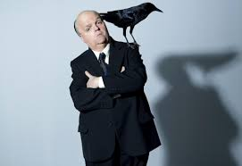

Slide 43
.. and
as regards the question of verbal or visual intertextuality, the allusion to other texts (books, films, sayings, etc.) is exemplified by a scene from the film Hitchcock (Gervasi, 2012). At the end of the film, which has focused on the story behind Hitchcock’s highly successful Psycho, the famous director says "Unfortunately I find myself once again bereft of all inspiration. I do hope something comes along soon." At this point a bird lands on his arm. The important question here for the audio describer is to decide how much help the audience requires in perceiving the connection to his next film The Birds. Prescriptive rules such as ‘Do not refer to intertextual ties’ or ‘Make intertextual ties explicit’ or ‘Omit intertextual references’ are not helpful. Thus the ADLAB guidelines engage in a kind of conversation:

Slide 44
The ADLAB guidelines
Use a simple description if you can assume the audience sees the connection with Hitchcock’s The Birds such as “A bird lands on his arm”.
If you are not certain, but think the audience will realise the connection you can use an enhanced description such As “A bird lands on his arm, as a sign of things to come”.
If you are certain that the audience will not make the connection, and you consider this scene important, then you can make it explicit... “A bird lands on his arm, alluding to his next film The Birds (AD linking marker and marked).
But your knowledge of the particular situation (who is likely to make up most of the audience, the likelihood that blind patrons are familiar with 1960s films, etc.) will affect your judgement here rather than hard and fast rules.

Slide 45
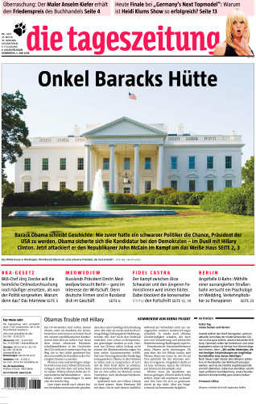

Slide 46
Conclusion
Audio description involves the study of all the semiotic resources in a text and how they interact, providing a vehicle that, in addition to providing an essential tool in promoting the social inclusion of the blind community, makes a contribution to harnessing our understanding of multimodality.

