Slide 1

Economic Geography
4 – Transport and location
121EC
A.Y. 2017/2018
Dr. Giuseppe Borruso
Department of Economics, Business, Mathematics and Statistics
University of Trieste
E-mail. giuseppe.borruso@econ.units.it
Ph. +39 040 558 7008
Skype: giuseppe.borruso
Notes:
Slides with (*) in footnotes have been modified by Jean-Paul Rodrigue materials. (see copyright). I have modified and elaborated materials in order to be suitable for the current course.
Copyright © 1998-2010, Dr. Jean-Paul Rodrigue, Dept. of Global Studies & Geography, Hofstra University. For personal or classroom use ONLY.

Slide 2
Learning Objectives
In this lesson we will:
  Introduce the importance of Transport in Location;
  Present the factors characterizing a transport system;
  Examine the growth factors in transport demand;
  Scale of spatial organization of transport
  The spatial structure of transport costs
  Route selection issues

Slide 3
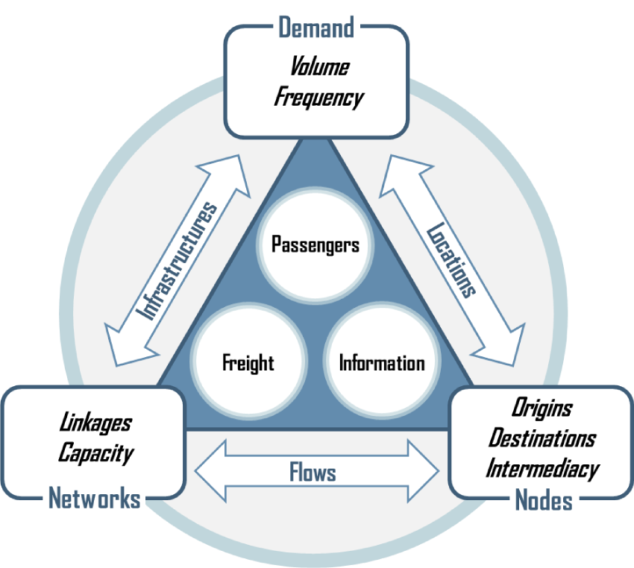
The Transport System
The transport system can be conceptualized as the set of relationships between nodes, networks and the demand. These relationships involve locations spatially expressing this demand, flows between them and infrastructures designed to handle these flows. All the components of a transport system are designed to facilitate the movements of passengers, freight and information, either as separate or joint components.

Slide 4
The Transport System
Demand. A derived function for the movement of people, freight and information for a variety of socioeconomic activities.
Nodes. Where movements are originating, ending and transiting (intermediacy); points of entry or exit in a transport system. They vary according to the geographical scale being considered ranging from local nodes (such as a subway station) to global nodes (such as port or airport terminals).
Networks. Composed of a set of linkages expressing the connectivity between places and the capacity to handle passenger or cargo volumes.
Locations. Nodes where demand is expressed as an origin, destination or point of transit. The level of spatial accumulation of socioeconomic activities (production and consumption) jointly defines demand and where this demand is taking place.
Flows. The amount of traffic over a network composed of nodes and linkages. This is jointly a function of the demand and the capacity of the linkages to support them.
Infrastructures. The conveyances such as roads and terminals expressing the physical reality of a network and designed to handle a demand with specific volume and frequency characteristics. Facilities enabling access to a network are jointly characterized by their centrality and the linkages that radiate from them.

Slide 5
Growth Factors in Transport Demand
Passengers
Freight
Passenger or ton-kms
Growth in production and consumption
Income growth
Quantity of Passengers or Freight
Industrial relocation
Economic specialization
Suburbanization
KM
Average Distance

Slide 6
Growth of (passengers and goods) transport and GDP (EU 27)
(1) cars, motor vehicles, two-wheelers, autbus and pullmans, trams, underground rail lines, railways, air transport, inland waterways, intra-EU maritime transportE
(2) Road railways inland waterways, pipelines, air and mairitime transport (intra EU)
GDP at constant prices and exchange rates 2000;
(Fonte: European Commission, Transport in Figures, 2010)

Slide 7
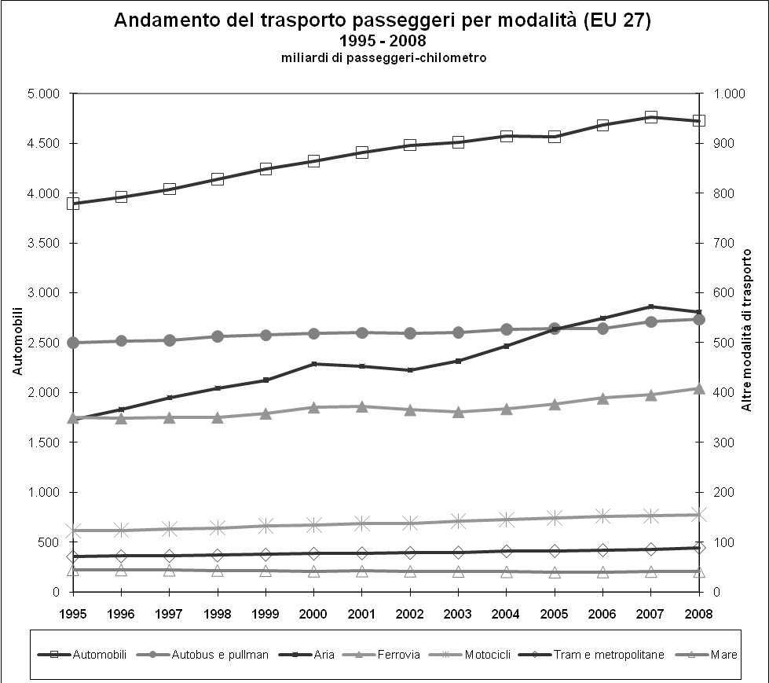
Transport modal split (EU 27) 1995 – 2007
Passengers transport
Goods transport
EUROPEAN UNION, Directorate-General for Energy and Transport - in co-operation with Eurostat, ENERGY AND TRANSPORT IN FIGURES 2010

Slide 8
Passengers Mobility Transition
Industrial
Revolution
Mass Production
Globalization
Individual
Motorized
Collective
Non-motorized
Economic Development

Slide 9
Transport modes and network structures
Transport/ communication | Object of transport | Nodes | Arcs | Flows
Road transport | Passengers/goods | cities; auto-port, airports, intersections | Road / motorway segments | Vehicles, passengers, goods
Rail transport | Passengers/goods | stations; intersections | Railway lines | Trains, passengers, goods
Air transport | Passengers/goods | Airports | Air routes | Airplanes/, passengers, goods
Maritime transport | Passengers/goods | Ports | Maritime roues | Ships/, passengers, goods
Pipelines | Commodities, raw materials; energy | Interchange stations (production sites / transofmartion sites) | Pipelines | m3; tonn of raw materials; commodities
Telecommunications | Data (information; messagges) | Transmission points / stations | Telephone cables; trans-oceanic cables | Data / information

Slide 10
Relative advantages of different transport modes
Transport | Main technical advantage | Use
Rail | Minimal resistance to movement, general flexiibility, safety | Interurban transport of goods and containers. Not good for short range
Motorway | Flexibililty (in terms of routes); high speed and easiness of movement | Individual transport. Average size of goods moved; door-to-door; interurban and short range transport
Inland waterway | High productivity and low power per tonn | Low – speed movement of goods of bulky dimension and low added value
Air transport | High speed | High added value goods if compared to mass and volume (2% of global merchandise weight; 40% of value!)
Pipelines | Continuous flow. Top reliability and safety | Trasporto di liquidi (oleodotti) e gas (gasdotti) dove il volume è elevato ed è necessaria la continuità di recapito
Haggett, 2001, p. 244 (da HAY W.H., An introduction to Transportation Engineering, New York, Wiley, 1961. p. 283

Slide 12
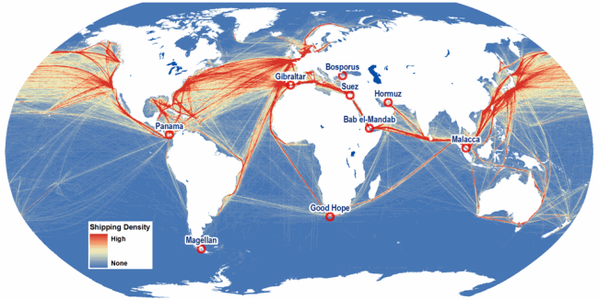
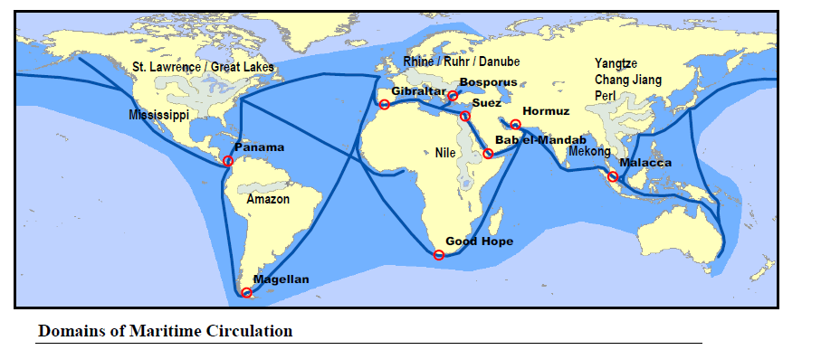

Slide 13
Performance Comparison for Selected Freight Modes
Vehicle
Capacity
Truck Equivalency
1500 Tons
52,500 Bushels
453,600 Gallons
57.7
(865.4 for 15 barges in tow)
Barge
100 Tons
3,500 Bushels
30,240 Gallons
Hopper car
3.8
10,000 Tons
350,000 Bushels
3,024,000 Gallons
100 car train unit
384.6
26 Tons; 910 Bushels
7,865 Gallons
9,000 for a tanker truck
1
Semi-trailer truck
5,000 TEU
2,116
Panamax containership
300,000 tons
2 million barrels of oil
9,330
VLCC
124 tons
5
747-400F
Notes:
Note: modes are not to scale.

Slide 14
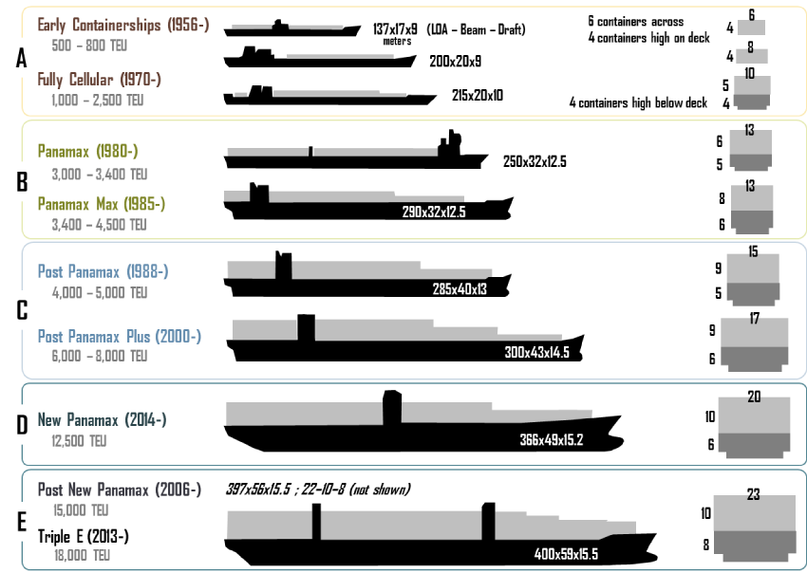
Evolution of Containerships
http://people.hofstra.edu/geotrans/eng/ch3en/conc3en/containerships.html

Slide 15
Characteristics of Some Historical Containerships
Year | Name | Capacity (TEU) | Yard | Length (m) | Width (m) | Draft (m) | Speed (knots)
1956 | Ideal X | 58 | US | 174.2 | 23.6 | ? | 18.0
1968 | Elbe Express | 730 | B&V | 171.0 | 24.5 | 7.9 | 20.0
1981 | Frankfurt Express | 3,430 | HDW | 271.0 | 32.3 | 11.5 | 23.0
1991 | Hanover Express | 4,407 | Samsung | 281.6 | 32.3 | 13.5 | 23.0
1995 | APL China | 4,832 | HDW | 262.0 | 40.0 | 12.0 | 24.6
1996 | Regina Maersk | 6,700 | Odense | 302.3 | 42.8 | 12.2 | 24.6
2001 | Hamburg Express | 7,506 | Hyundai | 304.0 | 42.8 | 14.5 | 25.0
2003 | OOCL Shenzhen | 8,063 | Samsung | 319.0 | 42.8 | 14.5 | 25.2
2005 | MSC Pamela | 9,200 | Samsung | 321.0 | 45.6 | 15.0 | 25.0
2006 | Emma Maersk | 14,500 | Odense | 393.0 | 56.4 | 15.5 | 24.5
Notes:
Source: adapted from F. Mewis and H. Klug (2004) “The Challenge of Very Large Container Ships – A Hydrodynamic View”, 9th Symposium on Practical Design of Ships and Other Floating Structures, Luebeck-Travemuende, Germany.

Slide 16
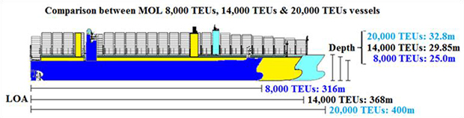
The increase in capacity of containeships
Shipbuilding company | Samsung Heavy Industries | Imabari Shipbuilding
Length | 400.0m | 400.0m
Breadth | 58.8m | 58.5m
Designed draft | 14.5m | 14.5m
Load draft | 16.0m | 16.0m
TEU capacity | 20,150 TEU | 20,150 TEU
Main engine | MAN B&W G95ME | MAN B&W G95ME
http://www.mol.co.jp/en/pr/2015/15013.html
Notes:
MOL Expands Large-scale Containership Fleet
-Building and Chartering Six 20,000 TEU Containerships for More Competitive Services-
TOKYO—Mitsui O.S.K. Lines, Ltd. (MOL; President: Koichi Muto) today announced that the company has signed a deal for construction of four 20,000 TEU containerships with Samsung Heavy Industries (President and CEO: Dae-young Park; Headquarters: Seoul, Korea). MOL also concluded an MOU for long-term chartering of two 20,000 TEU containerships with Shoei Kisen Kaisha, Ltd. (President: Yukito Higaki; Headquarters: Imabari-shi, Ehime Prefecture). The two containerships will be built at Imabari Shipbuilding Co., Ltd. (President: Yukito Higaki; Headquarters: Imabari-shi, Ehime Prefecture). The six vessels will be launched and delivered in 2017, and will serve the Asia-Europe service.
The 20,000 TEU type is the world's largest among delivered and on order containerships. The newbuilding vessels will adopt various highly advanced energy-saving technologies, which will further reduce fuel consumption and cost, in comparison with 14,000 TEU types that MOL currently operates. The main engines have the specifications which enable LNG use as fuel in the future remodeling.
MOL continues to offer high-quality and competitive services through fleet expansion.

Slide 17
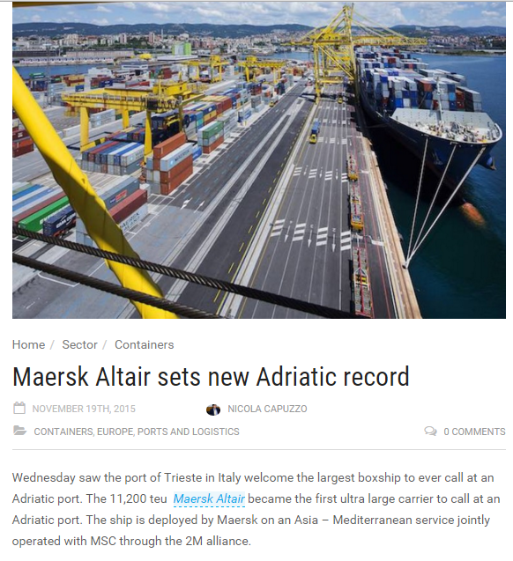
http://splash247.com/maersk-altair-sets-new-adriatic-record/

Slide 18
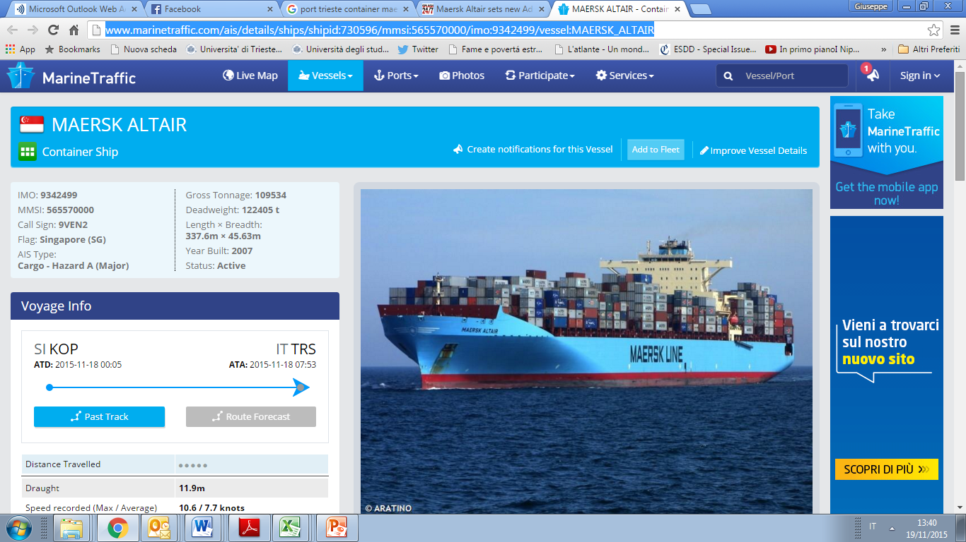
http://www.marinetraffic.com/ais/details/ships/shipid:730596/mmsi:565570000/imo:9342499/vessel:MAERSK_ALTAIR

Slide 19
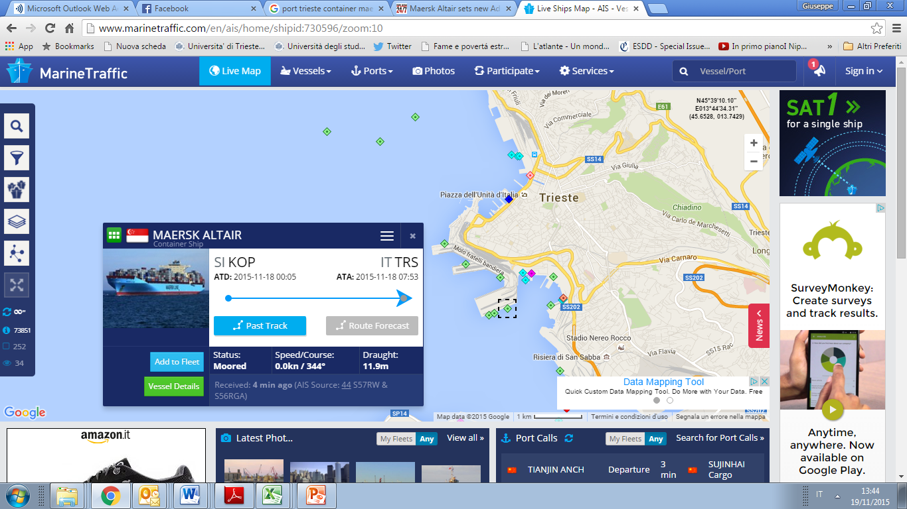
Large containerships in the Adriatic Sea
http://www.marinetraffic.com/en/

Slide 20
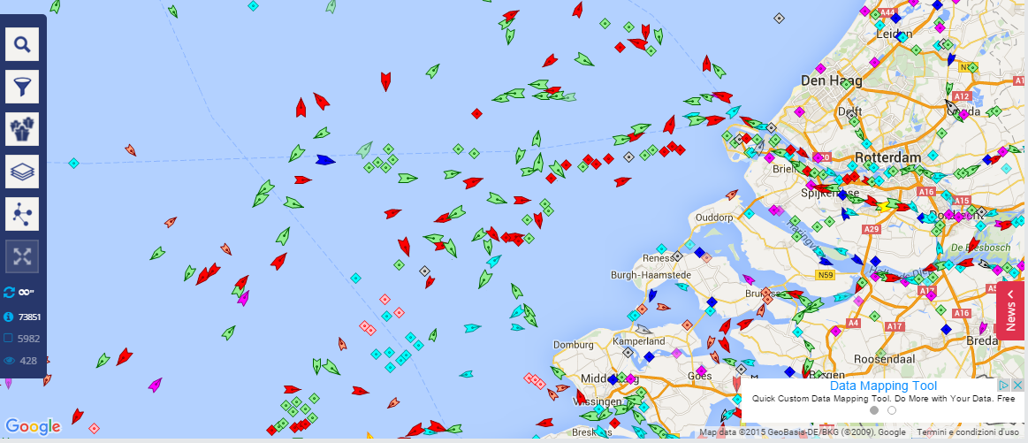
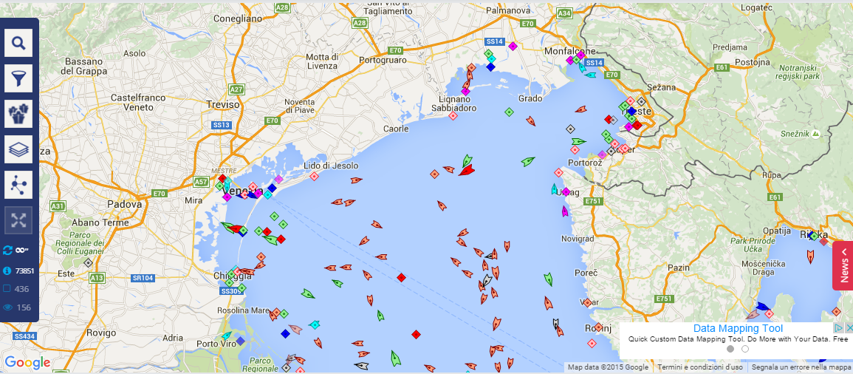
Marine traffic in Europe – 2 examples

Slide 21
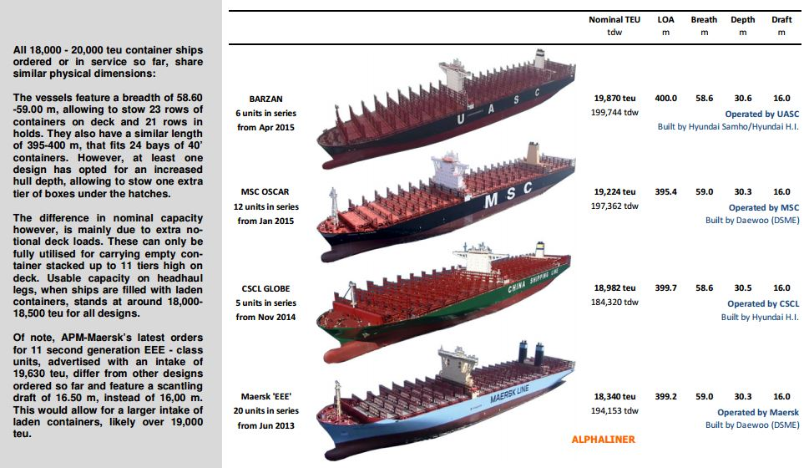
The containership gigantism
http://www.hellenicshippingnews.com/wp-content/uploads/2015/08/World%E2%80%99s-largest-containerships-Aug-2015.jpg

Slide 22
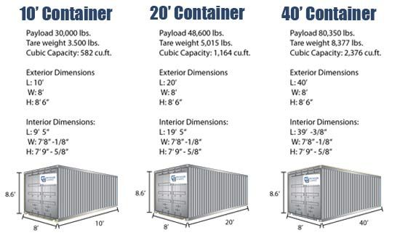
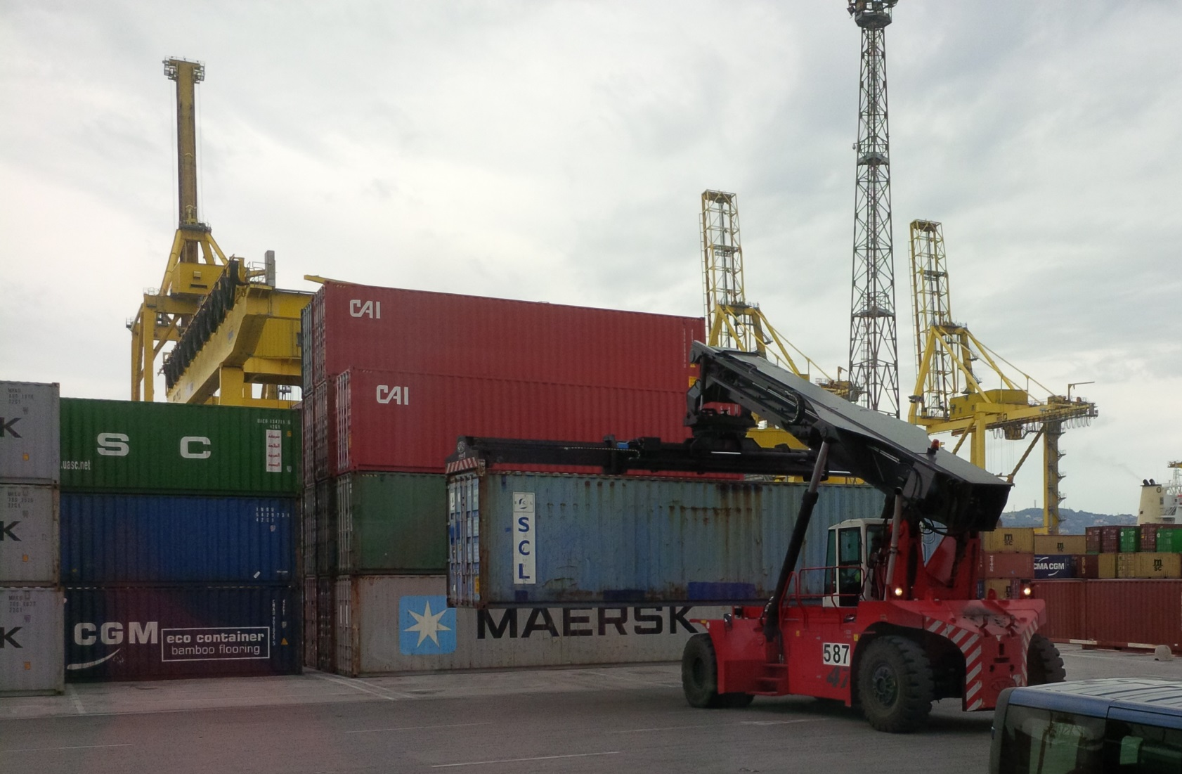
Containers’ handling in ports

Slide 23
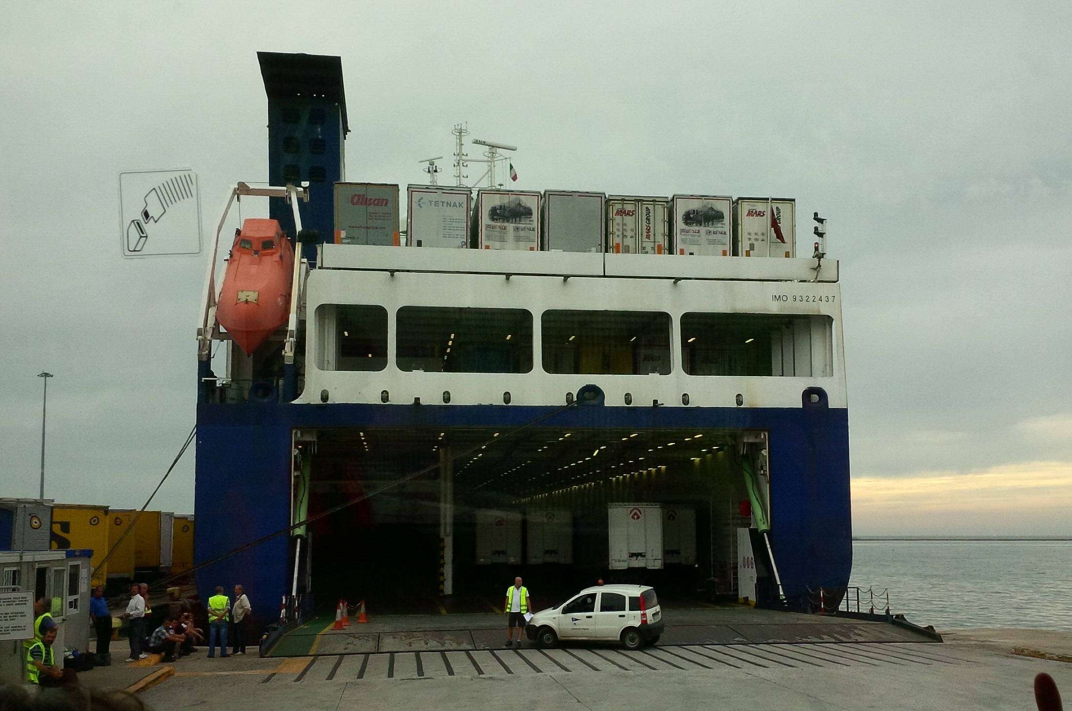
RO-RO ship

Slide 24
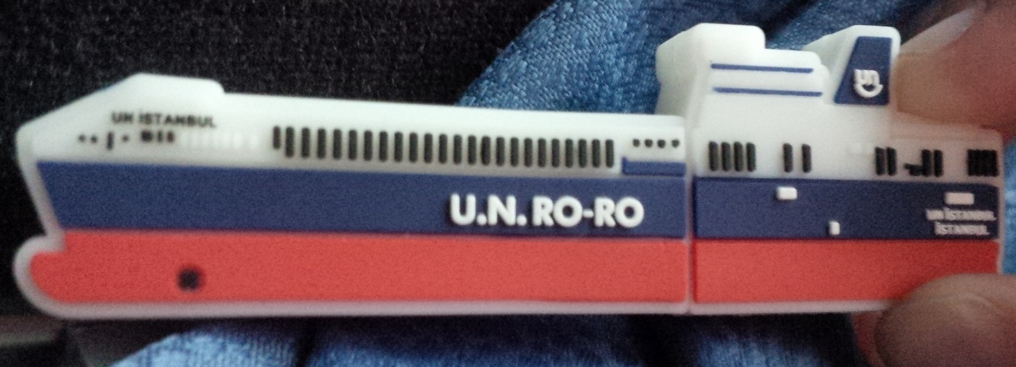
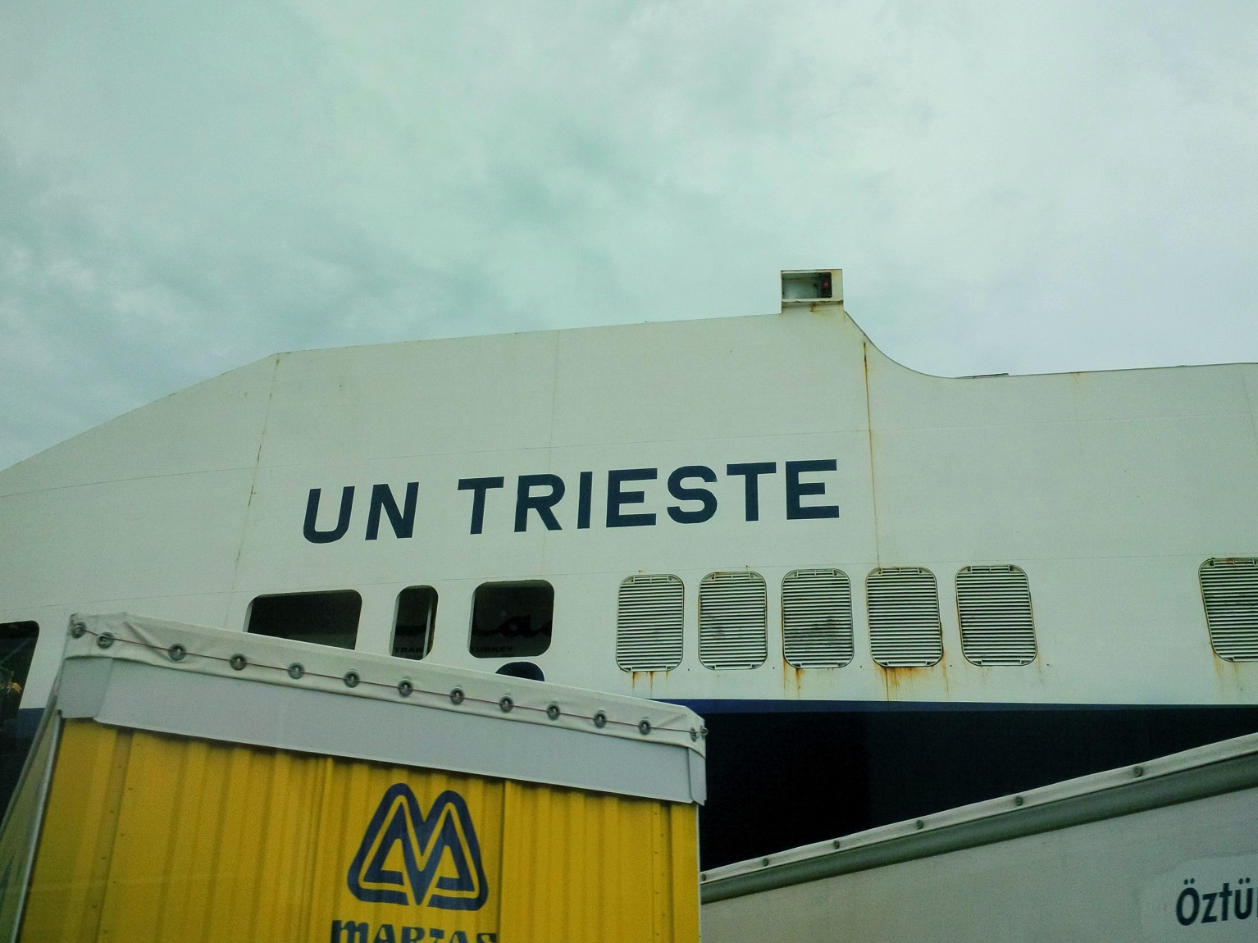
RO-RO ships

Slide 25
http://www.dailymail.co.uk/sciencetech/article-2636152/Watch-worlds-ships-sail-planets-oceans-REAL-TIME-Interactive-map-reveals-crowded-routes-taken-worlds-vessels.html
https://www.youtube.com/watch?v=gtffmxJmehs

Slide 26
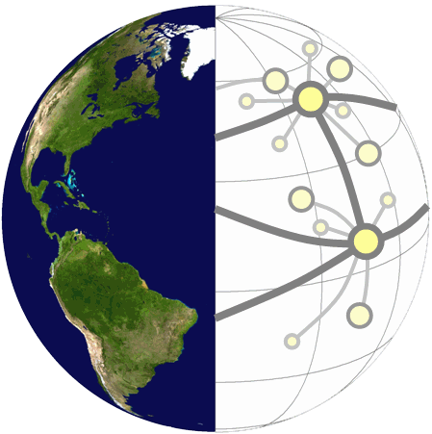
Scales of Spatial Organization for Transport
Scale |  | Nodes | Links | Relations
Global |  | Gateways and hubs (airports and ports) | Air and maritime lanes | Investment, trade and production
Regional |  | Cities | Corridors (rail lines, highways, canals) | Urban system and hinterland
Local |  | Employment and commercial activities | Roads and transit systems | Commuting and distribution

Slide 27
Gateways and Hubs
Gateway
Hub
Corridor

Slide 28
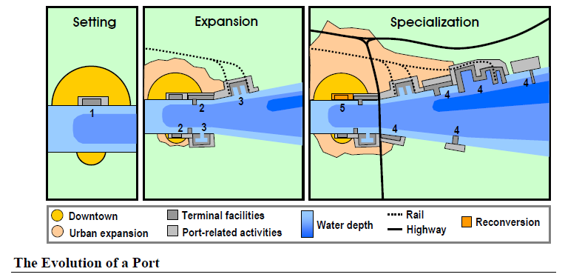
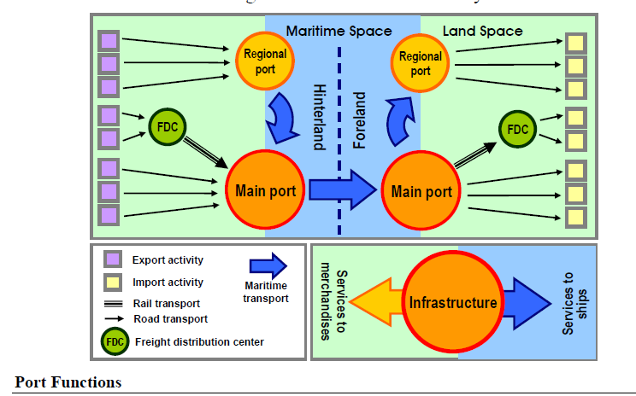

Slide 29
Modal
Gateways
Land
Logistics
Border
Manufacturing
Air
Maritime

Slide 30
Functional Integration of Supply Chains
Maritime
Distribution
Land Distribution
Shipping
Agent
Custom
Agent
Rail / Trucking
Trucking
Shipping Line
Stevedore
Freight
Forwarder
Depot
Economies of scale
Megacarrier
Level of functional integration
Notes:
Source: adapted from Robinson, R. (2002) “Ports as Elements in Value-Driven Chain Systems: The New Paradigm”, Maritime Policy and Management, Vol. 29, No. 3, pp. 241-255.

Slide 31
Impacts of River / Sea Shipping
Origin
Road / Rail
Road / Rail
Fluvial Port
Seaport
Fluvial
Maritime
Maritime
River/sea
Fluvial
Road / Rail
Road / Rail
Destination
A
B
C
Notes:
Source: adapted from Charlier, 1994.

Slide 32
The “Last Mile” in Freight Distribution
Massification
Atomization
Frequency
Capacity
GLOBAL
HINTERLAND
REGIONAL
LOCAL
Shipping Network
Corridor
Segment
Customer
“Last Mile”
Gateway
Inland
Terminal
Distribution
Center

Slide 33
The spatial structure of transport costs
Simplified hypotheses on transport: transport costs proportional to distance:
  Weber (minimum transport cost)
  Von Thunen (location rent)
Real world: transport costs hold a fixed loading component, a fixed unloading component and costs varying in a less than proportional way to travel’s length.
Economies of scale
Different weight of distace for different transport modes:
  Road
  Railway
  Water/Air

Slide 34
Different Friction of Distance Functions
1
2
Zone Change
Costs
Fixed Costs
Distance
3
4
Transshipment Costs

Slide 35
Different Components of Transport Time
Time
Transport Time
Timing
Distance
Punctuality
Frequency
Notes:
Source: adapted from Woxenius, J. (2006) “A Time Perspective on Transportation in Global Production Networks”, Growth and Change, Vol 37, No. 4

Slide 36
The spatial structure of transport costs
Transport
Cost
Transport
Cost
OT = Transport cost proportional to distance
OT = fixed loading cost
TV = variable transport cost
VZ = fixed unloading cost
T
Z
V
T
O
distance
D
O
distance
D
Transport cost function less than
proportional to distance
Fixed component of
loading and unloading costs
Transport cost function
proportional to distance

Slide 37
Spatial structure of transport costs
Road
Transport
costs
Rail
Air/Water
A
B
Distance
Modal split and distance:
A = 200 km
B = 500 km

Slide 38
Modal Split in EU, USA and Japan, 2005 (in % ton-km)
Copyright © 1998-2010, Dr. Jean-Paul Rodrigue, Dept. of Global Studies & Geography, Hofstra University. For personal or classroom use ONLY. This material (including graphics) is not public domain and cannot be published, in whole or in part, in ANY form (printed or electronic) and on any media without consent. This includes conference presentations. Permission MUST be requested prior to use.
Notes:
38
(*)
Source: BTS, EU & MLIT.
Eurostat, Panorama of Transport
Ministry of Land, Infrastructure, Transport and Tourism. http://www.mlit.go.jp/index_e.html

Slide 39
(Modal Split) in China, 1980 - 2005 (% ton-km)
Copyright © 1998-2010, Dr. Jean-Paul Rodrigue, Dept. of Global Studies & Geography, Hofstra University. For personal or classroom use ONLY. This material (including graphics) is not public domain and cannot be published, in whole or in part, in ANY form (printed or electronic) and on any media without consent. This includes conference presentations. Permission MUST be requested prior to use.
Notes:
(*)
Source: World Bank (2007) An Overview of China’s Transportation Sector – 2007. http://siteresources.worldbank.org/INTEAPREGTOPTRANSPORT/Resources/China-Transport-Overview-2007.pdf
39

Slide 40
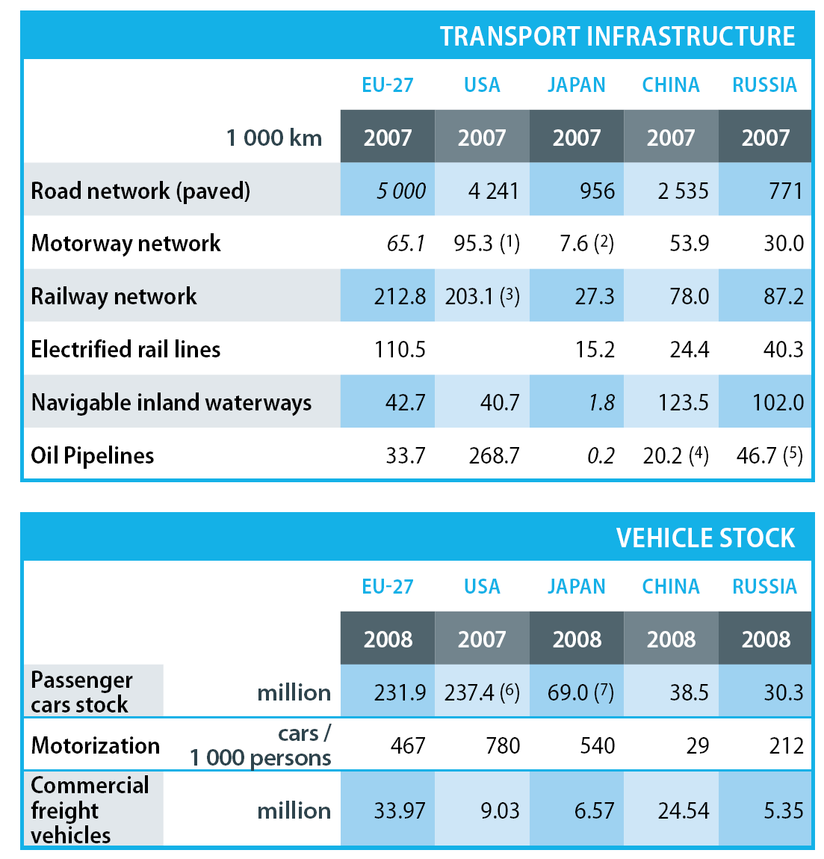
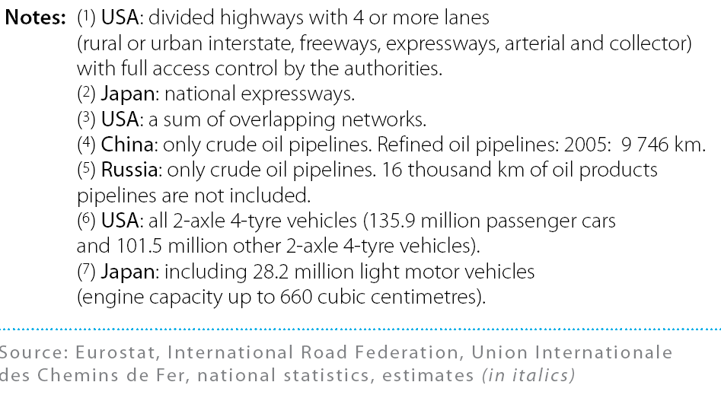
EU vs World – infrastructures & vehicles comparison

Slide 41
Ton-km Modal split in EU15 (1991 – 2008)

Slide 42
Zonal Freight Rates
Real transport cost
D1
Flat zonal rate
Costs
D2
I
II
III
IV
Distance

Slide 43
La struttura spaziale dei costi di trasporto
Costi di trasporto
W
Costi di trasporto
W
Z
Y
Z
Y
T
V
T
V
distanza
B
distanza
B
A
I
A
I
AB = distanza ad superare con trasporto da A a B o da B ad A o da A e B verso un punto intermedio I
AT (BV) = costo fisso di carico/scarico
TY = curva di costo di trasporto da A a B; VZ = curva di costo di trasporto da B ad A
ZWY = curva dei costi di trasporto totali

Slide 44
La struttura spaziale dei costi di trasporto
costi
C
C
C
T
A
T
B
T
B’
A’
A’; B’ = aree di mercato in dipendenza dei costi di trasporto
CT = costo di trasporto che delimita il cono di domanda

Slide 45
La struttura spaziale dei costi di trasporto
costi
C
C
C
T
B
T
A
B’
A’
A’; B’ = aree di mercato in dipendenza dei costi di trasporto
CT = costo di trasporto che delimita il cono di domanda

Slide 46
The Traveling Salesperson Problem
1
1
10 km
5 km
2
5 km
2
15 km
8 km
3
8 km
3
10 km
4
5
9 km
4
5
9 km
8 km
15 km
8 km
6
6
Total = 62 km
Total = 48 km

Slide 47
Effect of Topography on Route Selection
1
b
c
2
a
3
Low elevation
Medium elevation
High elevation

Slide 48
Effect of Transport Costs on Route Selection
1
Sea
a
2
R2 (land)
a
3
a
p1
p1
p2
R (land)
p2
R (land)
R2 (sea)
p3
R (sea)
R (sea)
R1 (land)
b
p4
b
p4
b
Land
R1 (sea)
R {C(sea) = C(land)}
R1 {C(sea) > C(land)}
R2 {C(sea) < C(land)}
R {ΔC(land) > ΔC(sea)}

Slide 49
Cost Minimization and Efficiency Maximization
Costs
Efficiency
Compromise
Low
High
Low
High

Slide 50
L’effetto di rifrazione come conseguenza della diversificazione dei costi di trasporto per unità di distanza
A
Costa
Mare
α
C
C’
C’’
Costa
Obiettivo: minimizzare costi di trasporto da
porto A a località B nell’entroterra
Costo f_{a} = (trasporto via mare) basso
Costo f_{b} = (trasporto via terra) alto
Se: costi omogenei; isotropia spaziale
=> C = punto di transito
Se: distanza massima per modo di trasporto più economico => C’’ = punto di transito
Loesch: legge di rifrazione ottica: via di minimo costo passa per C’, dove
β
Retroterra
B

Slide 51
References
CAPINERI C., Reti e Studi Geografici, in TINACCI MOSSELLO M. - CAPINERI C. (a cura di), Geografia delle Comunicazioni - Reti e Strutture Territoriali, Giappichelli Editore, Torino, 1996, pp. 23-36.
HAGGETT P., Geografia, Zanichelli, Bologna, 2001
ROCCA G., Geografia della comunicazione. Metodologie e problematiche dei processi di mobilità territoriale, Bologna, Pàtron, 2002
RODRIGUE J. P., COMTOIS C. and SLACK B., The Geography of Transport Systems, 2nd edition, Routledge, New York, 2009.
Web - http://people.hofstra.edu/geotrans

Slide 52
Derived demand
https://people.hofstra.edu/geotrans/eng/ch1en/conc1en/deriveddemand.html
https://people.hofstra.edu/geotrans/eng/ch1en/conc1en/trspsystem.html

Slide 54
Conceptual Corridor Development
A
B
C
D
E
F
Notes:
Source: adapted from Taaffe, E.J., H.L. Gauthier and M.E. O'Kelly (1996) Geography of Transportation, Second Edition, Upper Saddle River, NJ: Prentice Hall.

Slide 55
Road transport

Slide 56
Linearity, Capacity and Surface of Roads
Hard Surface
Wheeled vehicle
Linear Road
2 domestic
animals
Capacity
1 or 2 domestic
animals
1 domestic
animal
Curved Road
Soft Surface
1 person
Linearity

Slide 57
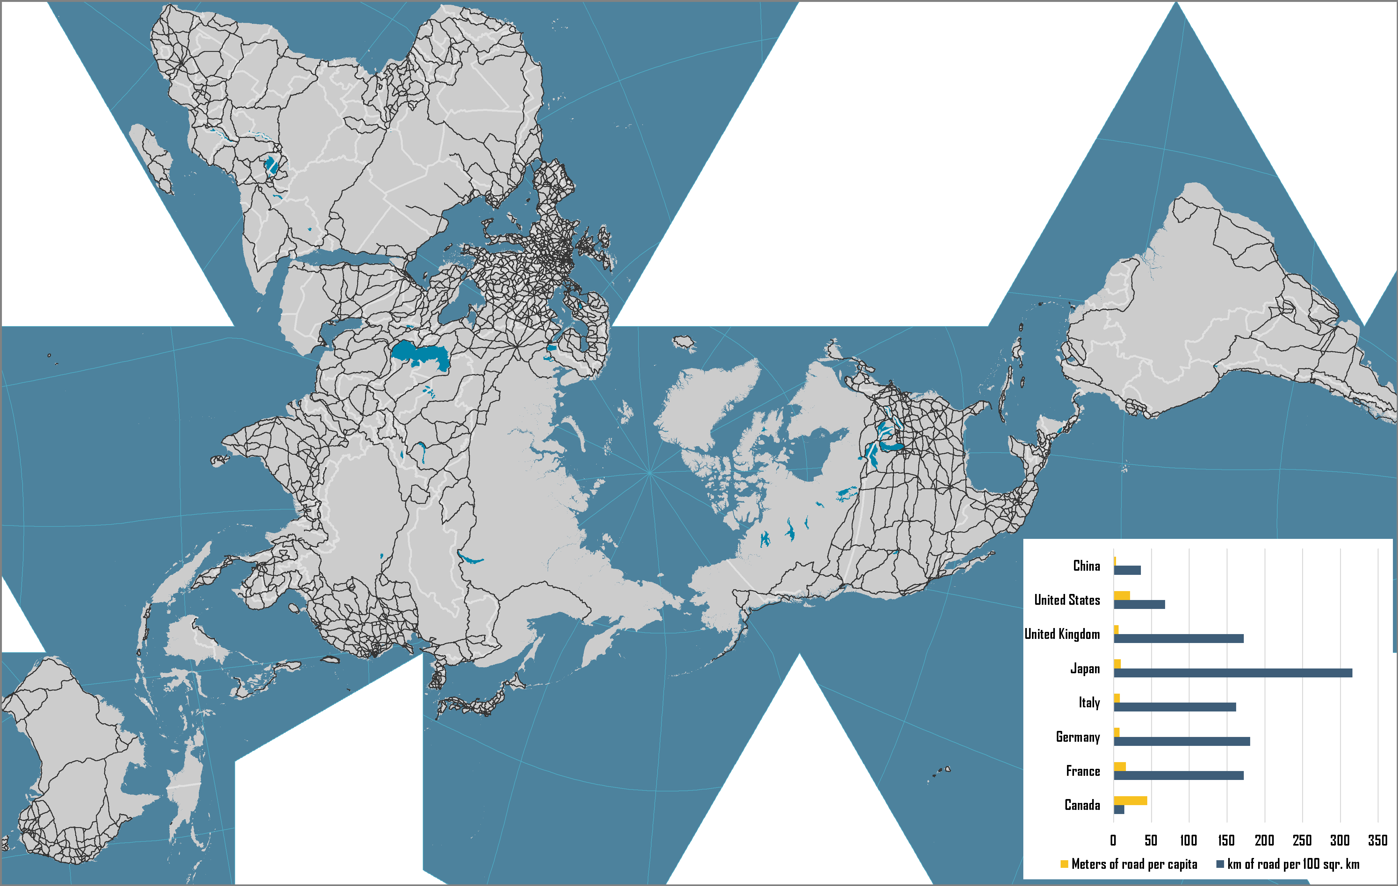
World Road Network

Slide 58
Road Transport Density Measures, 2000s
Notes:
Source: US Department of Transportation, BTS, G-7 Countries: Transportation Highlights

Slide 59
World Automobile Production and Fleet, 1965-2014
Notes:
Source: US Department of Energy, Transportation Energy Data Book. http://www-cta.ornl.gov/data/chapter3.shtml

Slide 60
Rail transport

Slide 61
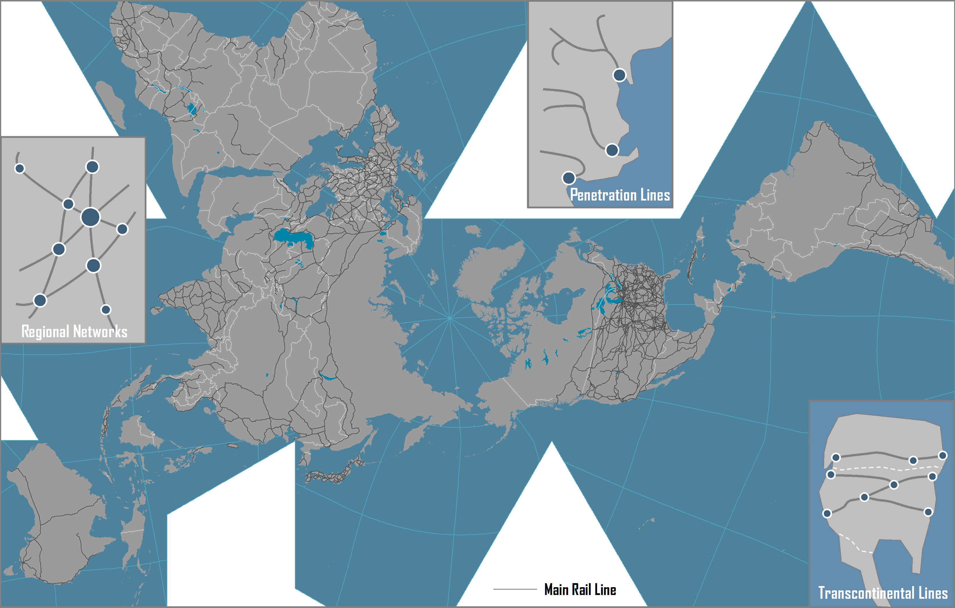
World Rail Network and Rail Systems

Slide 62
Geographical Settings of Rail Lines
Penetration Lines
Regional Networks
Transcontinental Lines

Slide 63
Economic Rationale of Rail Transportation
Market Area | Longest service area for inland transport (average length of 1,300 km). Service both the passengers and freight markets. Intermodal integration favored market segmentation and specialization.
Capacity | A wagon can carry 50 to 100 tons of freight. Economies of scale (unit trains and doublestacking).
Costs | High construction and maintenance costs. High operating costs: labor (60%), locomotives (16%) and fuel & equipment (24%). Shipping costs decrease with distance and load. Transshipments and train assembly increase costs.
Benefits | Accelerated industrialization. Support agricultural and energy supply systems. Intermodal connecting with international trade.
Regulation | Conventionally highly dependent from government subsidies. Governments financing, mainly for the sake of national economic imperatives. From regulation to deregulation. Private ownership and operations.

Slide 64
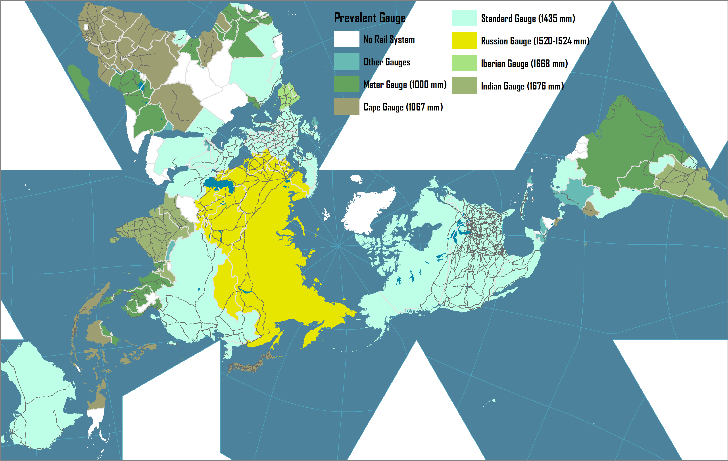
Major Gauges of the Global Rail Systems, 2008
Notes:
Source: CIA World Fact Book. https://www.cia.gov/library/publications/the-world-factbook/fields/2121.html

Slide 65
Spatial Performance of Rail and Road Transportation

Slide 66
Bypassing Effect of High Speed Rail
A
Intercity line
Rail station
High speed rail line
High speed rail station
Closed intercity line
Closed rail station
B

Slide 67
Comparison Between European, North American and Pacific Asian Railways
Issue | Europe | North America | Pacific Asia
Organisation | Separation of infrastructure from operations (for accountancy purposes) | Separation by region (markets) (private companies and concessions of vertically integrated companies) | Infrastructure and operations publicly owned
Market focus | Passenger oriented | Freight oriented | Passenger oriented
Ownership | Infrastructure mainly publicly owned with a few exceptions (e.g. UK). Freight equipment and terminals increasingly privately owned and operated. | Private | Public
Distances | Short to medium | Medium to long | Short to long
Notes:
Source: adapted from: C. Nash and C. Rivera-Trujillo (2004) “Rail regulatory reform in Europe – principles and practice”, STELLA Focus Group 5 synthesis meeting, Athens.

Slide 68
 | European Union | United States
Ownership of rail infrastructure | Close to 90% state owned | Entirely private
Technical characteristics | Low axle load (standard 22,5t), electric traction limiting height of loads, differences among EU countries (loading gauge, track gauge, power supply standards) | High axle load (standard 36t), no electric traction, max. axle weight 31,8t, national railroad infrastructure standards (USA and Canada)
Capacity | 400-750 meter in length, single stack, 80-120TEU or 40-60 semitrailers | 1300-3000m in length, double-stack, 250-600TEU or 120-280 semitrailers
Operators | 10 large operators | 6 large class I operators
Competition | Strong competition limited by informal national and political regulations | Semi oligopolistic competition according to regions
Operations | Dense network with numerous long and short-distance corridors. Average intermodal train distance ca. 500km. Sea containers and short-sea containers distribution in rail shuttle. | Large network with main long-distance corridors from gateway ports Average intermodal train distance 1000-1200km (US West) and 2500-3500km (US East). Sea containers distribution in port-hinterland trains. After transloading to domestic containers and semitrailers distribution in port-hinterland trains. Domestic containers and semitrailers in mostly in West- East directions.

Slide 69
Main Advantages of Railway Infrastructure Investment
Group | Benefit | Description
Public sector | Lower highway congestion and maintenance | Potential substitution effect. Each intermodal train can take 280 trucks off the roadways, while each bulk and merchandise train can remove up to 500 trucks. Every passenger train displaces hundreds of automobiles.
 | Improved safety and security | Freight railroads are safer than trucks. Railroads have one-fourth the rate of fatalities of trucks for intercity transportation, on a per ton-mile basis.
 | Economic growth | Economies of scale provide long distance transport services at a lower cost.
 | Environment | On average, railroads are three or more times more fuel efficient than trucks.
Shippers | Lower transit times | Reduced transit times lower shippers’ costs by lowering the inventory carrying costs of the transported goods.
 | Lower logistics costs | Due to economies of scale, freight rail can provide long-haul transportation services at a lower rate than trucks.
 | Improved reliability | Expanded rail capacity lowers the variability in transit time by reducing the uncertainty created from delays. Improved transportation on-time performance lowers manufacturing costs, both from reducing stock-outs and shut-downs, and from the ability to safely maintain lower inventory levels.
Rail operators | Increased ridership or traffic | Expanding freight capacity can increase the revenue of the freight railroads through increased business opportunities.
 | Improved reliability | Expanded rail capacity lowers the variability in transit time by reducing the uncertainty created from delays.
Notes:
Source: adapted from CSX Corporation (2007) U.S. Department of Transportation Corridors of the Future Program Application: The Southeast I-95 Corridor

Slide 70
Maritime transport

Slide 71
International Seaborne Trade and Exports of Goods, 1955-2015
Notes:
Source: World Bank and United Nations, Review of Maritime Transport. Data in current USD.

Slide 72
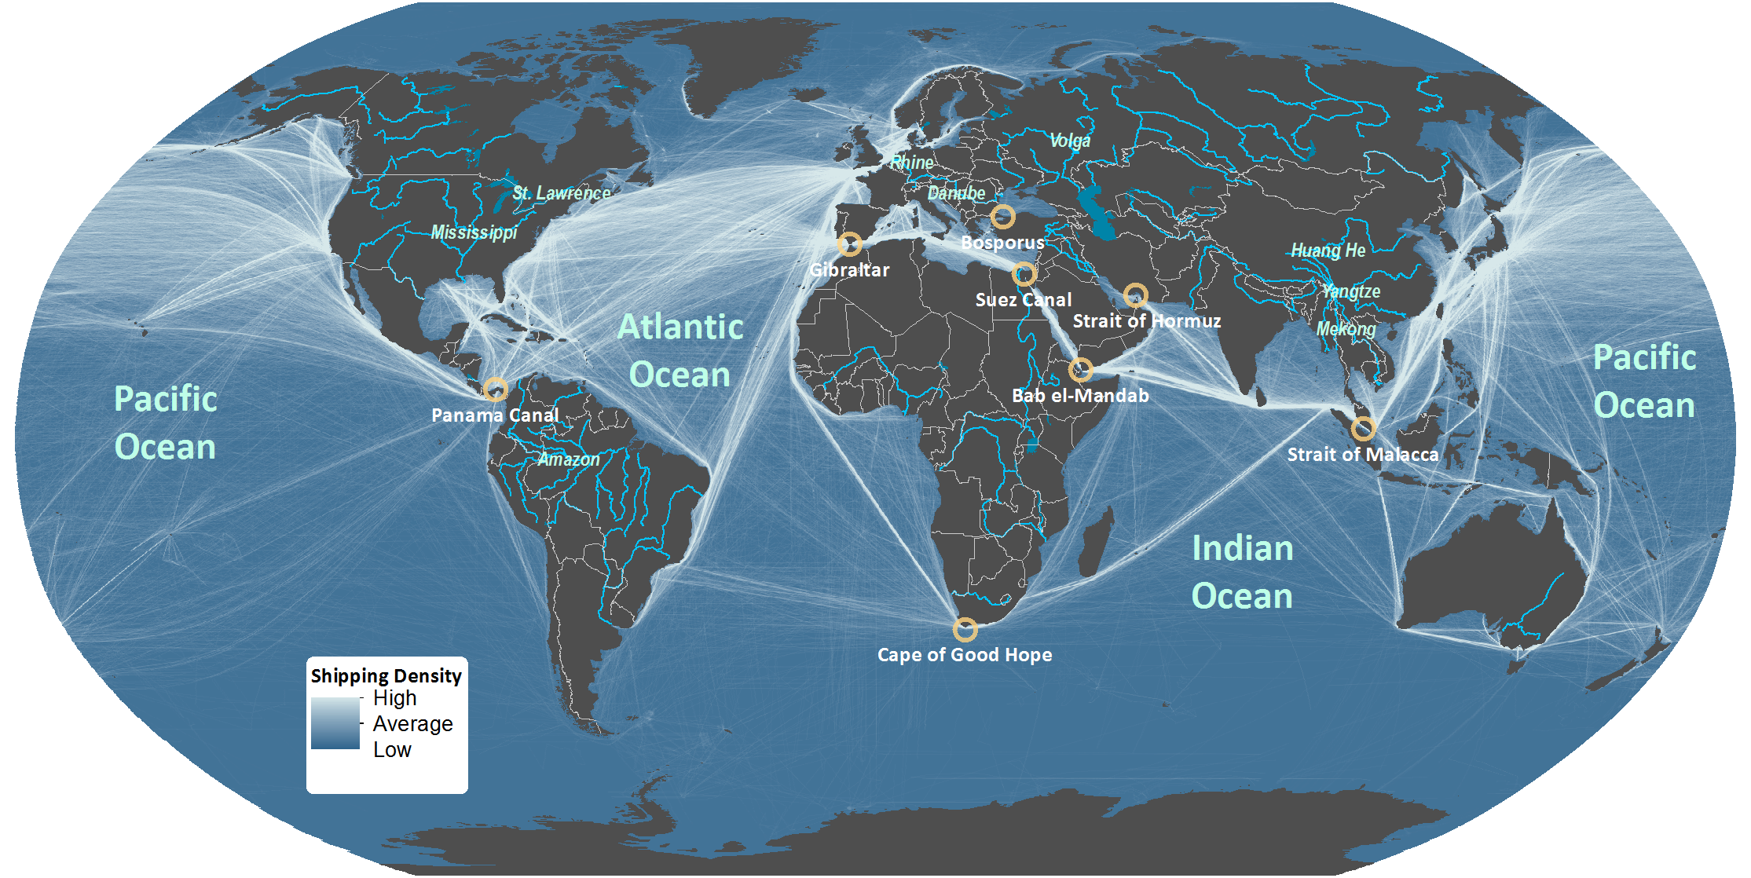
Domains of Maritime Circulation
Notes:
Source: Shipping density data adapted from National Center for Ecological Analysis and Synthesis, A Global Map of Human Impacts to Marine Ecosystems.
https://knb.ecoinformatics.org/#view/doi:10.5063/F1S180FS

Slide 73
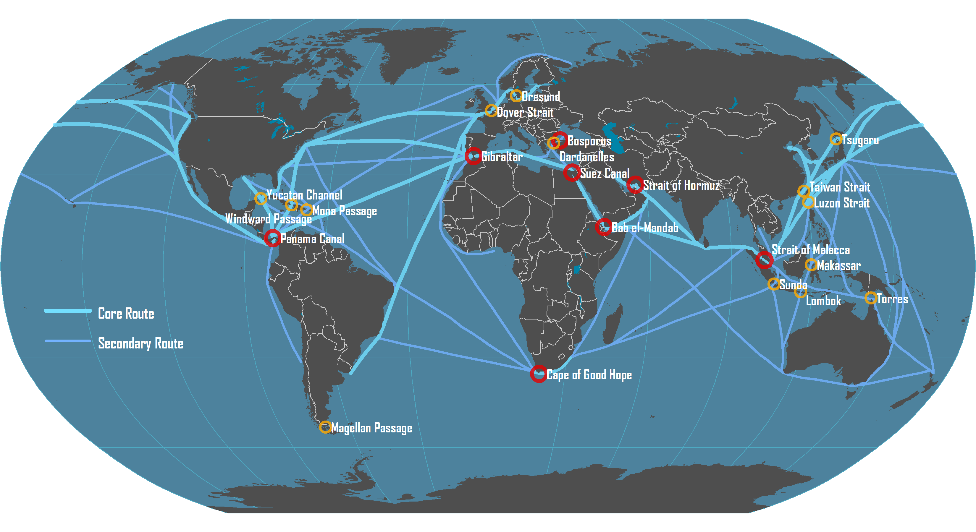
Main Maritime Shipping Routes

Slide 74

The Scales of Analysis of Maritime Transportation
Global Maritime Transport System
Global
Deep Sea Services
Maritime Range
Regional
Short Sea / Feeder Services
Port Cluster / Region / Hinterland
Port
Local
Terminal

Slide 75
The Concept of Maritime Range
HINTERLAND
FORELAND
EEZ
Customer
Port
Deep sea shipping service
Feeder
National Boundary

Slide 76
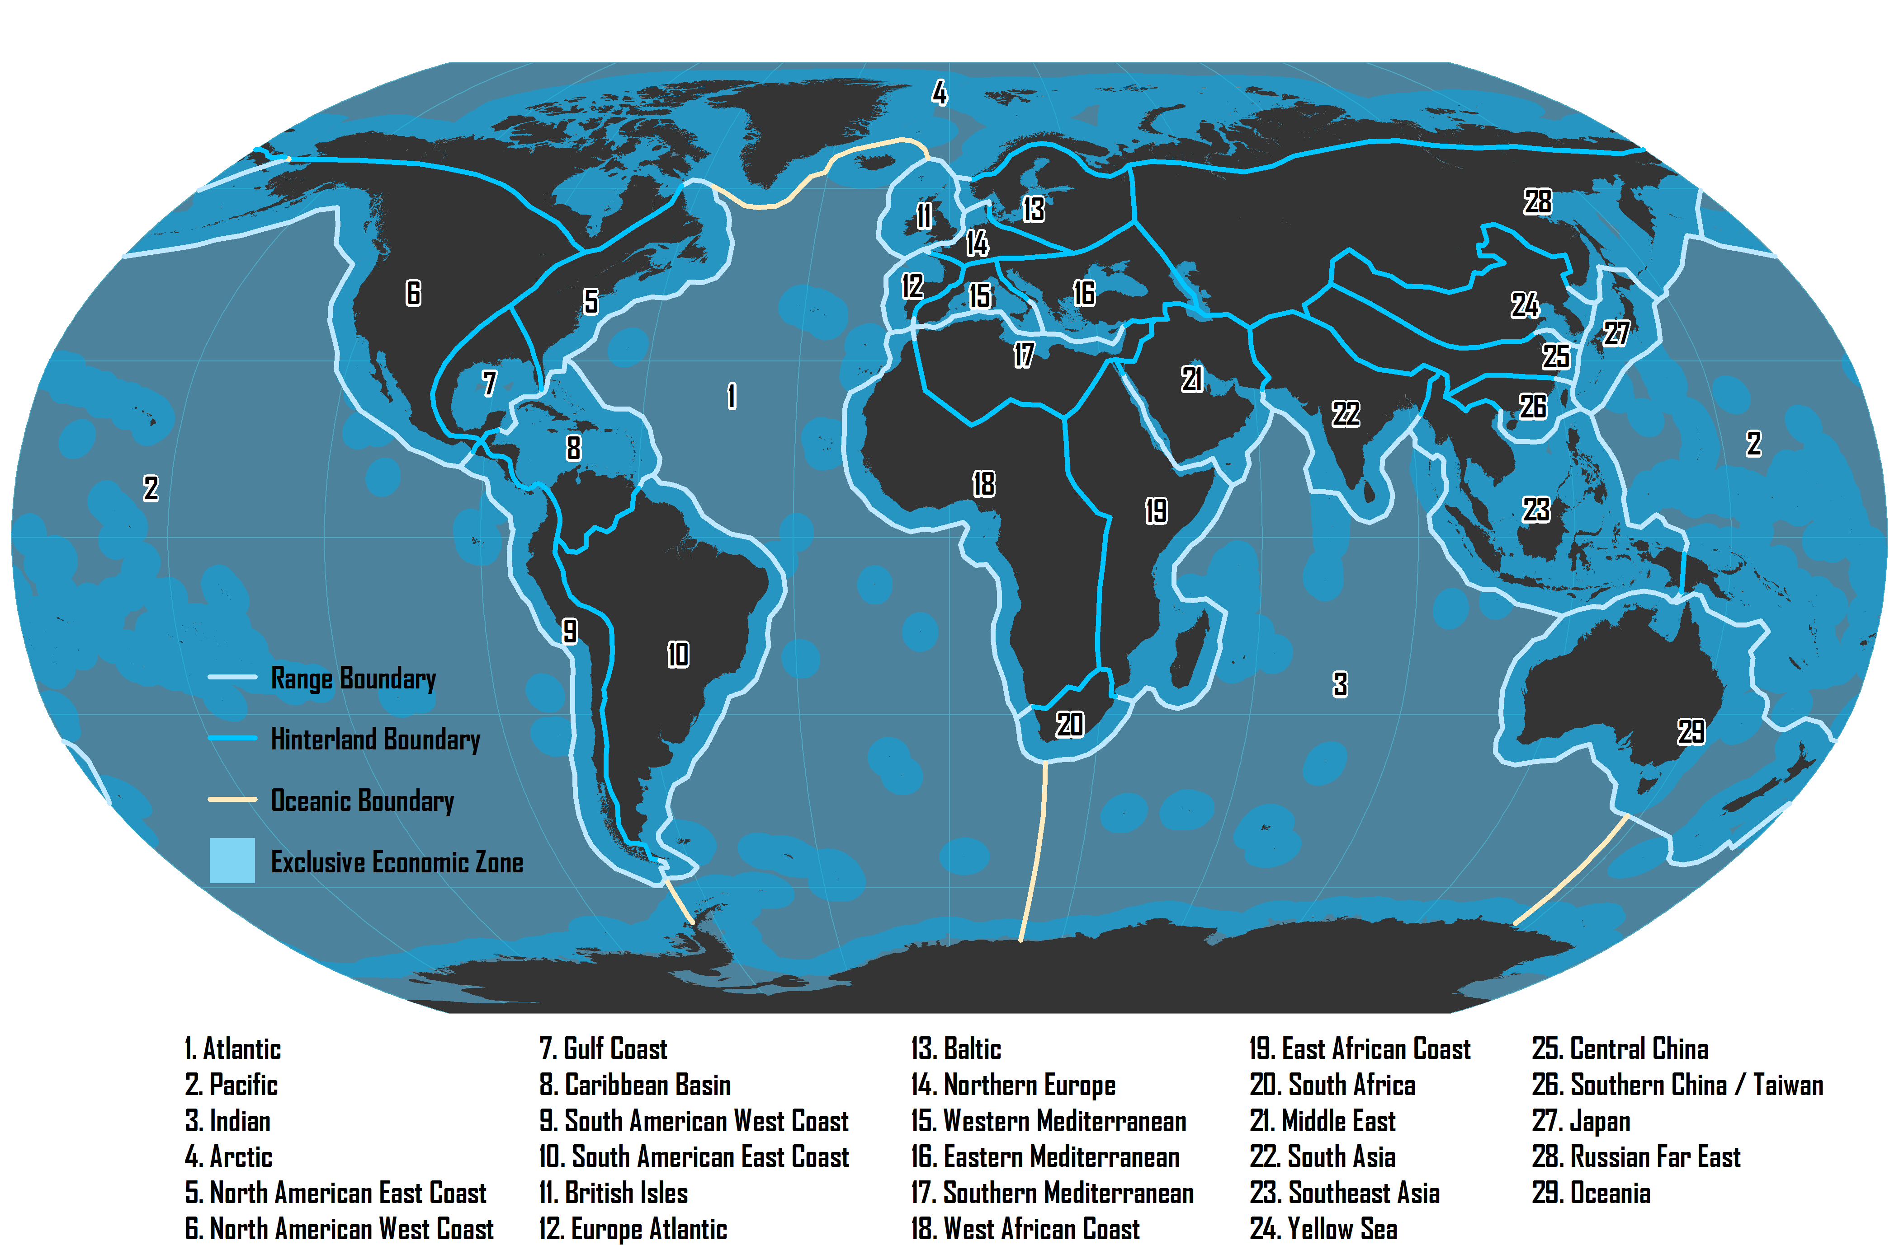
Major Maritime Ranges

Slide 77
Types of Maritime Routes
Port-to-Port
Pendulum
Round-the-World
Point to point services.
Empty backhauls.
Common for bulk freight.
Shipping service moving back and forth between two maritime ranges (seaboards).
Balancing the number of port calls and the frequency of services.
Can rely on transshipment hubs between ranges.
Servicing continuously a sequence of ports.
Sequence enables a round trip around the world.
Limited amount of ports per continent are serviced.
Involve a series of transshipment hubs.

Slide 78
Largest Ships by Category
MSC Oscar (2015)
LOA: 394 m
Beam: 59 m
Draft: 16 m
TEU: 19,224
Containership
TI Europe (2003)
LOA: 380 m
Beam: 68 m
Draft: 24.5 m
DWT: 442,000 t
Ultra Large
Crude Carrier
LOA: 362 m
Beam: 65 m
Draft: 23 m
DWT: 402,000 t
MS Ore Brazil (2011)
Bulk Carrier
Oasis of the Seas (2009)
LOA: 362 m
Beam: 60.5 m
Draft: 9.3 m
Passengers: 5,400
Cruise Ship

Slide 79
World’s Largest Maritime Container Shipping Operators, 2010
 | Total |  | Owned |  | Chartered
Operator | TEU | Ships | TEU | Ships | TEU | Ships | % Chart
APM-Maersk | 2,038,760 | 543 | 1,118,663 | 207 | 920,097 | 336 | 45.1%
MSC | 1,621,453 | 410 | 858,591 | 202 | 762,862 | 208 | 47.0%
CMA CGM Group | 1,072,891 | 372 | 343,351 | 85 | 729,540 | 287 | 68.0%
APL | 584,923 | 145 | 170,373 | 45 | 414,550 | 100 | 70.9%
Evergreen Line | 554,292 | 151 | 319,263 | 87 | 235,029 | 64 | 42.4%
Hapag-Lloyd | 533,371 | 122 | 292,613 | 60 | 240,758 | 62 | 45.1%
COSCO Container L. | 486,277 | 131 | 271,305 | 87 | 214,972 | 44 | 44.2%
Hanjin Shipping | 447,206 | 98 | 104,068 | 19 | 343,138 | 79 | 76.7%
CSCL | 437,564 | 121 | 250,099 | 71 | 187,465 | 50 | 42.8%
CSAV Group | 431,435 | 118 | 41,410 | 8 | 390,025 | 110 | 90.4%
MOL | 358,616 | 93 | 159,706 | 29 | 198,910 | 64 | 55.5%
OOCL | 354,648 | 77 | 254,768 | 42 | 99,880 | 35 | 28.2%
NYK | 354,007 | 92 | 280,379 | 54 | 73,628 | 38 | 20.8%
Hamburg Süd Group | 331,994 | 107 | 137,726 | 37 | 194,268 | 70 | 58.5%
K Line | 330,775 | 85 | 199,537 | 36 | 131,238 | 49 | 39.7%
Notes:
Source: Alphaliner. http://www.axs-alphaliner.com/top100/index.php

Slide 80
World’s Largest Maritime Container Shipping Operators, 2015
 | Total |  | Owned |  | Chartered
Operator | TEU | Ships | TEU | Ships | TEU | Ships | % Chart
APM-Maersk | 3,035,043 | 594 | 1,738,510 | 262 | 1,296,533 | 332 | 42.7%
MSC | 2,676,623 | 502 | 1,052,055 | 190 | 1,624,568 | 312 | 60.7%
CMA CGM Group | 1,832,508 | 471 | 603,820 | 88 | 1,228,688 | 383 | 67.0%
Evergreen Line | 951,876 | 200 | 547,991 | 106 | 403,885 | 94 | 42.4%
Hapag-Lloyd | 919,386 | 171 | 507,741 | 69 | 411,645 | 102 | 44.8%
COSCO Container L. | 857,751 | 164 | 464,412 | 85 | 393,339 | 79 | 45.9%
CSCL | 698,595 | 135 | 486,802 | 65 | 211,793 | 70 | 30.3%
Hamburg Süd Group | 641,723 | 134 | 292,311 | 44 | 349,412 | 90 | 54.4%
Hanjin Shipping | 633,564 | 105 | 278,102 | 38 | 355,462 | 67 | 56.1%
OOCL | 577,233 | 108 | 349,019 | 49 | 228,214 | 59 | 39.5%
MOL | 568,938 | 99 | 170,446 | 25 | 398,492 | 74 | 70.0%
APL | 533,533 | 84 | 399,895 | 51 | 133,638 | 33 | 25.0%
Yang Ming Marine | 529,432 | 99 | 196,481 | 42 | 332,951 | 57 | 62.9%
NYK Line | 527,223 | 109 | 279,294 | 48 | 247,929 | 61 | 47.0%
UASC | 467,624 | 55 | 297,876 | 32 | 169,748 | 23 | 36.3%
Hyundai M.M. | 388,969 | 58 | 165,080 | 22 | 223,889 | 36 | 57.6%
K Line | 378,368 | 68 | 80,150 | 12 | 298,218 | 56 | 78.8%
PIL (Pacific Int. Line) | 367,551 | 151 | 290,904 | 120 | 76,647 | 31 | 20.9%
Zim | 357,482 | 80 | 43,555 | 10 | 313,927 | 70 | 87.8%
Wan Hai Lines | 206,343 | 87 | 169,267 | 72 | 37,076 | 15 | 18.00%
Notes:
Source: Alphaliner. http://www.axs-alphaliner.com/top100/index.php

Slide 81
World’s Largest Maritime Container Shipping Operators, 2015
Notes:
Source: Alphaliner. http://www.axs-alphaliner.com/top100/index.php

Slide 82
World’s Largest Maritime Container Shipping Operators, 2016

Slide 83
Main Alliances in Container Maritime Shipping
Name | Shipping Lines | Total Capacity (2015)
2M (2015) | Maersk, Mediterranean Shipping Co. (MSC) | 7.711 M TEU
Ocean 3 (2015) | CMA-CGM, China Shipping Container Lines (CSCL), United Arab Shipping Company (UASC) | 2.997 M TEU
CKYHE (2014) | China Overseas Shipping Co. (COSCO), K-line, Yang Ming Line, Hanjin, Evergreen | 3.348 M TEU
G6 (2012) | American President Lines (APL), Hapag Lloyd, Hyundai Merchant Marine, Mitsui (MOL), Nippon (NYK), OOCL | 3.513 M TEU

Slide 84
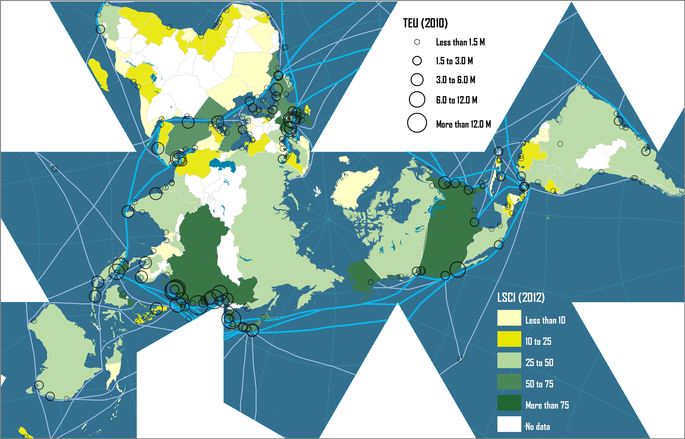
Liner Shipping Connectivity Index and Container Port Throughput
Notes:
Source: UNCTAD.

Slide 85
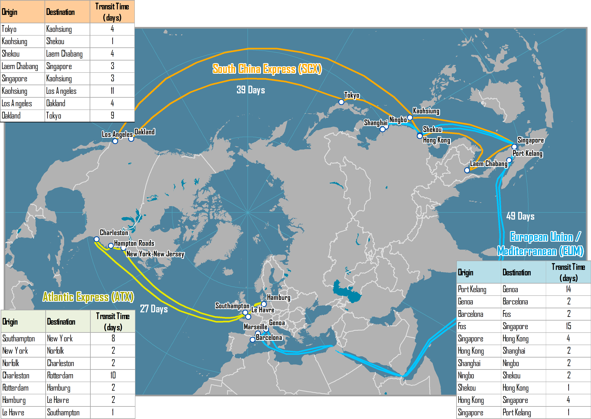
Three Major Pendulum Routes Serviced by OOCL, 2006

Slide 86
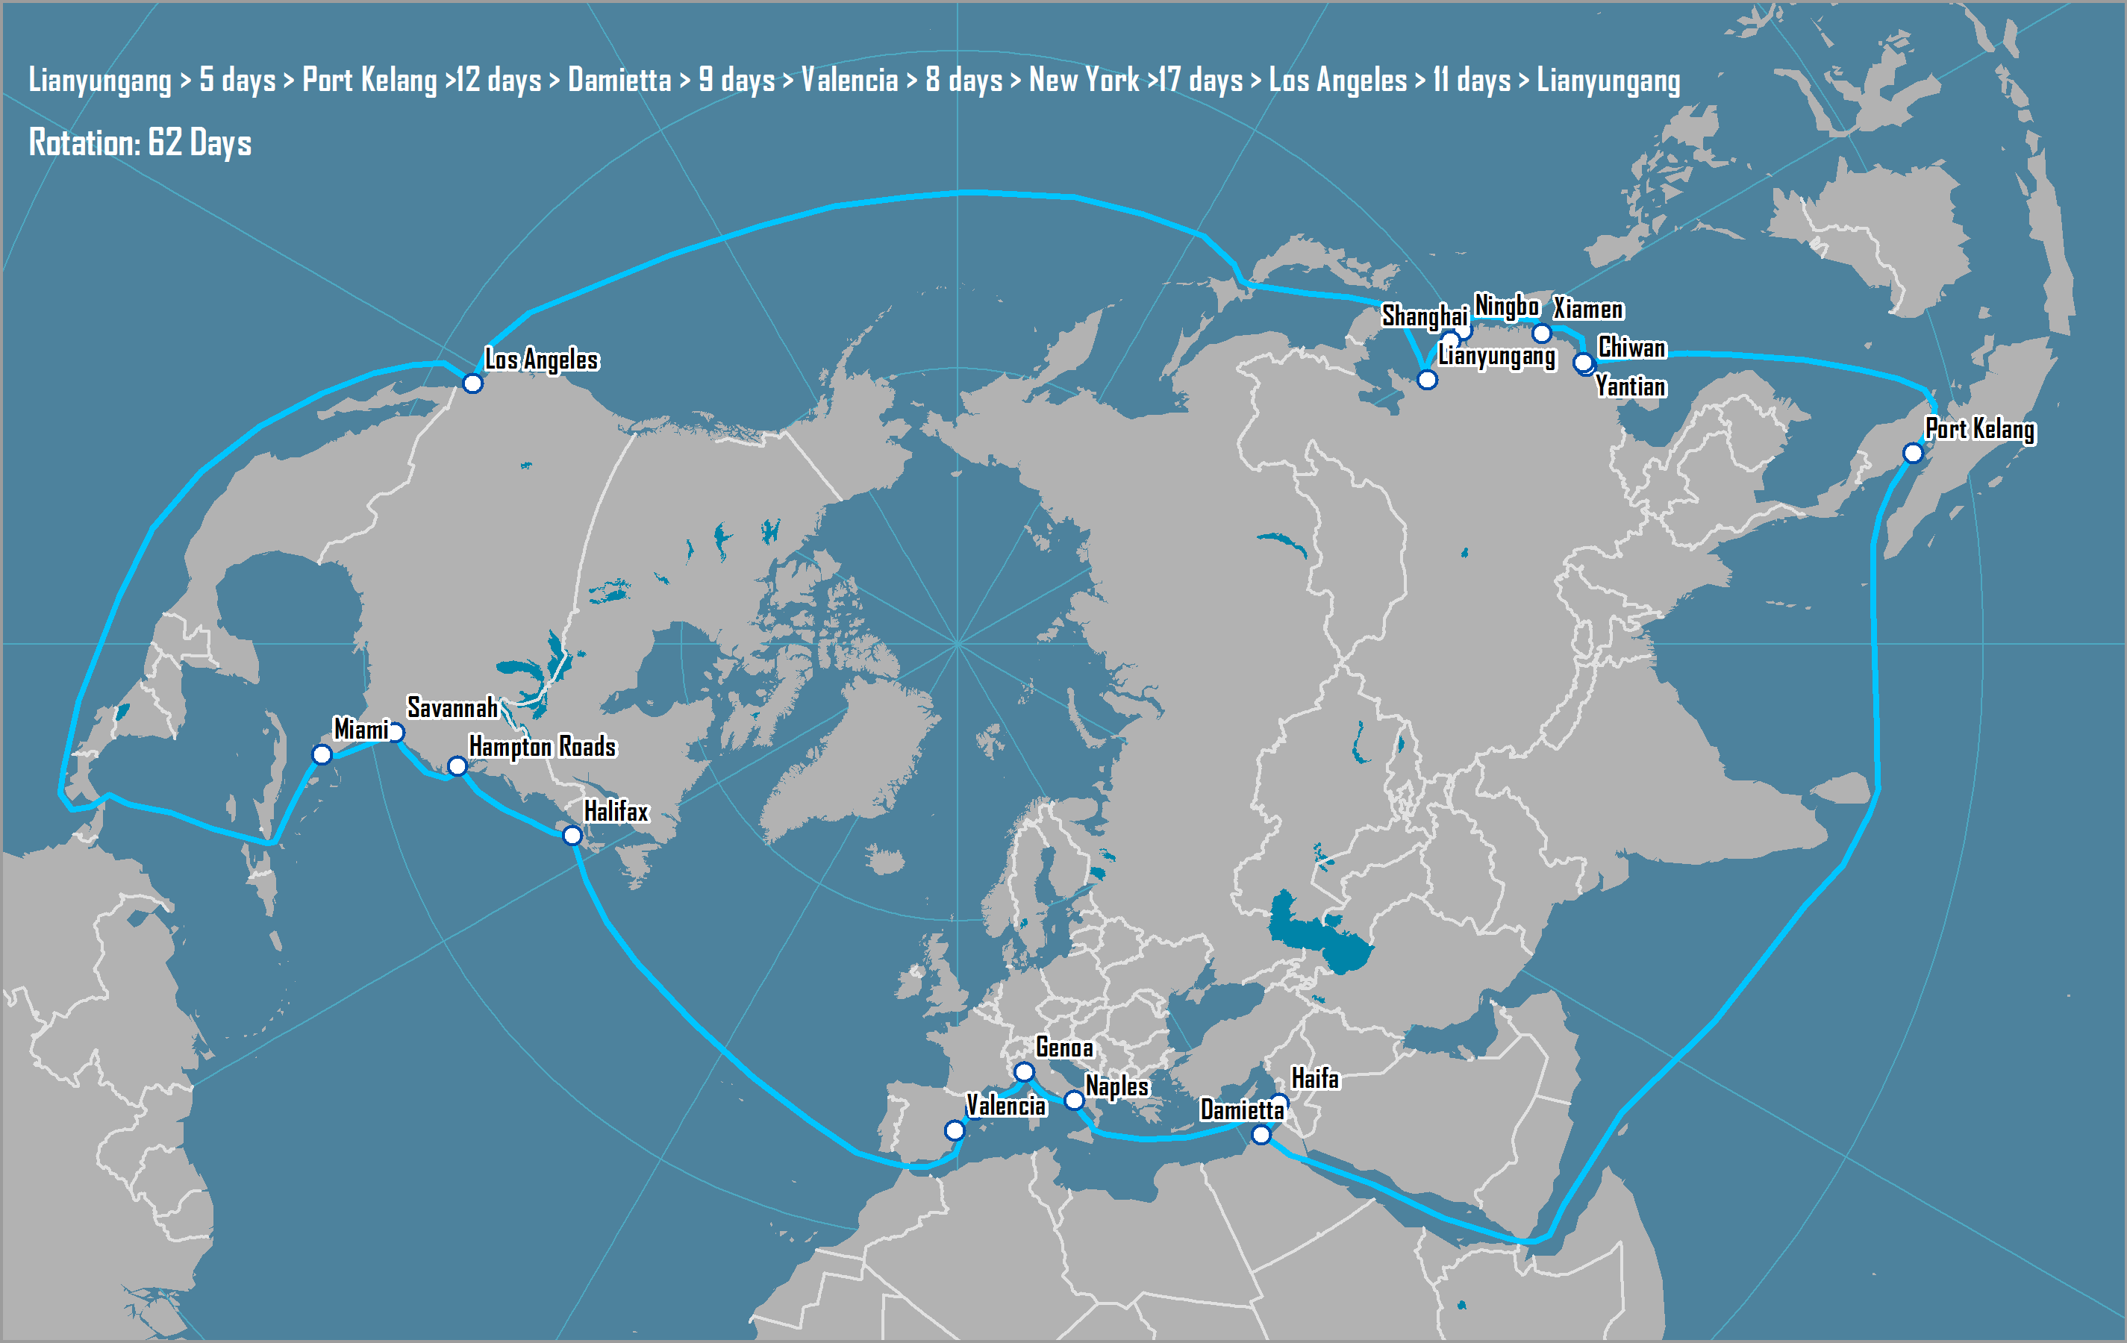
AMAX Round-the-World Route, 2005-2007
Notes:
Source: China Shipping http://www.chinashippingna.com/publish_dir/services/svcmaps/svcmap_amax.htm

Slide 87
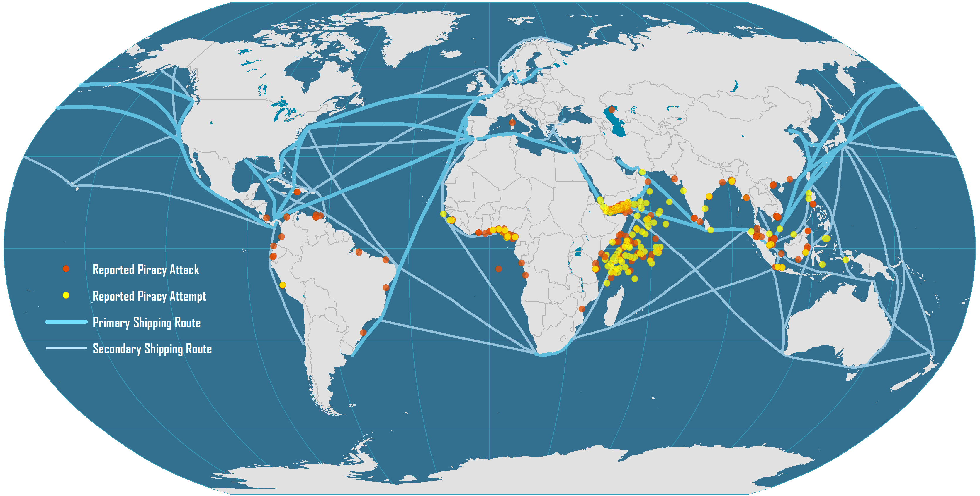
Global Maritime Piracy, 2008-2009
Notes:
Source: ICC International Maritime Bureau. Encoding of piracy events by William Moreto.

Slide 88
Evolution of Containerships
Early Containerships (1956-)
137x17x9
(LOA – Beam – Draft)
Containers across
6
500 – 800 TEU
meters
4
A
200x20x9
4
8
Fully Cellular (1970-)
10
1,000 – 2,500 TEU
215x20x10
Containers high on deck
5
Containers high below deck
4
13
Panamax (1980-)
6
3,000 – 3,400 TEU
250x32x12.5
5
B
Panamax Max (1985-)
8
3,400 – 4,500 TEU
290x32x12.5
17 bays
6
Post Panamax I (1988-)
15
4,000 – 6,000 TEU
300x40x13
17 bays
9
C
5
Post Panamax II (2000-)
17
6,000 – 8,500 TEU
20 bays
9
340x43x14.5
6
20
D
New-Panamax (2014-)
10
12,500 TEU
366x49x15.2
22 bays
6
Notes:
Source: Ashar and Rodrigue, 2012. All dimensions are in meters.

Slide 89
Evolution of Containerships
22
Post Panamax III (2006-)
10
11,000 - 15,000 TEU
397x56x15.5
8
E
23
24 bays
Triple E (2013-)
10
18,000 TEU
400x59x15.5
8

Slide 90
The Largest Available Containership, 1970-2015 (in TEUs)
“Triple E” Class
(18,000 TEU)
E “Emma” Class
(12,500 TEU)
S “Sovereign” Class
(8,000 TEU)
C10 Class
(4,500 TEU)
L “Lica” Class
(3,400 TEU)
R “Regina” Class
(6,000 TEU)
Notes:
“Triple E” Class (2013)
E “Emma” Class (2006)
S “Sovereign” Class (1997)
R “Regina” Class (1996)
C10 APL (1988)
L “Lica” Class (1981)

Slide 91
The Disadvantages of Scale in Maritime Shipping
Port of call issues
Less ports able to accommodate larger ships.
Pressures for expensive port infrastructure improvements.
Terminal operations
Higher throughput; Equipment and yard management issues.
Gate access and hinterland connections.
Supply chain constraints
Lead time issues.
Cargo risks (insurance).
Security and custom inspection issues.
Lower frequency; Risks to schedule reliability.
Higher inventory levels.

Slide 92
Characteristics of Some Historical Containerships
Year | Name | Capacity (TEU) | Yard | Length (m) | Width (m) | Draft (m) | Speed (knots)
1956 | Ideal X | 58 | US | 174.2 | 23.6 | 8.0 | 18.0
1968 | Elbe Express | 730 | B&V | 171.0 | 24.5 | 7.9 | 20.0
1970 | Sealand Navigator | 2,361 |  | 247.6 | 27.5 | 11.1
1972 | Liverpool Bay | 2,961 | B&V | 248.6 | 32.3 | 13.0 | 23.0
1981 | Frankfurt Express | 3,430 | HDW | 271.0 | 32.3 | 11.5 | 23.0
1991 | Hanover Express | 4,407 | Samsung | 281.6 | 32.3 | 13.5 | 23.0
1995 | APL China | 4,832 | HDW | 262.0 | 40.0 | 12.0 | 24.6
1996 | Regina Maersk | 6,700 | Odense | 302.3 | 42.8 | 12.2 | 24.6
1998 | Sovereign Maersk | 8,200 | Odense | 332.0 | 42.8 | 14.5 | 24.7
2001 | Hamburg Express | 7,506 | Hyundai | 304.0 | 42.8 | 14.5 | 25.0
2003 | OOCL Shenzhen | 8,063 | Samsung | 319.0 | 42.8 | 14.5 | 25.2
2005 | MSC Pamela | 9,200 | Samsung | 321.0 | 45.6 | 15.0 | 25.0
2006 | Emma Maersk | 14,700 | Odense | 397.0 | 56.0 | 16.0 | 24.5
2009 | MSC Beatrice | 13,798 | Samsung | 366.1 | 51.2 | 15.0 | 25.2
2012 | MSC Marco Polo | 16,000 | Daewoo | 396.0 | 53.6 | 16.0 | 25.1
2013 | Maersk Mc-Kinney Møller | 18,270 | Daewoo | 399.0 | 59 | 14.5 | 23.0
2015 | MSC Oscar | 19.224 | Daewoo | 394.0 | 59 | 16.0 | 22.8
Notes:
Source: adapted from F. Mewis and H. Klug (2004) “The Challenge of Very Large Container Ships – A Hydrodynamic View”, 9th Symposium on Practical Design of Ships and Other Floating Structures, Luebeck-Travemuende, Germany.

Slide 93
Specifications for Very Large Post-Panamax Containerships
 | “Triple E Class” (Maersk Mc-Kinney Møller) | “E Class” (Emma Maersk) | “S Class” (Sovereign Maersk)
Capacity (TEU) | 18,270 | 14,700 | 8,400
Length (meters) | 399 | 397 | 348
Width (meters) | 59 | 56 | 44
Containers (wide) | 23 | 22 | 17
Draft (meters) | 14.5 | 16 | 15
Deadweight (tons) | 194,150 | 156,900 | 105,000
Speed (knots) | 23 (19 optimal) | 25.5 | 25
Insured value | $140 M | $100 M | $50 M
Notes:
Source: Alphaliner.

Slide 94
Potential Impacts of Larger Containerships on Maritime Transport
Systems
Shipping Network
Port Operations
Hinterland
Cascading of ship assets; Less port of call options; Changes in the frequency of services; Increase in transshipment.
Dredging; Improved equipment; More yard storage.
Increased congestion; Pressure to invest in infrastructures; Modal shift; Setting of inland ports.

Slide 95
Average TEU per Port Call by Containership Size along a Maritime Range
Notes:
Source: Adapted from ISL Bremen

Slide 96
World Cellular Container Fleet, 2015
Notes:
Source: Alphaliner.

Slide 97
Operating Costs of Panamax and Post-panamax Containerships (in USD)
Notes:
Source: Drewry Shipping Consultants Ltd.

Slide 98
Maritime Deviation
5
4
2
D5
D4
D2
1
D1
Deviation
3
D3
Main Maritime Route

Slide 99
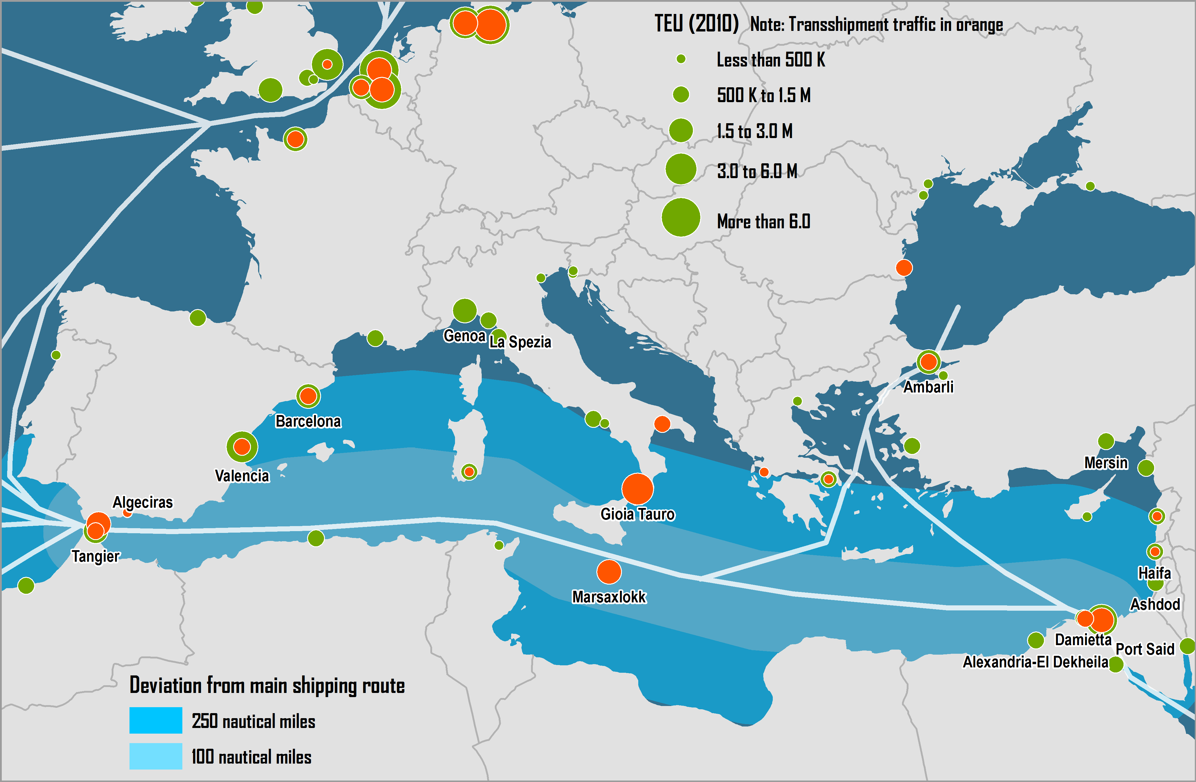
Deviation from the Main Shipping Route of Mediterranean Container Ports
Notes:
Source: Rodrigue, J-P and T. Notteboom (2010) “Foreland-Based Regionalization: Integrating Intermediate Hubs with Port Hinterlands”, Research in Transportation Economics, Vol. 27, pp. 19-29.

Slide 100
Tonnage by Country of Registry, 2013
Notes:
Source: DOT-MARAD, http://www.marad.dot.gov/library_landing_page/data_and_statistics/Data_and_Statistics.htm

Slide 101
Maritime Shipping Characteristics
 | Tramping | Liner Shipping
 | Transportation Demand
Number of shippers | Few | Many
Quantity | Large | Small
Density | High (weight) | Low (volume)
Unit value | Low | High
Regularity | Low | High
 | Transportation Supply
Contract | Vessel | Freight (bill of lading)
Vessels | Liquid and bulk | General cargo
Frequency | Low | High
 | Implications
Freight | Liquid and main bulk commodities | Minor bulk and general cargo (containerized)
Services | Supply / demand regulation | Prior to demand
Freight elasticity | Low | Low
Markets | Developing / developed countries | Developed / developed countries
 | Share in Maritime Transport (2000)
Tons | 70% | 30%
Value | 20% | 80%
Notes:
Source: adapted from P. Cariou (2003) Co-operation agreements in Liner Shipping.

Slide 102
Types of Maritime Cargo
Commodity type | Examples | Maritime Transshipment | Inland distribution
Liquid
A) Normal pressure and temperature | Crude oil, most oil products, wine, slurried coal | Pump/pipe | Pipeline
B) Other pressure and temperature | Liquefied gases (LNG, LPG), heavy oils, latex, bitumen, vegetable oils | Pumps, temperature controlled pipelines | Temperature controlled pipelines
Dry Bulk
A) Flowing | Grain, sugar, powders (alumina, cement) | Pneumatic / suction, conveyor, grabs | Pipes, conveyors, barge, rail wagon, lorry
B) Irregular | Coal, iron ores, non-ferrous ores, phosphate rock | Grab, conveyor | Conveyor, barge, rail wagon, lorry
Neo Bulk | Forest products, steel products, baled scrap | Lift-on/lift-off, roll-on/roll-off | Barge, rail wagon, lorry
Wheeled Units | Cars, lorries, rail wagons | Roll-on/roll-off | Rail wagon, lorry
Refrigerated/chilled cargo | Meat, fruit, dairy produce | Lift-on/lift-off | Rail wagon, lorry
Notes:
Source: adapted from D. Hilling and M. Browne (1998) “Ships, Ports and Bulk Freight Transport” in B. Hoyle and R.D. Knowles, Modern Transport Geography, London: Wiley.

Slide 103
Cargo, Trade and Ship Characteristics
Cargo Type | Trade Characteristics | Vessel Size
General Cargo
Conventional | Varied small consignments, Numerous consignees, Slow handling rates, Various routes, Numerous ports | Small
Unitized (containers) | More uniform cargo, Rapid handling, Many ports | Medium to large
Dry Bulk
Grain | Small to medium consignments, Varied handling rates, Many restrictive ports | Small to medium
Ores/coal | Large consignments, Long hauls, Moderate handling rates, Specialized terminals, Few ports | Medium to very large
Liquid
Crude oil | Very large consignments, Long hauls, Few routes, Specialized terminals, Few ports | Very large to ultra large
Oil products | Small shipments, Numerous consignees, Many ports | Small to medium
Notes:
Source: adapted from D. Hilling and M. Browne (1998) “Ships, Ports and Bulk Freight Transport” in B. Hoyle and R.D. Knowles (eds), Modern Transport Geography, London: Wiley, p. 246.

Slide 104
Characteristics of Short Sea Shipping Services
Characteristics | Regional Short Sea Services | Feeder Services | Ferry Services
Market | Regional or intra-corporation cargo | Feeder cargo (from/to deepsea services) | Regional cargo over short distances
Frequency | Fixed schedule with low frequency | Shipping line schedule | Fixed schedule with high frequency
Service orientation | Regional loop | Transshipment hubs | Point to point
Operations | Lift-on/Lift-off (Lo/Lo); Roll-on/Roll-off (Ro/Ro) | Lift-on/Lift-off (Lo/Lo) | Roll-on/Roll-off (Ro/Ro)
Cargo type | Containers, break bulk, Ro/Ro | Containers | Trucks, trailers, passengers
Infrastructure Requirements | Shore-side cranes, warehouses and container storage areas | Shore-side cranes and container storage areas | Minimal (quays), particularly if vessels have self-sustaining ramps
Competition | Road and rail transport (if present) | Direct port calls. Ferry services. | Road and air transport (if present). Feeder services.
Notes:
Source: I-95 Corridor Coalition (2005) “Short-Sea and Coastal Shipping Options Study”. http://144.202.240.28/pman/projectmanagement/Upfiles/reports/full343.pdf

Slide 105
Regional Short Sea Services
Feeder Services
Ferry Services

Slide 106
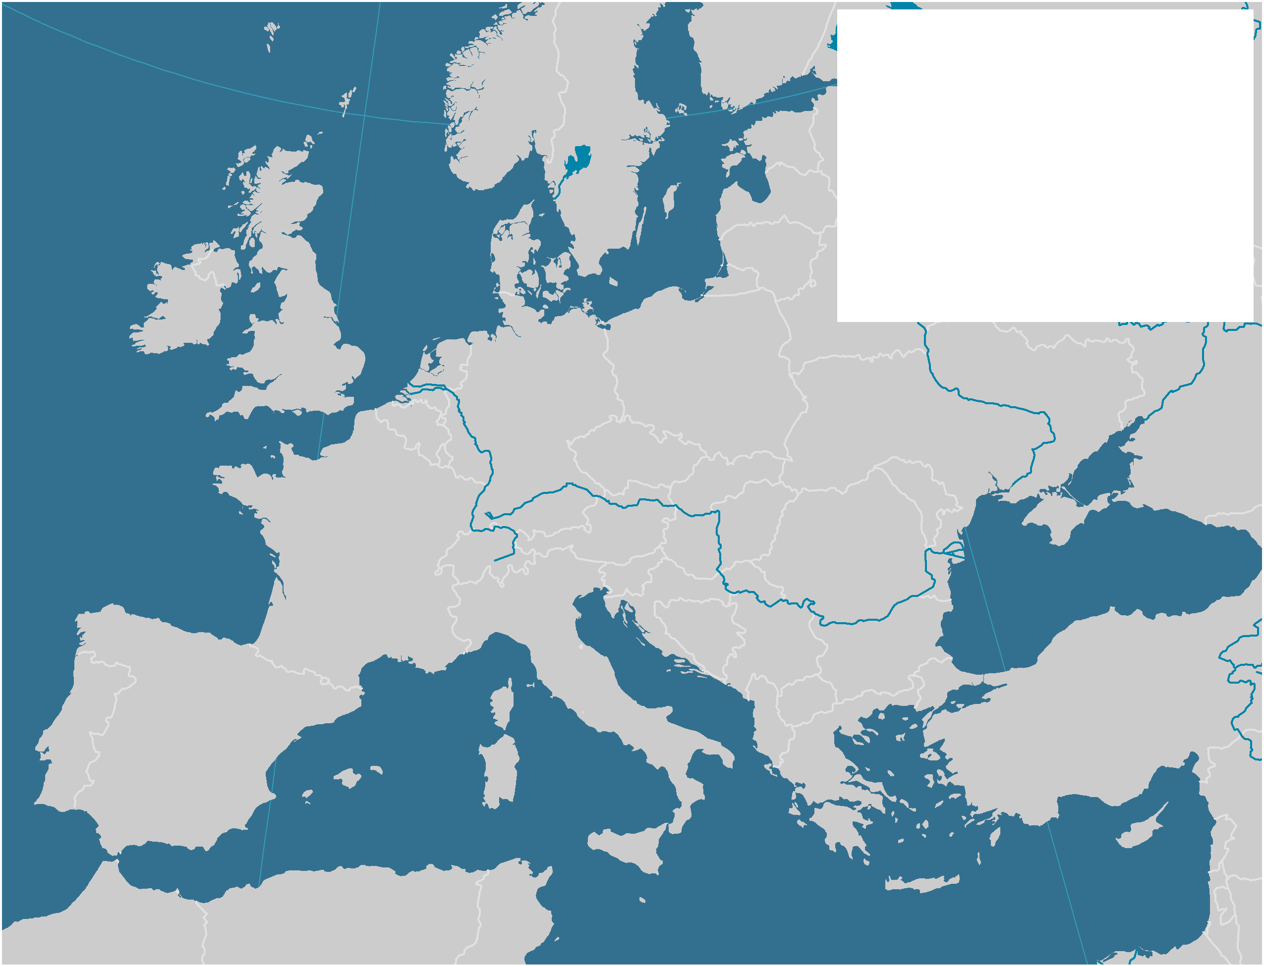
The European Short Sea Shipping Market
North
Sea
52
41
125
Cargo Carried (Million tons)
51
43
Baltic
110
Main Short Sea Shipping
Corridor
Atlantic
Ocean
443
536
From
To
Cargo Transited
(Million tons)
84
59
123
50
56
60
75
74
256
130
Black Sea
210
72
42
134
61
581
56
Mediterranean
Notes:
Source: Data from Eurostat.

Slide 107
Types of Pendulum Routes
Symmetrical
Asymmetrical
Inter-Hub
Notes:
CABOTAGE.

Slide 108
Factors Impacting Maritime Shipping Networks
Frequency of Service
Fleet and Vessel Size
Number of Port Calls
2
2
2
2
2
2
2
2
3
3
3
2
2
2
2
2
2
3
3
3
Port calls per week
4,000 TEU
5,000 TEU
Port calls per week

Slide 109
Pendulum Services and Cabotage
Country 1
A
Pendulum Service
D
B
E
Cabotage
C
F
Country 2

Slide 110
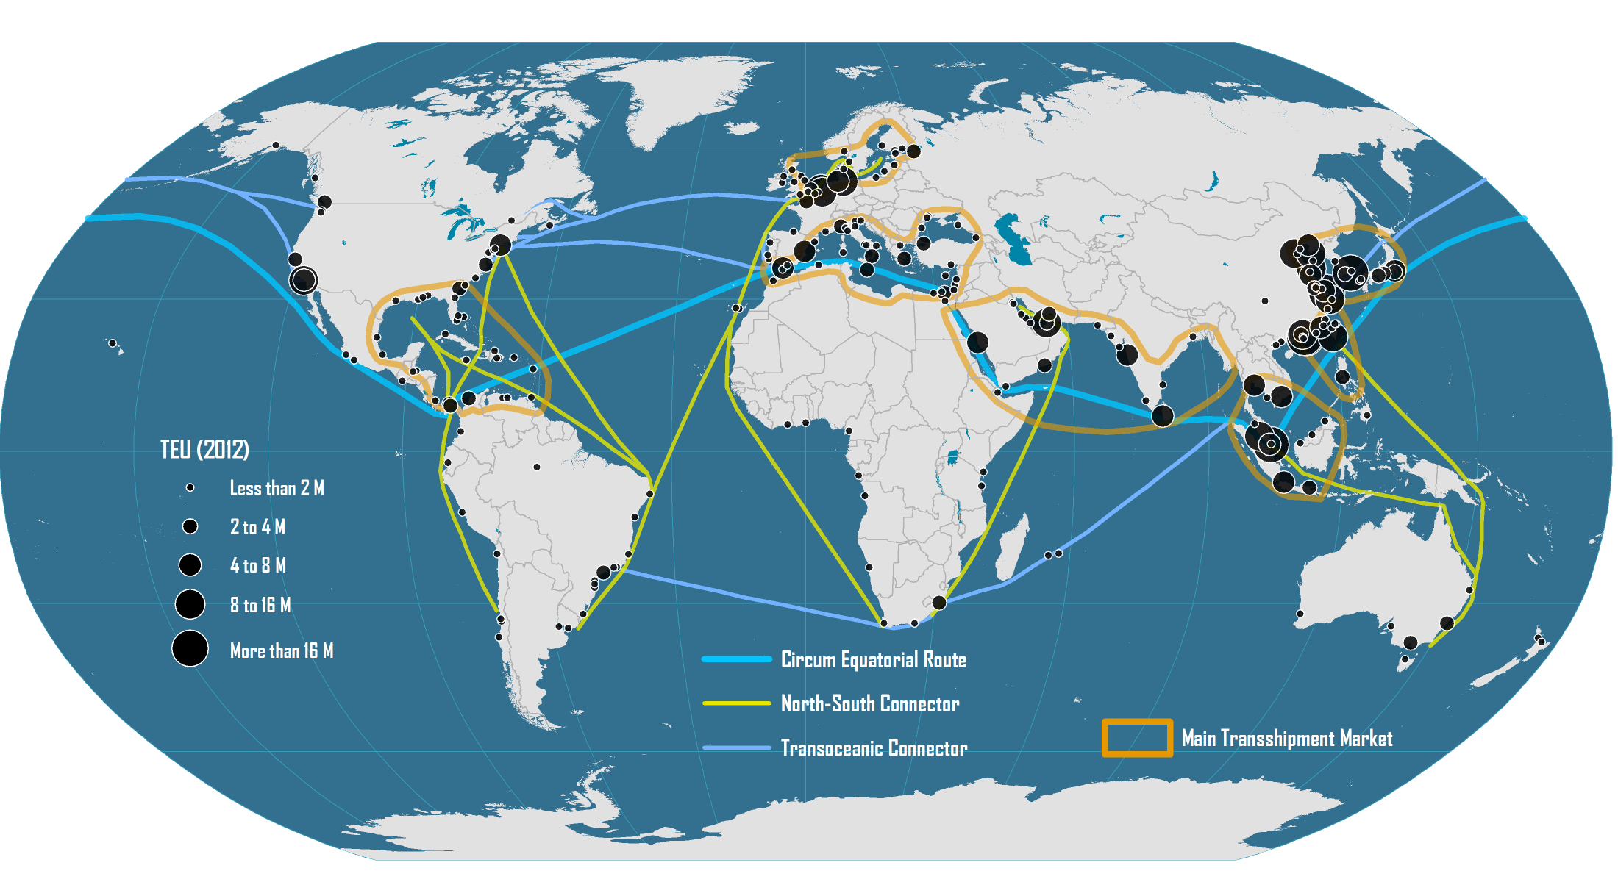
Emerging Global Maritime Freight Transport System

Slide 111
The Maritime Transport Life Cycle and Main National Actors
Financing and Insurance
UK & Scandinavia
1. Building
2. Ownership
3. Registration
4. Operations
5. Scrapping
Korea & China
(72%)
Greece, Japan &
China (38%)
Panama, Liberia
& Marshall Islands
(42%)
Denmark &
Switzerland (30%)
India, Bangladesh, China &
Pakistan (92%)
Seafarers
Philippines & Indonesia
Global Terminal Operators
Hong Kong, Netherlands, Singapore & UAE (44%)
Notes:
Source: Adapted from UNCTAD, Review of Maritime Transport, various issues. J. Hoffmann (2014) “Who controls the world's fleet? Trends in the ship owning countries”, Maritime Money Geneva Forum.

Slide 112
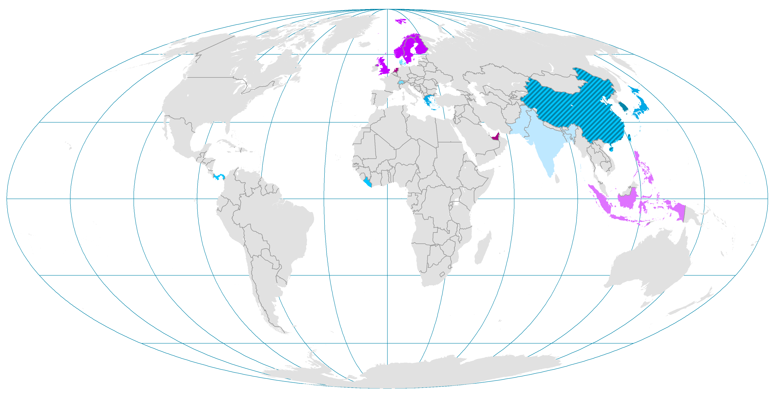
The Maritime Transport Life Cycle and Main National Actors
Hong Kong, Netherlands,
Singapore & UAE (44%)
UK & Scandinavia
Philippines & Indonesia
Financing and Insurance
Global Terminal Operators
Seafarers
SUPPORT
CORE
1. Building
2. Ownership
3. Registration
4. Operations
5. Scrapping
China, South Korea & Japan (91%)
Greece, Japan &
China (38%)
Panama, Liberia
& Marshall Islands
(42%)
Denmark &
Switzerland (30%)
India, Bangladesh, China &
Pakistan (95%)

Slide 113
Air transport

Slide 114
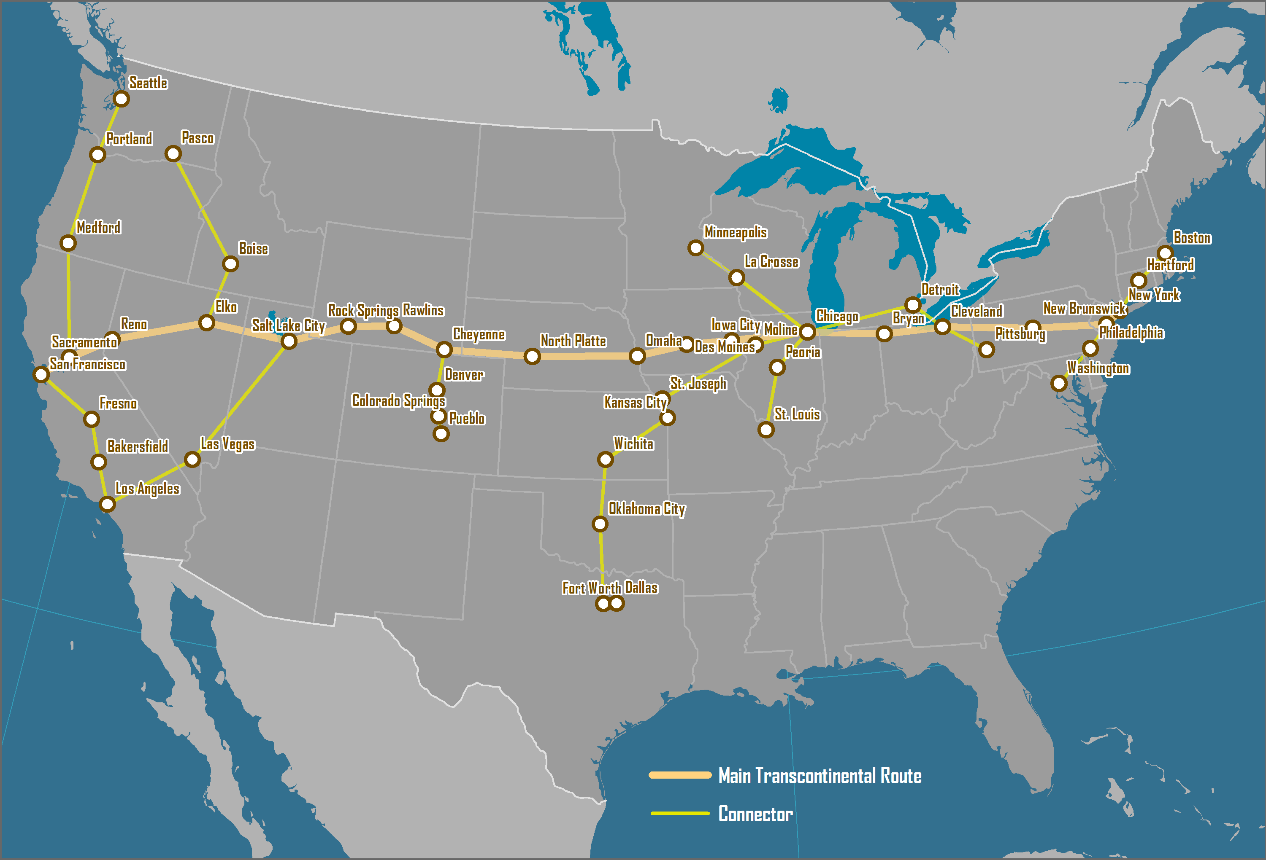
US Post Office Airmail Routes, 1921-26
Notes:
Source: adapted from C. Allaz (2005) History of Air Cargo and Airmail from the 18th Century, London: Christopher Foyle Publishing.

Slide 115
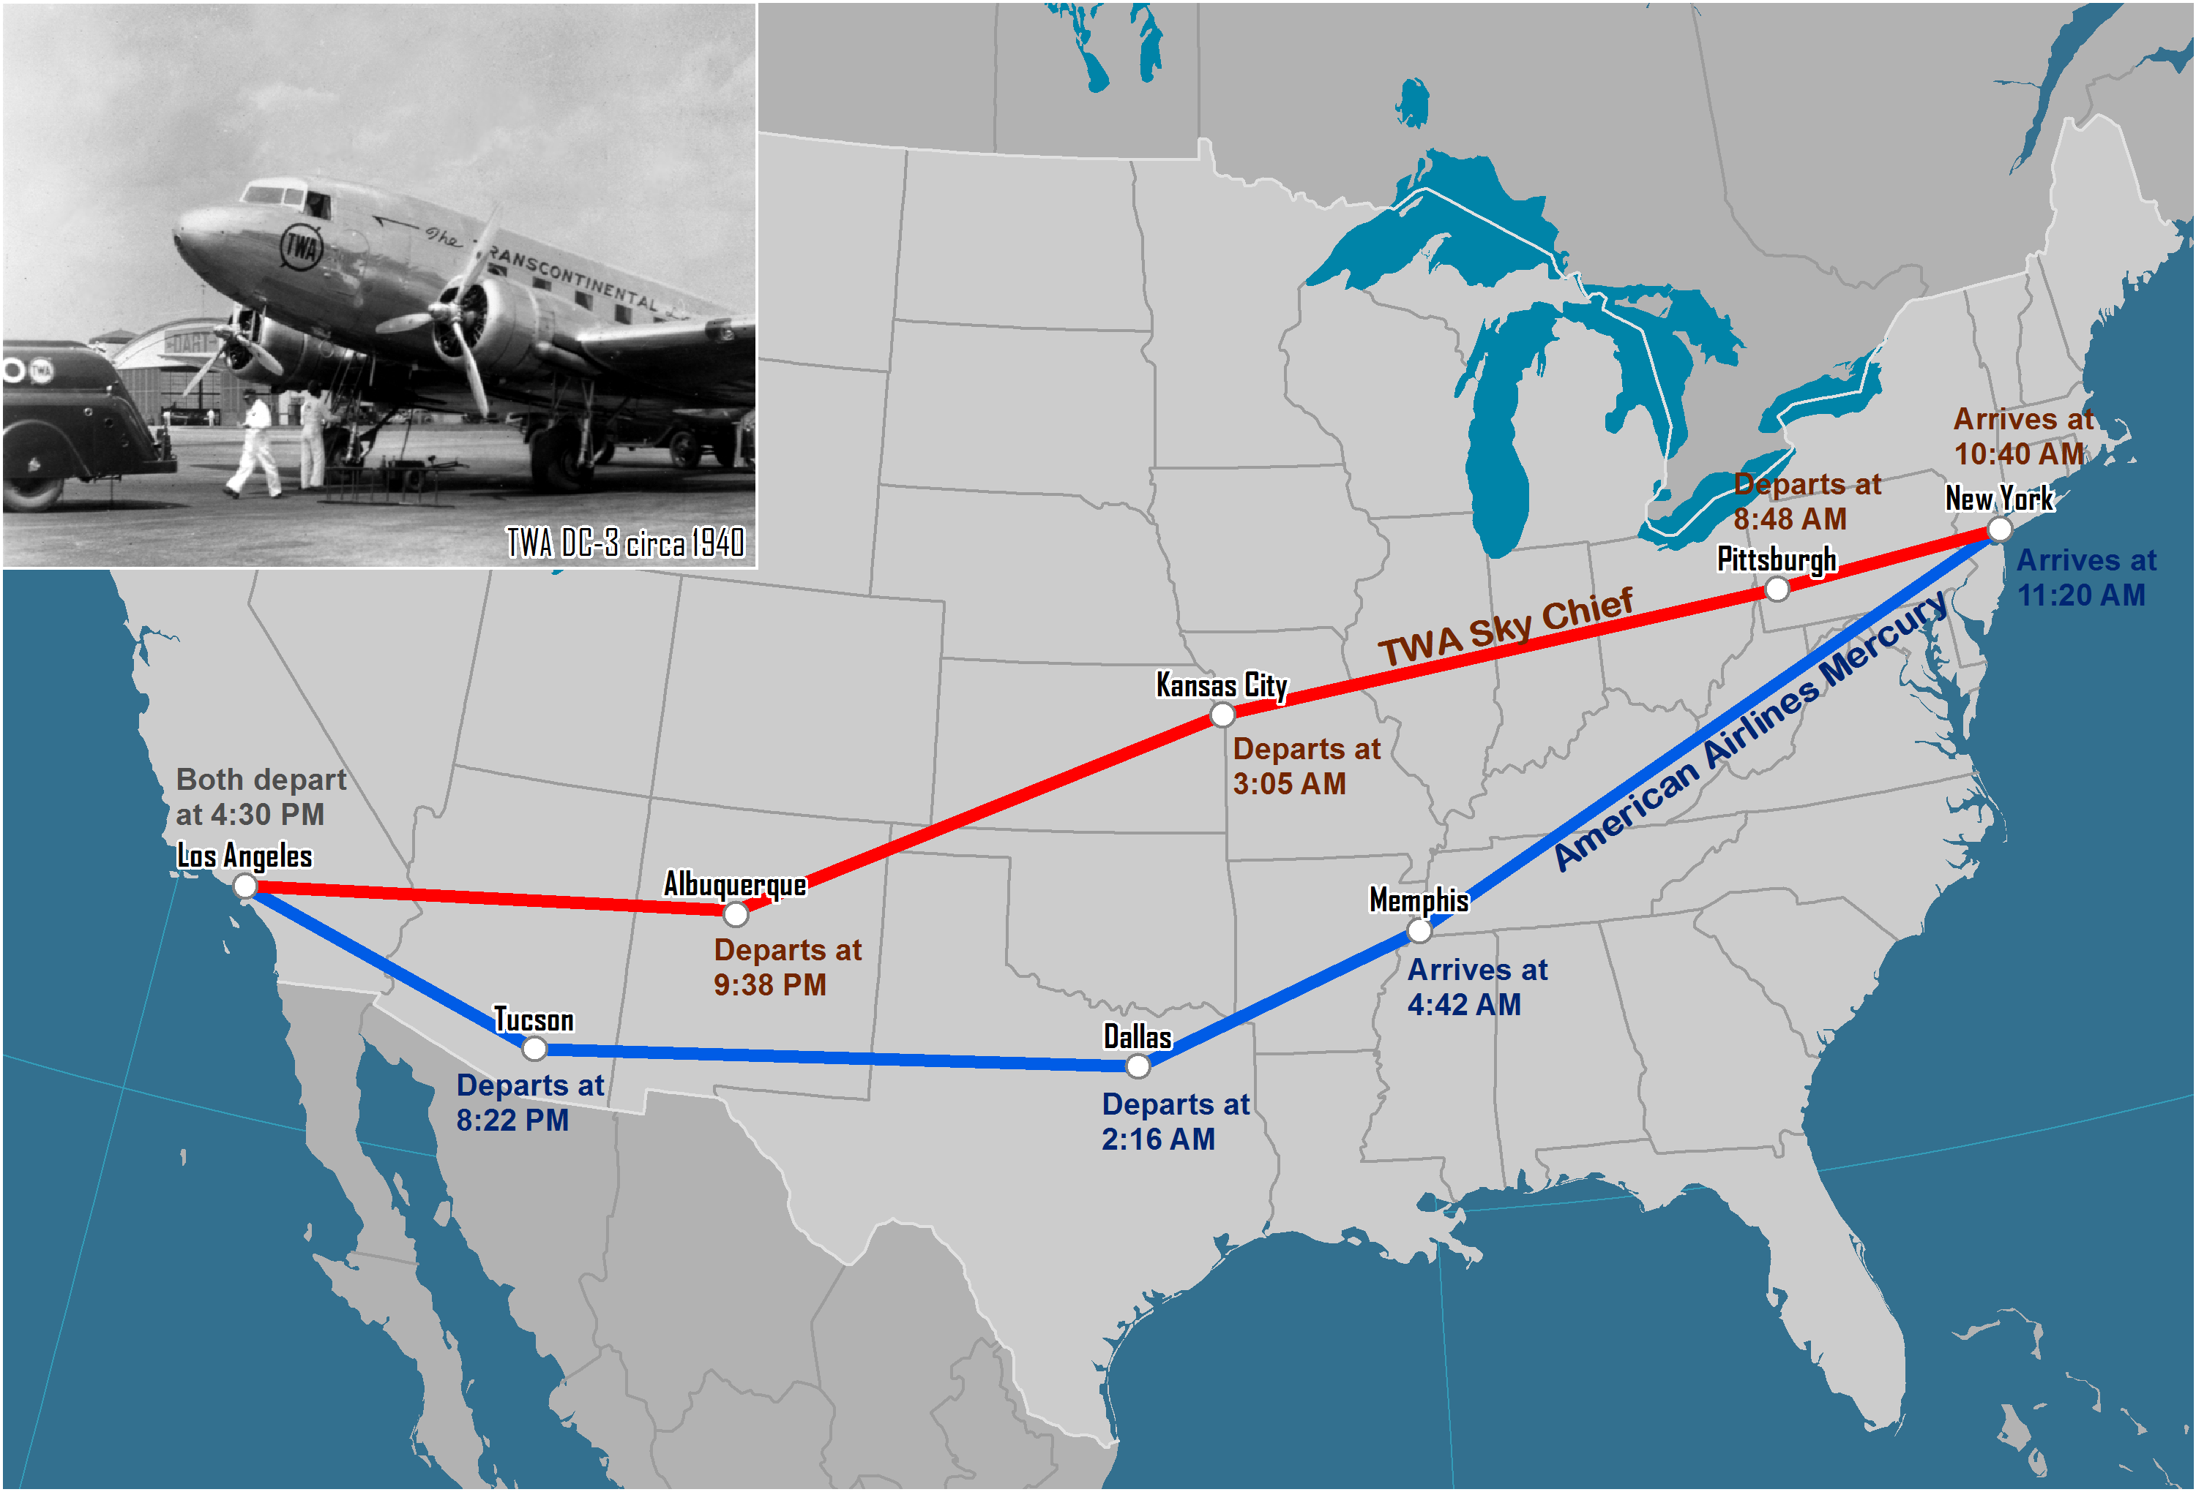
Selected Transcontinental DC-3 Routes, Late 1930s
Notes:
Source: Based on historic timetables available at www.airchive.com.

Slide 116
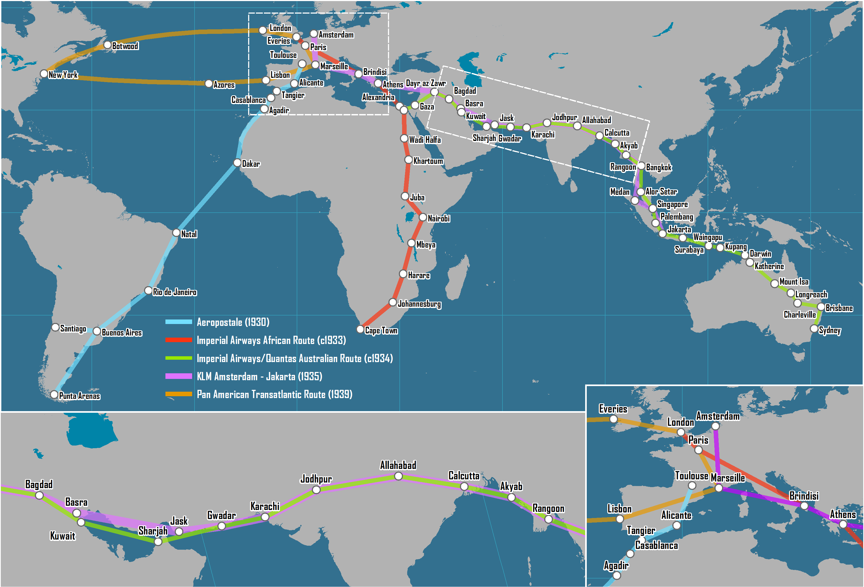
Early Intercontinental Air Routes, 1930s
Notes:
Source: adapted from B. J. Graham (1995) Geography and Air Transport, New York: Wiley, p. 13.

Slide 117
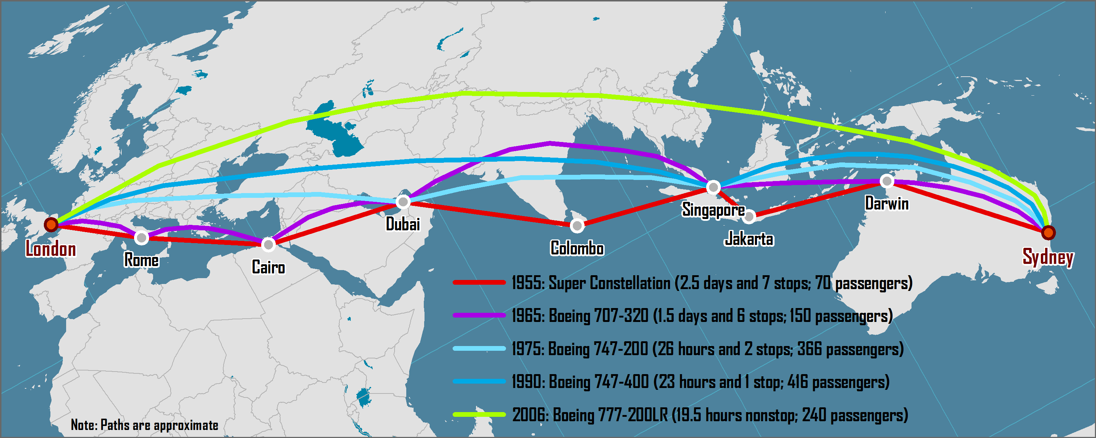
Shortest Air Route between London and Sydney, 1955 - 2006

Slide 118
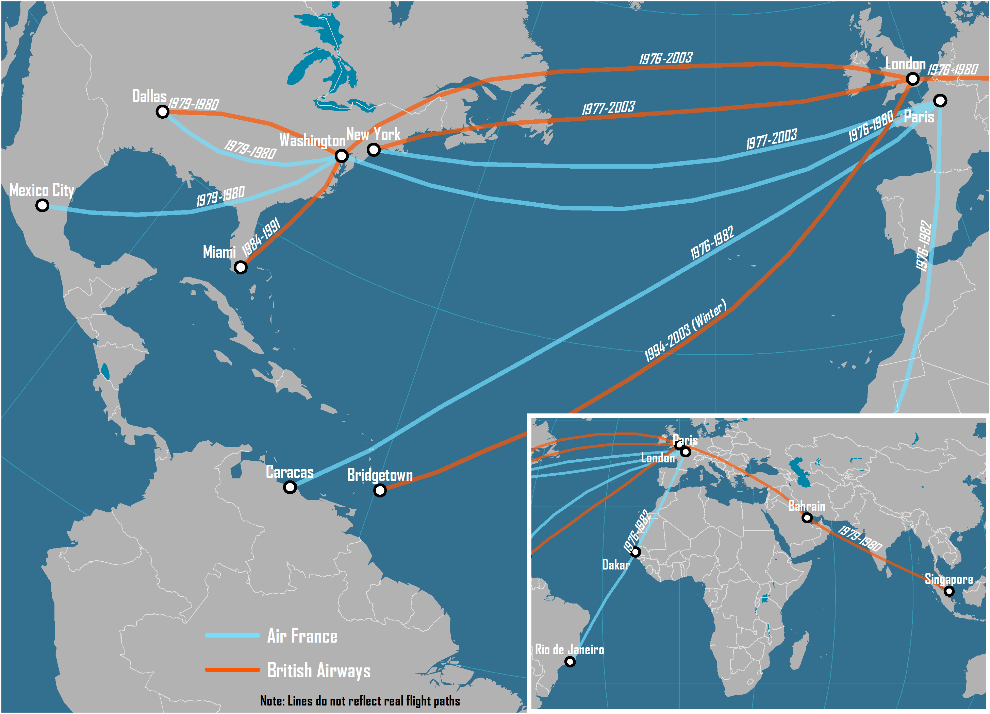
Concorde Services, 1976-2003

Slide 119
Average Airfare (roundtrip) between New York and London, 1946-2015 (in 2012 dollars)
Notes:
Source: Updated from Bowen, J. (2004) “World-Shapers: The Geographical Implications of Several Influential Jet Aircraft”, paper presented at the 2004 Conference of the American Association of Geographers.

Slide 120
Main Commercial Passenger Aircraft, 1935-2015
Aircraft | Year of First Commercial Service | Speed (km/hr) | Maximum Range at Full Payload (km) | Seating Capacity
Douglas DC-3 | 1935 | 346 | 563 | 30
Lockheed L-649 Constellation | 1943 | 560 | 8,200 | 95
Douglas DC-7 | 1953 | 555 | 7,500 | 105
Boeing 707-100 | 1958 | 897 | 6,820 | 110
Boeing 727-100 | 1964 | 870 | 4,300 | 134
Boeing 737-200 | 1967 | 780 | 3,500 | 97
Boeing 747-100 | 1970 | 907 | 9,045 | 385
McDonnell Douglas DC-10 | 1971 | 908 | 7,415 | 260
Airbus A300 | 1974 | 847 | 3,420 | 269
Boeing 767-200 | 1982 | 954 | 5,855 | 216
Boeing 747-400 | 1989 | 939 | 13,444 | 416
Boeing 777-200ER | 1995 | 1030 | 14,300 | 300
Airbus A340-500 | 2003 | 886 | 15,800 | 313
Airbus A380 | 2007 | 1050 | 14,800 | 544
Boeing 787-8 | 2012 | 902 | 15,700 | 250
Airbus A350 | 2015 | 902 | 15,200 | 280
Notes:
Source: adapted from T.R. Leinbach and J.T. Bowen (2004) Airspaces: Air Transport, Technology and Society, in D.B. Brunn, S.L. Cutter and J.W. Harrington (eds) Geography and Technology, Dordretch, The Netherlands: Kluwer.

Slide 121
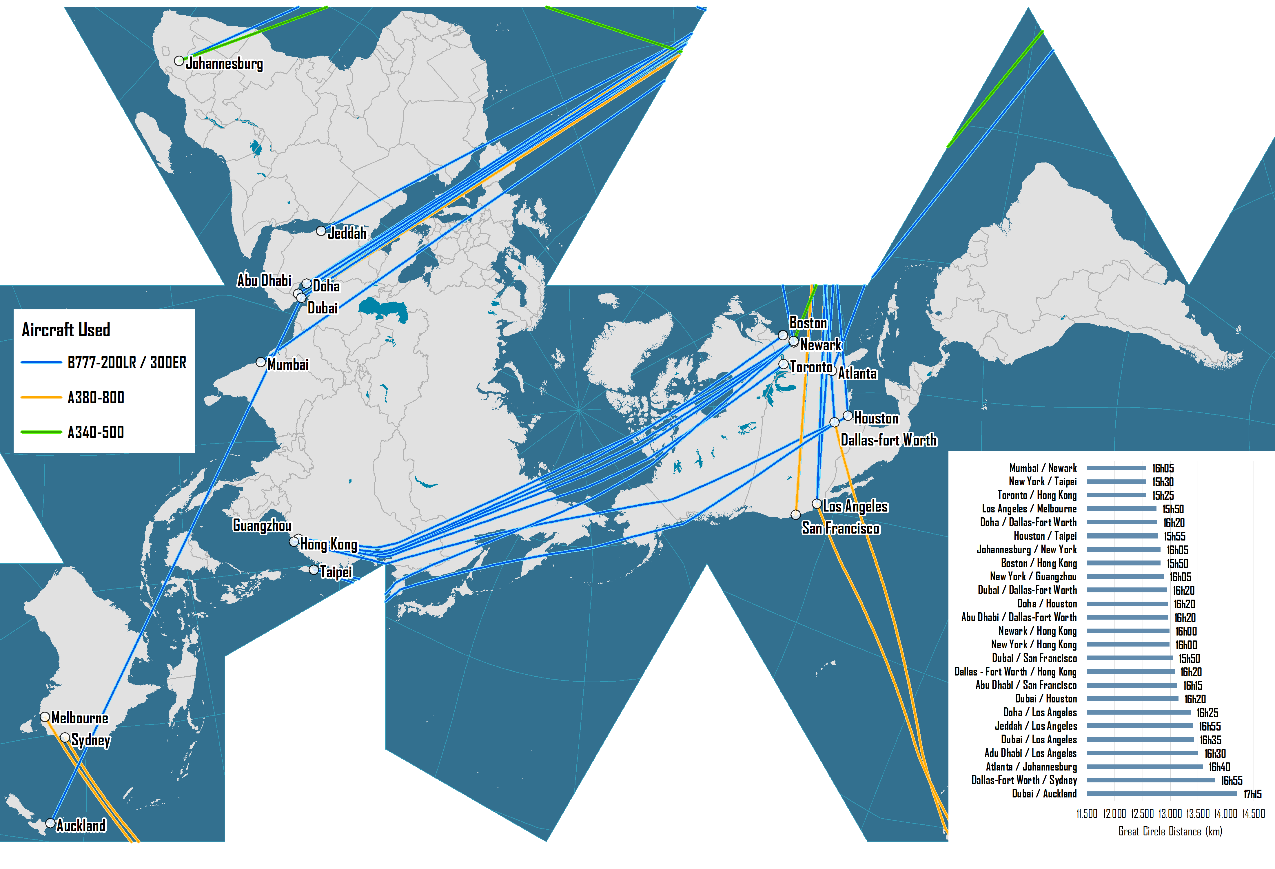
The World's Longest Nonstop Air Transport Routes, 2016

Slide 122
World Air Travel and World Air Freight Carried, 1950-2015
Notes:
Source: Airlines for America.
http://airlines.org/data/annual-results-world-airlines/

Slide 123
Annual Air Transportation Growth (Passengers and Freight) and Economic Growth, 1950-2015
Notes:
Source: Air Transport Association and Worldwatch Institute.

Slide 124
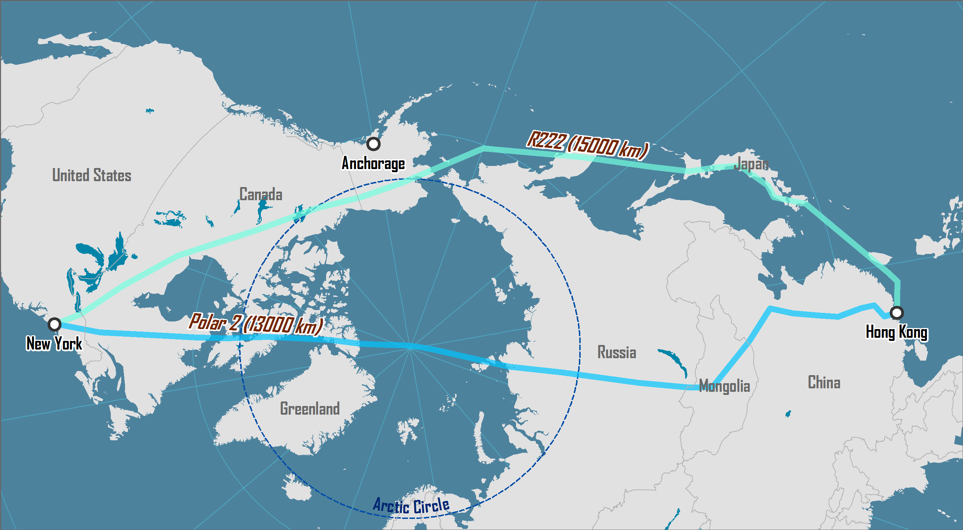
New York / Hong Kong Air Routes: Conventional and Polar

Slide 125
Airline Deregulation and Hub-and-Spoke Networks
Before Deregulation
After Deregulation
Hub
Hub

Slide 126
Strategies of Low-Cost Carriers
On-board operations | Optimum use of seating space. Minimal crew. Limited and paying cabin service.
Aircraft operations | Few (often one) types of aircraft used to minimize maintenance costs. Stair boarding instead of air bridges. Maximal usage of runway length (take-off thrust and braking on landing). Fast turn around to maximize aircraft use. No freight being carried.
Service network | Point-to-point services. Destinations commonly of less than two hours apart. Usage of secondary airports (lower gate rates).
Booking | Online booking to minimize transaction costs. No travel agent commissions.
Notes:
Source: adapted from Graham, B. and T. Vowles (2006) “Carriers within carriers: a strategic response to low-cost airline competition”, Transport Reviews, Vol. 26, pp. 105-126.

Slide 127
Strategies Used by Airlines to Save Fuel
Dimension | Strategy
Fleet | Retiring less fuel efficient aircrafts (e.g. DC-9, DC10, MD-80). Switching to more fuel efficient aircrafts (e.g. A330, A319).
Operations | Less engine idle at gates (electrical systems). Lower flying speed (-5%). More frequent plane and engine washing.
On board | Lighter seats. Removal of seat-pocket documents (e.g. magazines). Less water in bathrooms. Lighter service carts.
Passengers | Weight restrictions for luggage. Surcharges for first or second check-in luggage. Passengers weight surcharges (?)

Slide 128
Selected Low-Cost Carriers
Airline | Country | 2005 Fleet | 2005 Revenue (USD Millions)
Southwest | USA | 454 B737s | 7,584
EasyJet | UK | 62 A319s; 43 B737s | 2,365
Ryanair | Ireland | 107 B737s | 2,044
jetBlue | USA | 89 A320s; 19 ERJs | 1,701
Air Berlin | Germany | 8 A319s/A320; 40 737s; 3 Other | 1,457
Virgin Blue | Australia | 47 B737s | 1,335
WestJet | Canada | 56 B737s | 1,197
Gol | Brazil | 47 B737s | 1,140
Frontier | USA | 51 A318s/A319s/A320s | 944
AirAsia | Malaysia | 6 A320s; 21 B737s | 174
Notes:
Source: Air Transport World, July 2006.

Slide 129
Air Freedom Rights
First
Second
Third
Home
Country B
Country A
Fourth
Fifth
Sixth
Seventh
Eight
Ninth

Slide 130
Stages in Air Network Development
Stage 1
Stage 3
Stage 2
Stage 4
Notes:
Source: Adapted from O’Connor, K. (1995) “Airport Development in Southeast Asia”, Journal of Transport Geography, Vol. 3, No. 4, pp. 269-279.

Slide 131
Network Effect of Strategic Alliances
B
A
C
E
D

Slide 132
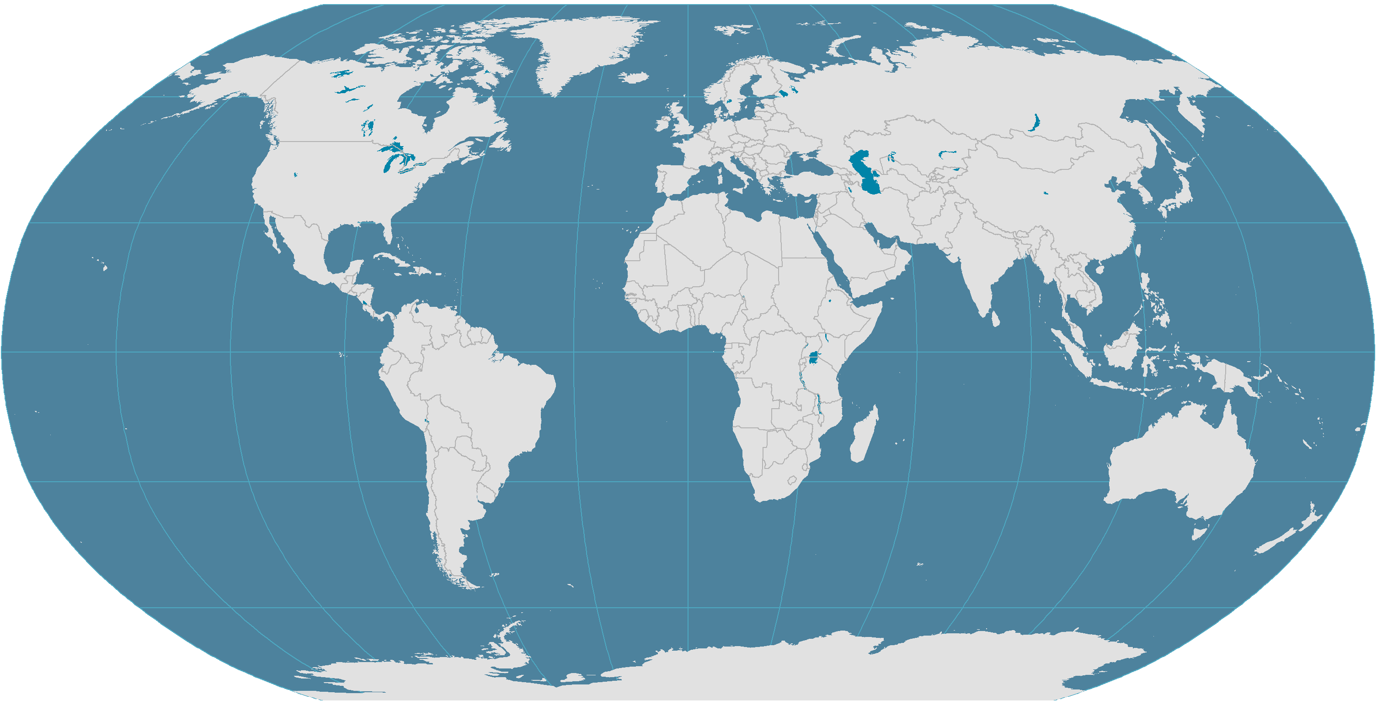
Major Air Traffic Flows Between Regions, 2010
North America
Europe
1.5%
8.7%
2.2%
13%
1.9%
1.1%
1.5%
19%
2.2%
2.9%
1.1%
1%
2.5%
7%
Northeast Asia
1.5%
2.8%
2%
1.6%
2.3%
1.7%
Middle East
1%
China
1.5%
1.1%
Central America
1.3%
1%
1%
South Asia
3%
Africa
Southeast Asia
2%
1.3%
South America
2%
Oceania
Notes:
Source: IATA, World Air Transport Statistics. In revenue passenger-km.

Slide 133
North America
Northeast Asia
Europe
Central America
China
Southeast Asia
South Asia
Oceania
South America
Middle East
Africa

Slide 134
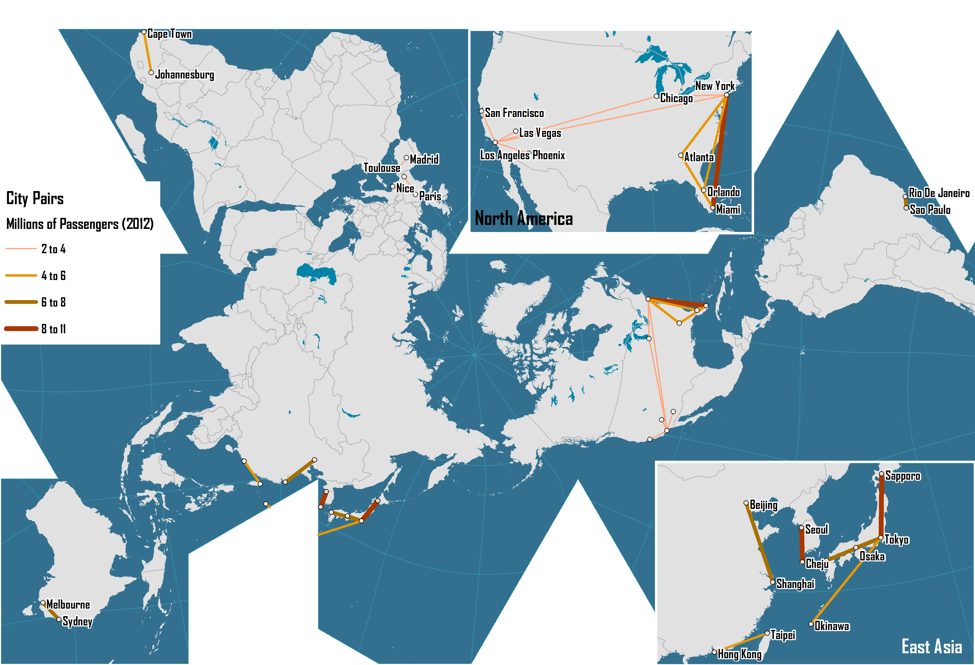
The World's Busiest Air Transport Routes, 2012
Notes:
Source: Amadeus.

Slide 135
Intermodal Transport

Slide 136
Intermodalism and Transmodalism
Intermodalism
Origin
Destination
Road
Rail
Maritime
Transmodalism
Origin
Destination
Rail
Rail

Slide 137
Major Steps in Intermodal Integration
Advanced Containers
Advanced Terminals
Regionalization
Intermodal rail crane (1985)
Doublestacking; IBCs (1985)
Intermodal Integration
Deregulation (1980s)
COFC (1967)
Transatlantic (1966); Containerships (1968)
Standardization (size and latching) (1965)
Containerization (1956)
TOFC (1950s)
Pallets (1930s)
Time

Slide 138
Integrated Transport Systems: From Fragmentation to Coordination
Factor | Cause | Consequence
Technology | Containerization & IT | Modal and intermodal innovations; Tracking shipments and managing fleets
Capital investments | Returns on investments | Highs costs and long amortization; Improve utilization to lessen capital costs
Alliances and M & A | Deregulation | Easier contractual agreements; joint ownership
Commodity chains | Globalization | Coordination of transportation and production (integrated demand)
Networks | Consolidation and interconnection | Economies of scale, efficiency and control.

Slide 139
The Benefits of Containerization
Transport Costs
Lower freight rates
Inventory Costs
Lower storage costs
Faster inventory turnover
Service Level
Time reliability
Higher frequency
Lower insurance rates
Lower packing and packaging costs
Minimal load unit

Slide 140
The Four Revolutions of Containerization
1- Containerization of Maritime Transport Systems
Container port
2- Containerization of Inland Transport Systems
Gateway
Pendulum
Services
Corridor
Intermodal terminal
3- Intermodal and Transmodal Operations
Inland Port
Transshipment
hub
Transloading
Notes:
Asaf Ashar: “The revolutions relate to a series of technological breakthroughs, expanding the boundaries of the shipping system in the pursuit of economies of scope. The first revolution was the unitization of cargo, or containerization, focusing on the ship to shore transfer process and inducing the development of specialized ships and ports. The second was the expansion of containerization to land transport modes, or intermodalism, using the marine boxes for the entire ship to door transport process. This revolution was facilitated by the development of unit-trains with articulated, double stack railcars, on or near dock intermodal yards to handle them, domestic containers (in the US) and near dock transloading terminals to transfer the content of marine to domestic boxes, and hinterland “dry” ports, serving as extensions of the marine ones. The third revolution included the development of transshipment, or ship to ship transfer, linking together different shipping services and expanding the reach of container shipping to smaller ports. The fourth revolution, as depicted there, revolves around a far reaching rationalization of the worldwide service pattern of shipping services intended to create a comprehensive, integrated network, defined there as the global grid. The core service pattern of this grid is cross- Panama, bi-directional (counter rotating) equatorial round the world (ERTW), functioning as the “ring road” for the major east/ west trades,”

Slide 141
The Four Revolutions of Containerization
Phase 1
Phase 3
Inland Port
Transshipment
hub
Phase 2
Phase 4
Gateway
CER
Intermodal
terminal

Slide 142
Intermodal Transport Chain
Composition
‘Last mile’
Interchange
Transfer
‘First mile’
Local / Regional Distribution
Decomposition
National / International Distribution
Transport Terminal

Slide 143
Intermodal Transportation as an Integrative Force
Multimodal Point-to-Point Network
Intermodal Integrated Network
C
C
A
A
B
B
Transshipment
Rail
Road
D
D
Transshipment
F
F
E
E

Slide 144
Integrated Freight Transport Systems: Intermodal and Transmodal Operations
Transloading facility
Road
Distribution Center/ Cross-docking
On-dock rail
Intermodal operations
Rail
Thruport
Maritime
Port container yard
Intermediate Hub
Transmodal operations

Slide 145
Conditions and Outcomes of Intermodal Transport
Conditions
Outcomes
Load Unit
Intermediate and finished goods in load units of less than 25 tons.
Lower Total Transport Costs
From economies of scale and the use of more effective modes and intermodal operations.
Modal Continuity
Sequence of connected infrastructure; an intermodal transport chain.
Modal shift
Each mode according to their respective time and cost advantages.
Transport Distance
Distances above 500 km (longer than one day of trucking) usually require intermodal transportation.
Consolidation / Deconsolidation
The requirement to consolidate and deconsolidate load units at intermodal terminals.
X
Cargo Value
Suitable for intermediate cargo values. Low and high value shipments are usually less suitable.
Higher load factor
Less LTL and more TL. Better utilization of existing capacity.
Frequency of shipments
Cargo flows need to be continuous and in similar quantities.
Less empty backhaul
Less vehicle-km of empty backhauls due to modal shift, higher load factor and consolidation.

Slide 146
Multimodal Transport System
National / Continental
Maritime / Land interface
Gateways and Hubs
A
B
C
Intermodal Corridor
Gateway or Hub
Regional
E
H
Intermodal terminal
Satellite Terminals
and Inland Ports
A
B
C
Distribution center
F
G
Modal Link
Local
E
H
Competition or
Complementarity
Distribution Centers
F
G

Slide 147
Driving Forces of Containerization and Intermodalism
Containerization
Unitization
Cellular ships
Specialized terminals
Land consumption
Standardization
Gantry cranes
Transshipment
Multi-rate structure
Management and coordination
Mergers
Modal integration
Logistics
Control over cargo
Multimodal operators
Through rates and billing
Deregulation
Intermodalism
Notes:
Source: adapted from Hayuth, Y. (1987) Intermodality: Concept and Practice, Essex: Lloyds of London Press.

Slide 148
Main Physical Characteristics of Containers
Type | Cubic Capacity | Tare Weight | Payload Weight | Gross Weight | Length / Width / Height
20 Footer | 33.2 cubic meters (1,170 cubic feet) | 2,150 kg - 2,220 kg (4,740 lb - 4,894 lb) | 21,850 kg - 28,160 kg (48,171 lb - 62,082 lb) | 24,000 kg - 30,480 kg (52,911 lb - 67,197 lb) | 6.058 m / 2.438 m / 2.591 m (20‘0" / 8'0“ / 8'6“)
40 Footer | 67.7 cubic meters (2,391 cubic feet) | 3,720 kg - 3,740 kg (8,201 lb - 8,245 lb) | 26,760 kg - 28,760 kg (58,996 lb - 63,405 lb) | 30,480 kg - 32,500 kg (67,197 lb - 71,650 lb) | 12.192 m / 2.438 m / 2.591 m (40'0“ / 8'0“ / 8'6")
40 Footer High Cube | 76.4 cubic meters (2,700 cubic feet) | 3,730 kg - 3,950 kg (8,223 lb - 8,708 lb) | 26,750 kg - 28,550 kg (58,974 lb - 62,942 lb) | 30,480 kg - 32,500 kg (67,197 lb - 71,650 lb) | 12.192 m / 2.438 m / 2.896 m (40'0“ / 8'0“ / 9'6")
40 Footer High Cube Reefer | 67.7 cubic meters (2,391 cubic feet) | 4,810 kg (10,604 lb) | 29,190 kg (64,353 lb) | 34,000 kg (74,957 lb) | 12.192 m / 2.438 m / 2.896 m (40'0“ / 8'0“ / 9'6“)
45 Footer High Cube | 86.5 cubic meters (3,055 cubic feet) | 4,740 kg (10,450 lb) | 28,280 kg (62,350 lb) | 33,020 kg (72,800 lb) | 13.716 m / / 2.438 m / 2.896 m (45'0“ / 8'0“ / 9'6“)
48 Footer High Cube | 98.8 cubic meters (3,489 cubic feet) | 5,140 kg (10,865 lb) | 25,340 kg (56,350 lb) | 30,480 kg (67,197 lb) | 14.630 m / 2.591 m / 2.908 m (48'0“ / 8'6“ / 9'6 1/2")
Notes:
Source: adapted from APL, Equipment Specifications, http://www.apl.com/equipment/

Slide 149
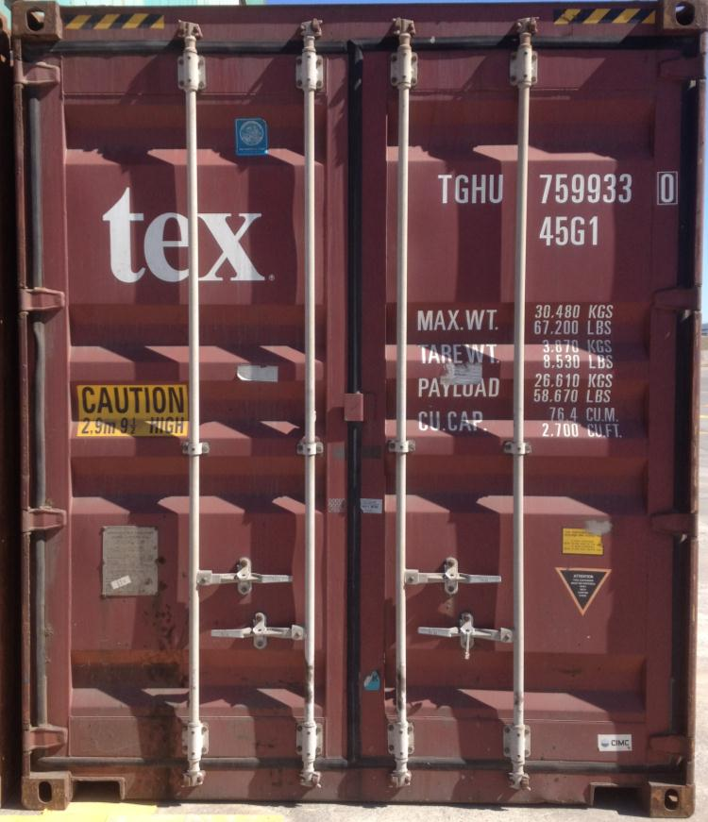
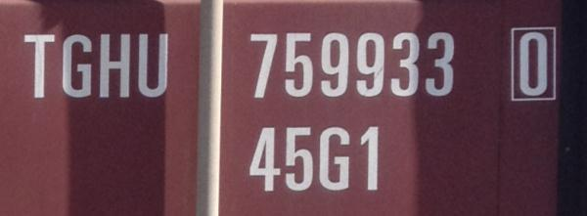
Container Identification System
Owner Code (3 letters): TGH
Product Group Code (1 letter): U
Registration Number (6 digits): 759933
Check Digit (1 digit): 0
Size & Type Code (4 digits/letters): 45G1
Operational Characteristics
Maximum weight: 30,480 kg
Container weight: 3,870 kg
Payload weight: 26,610 kg
Cubic capacity: 2,700 cubic feet

Slide 150
World Container Traffic and Throughput, 1980-2015
Notes:
Source: Drewry Shipping Consultants.

Slide 151
Containerization Growth Factors
Derived
Economic and income growth
Globalization (outsourcing)
Fragmentation of production and consumption
Substitution
Functional and geographical diffusion
New niches (commodities and cold chain)
Capture of bulk and break-bulk markets
Incidental
Trade imbalances
Repositioning of empty containers
Induced
Transshipment (hubbing, relay and intersection)
Notes:
Source: Adapted from Dewry Shipping Consultants.

Slide 152
Containerization Growth Factors
Substitution-Based
New niches (commodities and cold chain)
Capture of bulk and break-bulk markets
Containerization
Incidental
Trade imbalances
Repositioning of empty containers
Induced
Transshipment (hubbing, relay and intersection)
Derived
Economic and income growth
Globalization (outsourcing)
Fragmentation of production and consumption

Slide 153
Advantages of Containerization
Factor | Advantage
Standard transport product | ISO standard. Specialized ships, trucks and wagons. Unique identification number and size type code.
Flexibility of usage | Commodities (coal, wheat), manufactured goods, cars, frozen products. Adapted containers for dry cargo, liquids (oil and chemical products) and refrigerated cargo. Reuse of discarded containers.
Costs | Low transport costs; 20 times less than bulk transport. Economies of scale at modes and terminals.
Velocity | Fast transshipment operations. Low terminal turnaround times (port time reduced from 3 weeks to about 24 hours).
Warehousing | Own warehouse; Simpler and less expensive packaging. Stacking capability on ships, trains (doublestacking) and on the ground.
Security and Safety | Contents of the container is unknown to carriers. Can only be opened at the origin, at customs and at the destination. Reduced spoilage and losses (theft).

Slide 154
Challenges of Containerization
Factor | Challenge
Site constraints | Large consumption of terminal space (mostly for storage); move to urban periphery. Draft issues with larger containerships (more than 13 meters).
Infrastructure costs | Container handling infrastructures and equipment (giant cranes, warehousing facilities, inland road, rail access), are important investments.
Stacking | Complexity of arrangement of containers, both on the ground and on modes (containerships and double-stack trains). Restacking difficult to avoid.
Empty movements | Many containers are moved empty (20% of all flows). Either full or empty, a container takes the same amount of space. Divergence between production and consumption; repositioning.
Theft and losses | High value goods and a load unit that can opened or carried (on truck). Vulnerability between terminal and final destination. 10,000 containers are lost at sea each year (fall overboard).
Illicit trade | Common instrument used in the illicit trade of goods, drugs and weapons, as well as for illegal immigration. Concerns about the usage of containers for terrorism.

Slide 155
Advantages and Drawbacks of Containerization
Advantages
Drawbacks
Standardization
ISO standard (modes and equipment). Unique identification number and size type code.
Site Constraints
Large consumption of terminal space. Draft issues with larger containerships.
Flexibility
Commodities, manufactured goods, liquids and refrigerated goods.
Capital Intensiveness
Container handling infrastructures and equipment are important investments.
$
Costs
Low transport costs. Economies of scale at modes and terminals.
Stacking
Complexity of arrangement of containers, both on the ground and on modes.
$
Velocity
Fast transshipment operations.
Low terminal turnaround times.
Repositioning
Divergence between production and consumption; repositioning. 20% of all containers.
Warehousing
Own warehouse; simpler and less expensive packaging. Stacking capability.
Theft and Losses
High value goods vulnerable to thefts, particularly between terminal and final destination.
Security & Safety
Contents unknown to carriers. Reduced spoilage and losses.
Illicit Trade
Illicit trade of goods, drugs and weapons, as well as for illegal immigration.

Slide 156
Container Shipping Costs and Cargo Value
Products | Items / 40 Foot Container |  | Retail Value (USD) |  | Freight / Value (%)
 | Low | High | Low | High | Low | High
Clothing (low value) | 90,000 | 130,000 | 225,000 | 520,000 | 0.56 | 1.91
Clothing (mid range) | 25,000 | 60,000 | 500,000 | 3,600,000 | 0.08 | 0.86
Sports shoes | 18,000 | 28,000 | 350,000 | 2,520,000 | 0.12 | 0.23
Bicycles | 1,200 | 1,600 | 240,000 | 480,000 | 0.60 | 1.79
Toys (low quality) | 20,000 | 60,000 | 60,000 | 720,000 | 0.40 | 7.17
Consumer electronics (small) | 2,800 | 3,600 | 170,000 | 430,000 | 0.67 | 2.53
Consumer electronics (large) | 240 | 480 | 70,000 | 140,000 | 2.07 | 6.14
Appliances (small) | 600 | 1,200 | 45,000 | 100,000 | 2.90 | 9.56
Appliances (large) | 100 | 130 | 30,000 | 65,000 | 4.16 | 14.33
Furniture (assembled) | 250 | 600 | 20,000 | 150,000 | 1.93 | 21.50
Furniture (flat packed) | 1,000 | 3,000 | 70,000 | 360,000 | 0.80 | 6.14
Automobile parts | 600 | 15,000 | 50,000 | 375,000 | 0.77 | 8.60
Notes:
Source: OECD (2005) DSTI/DOT/MTC(2005)5/REV1
http://www.marisec.org/shippingfacts/uploads/File/MaritimeTransport&IndustrialRelocation.pdf?SID=3f22944566000a0e22f9181df5ce3508

Slide 157
Containerized Cargo Flows along Major Trade Routes, 1995-2015 (in millions of TEUs)
Notes:
Source: UNCTAD, Review of Maritime Transport, various years.

Slide 158
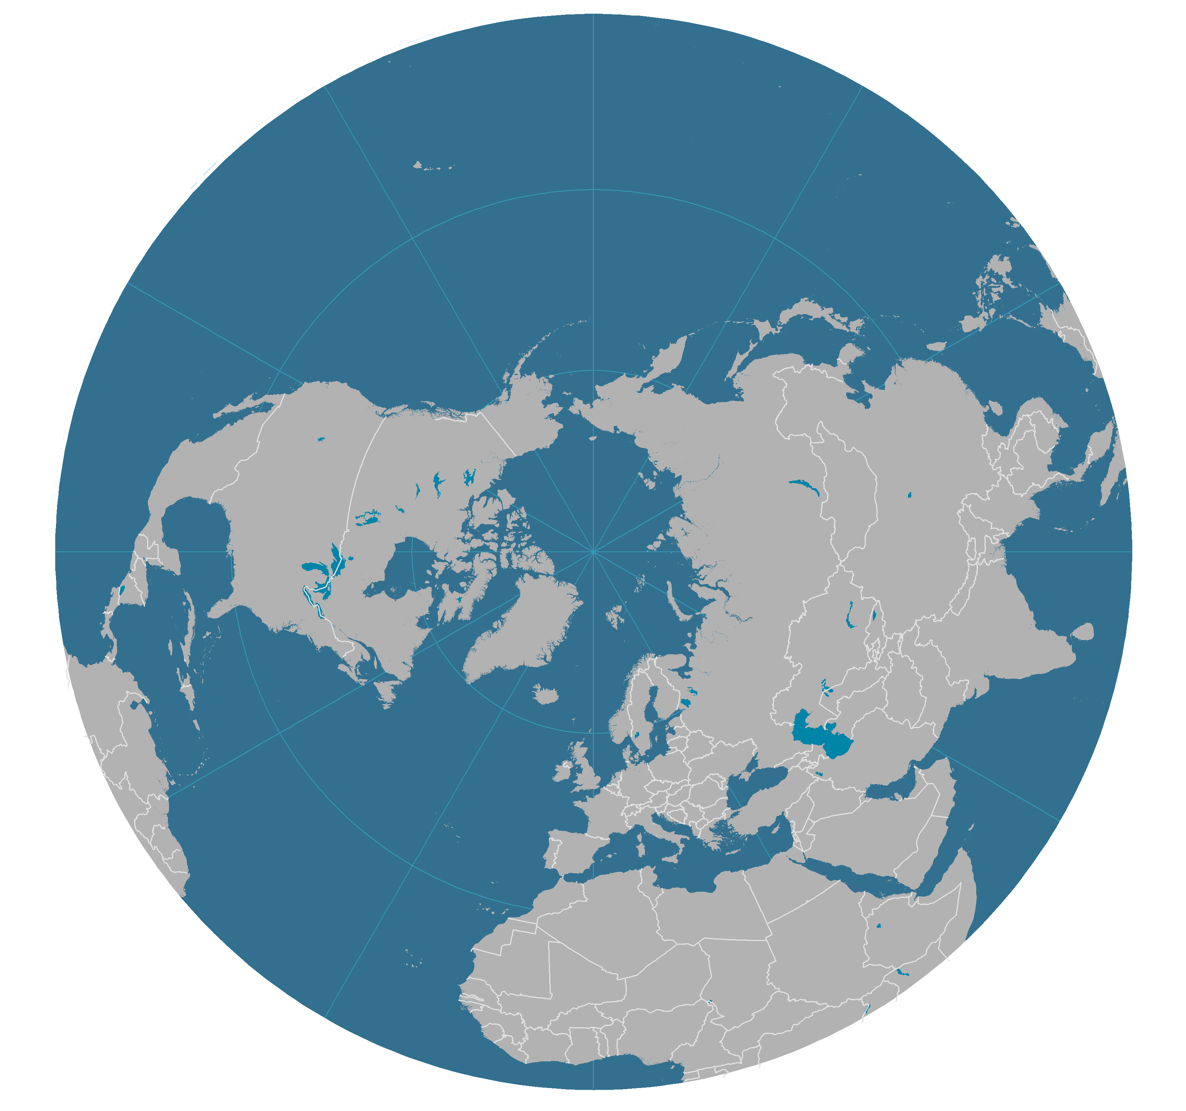
Containerized Cargo Flows along Major Trade Routes, 2012
Million TEUs
13.3 (+175%)
Growth (2006-2012)
13.1
6.9 (+48%)
Asia
16.0
27.0
North America
6.3 (+178%)
10.5
Imports (M TEUs)
13.7 (+293%)
2.7 (+55%)
17.3
Europe
3.6 (+23%)
9.0
Exports (M TEUs)

Slide 159
Intermodal Transportation Cost Function
C(T)
Local / Regional Distribution Costs
Decomposition
C(dc)
National / International Distribution Costs
Connection
C(cn)
Costs
C(I)
Interchange
C(cn)
Connection
Composition
C(cp)
Origin
Transshipment
Destination

Slide 160
Economies and Diseconomies of Scale in Container Shipping
Costs per TEU
Transshipment
Inland Transportation
Maritime Shipping
Capacity in TEU

Slide 161
Functional Integration of Supply Chains
Maritime
Distribution
Inland Distribution
Shipping
Agent
Custom
Agent
Rail / Trucking
Trucking
Stevedore
Freight
Forwarder
Distribution
center
Shipping Line
Carrier
Customer
Economies of scale
Megacarrier
Level of functional integration
Notes:
Source: adapted from Robinson, R. (2002) “Ports as Elements in Value-Driven Chain Systems: The New Paradigm”, Maritime Policy and Management, Vol. 29, No. 3, pp. 241-255.

Slide 162
Impacts of River / Sea Shipping
Origin
Road / Rail
Fluvial Port
Fluvial
Seaport
Maritime
River/sea
Fluvial
Road / Rail
Destination
A
B
C
Notes:
Source: adapted from Charlier, 1994.

