Slide 1
Genetics and Molecular Biology for Environmental Analysis
Molecular Ecology
lesson 13: Conservation genetics
Prof. Alberto Pallavicini
pallavic@units.it

Slide 2
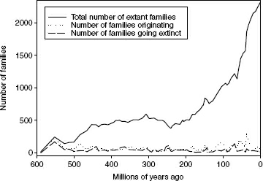
The Need for Conservation
Biodiversity quite simply refers to all of the different life forms on our planet, and includes species diversity and genetic diversity.
Notes:
We know from the fossil record that species diversity has been steadily increasing over the past 600 million years, despite the fact that as many as 99% of species that have ever lived are now extinct.
<number>

Slide 3
Around 96% of all extinctions have occurred at a fairly constant rate, creating what is known as the background extinction rate.
This has been estimated from the fossil record as an average of 25% of all living species going extinct every million years
Notes:
The remaining 4% or so of all extinctions occurred during five separate mass extinctions, which are identified from the fossil record as periods in which an estimated 75% or more of all living species went extinct. The most recent mass extinction occurred in the late Cretaceous (65 million years ago) when approximately 85% of all species, including the dinosaurs, were wiped out.
<number>

Slide 4
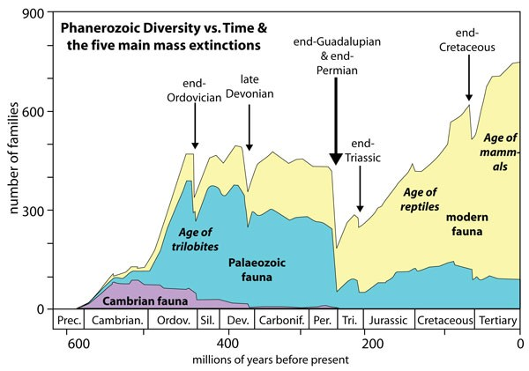
The five major extinctions.
Notes:
The remaining 4% or so of all extinctions occurred during five separate mass extinctions, which are identified from the fossil record as periods in which an estimated 75% or more of all living species went extinct. The most recent mass extinction occurred in the late Cretaceous (65 million years ago) when approximately 85% of all species, including the dinosaurs, were wiped out.
<number>

Slide 5
The numbers of species extinctions that have been recorded over the past 400 years
Taxonomic group | Number of extinctions | Percentage of taxonomic group
Mammals | 85 | 2.1
Birds | 113 | 1.3
Reptiles | 21 | 0.3
Amphibians | 2 | 0.05
Fish | 23 | 0.1
Invertebrates | 98 | 0.01
Flowering plants | 384 | 0.2

Slide 6
IUCN red list
We know little about the total proportion of threatened species simply because we lack the relevant information for most species.
For example, 32% of fishes that have been evaluated are classified as threatened, but because only around 5% (4446 species out of an estimated 31 300 species) of all fish species have been assessed, this value gives us limited insight into the status of fishes as a whole.

Slide 7
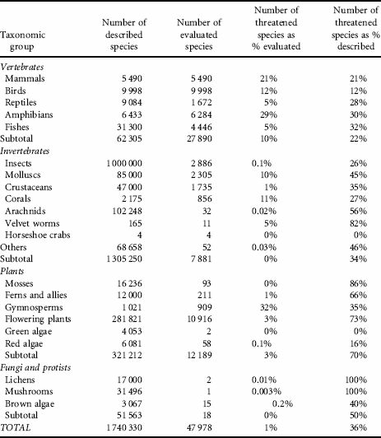

Slide 8
why are so many species threatened with extinction?
In most cases, the answer to this is anthropogenic activity. Farming, logging, mining, damming and building have destroyed the habitats of countless species around the world.
Many endemic species have suffered from human-mediated introductions of alien species, both deliberate and accidental. Hunting, fishing and trading have led to the overexploitation of many species, while countless others have suffered from industrial or agricultural pollution
Notes:
Although these processes are diverse, a common outcome is a reduction in the sizes of wild populations.
When this occurs, species begin to suffer from reduced genetic diversity and inbreeding, and this is where conservation genetics comes into play.
<number>

Slide 9
Taxonomy
Taxonomy is the science that enables us to quantify biodiversity, although its applications extend much further than this because without it our understanding of ecology and evolution would be greatly reduced: put simply, species are the fundamental units of biology.

Slide 10
Problem 2:
Lack of agreement on what “species” means.

Slide 11
Species concepts
More than 20 different species concepts can now be found in the literature.
biological species concept (BSC)
phylogenetic species concept (PSC).
The phylogenetic species concept defines a species as a group of organisms that shares a common ancestor and can be distinguished from other organisms that do not share that ancestor
Notes:
The PSC circumvents to some extent the problem of asexual reproduction, but it has been criticized for dividing organisms on the basis of characteristics that may have little biological relevance, and also for creating an overwhelmingly large number of species. Furthermore, two groups that are identified as separate species under the PSC may retain the potential to reproduce with one another. If reproduction between these two groups did occur, they would no longer be monophyletic and would therefore have to be reclassified as a single species.
<number>

Slide 12
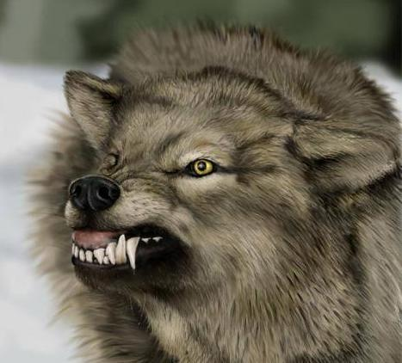
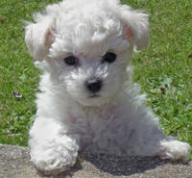
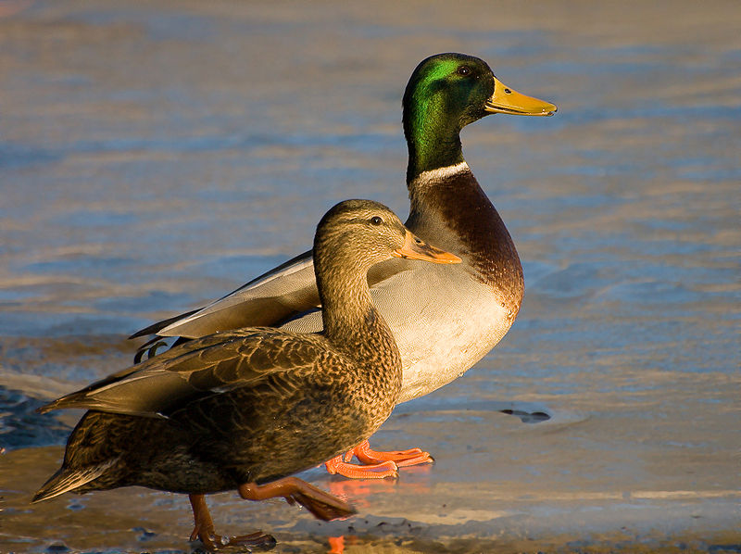
Defining what species are is a
complex task
Dependent on many factors
Interbreeding capabilities
Morphological variation
Ecological context
Genetic similarities
Canis lupus
Canis lupus (familiaris)
Anas platyrhynchos

Slide 13
Problem 3:
Current taxonomic methods may be insufficient.

Slide 14
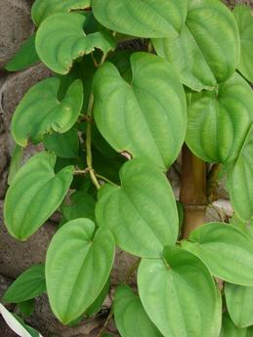
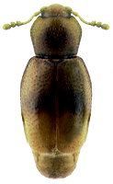
Classical taxonomy uses terminology that can act as a barrier to understanding and reduce the number of persons qualified to describe biodiversity
Leaves alternate proximally, opposite and ultimately decussate distally, 6–16 × 4–13 cm; petiole ca. as long as blade, winged, base clasping, basal lobes stipulate, growing as extensions of wings, less than
1 mm wide; blade 5–7-veined, ovate, glabrous, base typically sagittate, margins entire, apex acute to acuminate. Staminate inflorescences axillary, 1–2 per axil, paniculate, fasciculate; panicles bearing flowers singly,bracteolate, in a zigzag pattern along rachis, internodes less than 2 mm; rachis to 25 cm, secondary axes 1–3(–6), fasciculate, less than 3 cm, each subtended by deltate-ovate bracteole shorter than 1 mm. Pistillate inflorescences solitary, 4–8(–20)-flowered, 6–35 cm, internodes ca. 1 cm
The body form ranges from hemispherical (e.g., Cleidostethus) to elongate oval (e.g., Clypastraea) to latridiid-like (e.g., Foadia). Corylophids are typically dull brown, but some species have contrasting yellowish-brown patches on the pronotum or elytra. The integument is often densely punctured and may be glabrous or bear short, fine recumbent setae. Most corylophid adults can be diagnosed using the following morphological features: Maxilla with single apical lobe; Mesotrochanter short and strongly oblique; Head usually covered by pronotum; Frontoclypeal suture absent; Antennae elongate with 3-segmented club; Procoxal cavities closed externally; Tarsal formula 4-4-4; Pygidium exposed
.
Adding to the complexity, if the specimen to be identified is immature in its development or damaged and incomplete, identification may be impossible

Slide 15
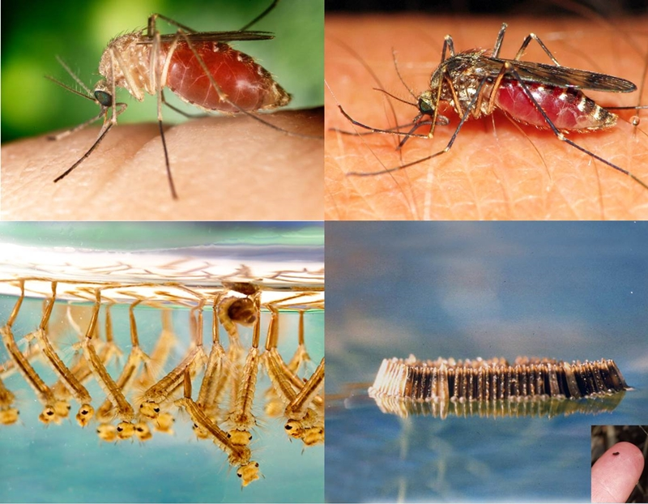
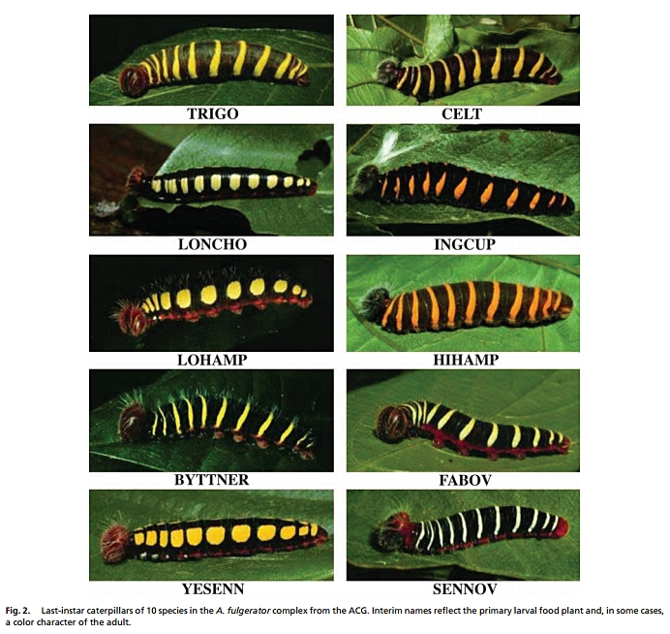
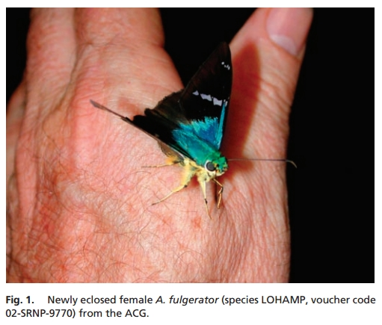
Using DNA can help clarify identity of different looking life forms, as well as provide the resolution that allows to differentiate species that appear identical, yet aren’t.

Slide 16
DNA barcoding
A more recently established approach to taxonomy seeks to identify species solely on the basis of a DNA barcode (or genetic barcode), which consists of one or a few DNA sequences.
Barcoding is founded on the premise that variation in the barcoding gene is lower within species than between species.

Slide 17
Leaves alternate proximally, opposite and ultimately decussate distally, 6–16 × 4–13 cm; petiole ca. as long as blade, winged, base clasping, basal lobes stipulate, growing as extensions of wings, less than 1 mm wide; blade 5–7-veined, ovate, glabrous, base typically sagittate, margins entire, apex acute to acuminate. Staminate inflorescences axillary, 1–2 per axil, paniculate, fasciculate; panicles bearing flowers singly,bracteolate, in a zigzag pattern along rachis, internodes less than 2 mm; rachis to 25 cm, secondary axes 1–3(–6), fasciculate, less than 3 cm, each subtended by deltate-ovate bracteole shorter than 1 mm. Pistillate inflorescences solitary, 4–8(–20)-flowered, 6–35 cm, internodes ca. 1 cm
Complex and
subjective
Simple (A,T,G, or C), objective
>Dioscorea alata (matK) gene, partial
ATTTAAATTATGTGTCAGATATATTAATACCCCATCCCATCCATCTGGAAATCCTGGTTCAAATACTTCAATGCTGGACTCAAGATGTTTCCTCTT
TGCATTTATTGCGATTCTTTCTCCACGAATATCATAATTCGAAT AGTTTCATTACTCCGAAAAAACCTATTTACGTGATTTCAATTTCAAAAGAAA
ATAAAAGATTTTTTCGAT TCCTATATAATTCTTATGTATTTGAATGTGAATTTGTATTAGTTTTTTTTCATAAGCAATCCTCTTATTT ACGATCAA
GGTCCTCTGGAGTCTTTCTTGAGCGAACACATTTCTATGGAAAAATGGGGCATTTTTTAGTAGTGTGTTGTAATTATTTTCAGAAGACCCAATG
GTTCTTCAAAGATCCTTTTCTGCATTATGTTCGATATC AAGGAAAAGCAATTCTGGTGTCAAAGGGAACTCGTCTTTTGATGAGGAAATGGAGA
TCTTACCTTGTCCATTTTTGGCAATATTATTTTCAATTTTGGTCTCATCCGCATAGGATTCATATAAACCAATTATCAAATTATTCCTTCTGTTTTC
TGGGTTATCTTTCAAATGTACTAATAAATTTTTCCGTGGTAAGGAGTCAAATGTTAGAAAATTCATTTGTAATAGATACTCTTACTAAGAAATT
TGATACCAGAGTTTCAGTTATTGCTCTTATTCG ATCATTGTCTAAAGCGAAATTTTGTACCGTATCCGGGCATCCTATTAGTAAGTCAATATGGA
CAAATTTC TCAGATTTGGATATTATTCATCGATTTGGTTGGATATGTAGAA

Slide 18
Choosing a DNA barcode
Several criteria go into selecting a DNA region that can serve as a barcode locus, including:
Discriminatory
Unique for species, identical for species members
Universal
Occurs in all species to be examined
Robust
Can be amplified by PCR, using a small number of primers

Slide 19
Candidates
Fail: Sequence is completely conserved, good for PCR, but uninformative as barcode
Fail: Sequence shows no conservation, impossible for PCR, but good as barcode
Win: Sequence shows some (ideally ~70%) conservation, good for PCR, good as barcode

Slide 20
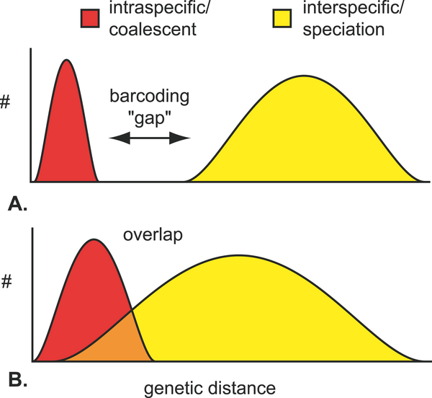
A good DNA barcode

Slide 21
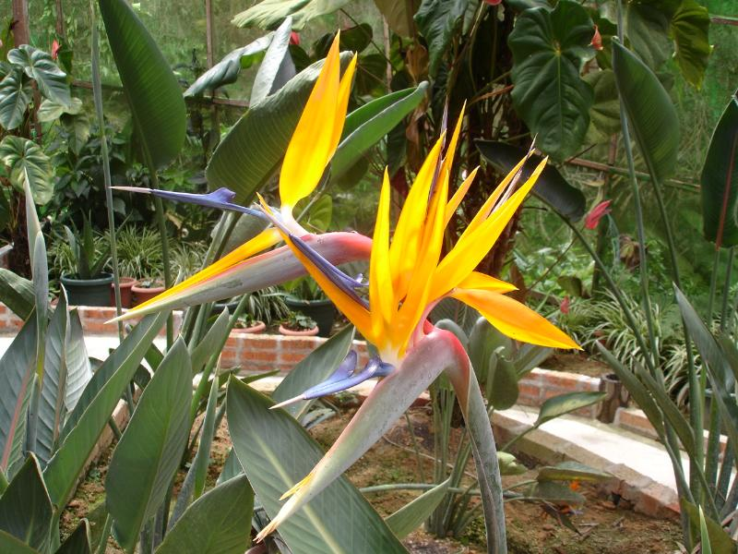
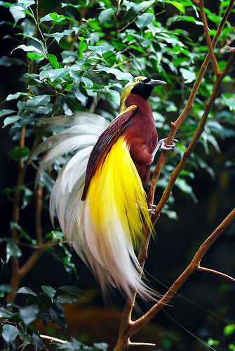
DNA Barcoding
Plants vs. Animals
The Consortium for the Barcode of Life recommended to use the mitochondrial gene for Cytochrome Oxidase I, COI, as universal barcode for animals.
Caveat: As any other potential DNA barcode locus, COI also entails the possibility of failure. Barcoding specific animals for which COI does not work may therefore require newly identifying an appropriate barcoding locus.

Slide 22
Who is advancing barcoding?
CONSORTIUM FOR THE BARCODE OF LIFE (CBOL) is an international initiative devoted to developing DNA barcoding as a global standard in taxonomy.
CBOL is a collaboration of natural history museums, herbaria, biological repositories, and biodiversity inventory sites, together with academic and commercial experts in genomics, taxonomy, electronics, and computer science. CBOL has more than 100 institutional members in 40 countries.
Notes:
The inaugural meeting for CBOL was held at The National Museum of Natural History, Washington DC in May 2004. The initial organizational support for CBOL was provided by a 2.5 year grant from the The Alfred P. Sloan Foundation, renewed in 2006 for 3 years.
<number>

Slide 23
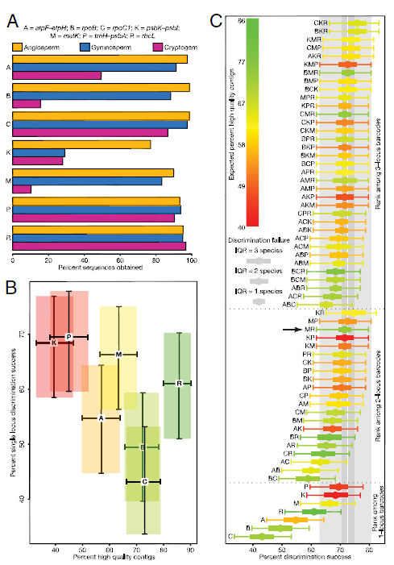
The Consortium for the Barcode of Life recommended to use the chloroplast genes rbcL and matK as universal plant barcodes.
Caveat: As any other potential DNA barcode locus, rbcL and/or matK entail the possibility of failure. Barcoding specific plants for which rbcL and/or matK do not work may therefore require newly identifying an appropriate barcoding locus.

Slide 24
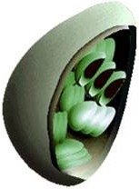
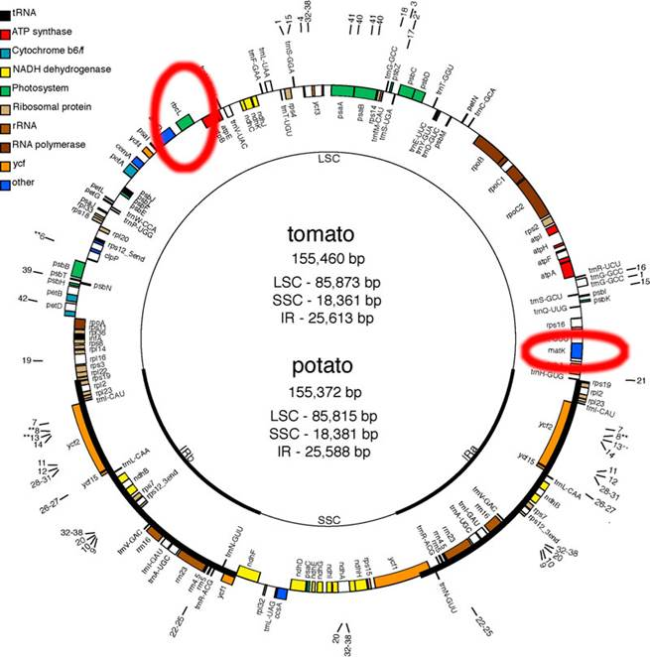
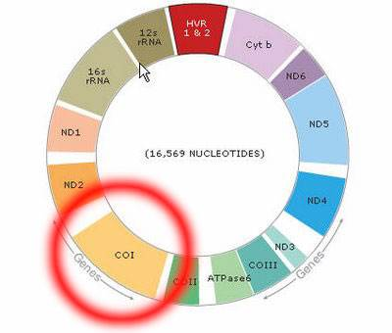
DNA Barcoding
Plants vs. Animals
Plants
Animals
RbcL
MatK
COI

Slide 25
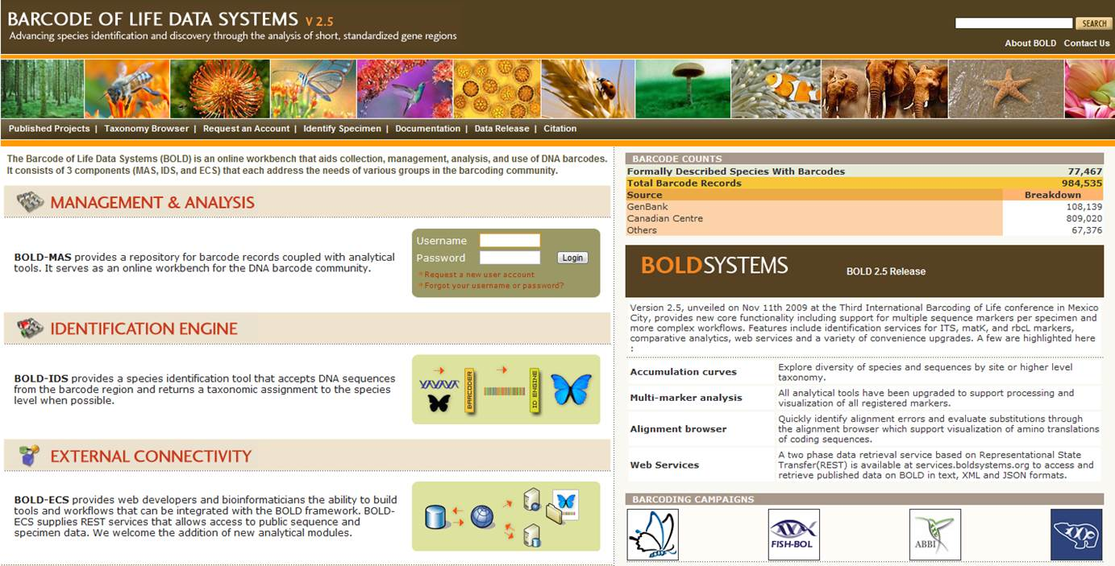
Contributing to Big Science

Slide 26
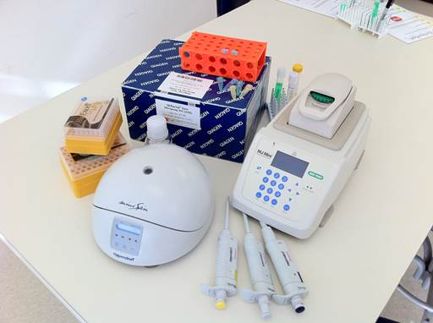
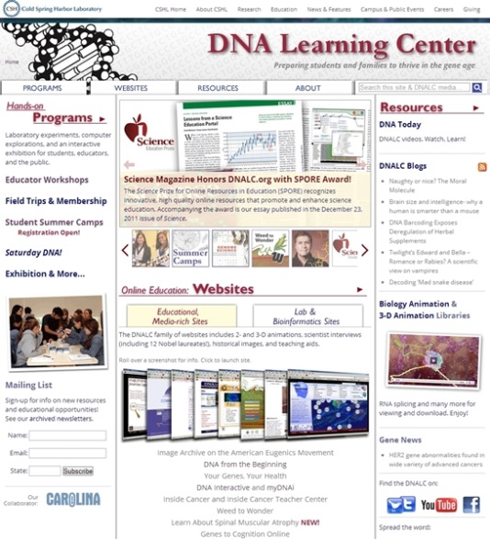
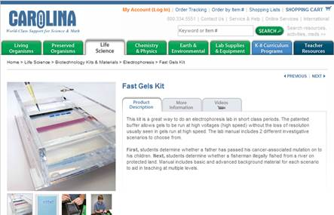
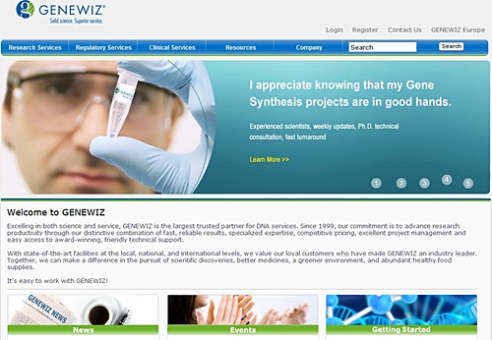
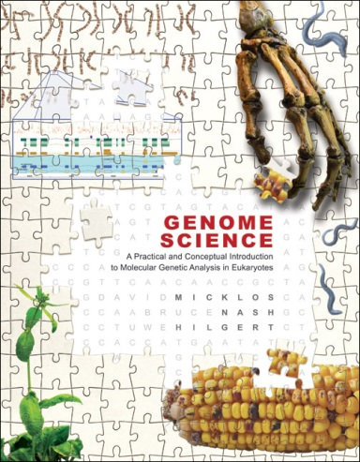
DNA Barcoding: The Works
Extract DNA
Amplify barcoding locus
Sequence barcode
Analyze sequence

Slide 27
CAVEATS
Although increasingly widely used, DNA barcoding is not without controversy. Critics have pointed out that the range of intraspecific sequence divergence can be difficult to predict.
Other researchers have highlighted potential issues surrounding the sample sizes on which DNA barcodes are typically based.

Slide 28
Although barcoding is not perfect we can argue that the same can be said for taxonomic delineations that are made on the basis of morphological characteristics;
limitations of morphology are particularly evident in (but not limited to) cryptic species, cryptic life stages (e.g. beetle larvae), and microbial species that require (but will not always be amenable to) culturing prior to identification.

Slide 29
Taxonomic group | Gene region | Reference
Animals | Cytochrome oxidase I (COI) mitochondrial region | Herbert et al. (2003)
Plants | Two chloroplast regions, rbcL and matK | CBOL Plant Working Group (2009)
Plants | Second internal transcribed spacer (ITS2) of nuclear ribosomal DNA | Chen et al. (2010)
Arbuscular mycorrhizal fungi | Nuclear rDNA (1500 bp fragment spanning small subunit, ITS region, and large subunit) | Stockinger et al. (2010)
Red algae | Cytochrome oxidase I (COI) mitochondrial region | Robba et al. (2006)
Microbial eukaryotes | Small subunit nuclear rDNA | Huber et al. (2007)
Bamboo corals | Mitochondrial regions: mismatch repair gene homologue (msh1) and intergenic region (igr4) between cyt b and NADH6 | van der Ham et al. (2009)

Slide 30
Conservation units
In an attempt to circumvent some of the problems that may be associated with taxonomic classification, conservation biologists sometimes concentrate on:
management units (MU) and
evolutionarily significant units (ESU).

Slide 31
Conservation units
An MU is ‘any population that exchanges so few migrants with others as to be genetically distinct from them’ (Avise, 2000), and is analogous to the stocks that are identified in fisheries.
Distinct MUs are often identified on the basis of significant differences in allele frequencies at multiple neutral loci.

Slide 32
Conservation units
An ESU consists of one or more populations that have been reproductively isolated for a considerable period of time, during which they have been following separate evolutionary pathways.
Examples of this may include lineages that diverged in separate refugia during glacial periods. ESUs have often been characterized by reciprocal monophyly in mtDNA and significant allele frequency differences at neutral nuclear loci

Slide 33
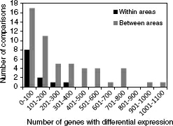
Conservation units
Non neutral markers
A combination of neutral genetic data and data from the transcriptome was used to characterize conservation units of threatened Atlantic salmon, Salmo salar, around the Bay of Fundy in Canada.
Notes:
Genetic differentiation among populations from four different geographical regions around the bay was inferred from neutral microsatellite loci, and gene expression was quantified using a cDNA salmonid microarray. Microsatellite data showed differentiation among all four geographical areas; similarly, the transcriptomic variation showed that a greater number of genes were being differentially expressed between each of the four areas compared to between different sites within each of the four areas (Figure 8.8). In general, patterns of variation in gene expression were consistent with the levels of genetic differentiation that were based on microsatellite loci, although the two measures of genetic differentiation were not strongly correlated.
<number>

Slide 34
Threatened populations are usually small and therefore lose genetic diversity at a relatively rapid rate following genetic drift.
Because drift is more important than selection at determining the fate of alleles in small populations, deleterious alleles are more likely to reach fixation and increase the genetic load

Slide 35
inbreeding
Small populations are susceptible to inbreeding, and if this leads to a reduction in fitness as a result of either dominance or overdominance, then the population will experience inbreeding depression.
In a diploid species, inbreeding increases the likelihood that an individual will have two alleles that are identical by descent at any given locus, and it therefore has the effect of increasing homozygosity at all loci.

Slide 36
inbreeding coefficient F
inbreeding accumulates at a rate that is inversely proportional to the size of the population

Slide 37
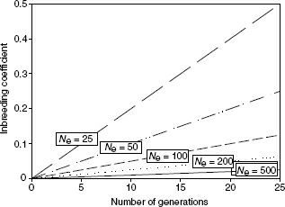
The increase over time in the inbreeding coefficients (F) of five populations of different sizes

Slide 38
Inbreeding and genetic diversity
Inbreeding threatens the survival of small populations when it leads to a reduction in fitness, a phenomenon that is known as inbreeding depression.

Slide 39
Outbreeding depression
Inbreeding depression is not the only possible deleterious outcome of mating between individuals with suboptimal levels of relatedness; another potential threat comes from outbreeding depression

Slide 40
loss of locally adapted genotypes
If individuals from two populations that are each adapted to their natal environments hybridize, their offspring will contain a mixture of alleles that may not be well suited to either environment. When this occurs, outbreeding depression will be evident in the first generation of offspring.
Notes:
Two genetic factors can lead to outbreeding depression. The first is the loss of locally adapted genotypes. If individuals from two populations that are each adapted to their natal environments hybridize, their offspring will contain a mixture of alleles that may not be well suited to either environment. When this occurs, outbreeding depression will be evident in the first generation of offspring.
<number>

Slide 41
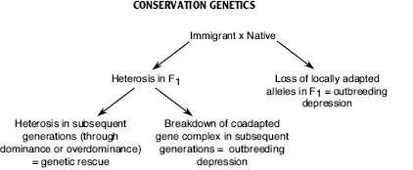
loss of positive epistatic interactions.
Epistasis refers to the interaction of genes from multiple loci, and their collective influence on particular traits.
Notes:
The group of loci involved in an epistatic interaction is known as a co-adapted gene complex, and if this complex is broken up through recombination then outbreeding depression may result.
<number>

Slide 42
Genetic rescue
When migrants are translocated from one population to another, they will often introduce new alleles into the recipient population. If this results in a reduction of inbreeding depression, it is known as genetic rescue
Genetic rescue will increase the growth rate of a population over multiple generations from the time when the novel genes were introduced. This is usually attributed to heterosis, which is elevated fitness in the offspring of genetically divergent individuals (sometimes known as hybrid vigour).

Slide 43
Translocations and captive breeding programmes
Translocations can slow or reverse the decline of small populations through genetic rescue, although source and destination populations should be genetically compatible and founder effects should be avoided.

Slide 44
Translocations and captive breeding programmes
Small population sizes mean that captive breeding programmes must be carefully managed so as to minimize inbreeding depression and loss of genetic diversity. Pedigree information can be used to reduce inbreeding, and N_{e} can be maximized if bottlenecks are avoided and variation in reproductive success (VRS) is kept as low as possible.

Slide 45
Useful Websites and Software
Consortium for the barcode of life: http://www.barcodeoflife.org
Barcode of Life data systems – includes an option to compare a sequence against their database when looking for a species match:http://www.boldsystems.org/views/login.php
IUCN – The International Union for Conservation of Nature: http://www.iucn.org/
BirdLife International: http://www.birdlife.org/
American Zoo and Aquarium Association Species Survival Plan Programs: www.aza.org/species-survival-plan-program/
FSTAT – software for calculating F statistics including inbreeding coefficients: http://www2.unil.ch/popgen/softwares/fstat.htm
Software that can be used to estimate genetic relationships among individuals:
Kinship and Relatedness: http://www.gsoftnet.us/GSoft.html
ML-relate: http://www.montana.edu/kalinowski/Software/MLRelate.htm
Coancestry and MER: http://www.zsl.org/science/research/software/
STORM – a program to test a varieof hypotheses regarding relatedness and mating patterns: http://web.me.com/tfrasier/Frasier_Lab/STORM.html

