Slide 1
Lesson Ten
More on subtitling
Semiotic characteristics

Slide 2
Diamesic translation in polysemiotic media
Subtitling can be defined (including films, TV, video and DVD) in the form of one or more lines of written text presented on the screen in sync with the original verbal content
(Henrik Gottlieb)

Slide 3
‘diamesic translation’
the type of verbal transfer that crosses over from writing to speech, or — as in the case of subtitling — from speech to writing.
This represents a break away from the semiotically ‘loyal’ types of isomesic translation, in which the language mode of the original is retained: processes as diverse as conference interpreting, post–synchronization (= dubbing) and literary translation.

Slide 4
‘polysemiotic’
The term refers to the fact that in film and TV productions, up to four semiotic channels are in operation simultaneously:
two nonverbal channels (image plus music, & sound effects)
and two verbal channels (dialogue, including narration and songs, plus written pictorial elements (eg. captions, signs, etc.)

Slide 5
Professional mainstream subtitling
Most minor European speech communities have favored subtitling over dubbing and voice–over ever since the introduction of sound film in the late 1920s.
In prototypical subtitling countries, interlingual subtitles, costing less than 10% of lip–sync dubbing, now constitute a major part of the reading matter.
As a case in point, in 2010 the average Dane spent more than 39 minutes daily reading television subtitles out of a total viewing time of 201 minutes.

Slide 6
Zabalbeascoa, Chaume
“no text can be made entirely of verbal signs because such signs always need some sort of physical support”
Naturally, this physical support gains semantic momentum in genuinely polysemiotic texts. The most prominent polysemiotic text type is the audiovisual text.
“a semiotic construct comprising several signifying codes that operate simultaneously in the production of meaning”

Slide 7
Translation for subtitling
Synchronous subtitling constitutes a fundamental break with the semiotic structure of sound film by re–introducing the translation mode of the silent movies, i.e. written signs.
A question of ‘co-occurrence’ not found in traditional translation.

Slide 8
Types of subtitle (a)
subtitles created directly from the dialogue (foreign or domestic) and cued by the subtitler before broadcasting or cinema screening (referred to as bona fide subtitling and found mostly in public–service TV and cinema)

Slide 9
Types of subtitle (b)
b) subtitles based on existing pre–cued subtitles in the source language or in another target language — (referred to as relay subtitling and typically found in commercial TV and on DVD)

Slide 10
Type of subtitle (c)
semi–live subtitling, in which (TV) subtitles are created by the subtitler before broadcast and cued during transmission

Slide 11
Type of subtitle (d)
live subtitling, where (TV) subtitles — typically intralingual ones — are created (sometimes using speech recognition technology) and cued, with a delay, during transmission.

Slide 12
Timing
a) when each subtitle appears and disappears (in other words, the in and out cues),
b) how long the individual subtitle stays on screen (i.e. the exposure time, or viewed differently, the reading time)

Slide 13
Bona fide subtitling
The subtitler cuts up the running dialogue into subtitle blocks.

Slide 14
Cueing
Finally, in the cueing phase the subtitler generates a specific set of time–codes for each subtitle, ensuring that subtitle blocks are in sync with the shot changes and follow the rhythm of the original dialogue, and that subtitles are unobtrusive and easy to read.

Slide 15
However…
no two subtitlers are in sync, literally speaking.
eg,. One Flew Over the Cuckoo’s Nest
subtitled by an American (intralingual) subtitler and by four professional Danish subtitlers:
the in and out times of the five sets of subtitles differ (as hardly two subtitles start or stop at the same place on the horizontal time axis); the segmentation of the dialogue and the resulting number of subtitles also differ considerably, and obviously, far from all subtitles stand a chance of being in sync with the original dialogue.
The differences in segmentation and cueing are even more pronounced if we move from the national to the international level.

Slide 16
Intralingual subtitling
(1) Same–language subtitling of foreign productions for language learners.
(2) Same–language subtitling of domestic productions for the Deaf and Hard of Hearing.

Slide 17
Type (2) for the deaf
This type is now gaining ground in most of the world’s industrialized nations, including the ones normally opposed to (interlingual) subtitling. In addition to its intralingual nature, type II subtitling typically contains elements of intersemiotic translation of plot–carrying sound effects that cannot be guessed by hearing–impaired viewers. In such instances, these nonverbal elements are rendered in writing, typically resulting in the insertion of bracketed subtitle lines as: (Waves washing ashore) or [crying].

Slide 18
Subtitling for the deaf and hard of hearing (HoH) –target audience?
Deaf: people who are deaf (completely) from birth;
deaf: people who go deaf later in life through age or illness;
HoH: people who are born with partial hearing
impairment or lose some hearing ability.
(slow readers, immigrants, etc.)
(in translation those who know the foreign language and those who
don’t, etc. etc.)

Slide 19
Deaf culture
Deafness is a clinical but also a sociological condition, a cultural issue.
Culture, as I have stressed, is what is ‘normal’
Katan (2004)
or, if you prefer
… a system of congruent and interrelated beliefs, values, strategies and cognitive environments which guide the shared basis of behaviour (e.g. text production).
The totally deaf live in a non-hearing culture where concepts such as pitch, rhythm, volume, etc. are, at best, vaguely understood.
The HoH have a hearing culture as a reference point.

Slide 20
Different needs
The above considerations call for the production of differing subtitles based on the requirements of each category of viewers; this has been the dilemma from the outset, as one version did not suit all users, and many users complained about the characteristics featured in the different media.

Slide 21
But, Jan Ivarsson
… even if the different requirements of the media and the types of audience concerned must be taken into account, some degree of harmonization can certainly be achieved, especially if state-of-the-art computer-based technology is used.

Slide 22
Subtitles
Subtitles for the hearing population are often acceptable (e.g. in Slovenia), but subtitles prepared specifically for the deaf are increasingly used.

Slide 23
Intralingual Subtitling for the Deaf
Franco and Santiago Araújo (2003) conclude,
following a pilot study on intralingual
subtitling in Brazil, that …
deaf subjects differ from hearing subjects in their requirements;
condensation and editing are crucial;
necessary orality markers and soundtrack noises must be integrated, requiring skilful condensing to not lose image-subtitle synchrony;
all should be checked with the help of deaf subjects;

Slide 24
Interlingual Subtitling for the Deaf: English to …(Italian)
An experiment:
THE WEST WING (Episode 10)
Two (and then three) Italian subtitled versions were
prepared:
> for hearing viewers (rapid and detailed)
> for non-hearing viewers (slower and less detailed)
> a ‘harmonised’ version

Slide 25
Experiment
Two groups of hearers:
Aged 52-85 (6 subjects)
Aged 22-27 (7 subjects)
Both groups were asked to fill in a questionnaire and comment on
such parameters as:
presentation rate
impact of shot changes
positioning
use of symbols
etc.
Modified after difficulties were encountered. It needed ‘slowing’, leading to
the production of a first ‘harmonised version’ i.e. a version that might
possibly be acceptable for both hearing and non-hearing subjects.

Slide 26
SDH version
An SDH version was also prepared, based on criteria from the limited literature on the subject and the results of the first experiment, for a group of 14 deaf subjects at the Trieste branch of the National Deaf Association. A quite wide age range but nobody under thirty.
The same questionnaire was used as in the first experiment

Slide 27
SDH version
In general, reception was better than in the hearing group.
They prefer colour coding to symbols for character identification.
Interestingly, their understanding of the subtitles (short and sharp, and connected to the visual) was greater that the understanding of the questionnaire.

Slide 28
Temporary conclusions
It would seem that the carefully and
specifically prepared SDH version succeeded
with its audience more than the ‘normal’
version for hearers even after its modifications. More
fine tuning will be carried out on the ‘harmonised
version’ which will then be shown to deaf
viewers. The SDH version will be shown to different
groups of ‘hearers’ ... until some kind of consensus
is achieved. Watch this space.

Slide 29
… this space
The harmonised version was shown to deaf viewers.
The group was comparable to the first experiment group in terms of numbers, age range, etc.
There was a much more negative response and much lower comprehension, though the symbols were indicated as the major problem.

Slide 30
All the time, the language is changing
The original text goes through continuous changes:
original English
> Italian translation
> Italian adaptation for subtitles
> ‘harmonised’ version (s)
> 1st experimental version for SDH
> … nth experimental version.

Slide 31
English to Italian

Slide 32
Language change: harmonised to SDH

Slide 33
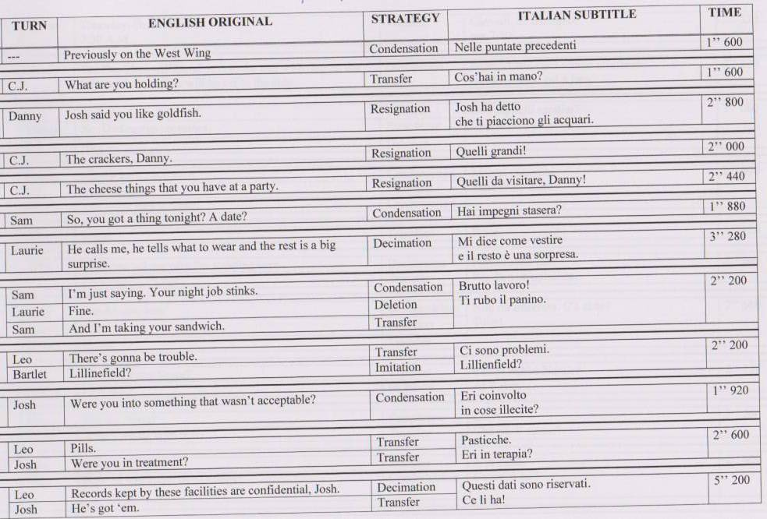

Slide 34
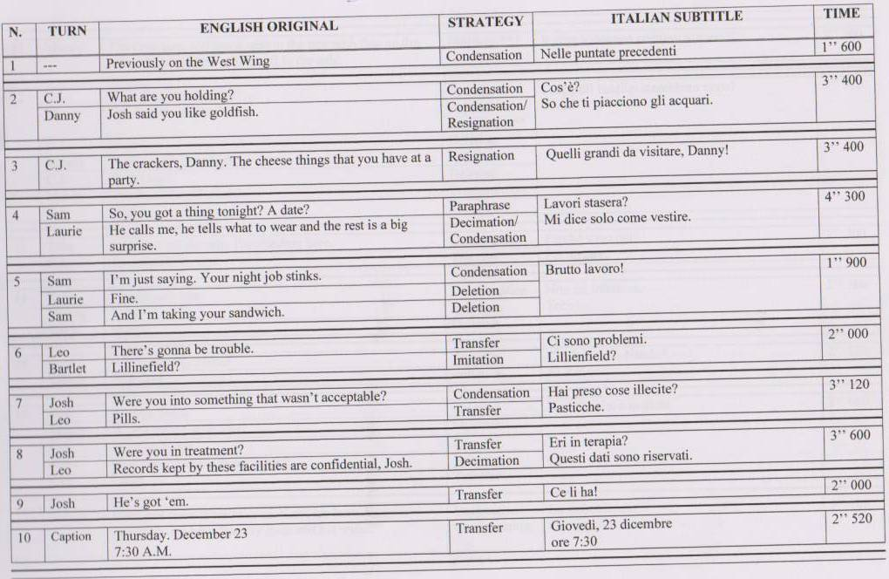

Slide 37
‘subtitling dialect into standard language’.
Straddling the fence between intra– and interlingual subtitling
A classic example of this is found in Danny Boyle’s Trainspotting (1996), in which parts of the Edinburgh (Scottish) English were subtitled into standard British English.
Cf Gomorra (Neapolitan to standard Italian)

Slide 38
Interlingual Subtitling
Subtitling from a foreign language into the domestic majority language: Denmark, Sweden, Norway, Iceland, the Netherlands, Portugal, Estonia, Slovenia, Croatia, Romania, Greece, Cyprus, Argentina, Brazil, Egypt.

Slide 39
Bilingual subtitling
(in cinemas) from a foreign language into two
domestic languages: Finland (Finnish and Swedish), Belgium (Flemish and French), Switzerland (German and French), Israel (Hebrew and Arabic).

Slide 40
Minority languages
Subtitling from national minority languages into the majority language: Ireland, Wales (English).

Slide 41
Immigrant language
Subtitling from the majority language into an immigrant language: Israel (Russian).

Slide 42
Local varieties
Subtitling from any local variety into the common written language: China (Mandarin).

Slide 43
Revoicing
Revoicing foreign–language dialogue in the favored language, with subtitles in a non–favoured domestic language: Latvia (voice–over in Latvian, subtitles in Russian).

Slide 44
Special cases
Subtitling of foreign–language dialogue in selected urban cinemas and, optionally, on DVD: France, Spain, Italy, Germany — all still predominantly dubbing countries.

Slide 45
Attitudes to subtitling
Attitudes differ greatly between speech communities in which reading subtitles is second nature to all segments of the population, and societies which see subtitling as something outlandish, often connected with the notion of art films.

Slide 46
A brief case study
Get Shorty

Slide 47
Original dialogue
Danish subtitles
Back–translation
Ray “Bones” Barboni : Let me explain something to you. Momo
is dead.
Lad mig forklare: Momo er død.
Let me explain:Momo is dead.
Which means that everything he had
now belongs to Jimmy Cap, including
you.
Alt hans tilhører nu Jimmy Capp.
Dig inklusive.
All this now belongs to Jimmy Cap.
Including you.

Slide 48
E.g., from now on, you start showing
me the proper fucking respect.
Q.e.d. skal du fandeme
vise mig respekt.
Q.e.d. you fucking show me respect.
Chili Palmer: “E.g.” means “for example”. What I think you want to say is “i.e.”.
Barboni: Bullshit! It’s short for ergo.
— Du mener ‘dvs.’.
— ‘Q.e.d.’ betyder ergo.
— You mean i.e.
— Q.e.d. means ergo.

Slide 49
Barboni’s bodyguard : To the best of my knowledge, “e.g.” means “for example”.
Det betyder
‘hvilket skulle bevises’.
It means ‘which should be proven’.
Barboni: E.g., i.e. fuck you! The point is this: is that when I say “jump”, you say
“OK”, okay?
Pisseligegyldigt! . . . Når jeg
siger ”hop!”, så siger du “okay!”.
Never fucking mind! When I say ‘jump!’, you say ‘okay’!.

Slide 50
Fansubbing
Aldo, etc.

Slide 51
SUBLIME/SUBTITLE WORKSHOP

