Slide 1

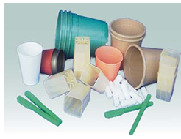
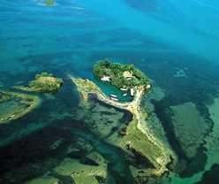

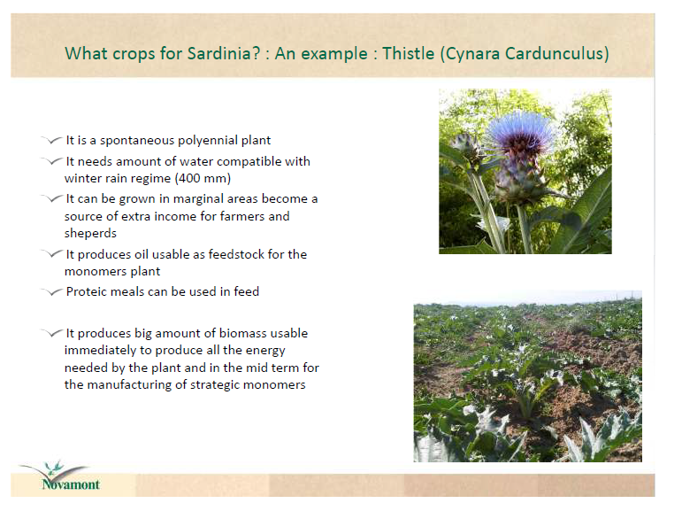
Chemistry for Bioeconomy and Circular economy

Slide 2

Mario Bonaccorso
What is the bioeconomy?
An economy using biological resources from the land and sea, as well as waste, as inputs to food and feed, industrial and energy production.
https://ilbioeconomista.com/

Slide 3

Mario Bonaccorso
The end of an era
“The Stone Age didn't end because we ran out of stones”, Yamani, 1973

Slide 4
Bio-based vs Oil-based
In times of historically low oil and coal prices a bioeconomy will only gradually emerge. In light of the COP 21 targets on GHG reduction, transition is a major urgency.
The IMF estimated the global subsidies on fossil fuels in 2015 at 5.3 trillion USD.

Slide 5
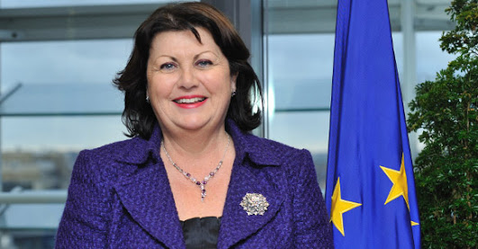
Towards the bioeconomy
"Europe needs to make the transition to a post-petroleum economy. Greater use of renewable resources is no longer just an option, it is a necessity. We must drive the transition from a fossil-based to a bio-based society with research and innovation as the motor. This is good for our environment, our food and energy security, and for Europe's competitiveness for the future."
Máire Geoghegan-Quinn
Past Commissioner for Research and Innovation

Slide 6
The European Strategy
The European Commission has adopted a strategy to shift the European economy towards greater and more sustainable use of renewable resources. The Commission's strategy and action plan,
"Innovating for Sustainable Growth: a Bioeconomy for Europe",
outlines a coherent, cross-sectoral and inter-disciplinary approach to the issue. The goal is a more innovative and low-emissions economy, reconciling market demands while ensuring biodiversity and environmental protection..

Slide 7
EU objectives for 2020: inclusive, smart sustainable growth
2012
2014

Slide 8
The BioCircular Economy
Bioeconomy is an integrated part of a sustainable circular economy.
The European Circular Economy Package offers great opportunities to reuse the vast majority of all bio waste and (unexploited) biomass stocks by 2030.
This involves systemic and efficient approaches across sectors, particularly innovation policy measures that aim to optimise bio-economy value networks and minimise waste and loss.

Slide 9
The bioeconomy: Manifesto of Utrecht
4th EU Bioeconomy Stakeholders’ Conference, Utrecht (NL) 12-13 April 2016
www.bioeconomyutrecht2016.eu
A European bioeconomy should contribute significantly to the goals formulated at COP 21 on greenhouse gas emission reductions, holding the global temperature rise below 2°C, using sustainable biomass in the most effective and efficient ways to produce food, materials, chemicals and energy.
See also http://bioeconomy.miur.it/

Slide 10
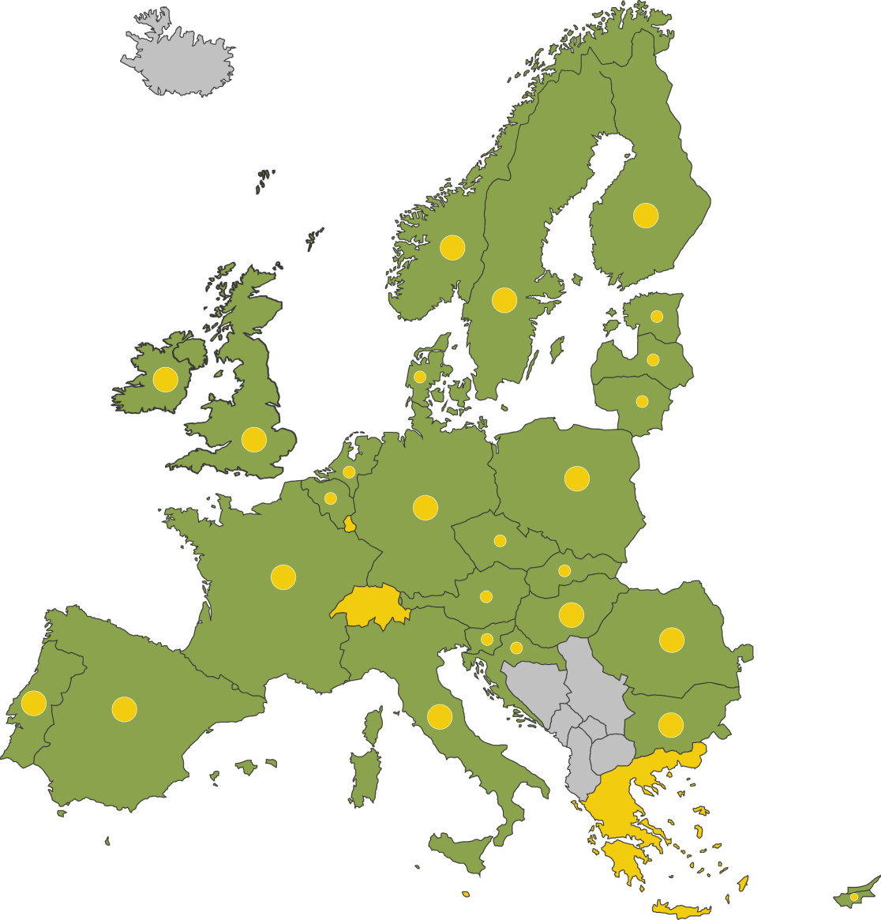
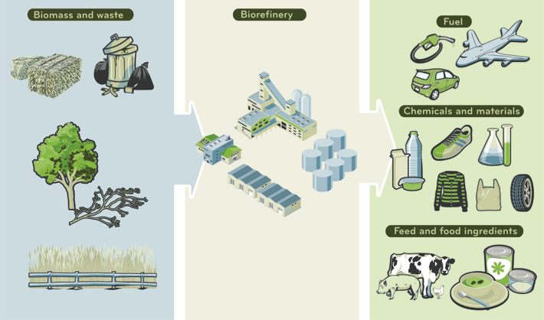
Bioeconomy in Europe
In Europe: about 2.000 Bil €/y and 20.0 Mil of jobs
Notes:
The Bio-based economy concept made simple: Making everyday products from biomass and waste, with biorefineries at the centre of it all.
The BBI is built on the principle of smart and efficient use of resources. It will focus on:
Unlocking the potential of residues and side-streams and waste (e.g. forest residues, agricultural lignocellulosic residues or dedicated crops), and
Optimising the utilisation of existing feedstock (forest and agricultural biomass)

Slide 11
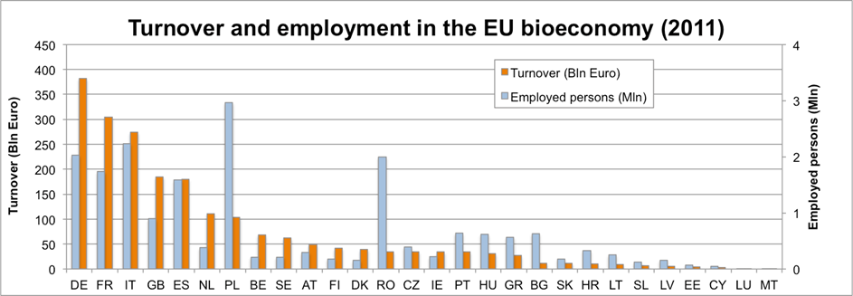
Bioeconomy in Italy
Bioeconomy
in Italy:
some figures
Source: SCAR – EUROSTAT 4th foresight 2015
about 255 Billion €/y
1.7 Million of jobs
R&D:
High participation in H2020 programs dealing with Bioeconomy
Qualified R&I public/private actors
Sometimes fragmented, limited infrastructures, few national funds

Slide 12
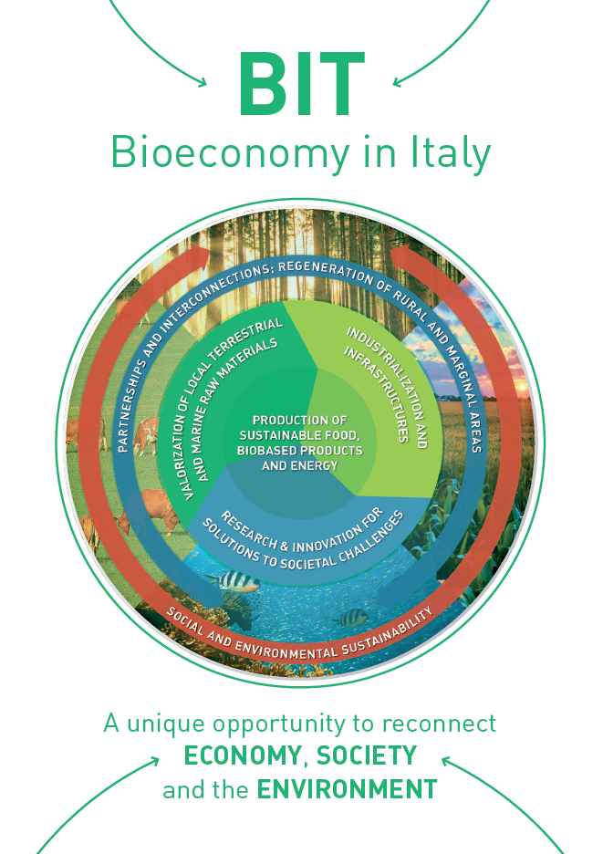






Promoted by:
Italian Presidency of Council of Ministers
Ministero dello
sviluppo economico
Fabio Fava
Italian Representative for Horizon2020 SC2
and for the Joint Technology Initiative “Biobased Industry”.
Involved:
Committee Productive Activities
Regions Conference
Agency for Territorial Cohesion
CLUSTER NAZIONALE BLUE GROWTH
DRAFT AVAILABLE AT :
www.agenziacoesione.gov.it/it/Notizie_e_documenti/news/2016/novembre/Documento_0014

Slide 13
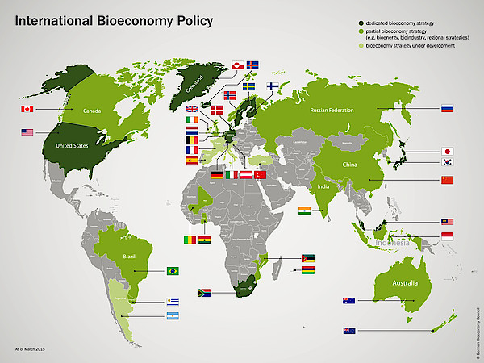
Bioeconomy policies in the world
https://www.youtube.com/watch?v=7O7pqs_NaEI

Slide 14
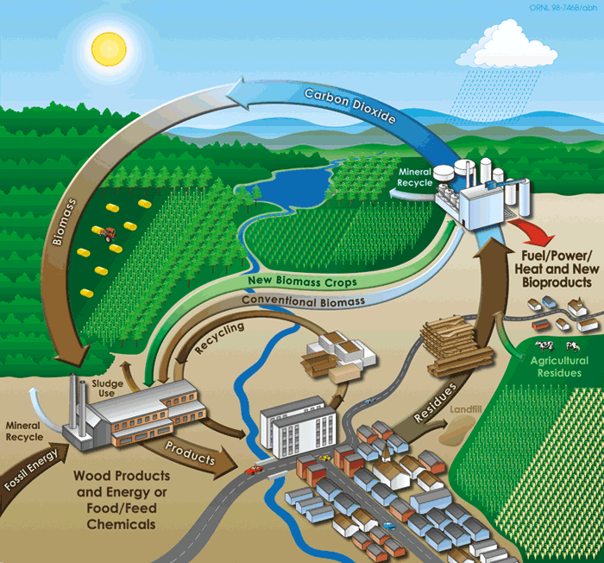
Territories and communities at the core of Integrated Biorefineries
Food ingredients
(Bio)
Cosmetics
Chemical
Textile
Pulp/
Paper
Pharma
Energy
Fuels
Fertilizers,
Feed
The Territory at the Core of European and Italian Bioeconomy

Slide 15
Bioeconomy: integration across sectors for new value chains
Fine chemicals
Nutraceuticals
Cosmetics
Bioactive mol.
Lubricants…..
Value
Monomers
Energy
Fuels
Materials
Feed
Fertilizers
Proteins Biomolecules
compost
Bioraffineries
Renewable carbon
Waste/residues from
Forestry, Sea, Urban and industrial activities, Food chain
Biomass from dedicated colture on marginal lands
residues
scarti
Feedstock
Processes
(biotechnologies, chemistry)
Products
Education, research, coherent policies
Notes:
15
This graph shows the value chain from raw material through intermediates up to the consumer product
And how the value of a product depends on investment in R&D. The more R&D – or you may also name it function and performance – the higher is the value.
Today biotech-products are in some way locked in the intermediate field which is not a very comfortable position. Positioning industrial biotechnology in high performance products or in materials dominant in the endproduct will bring esp. SME in a better situation attracting investors. Investors love investment opportunites high in the value chain. Therefore so far they prefer pharma investments.
Now this value chain also stands for different industries. Assembling these industries in our membership and cooperating all over the value chain is the beginn of KBBE and results in
Shorteing the time to market.
This is, what will make us competetive

Slide 16
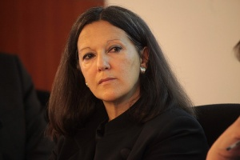

La sfida che ci sta di fronte, quella per far ripartire l’economia, è una rivoluzione industriale che rovescia il rapporto con il territorio.
Per oltre due secoli abbiamo assistito a una corsa a impianti sempre più grandi, con l’ambiente ridotto al ruolo di miniera e di discarica, con un inquinamento crescente, con una contrapposizione sempre più evidente tra lavoro e salute.
Catia Bastioli
Non si può più progettare lo sviluppo a tavolino, con formule anonime da replicare, con poche varianti, in tutto il pianeta.
Utilizzare i materiali prodotti come soluzioni per risolvere problemi, fornire servizi, aumentare la qualità della vita, assicurando un vantaggio per tutti e una capacità competitiva per la collettività, che si riconosce nel progetto e si impegna per il suo successo.
Amministratore delegato di Novamont, presidente di Terna, presidente del Kyoto Club, presidente del Cluster Tecnologico Nazionale SPRING.

Slide 17
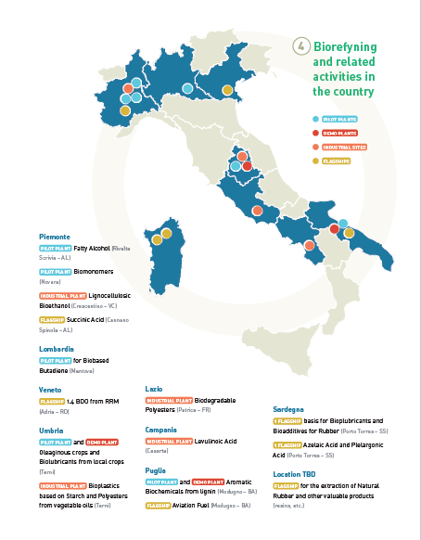
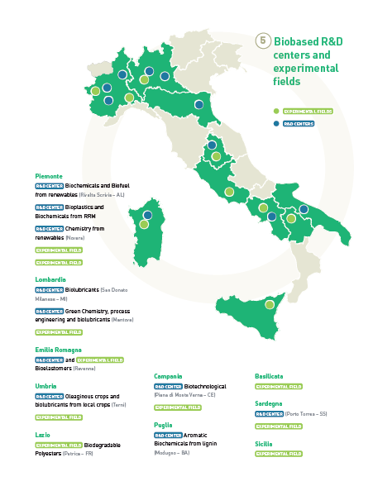
Italian Biorefineries
R&I Activities
Employment Annual Turnover
~ 105.000
(Biopharma, biotextile, leather, bioenergy, biofuels
Biobased-chemicals and materials)
~ € 27 Billion
(Biopharma, biotextile, leather, bioenergy, biofuels
Biobased chemicals and materials)
After: Eurostat data and Banca Intesa

Slide 18
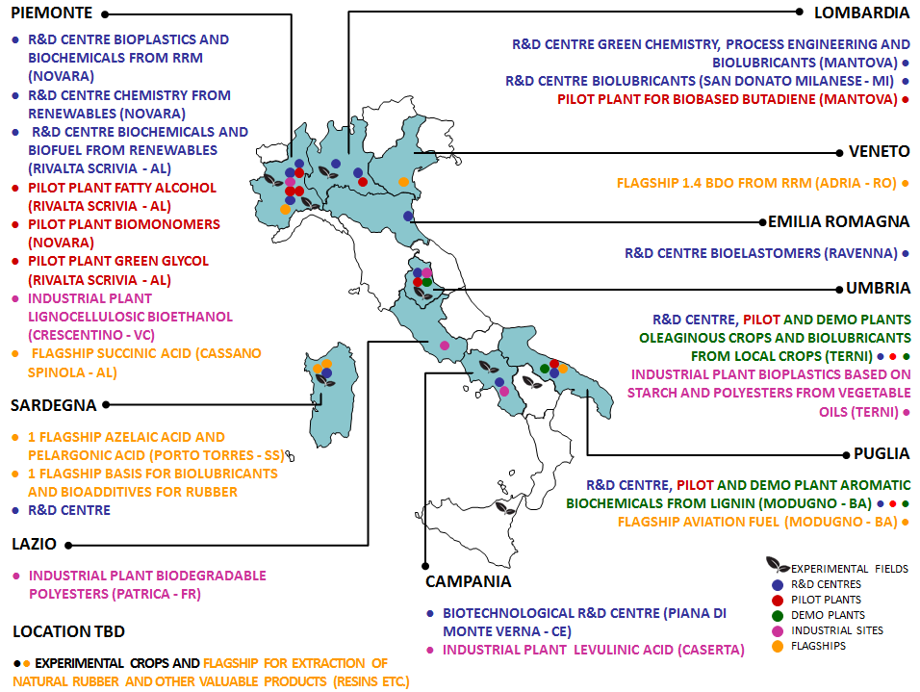

Slide 19








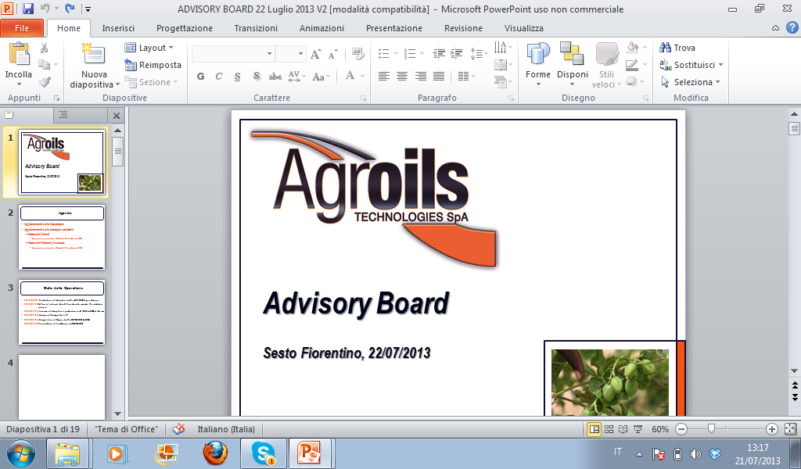









Italian Bioeconomy

Slide 20
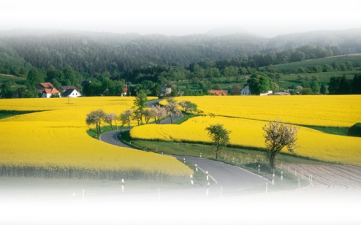





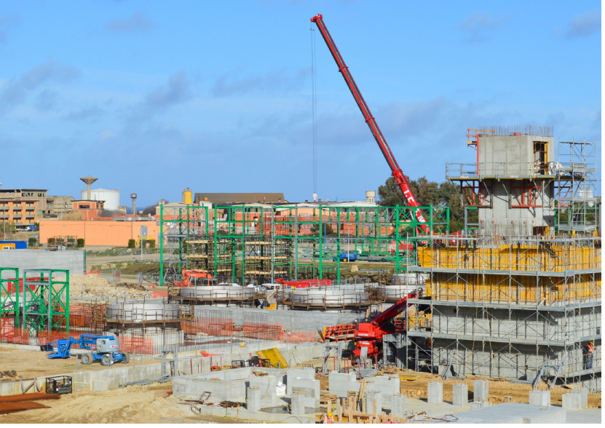
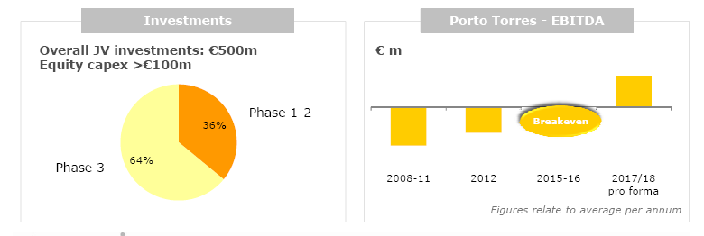
Porto Torres: From a traditional petrochemical site to an innovative biorefinery
Industrial Reconversion Activity
Biomass power plant
Soil remediation activity
7 plants in 3 phases
350,000 tons bio-based products (monomers, bio-plastics, bio-lubricants, oils for rubber industry , additives)
New R&S centre
More than 300 jobs
Porto Torres site reconversion project
Notes:
Il secondo esempio è quello della riconversione del sito di P.to Torres, forse il più grande progetto di riconversione industriale di un sito petrolchimico tradizionale in una moderna bioraffineria. Il sito era uno dei numerosi siti petrolchimici di Versalis, caratterizzato però da un andamento strutturalmente in perdita per diverse ragioni, tra cui principalmente la ridotta dimensione degli impianti. Questa riconversione vede tre attori, la JV Matrica creata da ENI Versalis/Novamont, Enipower e Syndial .
Il progetto è partito con la complessa fermata e messa in sicurezza di tutti gli impianti di petrolchimica presenti e non più competitivi, a cominciare dall’impianto di cracking, comprende tutte le necessarie attività di soil remediation necessarie nonché la costruzione di una centrale a biomasse che fornirà l’elettricità ed il vapore necessari per gli impianti di Matrica.
In Matrica, Novamont, società leader nel campo delle bioplastiche, ha fornito le tecnologie e Versalis la propria esperienza nella costruzione e gestione di grossi impianti petrolchimici. La nuova JV paritetica, costruirà e gestirà un complesso di 7 impianti in 3 fasi temporali distinte, per la produzione complessiva di 350.000 Tonn all’anno di diversi prodotti chimici qui elencati. La prima delle 3 fasi è prossima al completamento, vedete qui il cantiere, e quindi all’avvio previsto a metà del 2014. E’ una fase piuttosto delicata poiché questi impianti sono realizzati su questa scala per la prima volta nel mondo e soltanto nell’ultima delle 3 fasi verranno replicati su scala maggiore.
In parallelo è già stata avviata, a cura completamente di Novamont, la costruzione in loco della filiera agricola del cardo per la produzione dell’olio vegetale che costituisce la materia prima fondamentale della bioraffineria. Il progetto complessivo prevede un investimento di 1,2 mld di euro, di cui ca. 500 per le 3 fasi di investimento della sola Matrica,

Slide 21
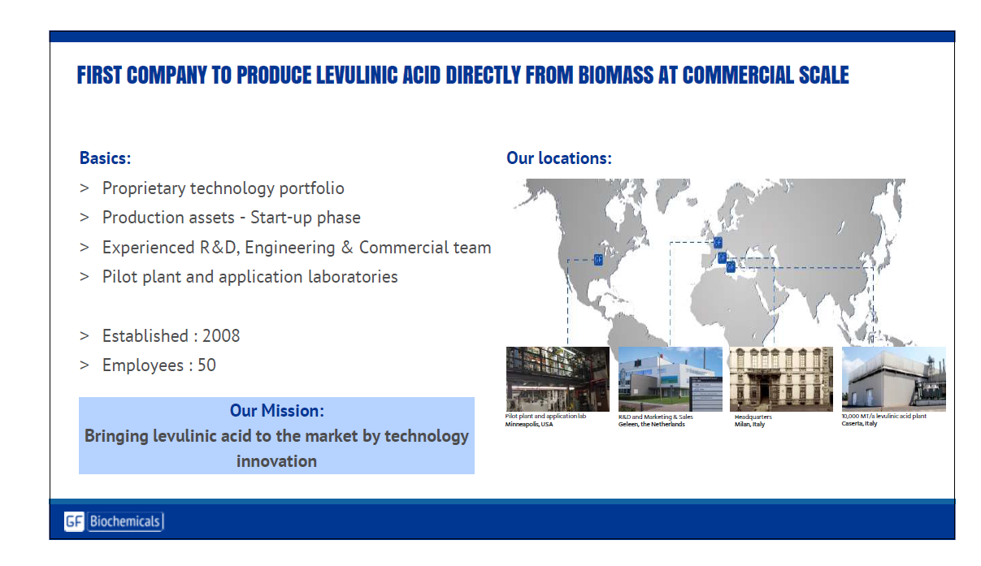
GFBiochemicals

Slide 22
The Italian Bioeconomy seen from abroad
Italy plays an important role in the European bioeconomy. The whole agro-food value chain in Italy is worth €152 billion each year, employs more than 1.2 million workers and generates 10% of the national GDP, thus representing one of the largest European agro-food value chains. Furthermore, considering that the bioeconomy is not only about the agro-food value chain, the Italian industry is also at the forefront of both the research and the production of new bio-based products, such as bioplastics and second generation biofuels. The Italian government is aware of the benefits of a coordinated bioeconomy strategy and expressed interest in possibly hosting the annual Bioeconomy Stakeholders Conference in Italy in 2014.
Interview with Maire Geoghegan-Quinn, IlBioeconomista.com

Slide 23
Italian
Bioeconomy Strategy:
main priorities
Improve sustainability, productivity and quality of products
More efficiently interconnections
Creating locally rooted value chains
Public and private stakeholders engagement
Valorization of terrestrial/marine biodiversity,
Ecosystem services within a circularity approach
Regenerate marginal lands and dismissed industrial sites
Growth of Bioeconomy in the Mediterranean area
Wider social cohesion and political stability in the area
Wider and more coherent political commitment
Increase investments in R&I, SMEs, education, training, communication
Coordination between regional, national and EU policies
Better engagement of a public dialogue while boosting market development
Increase Italian Bioeconomy turnover and jobs by 20% by 2030.

Slide 24
Uno sguardo allargato alla realtà italiana
Per quanto riguarda la quota del consumo finale lordo (Cfl) soddisfatto con fonti energetiche rinnovabili, nel 2014 l’Italia - secondo i dati Eurostat - ha raggiunto il 17,1%, superiore alla media europea del 16% e al 1° posto fra i cinque grandi Paesi europei, seguita da Spagna (16,2 %),Francia (14,3%), Germania (13,8%) e Regno Unito (7%).
Nel riciclo dei rifiuti urbani l’Italia (dati 2014), col 42%, si colloca un punto percentuale sotto la media Ue28 e al 3° posto fra i cinque grandi Paesi europei

Slide 25
Uno sguardo allargato alla realtà italiana
Nel 2012 sono state riciclate in Italia circa 99 milioni di tonnellate di rifiuti speciali, pari al 76% dei rifiuti prodotti. Rispetto ai cinque principali Paesi europei, l’Italia si colloca al primo posto.
La produttività delle risorse, misurata come consumo interno di materiali per unita di Pil (in euro di Pil per chilogrammo di materiale consumato) - colloca l’Italia al secondo posto, con 3 euro al kg, meglio della media europea (2 €/kg).
Per quanto riguarda l’ecoinnovazione – (brevetti e le pubblicazioni, i benefici ambientali e i benefici socio economici in termini di occupazione, esportazioni e fatturato) - l’Italia ha una posizione al di sopra della media europea, ma al 3° posto della classifica dei cinque grandi Paesi .
Con 1,4 milioni di ettari coltivati con criteri biologici, pari all’11,2% della superficie agricola utilizzata, ben superiore alla media europea, l’Italia si colloca in Europa al 2° posto, dopo la Spagna.
L’Italia si colloca, ben al di sopra della media, al 1° posto in Europa per prodotti agroalimentari certificati per qualità e tracciabilità, che coinvolgono circa un quarto dell’intera produzione agricola nazionale, davanti a Francia, Spagna, Germania e Regno Unito.
Per quanto riguarda il consumo di suolo, col 7% l’Italia è in una condizione peggiore della media europea (4,3%), in 4° posizione fra i cinque grandi Paesi europei, e simile alla Germania (7,2%.)

Slide 26
The Actors Boosting
Italian Biorefineries and Bioeconomy
CLUSTER NAZIONALE BLUE GROWTH
Mission :
Overcoming fragmentation
Public-private aggregations of stakeholders in a specific thematic area of strategic relevance for Italian industry
Cooperation between public and private R&I

Slide 27




The National Technological Cluster on Green Chemistry
103 Members
103 REALTÀ ADERENTI
R&D 40%
Multiple sectors represented:
Chimica
Farmaceutica
Alimentare
Cosmetica
Plastiche
Fonti rinnovabili
Biotecnologie industriali
Trasformazione
Smaltimento
Founders
4 SOCI FONDATORI
Regions formally involved

Slide 28


The National Technological Cluster on Green Chemistry
Interlocutor of National Institutions
Ministero dello
sviluppo economico
Inspiring policies and strategies to support R&D
Promotion of territorial cooperation and macro-regional sinergies
Identification of main national R&I needs
Promoting IT priorities inside EU funding programs
Promoting the participation of Italian public and private stakeholders in regional, national and EU funding programs

Slide 29
Bioeconomy in Europe
Notes:
The Bio-based economy concept made simple: Making everyday products from biomass and waste, with biorefineries at the centre of it all.
The BBI is built on the principle of smart and efficient use of resources. It will focus on:
Unlocking the potential of residues and side-streams and waste (e.g. forest residues, agricultural lignocellulosic residues or dedicated crops), and
Optimising the utilisation of existing feedstock (forest and agricultural biomass)

Slide 30
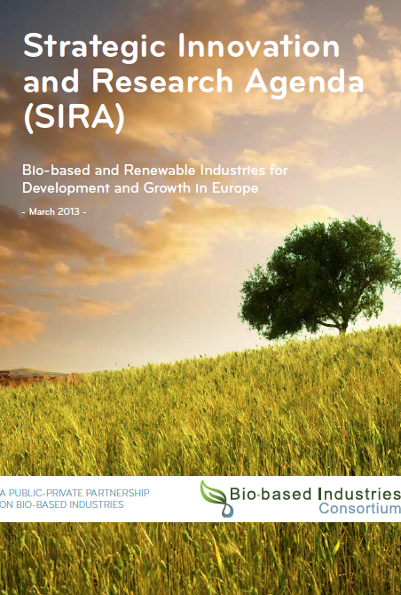
Come raggiungere una crescita intelligente, sostenibile ed inclusiva? Investendo in ricerca ed innovazione
80 Miliardi € (2014-2020)
3.8 Miliardi € per i settori di ricerca della filiera bioeconomia
Specifici per l’innovazione dell’industria per la bio-economia: € 3.7 Miliardi
(1/3 pubblico, 2/3 privato)

Slide 31

Horizon 2020: three pillars
Horizon 2020, the EU Commission R&I funding programme (~79 Bil, 2014-2020)
Excellent science
€ 24.4 bln
Industrial leadership
Societal challenges
€ 17.0 bln
€ 29.7 bln

Slide 32
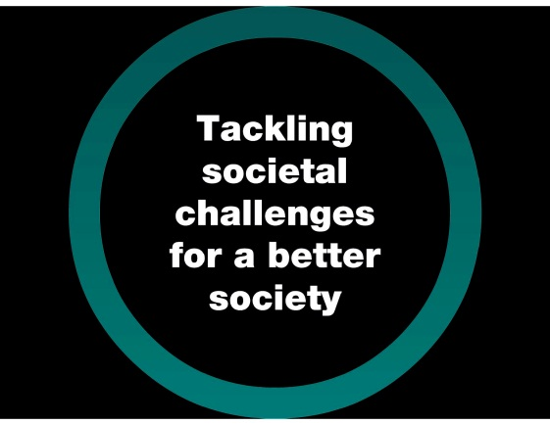

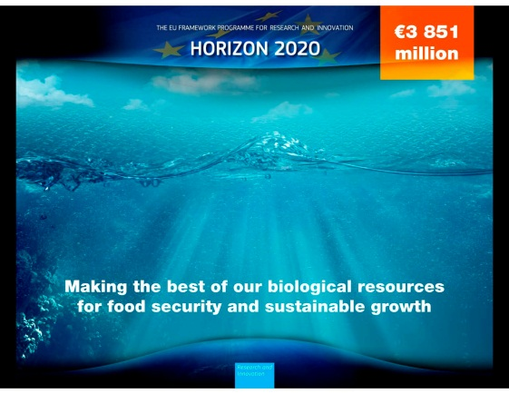
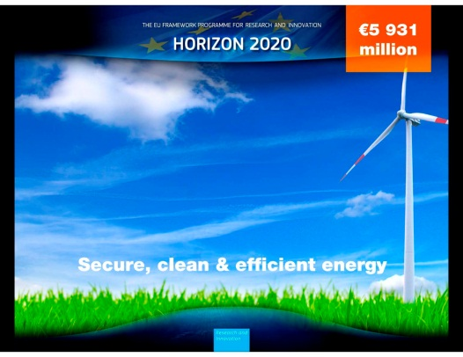
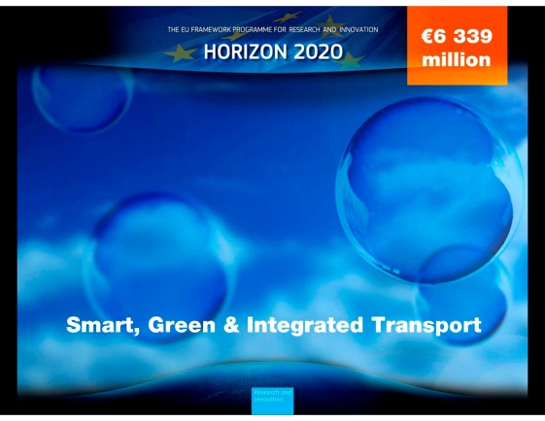
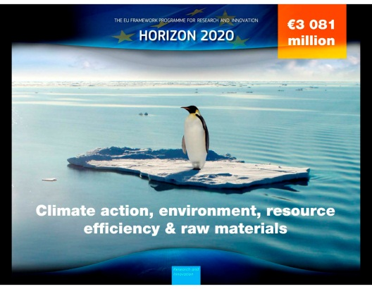
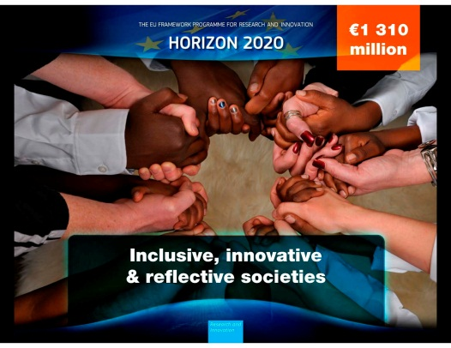
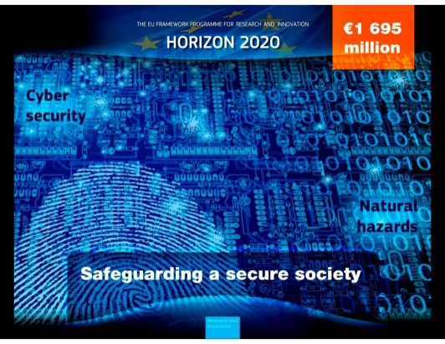
Horizon 2020, the EU Commission R&I funding programme (~79 Bil, 2014-2020)
Societal challenges
1. Health, demographic change and wellbeing (7.472 Bln)
2. Food security, sustainable agriculture and forestry, marine and maritime and inland water research, and the bioeconomy (3.851 Bln)
3. Secure, clean and efficient energy (5.931 Bln)
4. Smart, green and integrated transport (6.339 Bln)
5. Climate action, resource efficiency and raw materials (3.081 Bln)
6. Inclusive, innovative and reflective societies (1.310 Bln)
7. Secure societies (1.695 Bln)
Notes:
Third pillar dedicated to tackling societal challenges,
It means meeting the concerns of citizens and society and the EU policy objectives, relying on research and innovation.
For example, meeting the target to reduce CO2 emissions depends on new technologies and solutions for energy, transport, agriculture and the management of resources.
It requires a broad, multi-disciplinary approach that brings together researchers, industry, public bodies and users to create innovative solutions that will meet peoples' needs.
Breakthrough solutions come from multi-disciplinary collaborations, including social sciences & humanities
7 societal challenges are identified in the programme

Slide 33
Societal Challenge 2 (Bioeconomy): ~3.8 Billion, 2014-2020
SC2
WP 2014-2015
SC2
WP 2016-2017
SC2
WP 2018-2020
Under preparation
SFS-Sustainable Food Security
SFS – Sustainable Food Security –
BG-Blue Growth
BG - Blue Growth
ISIB- Innovative, Sustainable and Inclusive Bioeconomy
RUR – Rural Renaissance
New
Budget:~ 450 M €
BE – Bio-based innovation for sustainable goods and services
Budget: ~ 750 M €

Slide 34
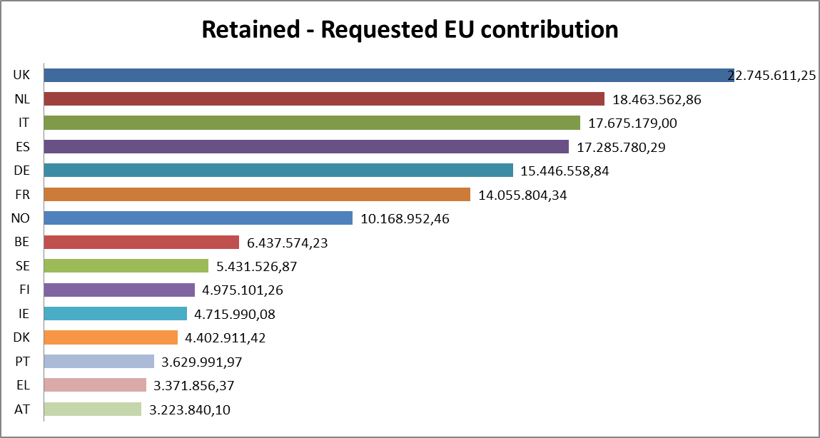
IT participation in SC2 2015 calls (c)
10.37%

Slide 35
A Public-Private Partnership on Bio-Based Industries
Realising the European Bio-economy Potential
€ 3.7 Billion (1/3 public, 2/3 private) 2014-2020
http://biconsortium.eu/
http://www.bbi-europe.eu/

Slide 36
About BBI JU
Objectives
De-risk investments;
Organize the value chains;
Reach critical mass of this “emerging” sector

Slide 37
The members
The members of BIC
  More than 200, from Agriculture, Agro-food, Forestry / Pulp and Paper, Biotechnology, Chemicals, Energy sectors
■ 77 Full members
  43 Large industries
  19 SMEs
  15 Clusters
■ 142 Associate members
  47 Universities
  71 RTOs
  10 European Associations
  7 Associations
  5 Technology platforms
  1 Public institution
  1 Bank
http://biconsortium.eu/

Slide 38
Italian partners of BIC (March 2016)
Full members
BioChemtex
GFBiochemicals Italy S.p.A.
Novamont
Soremartec - Gruppo Ferrero
ENI- Versalis
Associated members
SPRING
ENEA
National Interuniversity Consortium of Materials (INSTM)
Re-cord, University of Florence
Alma Mater Studiorum-Università di Bologna
Università Cattolica del Sacro Cuore
University of Modena and Reggio Emilia – Unimore
University of Naples "Federico II"

Slide 39
The focus
Feedstock
Sustainable biomass supply
Biorefineries
Efficient processing through R&D and upscaling in large-scale demo/flagship biorefineries
Markets, products and policies
Developing markets for bio-based products and optimising policy frameworks
and building new value chains

Slide 40
The strategic Innovation & Research Agenda
Value Chain 1: Lignocellulosic
Value Chain 2: Forest-based
Value Chain 3: Agro-based
Value Chain 4: Organic waste
Value Chain 5: Energy, pulp and chemicals biorefineries

Slide 41
Italian presence
in the funded proposals
  Call 2014:
  NOVAMONT, UNIBO, MATRICA, UNITO, FIAT, BARILLA,
  AEP Polymer Srl (TS).
  Call 2015.1:
  BIOCHEMTEX , AGRICONSULTING SPA
  Call 2015.2:
FVA SAS, UNIBO, CIAOTECH Srl, GFBiochemicals Italy S.p.A. (LEAD, IA) , NOVAMONT, LABORATORI ARCHA SRL, ARDAGH GROUP ITALY SRL, BARILLA, CHIESA VIRGINIO, FEMTO ENGINEERING SRL, INSTM, MYCOPLAST, SSICA, CENTRO EUROPEO PER I POLIMERI NANOSTRUTTURATI SCARL, UNINA FEDERICO II, UNIPR, ARTERRA BIOSCIENCE SRL, CENTRO RICERCHE FIAT SCPA, CNR, CONAIBO.

Slide 42
Research and innovation
Innovation: DEMO or FLAGSHIP
Coordination and support
BBI 2017.R1 – Valorisation of gaseous side streams from bio-based operations into chemical building blocks
BBI 2017.R2 – Innovative technologies for the pre-treatment and separation of lignocellulosic feedstock and complex composition streams into valuable fractions while maintaining key characteristics
BBI 2017.R3 – Exploiting extremophiles and extremozymes to broaden the processing conditions to convert biomass into high-value building blocks
BBI 2017.R4 – Proteins and other bioactive ingredients from side streams and residues
BBI 2017.R5 – Novel bio-based chemical precursors to improve the performance of mass consumption products
BBI 2017.R6 – Competitive biodegradable, compostable and/or recyclable bio-based plastics for a sustainable end-of-life phase
BBI 2017.R7 – Novel secondary bio-based chemicals without significant fossil-based counterparts but with high application potential
BBI 2017.D1 –Valorisation of liquid and solid side streams from bio-based operations into high added-value products to create new feedstock for bio-based products
BBI 2017.D2 – Integrated multi-valorisation of algae into advanced materials and high added-value additives
BBI 2017.D3 – Breakthrough primary bio-based chemicals without significant fossil-based counterparts but with high marketability
BBI 2017.D4 – Innovative bio-based fertilising products to increase the sustainability of fertilising practices in agriculture
BBI 2017.D5 – Advanced bio-based fibres and materials for large-volume applications
BBI 2017.F1 – Integrated ‘zero waste’ biorefinery utilising all fractions of the feedstock for production of chemicals and materials
BBI 2017.F2 – Large-scale production of proteins for food and feed applications from alternative, sustainable sources
BBI 2017.S1 – Establish cooperation and partnership with brand owners and consumer
representatives to improve the market access of sustainable bio-based products
BBI 2017.S2 – Identify opportunities for ICT to increase the efficiency of biomass
supply chains for the bio-based industry

Slide 43
The strategy of EU programming
Selecting priorities
Informal
Wide range expert
MS strategy
Open surveys….
Sense making, evidence
Implementation
Formal
Decision makers
Strategic intelligence

Slide 44
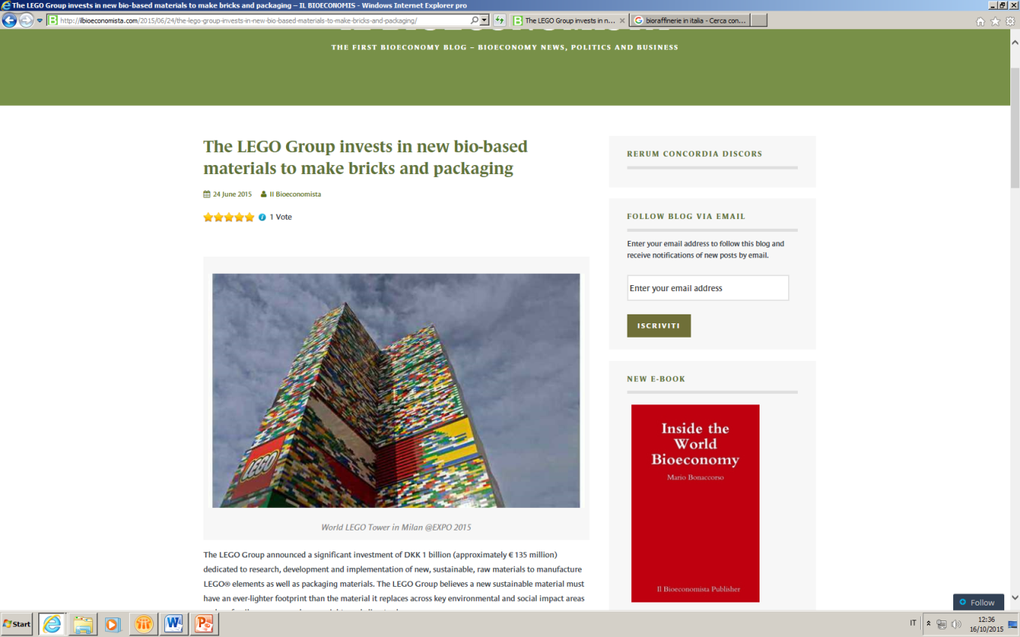
New players for Bioeconomy?
Bio-based bricks
The LEGO Group announced a significant investment of DKK 1 billion (approximately € 135 million) dedicated to research, development and implementation of new, sustainable, raw materials to manufacture LEGO® elements as well as packaging materials.

