Slide 2
Epigenetic (promoter methylation) can explain age-related changes in gene expression
Kacevska et al., Biochimie 2012

Slide 3
Pregnancy

Slide 4
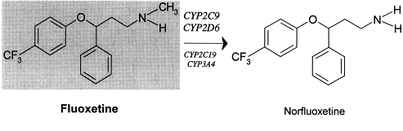
Pregnacy and cytochromes

Slide 5
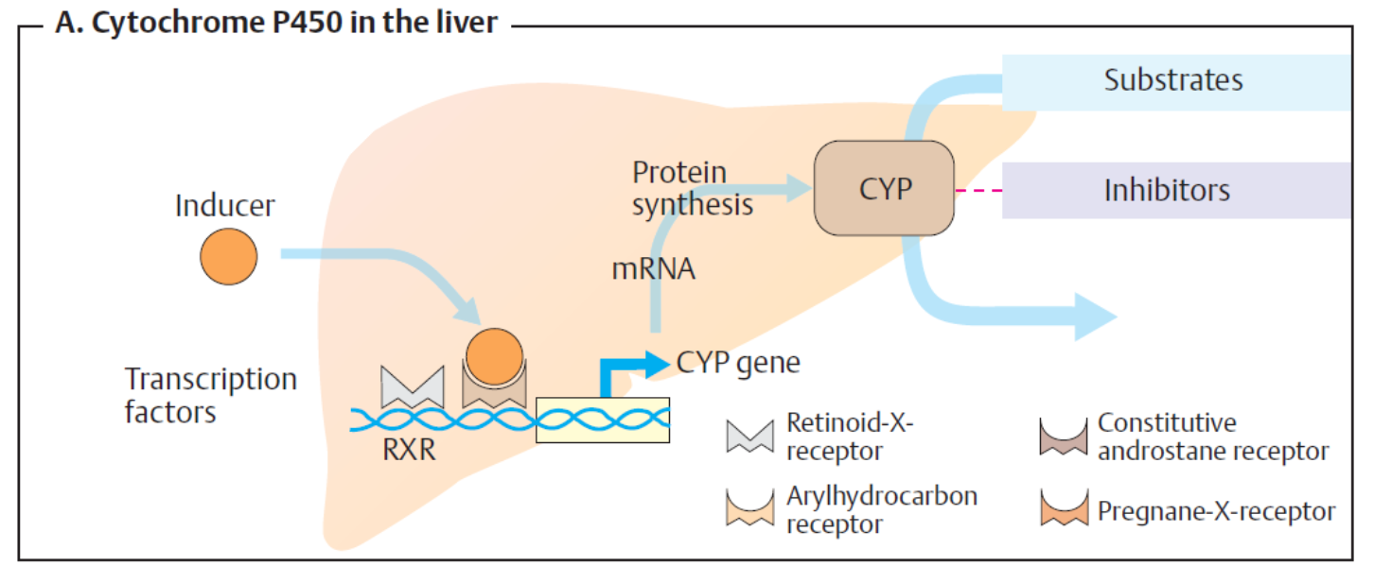
Drugs can induce expression of metabolizing enzymes

Slide 6
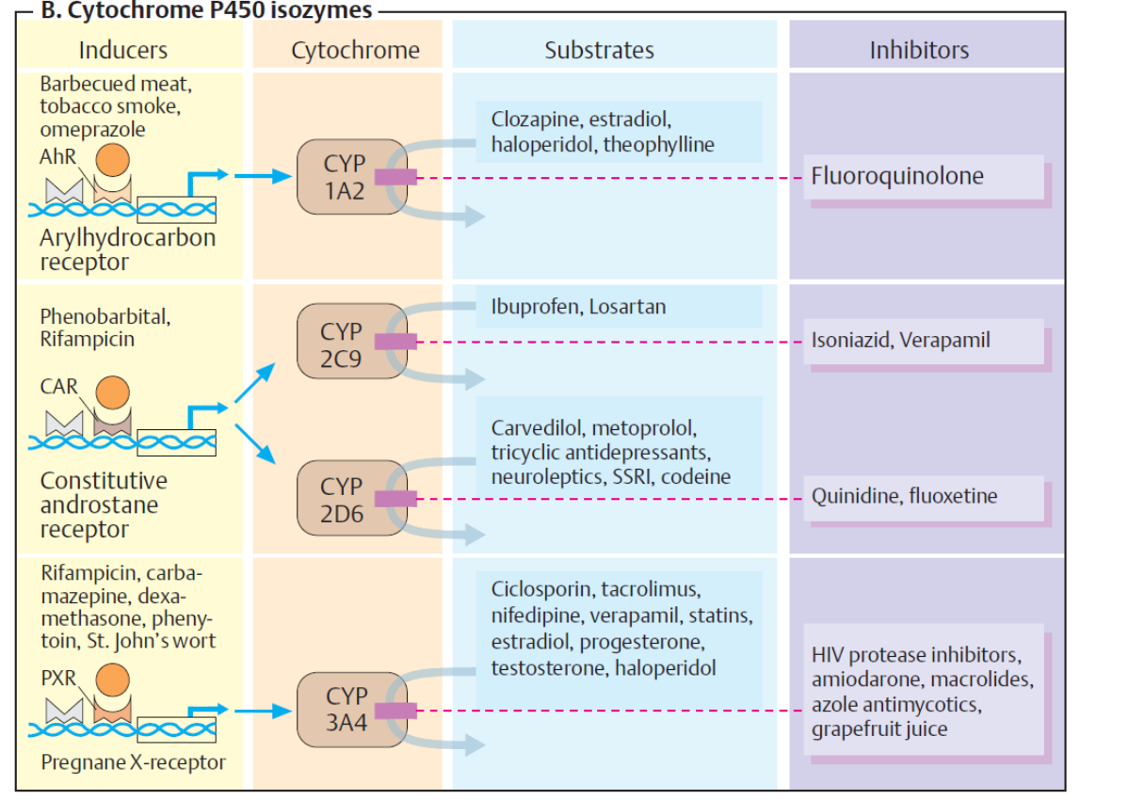

Slide 7
Personalized therapy
Treatment Outcome (same dose)
Responder
No effect
Adverse event

























Slide 8
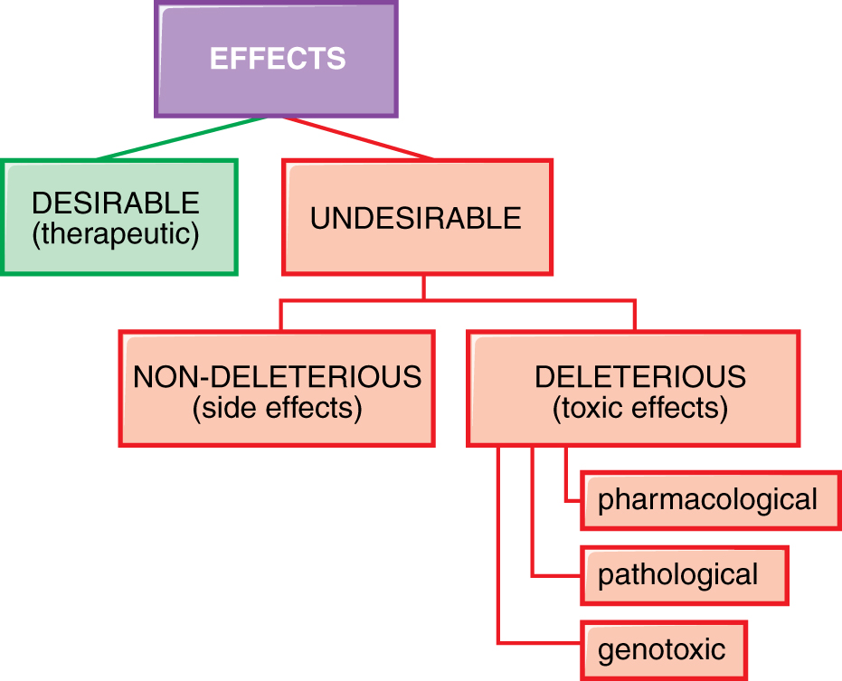
Drug effects
Goodman and Gilman, 2011

Slide 9
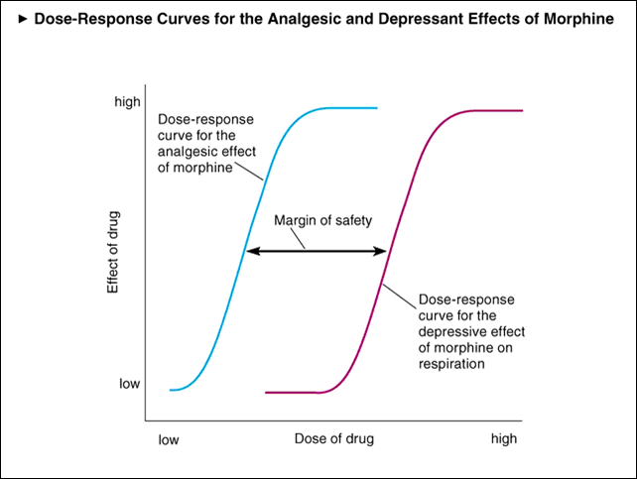
Dose dependent side effects: morphine

Slide 10
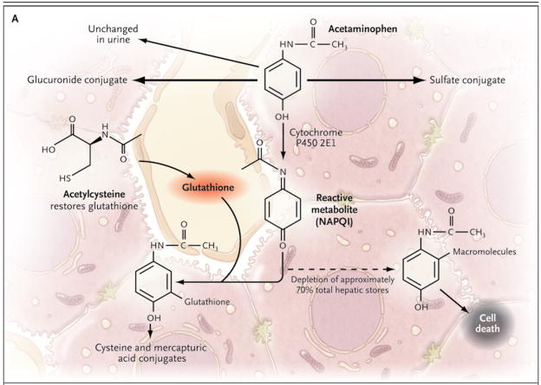
Dose dependent «off target» adverse events: paracetamol

Slide 11
Drugs that can give hypersensitivity reactions in humans

Slide 12
Hypersensitivity reactions

Slide 13
Ipotesi del meccanismo delle reazioni di ipersensibilità
"Hapten"
"Pharmacological interaction"
"Danger"

Slide 14
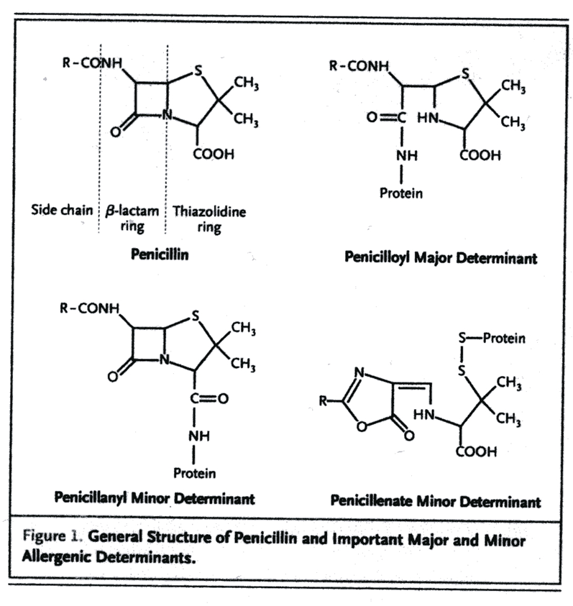
Hapten hypothesis

Slide 15
Pharmacological interaction

Slide 16
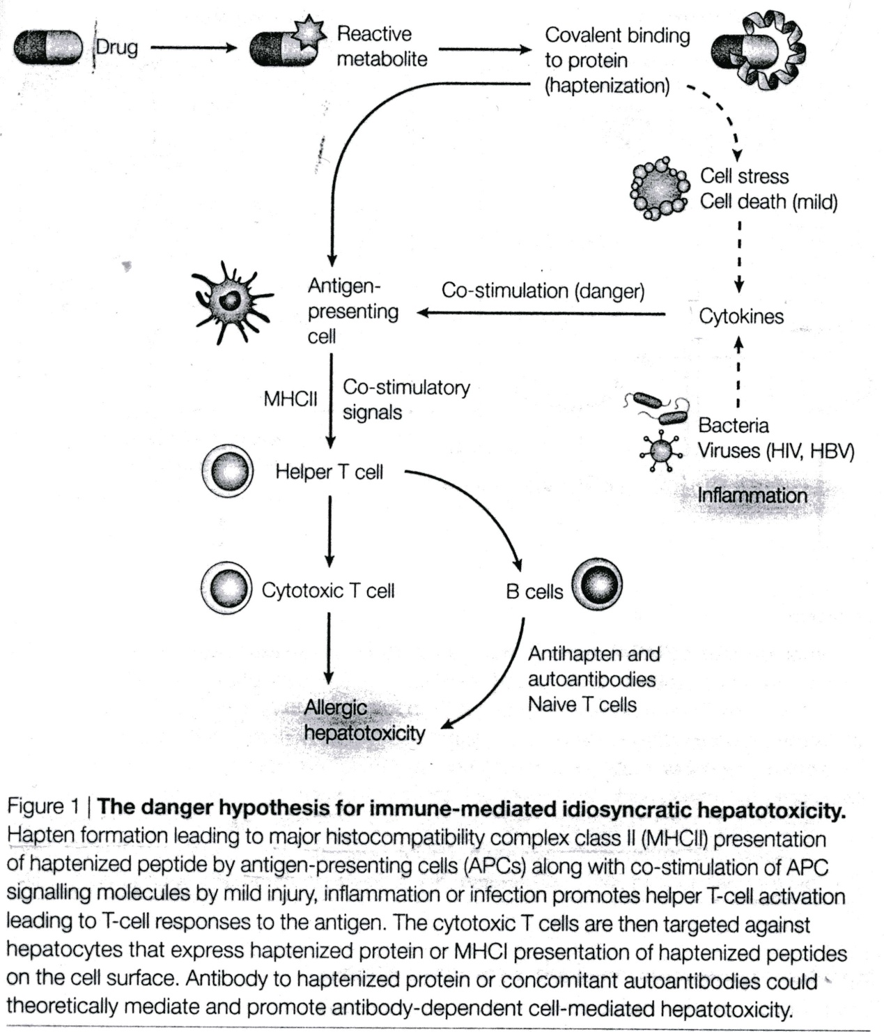
Danger hypothesis

