Slide 1
Pharmacogenomics
Identification of genes variants that influence drug effects.
Is it possible to predict the effect of a drug in a certain patient?
Pharmacogenetics/genomics associate to a certain phenotype (specific therapeutic outcome) a certain genotype.
The promise of pharmacogenomics is that by knowing the genotype in a patient it will be possible to predict the therapeutic outcome.

Slide 2

For some diseases the percentage of drug response is still unsatisfactory
US Food and Drug Administration

Slide 3
Interindividual variability in drug response
Treatment outcome
(same dose)
Response
No effect
Adverse effect

























Slide 4
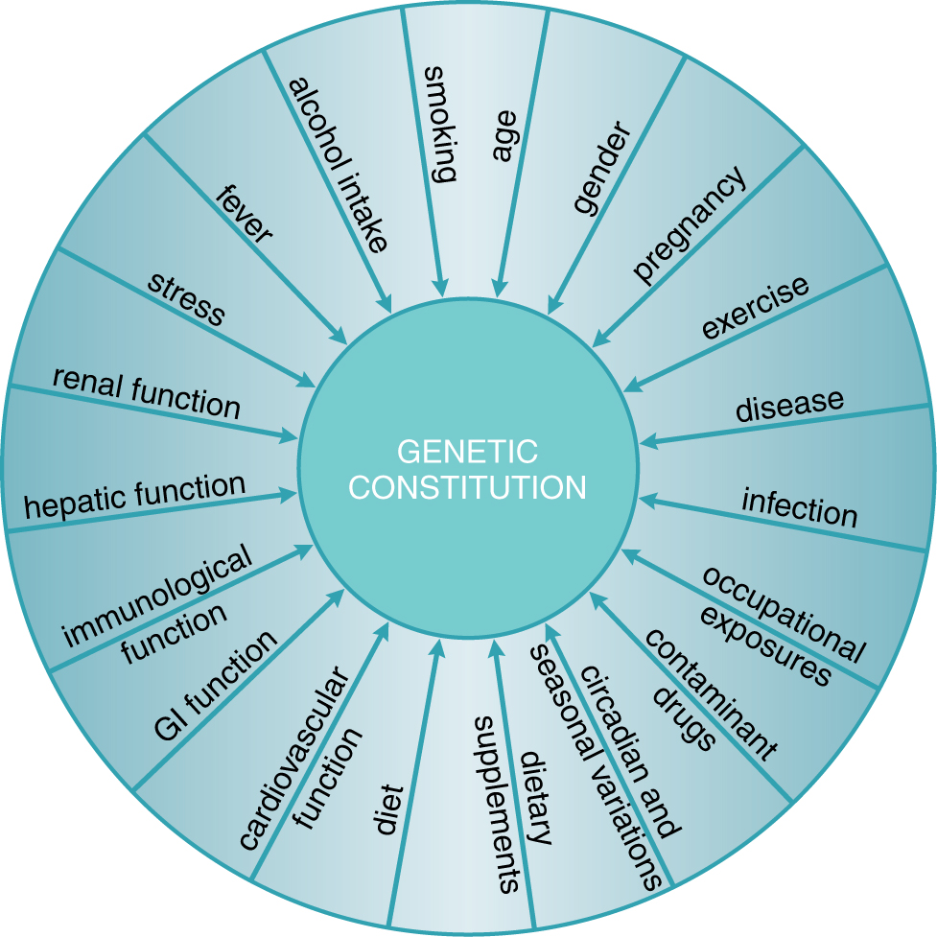
Exogenous and endogenous factors that contribute to interindividual variability in drug response
Physiological
Pathological
Genetic
Goodman and Gilman, 2011

Slide 5
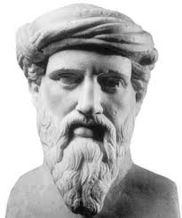

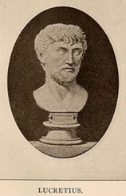
Genetic characteristics predispose to the response to substances
Pitagora
(Samo?, 570 b.C. – Metaponto, 495 b.C.)
He forbade his disciples to eat broad beans
(for the risk of favism?).
Lucrezio
(Campania, 98 /96 b.C. – Roma 55 /53 b.C.)
Quod ali cibus est aliis fuat acre venenum.
What is food for a man, it is poison for another.
«De rerum natura» Libro IV, linea 637
Pirmohamed, Br J Clin Pharmacol 2001
Ventura

Slide 6
Relling & Evans, Nature 2015

Slide 7
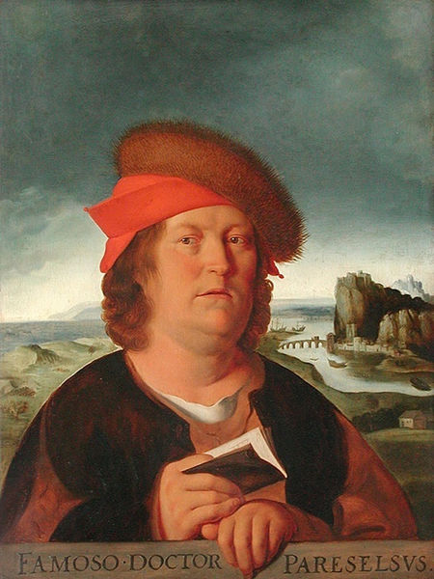
Modulation of the dose and drug effects
Paracelso (Philip Theophrastus Bombastus von Hohenheim)
(Einsiedeln 1493 – Salisburgo 1541)
“Omnia venenum sunt: nec sine veneno quicquam existit. Dosis sola facit, ut venenum non fit”
“All things are poison and nothing is without poison; only the dose makes a thing not a poison”
Yip et al., Clin Pharm Ther 2015

Slide 8
History of pharmacogenetics and pharmacogenomics
Pirmohamed, Br J Clin Pharmacol 2001

Slide 9
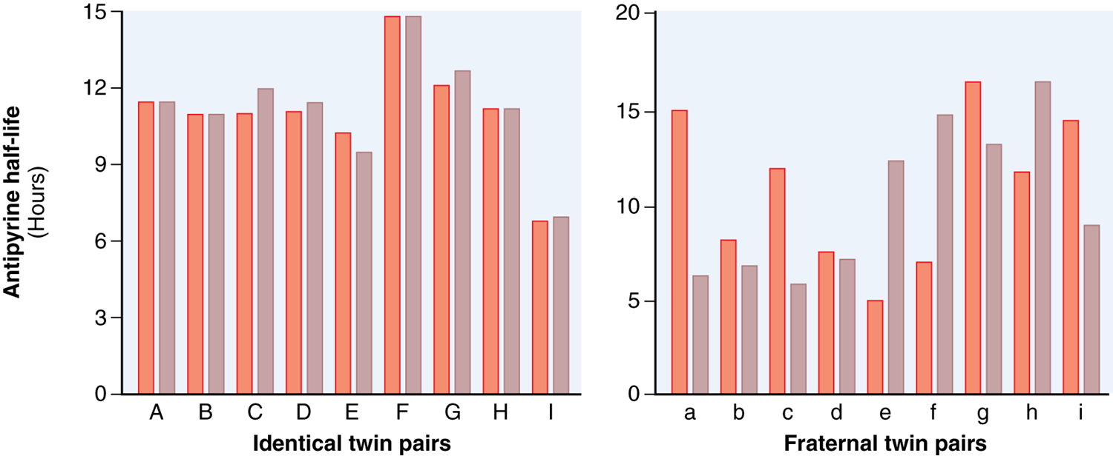
L’emivita dell’antipirina ha una concordanza maggiore nei gemelli identici che nei gemelli non identici.
Vessel & Page, Science 1968
Goodman and Gilman, 2011

Slide 10
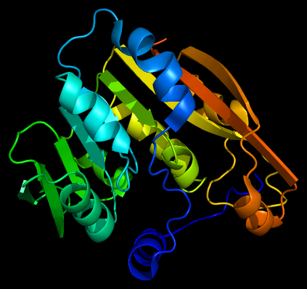
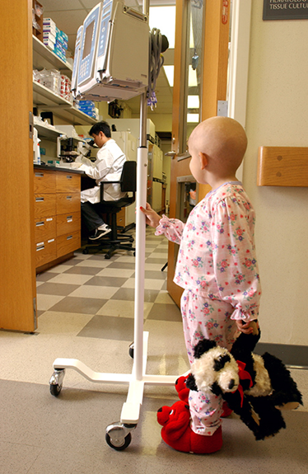
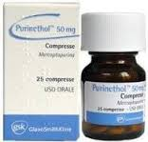
Exemple of pharmacogenetic trait
Enzyme thiopurine- S-methyltransferase
Thiopurine-S-methyltransferase enzymatic activity
Stocco et al., Human Mol Genet 2012

Slide 11
Cheok & Evans, 2006

Slide 12
Cheok & Evans, 2006

Slide 13

Definitions of genetic terms
Gene: fundamental unit, physical and functional, of heritability, that transmits biological information from a generation to the next.
Phenotype: morphological and functional characteristic of an organism determined by its genotype and modulated by the environment.
Genetic polymorphism: presence in the population of more variants of the same phenotype determined by different alleles with a frequency higher than 1%.
Allele: alternative form of a specific gene.

Slide 14
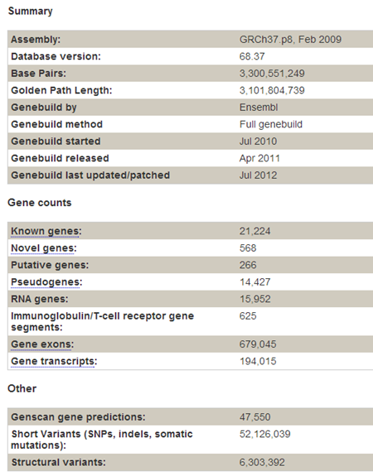
How big is the genome? How many genes does it contain?
http://jul2012.archive.ensembl.org/Homo_sapiens/Location/Genome?r=1:1-1000000

Slide 15
Objective of pharmacogenetic research
To associate to a certain PHENOTYPE (therapetuic response, adverse effects, resistance) a particular GENOTYPE
GENOTYPE
Single Nucleotide Variants (SNPs)
Deletions
Repeated sequences
Expression profiles (mRNA)
PHENOTYPE
Therapeutic response
Adverse effects
Lack of efficacy

Slide 16
Methods of pharmacogenetic research
The most critical step is to define and measure the drug-response phenotype.
Discovery model can be based on candidate gene studies or agnostic genome-wide analyses.
Pharmacogenetic discoveries require independent validation before they can be translated into clinical diagnostics.
The validation process can be facilitated by elucidating the mechanisms that determine how the variation alters drug responses.
Relling & Evans, Nature 2015

Slide 17
From the molecular point of view, drug efficacy is related to the concentration of active spiecies at the site of action.
Proteins that have a role in determining drugs:
- PHARMACOKINETICS (absorpion, distribution, metabolism, elimination, transport)
- PHARMACODYNAMICS (molecular targets)
can influence therapeutic response.

Slide 18
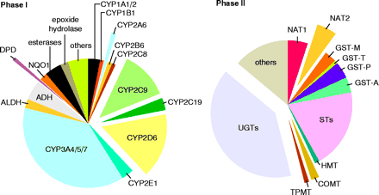
some of the main enzymes involved in the metabolic inactivation of drugs present polymorphisms of activity that are genetically determined
(Science 1999; 286: 487-491)

