Slide 1
Biotransformation of thiopurines
Stocco et al. J Clin Gastroenterol 2013

Slide 2
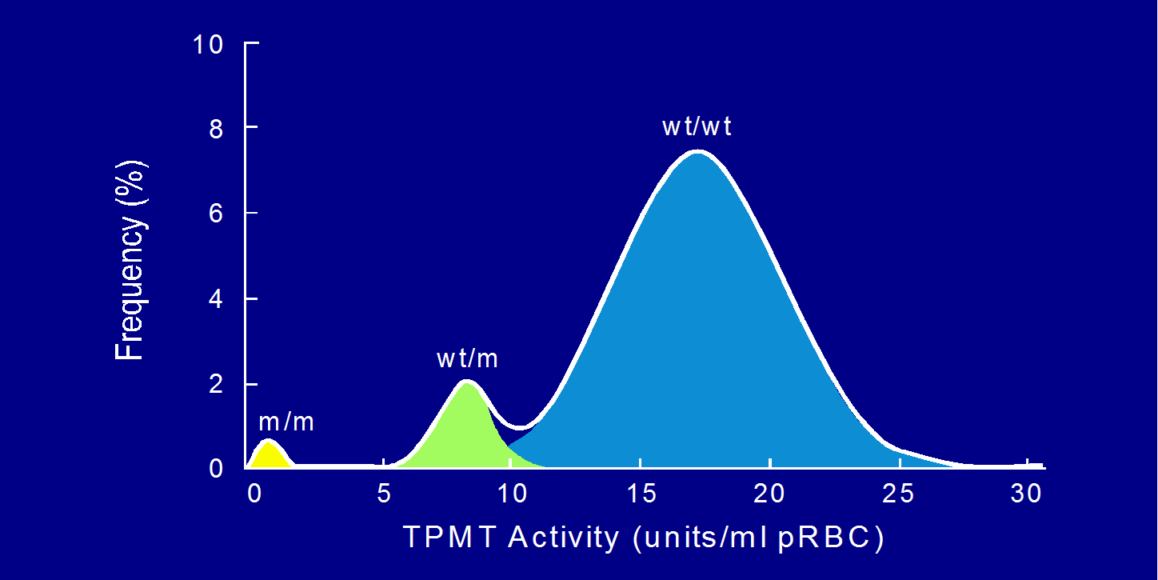
TPMT activity is inherited as an autosomal codominant trait
Caucasian population
Weinshilbaum and Sladek, Am J Hum Genet 1980

Slide 3
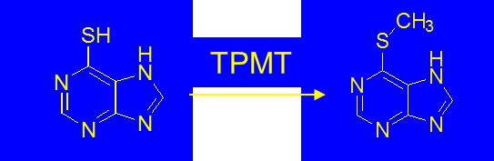
Example of genomic marker for personalized medicine: tiopurine-S-methyl-transferase (TPMT)
Enzyme of phase-II drug metabolism that catalyzes the methylation of thiopurines (6-mercaptopurine, 6-thioguanine) and other aromatic thiols.

Slide 4
Tiopurine-S-methyl-transferase (TPMT)
Physiologically, TPMT is involved in the biosynthesis of a cofactor that confers molibdenum binding propreties to proteins.
MDO meeting, Stuttgart 2014

Slide 5
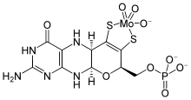
Qual’è la funzione endogena di TPMT? sembra essere coinvolto nella sintesi della molibdopterina, cofattore di alcuni enzimi (xantina ossidasi)

Slide 6
How to study TPMT gene variants?
Genotyping three SNPs allows to identify 95% of patients with reduced TPMT activity in Caucasians.
TPMT*2
TPMT*3

Slide 7
How to study TPMT gene variants?
Genotyping three SNPs allows to identify 95% of patients with reduced TPMT activity in Caucasians.
TPMT*2
TPMT*3

Slide 8
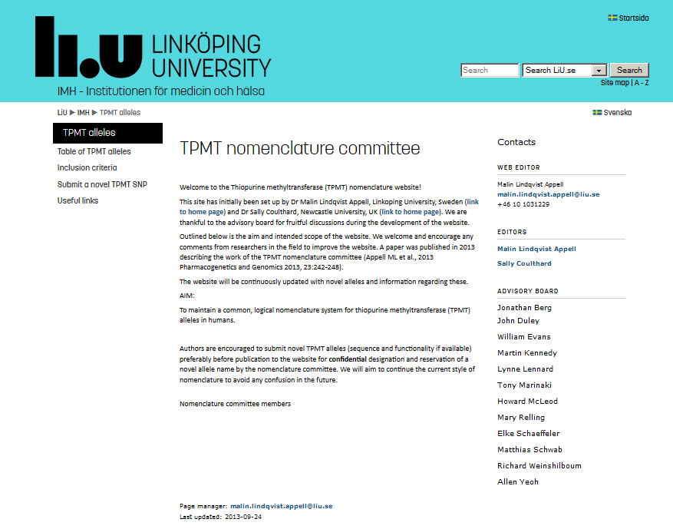
Official database of TPMT variant alleles
http://www.imh.liu.se/tpmtalleles?l=en

Slide 9
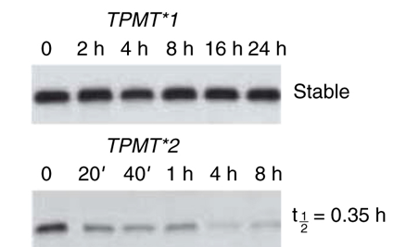
The protein encoded by the TPMT*3A variant allele is less stable than that encoded by the TPMT*1 (wild-type) allele
Dr. Evans’s lab (Tai et al., PNAS 1997)
picture from Jones TS et al, Clin Pharm Ther 2007

Slide 10
Cheok & Evans, 2006

Slide 11
Cheok & Evans, 2006

Slide 13
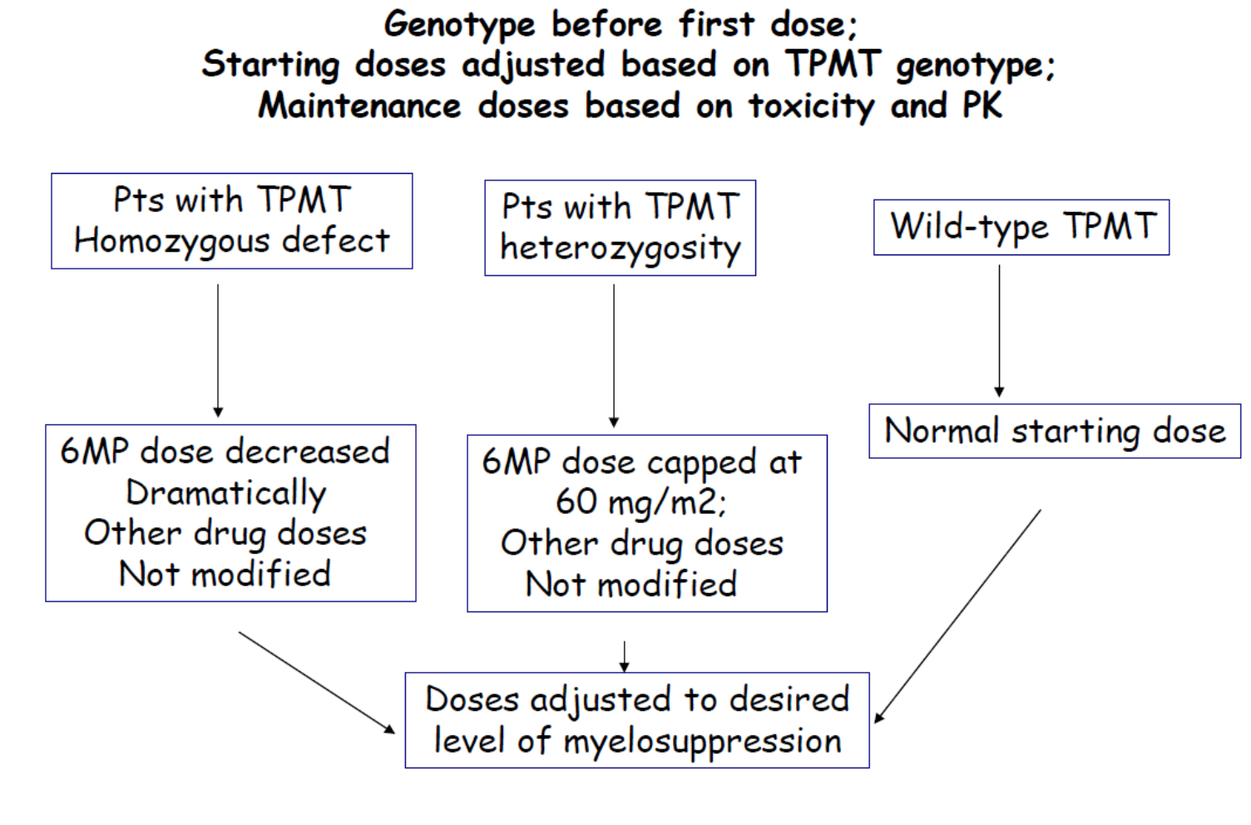

not
Relling et al., CPT 2013

Slide 14
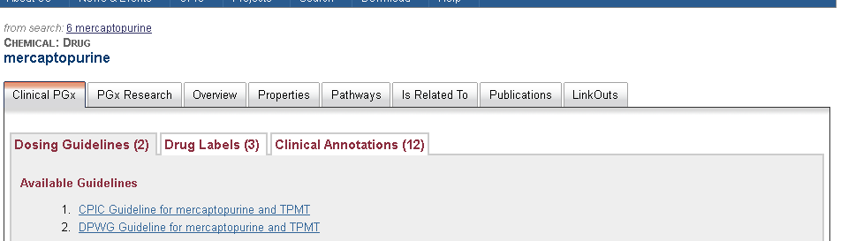
MERCAPTOPURINE and TPMT
GUIDELINES are designed to help clinicians by
  recommending the best pharmacogenetic test to perform
  Interpreting the pharmacogentic test results
  to optimize drug therapy

Slide 15
MERCAPTOPURINE and TPMT

