Slide 1
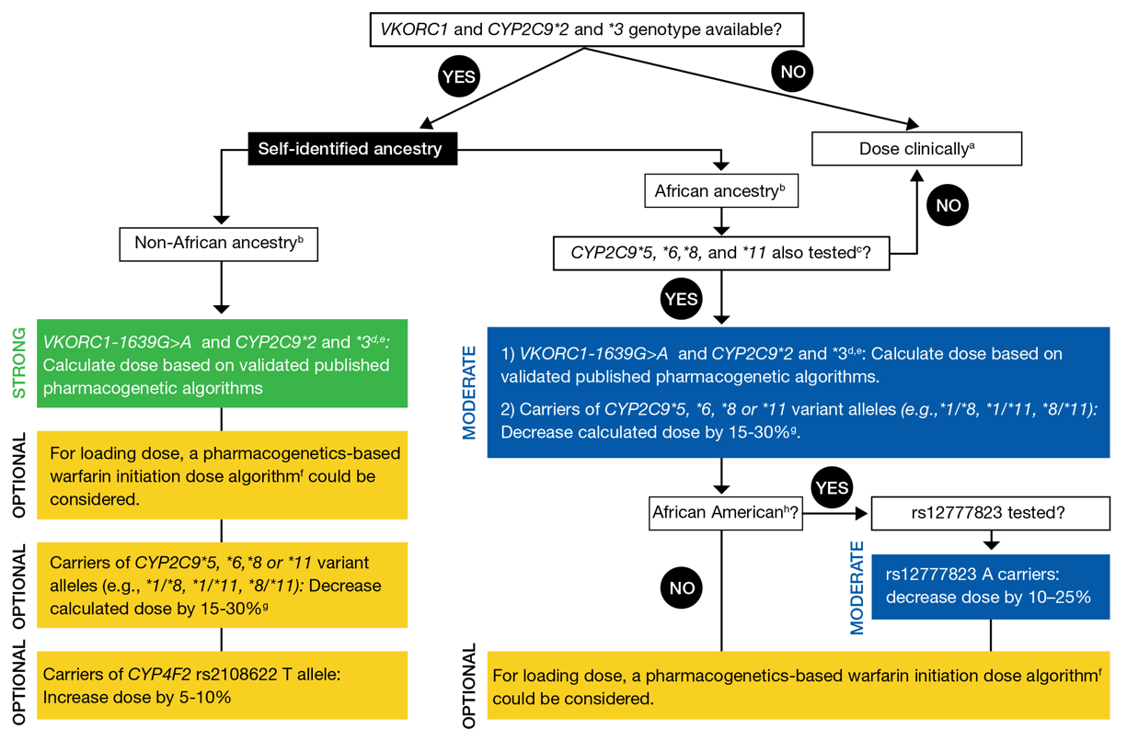
Johnson et al., Clin Pharm Ther 2017

Slide 2
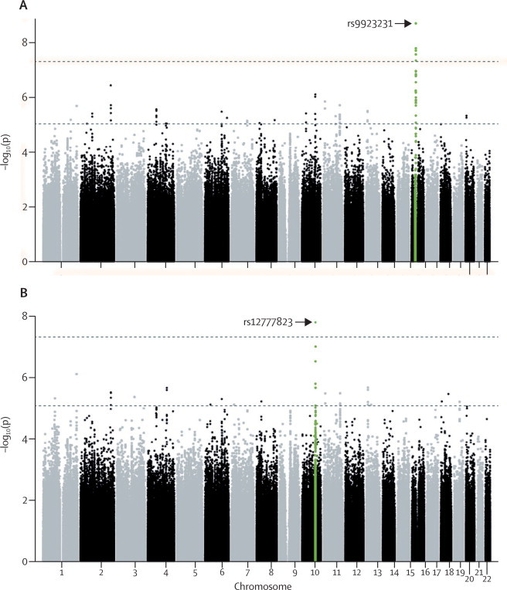
Perera et al., Lancet 2013

Slide 3
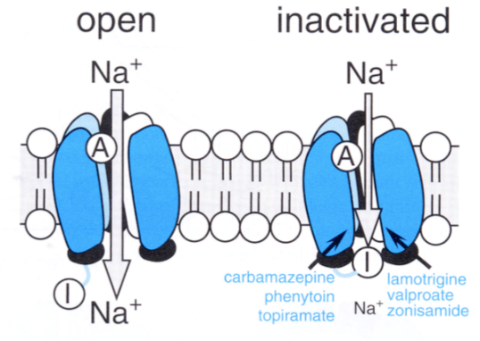
Carbamazepine
- Aromatic anticonvulsant
- Active by inhibition of sodium channels in the refractory state, therefore with an higher specificity for neurons that are hyperactive
- the allele HLA-B*15:02 is associated with severe dermatological reaction in Asian patients
- the allele HLA-A*31:01 is associated with hypersensitivity in Caucasian patients
Notes:
Rallentare il recupero dei canali al sodio, sebbene abbia anche effetti metabolici importanti interferendo con il ciclo degli inositoli e con la GSK-3 (glicogeno sintasi-chinasi 3), gli stessi bersaglii molecolari degli ioni litio.
Il farmaco può essere utilizzato nelle epilessie per il trattamento delle crisi parziali e delle crisi tonico-cloniche.

Slide 4
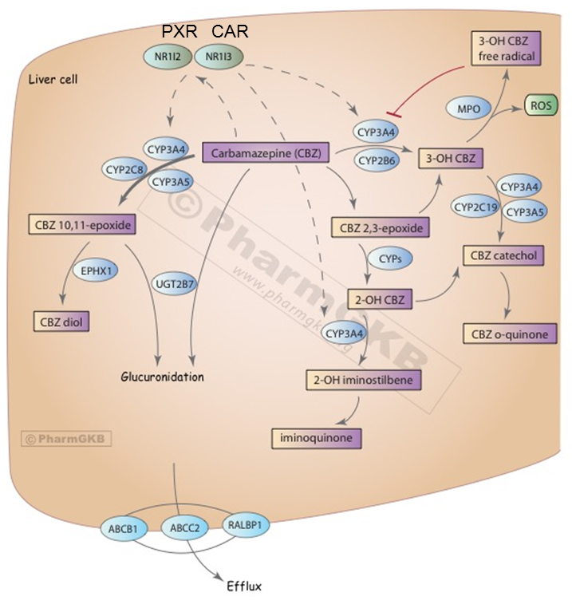
Carbamazepine biotransformation pathway

Slide 5
CPIC guidelines for carbamazepine

Slide 6
Pharmacogenetic testing my affect clinicians behaviour
Chen et al., Neurology 2014

Slide 8
Clinical use of pharmacogenetics tests
(Pharmaco)genetic tests must meet certain criteria concerning their:
- analytical validity (not trivial for genes such as CYP2D6)
- quality of data from genetic test
- test's performance characteristics
- clinical validity/utility
- penetrance of genetic variation on drug effects
- mechanism influencing drug effects (in vitro, PK, preclinical)
- clinical studies comparing outcomes of genetics-based prescribing
- therapeutic index, severity of toxicity, severity of disease

Slide 9
Clinical utility of pharmacogenetic testing
- The use of the test leads to improved health outcomes for patients who are subject to testing?
- What are the risks that occur as a result of testing?
- What are the costs of testing?
- How can testing influence the behavior of clinicians?

Slide 10
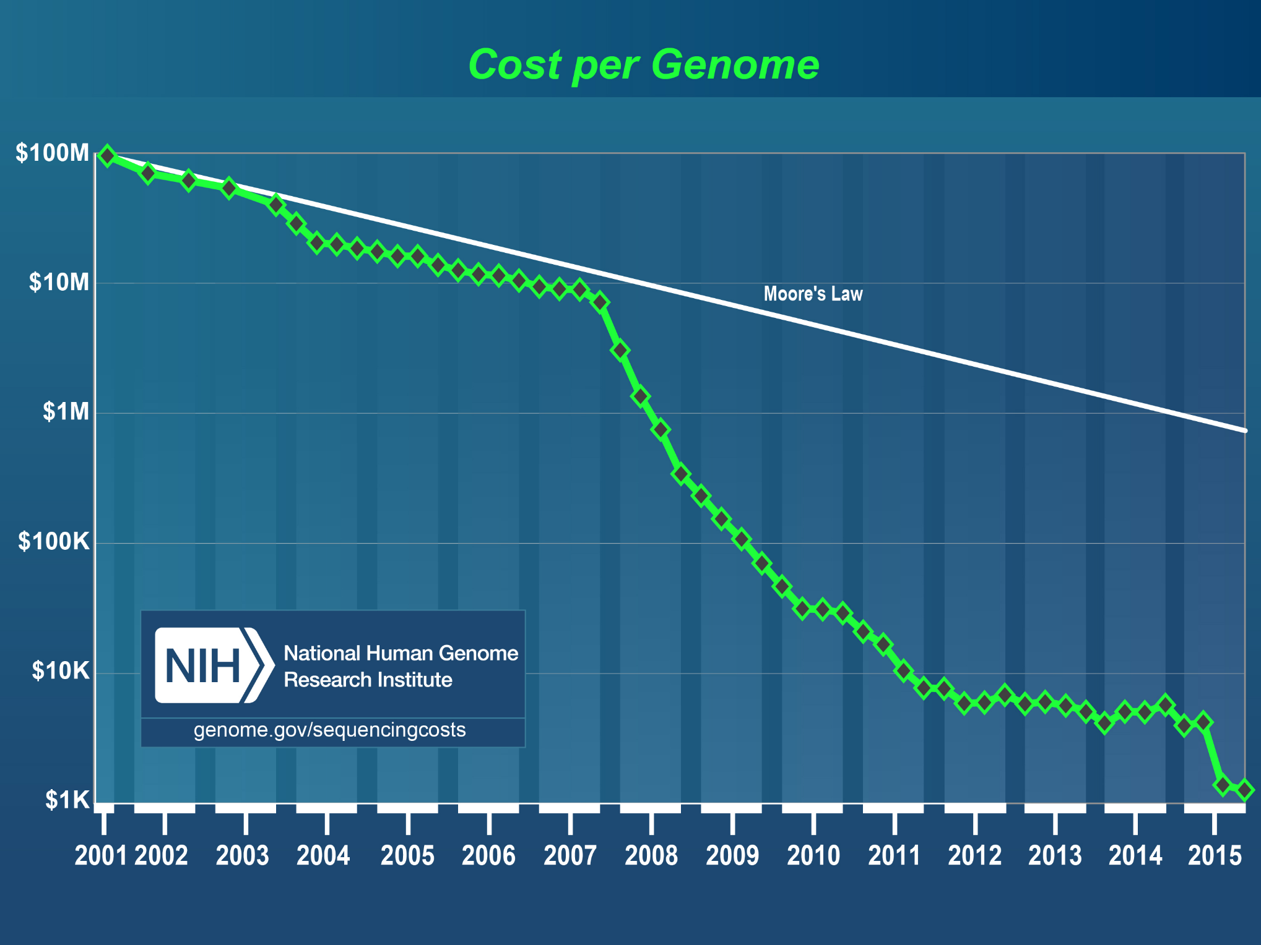
https://www.genome.gov/sequencingcosts/

Slide 11
Costs of testing
Plumpton et al., PharmacoEconomics 2016

Slide 12
Pharmacogenetic testing my affect clinicians behaviour
Chen et al., Neurology 2014

Slide 13
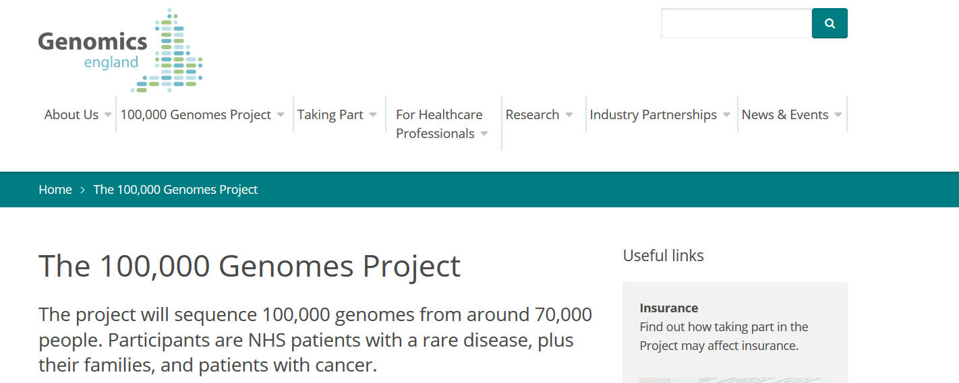
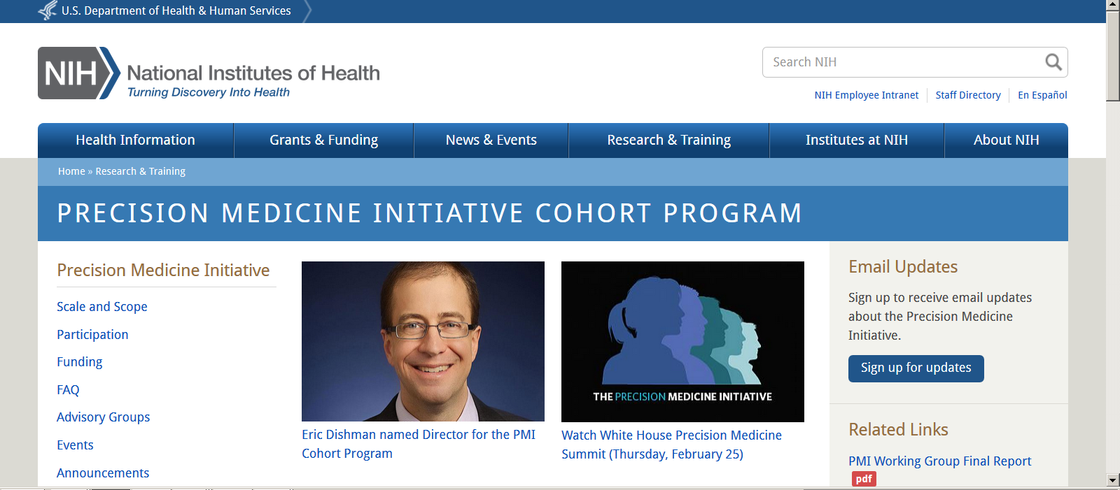
As the cost of sequencing continues to fall every individual will in the not-too-distant future have their germline genome sequenced early in life and the results will be available for clinical use throughout their lifetime.
clinicians need guidelines on how to interpret and deploy genetic variants to improve their prescribing

Slide 14
An important consideration for the actionability of a gene–drug relationship is the availability of an alternative therapy
Straightforward for medications:
- that are already therapeutically monitored (tacrolimus and CYP3A5);
- for which there are several valid alternative drugs (codeine and CYP2D6);
- for which the risk of severe adverse effects is extremely high (abacavir and HLA-B*57:01.
More difficult for medications for which the best alternative is unknown (tamoxifen and CYP2D6).

Slide 15
https://www.pharmgkb.org/view/dosing-guidelines.do?source=CPIC#

Slide 16
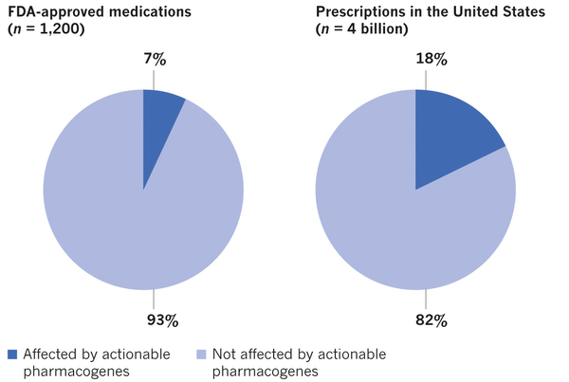
FDA/EMA approved medications
15% of medications contain pharmacogenomic information on their label
Relling & Evans, Nature 2015

Slide 17
Relling & Evans, Nature 2015

Slide 18
Pharmacogenetic testing approach
reactive approach in which a fresh genetic test is ordered every time it is required
vs
pre-emptive approach in which a single sample is assessed for many likely-to-be actionable genes at the same time

Slide 19
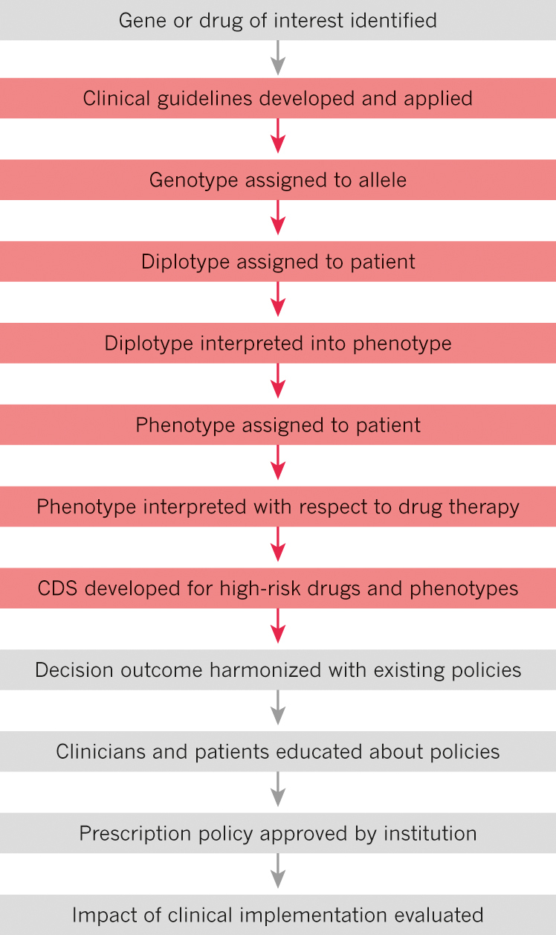
Bringing pharmacogenetic testing to the clinic
CDS = clinical decision support

Slide 20
Conclusions
Clinicians are accustomed to making prescribing decisions on the basis of patient characteristics such as age, kidney or liver function, drug–drug interactions and personal preferences.
Much of this takes place without optimal CDS to assist in compiling these characteristics and matching them with evidenced-based choices on medications and doses.
As CDS improves and becomes more widespread, and as the evidence to support pharmacogenomic testing continues to grow, momentum for the clinical implementation of pharmacogenomics should accelerate.
Going forward, there is a growing body of evidence to suggest that pharmacogenomics will become an important component of evidence-based precision medicine.
CDS = clinical decision support

