Slide 1

Cultural Influences on International Marketing
Donata Vianelli

Slide 2
Chapter Objectives
Identify elements of culture and examine how they affect international marketing practices around the world.
Describe national and regional character based on dimensions such as time orientation, business practices, gift giving, socializing, gender roles, and materialism.
Discuss cultural variability in terms of the Hofstede dimensions with appropriate examples and address cultural change in a marketing context.
Address the self-reference criterion and ethnocentrism and describe how they impede mutual understanding and cooperation, with direct negative effects on marketing practices.
Describe the global consumer culture as it manifests itself around the world.

Slide 3

Culture
Culture is defined as a continuously changing totality of learned and shared meanings, rituals, norms, and traditions among the members of an organization or society.
Culture is also defined as a society’s personality.

Slide 4
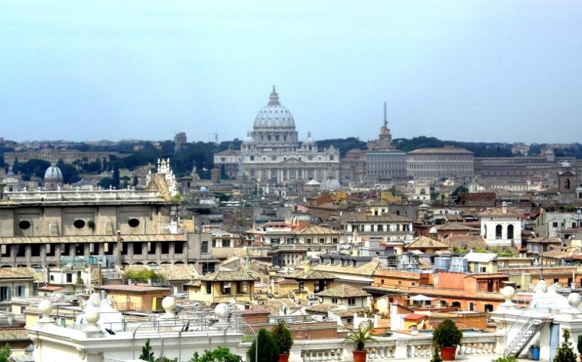
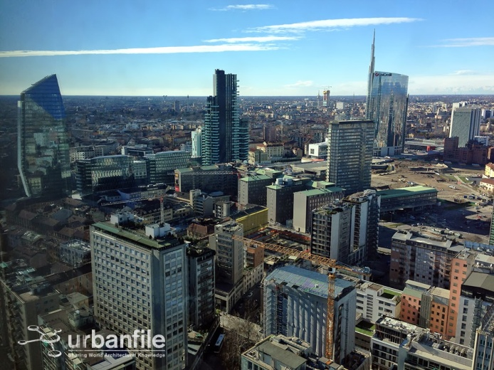
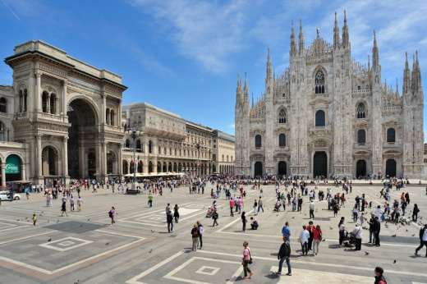
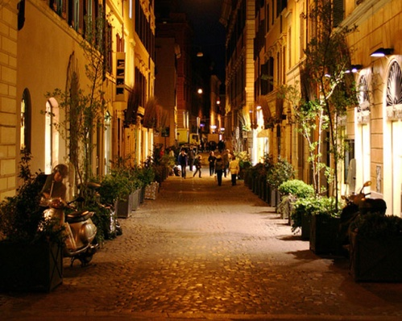
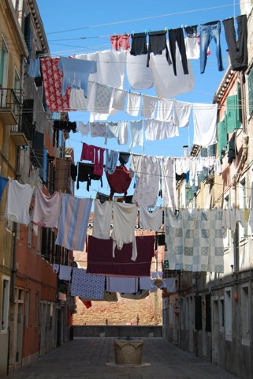
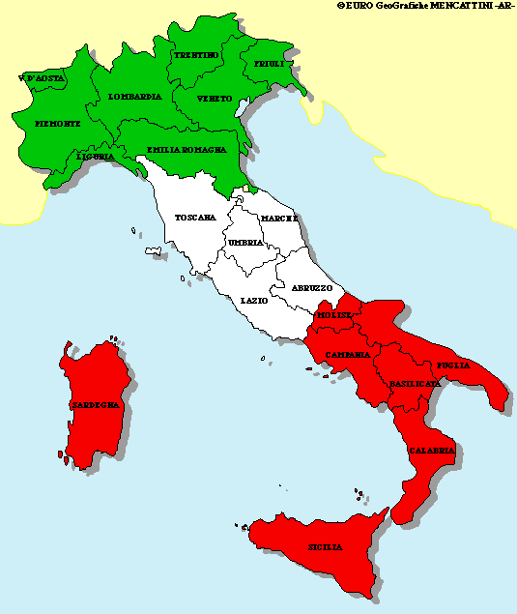
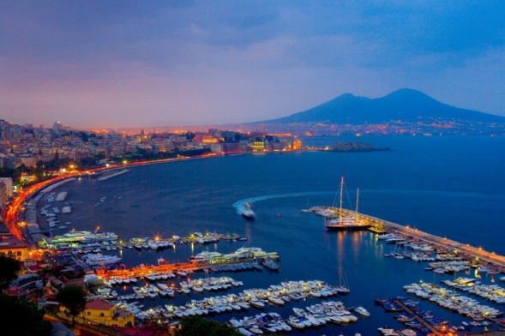
Subcultures
Rome
Milan
Naples

Slide 5

Subcultures

Slide 6
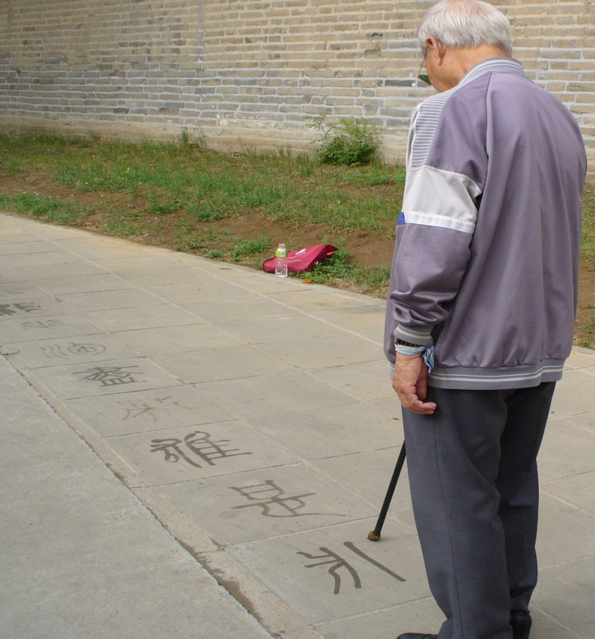
Elements of Culture
The main elements of culture are:
  Language
  Religion
  Cultural values
  Cultural norms

Slide 7
Elements of Culture: Language
Spoken/Written Language
  Same word, different meanings
  Poses a number of concerns to marketers:
    It creates difficulties in terms of correct translation
    Marketers may experience dilemma in unified markets where multiple languages are used as to which language(s) to use (India with more than 3000 dialects)
    High costs of translation.
    Language and target (for example, foreigners living in the United Arab Emirates)
    Written language convey meanings (n°4)

Slide 8
Problems of translation
For example, the Chinese translation proved difficult for Coke, which took two tries to get it right.
They first tried Ke-kou-ke-la because when pronounced it sounded roughly like Coca-Cola. It wasn't until after thousands of signs had been printed that they discovered that the phrase means "bite the wax tadpole" or "female horse stuffed with wax", depending on the dialect. Second time around things worked out much better. After researching 40,000 Chinese characters Coke came up with "ko-kou-ko-le" which translates roughly to the much more appropriate "happiness in the mouth". http://www.takingontobacco.org/intro/funny.html

Slide 9
Elements of Culture: Language (contd.)
Nonverbal communication
  Proxemics: The relationship between physical space and the process of communication (distance between people in the communication process)
  Postures, orientations, and oculesics: Individuals' positioning relative to their counterpart and the use/avoidance of eye contact during communication.
  Chronemics: The timing of verbal exchanges in a conversation with others.
  Haptics: The use of touch while conversing.
  Kinesics: Movements of parts of the body to facilitate communication, such as gesturing.
  Paralinguistics: Non-verbal aspects of speech, including emotional intonation, accents, and the quality of voice.
  Appearances: One's physical attire and overall grooming.
  Olfactions: Use of odors to convey messages, whether religious or personal. For example, not in all countries body odor is offensive

Slide 10

Non verbal language: High versus Low context cultures
Low context cultures (US, Canada, Germany, Switzerland
  What is said is precisely what is meant: the verbal message carries the full meaning of the sentence. Limited non verbal language.
High context cultures (East Asia, Middle East, Central and Southern Europe…)
  The message source, his or her standing in society or in the negotiating group, level of expertise, tone of voice and body language: everything is meaningful. Relationship are highly valued, trust is crucial.

Slide 11
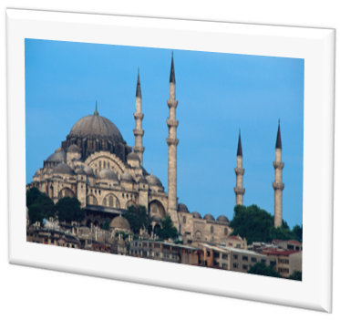
Elements of Culture: Religion
Defines a society's relationship to the supernatural.
Determines dominant values and attitudes.
Religious beliefs are important determinants of consumer behavior and can be linked to cultural behaviors that impact economic development and marketing.
Chapter 5

Slide 12
Religion and Its Impact on Business
Religion and business days:
  Dominant religion determines prayer time, the time for fasting, and creates restrictions on businesses.
Religion and gender roles:
  Differ from country to country – for example, in traditional Islamic countries, women’s business activities are restricted to a women-only environment, and genders do not interact outside the family.
Religion and gift giving:
  Marketers must be aware of religious holidays as gift-giving events.
Religion and marketing practices:
  Firms often must adapt their offering to the local culture to address consumers' religious concerns. Firms must also advertise according to the norms in certain cultures – for example, avoiding to portray women in Saudi Arabia.
Chapter 5

Slide 13
Elements of Culture: Cultural Values
  Values are enduring beliefs about a specific mode of conduct or desirable end-state.
  They guide behavior and are ordered by importance in relation to one another, thus forming a system of value priorities.
  Because they guide individuals' actions, attitudes, and judgments, cultural values affect consumer product preferences and perception of products.
Some exemples: China Shampoo Ad - Values of Success and Strength:
http://www.youtube.com/watch?v=imWeRR2GtxU
Chapter 5

Slide 14
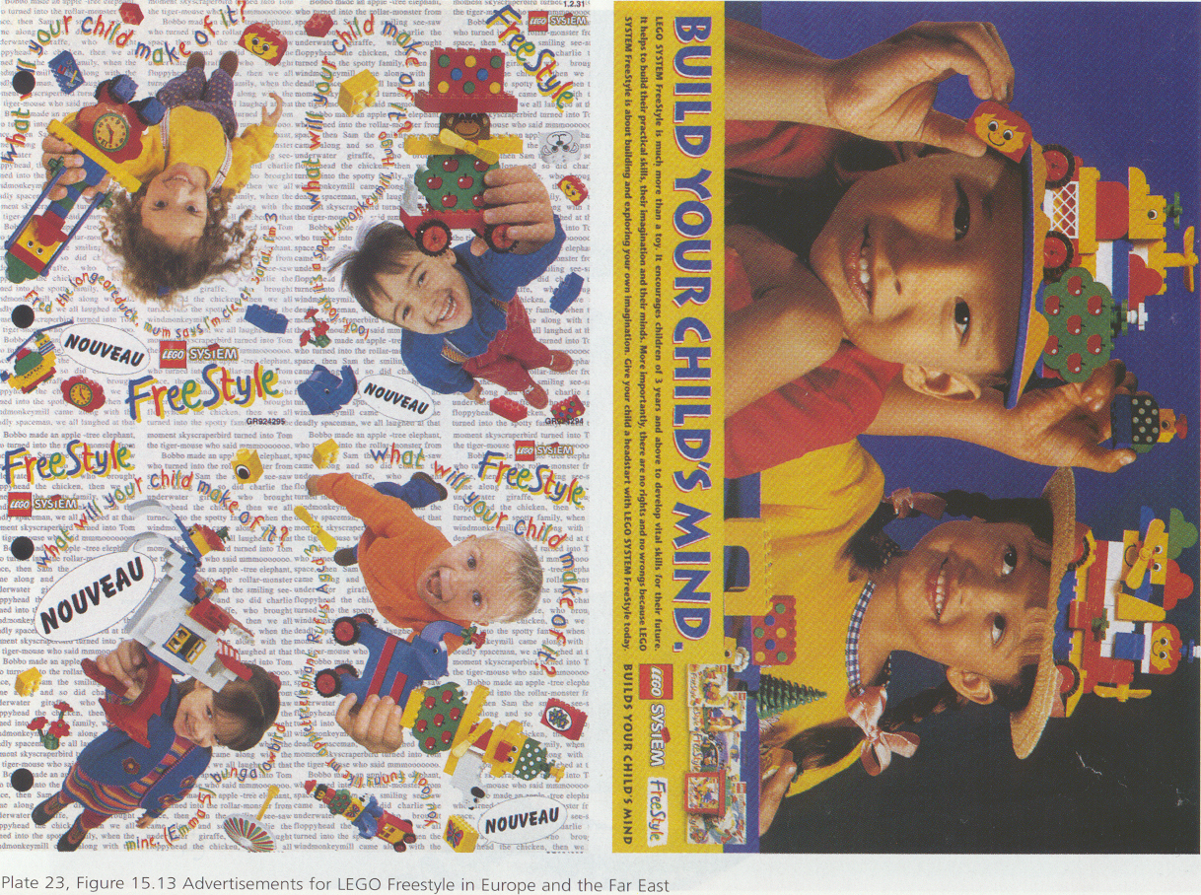
Source: Hollensen (2013)

Slide 15
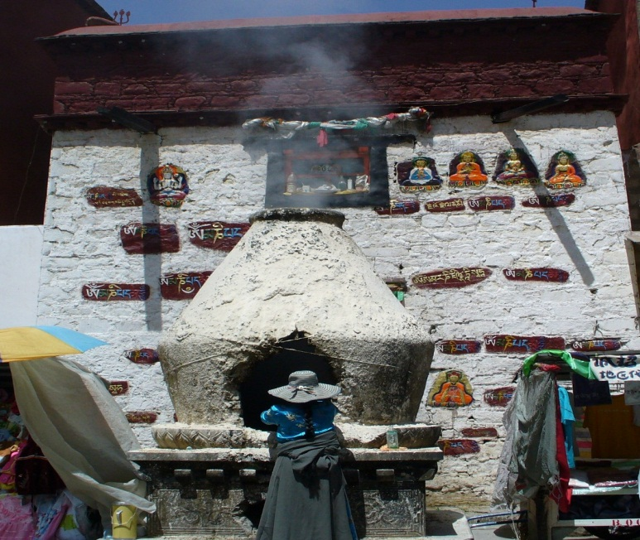
Learning New Cultures
Enculturation
  Process by which individuals learn the beliefs and behaviors endorsed by one’s own culture.
Acculturation
  Learning a new culture.
Assimilation
  Full adoption and maintenance of the new culture, and resistance to one’s old culture.
Chapter 5

Slide 16
Elements of Culture: Cultural Norms
Norms are derived from values and defined as rules that dictate what is right or wrong, acceptable or unacceptable.
  Imperative
    What an outsider must or must not do.
  Exclusive
    What locals may do but an outsider cannot do.
  Adiaphora
    What an outsider may or may not do.
Chapter 5

Slide 17

National/Regional Character
Time orientation:
  Monochronic time (M-time) – attributed to cultures where individuals usually do one thing at a time, sequentially.
  Polychronic time (P-time) – attributed to cultures where individuals perform multiple tasks at once, and tend to see time as fluid.
Business hours, business days:
  Business do not operate:
  on Sundays in Christian countries, on Fridays in Muslim countries, and on Saturdays, in Israel.
Gift giving:
  Knowing what gifts are appropriate, along with the manner in which they should be presented is essential.
Chapter 5

Slide 18
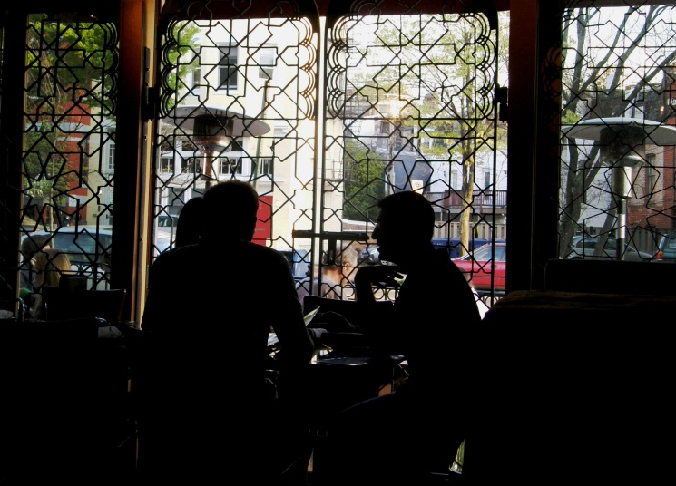
National/Regional Character (contd.)
Socializing:
  Appropriate conversations, talking business at dinner, etc.
Gender roles:
  Gender roles and role-related expectations are important when establishing business relationships.
Status concern and materialism:
  Familiarity with consumer concern for acquisitions and social status helps marketers determine appropriate marketing strategies.
Chapter 5

Slide 19
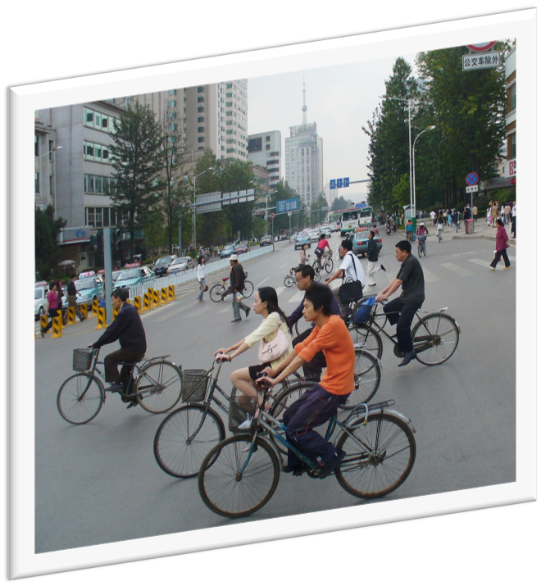
Other Manifestations of National and Regional Character
Contact
  e.g., phone, e-mail, in person.
Access
  e.g., transportation by bicycle, personal automobile, public transportation.
European and Asian consumers are more likely to travel by bicycle
Chapter 5

Slide 20
Cultural Variability
Term used to differentiate between cultures on the Hofstede Dimensions, which are:
  Power Distance: this dimension expresses the degree to which the less powerful members of a society accept and expect that power is distributed unequally (Hofstede)
  Your book: the manner in which interpersonal relationships are formed when there are perceived differences in power.
U.S.
Germany
China
Low
High
Chapter 5

Slide 21
Cultural Variability (contd.)
  Uncertainty Avoidance
    The extent to which individuals are threatened by uncertainty and risk and thus adopt beliefs and behaviors that help them to avoid the uncertainty.
U.S.
China
Low
High
Chapter 5

Slide 22
Cultural Variability
  Masculinity/Femininity
    Hofstede: The Masculinity side of this dimension represents a preference in society for achievement, heroism, assertiveness and material rewards for success. Society at large is more competitive. Its opposite, femininity, stands for a preference for cooperation, modesty, caring for the weak and quality of life.
    The extent to which a culture is characterized by assertiveness, rather than nurturing.
Sweden
United
States
High
Masculinity
Low
Masculinity
Chapter 5

Slide 23
Cultural Variability (contd.)
  Individualism/Collectivism
    The extent to which individuals prefer to act in the interest of the group rather than in their own self-interest.
Thailand
United
States
Low
Individualism
High
Individualism
Chapter 5

Slide 24
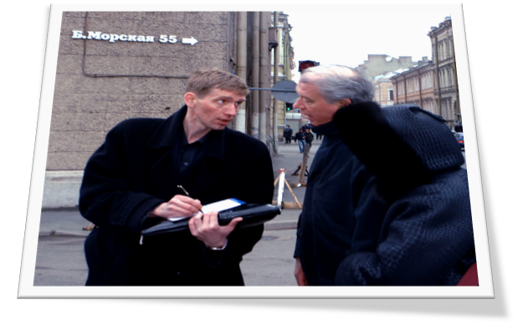
High vs. Low Context Cultures
Low-Context cultures:
  What is said is precisely what is meant.
High-Context cultures:
  The context of the message is meaningful
  Context: Message source is important:
    The source’s standing in society or in the negotiating group.
    The source’s level of expertise, tone of voice, body language.
Chapter 5

Slide 25
Cultural Change and Marketing
Marketers need to integrate culture when designing a marketing strategy by going through the following process:
Researching symbolic elements and cultural meanings in consumers’ lives
Identifying cultural meanings of the product
Designing the product accordingly
Designing the marketing campaign using
symbolic cultural elements
Chapter 5

Slide 26
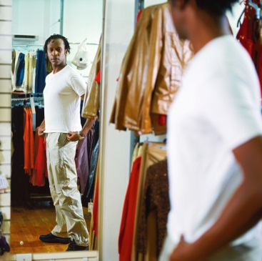
Obstacles to Cultural Understanding
  Ethnocentrism
    The belief that one’s own culture is superior to another and that strategies that are used in the home country will work just as well internationally.
  The Self-Reference Criterion:
    The unconscious reference to one’s own national culture, to home-country norms and values, and to their knowledge and experience in the process of making decisions in the home country.
Chapter 5

Slide 27
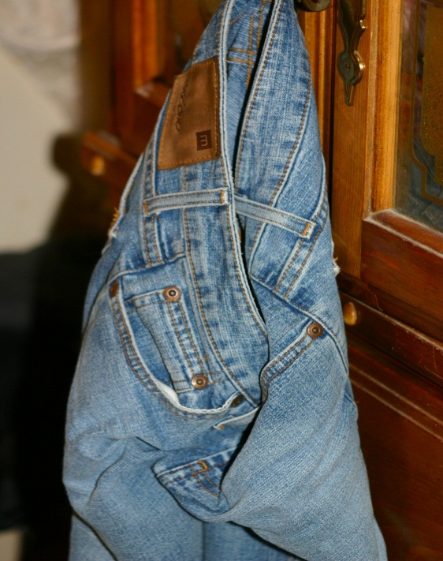
Global Consumer Culture
Defined in terms of shared consumption-related symbols and activities that are meaningful to market segments; attributed to the diffusion of Western products to the rest of the world.
  Entertainment (MTV, movies, CD’s)
  Hamburgers and pizza
  Jeans and running shoes, etc.
Chapter 5

Slide 28
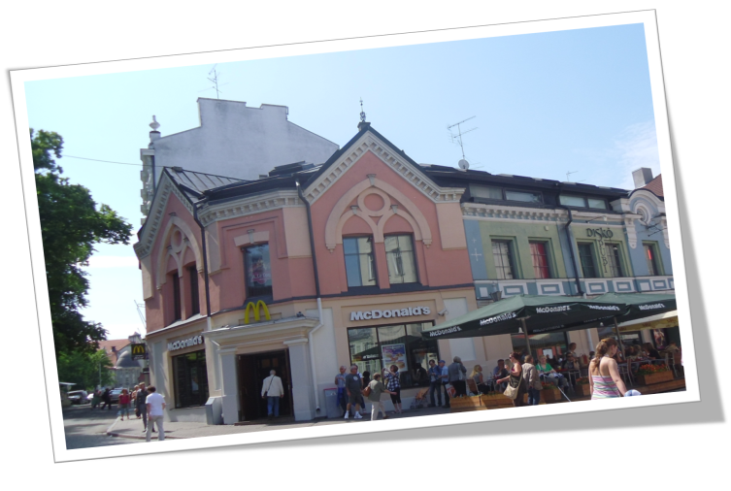
Global Consumer Culture Trends
Proliferation of transnational firms and the related globalized capitalism.
Globalized consumerism and the desire for material possessions.
Homogenization of global consumption.
    Referred to McDonaldination or Cocacolonization
Chapter 5

Slide 29
Positioning Based on Culture
Three alternatives:
Global consumer culture positioning
    Positioning the product to appeal to individuals who want to be part of a global consumer culture.
Local consumer culture positioning
    Positioning the product so that it is associated with local cultural meanings.
Foreign consumer culture positioning
    Positioning a products as symbolic of a desired foreign culture (e.g., French perfume, Andean folk music, etc.).
Chapter 5

