Slide 1
Analisi econometrica delle serie storiche con GRETL

Slide 2
Video utili su Gretl
Janelle Mann – con database
Video 1 – introduzione https://www.youtube.com/watch?v=SIArSaGLw7A
Video 2 -Basic Statistics (Video 2 of 7 in the gretl Instructional Video Series) https://www.youtube.com/watch?v=43E2yJOSvMg
Video 3 - OLS Estimation (Video 3 of 7 in the gretl Instructional Video Series) https://www.youtube.com/watch?v=lbwT6-qIhvg
Video 4 -Specification Tests: Part 1
Video 5 - Specification Tests: Part 2 (Video 5 of 7 in the gretl Instructional Video Series)
Video 6 - ARIMA(p,d,q) Models (Video 6 of 7 in the gretl Instructional Video Series)
Dataminingincae – senza database
Gretl Tutorial 1: Simple Linear Regression - https://www.youtube.com/watch?v=lsWUy3ALDmw
Gretl Tutorial 2: Coding Dummy Variables - https://www.youtube.com/watch?v=EV5LPjhAauU
Gretl Tutorial 3: Forecasting New Observations - https://www.youtube.com/watch?v=Li8ZYDoT4_A
Gretl Tutorial 4: Logistic Regression - https://www.youtube.com/watch?v=satwpF3QwYc
Gretl Tutorial 6: Modeling and Forecasting Time Series Data - https://www.youtube.com/watch?v=VTc9Ioy9bkQ

Slide 3
Video utili per le analisi delle serie temporali
Econometricsacademy (Ani Katchova) - Time Series ARIMA Models - https://www.youtube.com/watch?v=Y2khrpVo6qI
Econometricsacademy (Ani Katchova) - Time Series ARIMA Models Example - https://www.youtube.com/watch?v=JMPeo2wSRSg&t=40s
Janelle Mann - Video 6 - ARIMA(p,d,q) Models (Video 6 of 7 in the gretl Instructional Video Series)
Dataminingincae - Gretl Tutorial 6: Modeling and Forecasting Time Series Data - https://www.youtube.com/watch?v=VTc9Ioy9bkQ
Dataminingincae - Gretl Tutorial 7: Comparing Time Series Trend Models - https://www.youtube.com/watch?v=s0utCyinbA0
Analytics University (Indian professor) - Detecting AR & MA using ACF and PACF plots - https://www.youtube.com/watch?v=-vSzKfqcTDg

Slide 4
Definizioni
In generale, per serie si intende la classificazione di diverse osservazioni di un fenomeno rispetto ad un carattere qualitativo. Se tale carattere è il tempo, la serie viene detta storica o temporale.
In statistica, una serie storica (o temporale) si definisce come un insieme di variabili casuali ordinate rispetto al tempo, ed esprime la dinamica di un certo fenomeno nel tempo. Le serie storiche vengono studiate sia per interpretare un fenomeno (individuando componenti di trend, di ciclicità, di stagionalità e/o di accidentalità), sia per prevedere il suo andamento futuro.
Le serie storiche possono essere di tipo:
deterministico: se i valori della variabile possono essere esattamente determinati sulla base dei valori precedenti;
stocastico: se i valori della variabili possono essere determinati sulla base dei valori precedenti solo in misura parziale.
Per le serie storiche si assume un modello del tipo:
Y_t=f(t)+u_{t}
nel quale il valore del fenomeno al tempo t risulta dalla composizione di una sequenza deterministica, f(t), detta parte sistematica, e di una sequenza di variabili aleatorie, detta parte stocastica.

Slide 5
Perchè la previsione tramite le serie temporali?
It may be difficult or impossible or undesirable to explain the movement of y(t) through the use of a structural model, i.e., by relating it explicitly to other economic variables for 3 reasons:
Data are not available for those explanatory variable which are believed to affect y(t);
Data available, but the estimation of a regression model might result in standard errors that are so large as to make most of the estimated coefficients insignificant and the standard error of forecast unacceptably large;
The explanatory variables that are not lagged must themselves be forecasted, and this might be more difficult than forecasting y(t) itself. The resulting total forecast error might result as too large to be acceptable.
A time-series model accounts for patterns in the past movements of a particular variable (trends, cyclical behavior, systematic behavior), and uses that information to predict future movements of the variable. In a sense a time-series model is just a sophisticated method of extrapolation.
Business forecasting models
Single-equation regression models
Multi-equation simulation (two or more endogenous variables related to each other)
Time-series models
Combined regression and time-series models

Slide 6
Appunti da Econometric Models and Economic Forecasts / Robert S. Pindyck, Daniel L. Rubinfeld Copertina rigida – 1976
Extrapolation in a deterministic model
1. Smoothing (seasonally adjust)
Simple extrapolation models. Extrapolation in a deterministic model
Linear trend model (y_{t}=c₁+c₂t): it grows by b units every year
Exponential model (y_{t}=Ae^{rt}): it grows by a fixed percentage every year
Autoregressive trend model (y_{t}=c₁+c₂y_{t-1}): it increases by the same absolute amount
Logarithmic autoregressive trend model (logy_{t}=c₁+c₂logy_{t-1}): if c₁ is 0, c₂ is the compound rate of growth
quadratic trend model (y_{t}=c₁+c₂t+c₃t²):
logistic curve
Figure 15.1-15.6
2. Moving average models
It might be useful if we believe that a likely value for our series next month is a simple average of its values over the past 12 months. It might be more realistic to assume that more recent values play a greater role..
More realistically, we can use an exponentially weighted moving average (the weight declines over time).
3. Smoothing techniques
n-period moving average
4. Seasonal adjustments

Slide 7
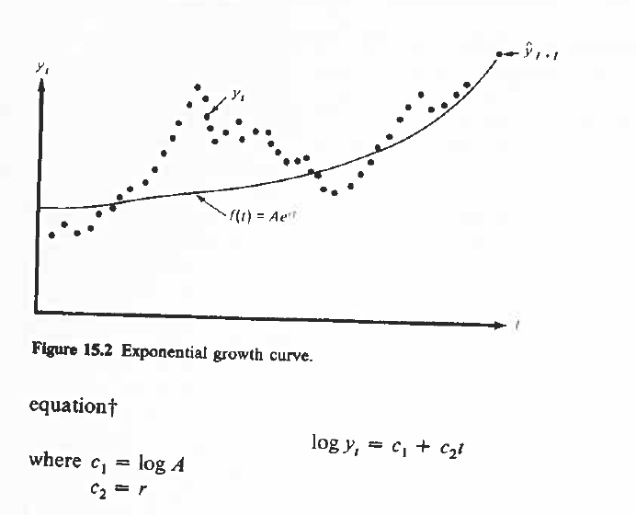
Modi di rappresentare il trend

Slide 8
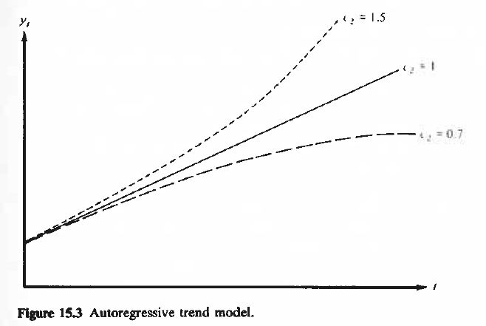
Modi di rappresentare il trend
Autoregressive trend model
Logarithmic autoregressive trend model

Slide 9
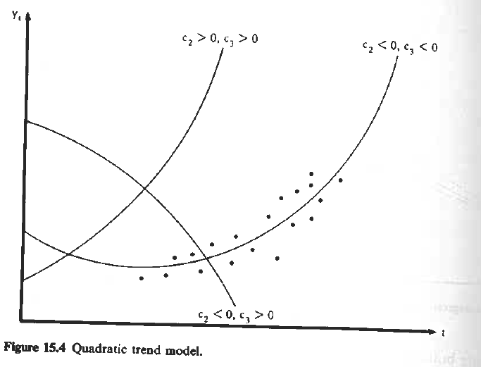
Modi di rappresentare il trend

Slide 10
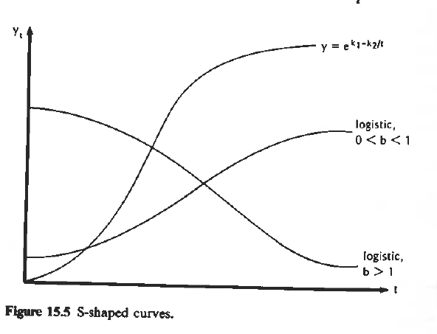
Modi di rappresentare il trend

Slide 11
Appunti da Econometric Models and Economic Forecasts / Robert S. Pindyck, Daniel L. Rubinfeld Copertina rigida – 1976
STOCHASTIC TIME SERIES
Time-series analysis presumes that the series has been generated by a stochastic (or random) process.
The description is given not in terms of a cause-effect relationship (regression model) but in terms of how that randomness is embodied in the process.
In other words, we assume that each value of the series is drawn randomly from a probability distribution.
The observed series is drawn from a set of jointly distributed random variables

Slide 12
Appunti da Econometric Models and Economic Forecasts / Robert S. Pindyck, Daniel L. Rubinfeld Copertina rigida – 1976
LINEAR TIME-SERIES MODELS
While there are many functional forms that can be used, we use a linear specification. The assumption of linearity allows us to make quantitative statements about the stochastic properties of the models and the forecasts generated.
The models are written as equations with fixed estimated coefficients, representing a stochastic structure that does not change over time.

Slide 13
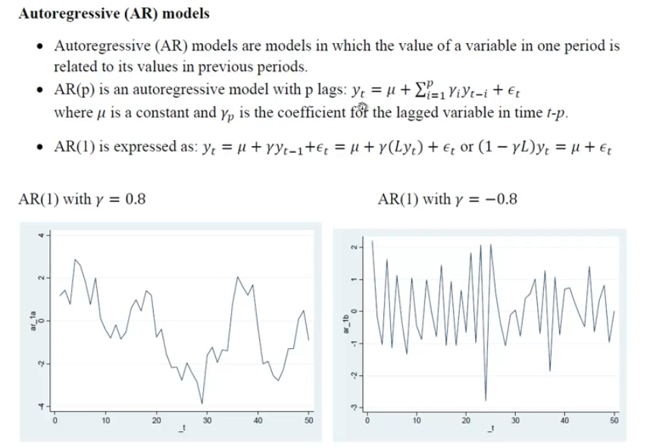
Modelli di serie storiche

Slide 14
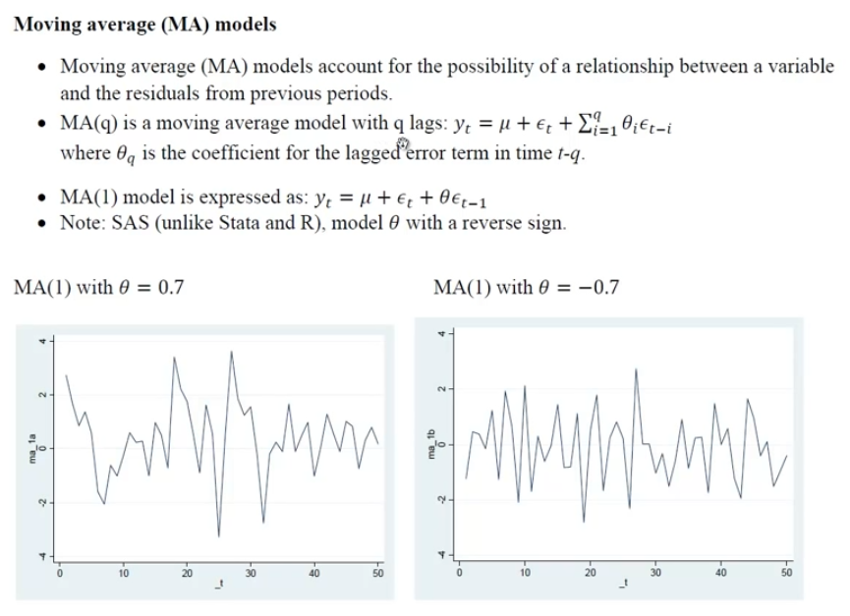
Ani Katchova - Time Series ARIMA Models - https://www.youtube.com/watch?v=Y2khrpVo6qI

Slide 15
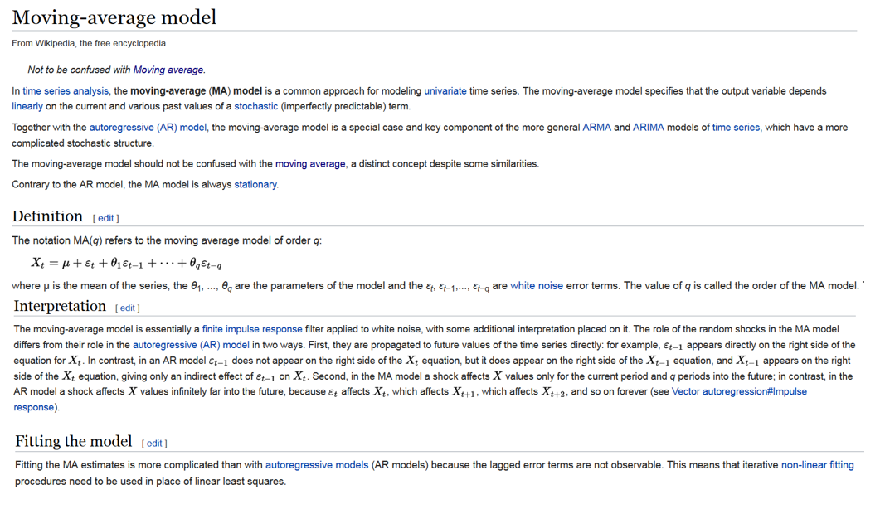
Modello MA: una descrizione più precisa

Slide 16
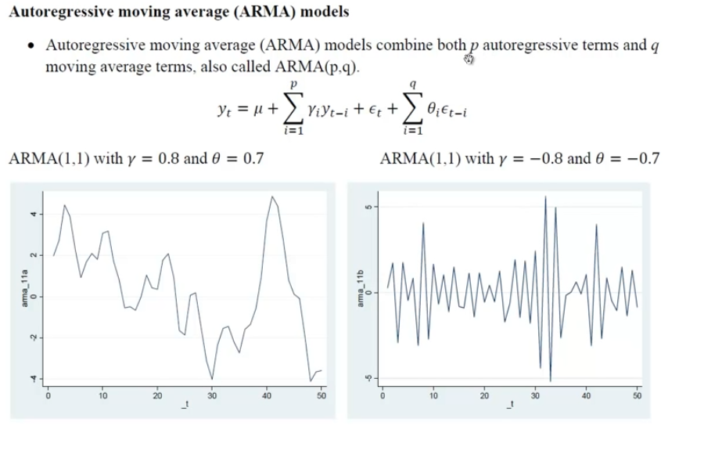

Slide 17
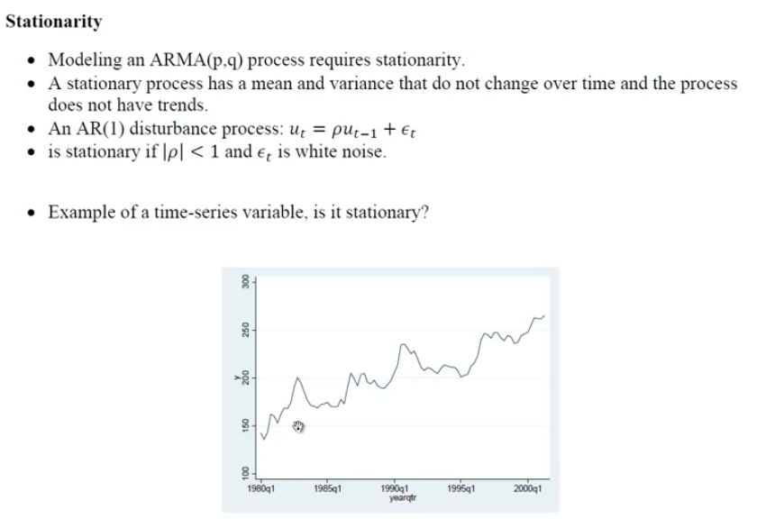
A random vector is said to be a white noise vector if its components each have a probability distribution with zero mean and finite variance, and are statistically independent:

Slide 18
STATIONARY AND NONSTATIONARY TIME SERIES
Stationary process: invariant with respect to time, it is easier to model the process via an equation with fixed coefficients that can be estimated from past data
The stochastic processes are assumed to be in equilibrium over time about a constant mean level.
One would suspect that many of the time series that one encounters in business and economics are not generated by stationary processes (GNP, prices, stocks)… certain classes of nonstationary processes can easily be transformed into stationary or approximately stationary processes.
If a stochastic process is stationary, the mean, the variance and the covariance is stationary and they can be estimated by the sample
The autocorrelation function provides us with a measure of how much correlation there is between neighboring data points in the series.
HOMOGENEOUS NONSTATIONARY PROCESSES
Probably very few of the time series one meets in practice are stationary. Fortunately, however, many of the nonstationary time series have the desirable property that if they are differenced one or more times, the resulting series will be stationary.
These are termed homogenous. The number of times that the original series must be difference before a stationary series results is called the order of homogeneity.
STATIONARITY AND THE AUTOCORRELATION FUNCTION
GNP is nonstationary. Difference it one or more times, construct a model for this new series, make a forecast and then integrate (e.g., remove the effect of differencing).
Correlogram is a plot of the autocorrelation function.

Slide 19
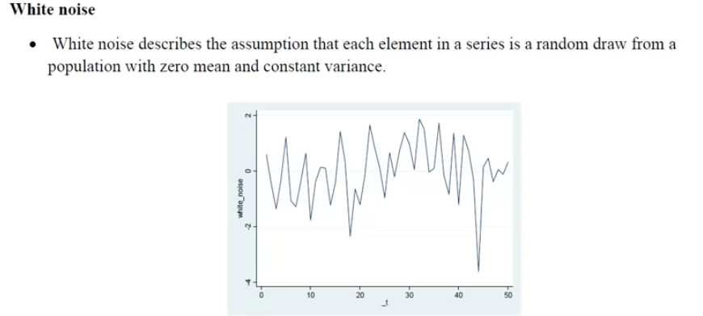

Slide 23
Esercizi da fare per uso di GRETL per analisi delle serie storiche
Determinare «d», ordine di differenziazione
Fare il grafico
Fare il ADF (Augemente Dickey-Fuller) Unit root test
Determinare «p» e «q»
Fare la previsione

Slide 24
Test di Dickey-Fuller

Slide 25
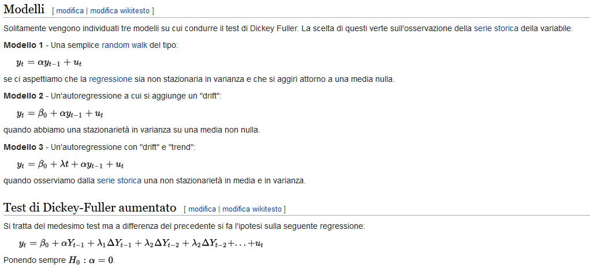
Test di Dickey-Fuller

Slide 26
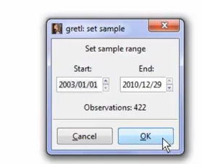
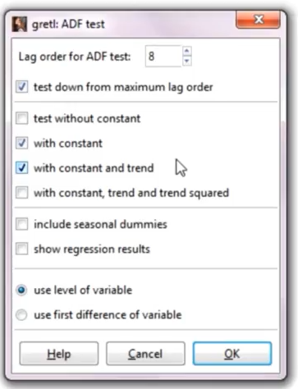
ADF (Augemente Dickey-Fuller) Unit root test
Lag order: radice cubica del numero di osservazioni (10% significance level)
Selezionare costanti e trend sulla base dell’ispezione del plot
Se dummy stagionali includerle
Scegliere se applicare il test alla variabile o alla sua differenza prima
Ho= serie non stazionaria (gamma=1)
Gretl Tutorial 6: Modeling and Forecasting Time Series Data - https://www.youtube.com/watch?v=VTc9Ioy9bkQ

Slide 27
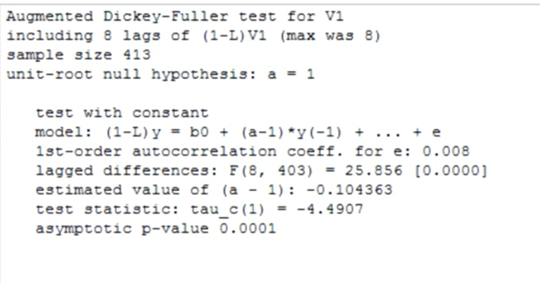

Slide 28
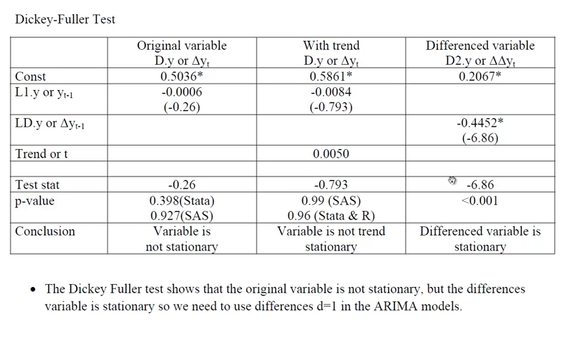

Slide 29
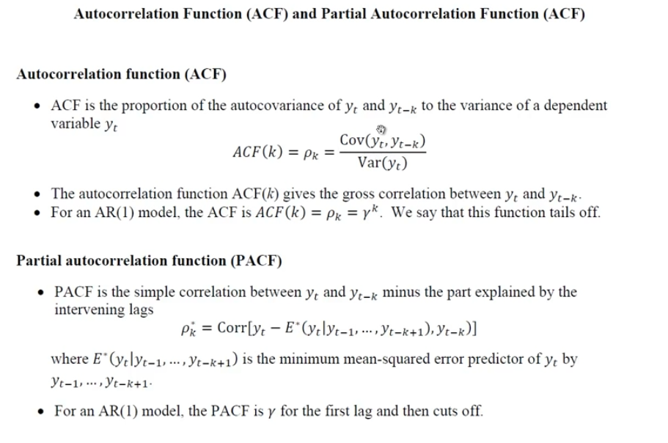

Slide 30
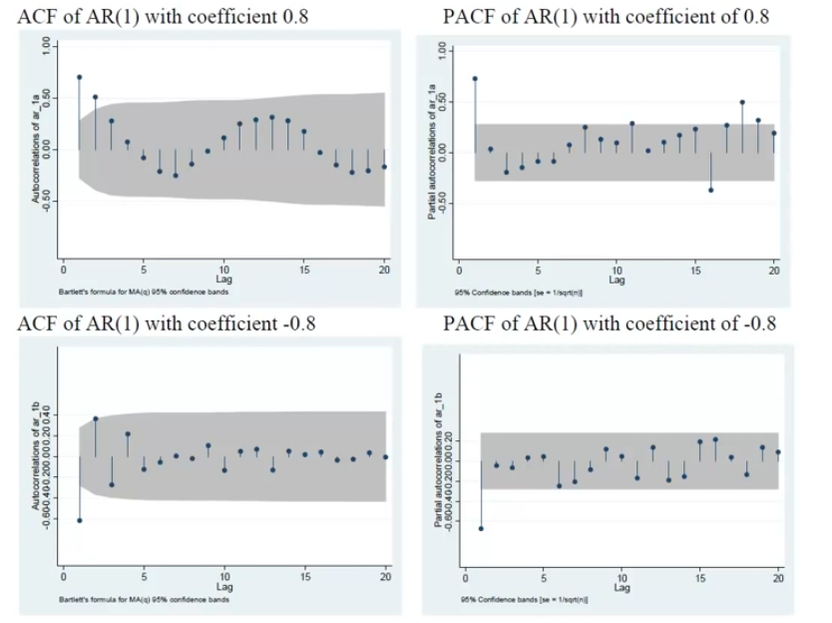

Slide 31
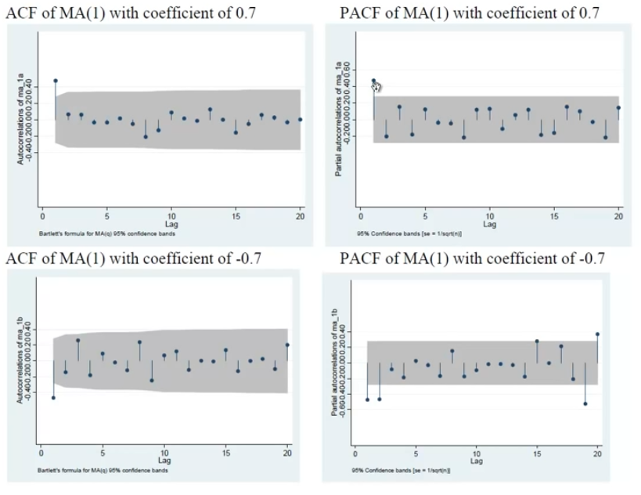

Slide 32
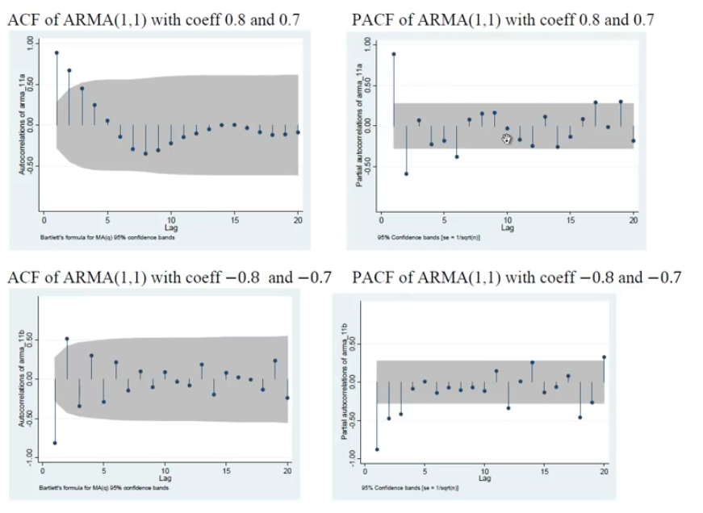

Slide 33
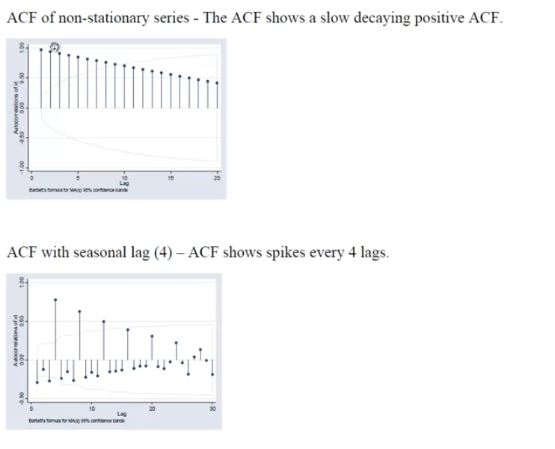

Slide 35
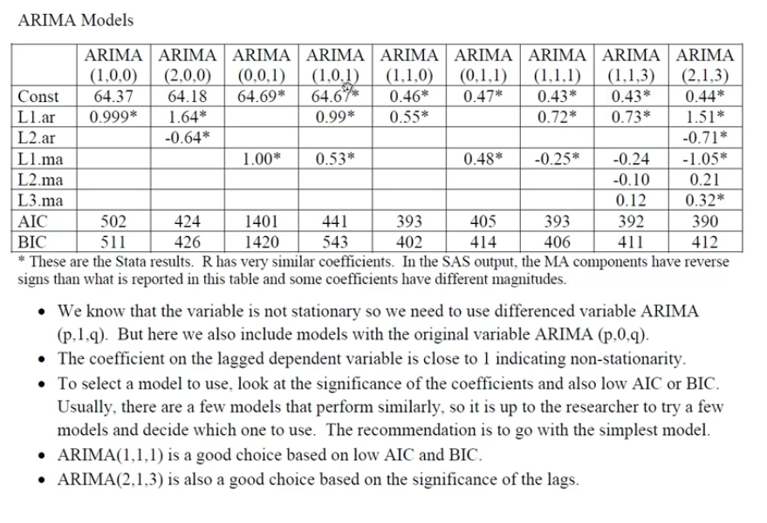

Slide 36
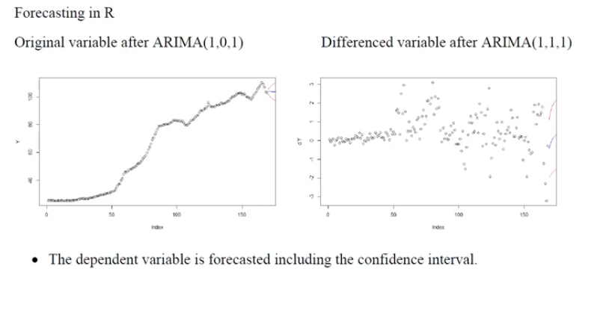
Forecasting

Slide 37
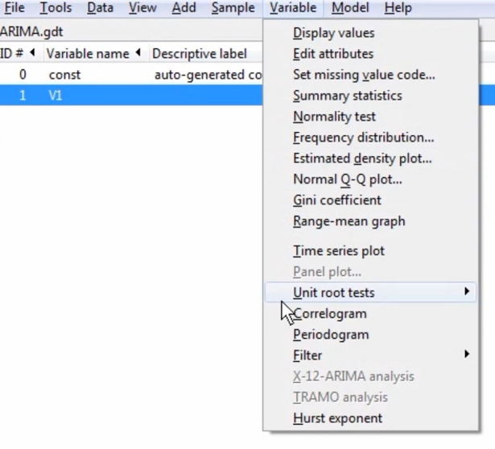
Esempio 1: database ARIMA
Lags=30

Slide 38
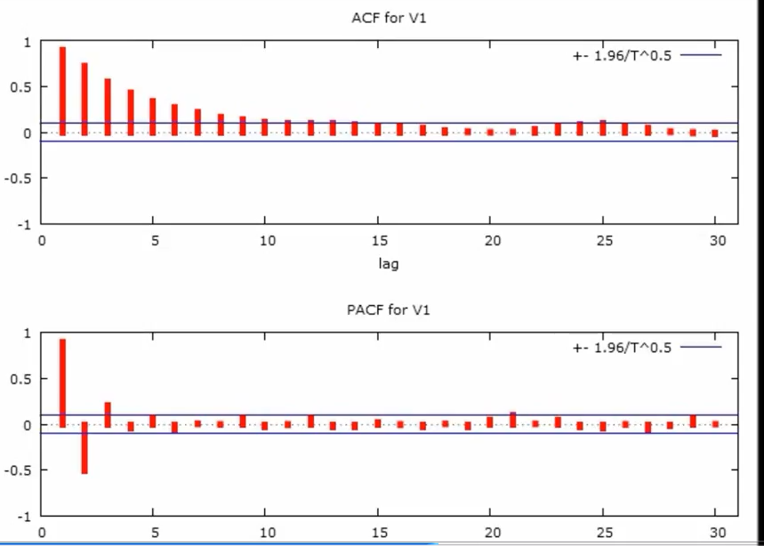
Determinare «p» e «q»
AR(1)MA(1)

Slide 39
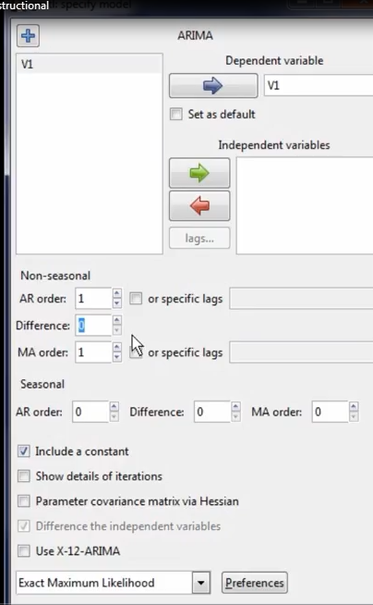
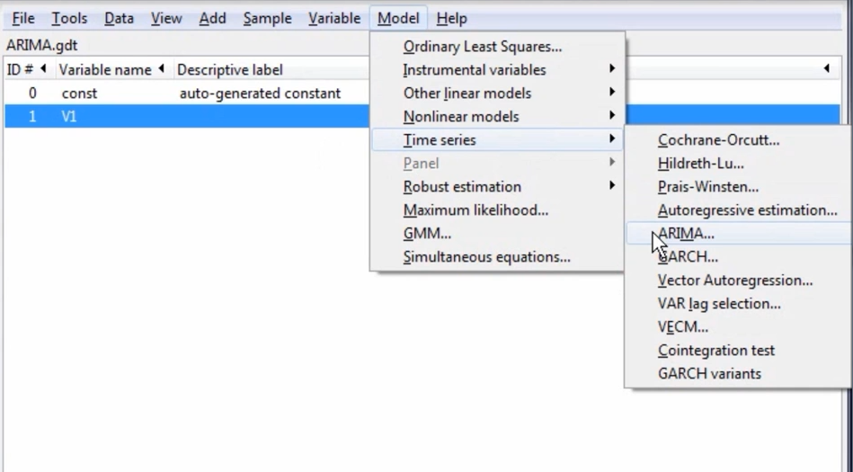
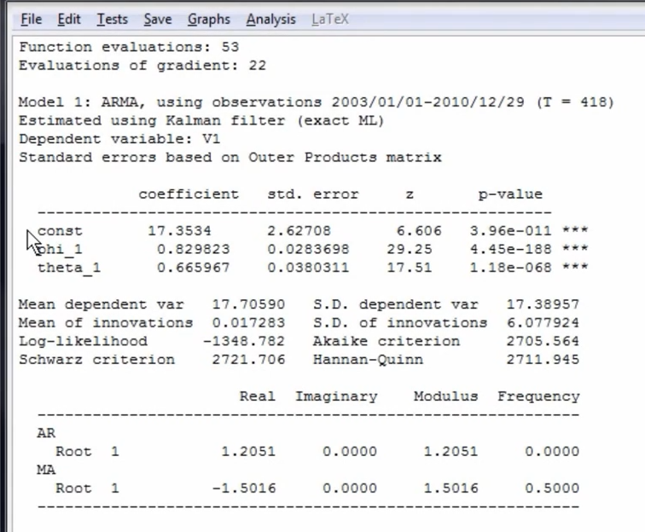
Stima

Slide 40
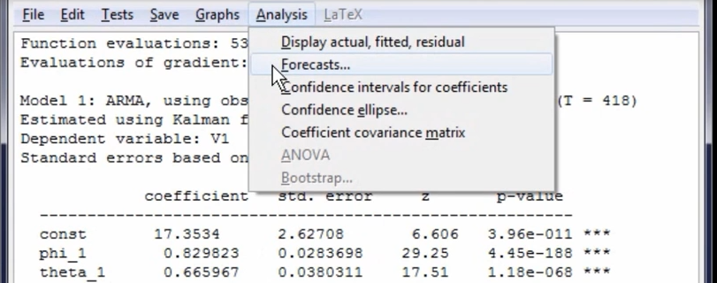
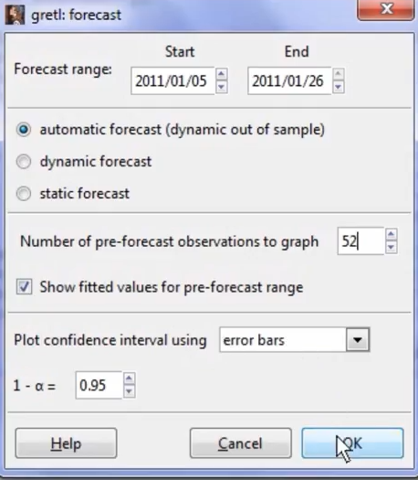
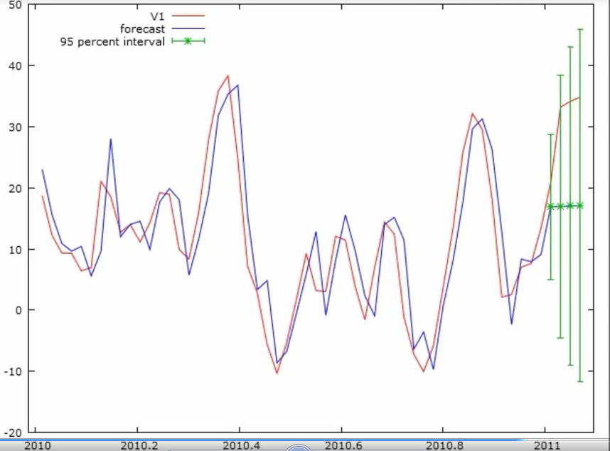

Slide 41
Ricerca della migliore specificazione
 | ARIMA (1,0,0) | ARIMA (0,0,1) | ARIMA (2,0,0) | ARIMA (0,0,2) | ARIMA (1,1,0) | ARIMA (0,1,1) | ARIMA (2,1,0) | ARIMA (0,1,2) | ARIMA (2,1,2) | ARIMA (2,2,2)
Cost.
L1.ar
L2.ar
L2.ar
….
M1.ma
M2.ma
M3.ma
…
AIC
BIC

Slide 42
Previsioni
GRETL FORECASTING AFTER ARIMA (quick example) - https://www.youtube.com/watch?v=7UCxcF7lAxQ
Trovare il migliore ARIMA variando I valori e confrontando gli indici di bontà del modello
Invocare la funzione Forecast
Aggiungere il numero di osservazioni da prevedere
Scegliere il tipo di previsione da fare (dinamico e automatico)
Esaminare la previsione

Slide 43
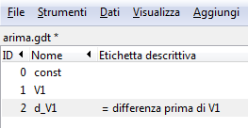
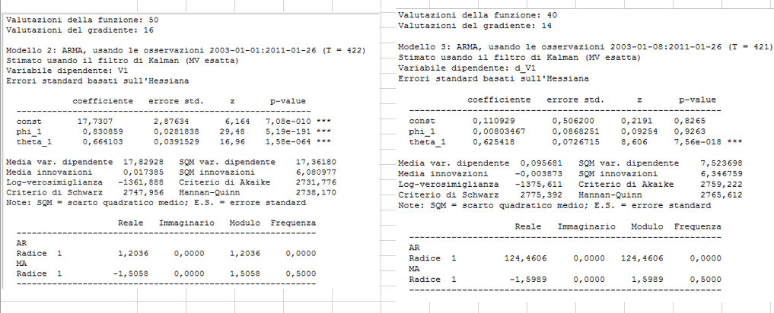
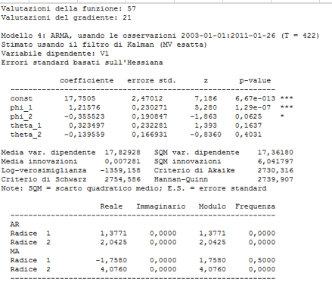
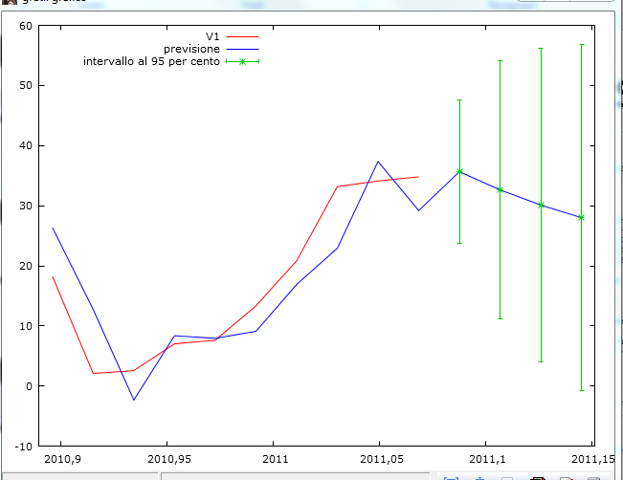
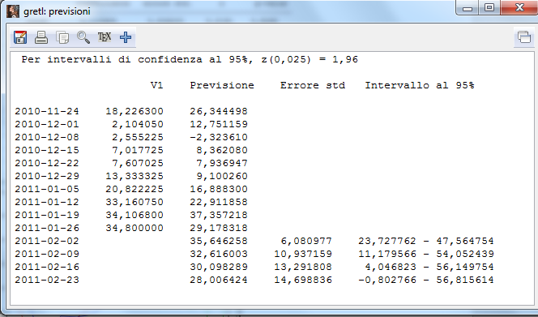
Esempio: dati arima

Slide 44
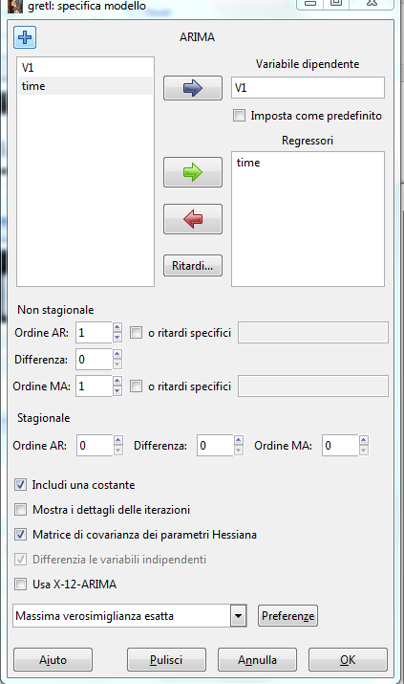
Modelli misti: arima + regressione
Avvertenza:
Predisporre la variabile indipendente con i valori futuri per la previsione out-of-sample (aggiungi osservazioni, inserimento manuale valori)
Estimated using BHHH method (conditional ML)

Slide 45
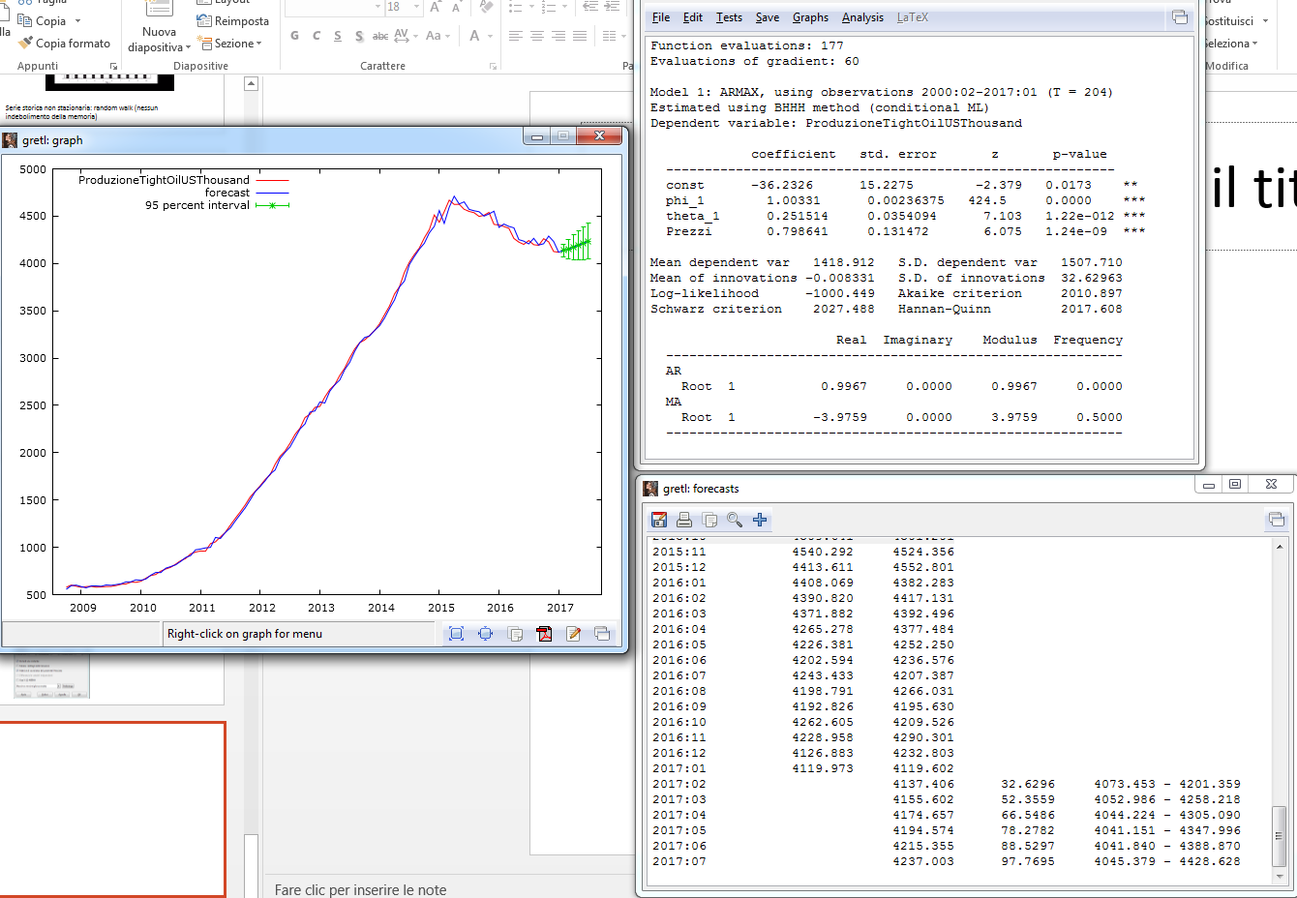
Esempio di stima di modello misto: serie storica + regressione

Slide 46
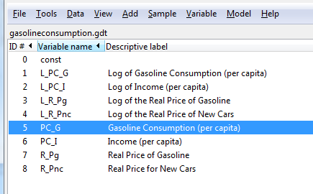
Esempio 2: database gasoline consumption

Slide 47
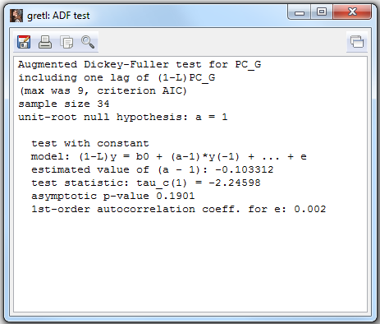
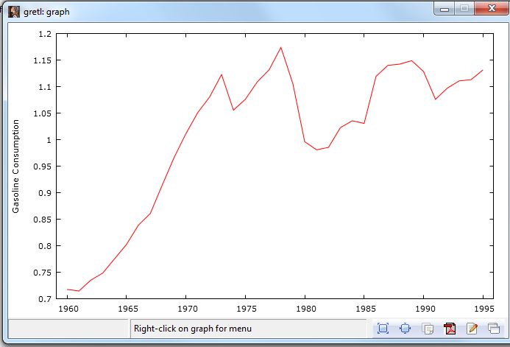
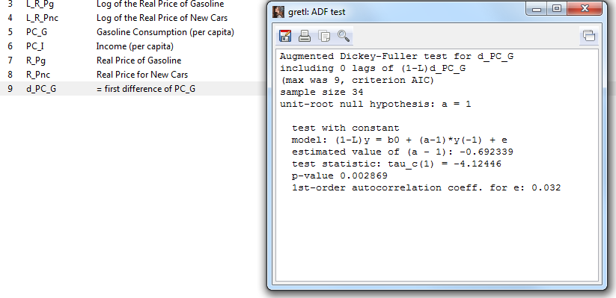
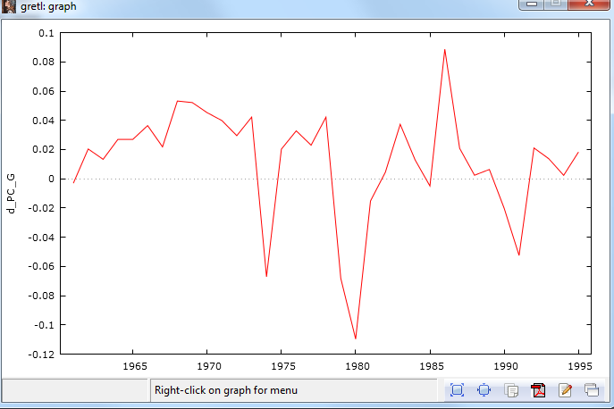
Stazionario?
Pare di no!
Adesso sì

Slide 48
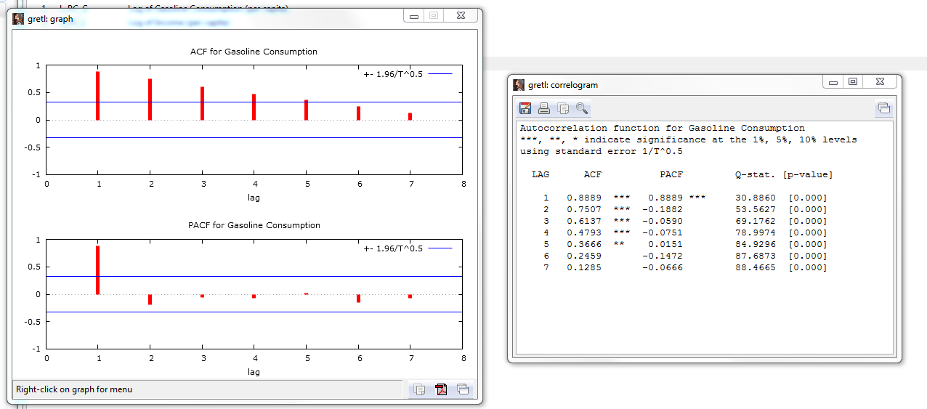
Correlogramma di PC_G (per capita gasoline consumption)
Ipotesi: ARIMA(1,1,0)???

Slide 49
Ricerca della migliore specificazione
 | ARIMA (1,0,0) | ARIMA (0,0,1) | ARIMA (2,0,0) | ARIMA (0,0,2) | ARIMA (1,1,0) | ARIMA (0,1,1) | ARIMA (2,1,0) | ARIMA (0,1,2) | ARIMA (2,1,2) | ARIMA (2,2,2)
Cost.
L1.ar
L2.ar
L2.ar
….
M1.ma
M2.ma
M3.ma
…
AIC
BIC

Slide 50
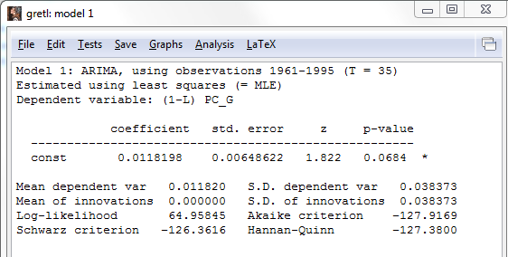
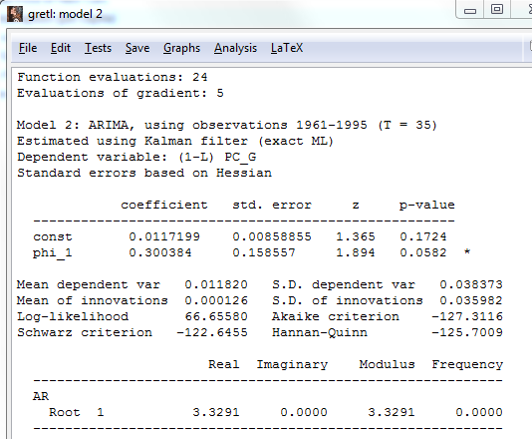
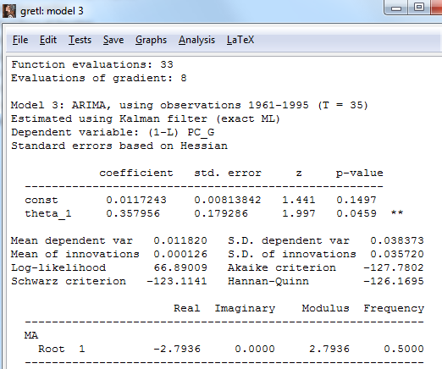
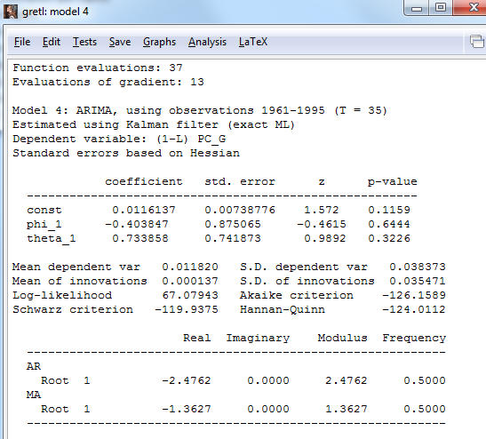
specificazioni
Arima (0,1,0)
Arima (1,1,0)
Arima (0,1,1)
Arima (1,1,1)

Slide 51
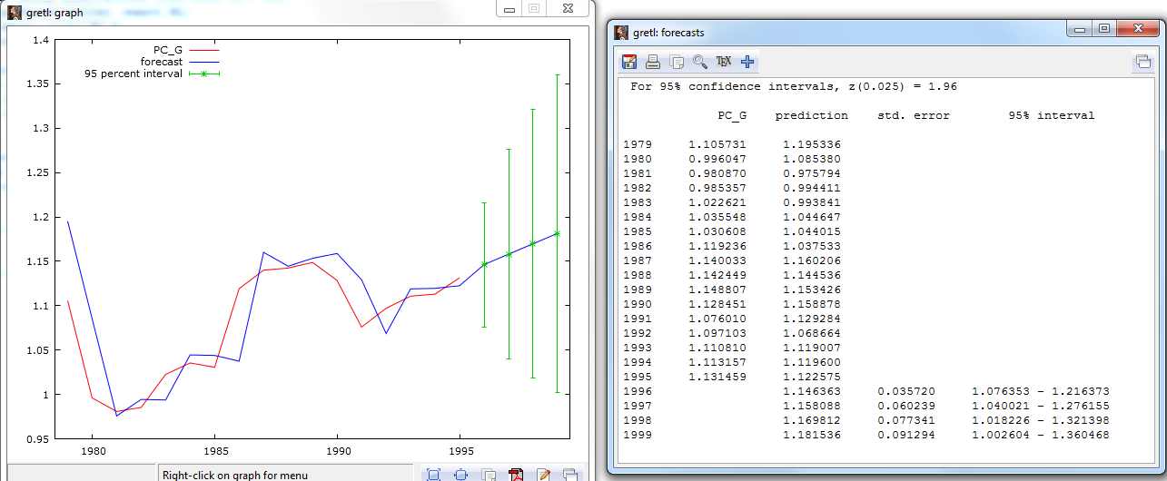
Previsione out of sample con Arima (0,1,1)

Slide 52
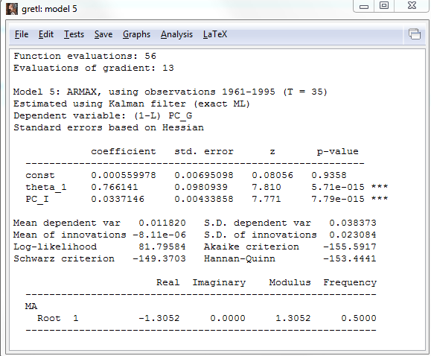
Combinare serie storiche e regressione: PC_I (income per capita)

Slide 53
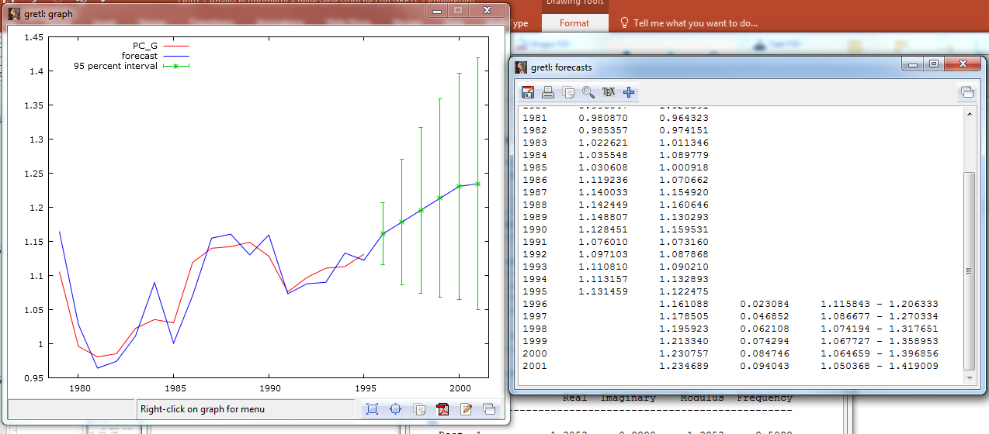
Nuova previsione

Slide 54
Compito per casa
Scegliere una serie storica da un dataset a piacere
Analizzarla graficamente
Se necessario, depurarla della componente stagionale
Studiarne la stazionarietà tramite il test di Dickey-Fuller: dopo quante differenziazioni «d» diventa stazionaria?
Analizzare il correlogramma e ipotizzare «p» e «q»
Stimare il modello della serie storica AR(p)I(d)MA(q) confrontando diverse specificazioni
Aggiungere se utile un regressore
Utilizzare il modello per la previsione

