Slide 1
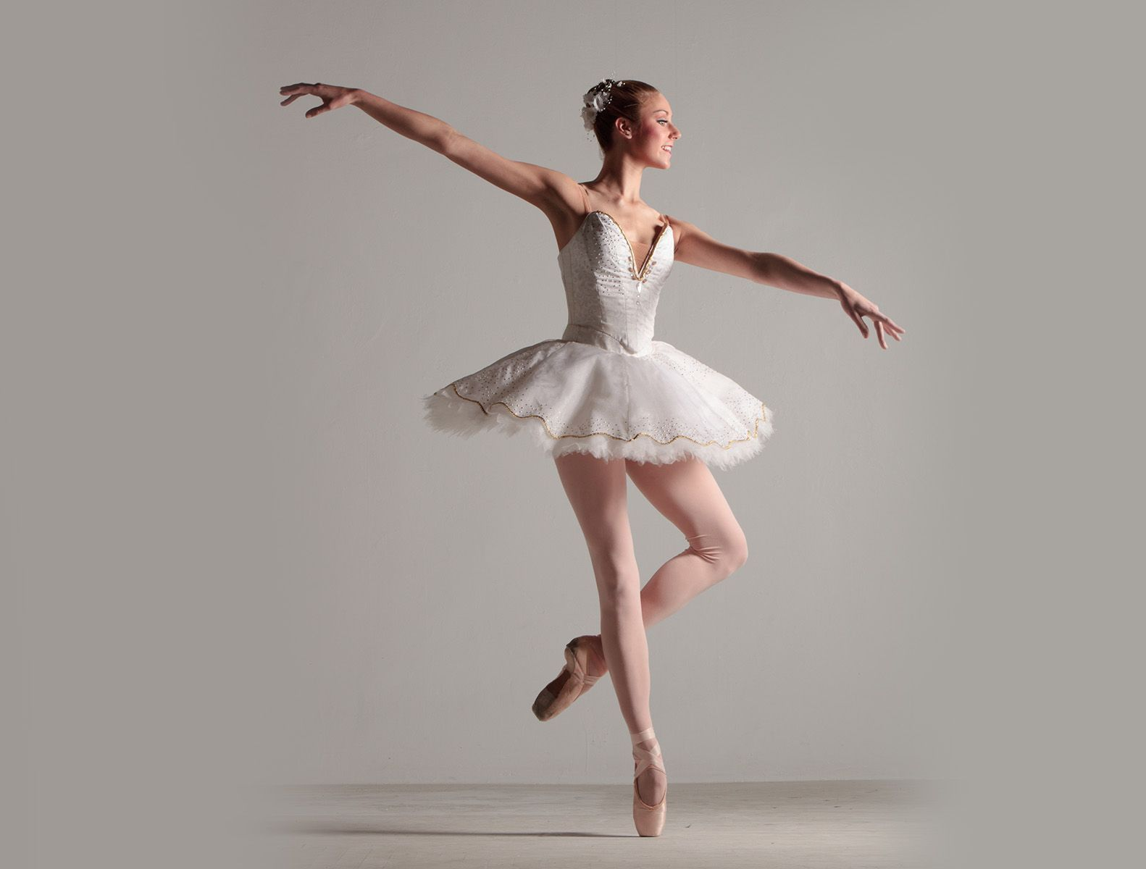
RIFLESSI TRONCOENCEFALICI
per le lezioni del prof. P. Paolo Battaglini
v 3.1
Principali fonti delle figure:
Purves et al., NEUROSCIENZE, Zanichelli
Kandel et al., PRINCIPI DI NEUROSCIENZE, Ambrosiana

Slide 2
QUADRO GENERALE
Veduta d’insieme del tronco dell’encefalo
orecchio interno
apparato vestibolare
recettori vestibolari
transduzione sensoriale
vie vestibolari
nistagmo vestibolare
nistagmo optocinetico
movimenti oculari
retina, fovea e macchia cieca
muscoli estrinseci dell’occhio
vie motorie per i movimenti oculari
stabilità della percezione visiva
soppressione saccadica
muscoli intrinseci degli occhi
riflessi pupillari
riflesso di orientamento
vie visive
funzioni visive del collicolo superiore

Slide 3
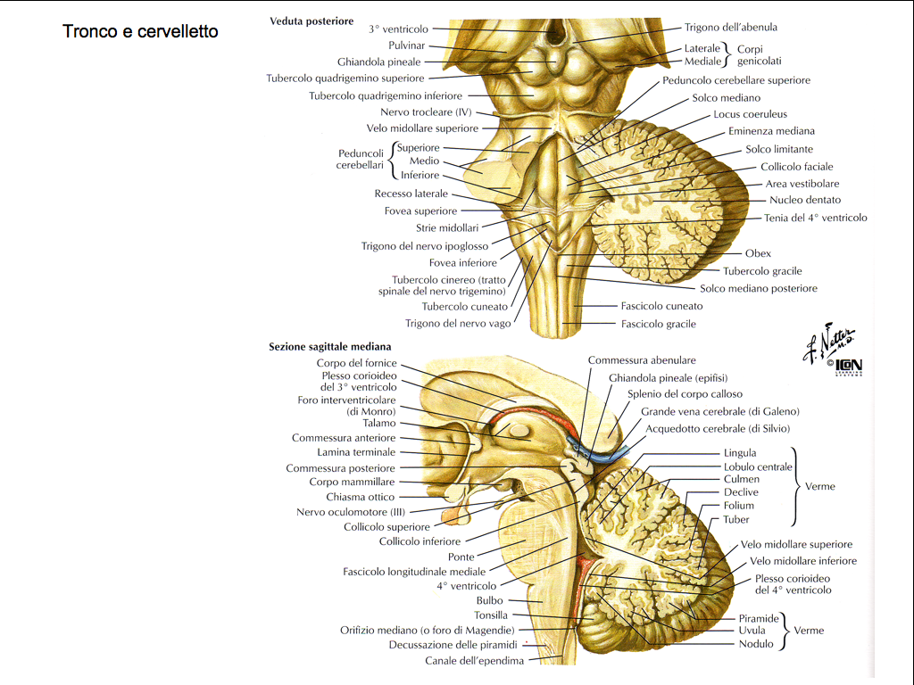
BRAINSTEM
Notes:
3

Slide 4
VESTIBULAR REFLEXS

Slide 5
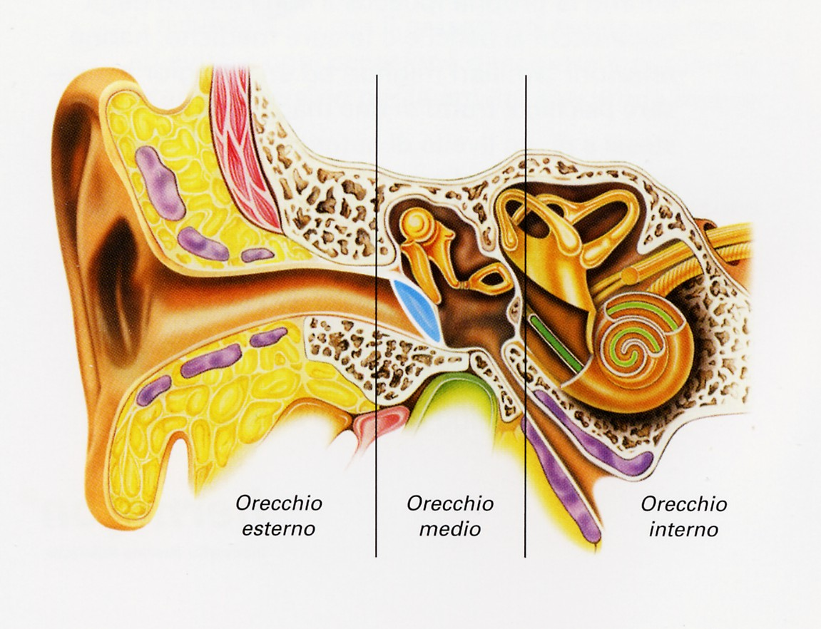
ANATOMY

Slide 6
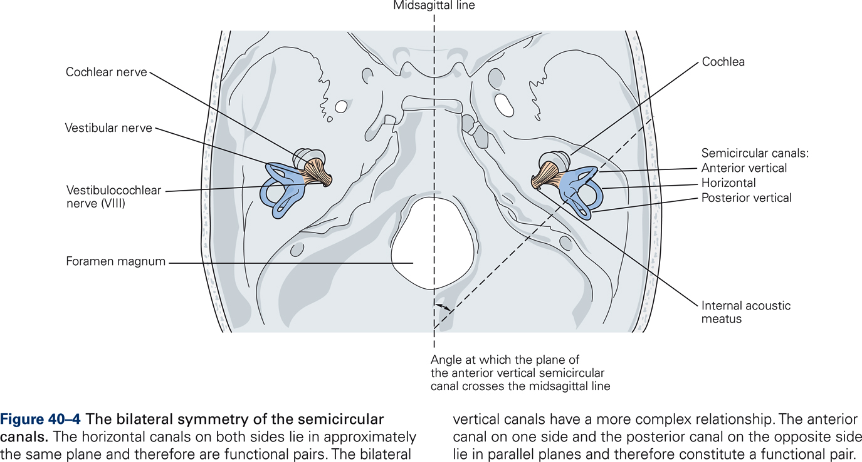
VESTIBULAR APPARATUS
Da Kandel et al., Principles of Neural Sciences, Mc Graw Hill

Slide 7
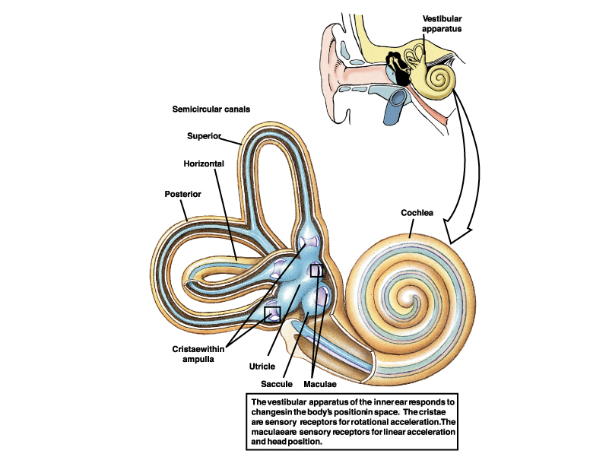
Equilibrio 1
INNER EAR

Slide 8
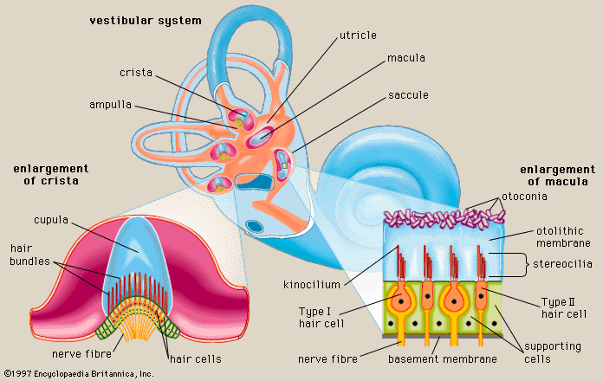
VESTIBULAR APPARTUS

Slide 9
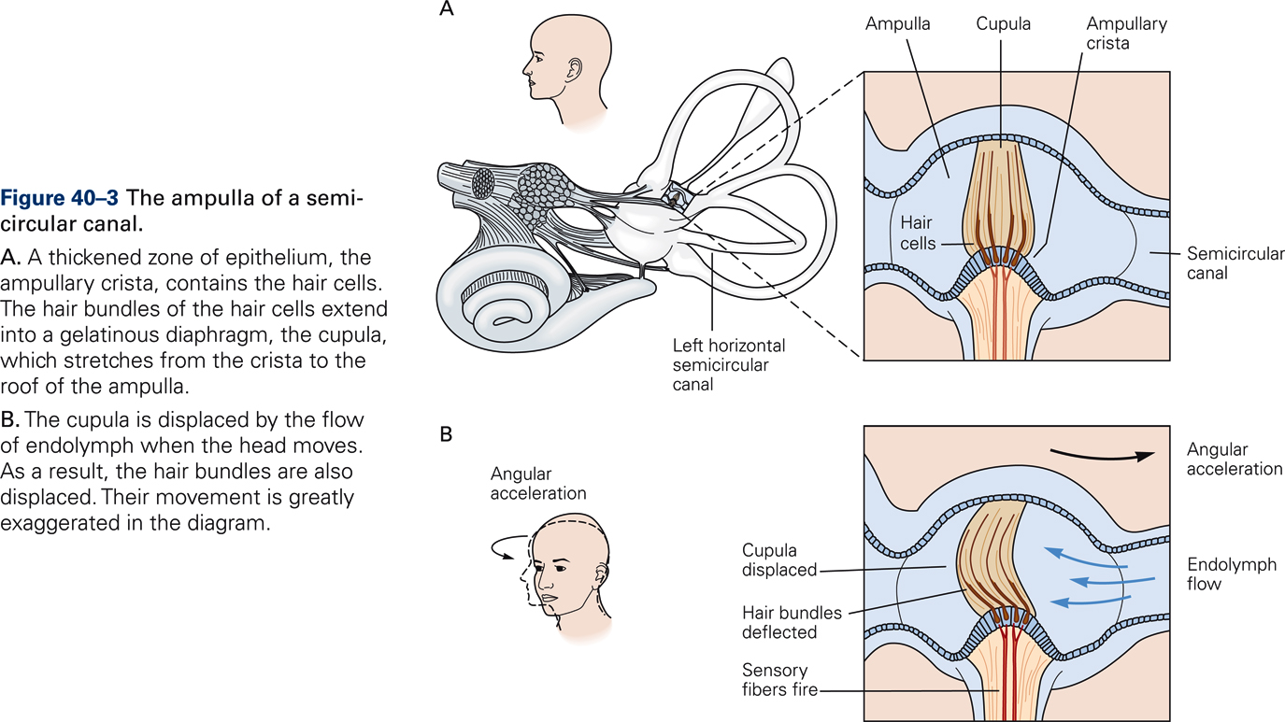
MOVEMENTS OF THE CUPOLA
Da Kandel et al., Principles of Neural Sciences, Mc Graw Hill

Slide 10
HAIR CELLS
Da Kandel et al., Principles of Neural Sciences, Mc Graw Hill

Slide 11
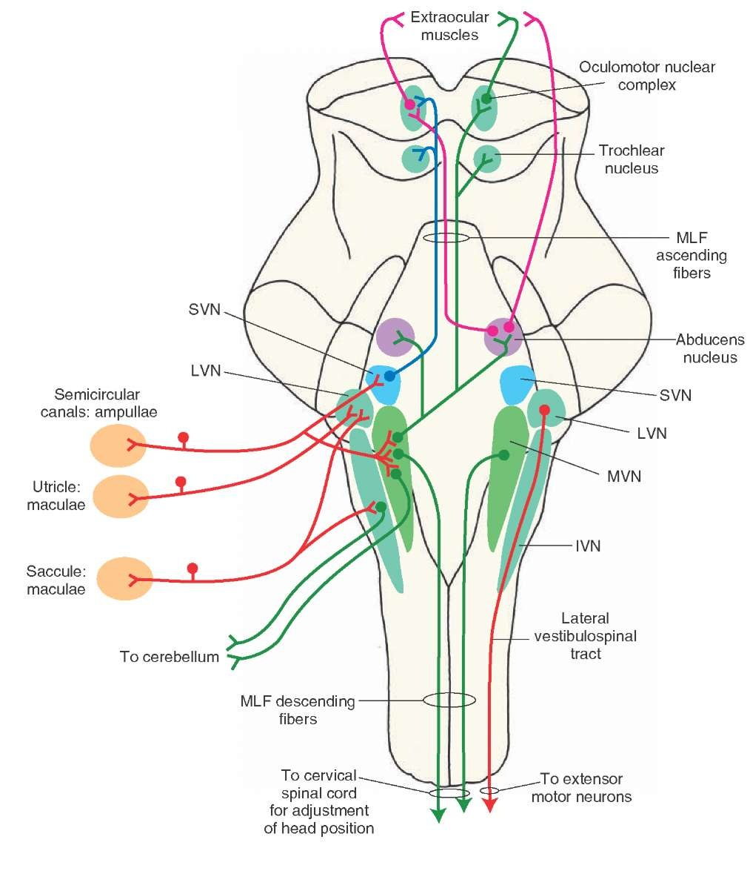
VESTIBULAR NUCLEI
Da Kandel et al., Principles of Neural Sciences, Mc Graw Hill

Slide 12
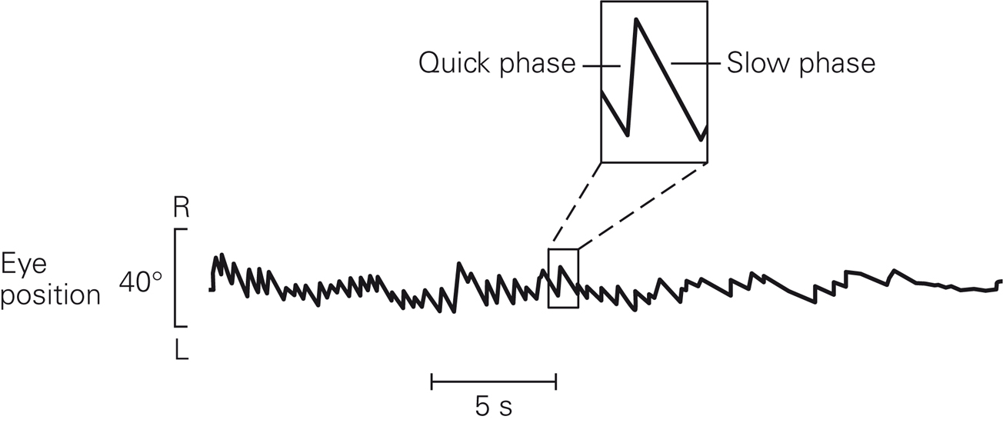
VESTIBULAR NYSTAGMUS
Da Kandel et al., Principles of Neural Sciences, Mc Graw Hill

Slide 13
OPTOKINETIC NYSTAGMUS
retina
Notes:
13

Slide 14
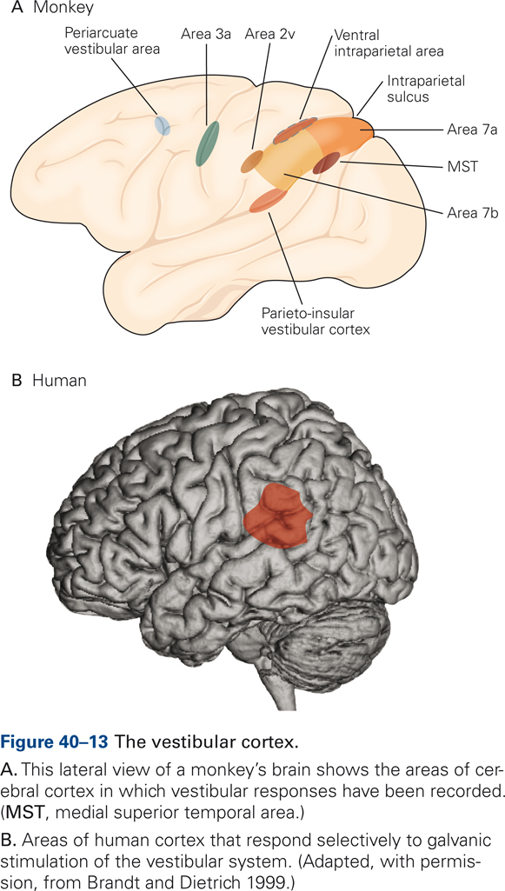
VESTIBULAR CORTEX
Da Kandel et al., Principles of Neural Sciences, Mc Graw Hill

Slide 15
EYE MOVEMENTS

Slide 16
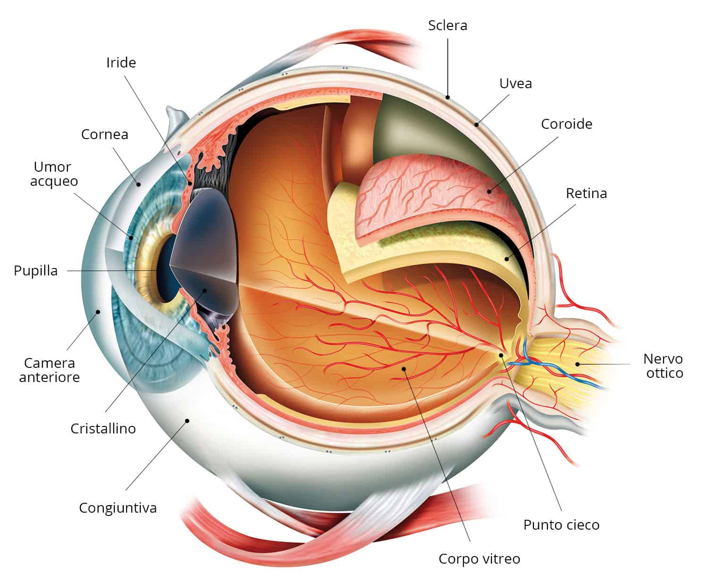
OCCHIO

Slide 17
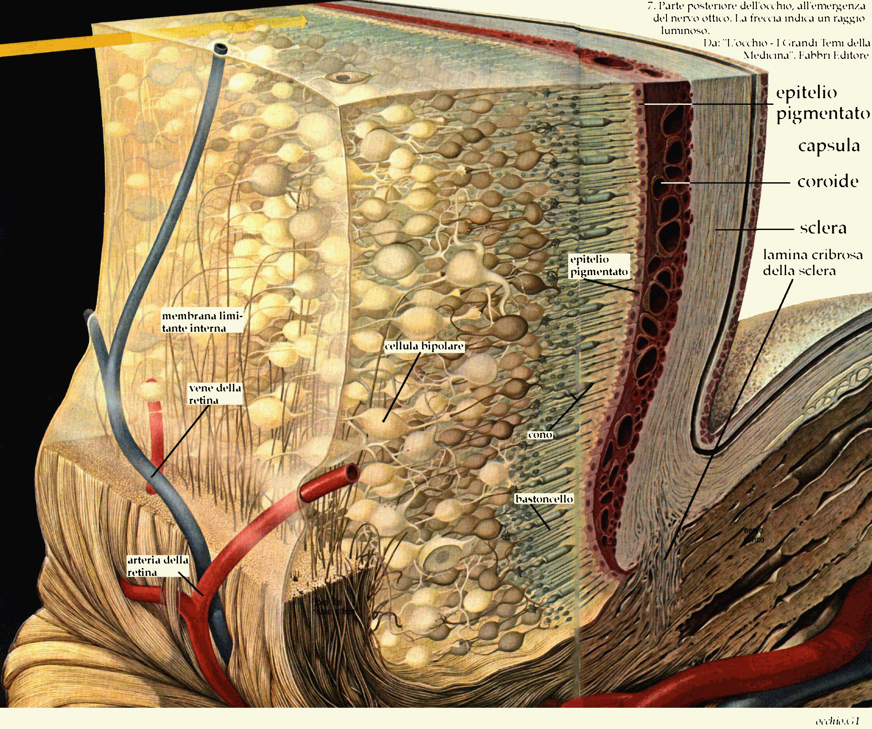
RETINA

Slide 18
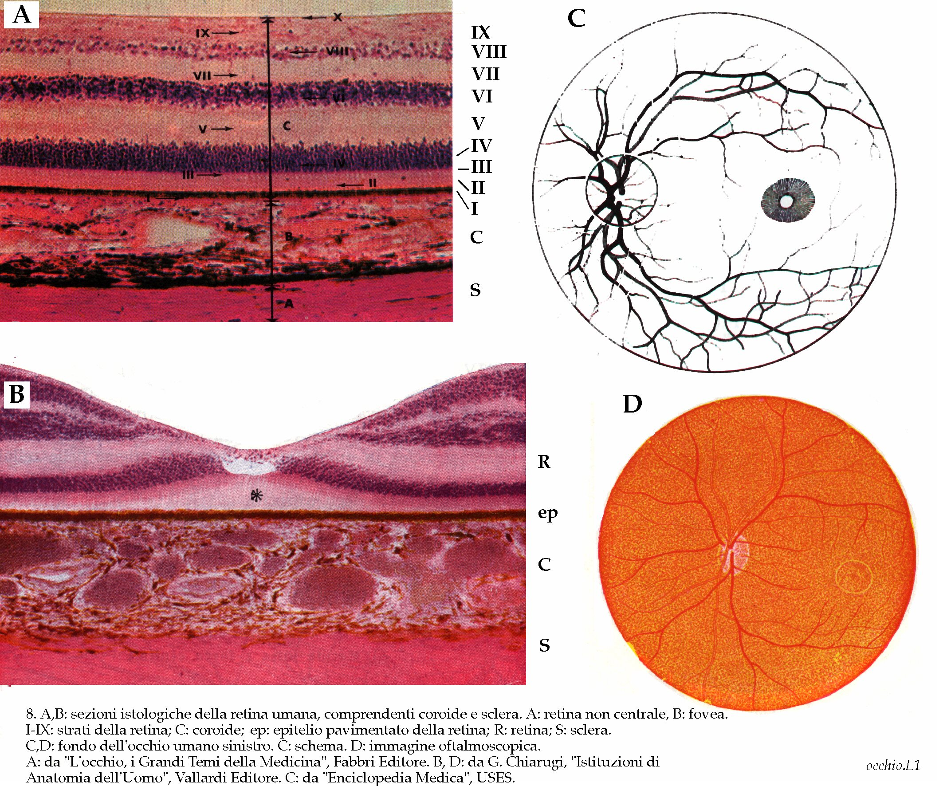
FOVEA

Slide 19
FOVEA
n m l i h g f e d c b a 9 8 7 6 5 4 3 2 1 0 1 2 3 4 5 6 7 8 9 a b c d e f g h i l m n
n m l i h g f e d c b a 9 8 7 6 5 4 3 2 1 0 1 2 3 4 5 6 7 8 9 a b c d e f g h i l m n
n m l i h g f e d c b a 9 8 7 6 5 4 3 2 1 0 1 2 3 4 5 6 7 8 9 a b c d e f g h i l m n
n m l i h g f e d c b a 9 8 7 6 5 4 3 2 1 0 1 2 3 4 5 6 7 8 9 a b c d e f g h i l m n
n m l i h g f e d c b a 9 8 7 6 5 4 3 2 1 0 1 2 3 4 5 6 7 8 9 a b c d e f g h i l m n
n m l i h g f e d c b a 9 8 7 6 5 4 3 2 1 0 1 2 3 4 5 6 7 8 9 a b c d e f g h i l m n
n m l i h g f e d c b a 9 8 7 6 5 4 3 2 1 0 1 2 3 4 5 6 7 8 9 a b c d e f g h i l m n
n m l i h g f e d c b a 9 8 7 6 5 4 3 2 1 0 1 2 3 4 5 6 7 8 9 a b c d e f g h i l m n
n m l i h g f e d c b a 9 8 7 6 5 4 3 2 1 0 1 2 3 4 5 6 7 8 9 a b c d e f g h i l m n
n m l i h g f e d c b a 9 8 7 6 5 4 3 2 1 0 1 2 3 4 5 6 7 8 9 a b c d e f g h i l m n
n m l i h g f e d c b a 9 8 7 6 5 4 3 2 1 o 1 2 3 4 5 6 7 8 9 a b c d e f g h i l m n
n m l i h g f e d c b a 9 8 7 6 5 4 3 2 1 0 1 2 3 4 5 6 7 8 9 a b c d e f g h i l m n
n m l i h g f e d c b a 9 8 7 6 5 4 3 2 1 0 1 2 3 4 5 6 7 8 9 a b c d e f g h i l m n
n m l i h g f e d c b a 9 8 7 6 5 4 3 2 1 0 1 2 3 4 5 6 7 8 9 a b c d e f g h i l m n
n m l i h g f e d c b a 9 8 7 6 5 4 3 2 1 0 1 2 3 4 5 6 7 8 9 a b c d e f g h i l m n
n m l i h g f e d c b a 9 8 7 6 5 4 3 2 1 0 1 2 3 4 5 6 7 8 9 a b c d e f g h i l m n
n m l i h g f e d c b a 9 8 7 6 5 4 3 2 1 0 1 2 3 4 5 6 7 8 9 a b c d e f g h i l m n
n m l i h g f e d c b a 9 8 7 6 5 4 3 2 1 0 1 2 3 4 5 6 7 8 9 a b c d e f g h i l m n
n m l i h g f e d c b a 9 8 7 6 5 4 3 2 1 0 1 2 3 4 5 6 7 8 9 a b c d e f g h i l m n
n m l i h g f e d c b a 9 8 7 6 5 4 3 2 1 0 1 2 3 4 5 6 7 8 9 a b c d e f g h i l m n
n m l i h g f e d c b a 9 8 7 6 5 4 3 2 1 0 1 2 3 4 5 6 7 8 9 a b c d e f g h i l m n

Slide 20
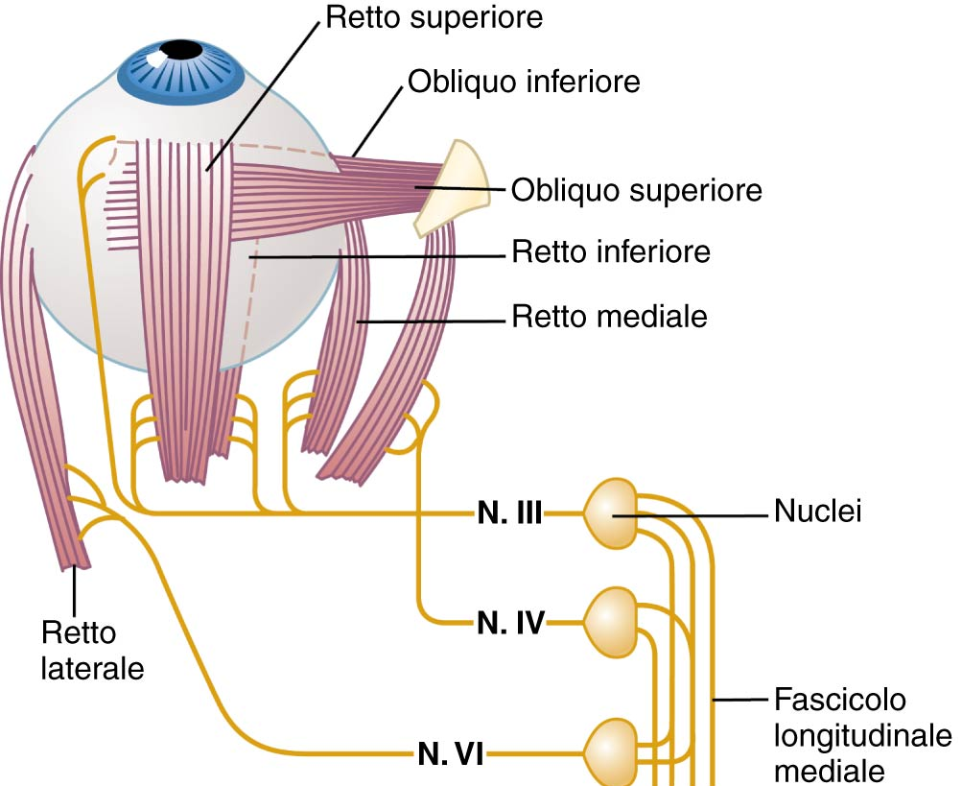
EXTRAOCULAR MUSCLES
SMALL EYE MOVEMENTS
tremors
drifts
micro-saccades
LARGE EYE MOVEMENTS
vestibular
optocinetic
saccadic
tracking
vergence
oculomotore
trocleare
abducente
Da Guyton e Hall, Fisiologia medica

Slide 21
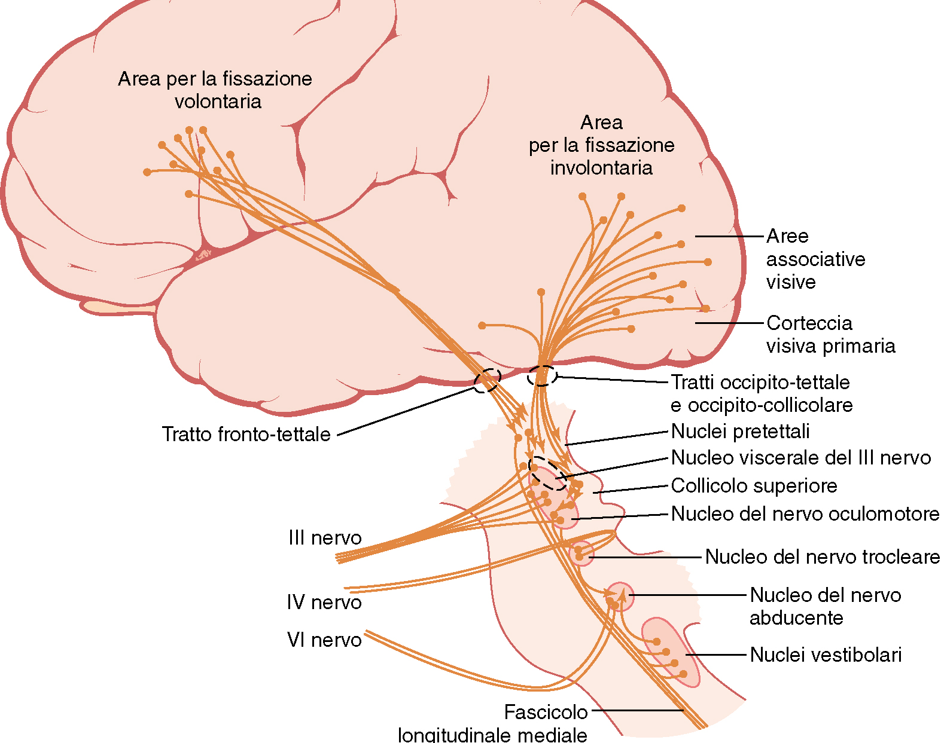
NEURONAL PATHWAYS FOR EYE MOVEMENTS
Da Guyton e Hall, Fisiologia medica

Slide 22
SOPPRESSIONE SACCADICA

Slide 23
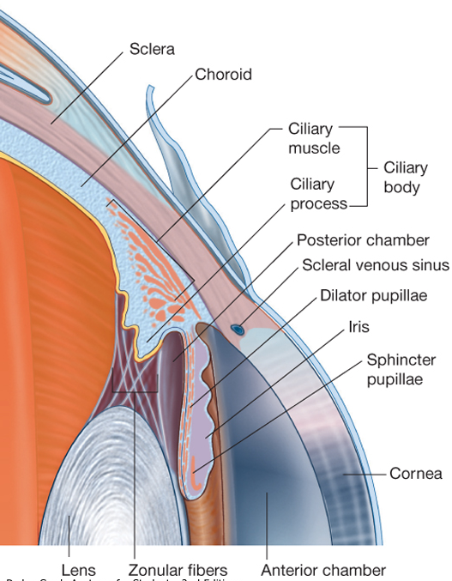
INTRINSIC EYE MUSCLES
miosi
midriasi

Slide 24
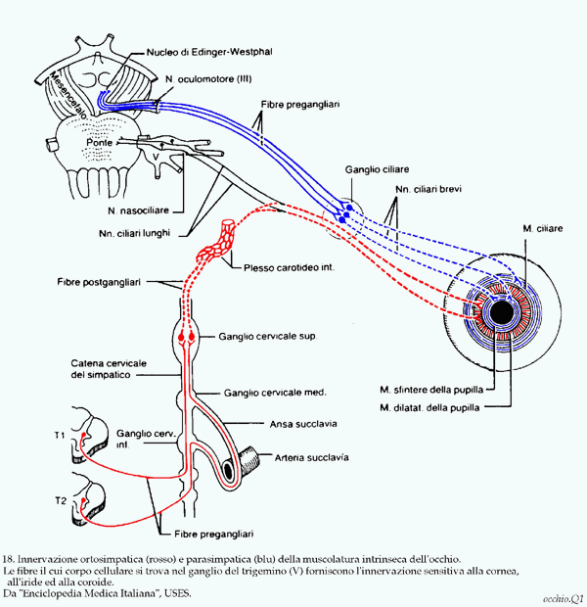
INTRINSIC EYE MUSCLES

Slide 25
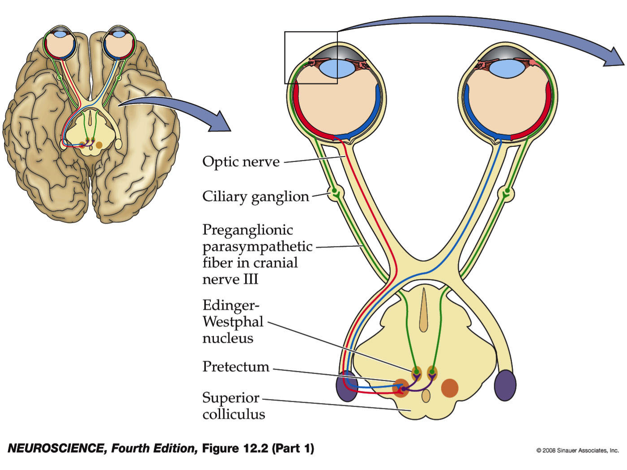
LIGHT REFLEX

Slide 26
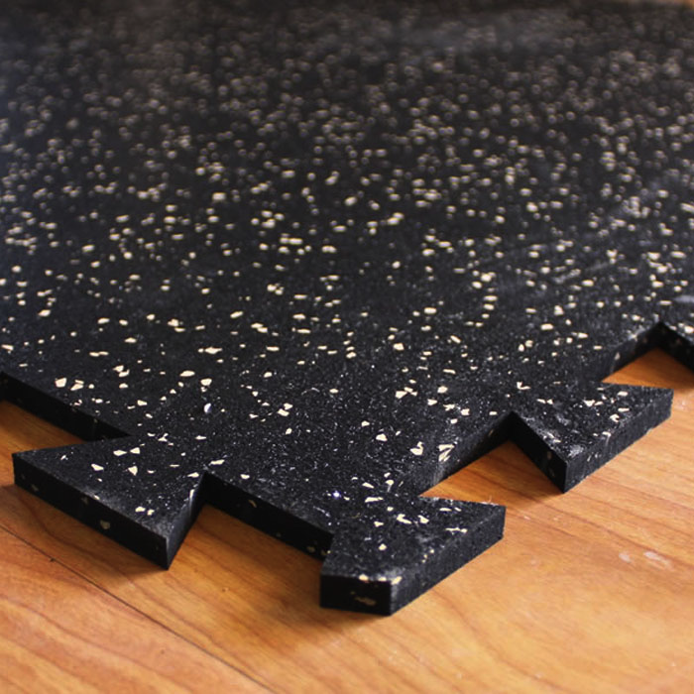
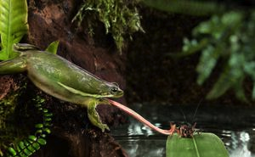
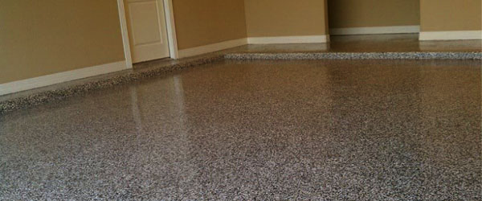
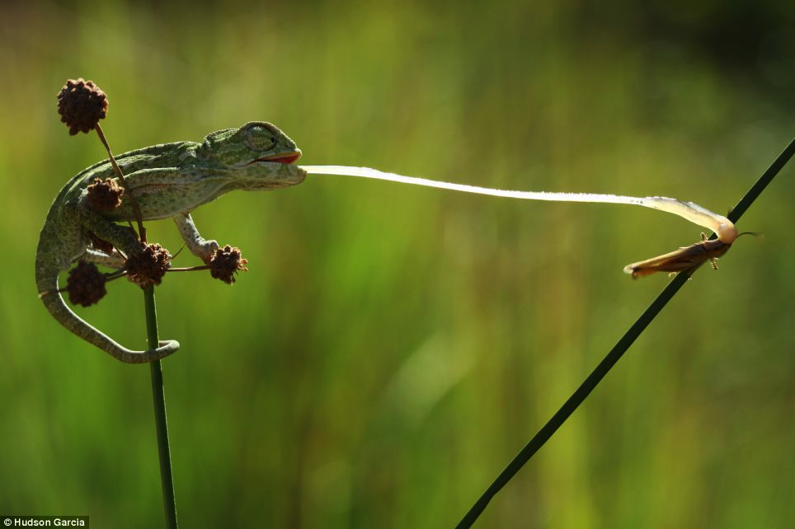
ORIENTING REFLEX

Slide 27
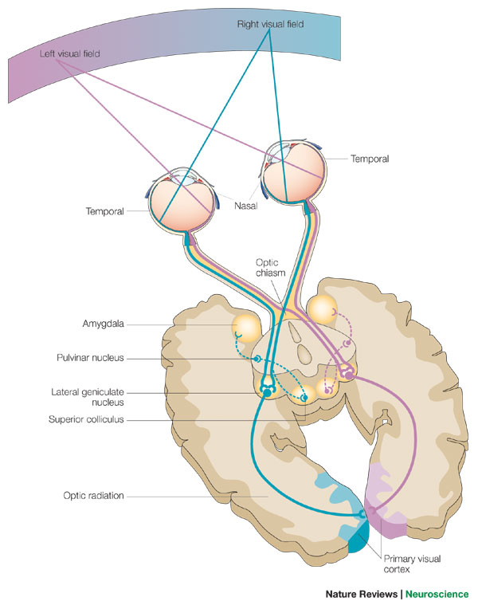
VISUAL PATHWAYS

Slide 28
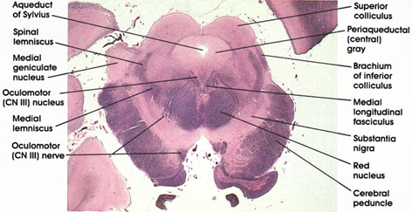
SUPERIOR COLLICULUS
The mammalian superior colliculus (SC) constitutes a major node in processing sensory information, incorporating cognitive factors, and issuing motor commands. The resulting action of orienting toward or away from a stimulus can be accomplished as an integrated movement across oculomotor, cephalomotor, and skeletomotor effectors. The SC also participates in preserving fixation during intersaccadic intervals. [Gandhi and Katnani, Annu. Rev. Neurosci. 2011. 34:205-31]
Many researchers have claimed that there is an alignment of auditory, somatosensory, visual and motor maps in the superior colliculus

Slide 29
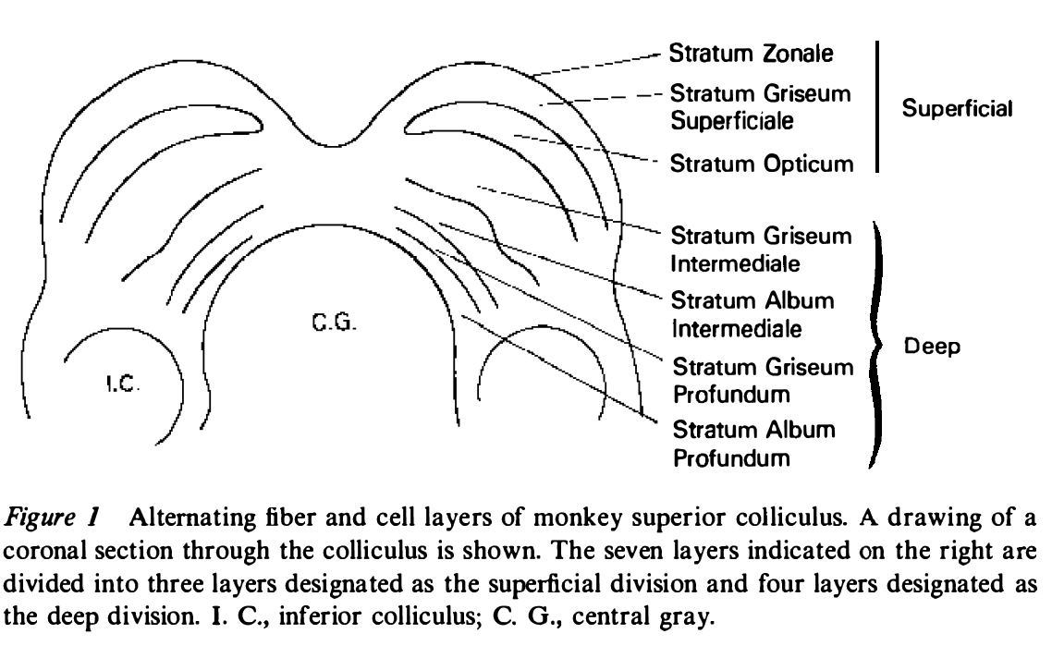
SUPERIOR COLLICULUS
The general function of the tectal system is to direct behavioral responses toward specific points in egocentric ("body-centered") space. Each layer of the tectum contains a topographic map of the surrounding world in retinotopic coordinates, and activation of neurons at a particular point in the map evokes a response directed toward the corresponding point in space. The tectum is also involved in generating spatially directed head turns and arm-reaching movements.
[From Wurtz RH and Albano JA, Annu. Rev. Neurosci. 1980.3:189-226]
Notes:
29

