Slide 1

Economic Geography
8 – Geography of population
121EC
A.Y. 2017/2018
Dr. Giuseppe Borruso
Faculty of Economics
University of Trieste
E-mail. giuseppe.borruso@econ.units.it
Ph. +39 040 558 7008
Skype: giuseppe.borruso
Notes:
Slides with (*) in footnotes have been modified by Jean-Paul Rodrigue materials. (v. riferimenti copyright a seguire). I have modified and elaborated materials in order to be suitable for the current course.
Copyright © 1998-2010, Dr. Jean-Paul Rodrigue, Dept. of Global Studies & Geography, Hofstra University. For personal or classroom use ONLY.
Powerpoint presentation elaborated from GEOG 135 – Economic Geography course by J. P. Rodrigue

Slide 2
Conditions of Usage
For personal and classroom use only
  Excludes any other forms of communication such as conference presentations, published reports and papers.
No modification and redistribution permitted
  Cannot be published, in whole or in part, in any form (printed or electronic) and on any media without consent.
Citation
  Dr. Jean-Paul Rodrigue, Dept. of Global Studies & Geography, Hofstra University.

Slide 3
Population Distribution and Structure
Global Population Distribution
Fertility and Mortality
Population Structure

Slide 4
Demography and Population Geography
Demography
  Systematic analysis of population phenomena through empirical, statistical and mathematical methods.
  Interested about changes in the population size and composition.
Population Geography
  Concerned by the spatial aspects of population:
    1- Simple description of the location of the population.
    2- Explanation of its spatial pattern and distribution.
    3- Geographical analysis (processes such as urbanization and migration).
  Demography rather emphasizes on time while population geography emphasizes on space.
Notes:
(*)

Slide 5
The Explosion of the World’s Population
The 20th Century
  Huge growth of the world’s population.
  Almost exponential from the 1920s until today.
  Population was multiplied by three.
  Around 80-85 million persons are added each year.
  60 million new urbanites per year.
  Urban population is now 2.6 billion, of which 1.7 billions are in developing countries.
  More than 65% of the global population is thus living in developing economies.
Notes:
(*)

Slide 6
The Explosion of the World’s Population
Human welfare
  Living conditions are improving in a number of areas, notably in newly industrialized economies.
    Insufficient to improve the welfare of the bulk of the world’s population.
  Paradox in developing countries:
    Population growth monitoring is essential in these areas.
    They have the least resources available to undertake such a process.
  Challenge of the degradation of the living environment of a significant share of the urban population.
  As the number of people increases, environmental impact also increases.
Notes:
(*)

Slide 7
World Population, 1000BC-2050AD (in billions)
Notes:
Source: WorldWatch Institute & United Nations, Population Forecast, 2006 Revision.

Slide 8
World Population 1804-2054 (in billions)
26 years
15 years
14 years
12 years
13 years
14 years
33 years
127 years
Notes:
(*)

Slide 9
Possible Trends in Population Growth, 2000-2050 (in billions)
Notes:
(*)

Slide 10
The Explosion of the World’s Population
The 1990s
  Critical decade for the future of the world’s population.
  The world’s nations by their actions or inactions will choose their demographic future.
  Population growth has started to slow down.
  Difficult to estimate; often lack of reliable population data.
2015 projections (United Nations)
  Population projections range from a low of 7.10 billion people to 7.83 billion.
  Difference of 720 million people in the short span of 15 years is nearly equal to the current population of Africa.
Notes:
(*)

Slide 11
The Explosion of the World’s Population
2050 Projections
  World population between 7.3 and 10.7 billion.
  8.9 billion is the most likely figure.
  In 1996 this number was estimated to be 9.4 billion.
  A 500 million difference!
  Global fertility rates have declined more rapidly than expected.
    66% attributed to improvements in health care; smaller families.
    33% attributed to increased mortality rates (Sub-Saharan Africa and parts of South Asia).
Notes:
(*)

Slide 12
The Explosion of the World’s Population
Demographic explosion of Third World countries
  Main ecological catastrophe affecting humanity.
  Population consumes resources:
    Food and raw materials.
    Scarce and often poorly managed.
  Population consumes energy:
    Requires important efforts to supply.
    Several forms of energy supply (coal and petroleum) are highly damaging for the environment.
  Population consumes space:
    Often taken at the expense of agriculture or the natural environment.
Notes:
(*)

Slide 13
Context
Definition
  Process during which the population of an area increases.
  Related to a complex economic, cultural and social environment.
  Two factors:
    (1) Number of births exceeds the number of deaths.
    (2) Migration flow is positive.
  Expressed in percentages.
  Birth rate of 20 per 1000 people.
  Death rate of 10 per 1000 people.
  Growth rate of 10 people per year per 1000 population, or 1%.
Births minus Deaths
Positive migratory balance
Population Growth
Society
Economy
Culture
Notes:
(*)

Slide 14
Context
Reasons for huge population growth
  Achieved “death control” more effectively then birth control.
  Modern medicine:
    Vastly decreased the number of deaths from many diseases (malaria, yellow fever, etc.).
  Famine:
    Reduced through better agriculture, distribution, storage and by international aid mechanisms.
  Infant mortality:
    Decreased in most areas.
  Improvement in the availability and quality of the water supply:
    Improved hygiene conditions.
    Decreased deaths caused by water borne diseases.
Notes:
(*)

Slide 15
Context
Birth control has been more difficult to achieve
  Religious beliefs.
  Cultural traditions.
  The importance of children as help, labor and security.
  The role of women is very limited in many societies.
Notes:
(*)

Slide 16
Growth Rates
High growth
  2% and above.
  Characteristic of many Third World countries.
Average growth
  Between 1 and 2%.
  Much of Latin America and parts of Asia, including China.
Low growth
  Between 0 and 1%.
  Europe, the United States and Canada are currently in this range.
Zero population growth (ZPG)
  Less than 0%.
  Several European countries.
High
2.0%
Average
1.0%
Low
0.0%
ZPG
Notes:
(*)

Slide 17
15 Largest Countries, 2005, 2050 (in millions)
Notes:
Source: FAO Statistical Database

Slide 18
World Population Distribution
Evolution of the world’s population
  Long historical process:
    Has been very slow up to recently.
    300 million people around year 0.
    Remained small until the last 250 years.
  A new growth trend:
    Has increased almost exponentially.
    From 1.6 billion in 1900 to 6 billion in 1999.
    To what it can be linked?
Population “explosion”
  Defines a process of strong demographic growth.
  Started after the Second World War.
  About 80 million people added each year.
  Major concern for the future of humanity.

Slide 19
World Population Distribution
Global population distribution
  3.4 billion people were living Asia in 2002.
  21% were Chinese.
Overpopulation
  China adds 1 million people per month.
  Most of the largest and most crowded cities in the world.
Notes:
Source: WRI.

Slide 20
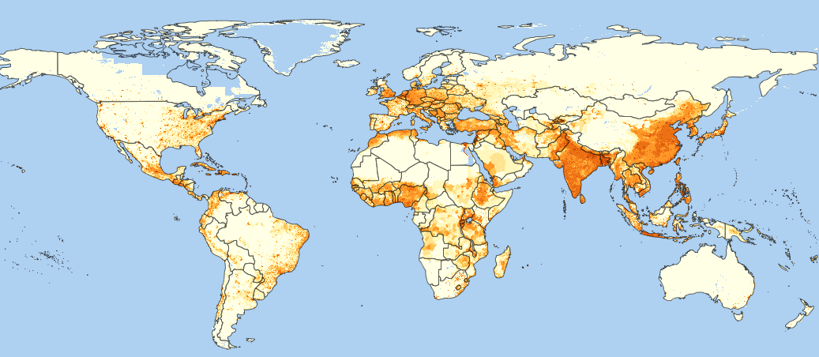
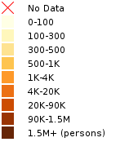
Population Count Future Estimates 2010
http://sedac.ciesin.columbia.edu/data/collection/gpw-v3/maps/gallery/browse

Slide 21
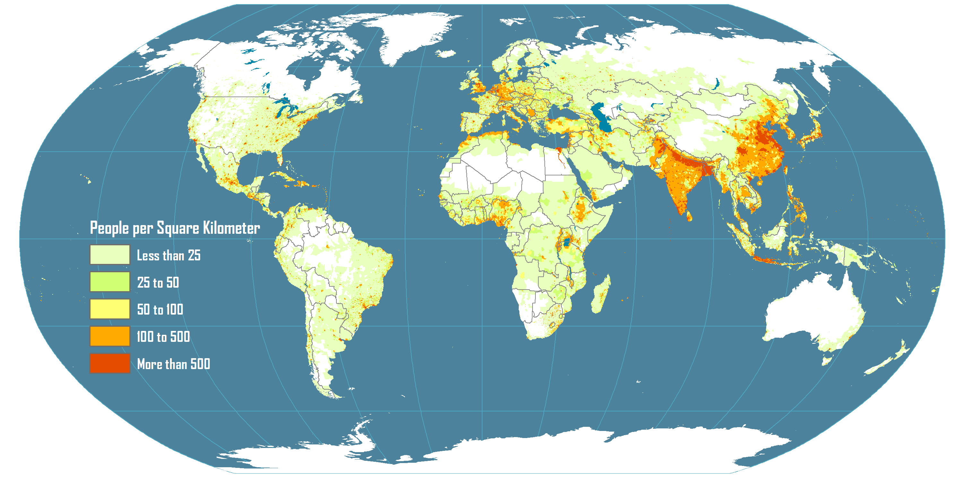
World Population Density and Distribution, 2005
Typical concentrations along major river systems.
Areas of large concentrations: South Asia, East Asia, Western Europe, Northeastern North America.
“Empty” areas are attributed to: harsh physical landscapes and harsh temperature.

Slide 22
Fertility and Mortality
Total Fertility Rate (TFR)
  Number of live births per female of reproductive age (15-49).
  Indicates population change over a long period of time.
  Instructive about societal norms in any given culture.
  A TFR of 2.1 is considered as being the replacement birth rate.
    Lower than 2.1 yields population decrease while rates greater than 2.1 yields population increase.
  Improvements in medical conditions lower the replacement rate (below 2.06 in many countries).
25 females between 15-49
10 children born that year
1,000
60
TFR = 2.04
= (60/1,000) * (49-15)

Slide 23
Total Fertility Rate, Selected Countries, 1995-2010
Replacement rate (2.1)
Notes:
SourceWorld Population Prospects, the 2010 Revision

Slide 24
TFR among Developed Countries, 2005, 2010
Notes:
Source: World Population Prospects, the 2010 Revision

Slide 25
Fertility and Mortality
Causes of death
  Throughout most of history famine, epidemics, and wars have been the leading causes of death.
  Primary causes of death began to shift to degenerative problems related to aging.
  These include such factors as heart disease and cancer.
Death and welfare
  Used to be considered a sign of the health of a population.
  Different age structures among the populations of different countries.
  Possible for a nation with high living standards to have a higher death rate than a poorer nation.
  Reason: overall older population.

Slide 26
Crude Death Rate, 2000

Slide 27
2. Fertility and Mortality
Life expectancy
  Number of years a person is expected to live.
  Based on current death rates.
  Does not necessarily apply to current generation.
  May change due to ameliorations in standards of living.
Context
  Strong geographical variations in life expectancy.
  Half a century ago, most people died before the age of 50.
  Global average life expectancy reached 66 years in 2006.
  Several achievements and failures:
    Economic development has benefited human health.
    Improvement in diet and sanitation.
    Urbanization may have adverse effects.
Notes:
Countries with high infant mortality rates have a strong impact on life expectancy. Sometimes, to filter this impact life expectancy after the age of 5 is used.

Slide 28
Life Expectancy Through Human History
Era | Life expectancy
Neanderthal (350,000 – 25,000 BC) | 20
Upper Paleolithic (40,000 – 10,000 BC) | 33
Neolithic (8,500 – 3,500 BC) | 20
Bronze Age (3,500 – 1,200 BC) | 18
Classical Greece and Rome (500 BC – 400 AD) | 28
Medieval Britain (400 – 1500 AD) | 33
Late 19th Century in Western Europe | 37
Average Global Life Expectancy (2006) | 66

Slide 29
2. Fertility and Mortality
Factors behind higher life expectancy
  About 40 years was gained in the 20th century.
  90% of the reduction in the death rate occurred before the introduction of antibiotics or vaccines.
  Major factors (33 years):
    Improved sanitation (for food and water).
    Reduction in crowding.
    Central heating.
    Sewer systems.
    Refrigeration.
  Improved health (7 years):
    Mainly medical technology.
    Small share attributed to drugs.

Slide 30
What Difference a Century Makes: Life Expectancy at Birth, 1910 and 1998

Slide 31
World Average Life Expectancy, 1950-2010
Notes:
Source: Worldwatch Institute.

Slide 32
Fertility and Mortality
Optimum life expectancy
  Life expectancy is ultimately dictated by human physiology:
    At some points, organs cease to function properly.
    Limit on the lifespan of non-cancerous human cells.
  Nearing life expectancy limits:
    Even if age-related diseases such cancer, heart disease, and stroke were eradicated, life expectancy would only increase by 15 years.
    Currently around 77 years.
    Expected to reach 85 years in most developed countries by 2030.

Slide 33
Population Pyramid
Definition
  Graph showing the breakdown of each sex by age group (cohort).
  Illustrates a nation’s population structure.
  Shows the male/female composition of the population.
  Most of the time, the breakdown involves 5 years periods.
Age group
75+
60-75
Males
45-60
Females
30-45
15-30
0-15
10
0
10
Percentage of the population
(or total figures)
Notes:
(*)

Slide 34
Population pyramids
Developing countries:
High natality rate
High mortality rate (older classes less populated)

Slide 35
Population pyramids
Most Developed countries:
Low natality rate (younger classes less populated)
Low mortality rate (older classes more populated)
Decreasing population in time

Slide 36
Population pyramids
Case study:
Province of Trieste – data at 31 Dec 2007
Top values: males and females 35 to 44 and 65 to 69;
males 45 to 49, females 60 to 64 and over 80
Decreasing population in time

Slide 37
Population Pyramid of Mexico, 2010
Notes:
Source: US Census Bureau, International Database

Slide 38
Population Pyramid of Sweden, 2010
Notes:
Source: US Census Bureau, International Database

Slide 39
Population Pyramid of United States, 2010
Notes:
Source: US Census Bureau, International Database

Slide 40
Population pyramids
Ideal situation:
Younger classes guarantee population replacement and stability
Natality and mortality rate at minimum values

Slide 41
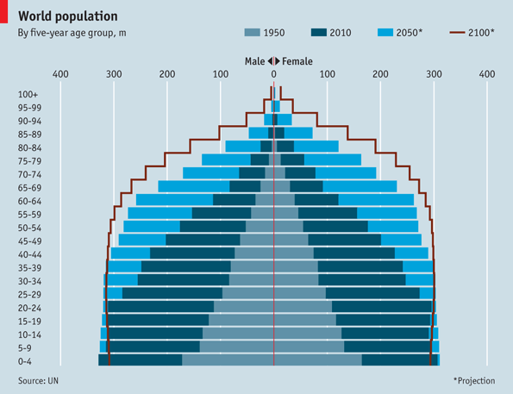
The world in 2100
The world's population pyramid is changing shape
THE world's population will reach 7 billion by the end of October, according to the latest projections from the United Nations.
For the first time the UN has attempted to look as far ahead as 2100, using various assumptions about how fertility and mortality rates might change over the years.
The average of these estimates suggests that the global population will cross 10 billion by 2085. By 2100, 22.3% of people will be aged 65 or over, up from just 7.6% in 2010.
The bulk of population growth is expected to come from the developing world. Africa's population will rise from 1 billion in 2010 to 3.6 billion in 2100. In 1950, 32% of the world's people lived in today's rich countries. By 2100, only 13% will.
May 13th 2011, 13:48 by The Economist online
http://www.economist.com/blogs/dailychart/2011/05/world_population

Slide 42
Current world population (ranked)
http://www.geohive.com/earth/population_now.aspx
rank | country | area sq.km. | population (all estimates)
 |  |  | yesterday 2012-10-21 | yearly growth | daily increase | today 2012-10-22
 | World | 510.072.000 | 7.075.852.119 | 1,10% | 211.757 | 7.076.063.876
1. | China | 9.596.960 | 1.355.341.010 | 0,42% | 15.539 | 1.355.356.548
2. | India | 3.287.590 | 1.263.451.671 | 1,32% | 45.542 | 1.263.497.213
3. | United States of America | 9.826.630 | 316.616.875 | 0,85% | 7.371 | 316.624.246
4. | Indonesia | 1.919.440 | 245.502.908 | 0,98% | 6.552 | 245.509.459
5. | Brazil | 8.511.965 | 198.871.616 | 0,84% | 4.56 | 198.876.176
6. | Pakistan | 803.940 | 180.927.944 | 1,77% | 8.721 | 180.936.666
7. | Nigeria | 923.768 | 167.922.975 | 2,53% | 11.55 | 167.934.525
8. | Bangladesh | 144.000 | 152.995.226 | 1,25% | 5.236 | 153.000.462
9. | Russian Federation | 17.075.200 | 142.658.517 | -0,10% | -399 | 142.658.118
10. | Japan | 377.835 | 126.406.332 | -0,07% | -253 | 126.406.079
11. | Mexico | 1.972.550 | 116.551.990 | 1,14% | 3.618 | 116.555.608
12. | Philippines | 300000 | 96.968.186 | 1,68% | 4.435 | 96.972.621
13. | Viet Nam | 329.560 | 90.010.842 | 1,02% | 2.505 | 90.013.347
14. | Ethiopia | 1.127.127 | 87.088.473 | 2,07% | 4.91 | 87.093.384
15. | Egypt | 1.001.450 | 84.388.089 | 1,67% | 3.837 | 84.391.925
16. | Germany | 357.021 | 81.939.765 | -0,20% | -456 | 81.939.309
17. | Iran (Islamic Republic of) | 1.648.000 | 75.852.629 | 1,04% | 2.15 | 75.854.779
18. | Turkey | 780.580 | 74.768.494 | 1,14% | 2.319 | 74.770.813
19. | Thailand | 514000 | 69.999.588 | 0,50% | 959 | 70.000.548
20. | Congo, Dem. Rep. of the | 2.345.410 | 70.134.315 | 2,62% | 4.99 | 70.139.305
21. | France | 643.427 | 63.557.279 | 0,51% | 888 | 63.558.167
22. | United Kingdom | 244.820 | 62.914.294 | 0,60% | 1.037 | 62.915.332
23. | Italy | 301.230 | 61.006.609 | 0,23% | 379 | 61.006.989
24. | South Africa | 1.219.912 | 50.817.813 | 0,51% | 710 | 50.818.523
25. | Myanmar | 678.500 | 48.842.799 | 0,79% | 1.057 | 48.843.857
UN: World Population Prospects: The 2010 Revision.; note: all numbers are estimates, the results of multiplying estimates with estimates should be seen as an indication of what can be, not as what is.

Slide 43
Dependency Ratio
Definition
  Comparison between the productive and non-productive population.
  Often expressed in non-productive per 100 productive.
  Non-productive population:
    Refers to the very old (usually >65 years of age) and the very young (usually <15).
    Considered to be the “non-productive” segments of society because they are not part of the labor force.
  Productive population:
    Between 15 and 65.
    This portion of the population constitutes the labor force.
    Revised to consider lower than 20 years in developed countries (increasing time spent for education).
Notes:
(*)

Slide 44
Dependency Ratio
Implications
  Society incurs costs in supporting its dependent population.
  Old age generates social costs:
    Retirement benefits.
    Increased medical expenditures.
    USA: 12% of the population over 65 accounting for 60% of health care costs.
    Greater consumption of other social services.
  Youths:
    Some medical costs.
    Great expenditures for education.
  National budgets often reflect these expenditures.
  Linked with the population pyramid:
    Pyramidal distributions have high dependency ratios.
    “Rectangular” distributions have high dependency ratios.
    Transitional pyramids have low dependency ratios.
Notes:
(*)

Slide 45
Dependency Ratio
Aging
  Major shift in health issues.
  1995: 380 million people aged 65 years and above.
  2020: over-65 population is projected to increase globally by 82%, to more than 690 million.
  For every baby born today in an industrialized country, there are 10 people aged 65 or over.
  By the year 2020 there will be 15 such elderly persons for each newborn.
  In developing countries, the ratio today is 2 people over 65 for every newborn, and 4 for every newborn by 2020.
Notes:
(*)

Slide 46
Population 60 and Over, Industrial and Developing Countries, 1950-95, With Projections to 2050
Notes:
Source: Worldwatch Institute. (*)

Slide 47
Dependency Ratio
Impacts
  Social security costs.
  Medical costs and the medical industry at large.
  Public sector funds such as the federal budget.
  Goods and services used by the elderly experience increasing demand levels.
  Those used by the young and/or middle aged will decline in relative importance.
  Local impacts (school districts).

Slide 48
Demographic Theory
The Malthusian Trap
Demographic Transition Theory

Slide 49
Malthusianism
1. Concept
  What are the principles of Malthusianism?
2. The Malthusian Crisis (trap)
  What does a Malthusian crisis involves?
3. Contemporary Issues

Slide 50
Concept
Context
  Thomas Malthus (1766-1834) in his book “Essays on the Principle of Population” (1798).
  Relationships between population and food resources (area under cultivation).
  Growth of available resources is linear while population growth is often non-linear (exponential).
  Took notice of famines in the Middle Ages, especially in the early 14th century (1316).
  From the data he gathered, population was doubling every 25 years.
  Over a century’s time, population would rise by a factor of 16 while food rose by a factor of 4.
Deficit
Demographic
growth
Resource
growth

Slide 51
1. The Malthusian Trap
Demographic growth
Creative pressure
  Opposed to the Malthusian perspective.
  Often labeled as the economic optimistic view.
  Brought forward in the early 1960s.
  Population has a positive impact on economic growth.
  Resources limited by humanity’s potential to invent.
  “Necessity is the mother of all inventions”.
  Scarcity and degradation are the sign of market failures.
  Population pressure forces the finding of solutions.
Problem
Higher occupation
densities
?
Pressures to increase
productivity
Solution
Innovations
Productivity growth
Outcome

Slide 52
1. The Malthusian Trap
Mitigating Resource Depletion
Discovery | An entirely new class of resources is made available. Often adds to existing resources. Offers new economic opportunities.
Substitution | An alternative resource is used. Some mineral resources maybe substituted by other, more abundant resources. Composites replacing metals. Fish farming replacing fishing. Telecommunications substituting for travel.
Reduce consumption | Reducing demand through more efficient use. Reducing demand through coercion.
Recycling | The output (waste) becomes an input. Some commodities difficult to recycle.
Re-use | Some finished goods reused (e.g. clothing, engines, tires).

Slide 53
1. The Malthusian Trap
Technological innovation and agriculture
  Intensification of agriculture.
  New methods of fertilization.
  Pesticide use.
  Irrigation.
  Multi-cropping systems in which more than one crop would be realized per year.
Creative pressure and global population growth
  Would lead to new productivity gains.
  Humans don’t deplete resources but, through technology, create them.
  Resources will become more abundant.
  Help overcome shortage in food production and employment.

Slide 54
1. The Malthusian Trap
Limits of food production by environmental factors
  Substitution is not possible for many resources.
  Soil exhaustion and erosion.
  Evolutionary factors such as the development of greater resistance to pesticides.
  Climate change.
  Loss of productive soils due to land use conversion to other purposes, such as urbanization.
  Water shortages and pollution.
Limits by technology
  May be available but not shared.
  Maybe too expensive for some regions (e.g. desalination).

Slide 55
1. The Malthusian Trap
Subsistence Economy
New Technology
Return to Subsistence
Equilibrium (Births = Deaths)
Higher incomes, higher births and
lower deaths
Populations growth, pressures on
resources less births and
more deaths
Death Rate
Births
Birth Rate
Deaths
Low
Income
Subsistence
Income
High
Income
Low
Income
Subsistence
Income
High
Income
Low
Income
Subsistence
Income
High
Income
Notes:
Source: New York Times, August 7 2007, “In Dusty Archives, a Theory of Affluence”

Slide 56
The Malthusian Crisis
The “Malthusian crisis”
  Available agricultural spaces are limited.
  Technical progresses (machinery, irrigation, fertilizers, and new types of crops) are slow to occur.
  Increasing incapability to support the population.
  If this persists, the population will eventually surpass the available resources.
  The outcomes are “Malthusian crises”:
    Food shortages.
    Famines.
    War and epidemics.
  “Fix” the population in accordance with available resources.
  Necessity of a “moral restraint” on reproduction.

Slide 57
The Malthusian Crisis
t3
Quantity
t2
Technological Innovation
t1
Resources
Population
Overexploitation
Time

Slide 58
The Malthusian Crisis
The Malthusian Crisis has not occurred
  Malthus has been criticized on several accounts during the 200 years since his work became known.
  Religious view (Protestantism), racist and elitist.
  Did not foresee the demographic transition:
    Changes in the economy that changed the role of children in the industrializing societies.
  Failed to account for improvements in technology:
    Enabled food production to increase at rates greater than arithmetic.
      Often at rates exceeding those of population growth.
    Enabled to access larger amounts of resources.
    Enabled forms of contraception.

Slide 59
1. Global Cereal Yields, 1961-2009 (kg per hectare)
Notes:
Source: FAO Database. www.fao.org

Slide 60
Contemporary Issues
The Malthusian crisis today
  Demographic growth:
    Between 1960 and 2000, three billion persons were added to the global population.
    To sustain this growth, agricultural resources had to be doubled.
    Required housing space surpassed all that was constructed since the beginning of mankind.
  Agricultural growth:
    Between 1960 and 1990, grain yields has increased by 92% while cultivated surfaces have only increased by 8%.
    Foresee a limit to growth in agricultural production.
  Consumption growth.
  Environmental degradation.

Slide 61
Contemporary Issues
Relevance of the Malthusian theory
  Was Malthus right or the trend in agricultural production will again increase to surpass population growth?
  Are improvements in agricultural techniques enough to answer demand?
  The next 25 years will be crucial and will bring forward answers to these questions.
  The work of Malthus continues to be important to demographers:
    Influence of many contemporary theorists from various academic disciplines.
    Built upon Malthus’s ideas and linked them to modern sciences.

Slide 62
Neo-Malthusianism
1. Neo-Malthusian Concepts
  How can the Malthusian theory be adapted to the current situation?
2. The Commons
  In which way common resources are used?
3. Neo-Malthusianism and Human Reproduction
  Is reproduction a right or privilege?

Slide 63
Neo-Malthusian Concepts
Carrying capacity
  Issue linked with the carrying capacity of land.
  Limits to absorb ever-greater numbers of people.
  Population growth has environmental impacts.
  Support of family planning, contraception and abortion.
  Population problems cannot be addressed through technology beyond the short term.
Overpopulation
  A multidimensional issue linked with the carrying capacity.
  Numbers should be linked with level of consumption.
  The United States would be more overpopulated than China.

Slide 64
Neo-Malthusian Concepts
Population bomb
  Fast population growth seen as a threat:
    The word “bomb” obviously refer to the lethal character of the problem.
  Brought forward by Paul Ehrlich in the late 1960s.
  Most Third World countries were in the middle of their demographic transition at the time.
  Ehrlich and others continued the basic Malthusian numbers game in which population growth outstrips food production.
  Moved Beyond Malthus in their consideration of many environmental issues.

Slide 65
Demographic Transition
1. Concept
  What is the demographic transition?
2. Stages
  What are the major stages of its occurrence?
3. Geographical Variations
  Does the demographic transition occurred at the same time and places?
Notes:
(*)

Slide 66
Concept
Overview
  A “social modernization” of the reproduction process:
    Improved health care and access to family planning.
    Higher educational levels, especially among women.
    Economic growth and rising per capita income levels.
    Urbanization and growing employment opportunities.
  Involves moving from one equilibrium to another:
    Initial equilibrium: High birth and death rates.
    Final equilibrium: Low birth and death rates.
  Theory backed by solid empirical evidence.
  Involves four phases.
Notes:
(*)

Slide 67
The demographic transition
Population
Time
Death,
Birth rates
Birth rate
Time
Death rate

Slide 68
Total Fertility Rate, Selected Units, 1950-2010

Slide 69
Global Population (1950-2010) and Growth Scenarios, 2010-2050
Notes:
Source: Population Division of the Department of Economic and Social Affairs of the United Nations Secretariat,
World Population Prospects: The 2010 Revision, http://esa.un.org/unpd/wpp/index.htm

Slide 70
Metropolitan Areas of More than 10 Million Inhabitants, 2010
Notes:
Source: United Nations, Department of Economic and Social Affairs, Population Division. World Urbanization Prospects: The 2009 Revision. New York: United Nations.

Slide 71
Major Phases of Demographic Change
Agricultural Revolution
  Feudal society.
  Wealth from agriculture and land ownership.
  Slow demographic growth.
Industrial Revolution
  Wage labor society.
  Wealth from industry and capital ownership.
  Fast demographic growth.
Post-Industrial Revolution
  Information society.
  Wealth from technological development.
  Slow demographic growth.
Agricultural
Revolution
12,000 years
Industrial
Revolution
200 years
Post-Industrial
Revolution

Slide 72
Stages in Demographic Transition
Stage I | Stage II | Stage III | Stage IV
High birth rates | High birth rates | Falling birth rates | Low birth rates
No or little Family Planning Parents have many children because few survive Many children are needed to work the land Children are a sign of virility Religious beliefs and cultural traditions encourage large families |  | Family Planning used A lower infant mortality rates Industrialization means less need for labor Increased desire for material possessions and less desire for large families Emancipation of women | Children as liabilities instead of assets
High death rates | Falling death rates | Low death rates | Low death rates
Disease and plague (e.g. bubonic, cholera, kwashiorkor) Famine, uncertain food supplies and poor diet Poor hygiene, no clean water or sewage disposal | Improved medicine Improved sanitation and waters supply Improvements in food production in terms of quality and quantity Improved transport to move food A decrease in child mortality
Notes:
(*)

Slide 73
Geographical Variations
Developed countries
  Took 250 years for most developed economies to go through their own demographic transition (from 1750 to 2000).
  Population growth never surpassed the capacity of these economies to accommodate it.
Developing countries
  Demographic transition started in the 20th century:
    The most advanced segment after WWI.
    The least advanced segment after WWII.
  Very few have went trough the transitory mutation.
  Most of them have a type III demographic transition.
  By the time they reach type IV, a huge amount a population will be added to their populations.
Notes:
(*)

Slide 74
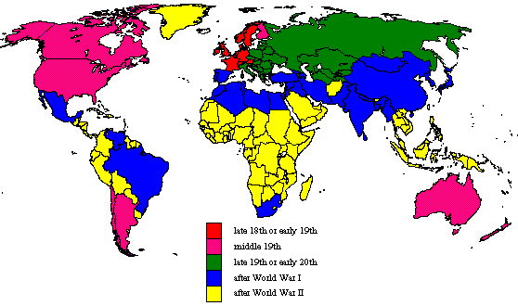
Beginning of Demographic Transition
Notes:
(*)

Slide 75
Migration
Causes of Migration
Patterns of Migration

Slide 76
1. Causes of Migration
Context
  Migrations as the response of individual decision-makers.
  Negative or push factors in his current area of residence:
  Positive or pull factors in the potential destination
  Intervening obstacles.
The problem of perception
  Assumes rational behavior on the part of the migrant:
    Not necessarily true since a migrant cannot be truly informed.
    The key word is perception of the pull factors.
    Information is never complete.
    Decisions are made based upon perceptions of reality at the destination relative to the known reality at the source.
  When the migrant’s information is highly inaccurate, a return migration may be one possible outcome.

Slide 77
Concepts Linked to Migration
Cultural settling
  Related to sex-specific migrations.
  Especially where males are the early migrants.
  Work for many years, sending remittances home to their families, especially if married.
  If able to stay in the developed country for a while, they may then send for their wives and children to join them.
  Enclave immigrant neighborhoods.
  Very limited assimilation because culture an identity are very difficult to change.
  Problems begin to surface when the children grow up.
  Caught between two worlds and not belonging to either.

Slide 78
Concepts Linked to Migration
International
Step migration
  Moving from a source to an eventual permanent destination.
  A Third World rural agricultural family may first move to the nearest town.
  Becomes part of the wage economy at the lowest level.
  After gaining experience, the family may next move to the nearest city.
  Later, on to the provincial capital, each time gaining a little in job opportunity, experience, and salary.
  Eventually, may move the national capital or major port city.
  More competitive situation but is better prepared to handle this.
Capital
Provincial
capital
Opportunities / Competition
Town
Village

Slide 79
Concepts Linked to Migration
Chain migrations
  A major source of information about potential destinations comes by word of mouth from family and friends.
  Involves the sequential migration of kinship or friendship groups.
  Very common in the Third World.
  Initially, one or two may go, usually the most motivated, best educated.
  Encourages a few more relatives or friends to follow.
    Rely upon them to teach the “ropes” in the new situation, get leads on jobs, etc.
  Eventually, larger numbers will follow this same pattern.
  Will often replicate the familiar network of the home region.
  Many large Third World cities have such residential patterns.
City
Village /
Region A
Village /
Region B

Slide 80
Concepts Linked to Migration
Distance - decay factor
  Inverse relationship between:
    Distance separating two places.
    Amount of information received by each about the other.
    Information decreases as distance increases.
  Direct relationship between
    Population size.
    Information generated.
  Closer destinations may often have an advantage.
  Population size can often overcome distance decay.
  A larger city can overcome distance decay and pull in migrants from wider areas.
Information

Slide 81
Concepts Linked to Migration
Migration field
  Area from which a destination draws its migrants.
  Closely related to the distance-decay factor.
  Larger cities have much more extensive migration fields than do smaller ones.
    Burlington, VT: The region and the State.
    New York: The world.

Slide 82
Concepts Linked to Migration
Fill-in migration
  Pattern in which, as one group of migrants moves out of an area, another enters to take its place.
  Often related to the improvement in welfare.
  Occur in American major cities.
Migrant group
Downtown
Suburbs

Slide 83
Types of Migration
Emigration and immigration
  Change in residence.
  Relative to origin and destination.
Requires information on:
  People and conditions.
  Two different places.
  Two different times.
Duration:
  Permanent.
  Seasonal / Temporary.
Choice / constraint:
  Improve one’s life.
  Leave inconvenient / threatening conditions.
A
Problems or benefits?
Emigrant
Immigrant
B
Problems or benefits?

Slide 84
Types of Migration
Gross migration
  Total number of people coming in and out of an area.
  Level of population turnover.
Net Migration
  Difference between immigration (in-migration) and emigration (out-migration).
  Positive value:
    More people coming in.
    Population growth.
      44% of North America and 88% of Europe.
  Negative value:
    More people coming out.
    Population decline.
Gross migration
Immigration
Emigration
Net migration

Slide 85
Major International Migration Patterns, Early 1990s

Slide 86
Types of Migration
Local Migration
  No state boundaries are crossed.
  Buying a new house in the same town or city.
  Difficult to research since they are usually missed in census data.
  Based on change of income or lifestyle.
  Often very high levels of local migration.
Central City
Suburb

Slide 87
Types of Migration
Temporary migration
  The mover still maintains roots at the source.
  Activity space.
  Difficult to quantify.
  Commuting:
    Cyclical migration.
    Usually done on a daily basis.
  Shopping.
  Often “consolidated” in one trip with several stops.
  Students/military.
    Periodic migration.
  Tourism or business travel.
Consolidation
Shopping
Leisure
Work
Education
Vacation
Permanent place
of residence

Slide 88
Types of Migration
Circular migration
  A type of temporary migration.
  Associated with agricultural work.
  The migrant follows the harvest of various crops, moving from one place to another each time.
  Very common in the US Southwest (Mexican farm workers) and in Western Europe (Eastern European farm workers).
Spring
Summer
Fall / Winter

Slide 89
Types of Migration
Voluntary migration
  The migrant makes the decision to move.
  Most migration is voluntary.
Involuntary
  Forced migration in which the mover has no role in the decision-making process.
  Slavery:
    About 11 million African slaves were brought to the Americas between 1519 and 1867.
    In 1860, there were close to 4 million slaves in the United States.
  Refugees.
  Military conscription.
  Children of migrants.
  Situations of divorce or separation.

Slide 90
Selective Migration
2
Context
  Many migrations are selective.
  Do not represent a cross section of the source population.
  Especially true in the early stages of a migration process.
Age-specific migrations
  One age group is dominant in a particular migration.
  International migration tends to involve younger people.
  The dominant group is between 25 and 45.
  Studies and retirement are also age-specific migrations.

Slide 91
Push - Pull Theory
1
Context
  Migrations as the response of individual decision-makers.
  Negative or push factors in his current area of residence:
    High unemployment and little opportunity.
    Great poverty.
    High crime.
    Repression or a recent disaster (e.g., drought or earthquake).
  Positive or pull factors in the potential destination:
    High job availability and higher wages.
    More exciting lifestyle.
    Political freedom, greater safety and security, etc.

Slide 92
Push - Pull Theory
1
Intervening obstacles
  Migration costs / transportation.
  Immigration laws and policies of the destination country.
The problem of perception
  Assumes rational behavior on the part of the migrant:
    Not necessarily true since a migrant cannot be truly informed.
    The key word is perception of the pull factors.
    Information is never complete.
    Decisions are made based upon perceptions of reality at the destination relative to the known reality at the source.
  When the migrant’s information is highly inaccurate, a return migration may be one possible outcome.

Slide 93
Push - Pull Theory
1
Intervening obstacles
Origin
Destination
Positive factors
Neutral factors
Negative factors
Notes:
Source: adapted from Peters and Larkin (1999), p. 199.

Slide 94
1. Push - Pull Theory
Push Factors | High unemployment and little opportunity. Poverty. High crime and corruption. Repression (political, religious). Recent disaster (drought, earthquake or war).
Pull Factors | High job availability and higher wages. More exciting lifestyle. Access to social services (healthcare and education). Greater safety and security.
Intervening opportunities | Migration costs / transportation. Immigration laws and policies of the destination country.

Slide 95
1. Causes of Migration
Labor shortages
High wages
Labor mobility
  The primary issue behind migration.
  Notably the case at the national level.
  Equilibrate the geographical differences in labor supply and demand.
  Accelerated with the globalization of the economy.
Remittances
  Capital sent by workers working abroad to their family / relatives at home.
  $276 billion in 2006 ($85 billion in 2000):
    $16 billion each year goes out of Saudi Arabia as remittances.
    2nd most important most important source of income for Mexico (after oil and before tourism); $25 billion in 2006.
    Now higher than official aid.
Migration
Surplus labor
Low wages
Notes:
One third of the population of Albania (total 3.2 million) has left to work abroad, mostly in Western Europe.

Slide 96
2. Migration Policies and Global Migration Patterns
Period | Policies | Pattern
Before 1914 | Open policies (“showing up”). Immigration as a source of labor and development. | From developed (Europe) to developing countries (Americas, Africa, Australia). Immigration from Europe between 1880 and 1910 was exceeded 25 million.
1920s and 1930s | “Closed door” linked with the economic depression. Deportation of immigrants. | Limited migration.
After 1945 | More open policies. Reconstruction in Europe (12% of labor force) and economic growth in America. | Beginning to shift from developing to developed countries (12%).
After 1973 | Relatively open policies, but with more stringent requirements. Growth of refugees and illegal immigration. | From developing to developed countries (88%). 3 million illegal immigrants entering the US per year. Estimates of 20-38 million illegals in the US alone.

Slide 97
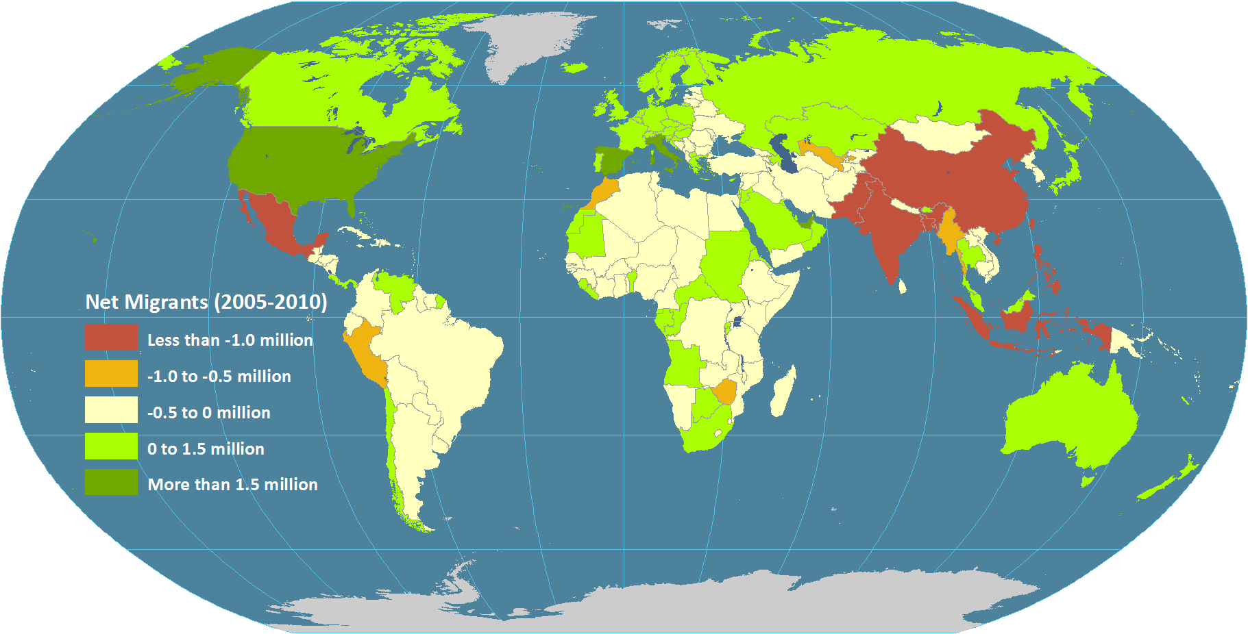
2. Global Net Migration (2005-2010)
Notes:
Source: UNEP (2012): The UNEP Environmental Data Explorer, as compiled from World Population Prospects, the 2010 Revision (WPP2010), United Nations Population Division. United Nations Environment Programme. http://geodata.grid.unep.ch.

Slide 98
2. Patterns of Migration
Growing level of temporary migration schemes
  Work permits.
  More in tune with seasonal and economic cycles.
Skilled migrants are increasingly sought after
  Lower costs.
  Cannot be easily recruited by another corporation.
Growing anti-immigration stance in many countries
  Health: carry endemic diseases.
  Economic: depress wages and increase social burden.
  Nationalism: undermine the cohesion of nation-states.
  Environment: cause additional population burdens.

Slide 99
References
GEOG 135 - Economic Geography
Professor: Dr. Jean-Paul Rodrigue
Powerpoint presentation ‘population’
Websites
  http://people.hofstra.edu/jean-paul_rodrigue/downloads/GEOG%20135%20Topic%203.pptx
  http://www.economist.com/blogs/dailychart/2011/10/world-population
  http://www.economist.com/node/18200618
  http://geodata.grid.unep.ch.
  http://www.economist.com/blogs/dailychart/2011/05/world_population
  http://www.geohive.com/earth/population_now.aspx
  http://sedac.ciesin.columbia.edu/data/collection/gpw-v3/maps/gallery/browse

Slide 100
Links
Gapminder: http://www.gapminder.org/
  Tools https://www.gapminder.org/tools/
  Videos http://www.gapminder.org/videos/dont-panic-the-facts-about-population/
IKEA boxes https://www.gapminder.org/videos/population-growth-explained-with-ikea-boxes/
Religion and babies
https://www.youtube.com/watch?v=ezVk1ahRF78

Slide 101
Links
Refugees
http://www.therefugeeproject.org
https://www.facebook.com/gapminder.org/videos/1014061668628791/
https://www.google.com/maps/d/viewer?mid=1z5UBHILIO5hcaTP2fSzsKxn7wQM&hl=en_US&ll=32.29383056462879%2C36.32968400531013&z=15
http://data.unhcr.org/syrianrefugees/settlement.php?id=176
Geospatial revolution
https://www.youtube.com/watch?v=ZdQjc30YPOk

