Slide 1

Economic Geography
9 – Geographic Information Systems and Geospatial technologies
121EC
A.Y. 2017/2018
Dr. Giuseppe Borruso
Faculty of Economics
University of Trieste
E-mail. giuseppe.borruso@econ.units.it
Ph. +39 040 558 7008
Skype: giuseppe.borruso
Notes:
Geografia delle Reti EC 503
I Modulo
Giuseppe Borruso
1
Slides with (*) in footnotes realized by Jean-Paul Rodrigue and modified. (See copyright). I have modified and elaborated materials in order to be suitable for the current course.
Copyright ©, Dr. Jean-Paul Rodrigue, Dept. of Global Studies & Geography, Hofstra University. For personal or classroom use ONLY.

Slide 2
Topics
What’s in your smartphone?
  Geography inside!
Geography at your fingertips
  ‘geographical’ devices
Geographical digital data and their representation
Position on the Earth
The geospatial technologies
Geography and ‘the crowd’
  Openstreet map and Volunteered Geographic Information
Geographic Information and business
  Digital maps and digital services

Slide 3





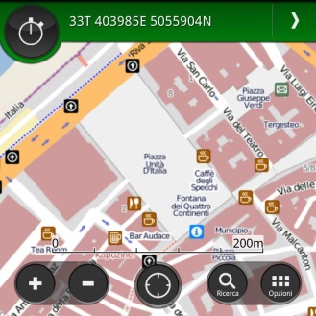











What’s in your smartphone?

Slide 4






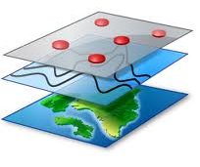




What’s in your smartphone?
Professional Apps
GPS (position)
Compass
(navigation)
Mobile phone cellular network:
GSM; 2-3-4G (voice; data; location)
Internet and Web (navigation
Data transmission)
On-field
working tools
Vector Maps and charts
Satellite imagery

Slide 5
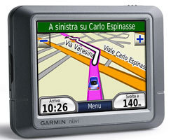
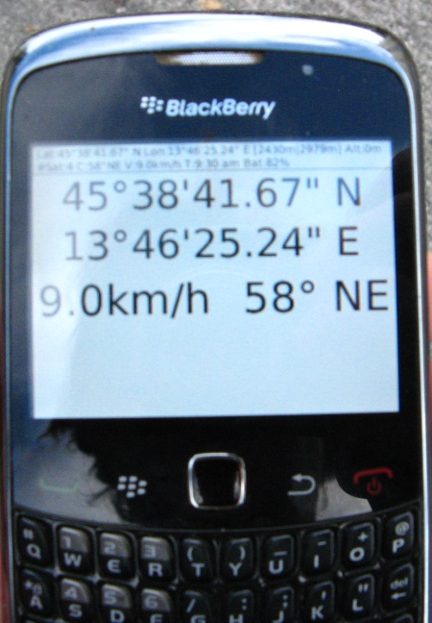
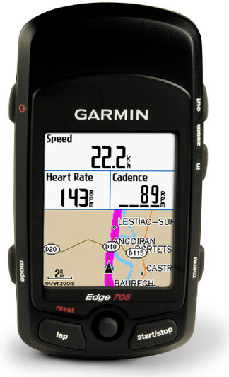
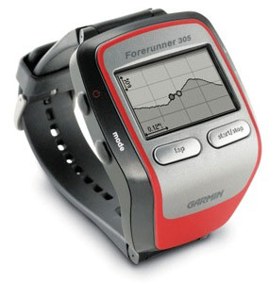
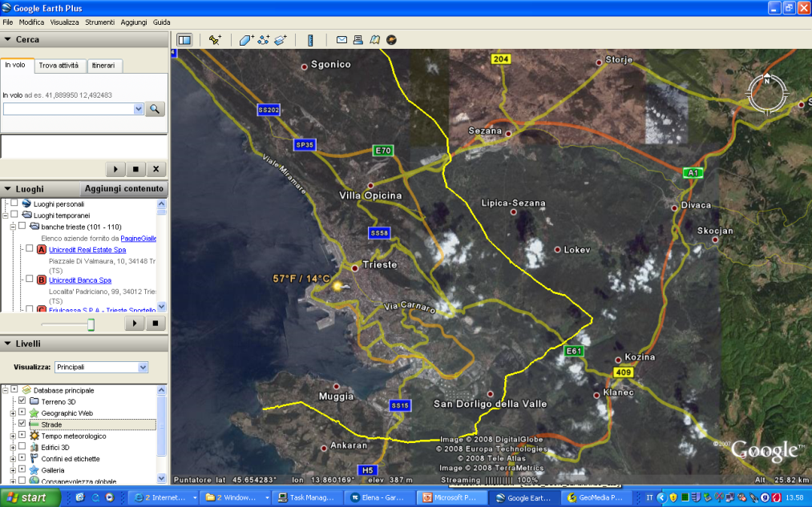

Geography at your fingertips
?
What have in common….
A mobile phone
cardio sport watch
A car navigation system
A web page
A tablet / smartphone
?

Slide 6
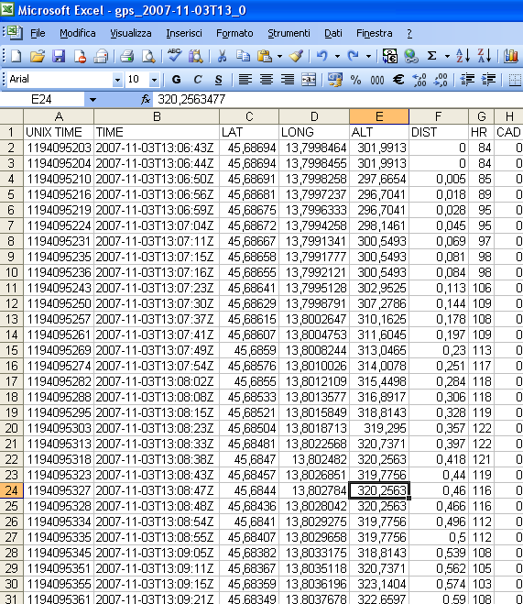
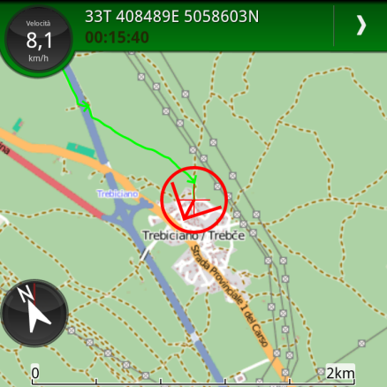
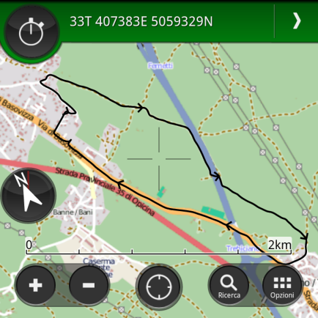
Geography at your fingertips
Geographical Coordinates

Slide 7
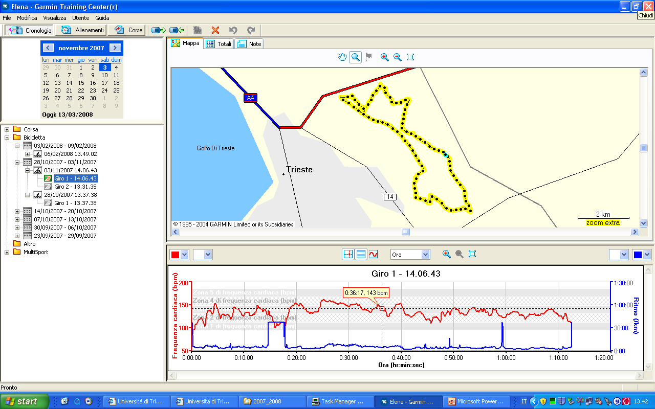
Geography at your fingertips
Geographical data in a training centre…

Slide 8
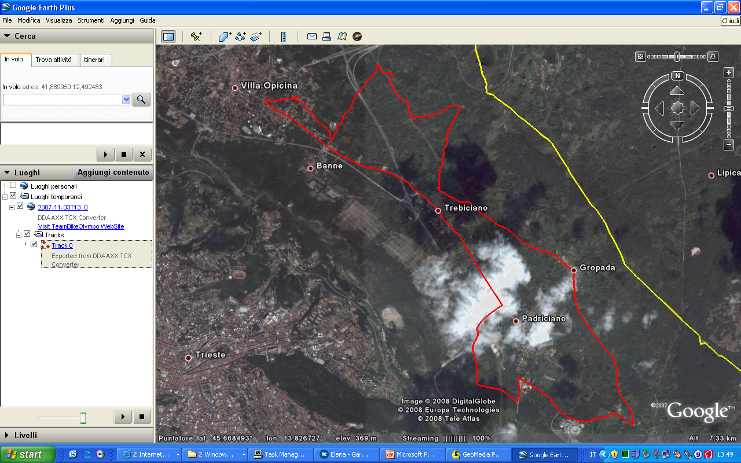
Geography at your fingertips
…geographical data in a virtual globe …

Slide 9
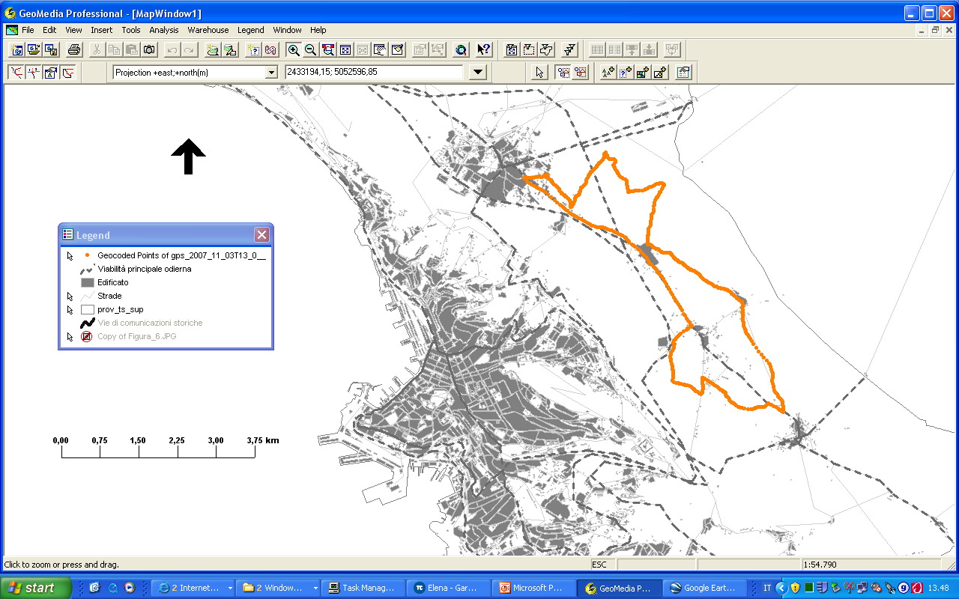
Geography at your fingertips
…geographical data in a professional GIS…

Slide 10
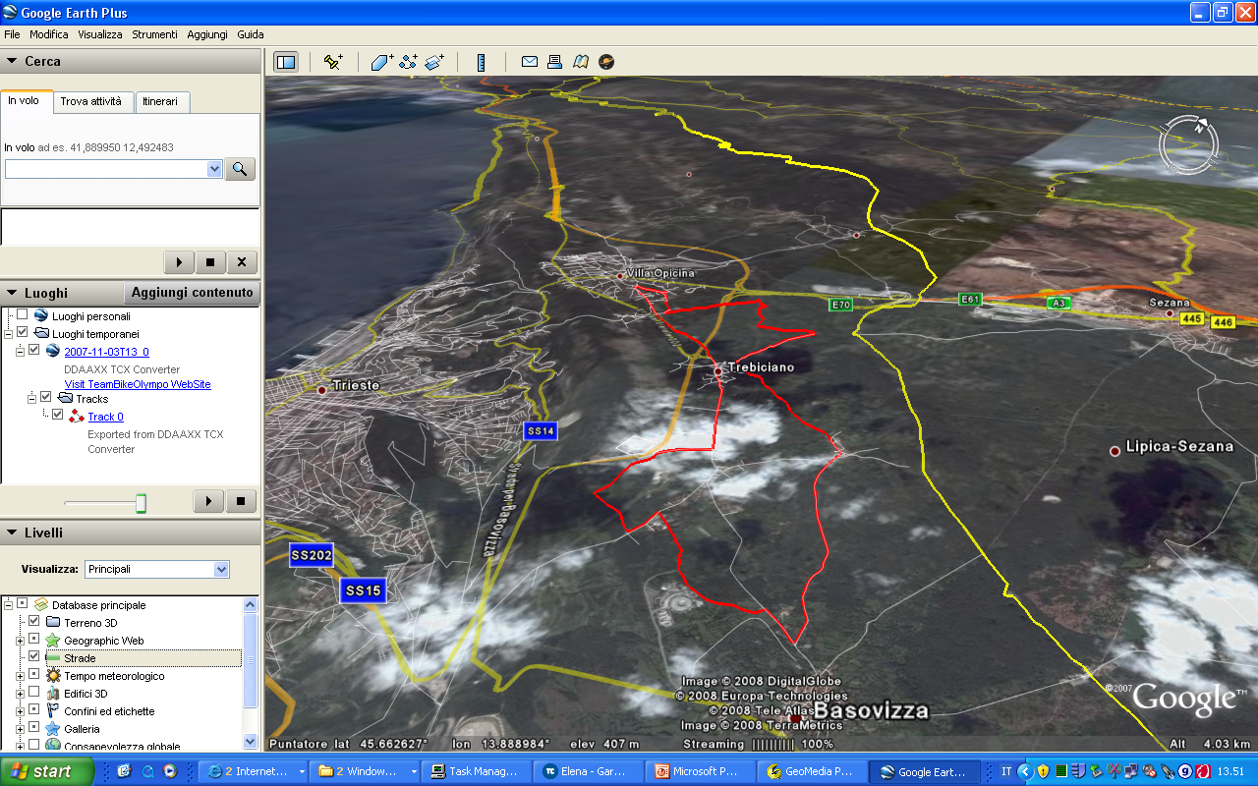
Geography at your fingertips
…geographical data and 3D mapping…

Slide 11
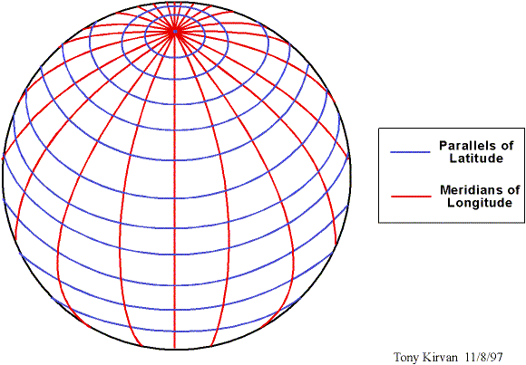
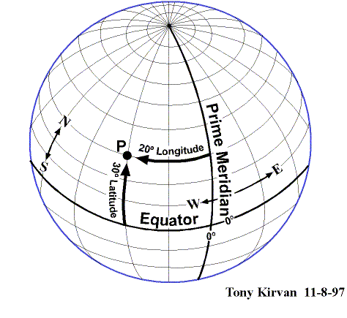
Position on Earth
Latitude and Longitude
Greenwich Meridian
λ = 0
P
O
φ
Equator
φ = 0
λ

Slide 12
Elipsoid
Major Axis
b semiaxis minor
a semiaxis major
f (flattening) = (a-b)/a
Minor
Axis
Ellipsoid = solid obtain by rotating an ellipse around its minor axis

Slide 13
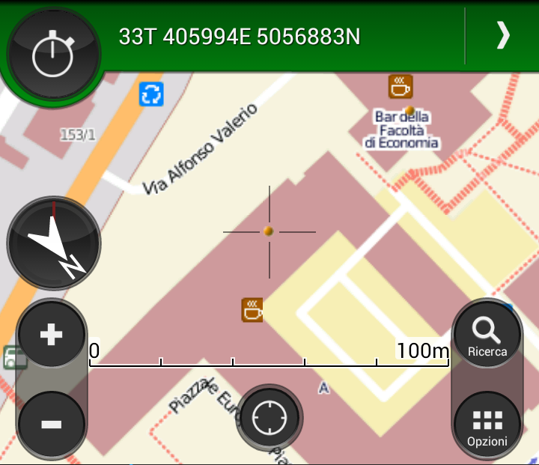
Where are we now?
University of Trieste, P.le Europa, 1 34127 Trieste, Italy, «A» Building, Room N.
N 45° 39’ 32,9’’; E 13° 47’ 36,1’’

Slide 14
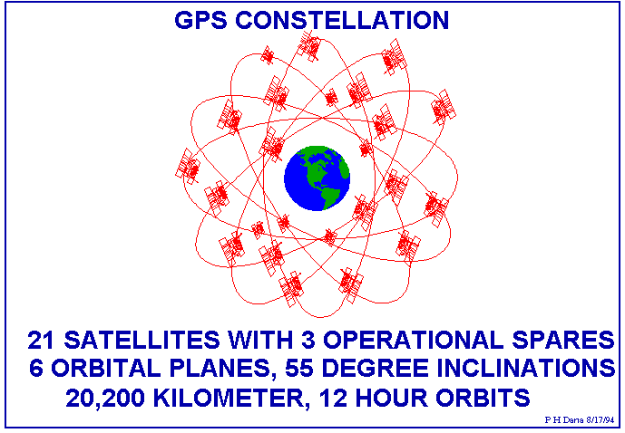
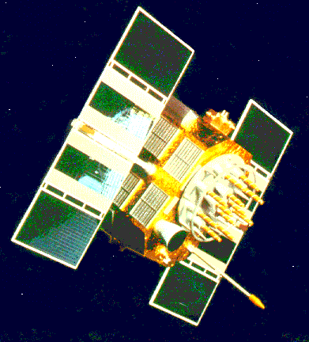
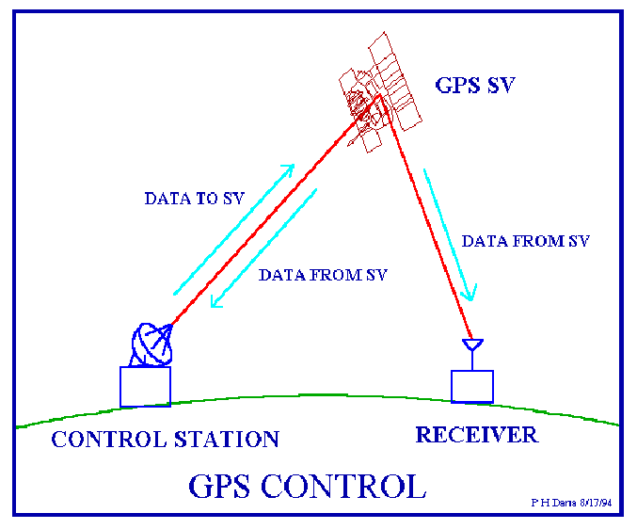
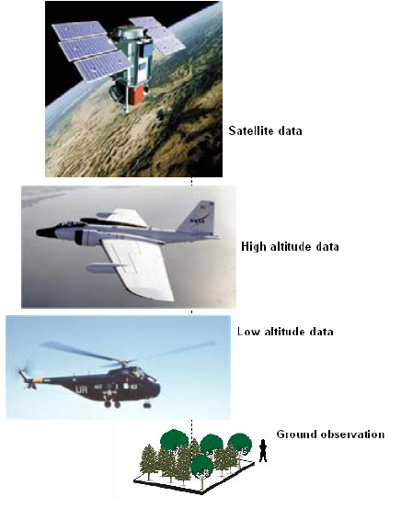
The geospatial technologies
GNSS (Global Navigation Satellite System).
GPS = Global Positioning System:
  Satellites to determine position on Earth (=coordinates)
  Constellation of satellites in orbit arount the Earth broadcasting their position
  4 satellites to determine positions of receivers
Remote Sensing:
Remote sensing: the science (the set of knowledge and technologies) for acquiring information concerning the Earth’s surface and its environment without being in direct contact with it).
It is referred to the process of data collecction by means of sensing and registering the electromagnetic energy, usually using aircraft and satellite mounted sensors.
When sensors are mounted on satellites, signals are transmitted to receiver stations on Earth where they are transformed in digital images.
Main satellite images: Ikonos, Landsat

Slide 15
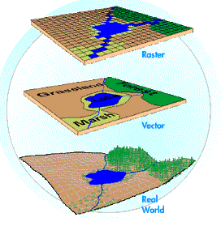
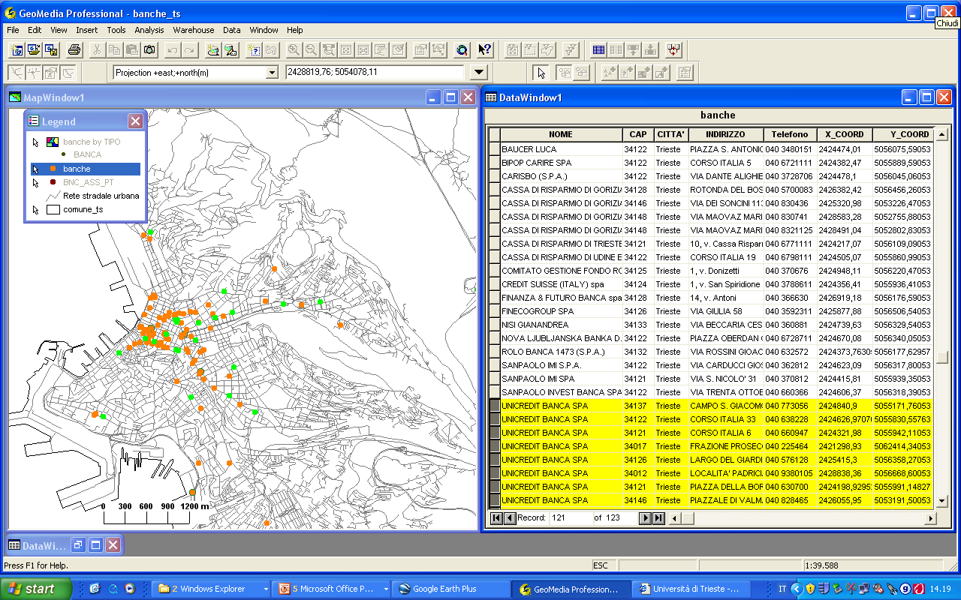
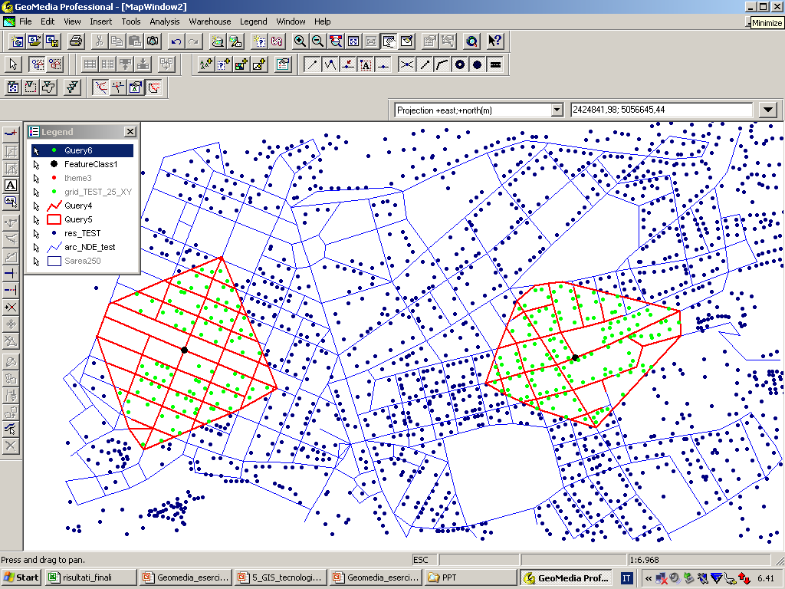
The geospatial technologies
A GIS is a an information system that allow:
  collecting;
  modelling;
  handling;
  retrieval;
  analysis
  of geographically referred data (georeferenced)
GIS:
  Organizes geographical information in different themes (points, lines or areas);
  Link each geographic element with information
  (attribute data) on the characters
  of the element and its geographical position (in coordinates)
  Allows advanced analysis of databases and (geo)graphical components

Slide 16
Geography and ‘the crowd’
Wiki
VGI
Wiki is usually a web application which allows people to add, modify, or delete content in a collaboration with others. Text is usually written using a simplified markup language or a rich-text editor
The encyclopedia project Wikipedia is the most popular wiki on the public web in terms of page views
Volunteered geographic information (VGI) is the harnessing of tools to create, assemble, and disseminate geographic data provided voluntarily by individuals (Goodchild, 2007). Some examples of this phenomenon are WikiMapia, OpenStreetMap, and Google Map Maker. VGI can also be seen as an extension of critical and participatory approaches to geographic information systems^{[2]} and as a specific concern within online or web credibility.^{[3]} These sites provide general base map information and allow users to create their own content by marking locations where various events occurred or certain features exist, but aren’t already shown on the base map.
Rather than the map itself, the data generated by the OpenStreetMap project are considered its primary output. These data are then available for use in both traditional applications, like their usage by Craigslist, Geocaching, MapQuest Open, JMP statistical software, and Foursquare to replace Google Maps, and more unusual roles, like replacing default data included with GPS receivers.

Slide 17
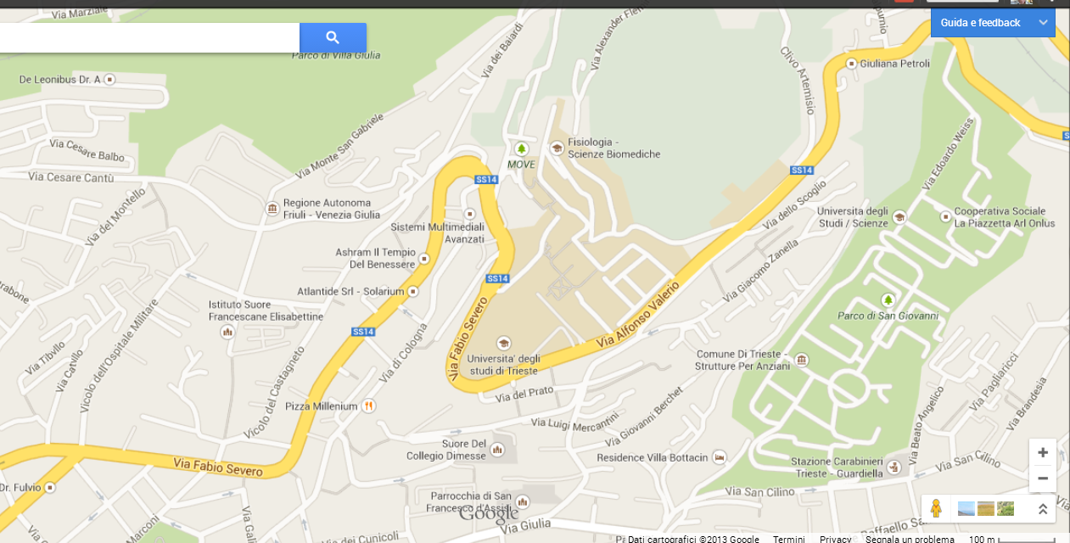
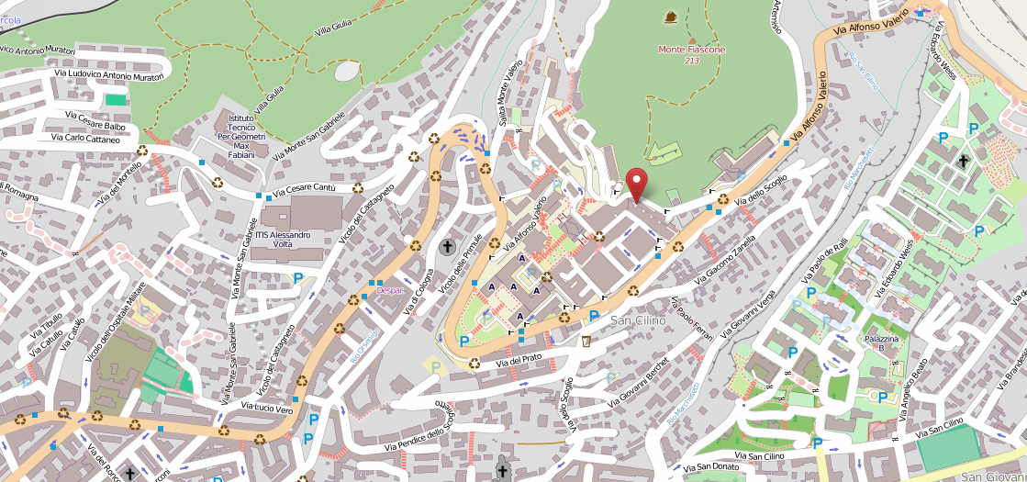
Google vs OpenStreetMaps
Trieste (Italy)

Slide 18
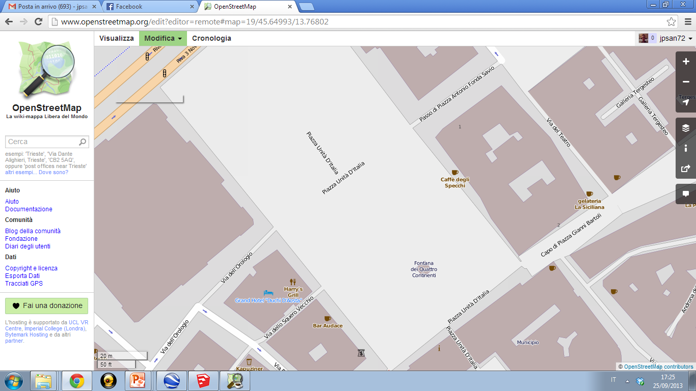

Slide 19
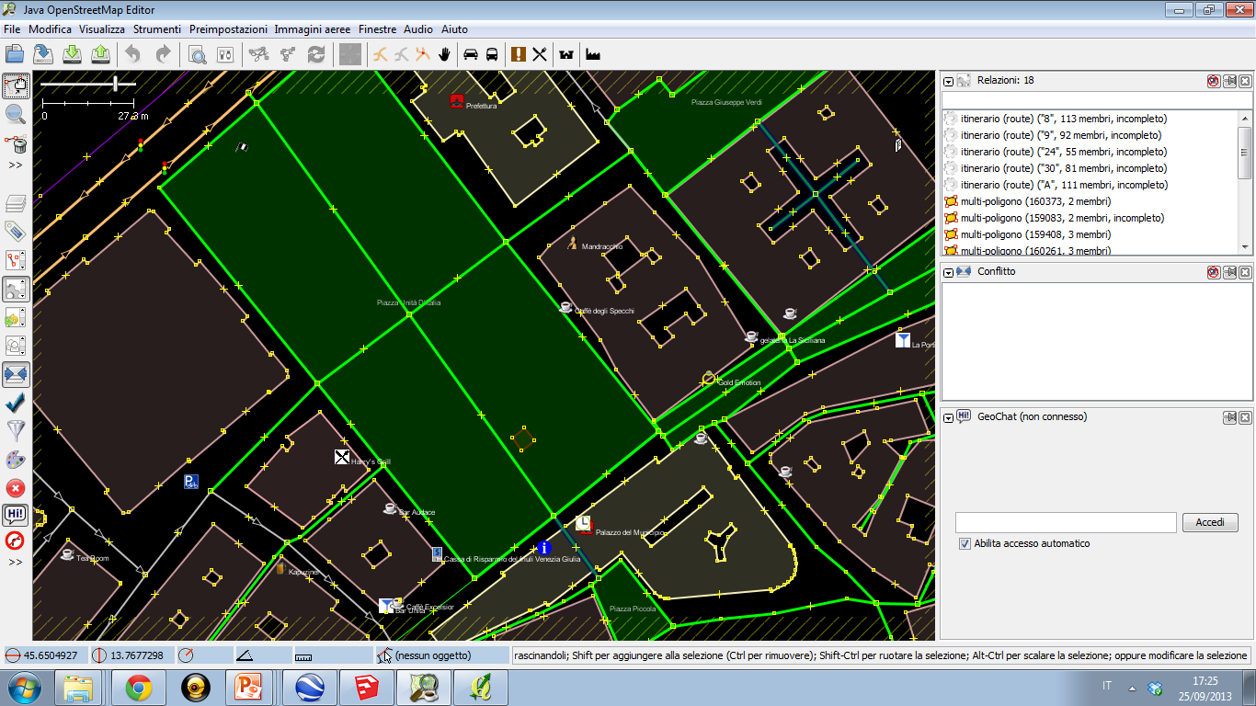

Slide 20
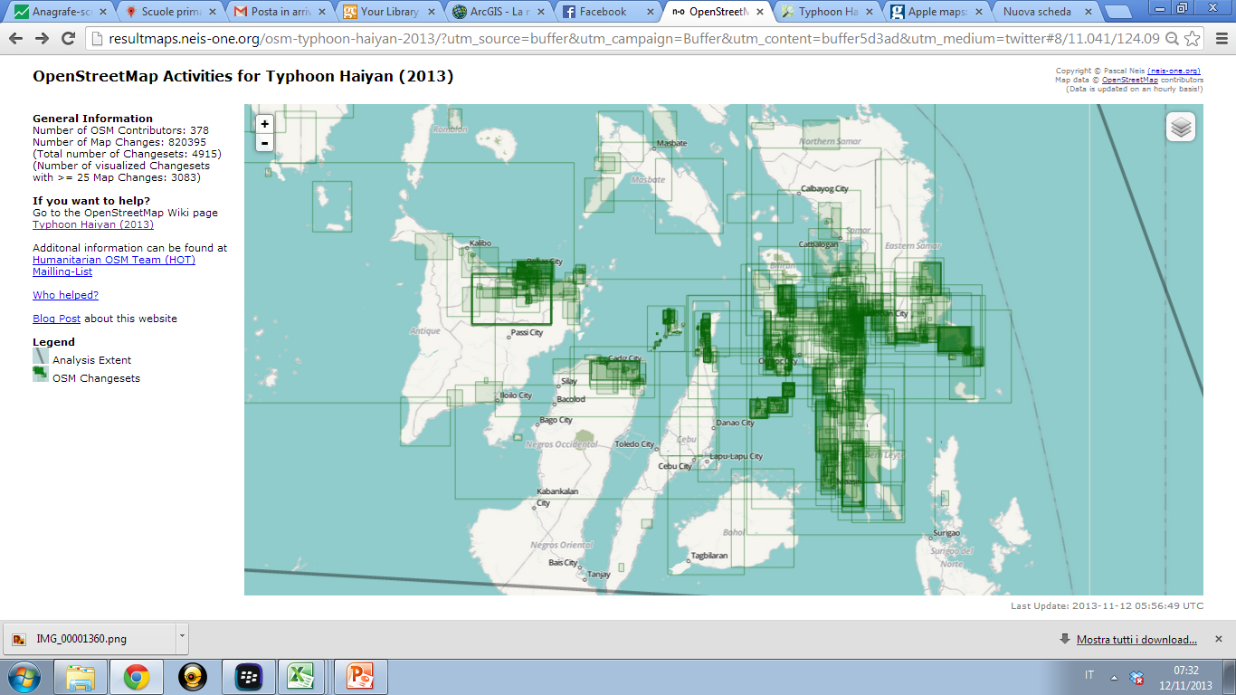
Neogeography: volunteers at work
http://resultmaps.neis-one.org/osm-typhoon-haiyan-2013/?utm_source=buffer&utm_campaign=Buffer&utm_content=buffer5d3ad&utm_medium=twitter#8/11.041/124.096
http://wiki.openstreetmap.org/wiki/Typhoon_Haiyan_%282013%29

Slide 21
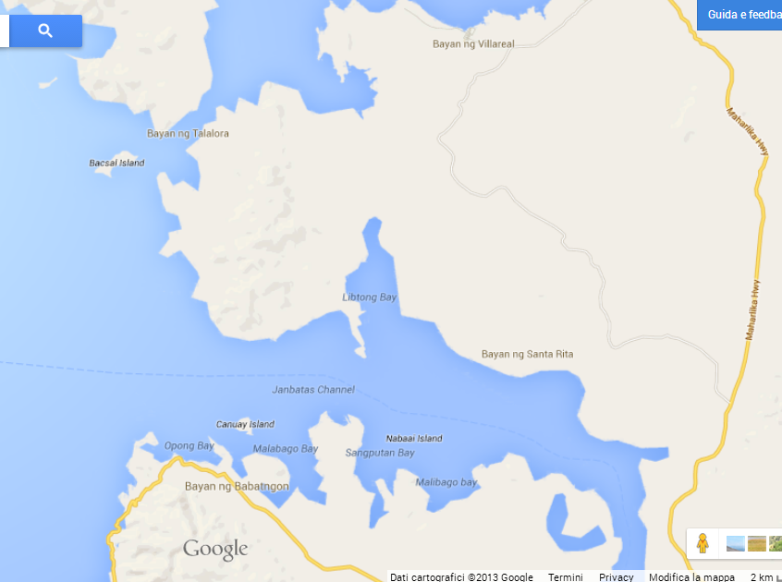
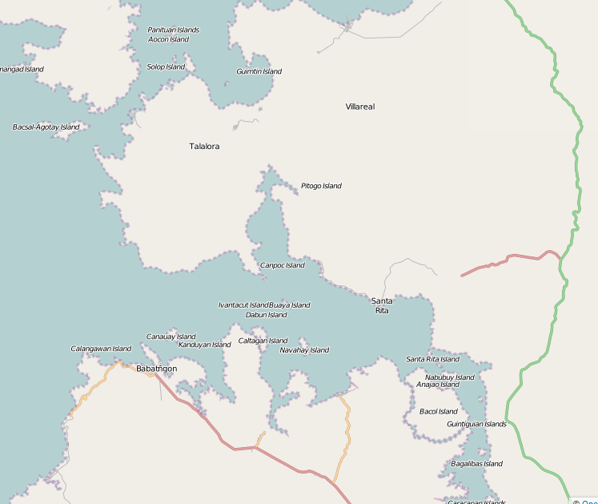
Google vs OpenStreetMaps
Philippines Islands

Slide 22
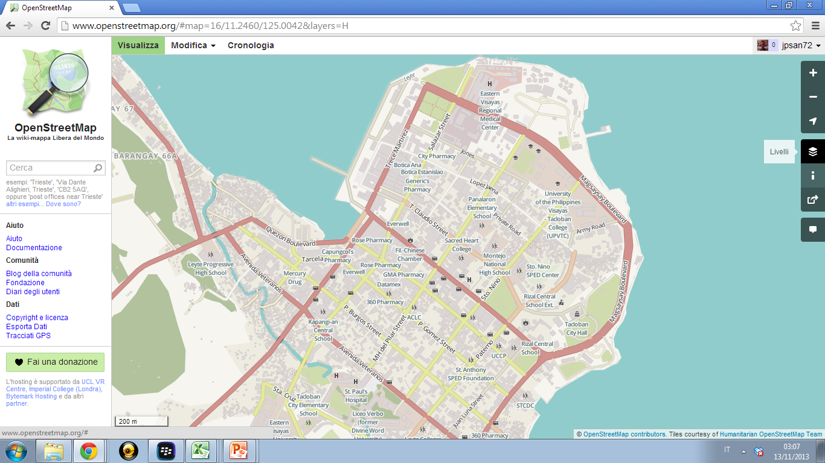

Slide 23
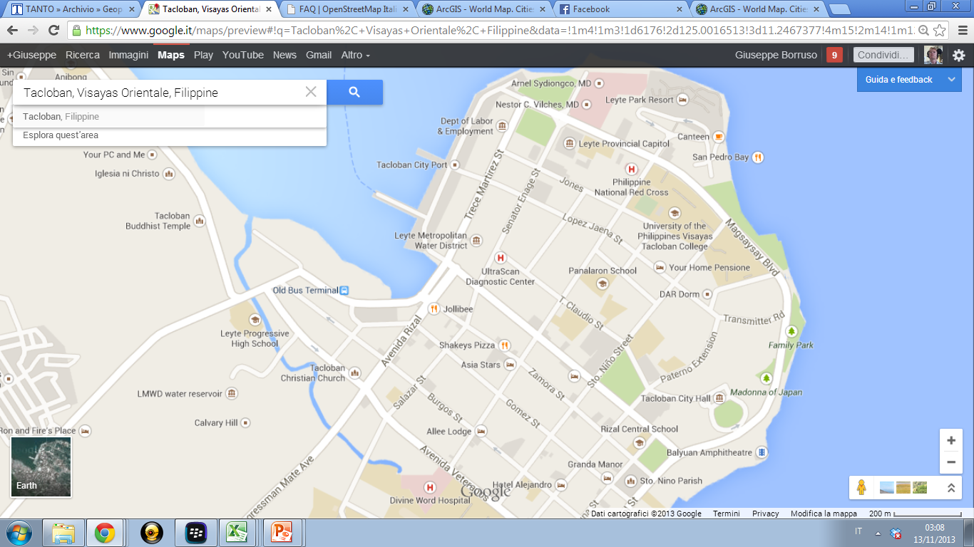

Slide 24
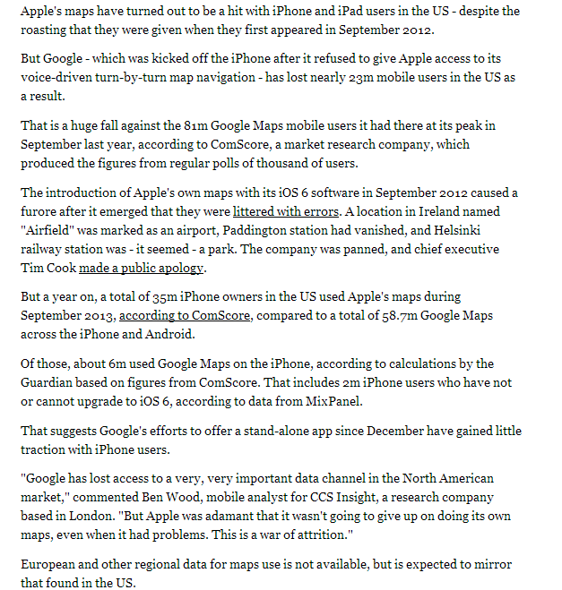
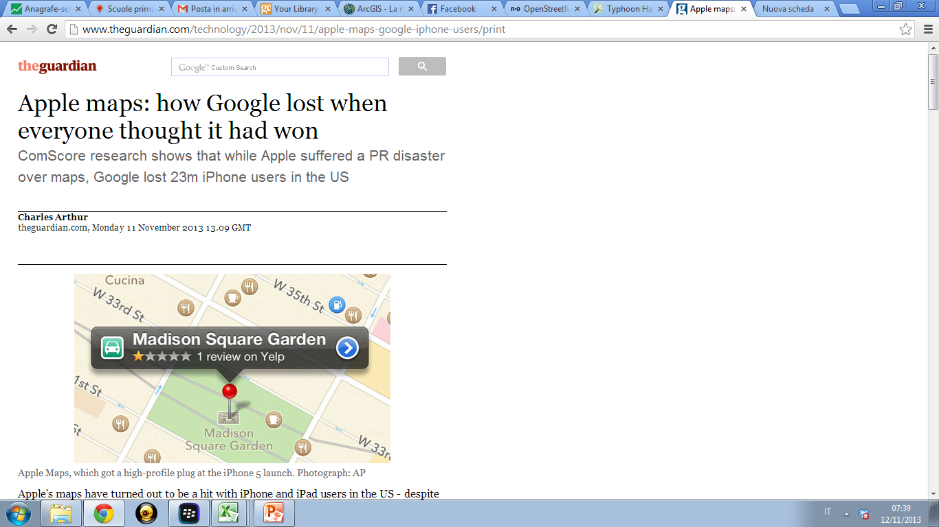
Maps in business
http://www.theguardian.com/technology/2013/nov/11/apple-maps-google-iphone-users

Slide 25

Maps in business
Impact of Geospatial Services
an Oxera report [What is the impact of geo?] estimates the revenues from global Geo services at $150 billion to $270 billion per year.
larger than estimates of the size of the video game industry,
generates around one-third of the annual revenue generated by the airline industry.
http://apb.directionsmag.com/entry/google-shares-oxeras-report-on-impact-of-geospatial-services-on-the-wo/306916

Slide 26
Geospatial tools
From desktop to browser
Websites for uploading and visualizing datasets with a geospatial component
Allowing simple data visualization and analysis
Examples:
  http://geocommons.com
  http://www.arcgis.com
  http://www.giscloud.com/
  https://mapsengine.google.com/map/

Slide 27
The Geospatial Revolution
GI technologies according to Penn State University
http://geospatialrevolution.psu.edu/episode1/complete
http://geospatialrevolution.psu.edu/episode2/complete

Slide 28
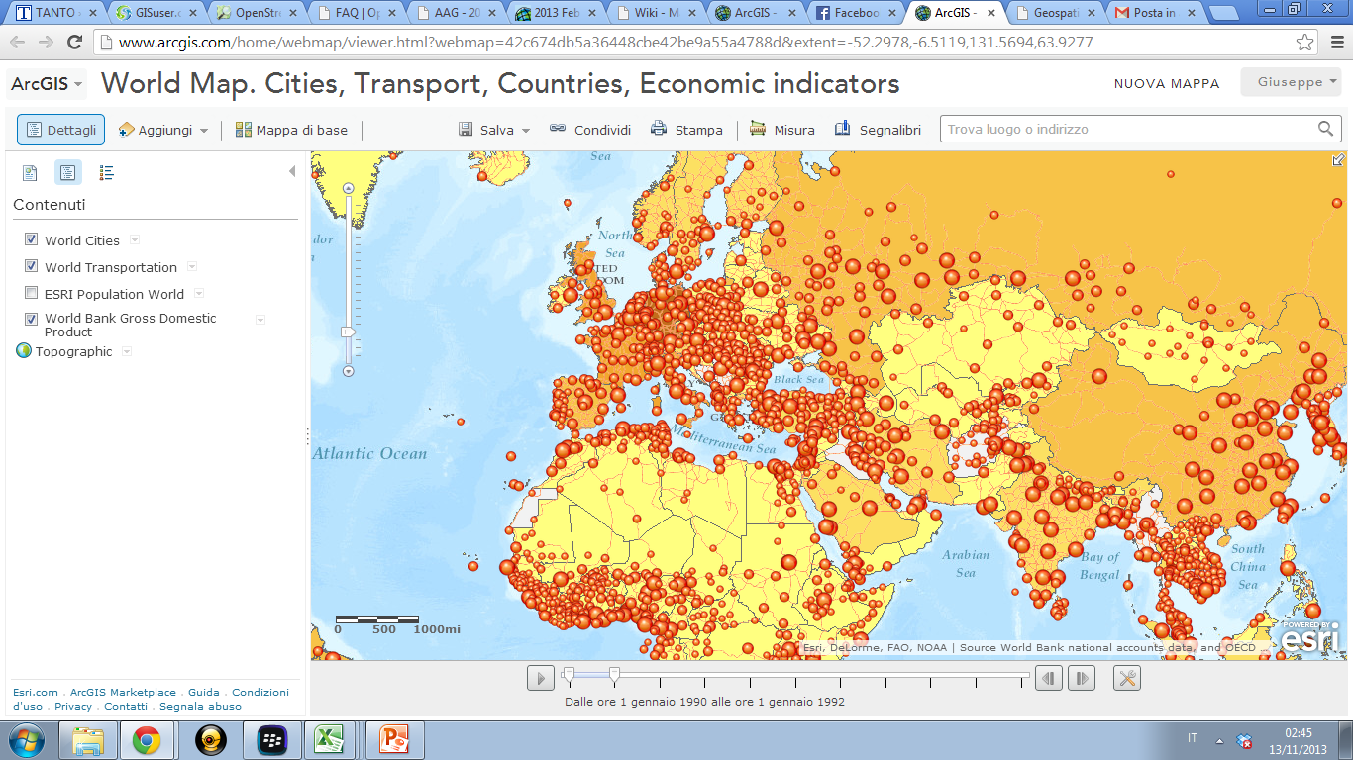
Playing with (on-line) maps http://t.co/0C3L8lf9vJ

Slide 29
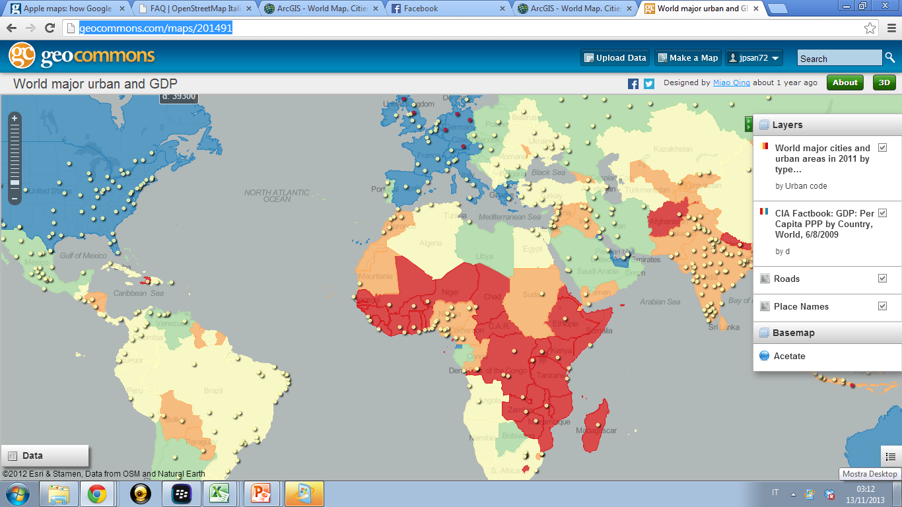
Playing with (on-line) maps http://geocommons.com/maps/201491

Slide 30
Selected References
BURROUGH P. A. - MCDONNELL R. A., Principles of Geographical Information Systems, Oxford University Press, Oxford, 1998.
EUROPEAN COMMISSION, Panel – GI: Pan European link for Geographical Information, 2000. *
GOODCHILD M. F., What is Geographic Information Science?, NCGIA Core Curriculum in GIScience, http://www.ncgia.ucsb.edu/giscc/units/u002/u002.html, posted October 7, 1997.**
LONGLEY P. A. - GOODCHILD M. F. - MAGUIRE D. J. - RHIND D. W., Geographic Information - Systems and Science, Wiley, Chichester, 2001***
McGUIRE D., An overview and definition of GIS, in Goodchild M., McGuire D., Rhind D., Geographic Information Systems, Wiley, 1991, pp. 9 – 20 **
O’ SULLIVAN D., UNWIN D.J., Geographic Information Analysis, Wiley, London, 2003 ****
WORBOYS M. F., DUCKHAM M., GIS - A Computing Perspective, CRC Press, London, 2005.
* Available on the Web. Website to be communicated.
** Available in download area of the Master course
*** Chapters from the first edition of the ‘Big Book’ (Goodchild M., McGuire D., Rhind D., Geographic Information Systems, Wiley, 1991) are available at http://www.wiley.com/gis
Selected chapters are also available in the download area of the Master course
**** Chapter 1 available in download area of the Master course

Slide 31
Links
https://esrimedia.maps.arcgis.com/apps/Minimalist/index.html?appid=f3fc8d5650e64a7a8a5cc6490326f3e1
https://www.arcgis.com/home/webmap/viewer.html?webmap=df8bcc10430f48878b01c96e907a1fc3
https://www.usgs.gov/products/data-and-tools/real-time-data/wildfire
https://esrimedia.maps.arcgis.com/apps/Minimalist ndex.html?appid=f3fc8d5650e64a7a8a5cc6490326f3e1

Slide 32
Link
https://www.ushahidi.com/
https://earthdata.nasa.gov/earth-observation-data/near-real-time/download-nrt-data#ed-modis
https://www.arcgis.com/home/webmap/viewer.html?webmap=df8bcc10430f48878b01c96e907a1fc3
https://esrimedia.maps.arcgis.com/apps/Minimalist/index.html?appid=f3fc8d5650e64a7a8a5cc6490326f3e1
https://www.oxera.com/Latest-Thinking/Publications/Reports/2013/What-is-the-economic-impact-of-Geo-services.aspx
https://www.ons.gov.uk/help/localstatistics
http://ec.europa.eu/eurostat/web/gisco/geodata
http://ec.europa.eu/eurostat/statistics-explained/images/d/da/Gross_domestic_product_%28GDP%29_per_inhabitant%2C_in_purchasing_power_standard_%28PPS%29%2C_by_NUTS_2_regions%2C_2010.png
http://ec.europa.eu/eurostat/web/gisco/geodata/reference-data/population-distribution-demography

