Slide 1
Mechanical interaction

Slide 2
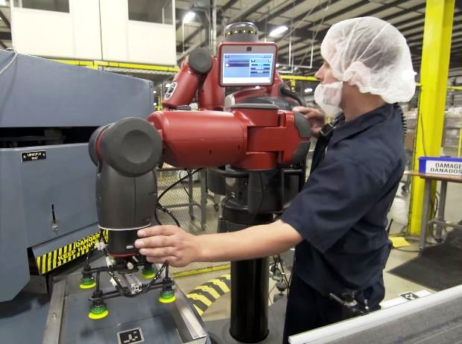
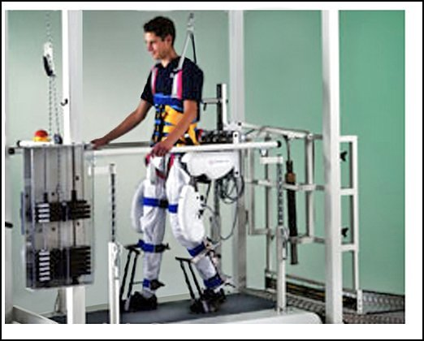
Examples of machine mechanically interacting with humans
https://www.youtube.com/watch?v=tlgKsTMmywk
https://www.youtube.com/watch?v=-EdfmoVBR5k

Slide 3
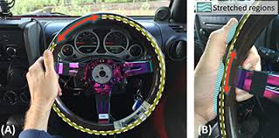
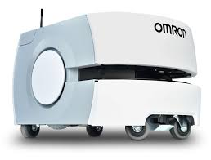
https://www.youtube.com/watch?v=hVt0w68kMgc
https://www.youtube.com/watch?v=v_1w4x4bMpA

Slide 4
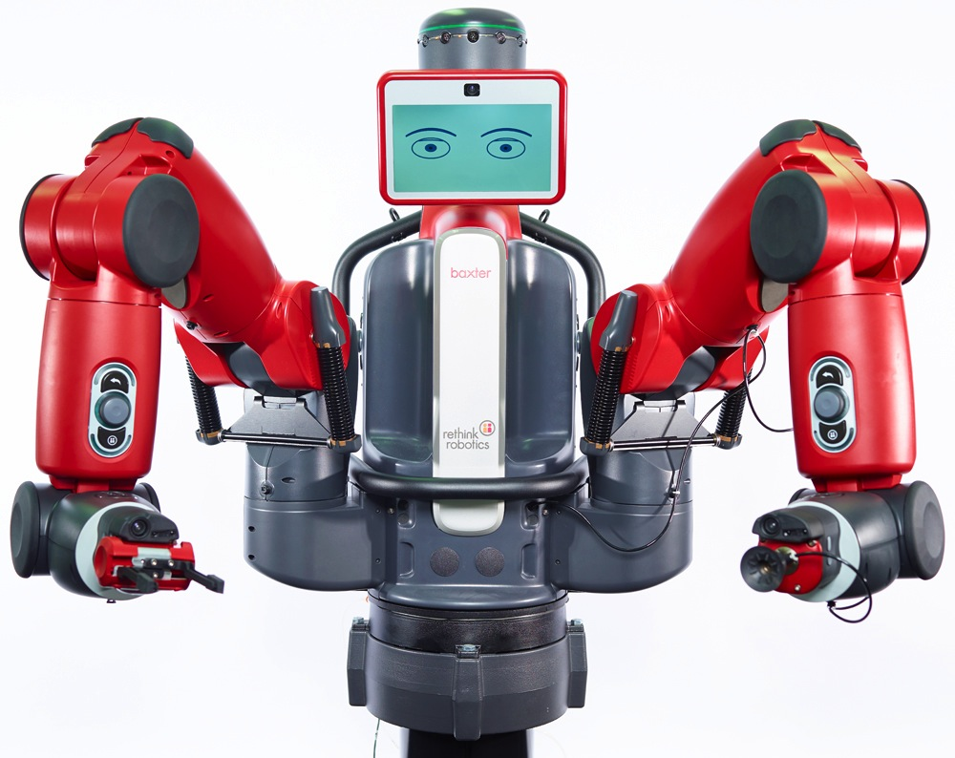
Bakster robot
https://www.youtube.com/watch?v=gXOkWuSCkRI&t=95s
https://www.youtube.com/watch?v=FJJe8PXEUhk

Slide 5
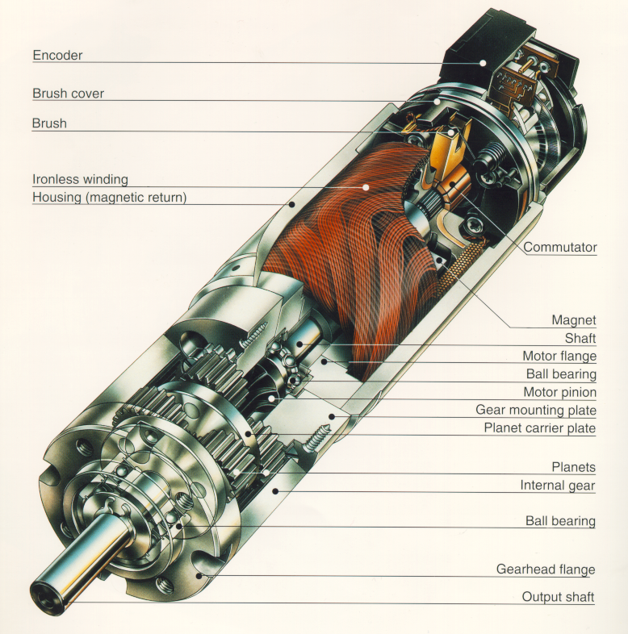
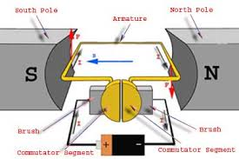
DC-Motors
simple, cheap
easy to control
1W - 1kW
can be overloaded
brushes wear

Slide 6
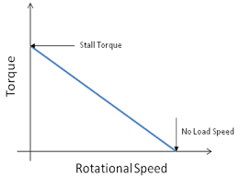
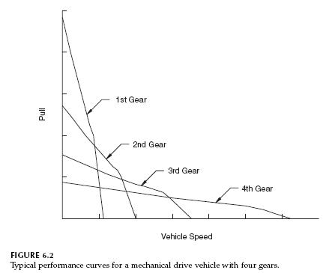
Effect of gearbox
Load curve
$$\frac{ω2}{ω1}=τ=gear ratio<1$$
$$\frac{Torque2}{Torque1}=\frac{1}{τ}=1/gear ratio>1$$

Slide 8
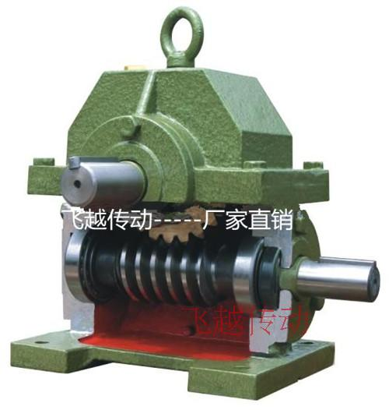
$$\frac{ω2}{ω1}=τ=gear ratio$$
$$\frac{Torque1}{Torque2}=τ=gear ratio$$
$$ω2$$
$$ω1$$

Slide 9
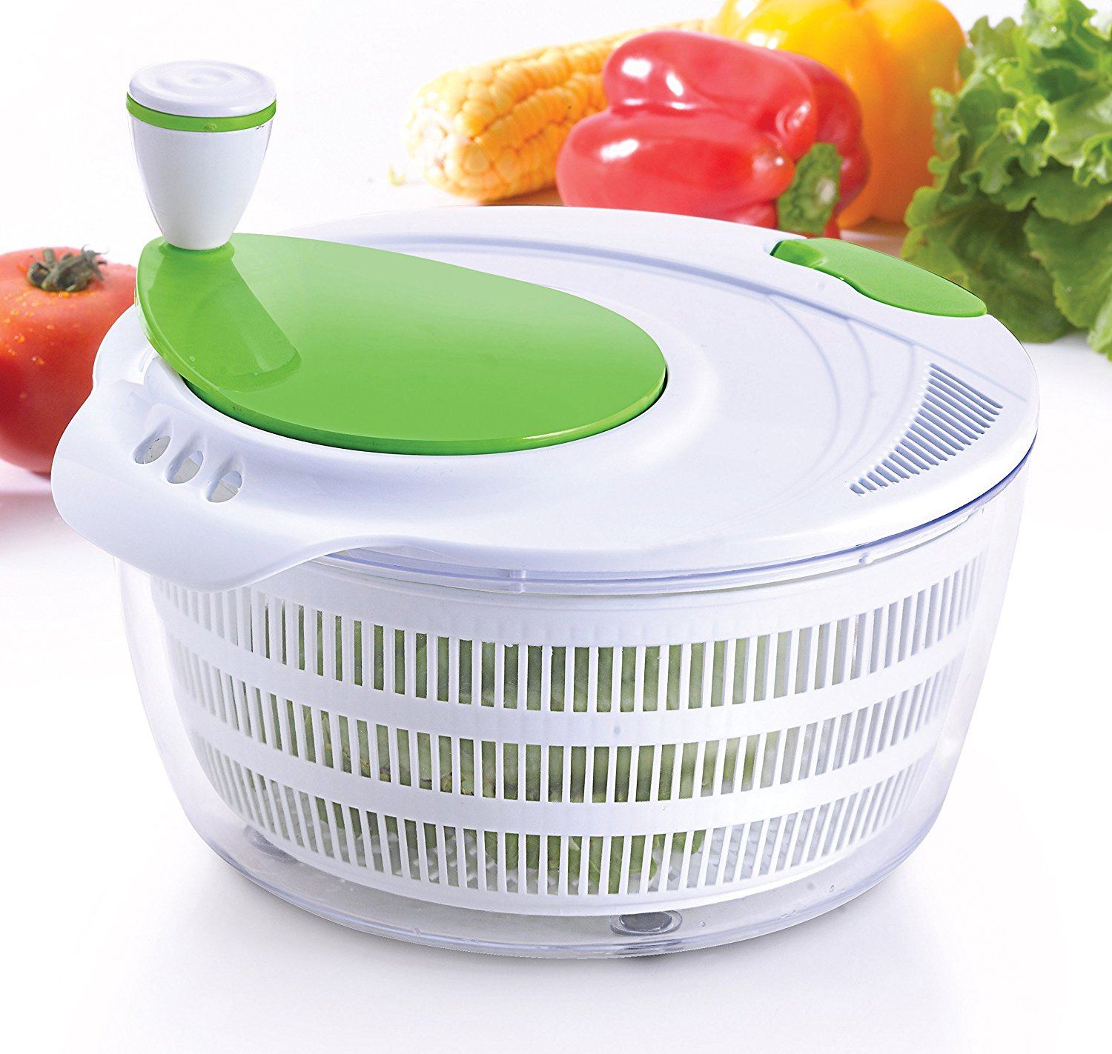
Example of a gear unit operating in reverse mode

Slide 10
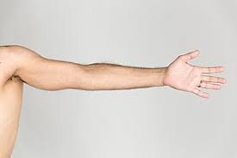
Class exercise: calculate the torque that must have an electric motor to lift a person's arm through a cable wrapped around a drum.

Slide 11
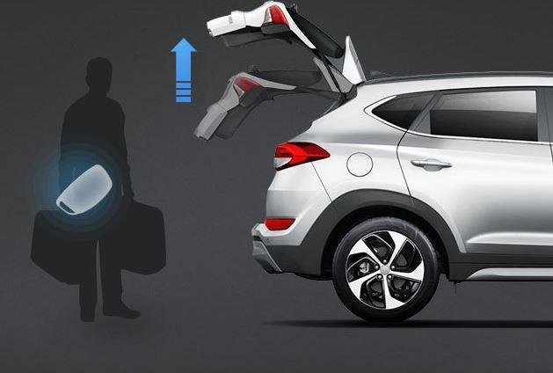
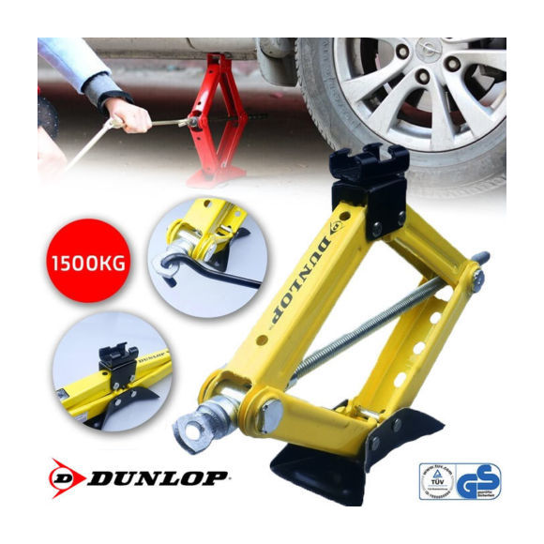
Reversible and not reversible
$$\frac{Torque2}{Friction Torque}=τ≫1$$

Slide 12
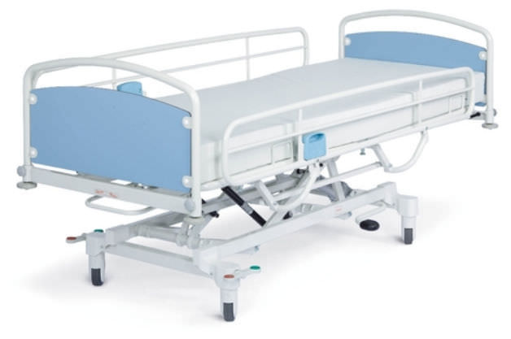
Class exercise: Assuming that the operating crank of a hospital bed has a friction torque of 0.3 Nm, and that the patient + bed weight is 100 kg, what should be the reduction ratio for the bed to be irreversible?

Slide 13
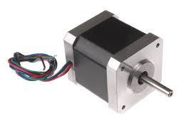
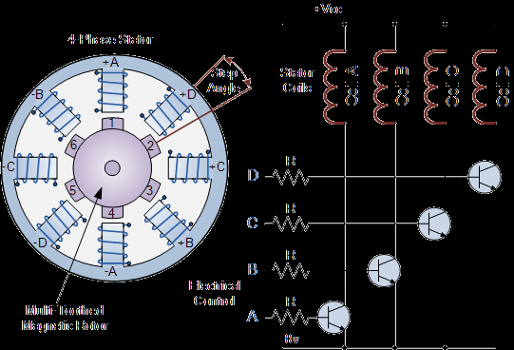
Step motor

Slide 14
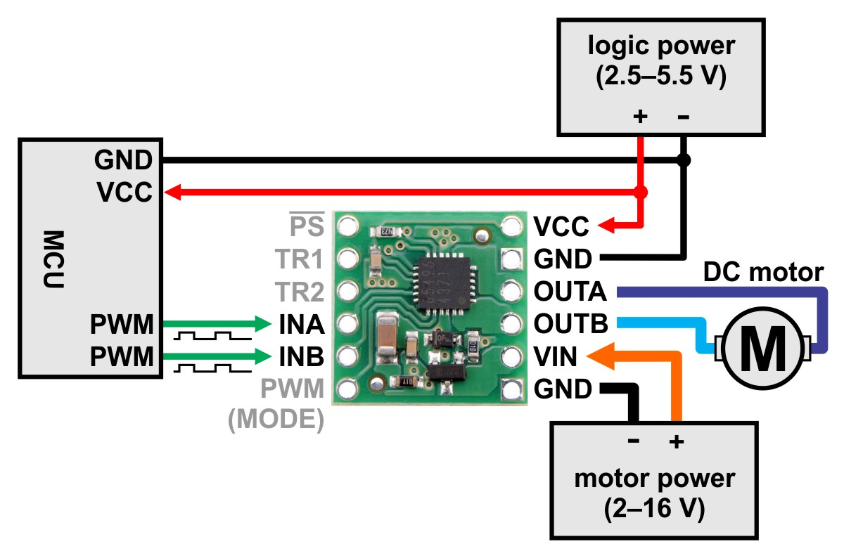
driver

Slide 18
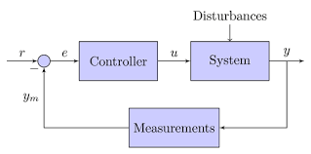
Control and feedback

Slide 19
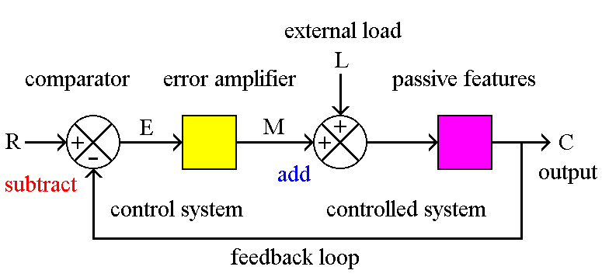
Error and other details

Slide 20
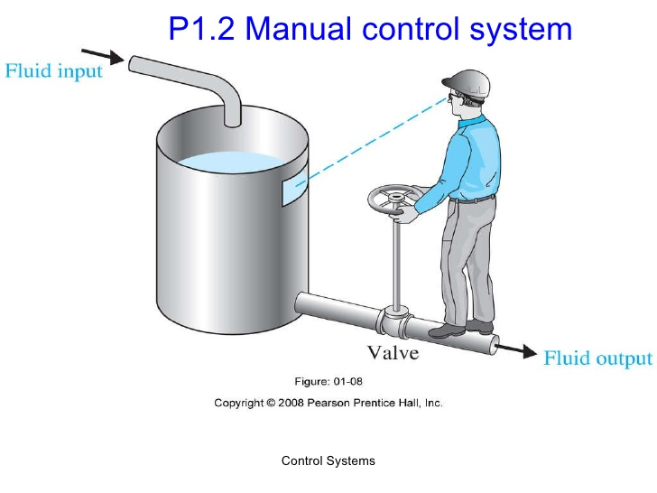
Example of a control system that replace a human operator

Slide 21
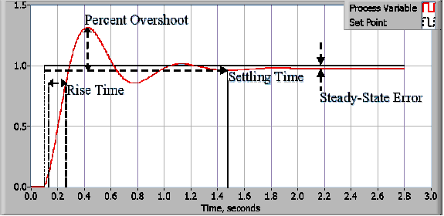

Slide 22
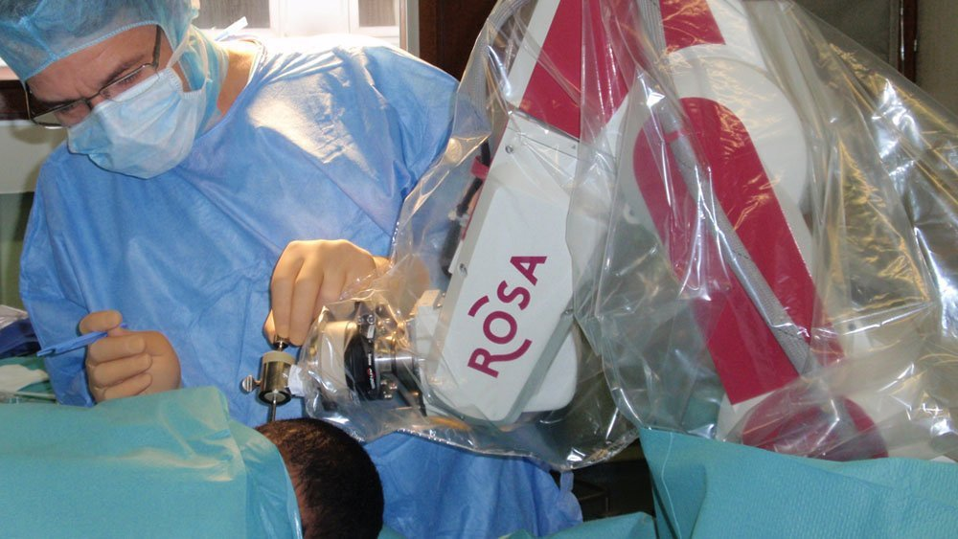
Overshoot problem :example of neurosurgical robot

Slide 23
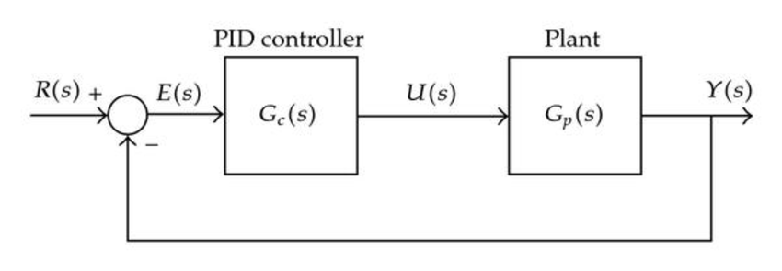
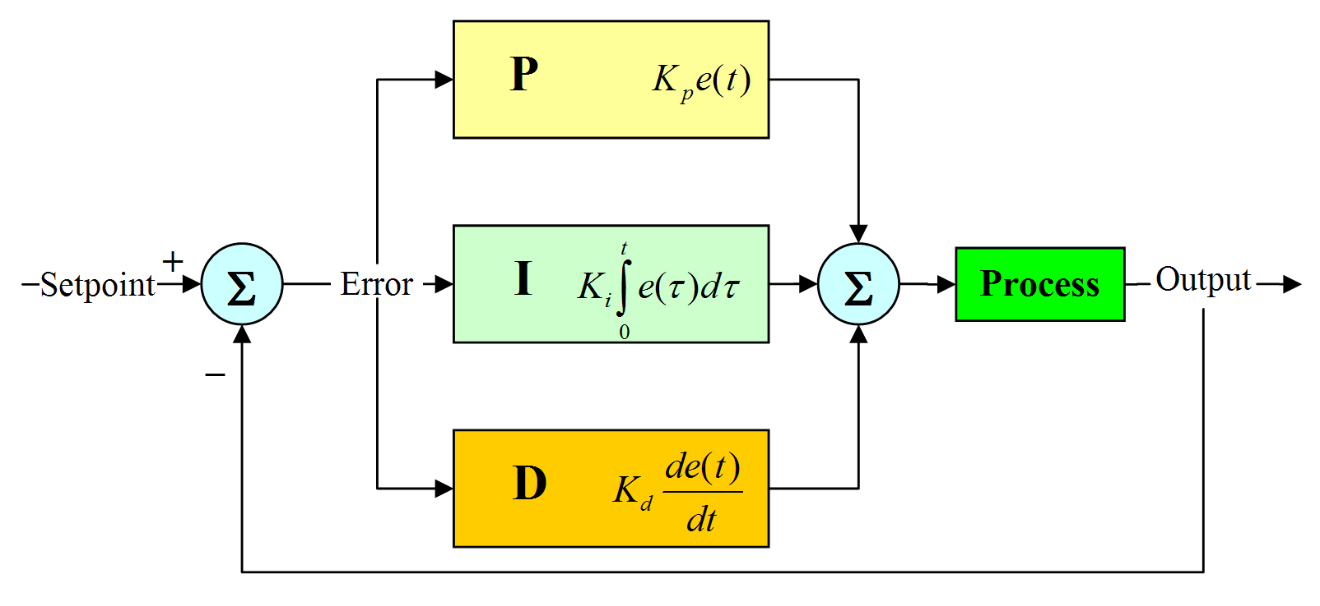
PID

Slide 24
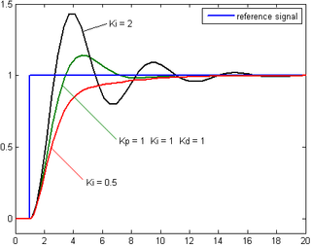

Slide 25
Example of PD model applied to neurorehabilitation

Slide 26
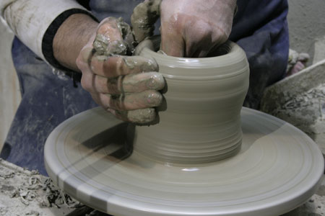
Stability
Example of instability in human-in-the-loop system

Slide 27
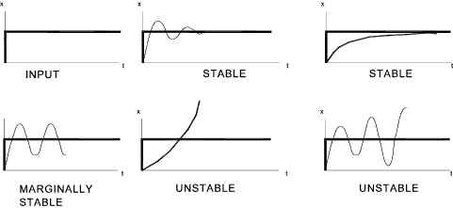
Stability
Trend and video

Slide 28
Show video on stability
Different behaviour of stability
https://www.youtube.com/watch?v=fusr9eTceEo

Slide 31
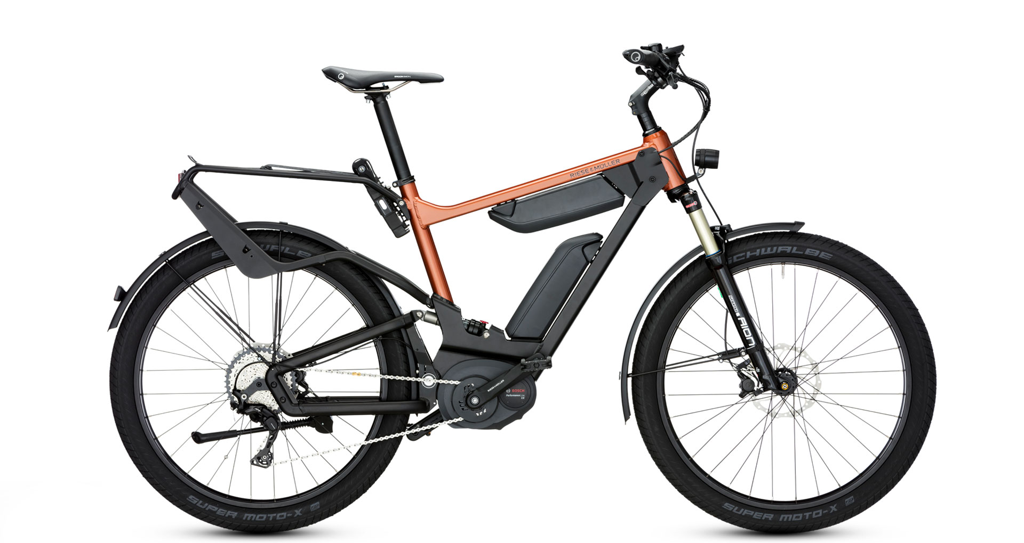
Force sensor (application: electric bike)
How is recorded the activity of the user?

Slide 32
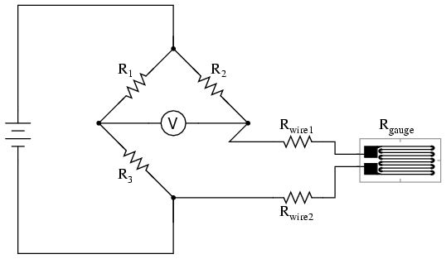
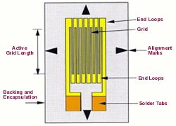
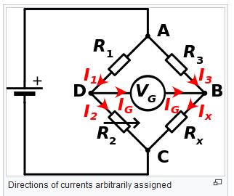
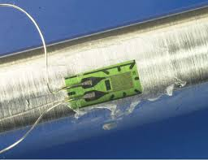
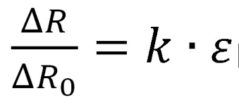
Strain gauge

Slide 33
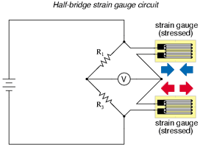
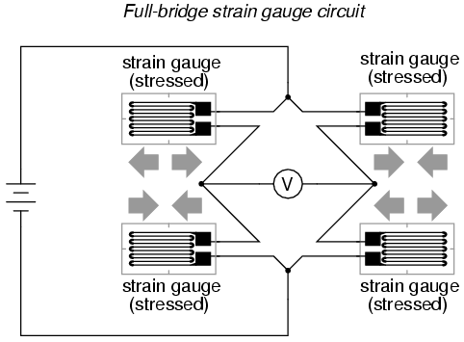
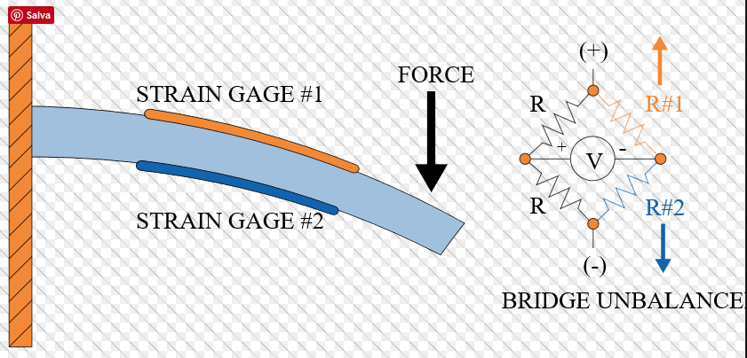
Half Bridge / full bridge

Slide 34
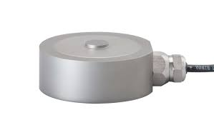
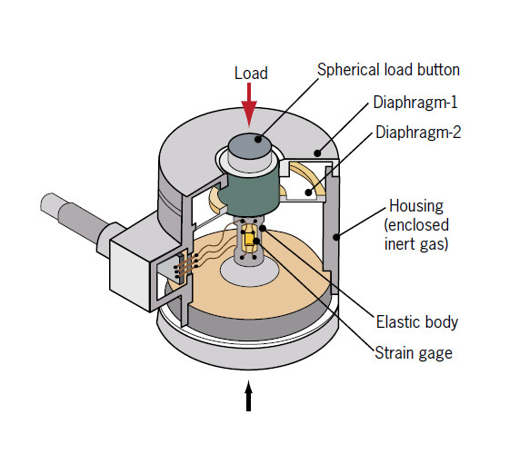
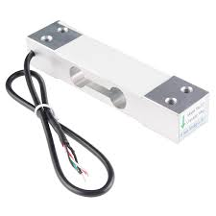
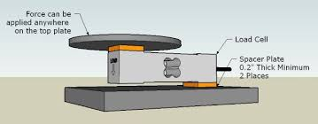
LOAD CELL

Slide 35
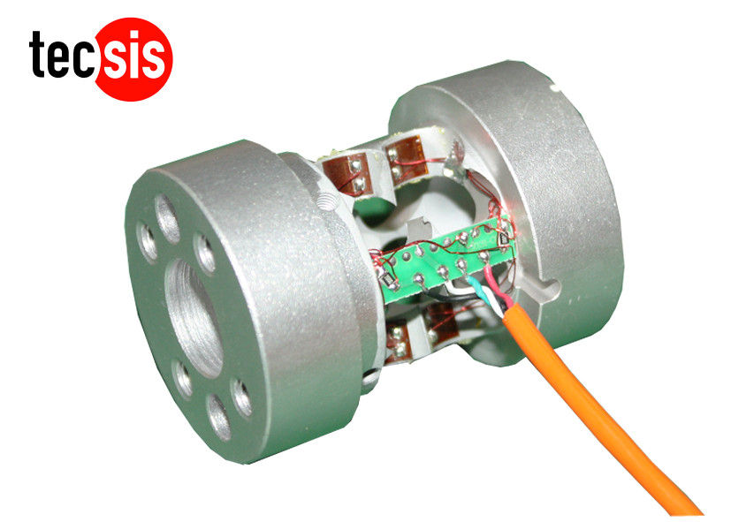
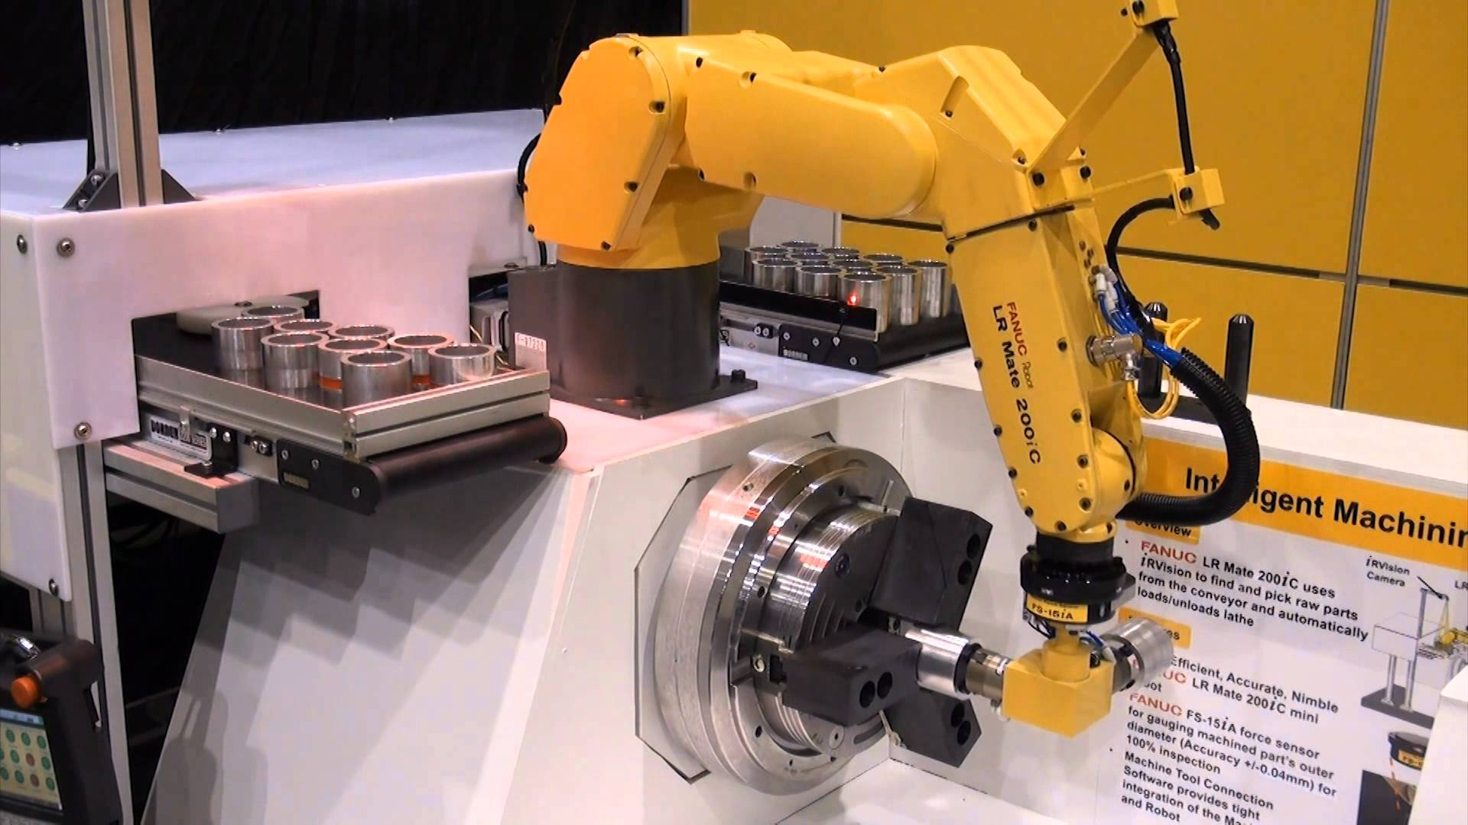
Robotic load cell
Example kuka: https://www.youtube.com/watch?v=Rvqq-OOtUkA

Slide 36
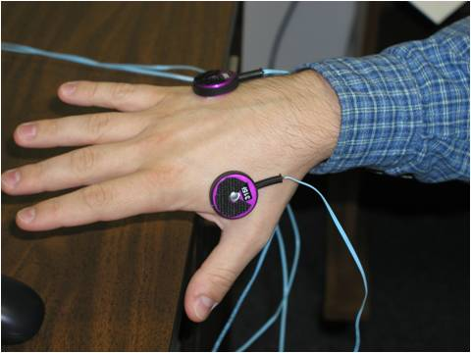
Vibrotactile

Slide 37
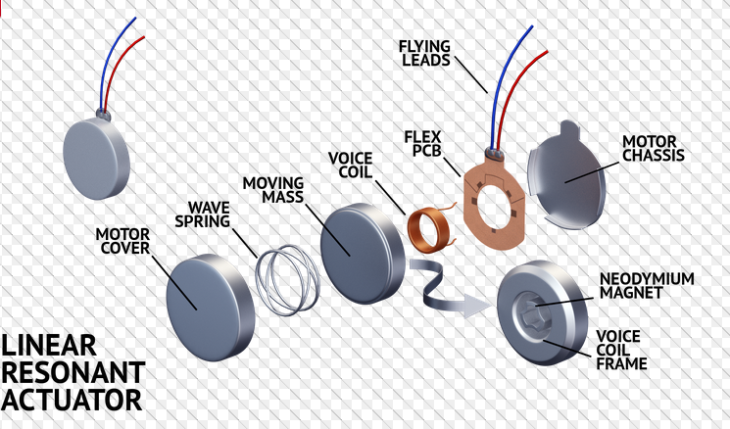
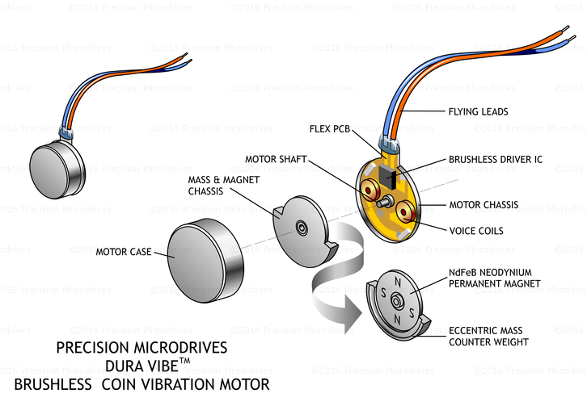
How they work

Slide 38
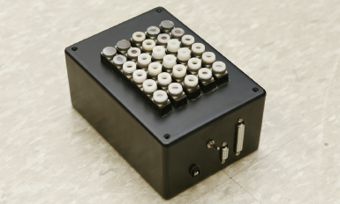
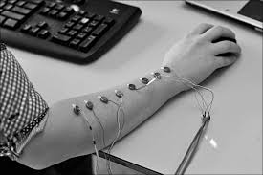
Application and configuration

Slide 39
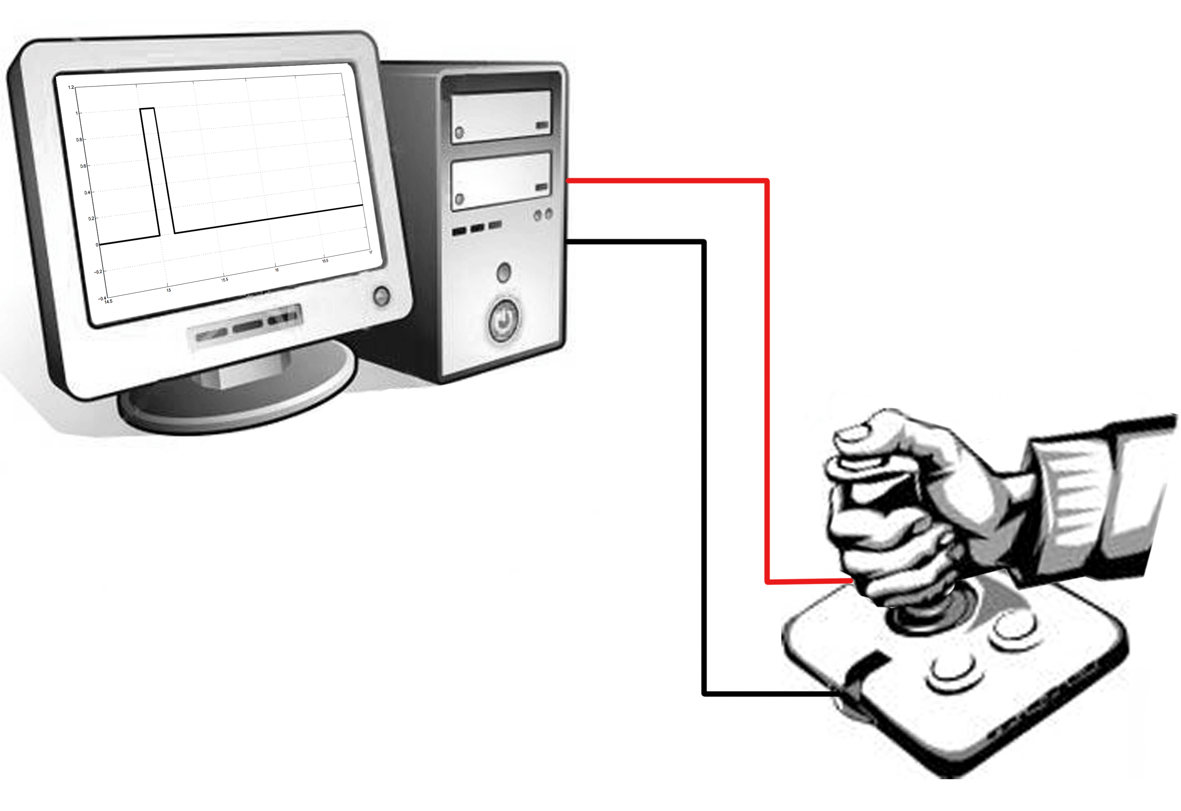
Joystick training by means of vibration prompts
Study and analysis of reaction times and accuracy during a training session
Development of a pratical training protocol for telemanipulation tasks

