Slide 1
Genoa International
Economic
Conference
April May 1922

Slide 2
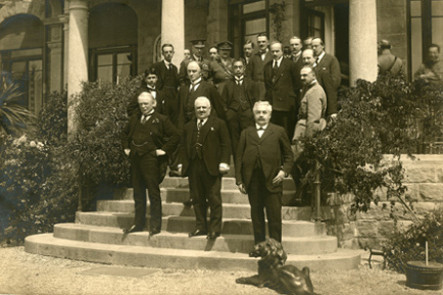
Genova Villa Raggio
The 1922 Genoa Conference, British Prime Minister Lloyd George on front row, left

Slide 3
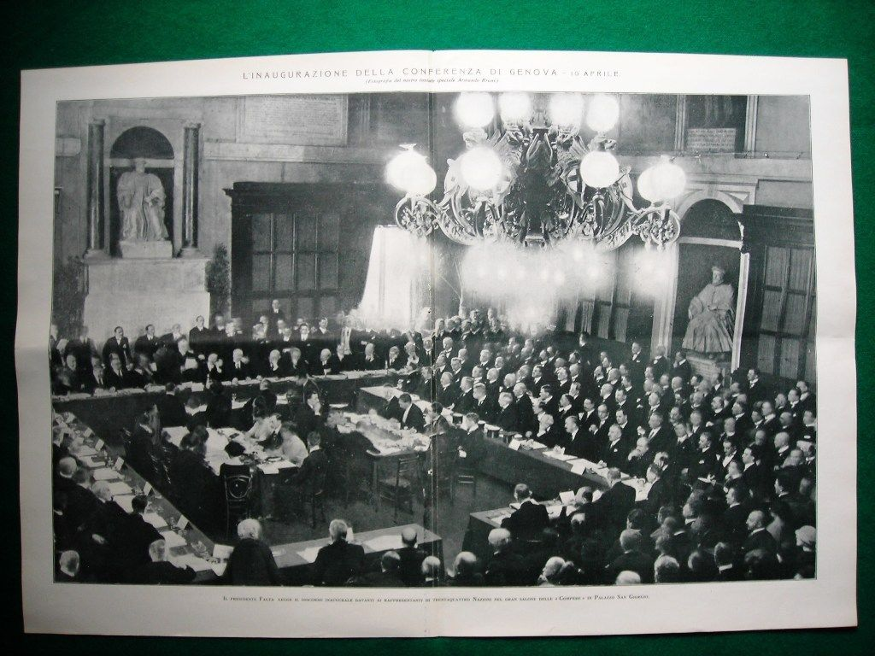

Slide 4
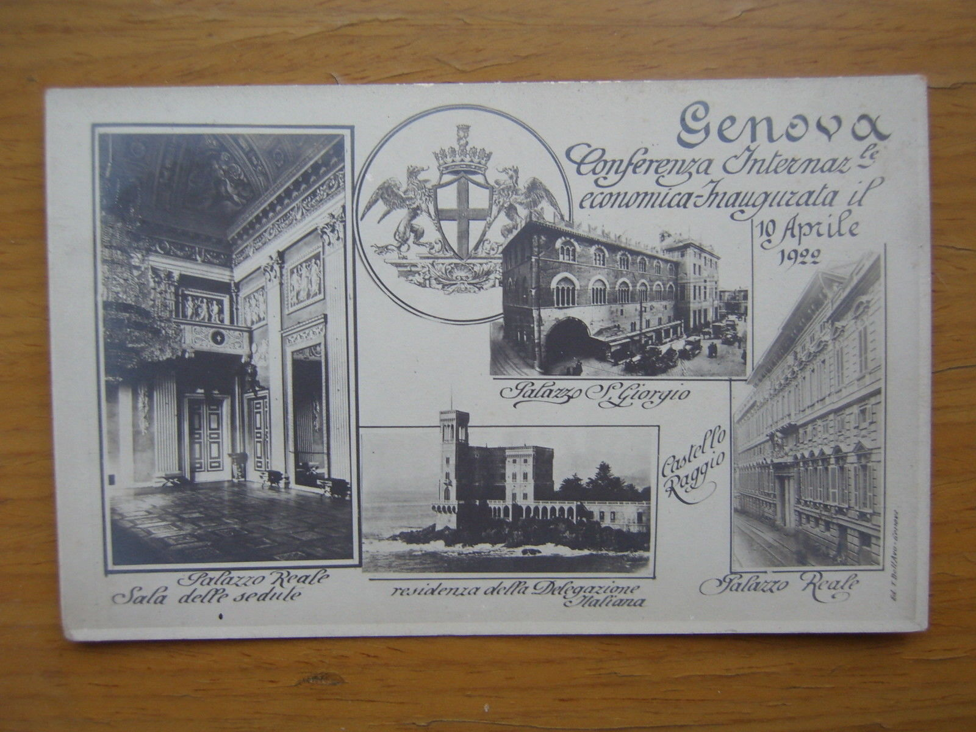

Slide 5
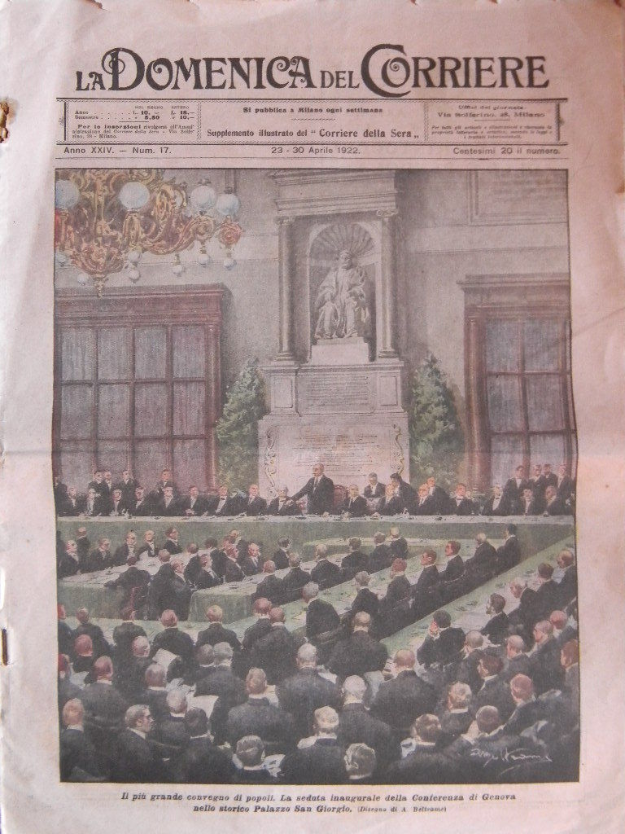

Slide 6
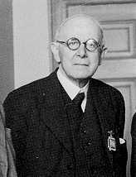
Ralph Hawtrey

Slide 13
