Slide 1
Human machine interaction
Paolo Gallina
pgallina@units.it
040 5583829
Ed. C5, first floor

Slide 2
Question
In which modes a machine interact with humans?

Slide 3
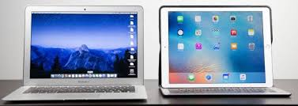
INTRODUCtION
Output:
Video
Audio
vibration
Examples of Interacting machines
Input:
Keyboard
Mouse
Eye tracking
Voice
Interface

Slide 4
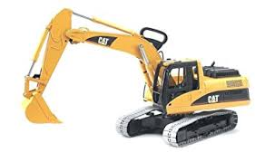
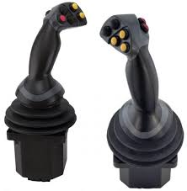
Interaction can be complex
Interface
Concept: - Degree of freedom (DoF)
DoFMapping

Slide 5
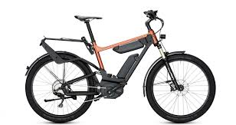
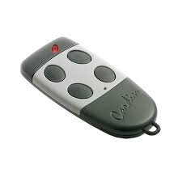
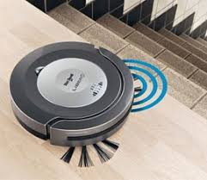
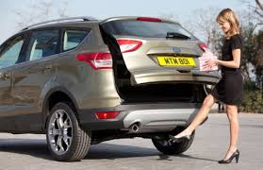
In every day life

Slide 6
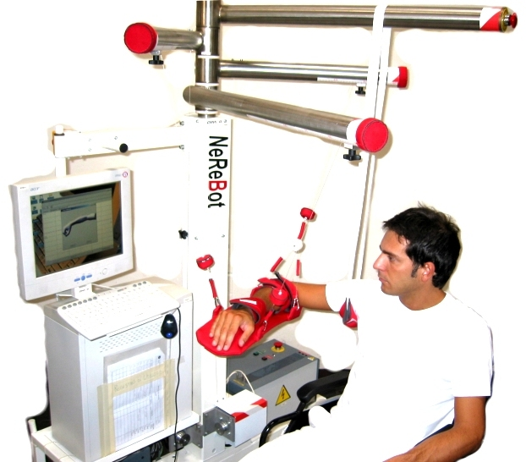
Examples

Slide 7
Exoscheleton examples
https://www.youtube.com/watch?v=2Ysb-Oko3Bg

Slide 8
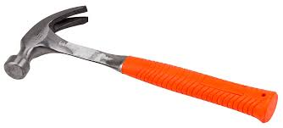
Even simple tools change the our brain (short term neuroplasticity phenomena)
Citare da «L’anima delle macchine, Dedalo ed.»
Collaborazione con Carlo Fantoni

Slide 9
Training
S-Curve or Sigmoid function

Slide 10
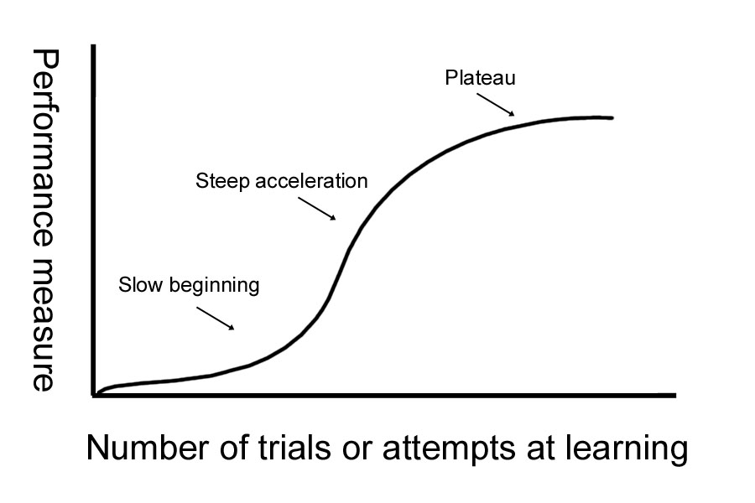
-With repetition of almost any motor task, learning occurs, and a person becomes more efficient
-measure of skill on the Y axis
and
number of trials on the X-axis
An S-shaped curve of growth levels off because stability is attained, a resource needed for growth is limited, or a ceiling of performance is reached.
Quantitative Assessment of Backhoe Operator Skill
(book)
See: Research methods in human-computer interaction
The S-shaped learning curve is most obvious when someone learns a highly complex task. The initial part of the curve rises slowly as a person becomes familiar with basic components of a skill. The steep ascending phase occurs when there is enough experience with rudiments or simple components to start "putting it all together."

Slide 11
Syllabus
ARGOMENTI | SUB-ARGOMENTI
Introduzione | Esempi di macchine interagenti
Strategie di progettazione | Usabilità e Human-centered interface
 | Human-centered interface, coadattamento
Interazione meccanica | Attuatori e riduttori
 | Sensori di forza
 | Sistemi vibrotattili
 | Controlli
 | Interfacce aptiche
Interazione visiva | visori e telecamere
 | realtà virtuale
 | realtà aumentata
Interazione sonora | sonificazione
Interazione uomo computer | interfacce grafiche
tecnologia indossabile
Tecnologia persuasiva | Macchine anti-edonistiche
 | Da tecnologia persuasiva
 | panoptico
Interazione uomo-robot | tamagotchi e Clifford Nass
 | cobot
 | uncanny valley
 | empatia artificiale
 | affective computing

Slide 12
FINAL TEST
3 questions about the program in class

