Slide 1
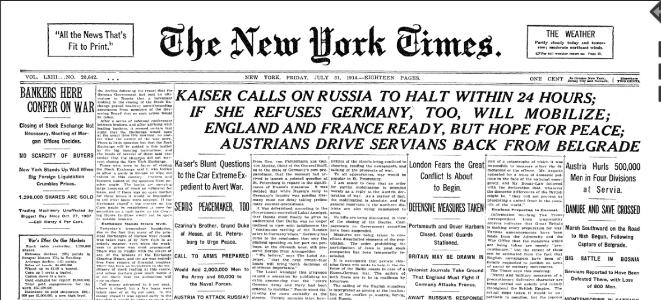

Slide 2
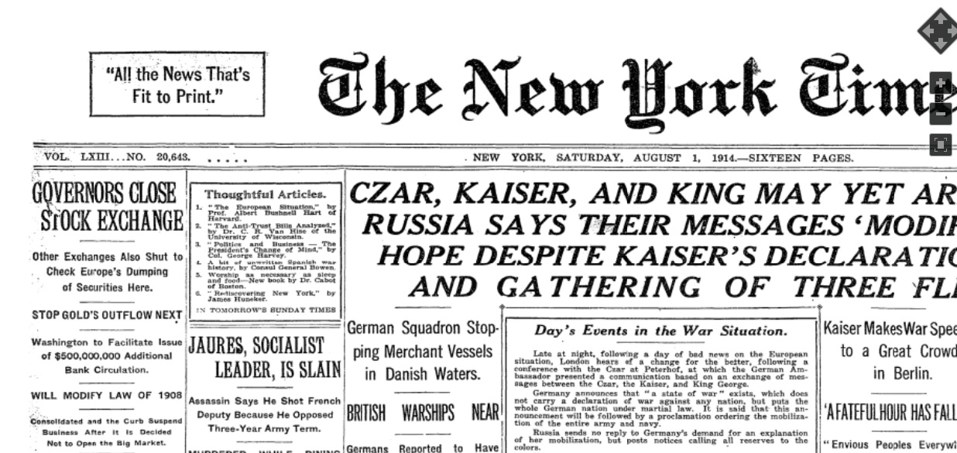

Slide 3

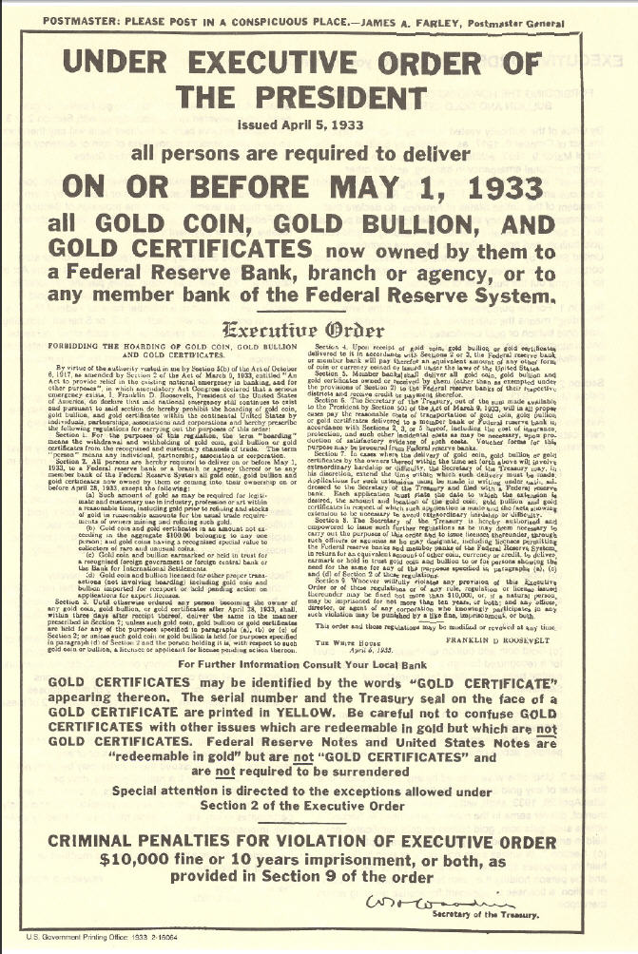

Slide 4
The next morning, 9:30 a.m. on July 14. Morghenthau began a “meeting of the full American team by reporting cheerily that White had “worked up until three o’clock this morning with the Drafting Committee on the Fund and he feels [the text] is in excellent shape. Morghenthau had no idea what exactly that meant, and likely no interest. But among the achievements of the committee, composed entirely of White’s technicians, was strategically replacing “gold” with “gold and U.S, dollars” through the 96-page Final Act. White never submitted the changes for consideration in Commission I, yet they would become an important part of the IMF Articles of Agreement. Keynes would only discover them after his departure from Bretton Woods.” Morghenthau, Diaries, Vol. 754, July 14, 1944, p.3. Benn Steil, The Battle of Bretton Woods, Princeton, 2013, pag. 216.

Slide 5
No sooner had the delegations departed Bretton Woods than controversy erupted between the British and the Americans over the meaning of what had been signed. “We, all of us, had to sign, of course, before we had had a chance of reading through a clean and consecutive copy of the document,” Keynes offered by way of explanation five months later. “All we had seen of it was the dotted line.
Our only excuse,” he added, lifting some prose from Shakespeare, “is the knowledge that our hosts had made final arrangements to throw us out of the hotel, unhouselled, disappointed, unaneled, within a few hours.”¹
¹ Foreign Office (Dec. 29, 1944) FO371/45662, Keynes Memorandum. (Chap. 9, pag. 251)

Slide 6
1. Foreign Office (Dec. 29,1944)
Ghost:
Thus was I, sleeping, by a brother’s hand
of life, of crown, of queen, at once dispatch’d
cut off even in the blossoms of my sin,
unhousel’d, disappointed, unaneled;
no reckoning made, but sent to my account
with all my imperfections on my head
(Hamlet, Act 1, Scene 5, Lines 74-79)
Note to pag. 397 n. 1
Five more hours of debate ensued, whereafter the vote was taken. In a mark of disgruntled resignation, half the peers abstained. The resolution to approve the financial agreement was carried by a margin of 90 to 8. The British debt to the United States was ultimately repaid with a final installment of $83.25 million in December 2006, under the government of Prime Minister Tony Blair. (Pag- 287)
The Battle of Bretton Woods by Benn Steil, Princeton, 2013, pag. 287

Slide 7
Nixon’s announcement on the 15° August 1971:
"I have directed Secretary Connally to suspend temporarily the convertibility of the American dollar except in amounts and conditions determined to be in the interest of monetary stability and in the best interests of the United States”.

Slide 8
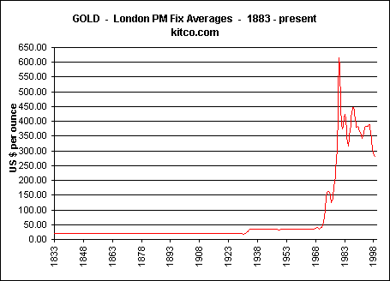

Slide 9
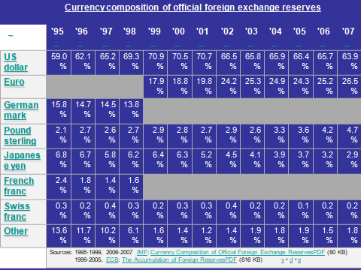

Slide 10
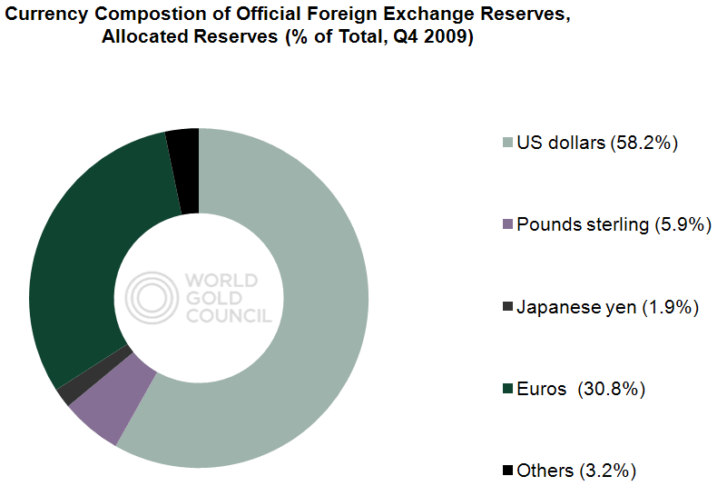
http://www.gold.org/government_affairs/reserve_asset_management/

Slide 11
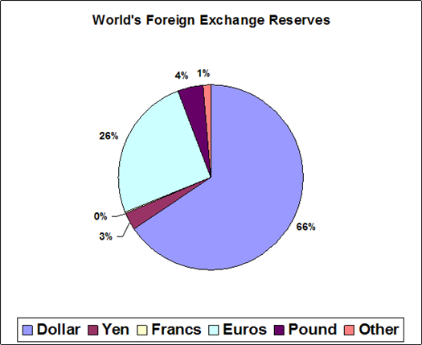
http://data.imf.org/?sk=E6A5F467-C14B-4AA8-9F6D-5A09EC4E62A4
http://data.imf.org/?sk=E6A5F467-C14B-4AA8-9F6D-5A09EC4E62A4
http://data.imf.org/?sk=E6A5F467-C14B-4AA8-9F6D-5A09EC4E62A4
World – Allocated Reserves by Currency for Q2 2017
WWW.PINES.IT

Slide 12
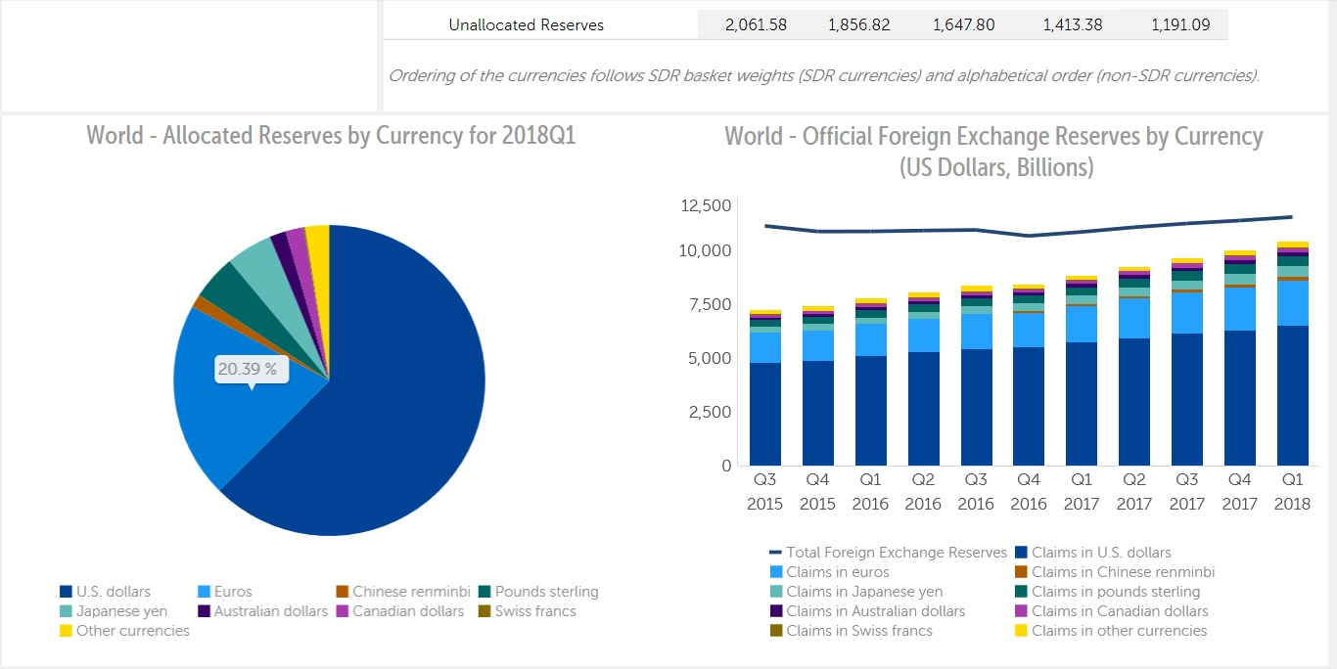
World – Official Foreign Exchange Reserves 2015-2018
http://data.imf.org/?sk=E6A5F467-C14B-4AA8-9F6D-5A09EC4E62A4

Slide 13
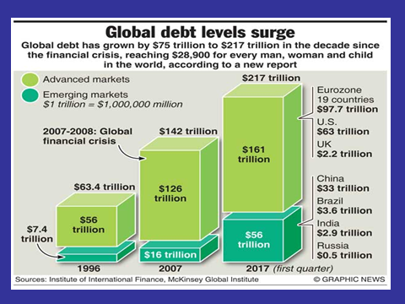

Slide 14
World - Data | 2000 | 2005 | 2007 | 2008 | 2014 | 2017
GDP (current US$) (billions) | 32,001 | 45,232 | 54,891 | 60,587 | 87.180 | 80,684
GDP growth (annual %) | 4.1 | 3.5 | 3.8 | 2.0 | 2.9 | 3.2
Inflation, GDP deflator (annual %) | 4.7 | 4.9 | 5.4 | 8.1 | 2.0 | 3.4
http://databank.worldbank.org/data/reports.aspx?source=2&series=NY.GDP.MKTP.KD.ZG&country=

Slide 15
Central Bank Gold Agreements
On 19th May 2014, the European Central Bank and 20 other European central banks announced the signing of the fourth Central Bank Gold agreement.
This agreement, which applies as of 27 September 2014, will last for five years and the signatories have stated that they currently do not have any plans to sell significant amounts of gold.

