Slide 1
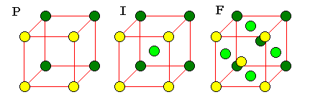
Solid state chemistry

Slide 2
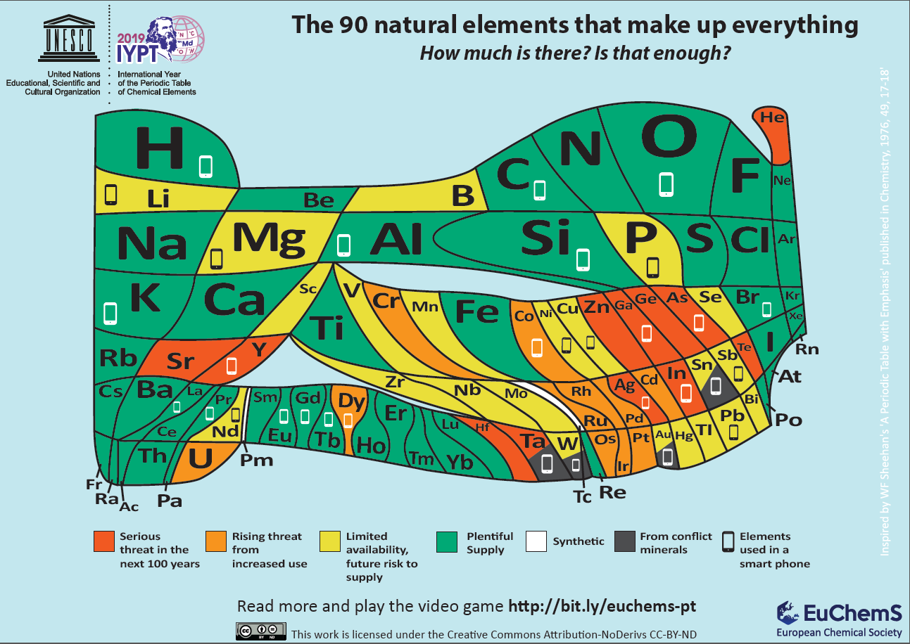

Slide 3



Sustainability, Transformation and Progress
Good quality of the air
Clean water
Natural and fresh food
Fire / agricolture

Slide 4
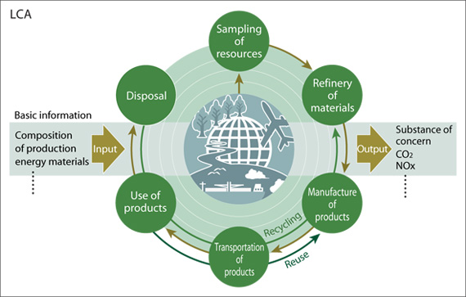
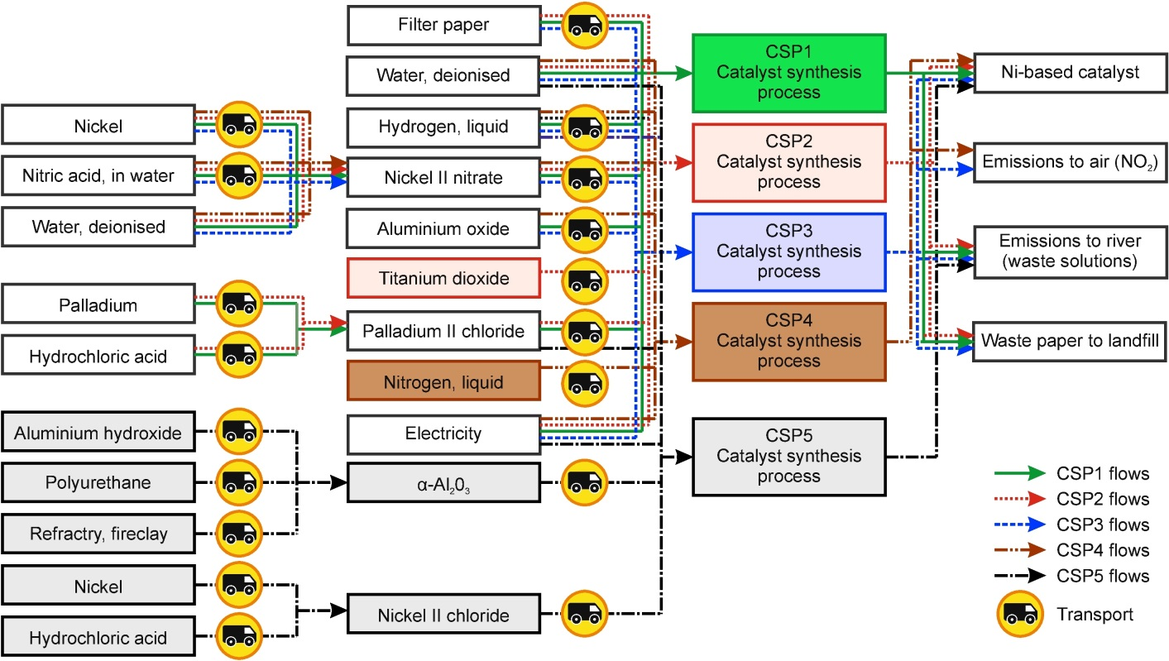
Life Cycle Assessment

Slide 5

Depletion
Once you eat the cake, you don't have it any more

Slide 6
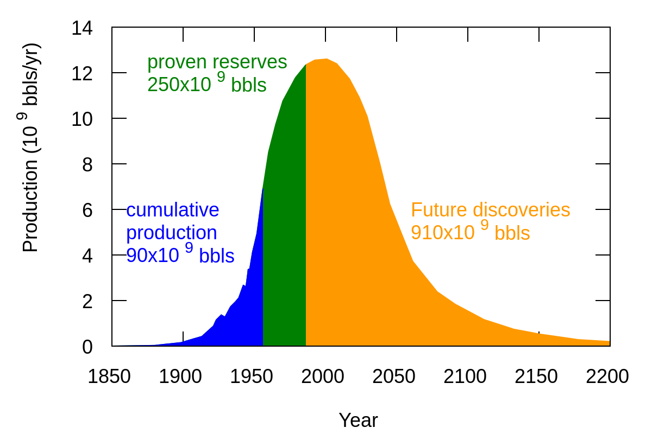

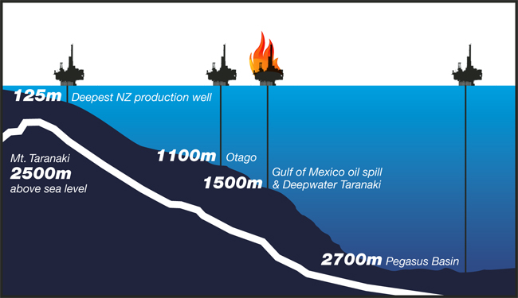

Depletion:
EROEI = Energy Delivered / Energy Required to Deliver that Energy

Slide 7
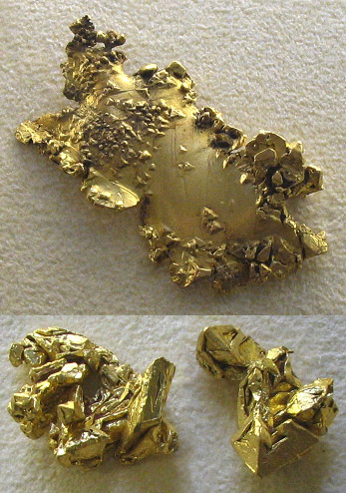
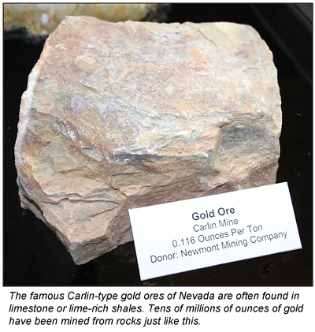
Depletion:
As you eat the cake, it becomes less and less tasty

Slide 8
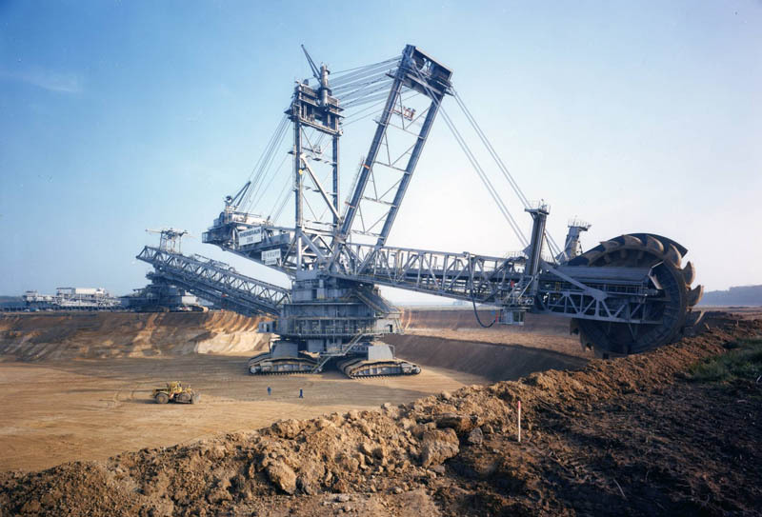
Mining requires energy

Slide 9
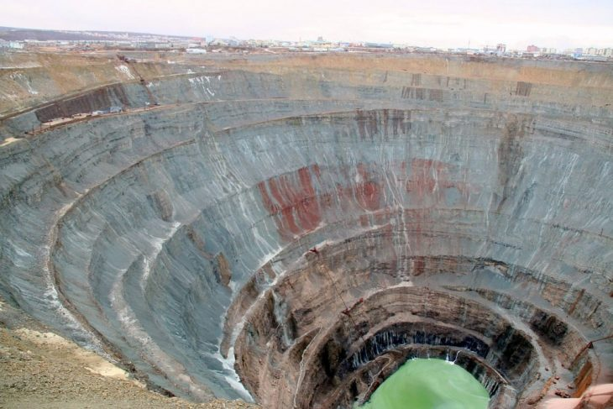
Incredible Open-Pit Mines
Mirny Mine, Russia

Slide 10
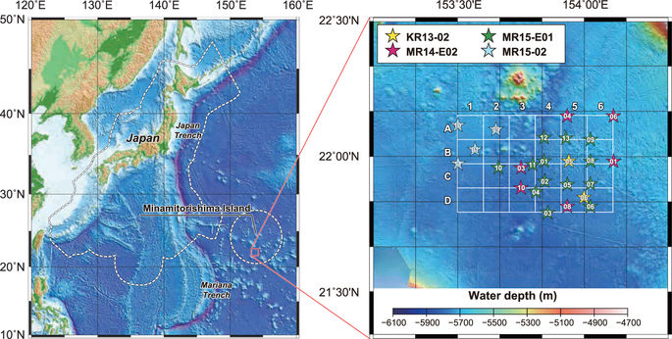
The tremendous potential of deep-sea mud as a source of rare-earth elements
Scientific Reports volume 8, Article number: 5763 (2018)

Slide 11
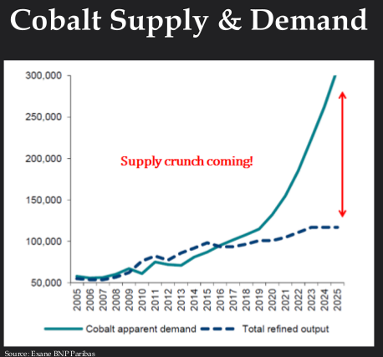

Ethical Cobalt extraction
Replacing noble metals with base metal

Slide 12
Pb cycle 1993
Industrial Waste 93.000
recycle
Postconsumer recycle
670.000
Secondary lead recovery
600
700.000
Industrial Waste 20.000
16.000
4.000
940.000
Storage Batteries
100.000
Product 800.000
Industrial Waste 42.000
Primary Pb
41.400
60.000
Metal Fabrications
760.000
Product
Industrial Waste 38.000
240.000
Other producion
Product

Slide 13
Platinum group recycling
100%
of plant waste
Metal fabrication
100%
Metal production
60%
Mining and refining
143 tons
40%
Chemical conversion for catalyst and other uses
85%
Automotive catalyst manufacture
Automotive catalytic converters
waste
11%
4%
Chemical catalysts and chemicals
Petroleum catalysts
12%
88%
scrap
85%
97%

Slide 14
INTRODUCTION
Three States of Matter:
  Solids
  Liquids
  Gases
  Solids:
  The aggregates of atoms which preserve their volumes and shapes unless subjected to large external force are called solids”.
  There are two types of solids :
  Amorphous (non-crystalline) and
  Crystalline

Slide 15
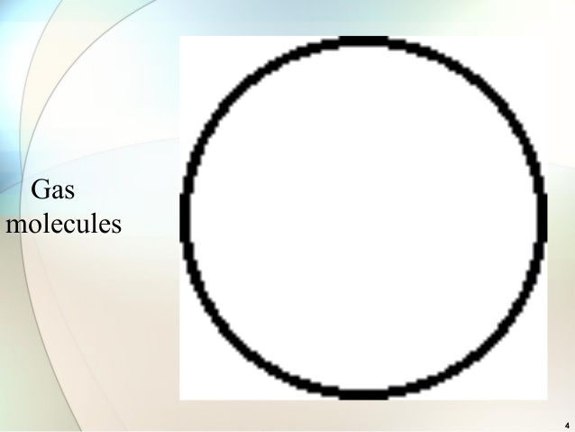

Slide 16
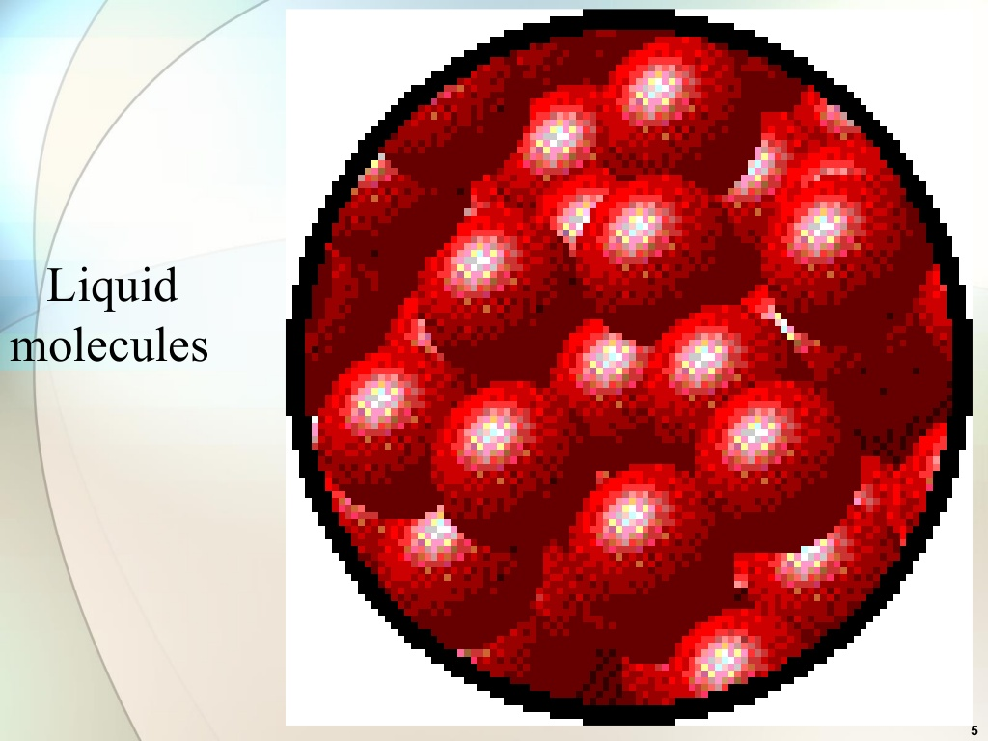

Slide 17
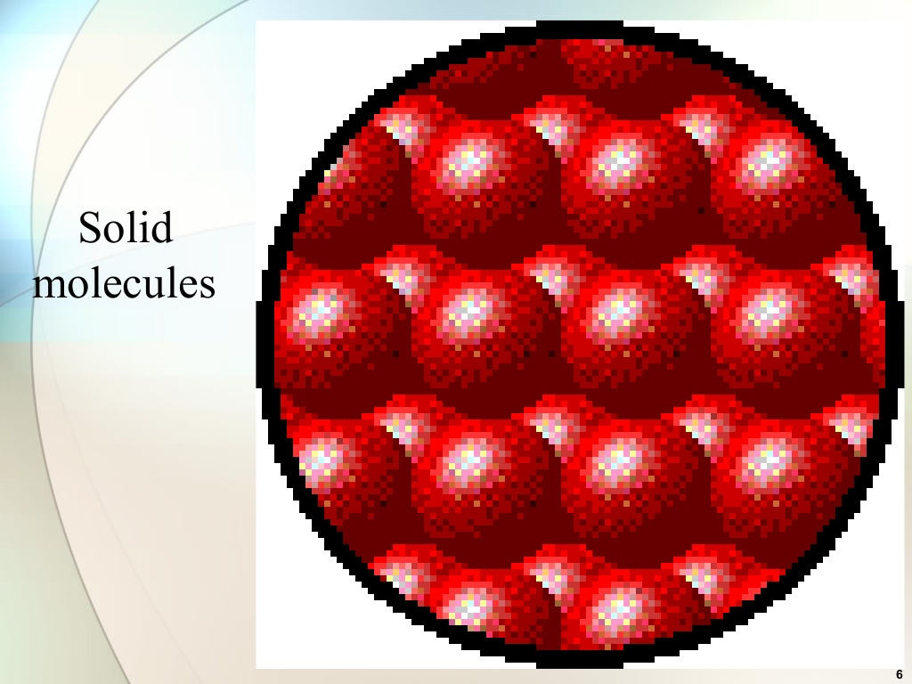

Slide 18
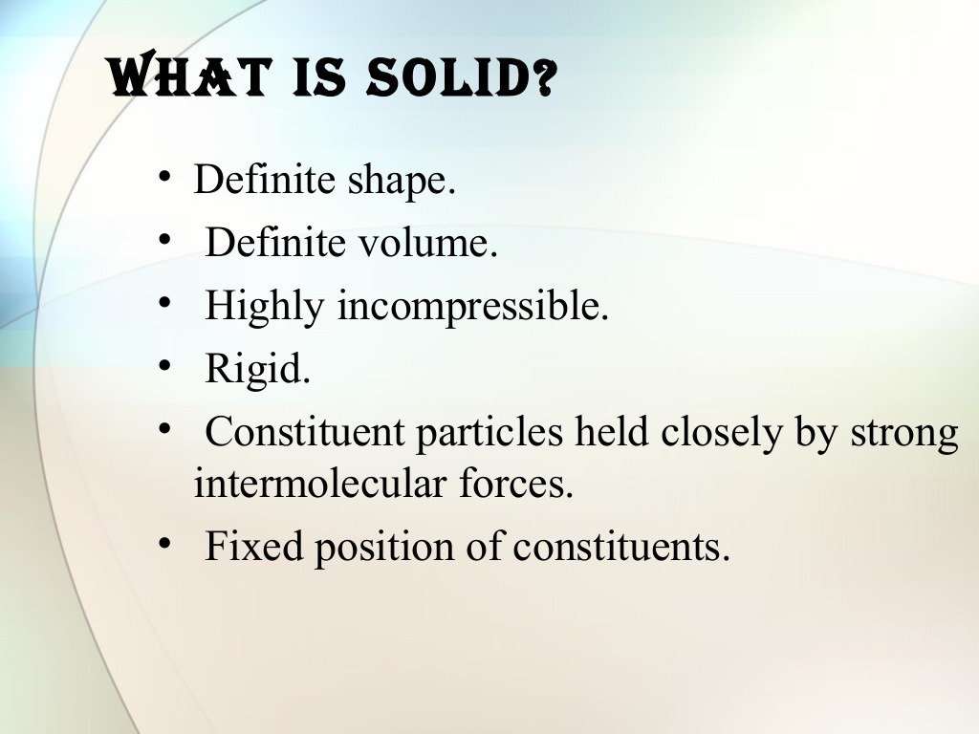

Slide 19
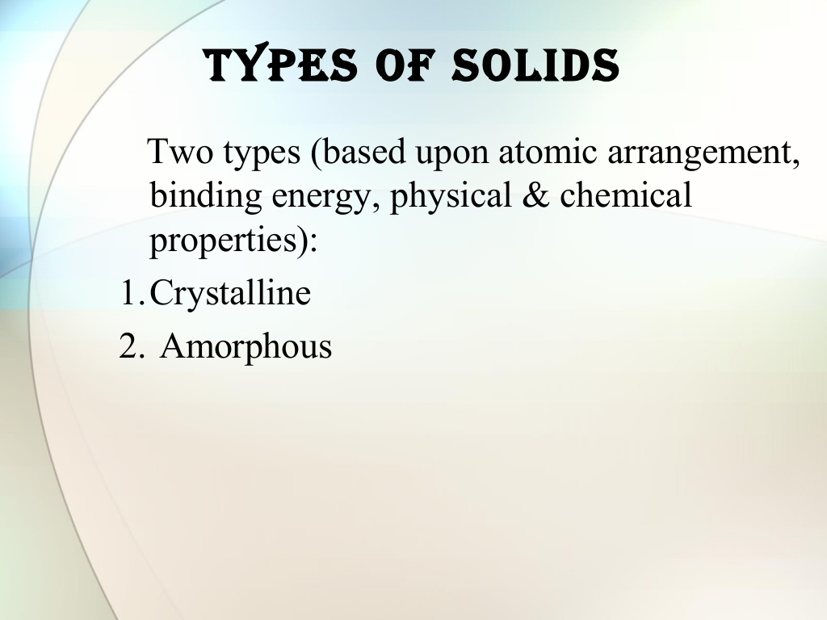

Slide 20
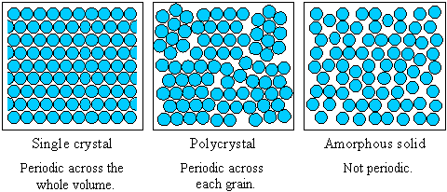
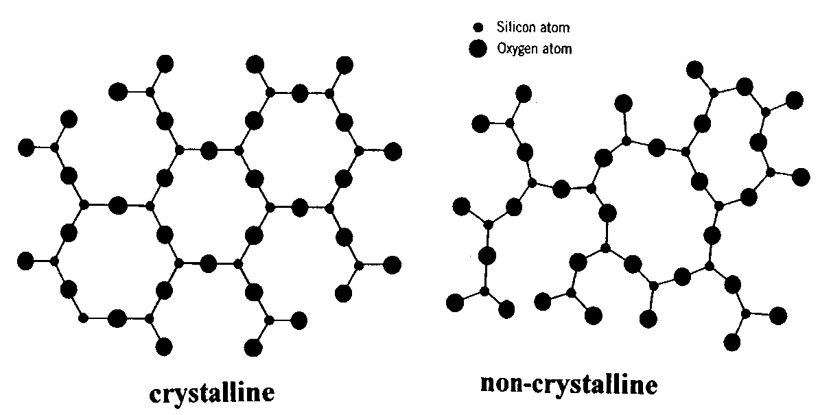

Slide 21
Difference Between Amorphous and Crystalline Solids
Amorphous
Amorphous solids (means without form) are the solids which lacks the regular arrangement of atoms or molecules and hence they have a short range order or no order in their structure
Do not have sharp melting point (because all bonds are not equally strong)
Isotropic (Physical properties are same in different directions)
Examples: glass, wax, plastics, etc.
Crystalline
A crystalline solid is the one in which there is a regular repeating pattern in the structure, or in other words, there is long-range order
Have sharp melting point (because all bond are equally strong)
Anisotropic (Physical properties are different in different directions)
Examples: diamond, table salt, ice, methanol, sodium chloride, etc.

Slide 22
CRYSTAL LATTICES
A lattice is an infinite, regular array of points in space.
# In the definition it should be noticed that no mention is made of atoms or any physical objects, just points in space - no more, no less. Hence we treat the lattice as a mathematical abstraction. Therefore, it is clear that there is no lattice inside the crystal. Even if we look the crystal through a powerful microscope we will not be able to see the lattice points, but rather atoms or groups of atoms. The lattice provides the 'recipe' that determines how the atomic or molecular units are to be repeated throughout the space to make the crystal structure.

Slide 23
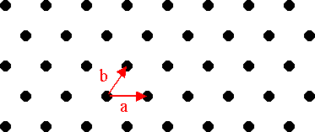
Plane Lattice
Consider an array of points in such a way that the environment about any point is identical with the environment about any other point. Such an array of points in two dimensions is shown in Fig. and is called a plane lattice.
For constructing a two dimensional lattice, choose any two convenient axis such that the points lie at equal intervals a and b along these axis as shown in the Fig. There are generally 5 lattices in two dimensions: Oblique, Square, Hexagonal, Rectangular and Centered Rectangular lattice.

Slide 24
Space Lattice
If this array of points is extended to three dimensions then the array of points is called space lattice. For constructing the space lattice the points are arranged at equal intervals c in the third direction also. There are 14 space lattices in total, called Bravais Lattice.
Thus a lattice may also be defined as a parallel net like arrangement of points such that the environment about any point is identical with the environment about any other point.

Slide 25
Basis
A basis is defined as an assembly of atoms, ions or molecules identical in composition, arrangement and orientation.
Basis consists of the simplest arrangement of atoms which is repeated at every point in the lattice to build up the crystal structure.
The number of atoms in a basis may be one as in case of many metals and inert gases, but could be as large as 1000 in many structures.
In ionic crystals, a basis is composed of two distinct types of ions. For example, Na⁺ and Cl⁻ in a NaCl crystal.

Slide 26
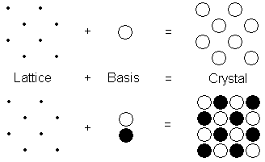
When basis is attached identically to each lattice point, the actual crystal structure is formed as shown in the Fig.
The relation can be written as
Lattice + Basis = Crystal Structure

Slide 27
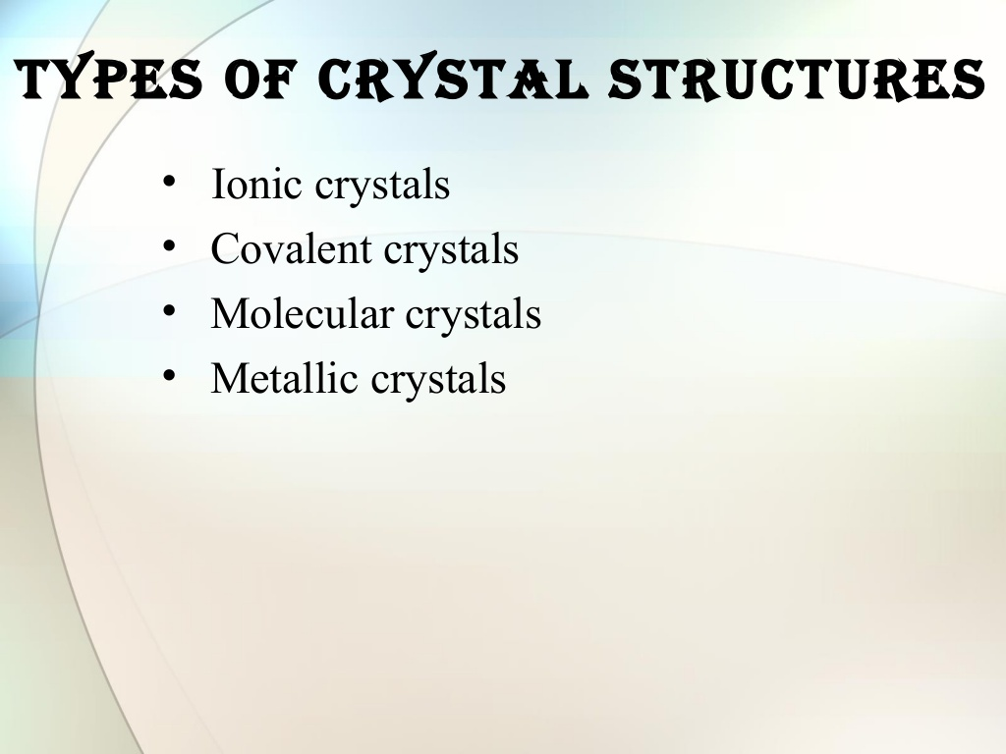

Slide 28
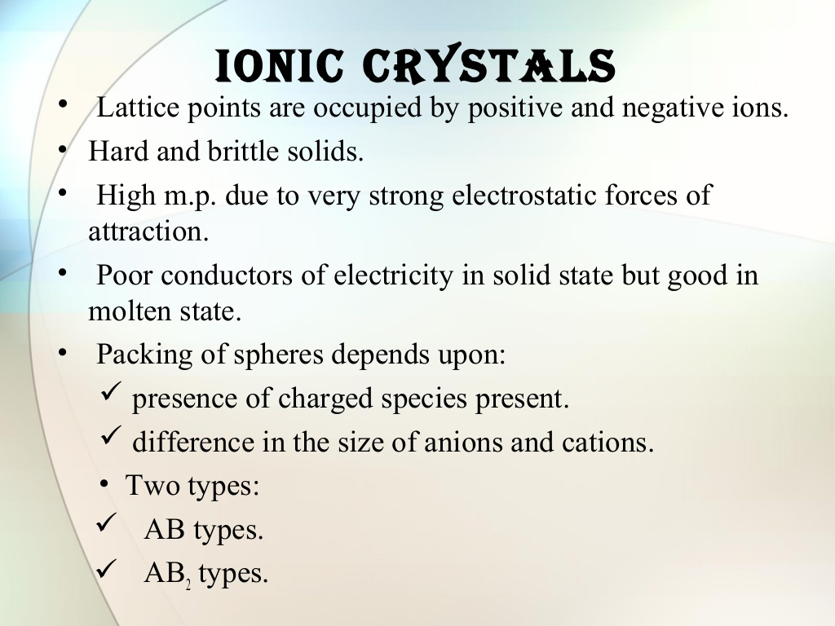

Slide 29
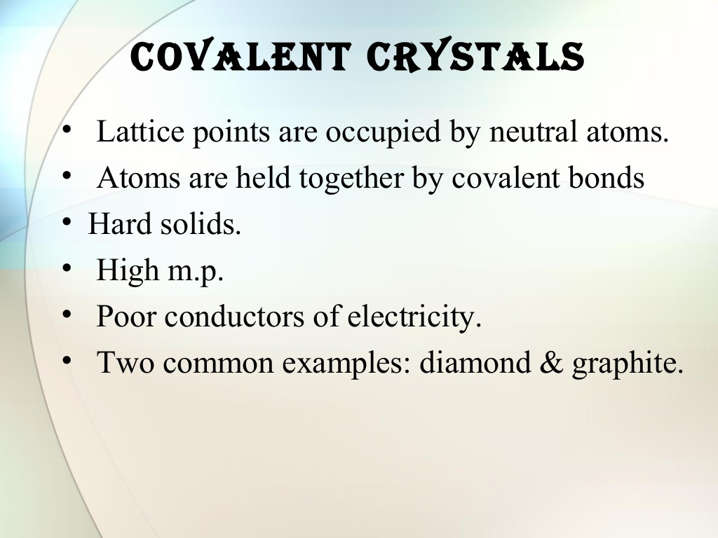

Slide 30
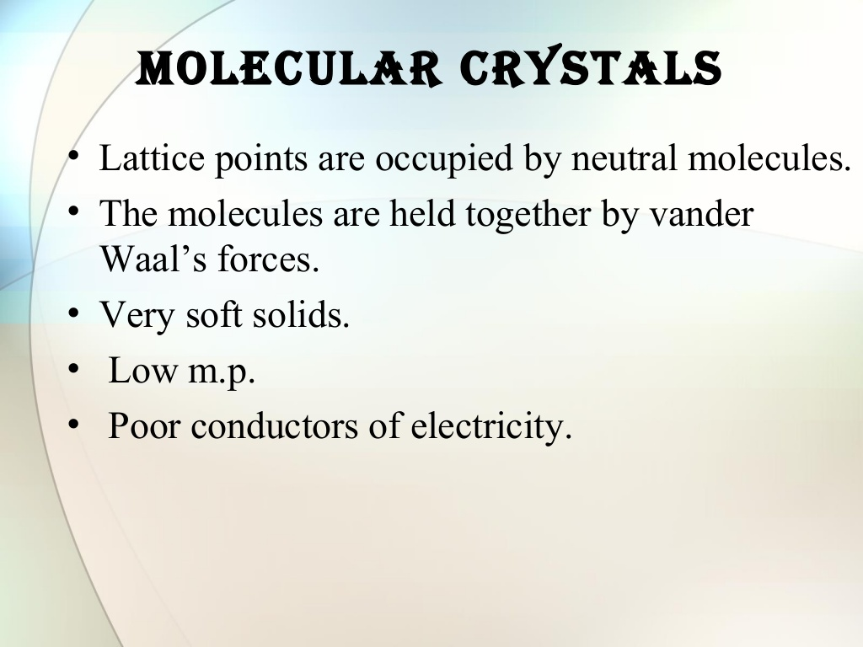

Slide 32
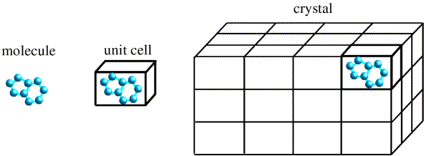
UNIT CELL
A unit cell is a region of space which when repeated by primitive translation vectors fills all space. Thus a unit cell is defined as the smallest geometrical figure, the repetitions of which give the actual crystal structure.
The choice of the unit cell is not unique. It can be constructed in a number of ways, but the unit cell should be chosen in such a way that it conveys all the symmetry of a crystal lattice, by having shortest possible size, which makes the mathematical calculations easy.
Each atom or molecule in a unit cell is considered as a lattice point. The distance between the two atoms or ions of the same type is the ‘length of the unit cell’.

Slide 33
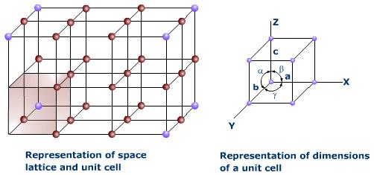
In general, a unit cell may be defined as the smallest volume of a solid from which the entire crystal may be constructed by translational repetitions in 3-dimension and which represent fully all the characteristics of a particular crystal. In Fig. a three dimensional unit cell is shown by the shaded portion.

Slide 34
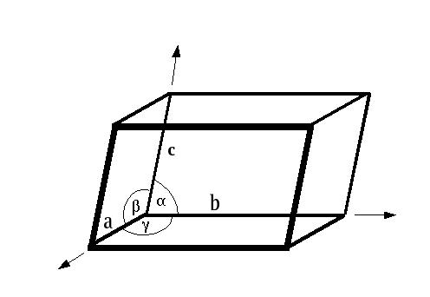
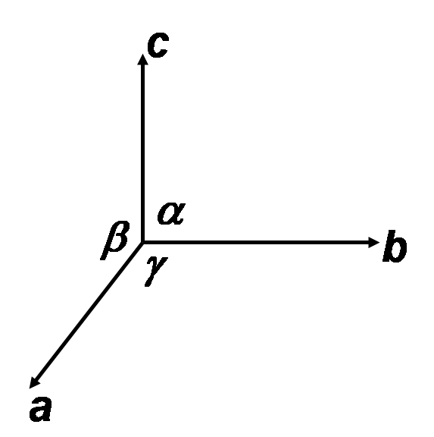
For a three dimensional case, the unit cell is a parallelepiped formed by basic vectors a, b and c as concurrent edges and the angles α, β and γ, between (b, c), (c, a), and (a, b) respectively as explained in the following Figures.
Lattice parameters
a, b, c
α, β, χ

Slide 35
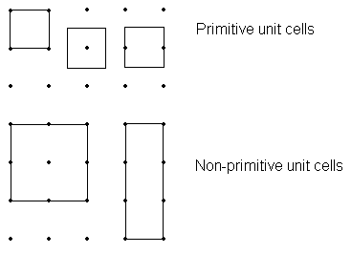
Primitive and Non - primitive unit cell
contain just one lattice point
contain more than one lattice point

Slide 36
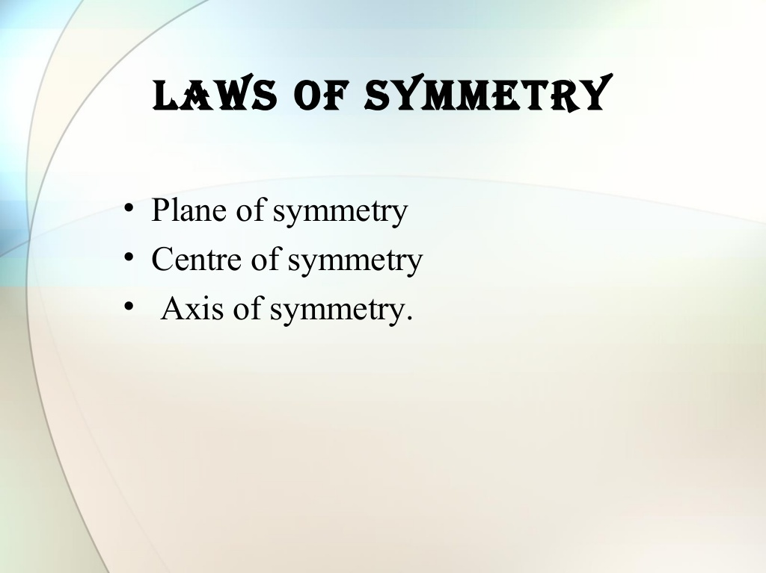

Slide 37
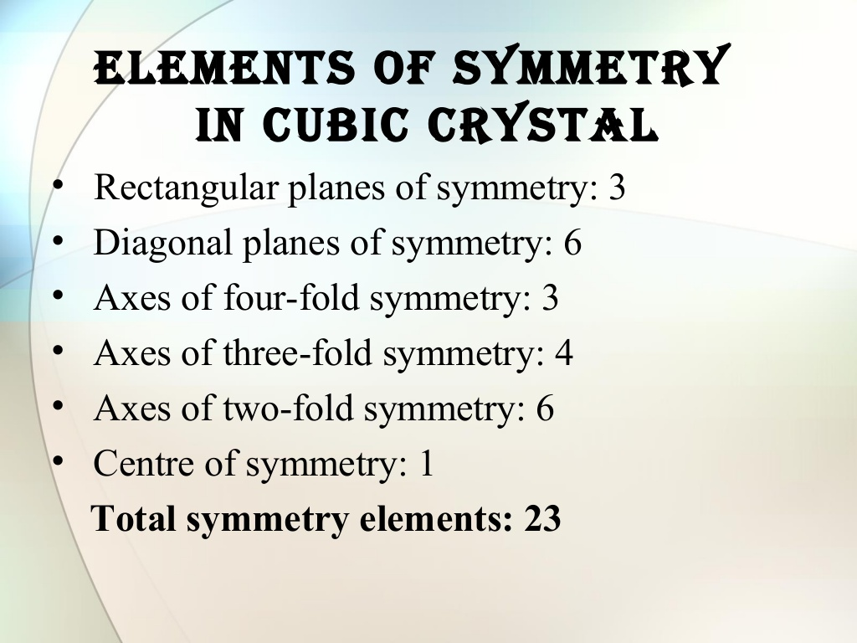

Slide 38
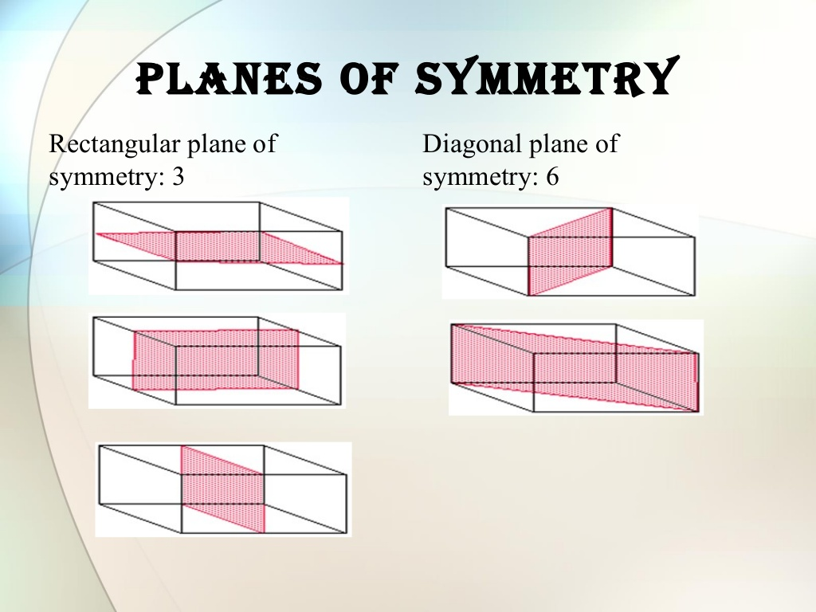

Slide 39
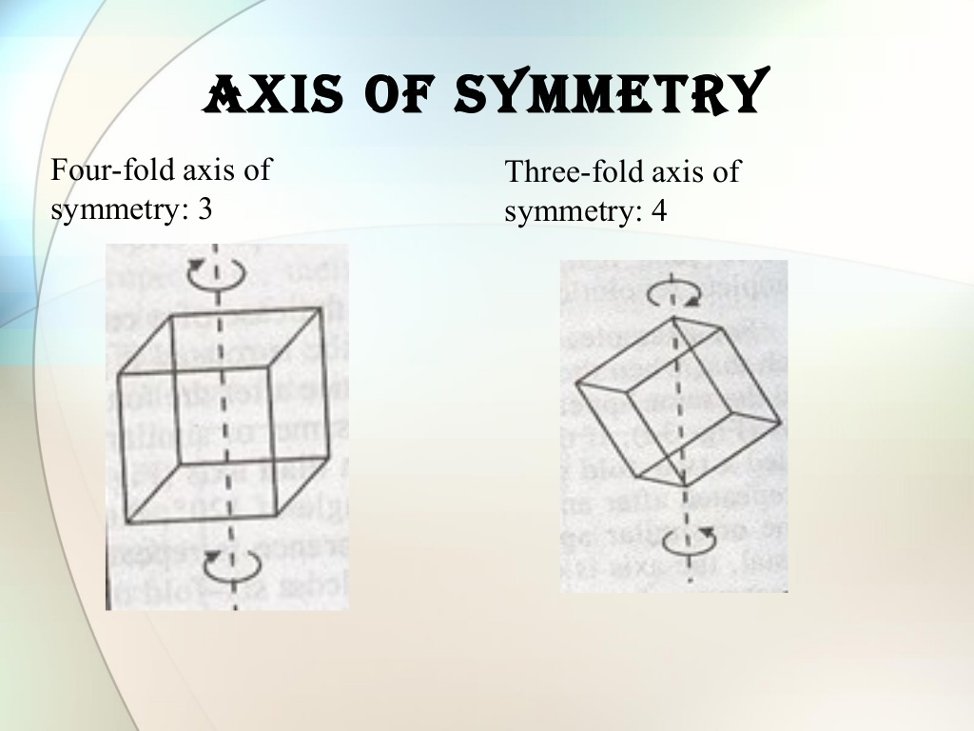

Slide 40
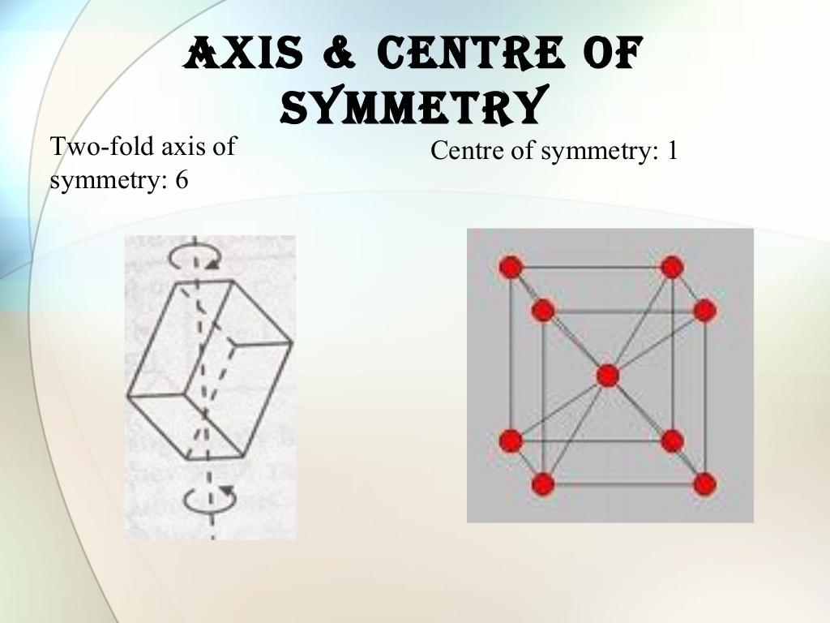

Slide 41
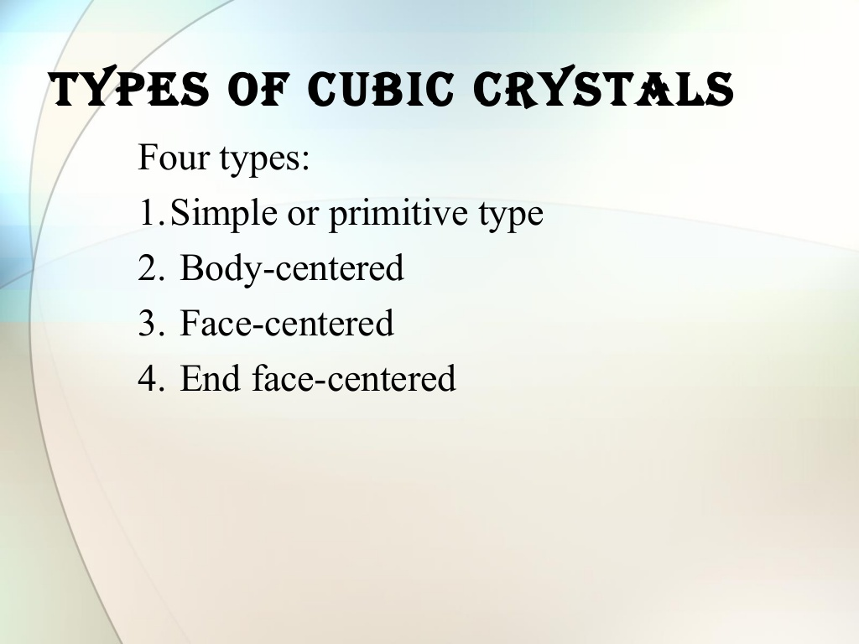

Slide 42
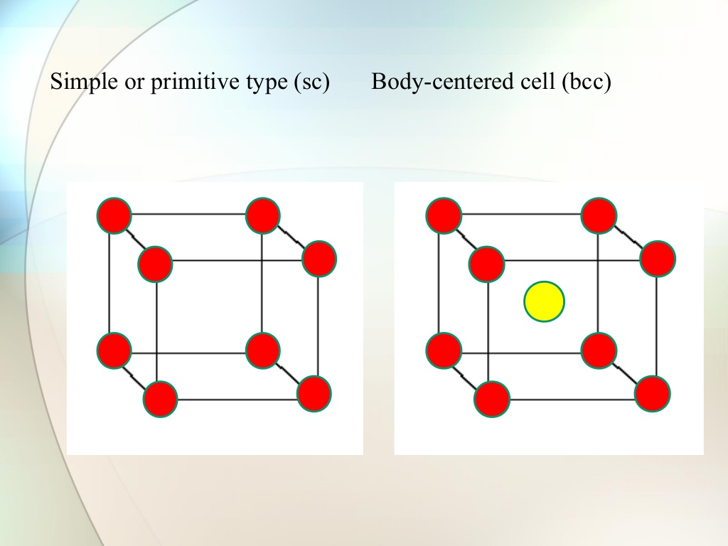

Slide 43
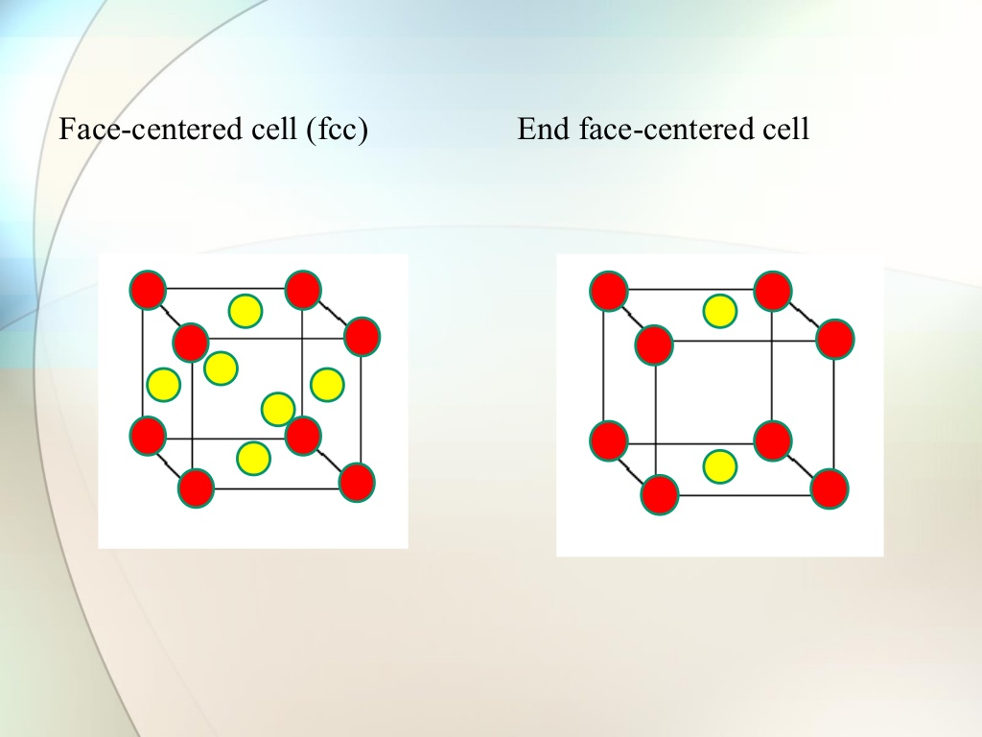

Slide 44
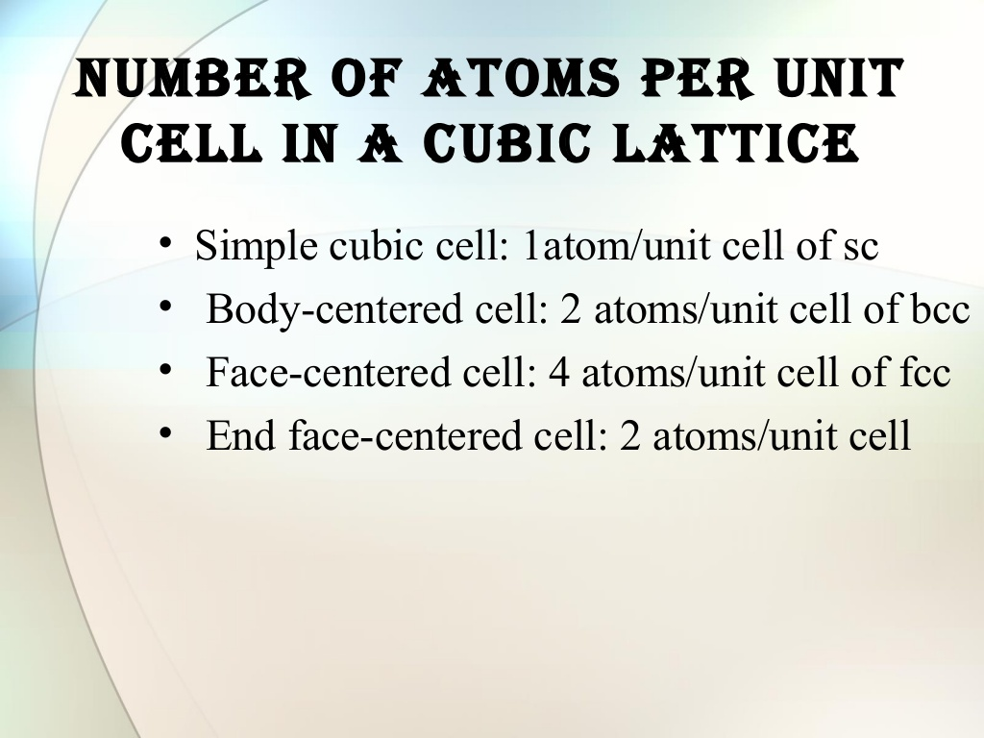

Slide 45
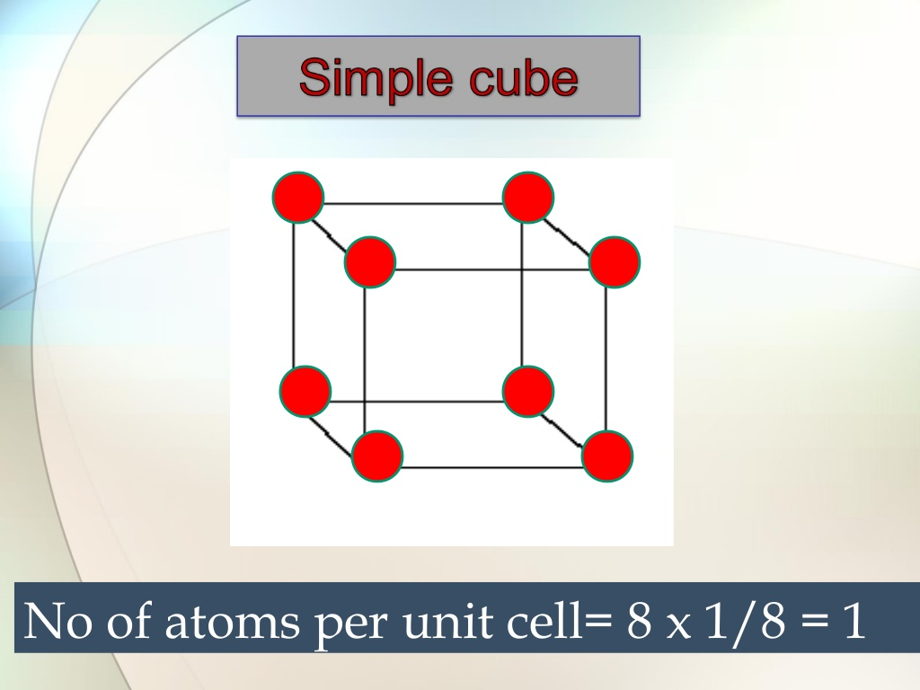

Slide 46
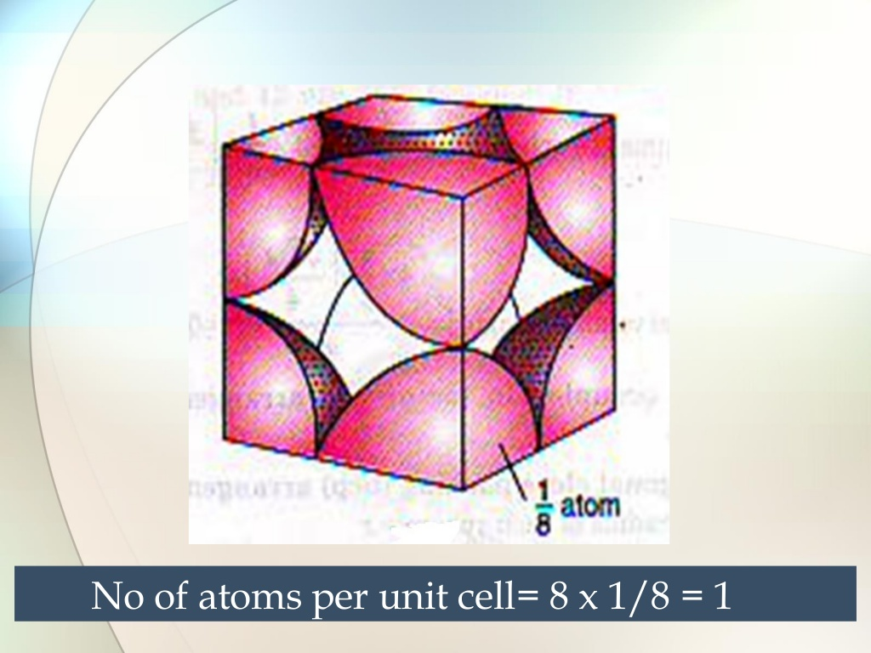

Slide 47
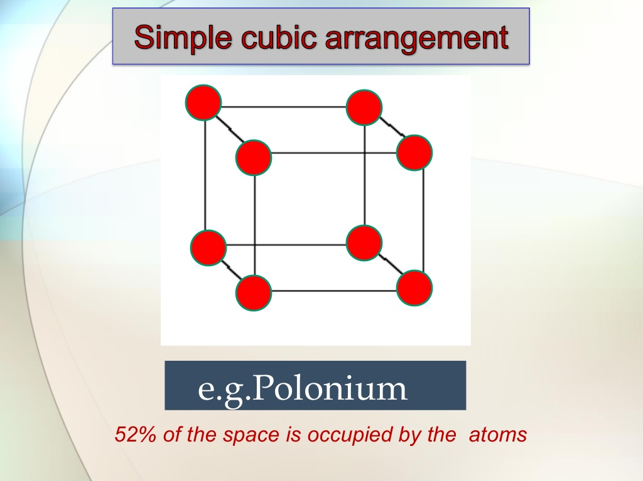

Slide 48
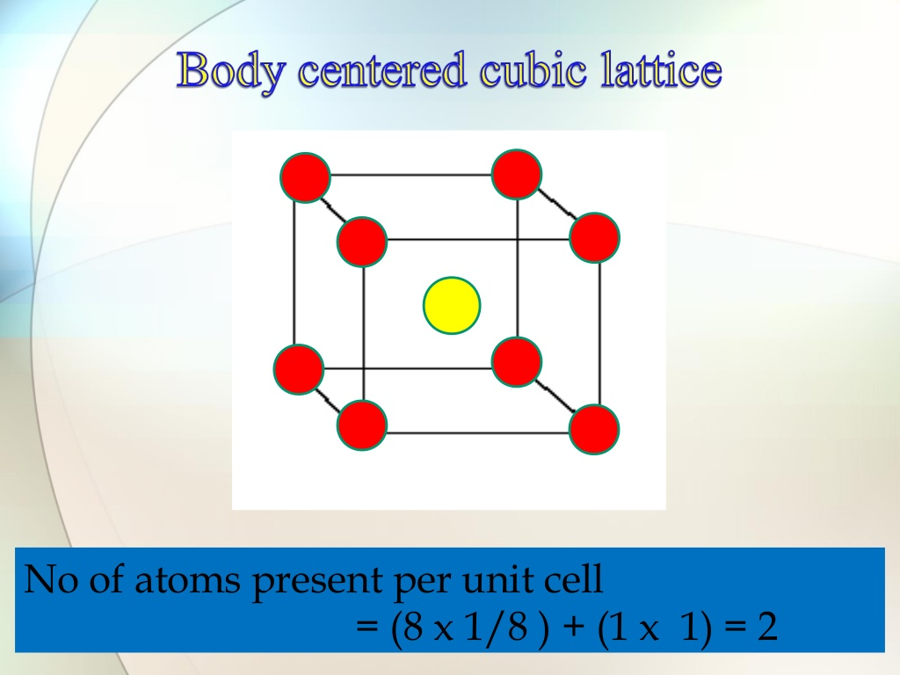

Slide 49
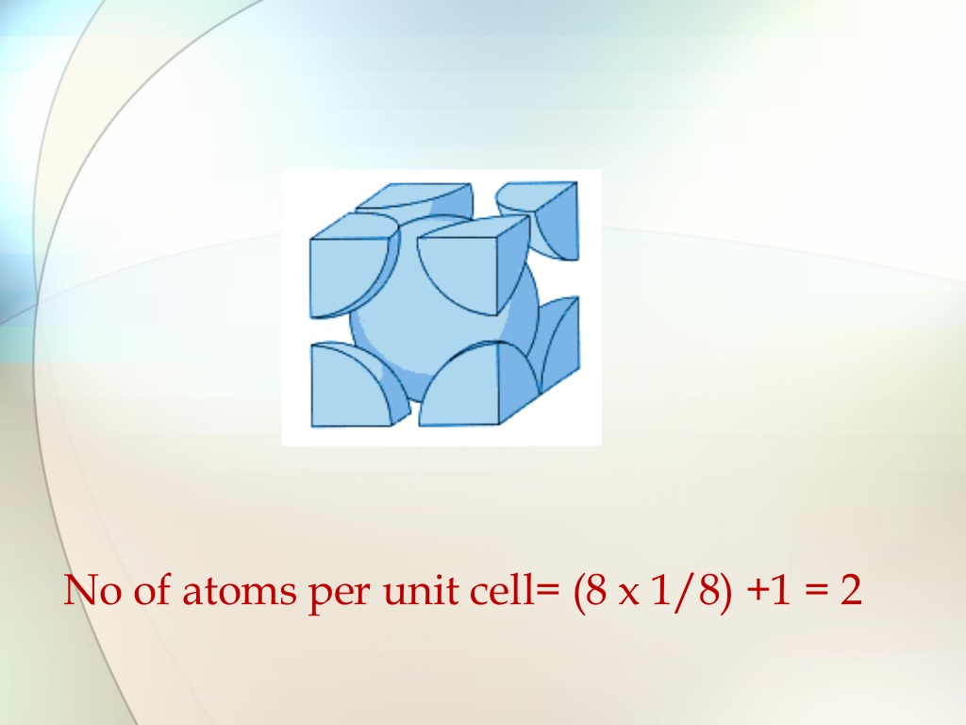

Slide 50
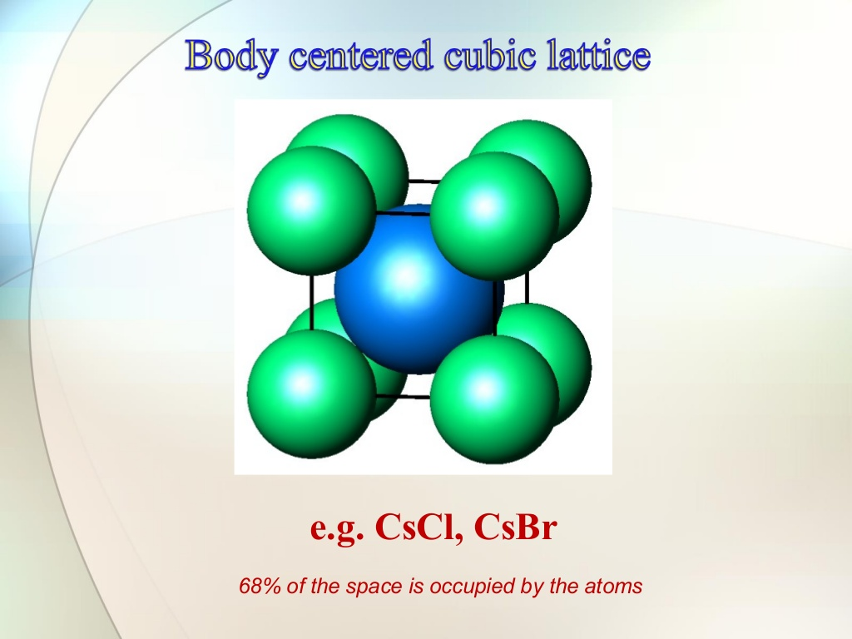

Slide 51
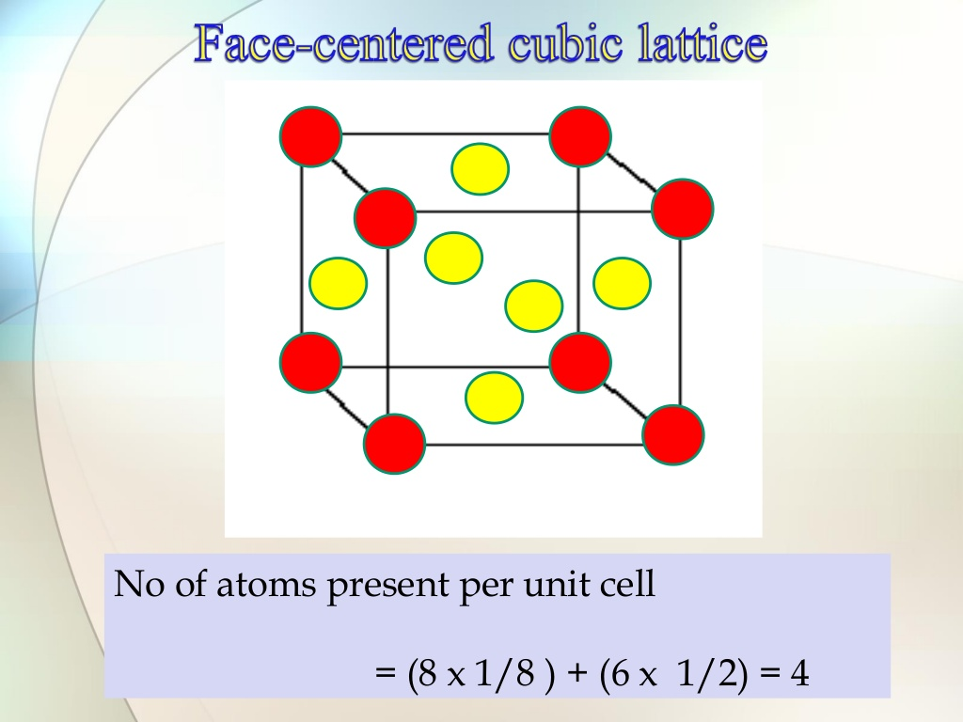

Slide 52
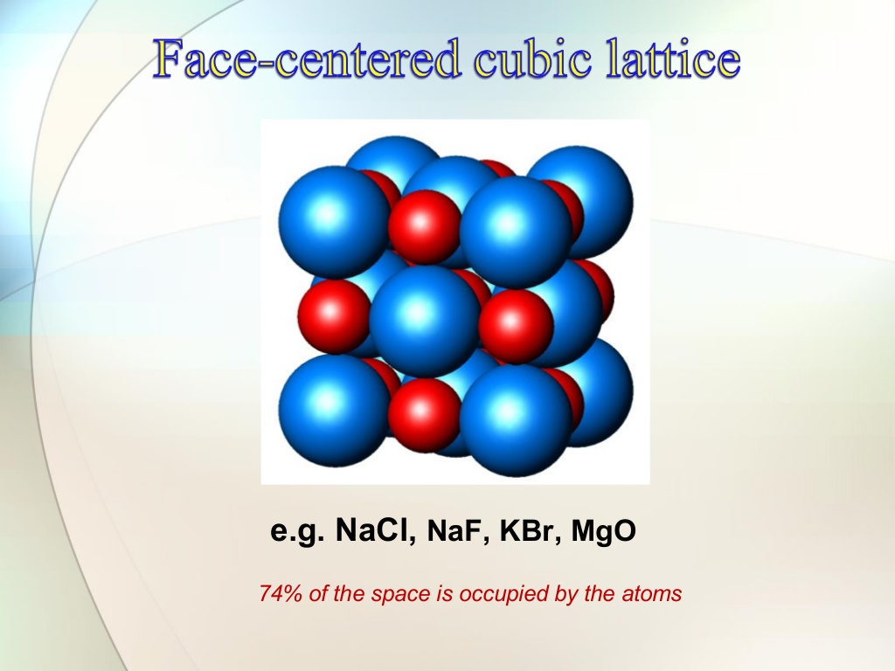

Slide 53
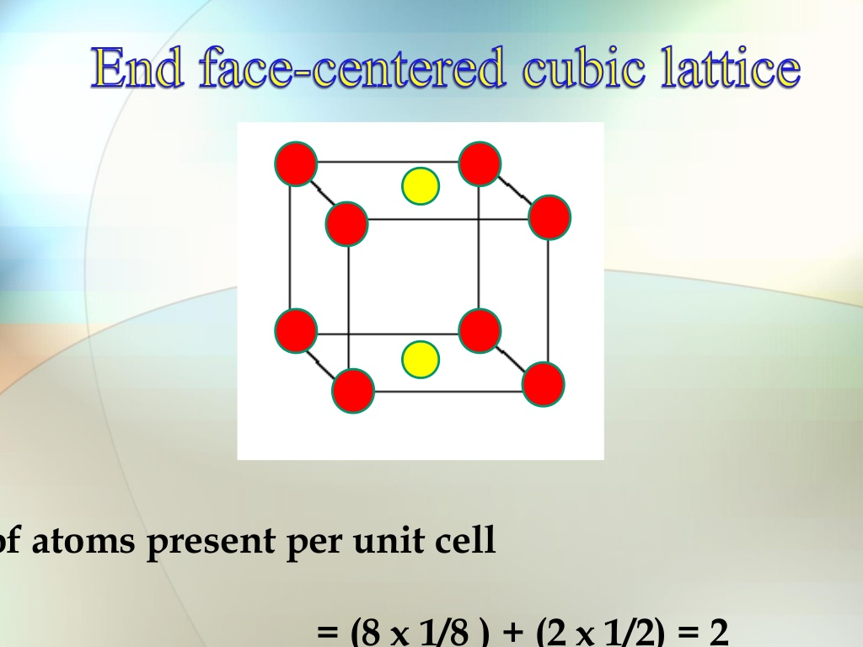

Slide 54
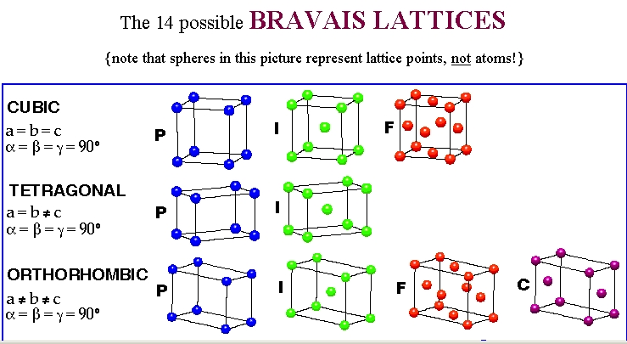
Type of unit cells
P Simple
I Body-centred
F Face-centred
C Base(side)-centred

Slide 55
CRYSTAL SYSTEMS AND BRAVAIS LATTICES
Crystals of different substances have similar shapes and hence the crystals are classified into the so called crystal systems depending upon their axial ratio and the interfacial angles α, β and γ. In three-dimension, there are 7 crystal systems. Bravais showed that throughout the seven crystal systems there are fourteen unique lattice types possible. These are known as Bravais or space lattices.

Slide 56
No. | Crystal class | Intercepts on Axes | Angles between Axes | Bravais space lattice
1 | Cubic | a = b = c | α = β = γ = 90⁰ | Simple, body-centred, face-centred
2 | Tetragonal | a = b ≠ c | α = β = γ = 90⁰ | Simple, body-centred
3 | Orthorhombic | a ≠ b ≠ c | α = β = γ = 90⁰ | Simple, body-centred, face-centred, Base(side)-centred
4 | Trigonal | a = b = c | α = β = γ ≠ 90⁰ | Simple
5 | Hexagonal | a = b ≠ c | = β = 90⁰, γ = 120⁰ | Simple
6 | Monoclinic | a ≠ b ≠ c | α = γ = 90⁰ ≠ β | Simple, base-centred
7 | Triclinic | a ≠ b ≠ c | α ≠ β ≠ γ | Simple

Slide 58
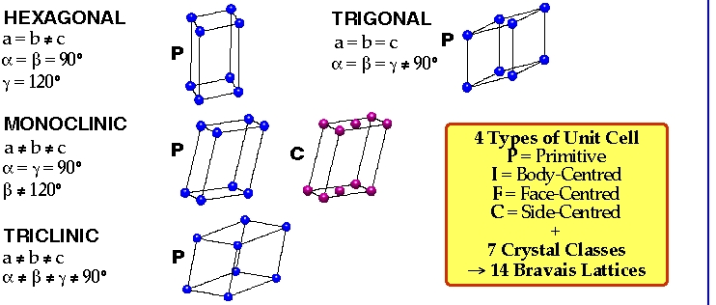

Slide 59


Slide 60


Slide 61


Slide 62


Slide 63


Slide 64


Slide 65


Slide 66


Slide 67
No. | Crystal class | Intercepts on Axes | Angles between Axes | Bravais space lattice
1 | Cubic | a = b = c | α = β = γ = 90⁰ | Simple, body-centred, face-centred
2 | Tetragonal | a = b ≠ c | α = β = γ = 90⁰ | Simple, body-centred
3 | Orthorhombic | a ≠ b ≠ c | α = β = γ = 90⁰ | Simple, body-centred, face-centred, Base(side)-centred
4 | Trigonal | a = b = c | α = β = γ ≠ 90⁰ | Simple
5 | Hexagonal | a = b ≠ c | = β = 90⁰, γ = 120⁰ | Simple
6 | Monoclinic | a ≠ b ≠ c | α = γ = 90⁰ ≠ β | Simple, base-centred
7 | Triclinic | a ≠ b ≠ c | α ≠ β ≠ γ | Simple

Slide 70

MILLER INDICES
The crystal structure may be regarded as made up of an aggregate of a set of parallel equidistant planes passing through at least one lattice point or a number of lattice points. These planes are known as Lattice Planes. For a given crystal, lattice planes can be chosen in different ways as shown in Fig.

Slide 71
In order to designate a lattice plane, British mineralogist William H. Miller, in 1839, developed a method by using three numbers (h k l) which are known as Miller Indices.
Miller Indices are the three smallest possible integers, which have the same ratio as the reciprocals of intercepts of the plane concerned on the three axis.
# Miller indices are integer sets that were created to distinguish directions and planes in a lattice. They are used primarily in crystalline structures because they describe planes in relation to a larger lattice in relative terms, as opposed to absolute terms. An example of this is describing planes in a building, Miller indices would distinguish the floor from the walls, and north wall from west wall, however it would not distinguish the 4th floor from the 5th floor. This is useful in crystal lattices because the planes are the same in many directions(like floors in a tall building).

Slide 72


Slide 73
Important points:
Miller indices define the orientation of the plane within the unit cell
If a set of planes is parallel to any of the axes, it would cut that axes at ∞, hence the Miller index along that direction is 1/∞ = 0.
If a plane to be indexed has an intercept along the negative portion of a coordinate axis, a minus sign is placed over the corresponding index.
The Miller Index defines a set of planes parallel to one another (remember the unit cell is a subset of the “infinite” crystal), e.g., (002) planes are parallel to (001) planes, and so on.

Slide 74

Let us take an example to find the Miller Indices of a given plane(see Fig.):
Intercepts: 2a 1b 1c
Dividing by unit translation vectors: 2a/a 1b/b 1c/c = 2 1 1
Taking the reciprocals: ½ 1/1 1/1
Reducing to whole numbers: 1 2 2
Miller indices: (122)

Slide 75


Slide 76


Slide 77


Slide 78


Slide 79


Slide 80


Slide 81

INTERPLANER DISTANCE OR SPACING
Interplaner spacing is defined as the perpendicular distance d_{hkl} between corresponding planes. It is also perpendicular distance from the origin to the set of parallel planes (see Fig.)

Slide 82
For a cubic lattice, a = b = c, therefore, we get
Also, For a cubic lattice,
d₁₀₀ = a, d₁₁₀ = a/√2 and d₁₁₁ = a/√3.

Slide 83
Physical Parameters for Crystal Structure
(i) Number of Atoms per Unit Cell
Number of atoms per unit cell determines how closely the solid is packed and is given by
N = N_{c}/8 + N_{f}/2 + N_{i}
here N_{c} is the number of corner atoms, N_{f} the number of face centred atoms and N_{i} the number of body centred atoms(see Fig.).
For SC crystal : In a SC crystal, there are 8 atoms only, each at one corner. Each atom is shared by 8 unit cells. Therefore, we have
N = N_{c}/8 = 8/8 = 1
For BCC crystal :N = N_{c}/8 + N_{f}/2 + N_{i} = 8/8 + 0 + 1 = 2
For FCC crystal :N = N_{c}/8 + N_{f}/2 + N_{i} = 8/8 + 6/2 + 0 = 4

Slide 84
(ii) Coordination Number (CN)
In a crystal, the number of nearest neighbours of the same type and at equal distances from the given atom is called coordination number.
For SC : The corner atoms are the nearest neighbours of each other. Here CN = 6 (see Fig.) which is a group of 8 unit cell and atom at the centre has six corner atoms as its nearest neighbours).

Slide 85
For BCC : In this case all the corner atoms are at equal distances from the body centered atom.
Hence CN = 8.
For FCC : Here the nearest neighbours of any corner atom are the face centered atoms of the surrounding unit cells. Now for any corner atom there are 4 face centered atoms in each plane and there are three such planes. Therefore, CN = 12.

Slide 86
(iii) Atomic Radius and Nearest Neighbour Distance (NND)
In a crystal the atoms are assumed to be spheres in contact. Now atomic radius is defined as half the distance between the nearest neighbours in a crystal of pure element, i.e., the distance between the centres of neighbouring atoms.
For SC : In a SC structure, corner atoms are the nearest neighbours and are in touch with each other. If the side of the unit cell is ‘a’ and ‘r’ be the radius , then
2r = a or r = a/2
Now Nearest Neighbour Distance(NND) is given by 2r
Therefore, NND = 2r = a

Slide 87


For FCC : r = √2 a/4
NND = a/√2

Slide 88

For BCC : r = √3 a/4
NND = √3 a/2.

Slide 89
(iv) Atomic Packing Fraction (or Factor) (APF)
It is defined as the ratio of the volume of the atoms occupying the unit cell to the volume of the unit cell. It is also called relative packing density.
APF = Volume occupied by the atoms in a unit cell / Volume of the unit cell.
SC Crystal : No. of atoms/unit cell = 1
Volume of one atom = 4/3 πr³
Side of the unit cell = a = 2r
Volume of the unit cell = a³
APF = = = π/6 = 0.52 = 52%.
BCC Crystal : No. of atoms/unit cell = 2
Volume of two atoms = 2x4/3 πr³
Side of the unit cell = a = 4r/√3
Volume of the unit cell = a³
APF = = = √3π/8 = 0.68 = 68%.
FCC Crystal : No. of atoms/unit cell = 4
Volume of four atoms = 4x4/3 πr³
Side of the unit cell = a = 4r/√2
Volume of the unit cell = a³
APF = = = √2π/6 = 0.74 = 74%.

Slide 90


Closed Packed Structures
In a closed packed structure the constituent atoms are so arranged as to occupy minimum possible volume, reaching the maximum density.
2-layers closed packed structure
Planar closed packed spheres

Slide 91

Closed Packed Structures
hcp
ccp
Hexagonal Closed Packed
Cubic Closed Packed

Slide 92


c.c.p. structure
(111) Of a FCC structure

Slide 93

h.c.p. structure

Slide 94

h.c.p. structure

Slide 95


Interstitial sites in Closed Packed Structures

Slide 96


Interstitial sites in Closed Packed Structures
Stable Bonding Configurations in Ionic solids.
In reality an ideal fit of a cation into the close packed anion arrangement almost never occurs. Now consider what would be the consequence of placing a cation that is (a) larger than the ideal, (b) smaller than the ideal, into the cation sites.
For a stable coordination the bonded cation and anion must be in contact with each other.
If r_{cation}/r_{anion} becomes too big, the close packed structure of anions is converted into a simple cubic structure

Slide 97

Interstitial sites in Closed Packed Structures

Slide 98


Cubic structures

Slide 99


Slide 100


Slide 101


Rock salt structure
r_{Na} = 0.102 nm
r_{Cl} = 0.181 nm
r_{Na}/r _{Cl} = 0.564
Octahedral sites preferred

Slide 102

Zinc blende structure
Zn ²⁺
S ²⁻
r_{Zn}/r_{S} = 0.074/0.184= 0.402
tetrahedral sites preferred

Slide 103


Fluorite and antifluorite
Calcium Fluorite (CaF₂)
Cations in cubic sites
UO_{2,} ThO₂, ZrO₂, CeO₂
Antifluorite structure –
positions of cations and
anions reversed
Fluorite structure

Slide 104

Perovskite ABO₃
Perovskite structure
Ex: complex oxide
BaTiO₃

Slide 105


Perovskite ABO₃

Slide 106



Spinels
Normal
Inverse

Slide 107

Spinels
Normal
Inverse
In order to explain the adoption of a particular cation distribution in a spinel structure, one must take into account the crystal field stabilization energies (CFSE) of the transition metals present. Some ions may have a distinct preference for the octahedral site depending on the d-electron count. If the A²⁺ ions have a strong preference for the octahedral site, they will displace half of the B³⁺ ions from the octahedral sites to tetrahedral sites. Similarly, if the B³⁺ ions have a low or zero octahedral site stabilization energy (OSSE), then they will occupy tetrahedral sites, leaving octahedral sites for the A²⁺ ions.

Slide 108


Slide 109


Slide 110


Slide 111


Slide 112



Slide 113


Slide 114


Slide 115


Slide 116


Slide 117


Slide 118


Slide 119


Slide 120


Slide 121
DEFECTS IN SOLIDS
No real crystal is perfect. Real crystals feature defects or irregularities in their ideal arrangements and it is these defects that critically determine many of the electrical and mechanical properties of real materials.
Ideally a perfect crystal is the one in which atoms are arranged in perfectly regular manner in all directions. The deviations of crystals from their perfect periodicity are called defects or imperfections.
These imperfections can be of different types such as:
point defects (zero–dimensional defects),
line defects (one–dimensional)
defects over a surface or a plane (two–dimensional) and volume defects (three–dimensional).

Slide 122
Point Defects
A point defect is a very localized imperfection in the regularity of a lattice and it does not spread over more than one or two lattice spacings. These defects are observed in metallic crystals (vacancies, substitutional impurity and interstitials) as well as in ionic crystals (Schottky and Frenkel) and are discussed here in brief.
Vacancies
The absence of an atom or ion from a normally occupied site in a crystal is called a vacancy (see Fig.)
Substitutional Impurity
In this kind of defect, a foreign atom occupy a regular site in the crystal structure (see Fig.), i.e., .substitutional atom replaces the host atom from its position. For example, when a pure semiconductor crystal of Silicon or Germanium is doped with a trivalent or pentavalent impurity, we call it a substitutional impurity.

Slide 123
Interstitial Impurity
An interstitial is an atom or ion which can be inserted into the voids between the regularly occupied sites. In a closed packed arrangement of atoms the packing fraction is generally less than one. Therefore an extra atom, of smaller size than the parent atom, can enter the interstitial space without disturbing the regularly positioned atoms. Such an extra impure atom is called interstitial impurity while an extra atom in an interstitial position is called self – interstitial atom, as shown in Fig. If the size of the extra atom is not small then it will produce atomic distortion.

Slide 124

(c) 2003 Brooks/Cole Publishing / Thomson Learning

Slide 125


Emerald and Ruby:
Cr³⁺ impurities
Cr₂O₃: green

Slide 126




Slide 127

Charge compensation: vacancy formation
When a divalent cation replaces a monovalent cation, a second monovalent cation must also be removed, creating a vacancy.

Slide 128
Charge compensation: change in oxidation state
When a divalent cation replaces a monovalent cation, an anion must change its oxidation state.

Slide 129
Schottky Defect
In a metal, a vacancy is created if an atom is missing from its lattice position. In ionic crystals, a cation – anion pair will be missing from the respective lattice sites, as shown in Fig. Creation of such a pair, of one cation vacancy together with one anion vacancy, is called Schottky defect. Thus the interior of the ionic crystals remain electrically neutral.
Frenkel Defect
When an atom or ion leaves its normal position or site and is found to occupy another position in the interstice we get a Frenkel defect. Thus, in this case, two imperfections are created – an interstitial and a vacancy as shown in Fig. Normally anion leaves its parent site and occupy the interstitial space. These defects are dominant in open structures such as silver halides. Also a Frenkel defect does not affect the electrical neutrality of a crystal.

Slide 130
Shottky defect
n = number of vacancy pairs
N = total number of sites
E = energy required to produce a pair
of vacancies in the interior of a crystal

Slide 131
Frenkel defect
n = number of vacancies = number of atoms in interstitial sites
N = total number of sites
N_{i} = number of interstitial positions in the crystal
E_{i} = energy required to produce a pair of vacancies in the interior of a crystal

Slide 132


Line Defects: Dislocations
Edge Dislocations
First elementary dislocation type:
edge dislocations

Slide 133



Stacking faults
Errors in crystals packing
Domains formation

Slide 134
Electronic properties of materials
Justify:
Electron transport properties
Optical properties

Slide 135


Metallic bond: LCAO model
Molecular orbital for N atoms:
In the case of Na
(and other metals)
Metallic bond
Overlapping of the energy states deriving for higher occupied and lowest unoccupied atomic orbitals: electrons are allowed to spread around over all the atoms in the “molecule” (= crystal).

Slide 136

Metallic bond: LCAO model
In the case of Si:
3p
3s

Slide 137





Free Electron Model
In one dimension:
In 3D (crystal):
$$−\frac{h}{8π^{2}m_{e}}\frac{d^{2}Ψ}{dx^{2}}=(E−V)Ψ$$
$$E= \frac{h^{2}}{8m_{e}}\left(\frac{n_{a}^{2} }{a^{2}}+\frac{n_{b}^{2} }{b^{2}}+\frac{n_{c}^{2} }{c^{2}}\right)$$
Many states with the same energy!!!!
$$V=0; Ψ_{x=0}=0;Ψ_{x=a}$$
$$E= \frac{n^{2}h^{2}}{8m_{e}a^{2}}$$

Slide 138


Free Electron Model
Density of states
$$N_{\left(E\right)}dE=\frac{2{\left(2m_{e}\right)}^{3/2}VE^{1/2}}{π^{2}ℏ^{3}}dE$$
Fermi-Dirac “filling” function
E_{F} = Fermi Level
Energy of the highest
occupied state at 0 K

Slide 139


Band structure model
Electrical properties of a material depend on the filling of bands

Slide 140

Band structure model: metal

Slide 141


Band structure model: insulator
$$\text{λ} \left(\text{nm}\right)\text{= }\frac{\text{hc}}{\text{E}\text{ (}\text{eV}\text{)}}\text{=}\frac{\text{1240}}{\text{E}\text{ (}\text{eV}\text{)}}$$

Slide 142

Intrinsic semiconductor
Eg
Band Gap
max 3.2 – 3.3 eV

Slide 143



Extrinsic semiconductor
n-type
p-type

Slide 144

Electron-hole formation

Slide 145


Direct band gap
Indirect band gap

Slide 146


Tauc plot
$$αhυ=A{\left(hυ−E_{g}\right)}^{n}$$
n = 1/2 for direct allowed transitions
n = 2 for indirect allowed transitions
Direct
Indirect
 | Material | Colour | Direct E_{g} (eV) | Indirect E_{g} (eV)
a | CoWO₄ | Blue | 2.68 | 1.80
b | NiWO₄ | Ochre | 2.95 | 1.82
c | CuWO₄ | Brown-Green | 2.41 | 1.78
d | ZnWO₄ | White | 5.85 | 3.14

Slide 147

Current Flow in n-type Semiconductors
The DC voltage source has a positive terminal that attracts the free electrons in the semiconductor and pulls them away from their atoms leaving the atoms charged positively.
Electrons from the negative terminal of the supply enter the semiconductor material and are attracted by the positive charge of the atoms missing one of their electrons.
Current (electrons) flows from the positive terminal to the negative terminal.

Slide 148

Current Flow in p-type Semiconductors
Electrons from the negative supply terminal are attracted to the positive holes and fill them.
The positive terminal of the supply pulls the electrons from the holes leaving the holes to attract more electrons.
Current (electrons) flows from the negative terminal to the positive terminal.
Inside the semiconductor current flow is actually by the movement of the holes from positive to negative.

Slide 149



p-n junction

Slide 150


Solar cells

Slide 151

Surfaces
Represent the place in which the solid interacts with the environment.
Atoms on the surface have different chemical environment with respect to those in the bulk.
Vertex
Corner
Different coordination number
Facet
Number of superficial atoms
Metal dispersion =
Total number of atoms

Slide 152



Surfaces
$$γ=\frac{∂G}{∂A}$$
Surface energy
quantifies the disruption of intermolecular bonds that occur when a surface is created.
$${ΔG}_{i}=\sum_{j}{γ_{j}O_{j}}$$
represents the difference in energy between a real crystal composed of i molecules with a surface and a similar configuration of i molecules located inside an infinitely large crystal. This quantity is therefore the energy associated with the surface.
The equilibrium shape of the crystal will then be that which minimizes the value of ${ΔG}_{i}$.

Slide 153

Metal surfaces

Slide 154

Metal surfaces

Slide 155

Metal surfaces – High-Miller-Index Stepped Surface
8(111) x (100)
6(111) x (100)
4(111) x (100)

Slide 156

Metal surfaces - Superlattice
fcc (100) – (2x2)

Slide 157

Metal surfaces - Superlattice
fcc (111) – (2x2)

Slide 158


Metal surfaces - Superlattice

Slide 159


Metal surfaces - Reconstruction
Pd(110)

Slide 160

Metal surfaces - Reconstruction

Slide 161

Metal surfaces - Reconstruction
(7x7) Reconstruction of Si (111)
19 dangling bonds of (7x7) reconstructed surface
(12 adatom, 6 rest atom, 1 corner hole)

Slide 162
Coverage of adsorbate molecules
Definition of coverage: one monolayer corresponds to one adsorbate atom or molecules for each unit cell of the clean, unreconstructed substrate surface.
For example, the surface coverage of atom on fcc(100) is one-half a monolayer.

Slide 163

Metal surfaces – Adsorbate induced reconstructuring
Ni (100) – c(2x2) - C
Carbon chemisorption induced restructuring of the Ni (100) surface.
Four Ni atoms surrounding each carbon atom rotate to form reconstructed substrate.

Slide 164

Metal surfaces – Adsorbate induced reconstructuring
Fe (110) – (2x2)-S
S-Fe (110), Sulfur-chemisorption-induced restructuring of the Fe(110) surface.

Slide 165

Metal surfaces – Adsorbate induced reconstructuring
Sulfur-chemisorption-induced restructuring of the Ir (110) surface
fcc(111) surface restructure more frequently upon chemisorption than do the closer-packed crystal faces.

Slide 166

Ionic material surfaces
Stable
Not stable
Type 1 is neutral with equal numbers of anions and cations on each plane and type 2 is charged but there is no dipole moment perpendicular to the surface because of the symmetrical stacking sequence. Both these surfaces should have modest surface energies and may be stable with only limited relaxations of the ions in the surface region. The type 3 surface is charged and has a dipole moment in the repeat unit perpendicular to the surface. This surface can only be stabilised by substantial reconstruction.

Slide 167


Ionic material surfaces

Slide 168


Ionic material surfaces

