Slide 1

Economic Geography
5 – Location of industrial activities
121EC
A.Y. 2018/2019
Dr. Giuseppe Borruso
Department of Economics, Business, Mathematics and Statistics
University of Trieste
E-mail. giuseppe.borruso@econ.units.it
Ph. +39 040 558 7008
Skype: giuseppe.borruso
Notes:
Slides with (*) in footnotes have been modified by Jean-Paul Rodrigue materials. (v. riferimenti copyright a seguire). I have modified and elaborated materials in order to be suitable for the current course.
Copyright © 1998-2010, Dr. Jean-Paul Rodrigue, Dept. of Global Studies & Geography, Hofstra University. For personal or classroom use ONLY.

Slide 2
Learning Objectives
In this lesson we will:
  Introduce the industrial location’s factors;
  Examine the spatiality of location factors;
  Focus on: industry clusters
  (industrial districts);
  Present Weber’s theory of industry location

Slide 3
Topics
Industry: characteristics
Factors of industrial location
Insight: diffusion processes
‘Geographical’ production factors
  Industry clusters
  The Silicon Valley case
Industrial location theory
Notes:
Diparimento di Scienze Geografiche e Storiche - Introduzione ai GIS
3

Slide 4
Industry: characteristics
Industrialization is an essential aspect of World Economic Growth
Dimensions, transformation of spaces, impact on economies, effects on development and lifestyles.
Industry: from manifacturing to ‘trivialization’: from the secondary sector to (almost) every production type

Slide 5
Industry. Production systems
Vertical
  Production processes linked together in line
  Transformation of raw materials in a final product (i.e., steel industry)
Orizontal – lateral
  Differentiate productive processes
  To converge in an assembly industry (i.e., automotive)
Services
  Production processes of services, organized by other operators (i.e., energy supply, transport infrastructure)

Slide 6
Industry. Main categories
Mining industry
  (basic)
Manifacturing
  (processing)
Construction
Energy

Slide 7
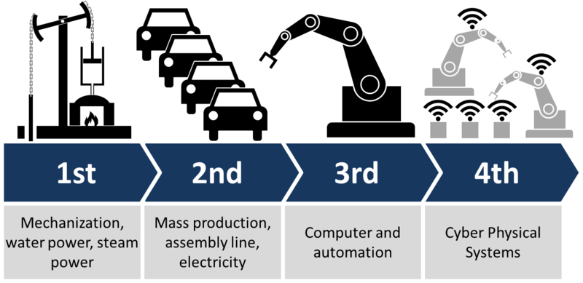
Industry. The ‘revolutions’

Slide 8
Industry. The ‘revolutions’
I industrial revolution
  England (XVIII – start XIX Century ).
  Steam machine (James Watt, 1783).
  Coale; iron; textiles
  New organization of labour (it substitute the ‘makers’ model)
  Countryside – City movements and migrations
II industrial revolution
  End XIX Century - Beginining of XX century
  Coal -> Oil, hidroelectrig energy
  New industries, new locations, new markets, new products. Series production. Fordism
III industrial revolution
  End of XX century – To-date
  Hi tech: electronics, robotics, telecommunication, bio-tech
IV industrial revolution
  Cyber-physical systems
  Makers
  Circular economy
  3D Printing

Slide 9
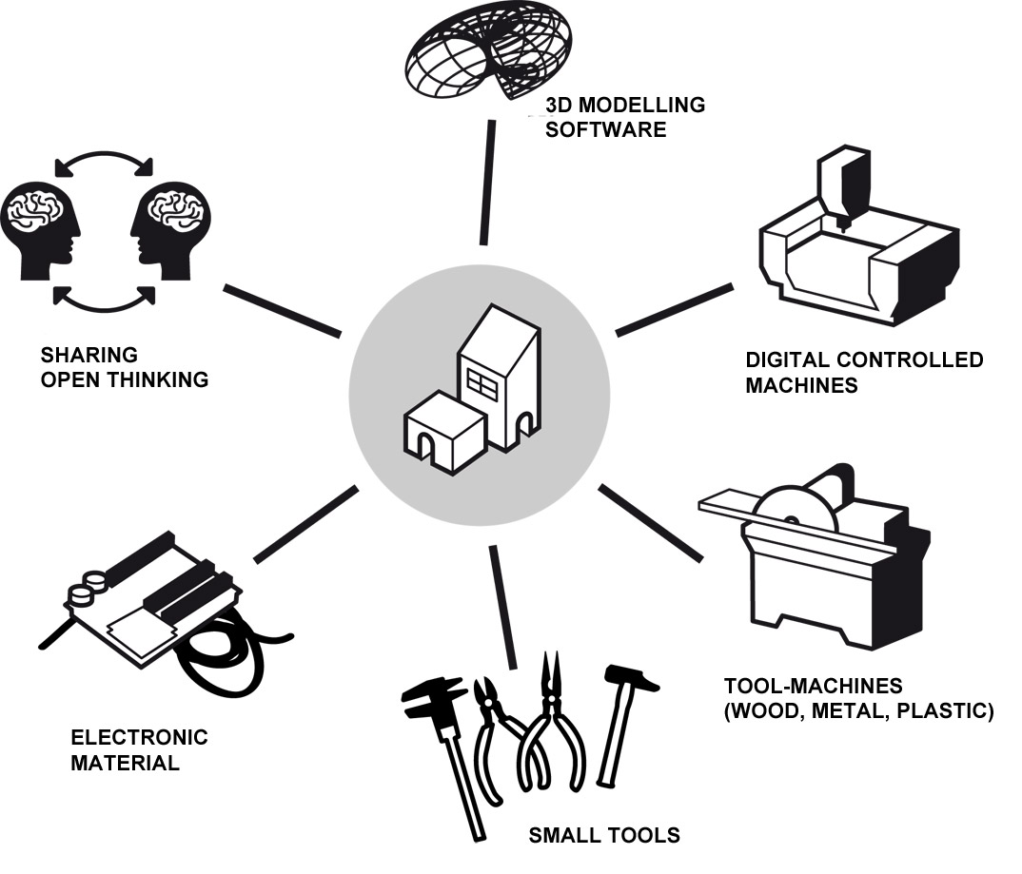
IV Industrial revolution

Slide 10
Industrial location
Spatial distribution and location of industries:
  Inserting a manufacturing firm in a given territory is important in terms of the spatial reorganization of:
    Demographic component;
    Urban structure;
    Other economic activities;
    Network of flows and traffic;
    Political- social rules.
Industrial geography: where and why industries in a given territory
  => location as a process of setting an industry. It is important to examine:
  The factors of industrial location;
  The ‘geography’ of production factors;
  Location theories

Slide 11
Industrial location
Geographical studies on the spatial distribution and location of manufacturing activities;
Factors of industrial location;
‘Geographical’ production factors;
  Land
  Capital
  Labor
  Information
Scale, manufacturing relocation and spatial concentration
Industrial location theory
  Weber, Smith
  Hoover, Palander

Slide 12
Industrial location’s factors
Natural elements
  Environment influences location
  Industries influence environment moving resources and technologies (i.e., water)
  Industry-nature relationship (externalities)
Technical factors
  Energy supply;
  Organization of transport systems;
  (technological changes make the location issue a more elastic one)
Demographic factors
  Population-industry relationship
  Population = demand of products; = workforce supply
  Expected demographic dynamics and socio-economical qualities (gender, age, education, etc.)
Historical-cultural factors
  ‘endogenous culture’ of a territory: pre-industrial organizational production often put he basis for future industrial setting.
  (industry not always an element of break with territory)
Economical factors
  More complex ones and directly related to the nature of the production activity
  Capital, work, land+ knowledge (entrepreneurship and managerial education)
Psycho-social factors
  Non-objective elements of territory;
  Actors and strategic choices: relocation; delocalization, multi-localization
  The cognitive and perceptive behavior of the company’s decision maker is relevant
  Relevant the environmental amenities
  Knowledge or ‘perception’ of the competitors’ spatial structure
Political factors
  Regional economical development
  Political target = avoid interregional imbalances deriving from a high industrial concentration (spatial planning => capacity of intervention over different aspects concerning a territory’s organization)

Slide 13
Spatiality of production factors
Economics analyzes scarcity, remuneration, accumulation of production factors;
Spatiality (spatial dimension)
Land
Capital
Labor
Information
  Entrepreneurial and managerial culture, innovation capacity

Slide 14
Spatiality of production factors
Land:
  Location (space)
  Physical support to the social organization (territory)
  Container of renewable and non-renewable resources (environment)
  Accessibility (transport)
  Physical location of industry
    Competition with other human activities;
    Preference for flat lands; water; waste disposal
    Land <> climate (advantages of setting in certain climate zones)
    Land vs territory (space transformed by work: cities and communication networks)
    Land as set of renewable resources

Slide 15
Spatiality of production factors
Capital:
  Usually considered mobile and non spatial
  Technical component of capital is located in the existing production places => places where investments for innovation and modernization will be directed (capital intensive structures)
  Financial capital in a free market chooses the areas in which a stable development is present (reduction of uncertainty)
  Consequences on the capital’s costs (interests)
  => financial instrument used as regional development policy
  Bank system and location of credit management structures

Slide 16
Spatiality of production factors
Labor:
  Production factor whose supply is more uniformly distributed in space
  Historical empirical evidence: long range migrations towards places of high workforce demand
  From a qualitative point of view, work is not mobile in space (related to a given territory)
  Labor is not related to the regulation of markets as it is an element of spatial organization and at the same time oriented and qualified by place.
  Economic neoclassic theory:
  Labor = undifferentiated set and production factor expressed by its price (without considering the social context)
  => ‘a-spatial hypothesis’:
    Employers and employee hold a satisfactory knowledge of employment and wages thanks to the market;
    Individuals are rational (maximization of profits and wages)
    Individual decisions are not influent over the general level of wages
    There are no obstacles to the mobility of labor
    Labor = exchangeable and homogenous in every particular market

Slide 17
Spatiality of production factors
Labor:
  It’s a ‘living’ production factor, not just a SIMPLE input
  Worker = carrier of a cultural process deriving from the environment
  Labor = pseudo-commodity
  Labor is crucial in location. The cost of a unit of labor increases more than the average of the production costs.
  Location processes and production conversion:
    Industrialization in ‘new countries’ (NIC – new industrialized countries) having a low cost of the workforce
    Specialization of the countries of ‘old’ industrialization in sectors producing capital-goods and non standard consumption goods and dedicated to selected and non-fragmented market shares.

Slide 18
Spatiality of production factors
Information:
  Technical knowledge (know how)
    Network of centres
    Network of the existing industrial development
    Entrepreneurial innovation
    Research and development
    Innovation diffusion
      Filtering down
      Learning by doing
      Learning by seeing
    Telematics - ICT
  Political – economical information
    Role of ‘capital cities’ in industrial location (es. Rome after Milan and Turin)

Slide 19
Industry: Scale, production decentralization, spatial concentration
Location choices and production scales
Optimal dimension: production techniques in the different industry branches
  Steel industry integrated cycle; automotive;
  Production place <= external to industry environment (physical and human resources)
  Emphasis on the market: large vs small (residual) enterprises;
  Objection = existence of spatial systems of small and medium enterprises:
    High competition;
    Economies of agglomeration;
    Specialization of the different phases and stages;
    “spread manufacturing” (see industry clusters)

Slide 20
Industry: Scale, production decentralization, spatial concentration
Tani (1987):
  Relationship between technological development, market dimension and economic production scale does not necessarily imply bigger dimensions of single production units:
  Technical de-construction of the production process:
    By means of the organization of the same firm in parallel lines;
    Decentralization of some of the production stages outside the company / firm (productive decentralization);
    Organization of a system of firms / enterprises geographically contiguous and functionally integrated in small and medium enterprises (industry cluster).

Slide 21
The recombination of the production process
Phase “A”
Phase“D”
Phase“C”
Phase“F”
Phase“B”
Phase“E”
Phase“A” (n=3)
Phase“D” (n=4)
Phase“C” (n= 7)
Phase“F” (n=1)
Phase“B” (n=2)
Phase“E” (n=5)

Slide 22
The new model of industrial production
Centre
Semiperiphery
Periphery
Strategic decisions
Big manifacturing
Research and development
Production
Sales
Production
Multinational Firm
Strategic decisions
Sales
Research and development
Sales
Sales
Production
Production
Transnational Manifacturing
Strategic decisions
Sales
Research and development
Sales
Production
Sales
Legend
Delocalized
Juridical framework
Business relationship
Decision maker
à
Activity

Slide 23
The product lifecycle
No change
No change
Components’
substitution
Low complexity change
process Innovation
Product improvement
Medium complexity change
New product
radical change
New process
New generation process
Improvement of
No change
exhisting process
Innovation’s product
Product’s lifecyclce

Slide 24
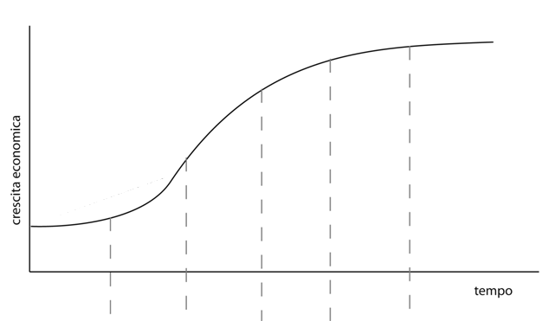
Factors influencing the product’s lifecycle
Rate of product’s sales
Time
Capital
Capital
Capital
External Economies
External Economies
Non specialized workforce
External Economies
Importance of elements
Non specialized workforce
Know-how
Know-how
Non specialized workforce
Know-how
Management
Management
Management
Stage 1
Stage 2
Stage 3

Slide 25
Product’s lifecycle and spatial diffusion
Product’s ratio of sales
Time
Central areas
Production
Semiperipheral areas
Peripheral areas

Slide 26
Factors and spatial diffusion
Capital
Capital
Capital
External Economies
External Economies
Non specialized workforce
External Economies
Importance of elements
Non specialized workforce
Know-how
Know-how
Non specialized workforce
Know-how
Management
Management
Management
Stage 1
Stage 2
Stage 3
Central Areas
Production
Semi-peripheral areas
Peripheral areas

Slide 27
Spatial diffusion
In geography we highlight two macro types of diffusion:
Diffusion as relocation (original location is abandoned: migrations; industrial re-location);
Diffusion as expansion (sprading from one place to another one):
  Contagion (direct contact: epidemics; economic crisis);
  Hierarchical or ‘waterfall’ (diffusion follows different steps or stages: example - innovation).
    Bottom up
    Top down

Slide 28
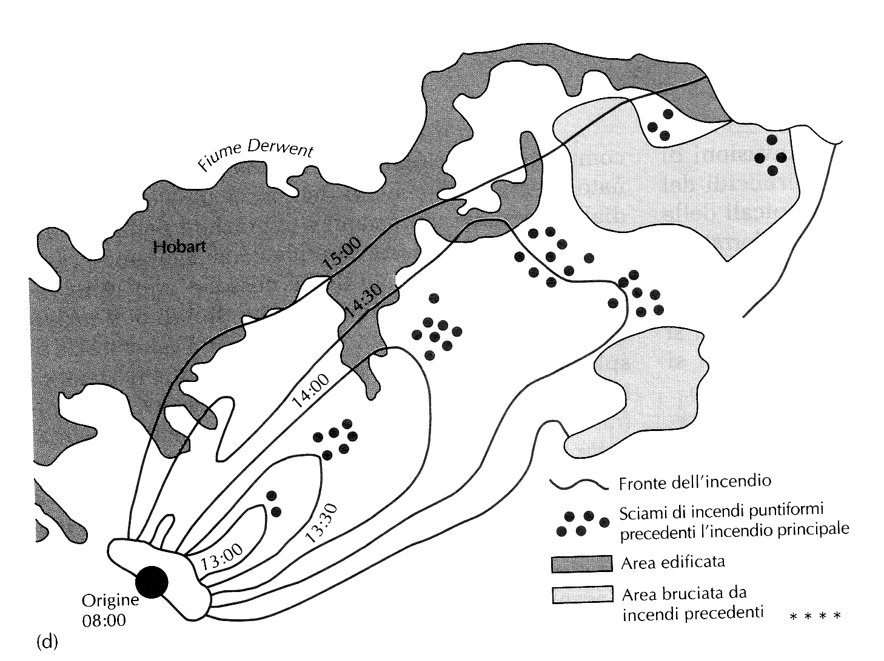
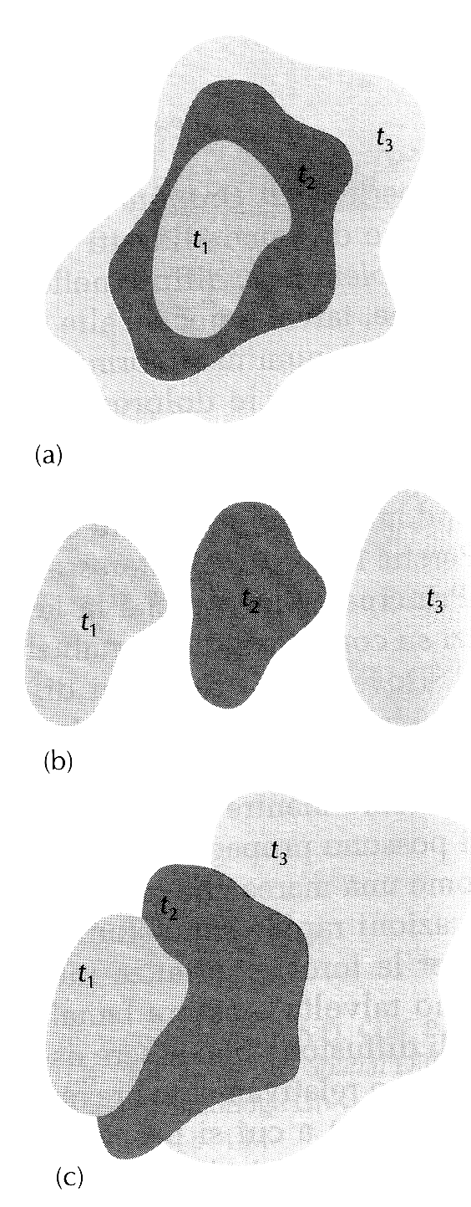
Spatial diffusion
- Expansion (a)
- Relocation (b)
- Combined effects of expansion and relocation (c) and (d)

Slide 29
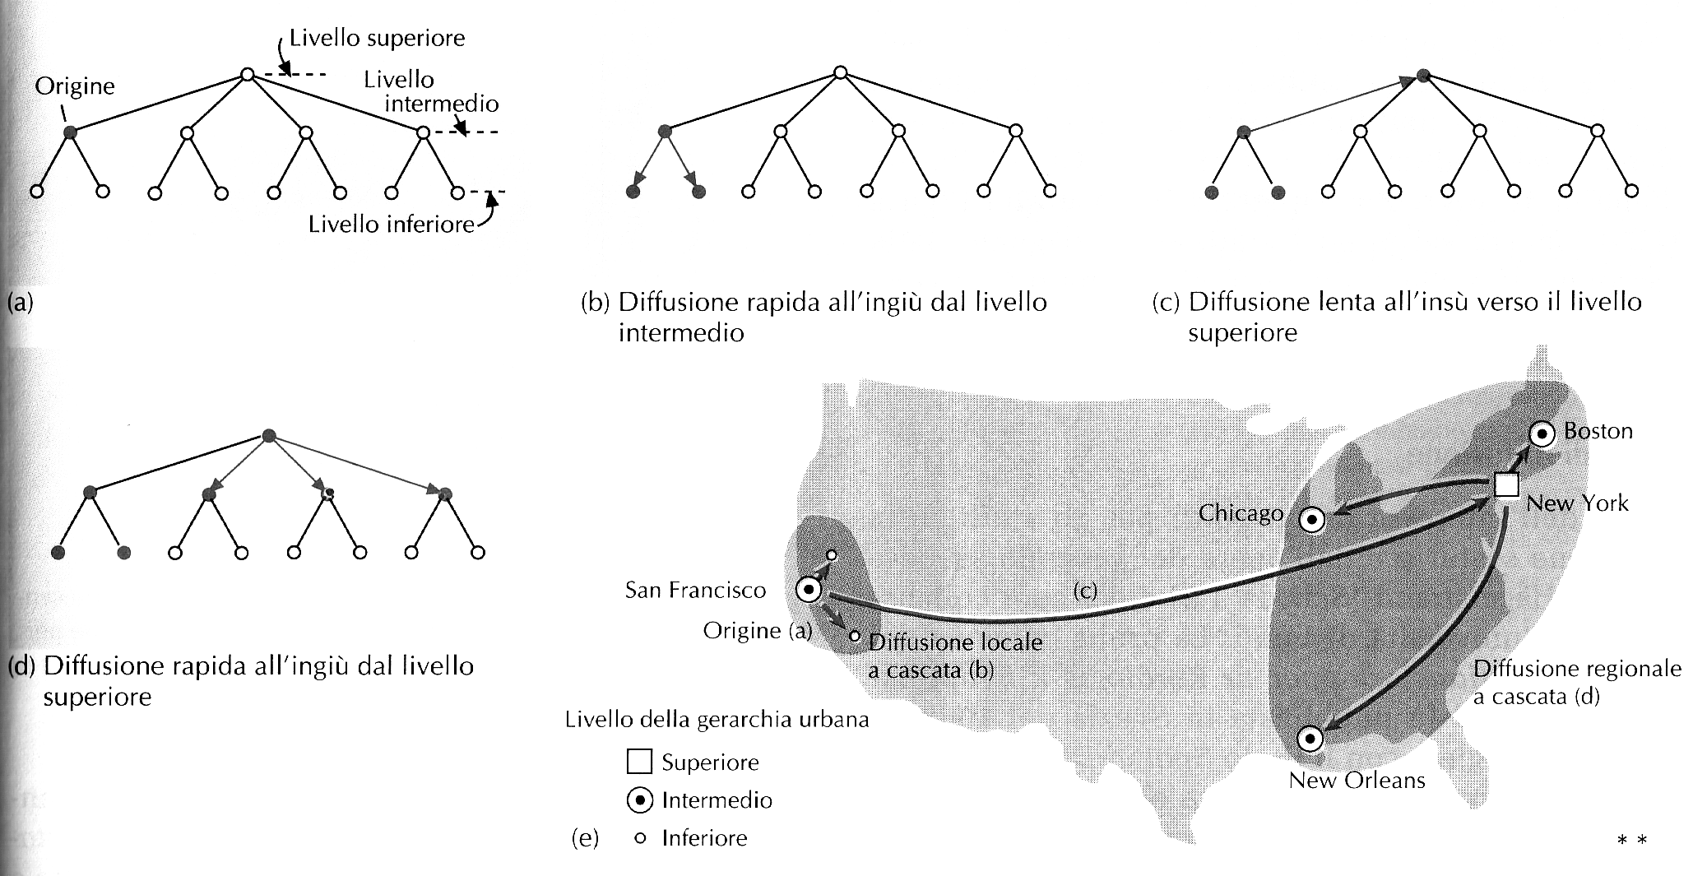
Hierarchical spatial diffusion

Slide 30
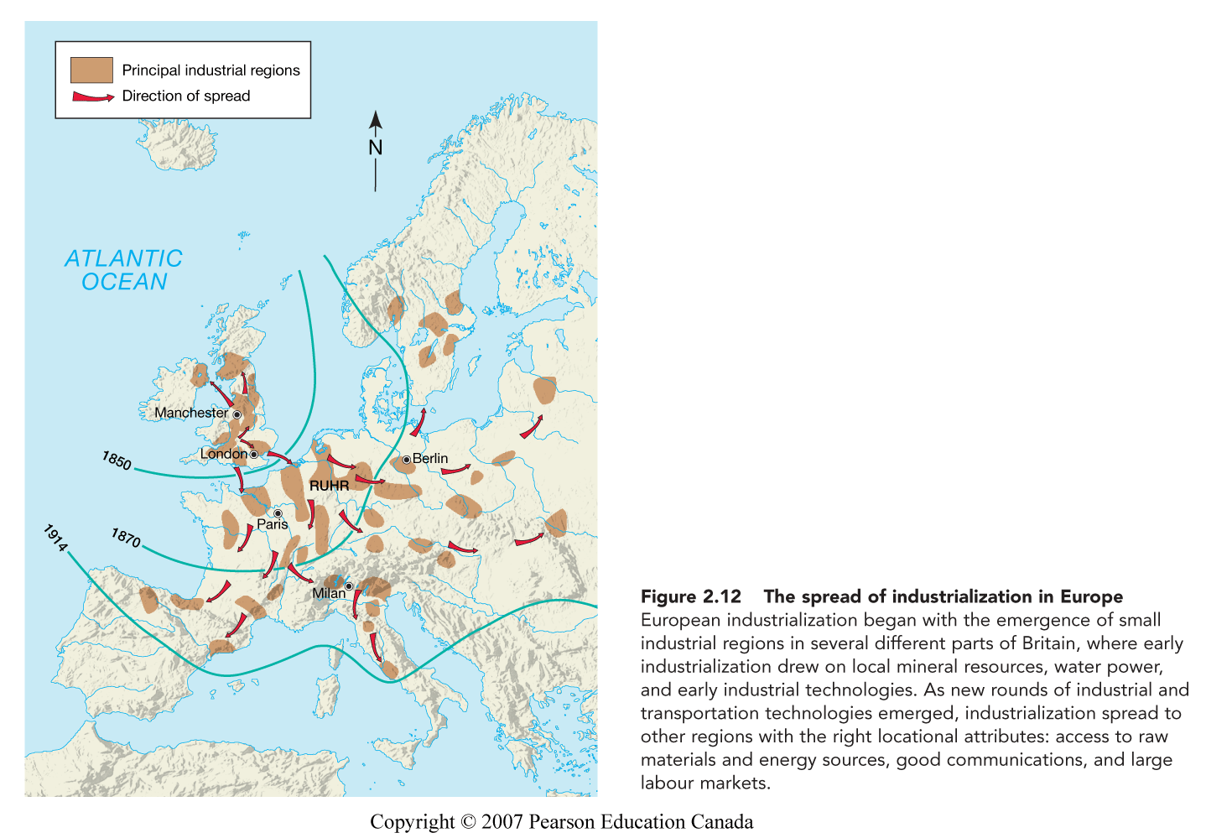

Slide 31
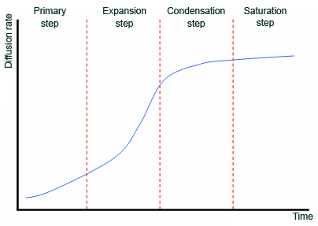
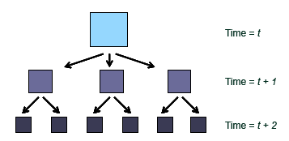
Spatial diffusion: modes
Principle of non-spatially dependant Hierarchical diffusion at successive moments of time
Typical successive stages of diffusion rate during the diffusion process. For an innovation, they are called Innovators, Early majority, Late majority and Laggards
Case study: Spatial diffusion in music
https://www.youtube.com/watch?v=_euGMuX8EG8

Slide 32
Industry Clusters
1st law of Geography (Tobler, 1970): “Everything is related to everything else, but near things are more related than those far apart” (distance decay effect)
=> very few of us live in complete isolation from the rest of society.
It is likely that many of our behaviours, choices, aspirations and ideals are influenced by those with whom we interact in our everyday lives.

Slide 33
Industry clusters
  Clusters illustrate why place still matters in the global economy.
  Michael Porter defines clusters as groups of similar and related firms concentrated in a small geographic area (Porter, 1998).
    interconnected firms in the same fields,
    specialized suppliers,
    service providers,
    firms in related industries,
    associated institutions (such as trade associations, universities, technology transfer centers, etc.).

Slide 34
Industry clusters (Industrial districts)
Industry clusters are geographic concentrations of competing, complementary, or interdependent firms and industries that do business with each other and/or have common needs for talent, technology, and infrastructure.
The firms included in the cluster may be both competitive and cooperative. They may compete directly with some members of the cluster, purchase inputs from other cluster members, and rely on the services of other cluster firms in the operation of their business.
Industry clusters are dynamic entities. They may change as the industries within them change or as external conditions change
An important characteristic of clusters is that they are centered on firms that sell outside the local, state, or even national market
Clusters may include government, nonprofit organizations, educational institutions, and other infrastructure and service providers whose presence is key to the strength of the cluster.
An industry cluster is an interconnected group of industries and firms. It differs from trade associations, which may have a narrower membership and focus.
  A trade association, for example, may include the members of a single industry and focus entirely on lobbying. By contrast clusters are agglomerations of regional industries and interdependent firms that are key to the success of the industry in the state.
  Organized industry clusters contribute broadly to the well-being of the region by addressing workforce recruitment and training issues, developing needed infrastructure, and establishing research and training programs at universities and technical colleges, to name a few.

Slide 35
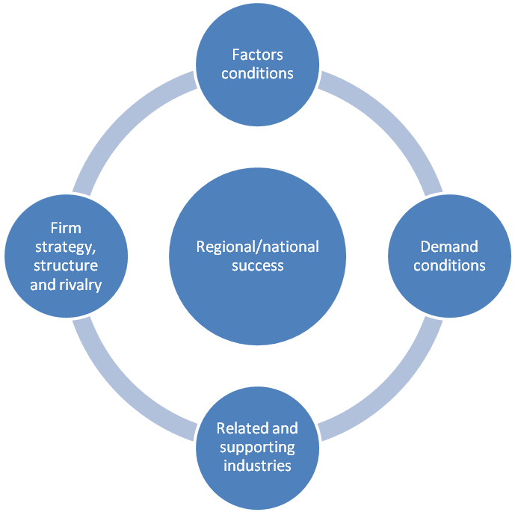
Industry clusters (Porter’s definitions)
“[…clusters are] a geographical concentration of firms interconnected by being part of the same industry or the same supply chain, by a common resource or market, by similar philosophy, by facing similar opportunities and challenges or by collaborating with the same university or research institution”¹
Michael Porter “Diamond of Advantage”, a model that offers insights into industry clusters and competitiveness:
  regions develop a competitive advantage based on their firms' ability to continually innovate, and that economic vitality is a direct product of the competitiveness of local industries.
[1] Michael E. Porter, “Clusters and the new economics of competition, Harvard Business Review, 1998

Slide 36
Definition and Advantages
Set of enterprises competitive or cooperative, which produce and sell related products, facing common challenges and opportunities.
Lower inputs and transaction costs;
High quality information at lower cost;
Higher level of trust;
Skilled labour force.

Slide 37
Effects on Environment
Increase productivity → way in which companies compete;
Benefits on innovation;
Creation of new businesses.

Slide 38
Industry clusters: factors innovation and growth
The factors that drive innovation and a cluster's growth include:
  FACTOR CONDITIONS: such as a specialized labor pool, specialized infrastructure, and sometimes selective disadvantages;
  HOME DEMAND: or local customers who push companies to innovate, especially if their needs or tastes anticipate global or local demand;
  RELATED AND SUPPORTING INDUSTRIES: nationally competitive local supplier industries that create business infrastructure and spur innovation and spin off industries;
  INDUSTRY STRATEGY, STRUCTURE AND RIVALRY: intense rivalry among local industries that is more motivating than foreign competition, and a local "culture" that influences individual industries’ attitudes toward innovation and competition
  government and chance. Historical accident and/or government actions tend to play significant roles in the development or location of industry clusters.

Slide 39
Industry clusters (Marshall definitions)
Location variables (Marshall):
  Decreasing transport costs (not relevant in location) and spatial specilisation processes;
  Geographical, historical – political, psychological factors;
  Localized economies:
    know how diffusion and capacity;
    Innovations and findings continuous through time;
    Trade and transport system development;
    Face to face agreement;
    Complementariety between industries specialized in terms of stages / phases (process) or types (of product);
    Enlarging specialized labor market (immigrant)
    Attracting entrepreneurial capacities.
  Marhsall’s analysis considers firm as homogeneus or specialized BUT capable of being extended to different industries - external economies, and complementariety of the job market and consolidated on the demand of goods)
  Marshall does not analyse the work in means of developing activities
  Marshall admits the possibility of congestion diseconomies.

Slide 40
Industry clusters (Industrial districts)
Marshall (1920) identified the firm’s external economies, although internal to the district, the basic foundations' of the distrcts’ (or local labor systems) competitiveness..
The spatial aggregation of several firms, each one operating in full technical and organizational efficiency, related in terms of production and distribution processes, determines a particular efficency condition for the overall economic system.
Economical advantages:
  Reduction of production costs;
  Reduction of transaction costs;
  Innovative and incremental dynamics settings.
The environment allows an organization based on a non-hierarchical order. The spontaneous and self propelling character in producing external economies seems to originate from evolutionary stability and by the convergence of a set of socio-economical, institutional and manufacturing.

Slide 41
Industry clusters (Industrial districts)
Technological conditions:
  Economies of scale relevant at plant level and not firm’s one;
  Technologies having minimal efficient dimensions at local, limited-production scales;
  Spatial concentration of the manufacturing relations among specialized companies.
Market conditions
  A growing market
  Standardized growth of the market and of the related specific manufacturing techniques
  Lack of substantial changes within the market relationships
Firm’s external economies:
  Economies external to firms but internal to local community; spread, as not appropriable individually by a single player;
  Localized, as belonging to firms rooted there;
  Localizing, as few and maintaining relations between neighbouring companies;
  Influenced by technological, market, socio-economical and geographical aspects;
  External economies are generated ‘unocunsciously’ through the operation of other different local actors payers within the district.

Slide 42
Industrial District vs. Cluster
Industrial District
Alfred Marshall 1890: area where concentrations of competing, complementary, or independent firms and industries do business together or have common needs;
Efficient and flexible companies, usually small and medium sized;
Cooperation and/or competition
Giacomo Beccantini: “socio-territorial entities characterized by the active presence of both a community of people and a population of firms in a bounded area with a dominant industrial activity”;
Local outsourcing;
Economies of scale and scope.
Cluster
Porter: “Geographical proximate group of interconnected companies and associated institutions in a particular field, linked by commonalities and complementarities of various types”;
Small, medium and big enterprises are welcome
Cluster’s players:
  Firms
  Financial Institutions
  Public Actors
  Universities and Research Institutes
  Organizations for collaborations
  Media

Slide 43
Clusters Vs Industrial Districts
INDUSTRIAL DISTRICT
More defined boundaries
Smaller space
Homogeneity
CLUSTER
Less defined boundaries
Wider space
Heterogeneity
→In products and sectors

Slide 44
Evolution of the Concept of cluster
1890
1980s
2000s
1950s
1990s
Marshallian
“Industrial
Districts”
New Industrial
Spaces
Industrial
Clusters & Clusters
Industrial Location
3 Economic Agglomerations:
- Of localization
- Of urbanization
- Internal returns to
scale
Italian
Industrial
Districts
Regional Innovation
System

Slide 45
HOW CLUSTERS EFFECT COMPETITION
Driving the direction and pace of innovation
Stimulating the formations of new business
Increasing productivity

Slide 46
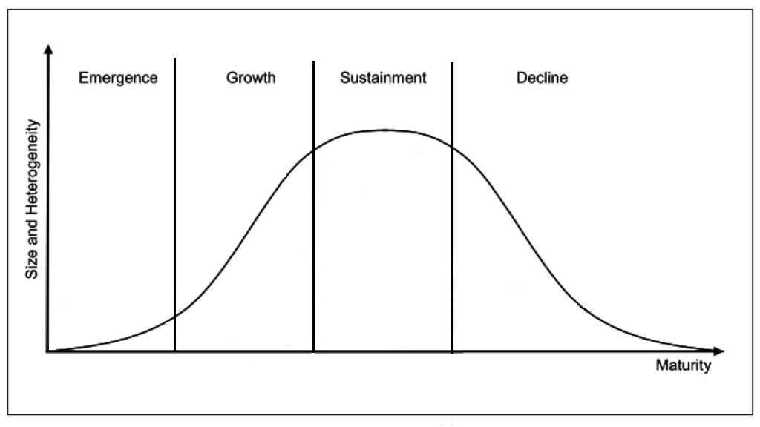
The Cluster Life Cycle (1)

Slide 47
The Cluster Life Cycle (2)
Emergence: there are few firms pioneering a new product, technological path or even a completely new industry and therefore have the push to innovate even though competition is not fierce yet. At this point we don’t have a cluster yet, as only when the firms start to interconnect and create synergies we can start talking of clusters. This may or may not happen due to several factors, for instance the absence of supporting research institutions or the fact that firm simply develop very different cultures and take different technological approaches.
Growth: if technological trajectory homogeneity is achieved and spin-offs from the original firms occur, the cluster becomes more definable, and heterogeneity decreases.
Sustainment: the cluster enjoys stability of interconnection and the spread of technology is even among firms. This is a phase of stagnation.
Decline: the cluster faces a decline in the number of firms and an increasing number of mergers and acquisitions, capital moves away from the area and start-ups formation is close to zero.

Slide 48
Lifecycle
Beginning → multiple causes;
Development → on average 10 years to gain competitive advantage;
→ responses from institutions;
→ rivalry;
Decline → internal or external factors.

Slide 49
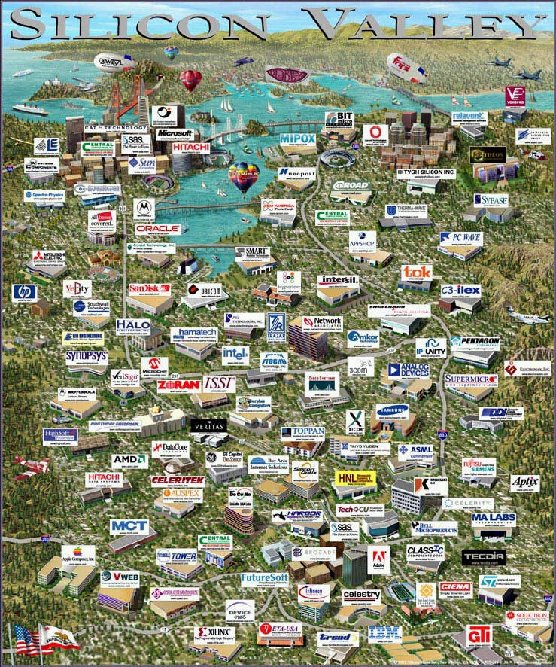
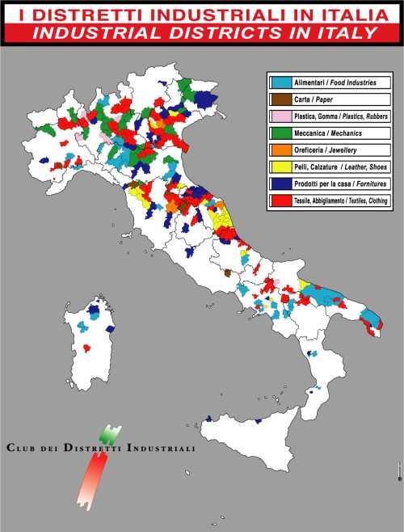
Industry clusters
(Industrial districts)

Slide 50
Innovative Clusters
Broersma “industry groups that have strong innovative links with each other, but weak innovative links with the rest of the industries”
Informal unions of different kinds of organizations in which knowledge and discoveries flow without boundaries
Porter’s Diamond of Advantage
The Inner dynamic of an Innovative Cluster

Slide 51
Cluster’s Policies
”Organized efforts to increase growth and competitiveness of Clusters within a region, involving firms, government and research community” (The Cluster Initiative Greenbook).
Cluster policies are a mean to improve and succeed, rather than an end to reach a goal
Sustain Network of SMEs as large companies are less dependent on territory
Take advantage of geographical proximity in order to build trust and social norms
Let the private sector lead
Focus mainly on short-term
Greenbook’s 6 Cluster Initiatives:
Research and Networking
Policy Action
Commercial Cooperation
Education and Training
Innovation and Technology
Cluster Expansion

Slide 52
Advantages and Disadvantages of Innovative Clusters
Advantages
Innovative ideas arising from Clusters’ fertile grounds and Knowledge creation through Universities;
Higher employment rates and wage growths bring economic growth, welfare and attract customers and investors;
Long-term relationships with suppliers that will deliver high-quality inputs, merge of production processes in order to enjoy lower costs and economies of scale
Start-ups can easily find partners and take advantage of their expertise, presence of SMEs allow closer relationships with customers
Disadvantages
Overspecialization of the Cluster
Lock-In effect
Cost-reduction most important than the need to innovate
Poor relationships and trust among the Cluster’s players which are the basis for its existence
Mismatch between long and short-term strategies
Inability of comparing Clusters

Slide 53
Focus on:
THE SILICON VALLEY CLUSTER

Slide 54
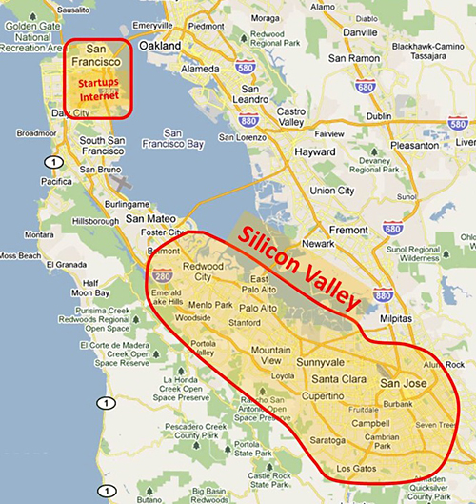

Slide 55
HISTORY: 1920/1940
Electric Engineering and Stanford’s entrepreneurial thinking
THE ROLE OF STANFORD
Hiring of Frederick Terman(1925)
Creation of a start – up incubator
Diffusion of entrepreneurial thinking and encouragement to students to follow the entrepreneurial path. HP is founded in 1939
REDISCOVERY OF ELECTRONIC COMPUTING
Alan Turing theorizes a programmable machine (1937)
Kondrad Zuse builds the first Turing machine (1941)

Slide 56
HISTORY: THE 1940’s
The WW2 and the role of cryptography
NECESSITY TO DECRYPT THE NAZI MESSAGES
Strong push to develop automatic decrypting machines;
Creation of the first digital programmable machine (1943)
Invention of the transistor (1947)
→the foundation to the development of the computer industry are laid down.

Slide 57
HISTORY: THE 1950’s
The birth of the semiconductor industry
Release of the transistor patent
Creation of The Stanford Industrial park with the purpose of creating innovation
William Shockley moves to the Santa Clara Valley and hires a lot of young engineers
Concentration of venture capital firms in the bay area
→The Bay Area becomes a very business friendly environment.
Fairchild semiconductors starts innovating the transistor technology
  Usage of silicon instead of germanium
  Development of the integrated circuit
→ The semiconductor industry starts to flourish

Slide 58
HISTORY: 1960/1975
The inventions and the boom
NEW WAVE OF INNOVATION BY FAIRCHILD
Bob Widlar produces the first “chip” (1963)
Dave Talbert creates the first analog integrated circuit (1964)
Frank Wanlass uses three layers (conducting, isolating, semiconducting) to build chips
→easier manufacturing and increased transistor density on boards.
Federico Faggin substitutes the aluminum control gates with silicon based ones
→low power consumption and heating, higher density
Boom in the semiconductor industry in the area, with a lot of start-ups and spinoffs from Fairchild, that faced a lot of key employees leaving to open their own company

Slide 59
HISTORY: 1960/1975 (2)
The inventions and the boom
MORE DEVELOPMENTS IN THE COMPUTER INDUSTRY
Foundation of Intel (1968)
  invention of the dynamic RAM memory
  Miniaturization of the processor, the first microprocessor is built.
East Coast firms such as IBM open their labs in the Silicon Valley
  invention of the floppy disk
A NEW TYPE OF CUSTOMERS ENTER THE MARKET
The hobbysists create the market for personal computer
The Silicon Valley is “officially” born. a center of gravity for capital and ideas.

Slide 60
HISTORY: 1975/1980
The semiconductor wars and the coming of Apple
THE MAIN COMPUTER PRODUCERS ENGAGE IN A WAR FOR THE MOST POWERFUL COMPUTER
Necessity to increase data storage
Necessity to optimize user interfaces and database management
APPLE IS FOUNDED IN 1976
Production of the Apple I
Boom with the Apple II
Implementation in the Apple II of the first spreadsheet program
→Record IPO in 1979

Slide 61
HISTORY: THE 1980’S
Apple vs Microsoft
AN INCREASED NUMBER OF INDIVIDUALS AND BUSINESSES REALIZE THE POTENTIAL BENEFITS OF USING COMPUTERS
There is an incredible demand for more compex software
New operative systems are required as the technology evolves
→Microsoft is hired by IBM to develop an OS
There is a shift in the focus of computers, from harware-based to software based. In this context the battle between Apple operative system and Microsoft operative system takes place. With the former relying on proprietary technology and software, and the latter engaging a more “open” approach.

Slide 62
HISTORY: 1990/2005
The Internet revolution and the dot-com bubble
THE INTERNET BECOMES AVAILABLE TO THE PUBLIC
Creation of the market for browsers (Netscape Altavista and IE)
Creation of the market for search engines (Google and AOL)
Rise of the e-commerce and increased importance of websites for companies
→Incredible amounts of money invested into dot-com companies
The Silicon Valley starts looking like it does now. Basically, a complex cluster of different industries that live in symbiosis, with high capital availability and productiviy.

Slide 63
HISTORY: 1990/2005 (2)
The Internet revolution and the dot-com bubble
THE LAST TWO WAVES OF INNOVATION IN THE SILICON VALLEY ARE SMARTPHONES AND SOCIAL MEDIA
Apple launches the first iPhone (2003) creating a new market
Facebook is founded in 2005

Slide 64
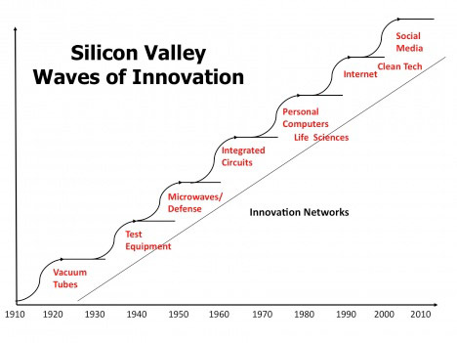

Slide 65
PORTER’S DEFINITION
“[…clusters are] a geographical concentration of firms interconnected by being part of the same industry or the same supply chain, by a common resource or market, by similar philosophy, by facing similar opportunities and challenges or by collaborating with the same university or research institution”¹
IN THE SILICON VALLEY WE HAVE
Firms part of the same industry (microprocessors, computers, software etc. taken separately)
Firms part of the same supply chain (the same sectors taken together)
Fundamental role of Stanford and UC Berkeley throughout the area’s history
[1] Michael E. Porter, “Clusters and the new economics of competition, Harvard Business Review, 1998

Slide 66
PORTER’S DEFINITION (2)
STANFORD
VENTURE CAPITAL
$$$
FIRMS
PROXIMITY IN THE SILICON VALLEY

Slide 67
PORTER’S DIAMOND MODEL (2)
FACTOR INPUTS
  Cheap raw materials in the semiconductor era
  Steady production of talent inside Stanford
  Availability of Capital thanks to VC firms and successful IPO’s

Slide 68
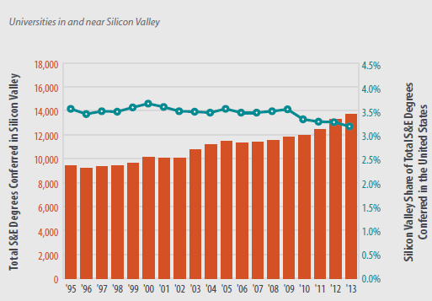

Slide 69
PORTER’S DIAMOND MODEL (3)
DEMAND CONDITIONS
  Shift from defense-only demand to hobbyists
  Hobbyists create the market for home based computers and provide input for further development
  As miniaturization occurs and software becomes more complex the demand for computers, software and microprocessors skyrockets
  New high demand markets arise with the coming of Internet

Slide 70
PORTER’S DIAMOND MODEL (4)
RELATED AND SUPPORTING INDUSTRIES
  Many interdependent industries promote the transfer of knowledge and know-how;
  The different industries that coexist in the area support each other and often cooperate (e.g. chip, computers and software firms)

Slide 71
PORTER’S DIAMOND MODEL (5)
FIRM STRATEGY, STRUCTURE AND RIVALRY
  Positive effect of close competition in the various industries
  Coexistence of different approaches
  There are not dominant strategies and business models

Slide 72
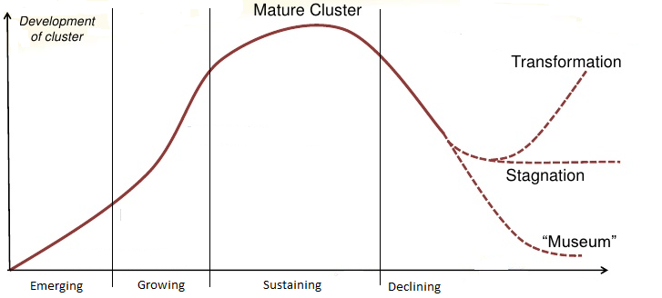
THE CLUSTER LIFE CYCLE (2)

Slide 73
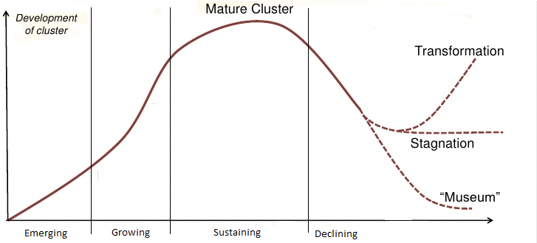
Cluster Life Cycle
Emergence: driven by environmental advantages or market demand
Growth: pressure on innovation, competition starts to emerge
Sustainment: phase of stability, strategies of cost minimizing, fixed capital requirements
Decline: investments drop due to new incumbent ideas/technologies
Transformation: a new Cluster is formed from the previous one
Stagnation: symbol Clusters remaining in the market
Museum: disappearing Clusters

Slide 74
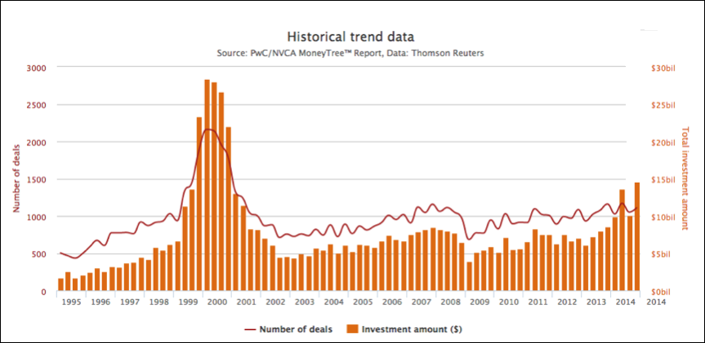
THE PRESENT SITUATION
Dot-com bubble
Global crisis

Slide 75
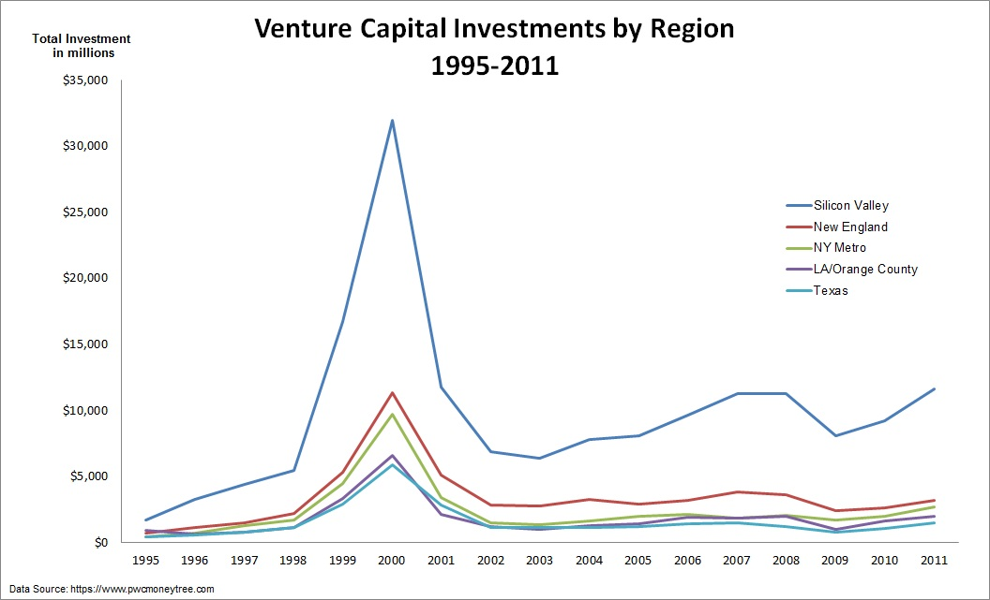
THE PRESENT SITUATION (1)

Slide 76
HETEROGENEITY CREATION
APPLE
Prevents the emergence of a dominant design
Created the online music market
Created the smarphone market and all the related industries (apps)

Slide 77
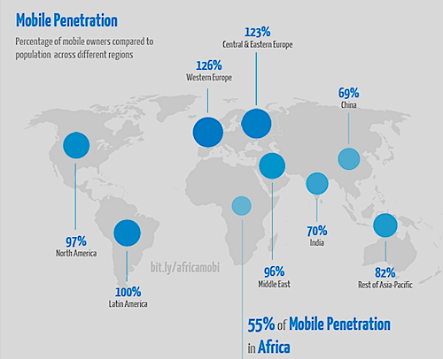

Slide 78
