Slide 1
Proverbs and Sayings
About Money

Slide 2
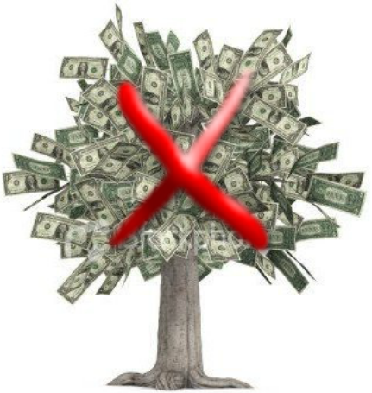
Proverbs & Sayings About Money

Slide 3
Proverbs & Sayings About Money
Money doesn’t grow on trees

Slide 4
Proverbs & Sayings About Money
1. The best things in life are _____.

Slide 5
Proverbs & Sayings About Money
1. The best things in life are free.

Slide 6
Proverbs & Sayings About Money
2. _____ is money.

Slide 7
Proverbs & Sayings About Money
2. Time is money.

Slide 8
Proverbs & Sayings About Money
3. Take care of the pennies and the _____ will
take care of themselves.

Slide 9
Proverbs & Sayings About Money
3. Take care of the pennies and the pounds will
take care of themselves.

Slide 10
Proverbs & Sayings About Money
4. Money _____.

Slide 11
Proverbs & Sayings About Money
4. Money talks.

Slide 12
Proverbs & Sayings About Money
5. Neither a borrower nor a ________ be.

Slide 13
Proverbs & Sayings About Money
5. Neither a borrower nor a lender be.
LORD POLONIUS: Neither a borrower nor a lender be; For loan oft loses both itself and friend, And borrowing dulls the edge of husbandry.
From Shakespeare's Hamlet, 1602

Slide 14
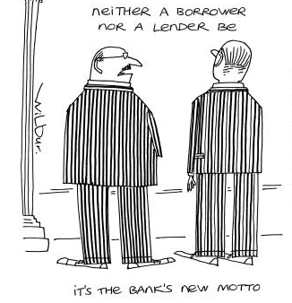
.

Slide 15
Proverbs & Sayings About Money
6. Health is better than _____.

Slide 16
Proverbs & Sayings About Money
6. Health is better than wealth.

Slide 17
Proverbs & Sayings About Money
7. A _____ and his money are soon parted.

Slide 18
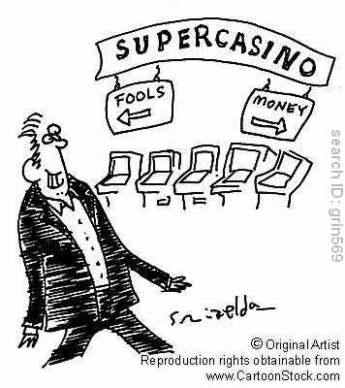
Proverbs & Sayings About Money
7. A fool and his money are soon parted.

Slide 19
Proverbs & Sayings About Money
8. Money is the root of all _____.

Slide 20
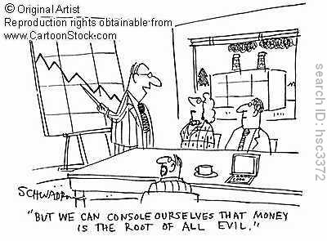
Proverbs & Sayings About Money
8. Money is the root of all evil.

Slide 21
Proverbs & Sayings About Money
9. Money makes the _____ go round.

Slide 22
Proverbs & Sayings About Money
9. Money makes the world go round.

Slide 23
Proverbs & Sayings About Money
10. Money is a good _____, but a bad master.

Slide 24
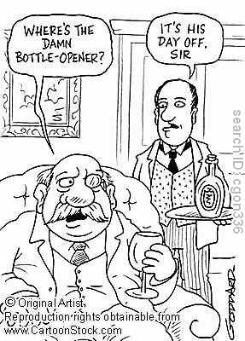
Proverbs & Sayings About Money
10. Money is a good servant, but a bad master.

