Slide 1
CALENDARIO DELLE LEZIONI - NOVEMBRE
14/11, ore 14-16, edificio Q
20/11, ore 11-13, edificio Q
21/11, ore 14-16, edificio Q
22/11, ore 9-11, edificio Q
27/11, ore 11-13, aula Z
29/11, ore 9-11, aula Z

Slide 2
CALENDARIO DELLE LEZIONI - DICEMBRE
4/12, ore 11-13, edificio Q
5/12, ore 14-16,edificio Q
6/12, ore 9-11, edificio Q
11/12, ore 11-13, edificio Q
12/12, ore 14-16, edificio Q
18/12, ore 11-13,edificio Q
19/12, ore 14-16, edificio Q (eventuale recupero)

Slide 3
Programma di massima
Articolato in 12 lezioni
Nella maggior parte di queste faremo uso di computer con delle semplici applicazioni della genomica, con particolare attenzione all’analisi di dati genomici e trascrittomici
Per comodità tutti i tool che utilizzeremo sono inseriti come moduli operativi in un software commerciale, il CLC Genomics Workbench 11 (prodotto dalla Qiagen)
Ci connetteremo ad un server in remoto che gestirà le sessioni di tutti gli utenti

Slide 4
Contatti
Marco Gerdol
Edificio Q – Stanza 214
Tel. 0405588676
Mail: mgerdol@units.it
Per richieste riguardo agli esami si prega di mettere in copia alle mail anche il Prof. Pallavicini

Slide 5
Materiale didattico e modalità di esame
Tutto il materiale didattico verrà messo a disposizione su Moodle2
Slides riguardanti la parte teorica
Pdf riguardanti i tutorials di alcune parti «pratiche» viste a lezione, in particolare per quanto riguarda le esercitazioni al CLC Genomics Workbench
Esame a risposta multipla (salvo diverse richieste/esigenze da parte degli studenti)
45 domande, 4 possibili risposte, una soltanto corretta, nessuna penalità per risposte errate

Slide 6
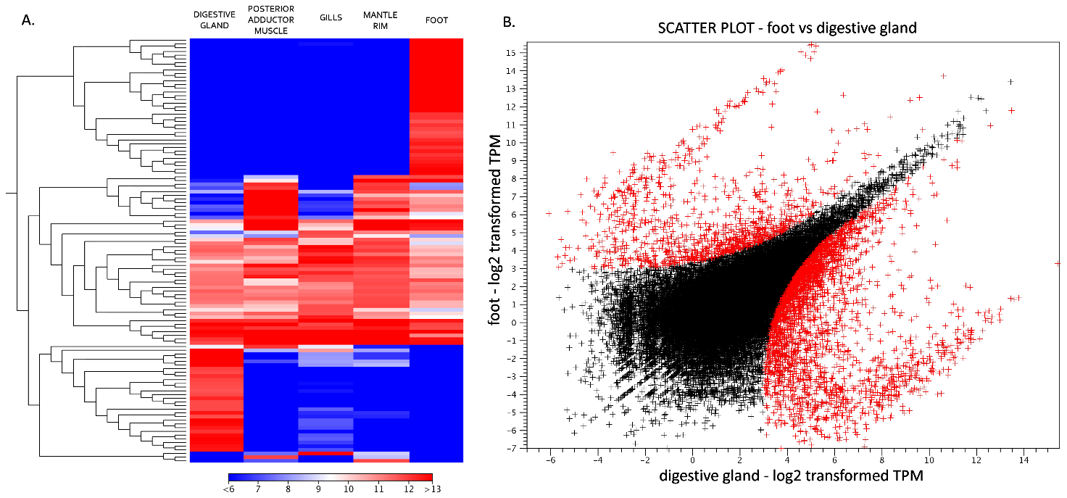
Esempi di domande
L’immagine mostrata sopra è tratta da una recente pubblicazione e riassume alcuni dettagli di un esperimento di espressione genica tramite RNA-seq. Tuttavia alcuni dettagli sono stati volutamente nascosti. La scala colorimetrica della heat map a sinistra indica:
a) La profondità di sequenziamento dei vari campioni.
b) I livelli di espressione di ciascun gene nei vari campioni
c) I p-value di sovra e sotto-espressione per ciascun gene
d) Il numero di falsi positivi per ciascun campione

Slide 7
Esempi di domande
La zero-mode waveguide è una camera di visualizzazione nanofotonica utilizzata dai sequenziatori:
a) SMRT PacBio
b) Illumina
c) 454
d) Nanopore
Gli adattatori sviluppati per la costruzione di librerie Illumina sono chiamati:
a) X adapters
b) Y adapters
c) Blunt End adapters
d) Linkers

Slide 9
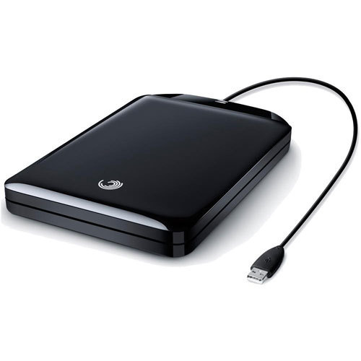
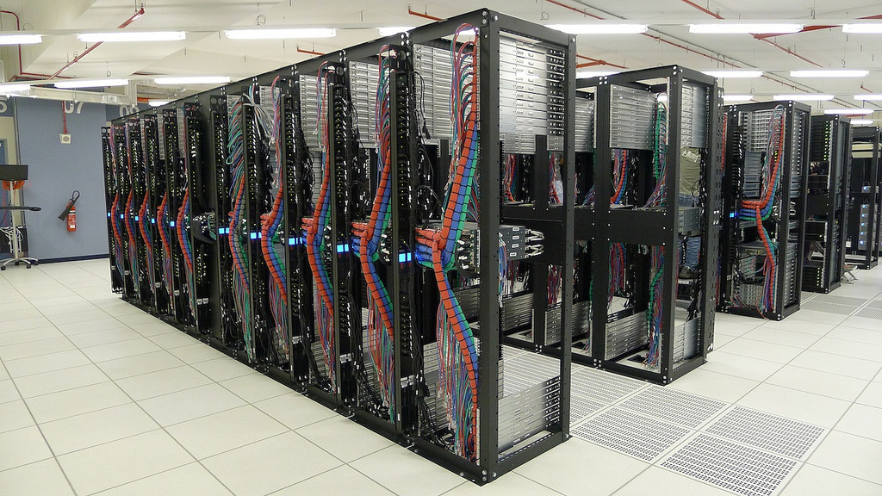
Management of genomics data: not an easy task!
First issue: data outputs are large! We are talking about several dozen Gb of raw data per sequencing run
Mid-size genomics labs usually need several Tb of storage space to manage sequencing data for current analyses, and additional space for data backup
Disk space requirements are increasing over time, as the outputs of sequencing platforms increase as well
Need for storage of both raw sequencing data and «clean» sequencing data
Data is usually deleted/moved to a public repository only after the analyses have been completed and the results have been published
Need to re-use data in the future
Files generated by the analyses are also large -> each raw file generates files at least 3 times larger

Slide 10
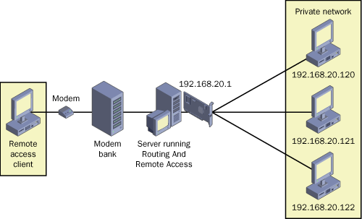

Management of genomics data: not an easy task!
Second issue: the computational power required is not negligible
Multiple CPUs are usually required to run de novo assembly and mapping algorithms
High RAM memory is required to load sequencing data
Use of high-performance servers, clusters for data analysis managed by external services or units specifically created by each institution
Genomics analysis are not something you can usually perform on your laptop!
This can be done by remote access to a server: the screen displays data generated by calculations performed by a remote CPU

Slide 11
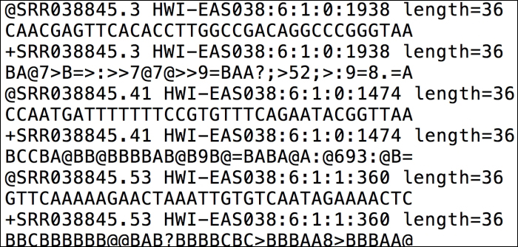

Management of genomics data: not an easy task!
Third issue: data format compatibility
Each sequencing platforms generate output files that need to be interpreted in order to be «read» by downstream applications
Each third-party application uses its own file formats
Moving back and forth between one application and another requires the capability of reading different formats
Extensive use of scripts (i.e. BioPerl, Phyton, ecc.) for format conversion in bioinformatics
Several applications have built-in scripts that enable such conversions in an automated version

Slide 12
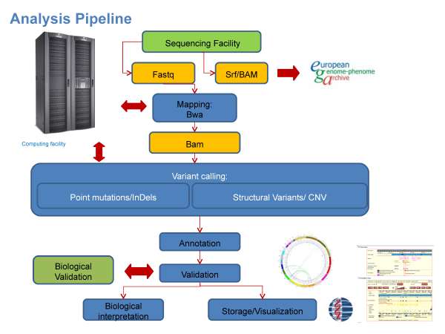
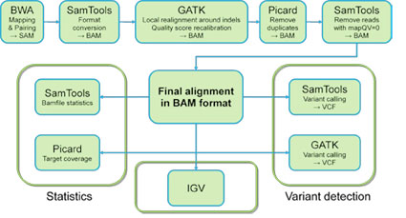
Management of genomics data: not an easy task!
Fourth issue: many different standalone tools, developed by different people, perform tasks than can be useful
These tools can be combined sequentially to create a pipeline for data analysis
This process is for advanced users, who have the skills necessary to run all programs (often through command line), debug possible issues and have at least some basic programming knowledge
The whole process is not simple
Not suitable for «regular users», i.e. biologists, doctors, etc. with no bioinformatics background

Slide 13
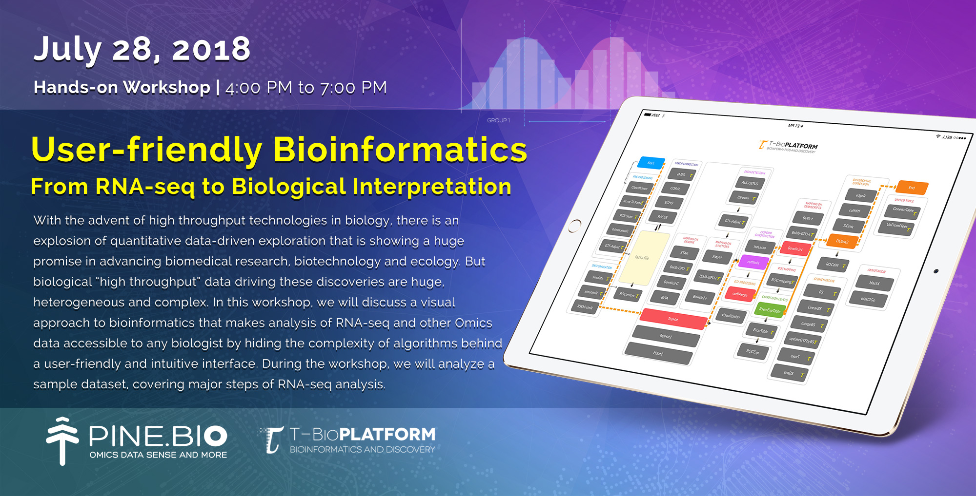
What is the solution to these problems?
Development of user-friendly software which combine these tools in a user-friendly interface
They can manage different data formats and read sequencing outputs
The can create reports, graphs and tables which can be exported and easily interpreted by the final user
No need for advanced bioinformatics skills
Obviously some training is needed to understand how to carry out the analyses correctly

Slide 14


What are the main features of these softwares?
They need to be constantly updated to keep up-to-date with most recent innovations in the field of sequencing, otherwise they get old very quickly
They need to be easy to use and compatible with the most frequently used operating systems (Windows, Mac, Linux)
They need to include multiple tools to enable all the phases of an analysis, from raw data import to the desired outcomes
They need to provide clear results, summarized in tables, figures, graphs that can be understood by end-users
The management of these aspects requires constant support, the development of user guides and tutorials, and therefore most of such software are developed (or have been bought) by large companies than can provide financial support

Slide 15
Galaxy: an open-source option
«Galaxy is an open source, web-based platform for data intensive biomedical research. […] You can install your own Galaxy by following the tutorial and choose from thousands of tools from the Tool Shed.”
Galaxy is a collection of tools available online on public servers that can help users lacking an appropriate computer to carry out advanced genomics analyses online
https://usegalaxy.org

Slide 16
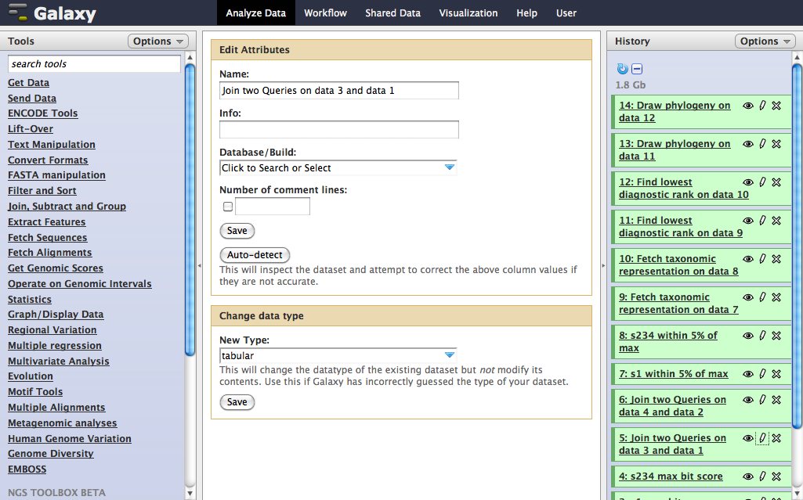
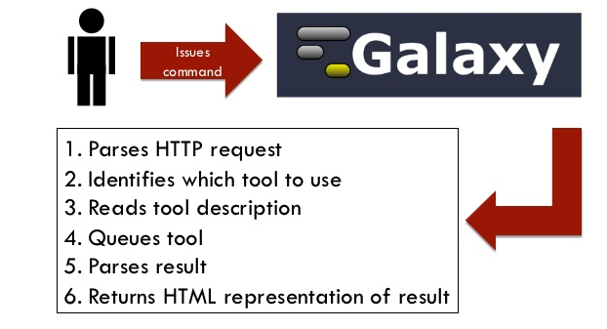
Galaxy: an open-source option
Galaxy still requires basic understanding of the main parameters of each tool and allows the combination of different tools for the creation of a custom pipeline of analysis
It is a tool for intermediate/advanced users, with limited capabilities of data visualization
It allows the user to compute otherwise unsolvable tasks, but it does not provide much help in the interpretation of results
The user can upload/download files from Galaxy servers, but all tasks are performed remotely!
This is a good option as long as you know what you are actually doing… but most basic users do not have this knowledge

Slide 17
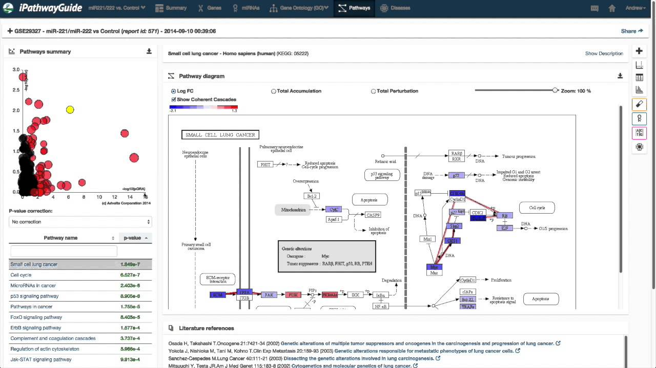

User-friendly options
Most of these started as tools freely available to the public, and were later purchased by larger companies
They now require registration and access through the payment of an annual fee
This means they are only affordable to universities and/or large research centers
One example is iPathwayGuide

Slide 18

CLC Genomics Workbench: use and applications
User friendly interface that integrates many standalone applications which can be usually run by command line
«Core bioinformatics tools»: sequence visualization and editing, BLAST, MSA, etc.
Advanced tools: RNA-seq pipeline, variant detection,biological insights, etc.
Plugins which allow particular investigations (e.g. CLC microbial genomics)

Slide 19
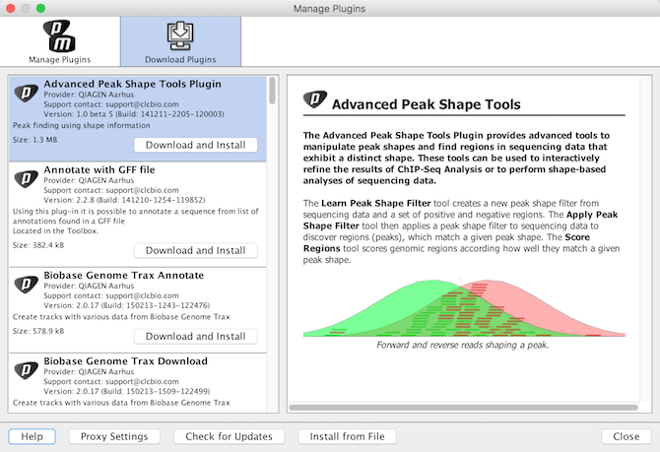
Plugins can be installed separately by users working in specific fields of research (e.g. Human clinical genomics).
We will use some of these features BUT not all of them are freely available

Slide 20
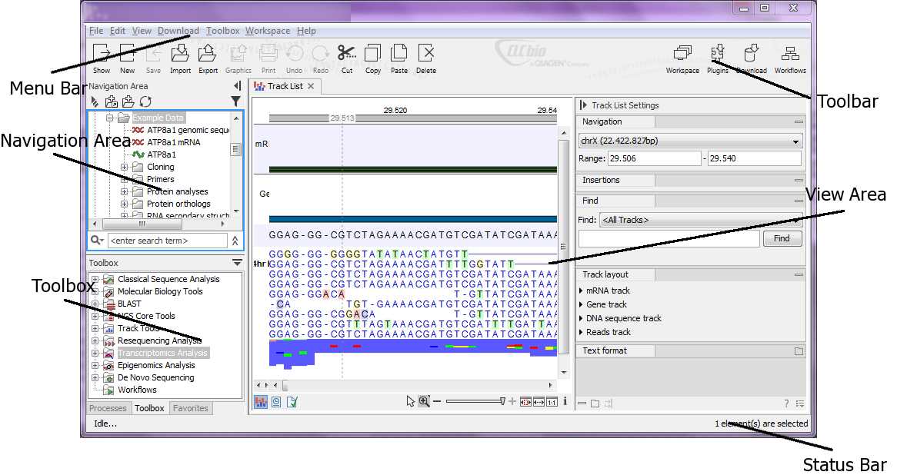
User interface
You will be able to have remote access to CLC Genomics Workbench as a guest user from our own laptop

Slide 21
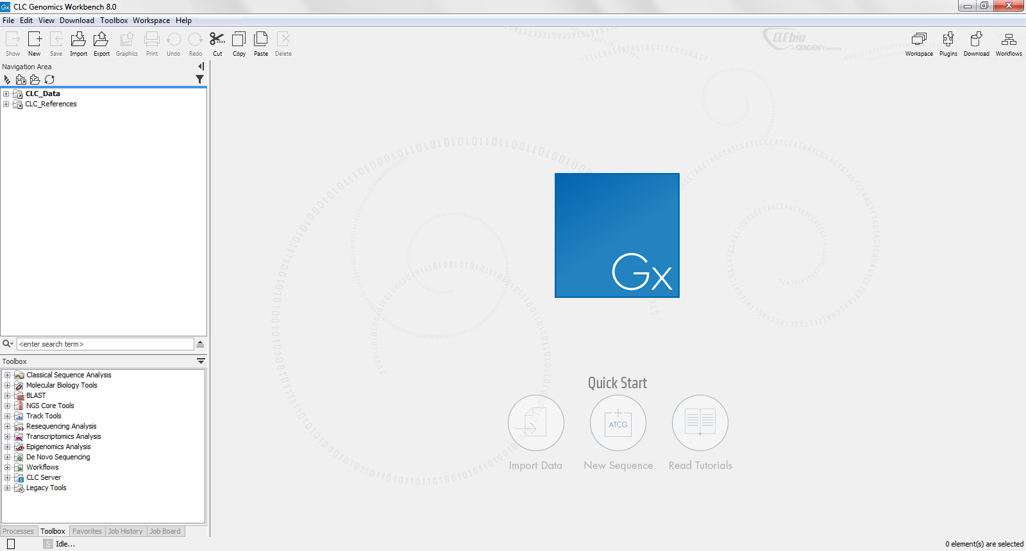
Empty workspace

Slide 22
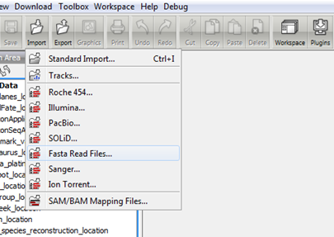
Importing and exporting files
Support for most of the commonly used file formats in bioinformatics. Allows the conversion between different file formats
FASTA, FASTQ (NGS outputs!), Sanger sequencing traces, annotation files (GFF), mapping files (SAM/BAM), phylogetic trees (Newick), protein structure files (pdb), etc.
Data can be directly imported from NCBI through accession IDs

Slide 23
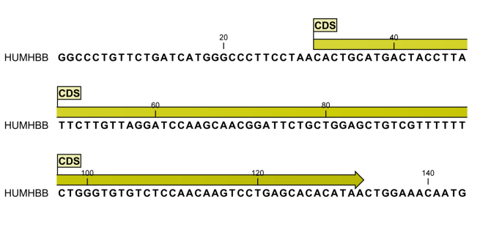
Basic sequence analysis
Visualization and editing
Use of annotations: gene regions in genomes; intron and exons within genes; CDS regions in mRNAs; SNPs in nucleotidic sequences; conserved domains in proteins, etc.

Slide 24
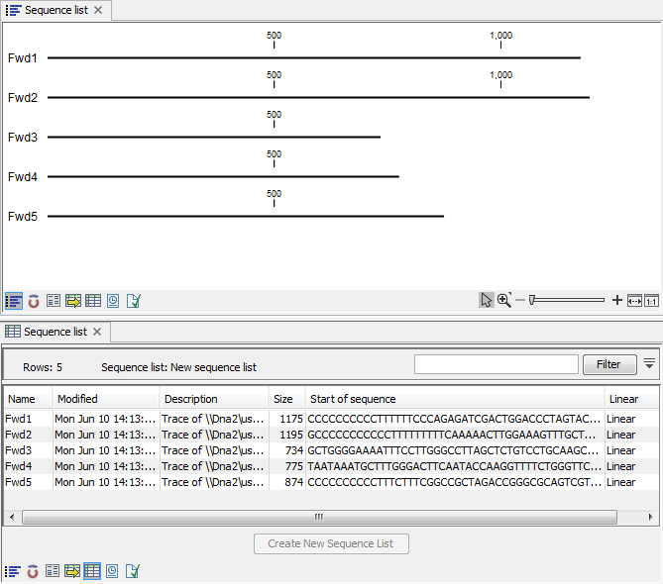
Basic sequence analysis
Sequences are usually grouped in lists
Examples: all the chromosomes of a genome; all the mRNAs in a transcritome
Useful tool for running analyses on multiple sequence sets

Slide 25
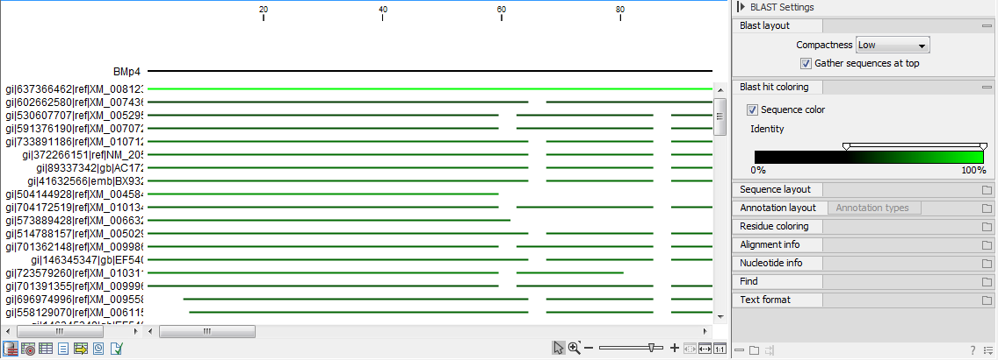
BLAST
Probably the most important tool in comparative genomics
Allows to detect similarity between sequences
Fundamental for sequence functional annotation
Can be used to look for similarities in a local database or in a publicly available database at the NCBI

Slide 26
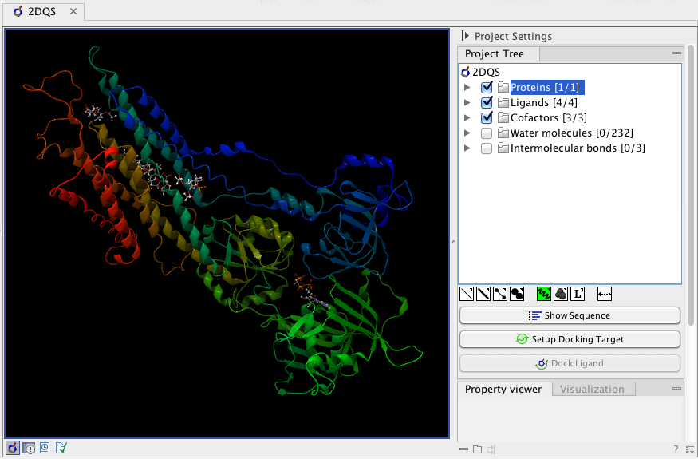
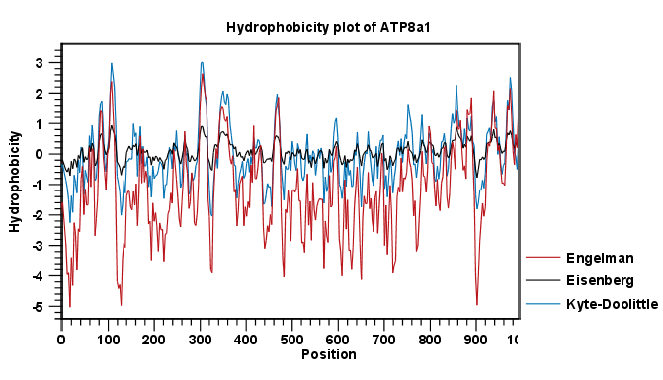
Other features
3D protein view
Protein plots (hydrophobicity, antigenicity, charge, etc.)

Slide 27
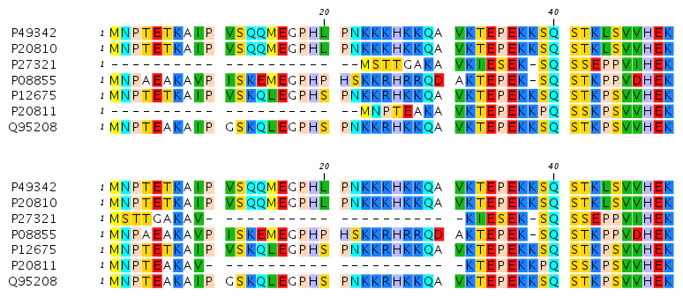
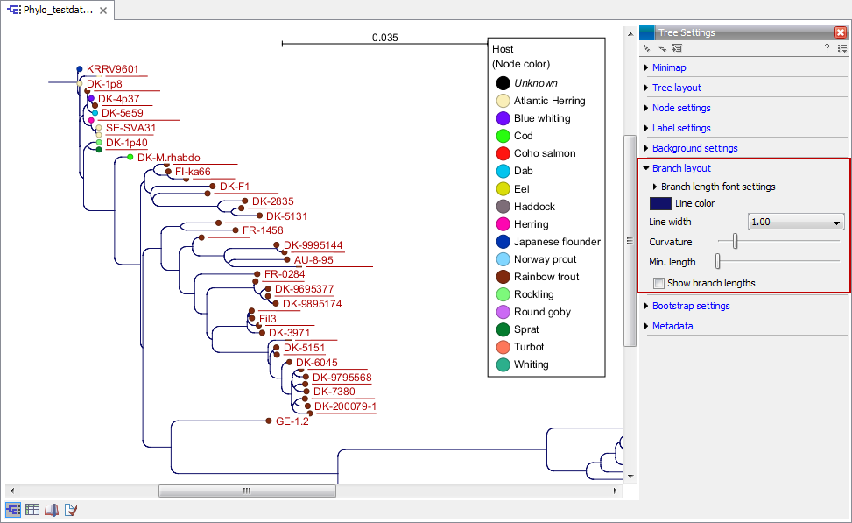
Multiple sequence alignment and phylogeny
CLUSTALW, MUSCLE etc. Are important tools to align a set of homologous sequences.
This permits to identify mutations and divergent nucleotides/aa residues
MSA are often used as an input for phylogenetic analyses (Neighbour-Joining, Maximum Likelihood, Bayesian inference,etc.

Slide 28
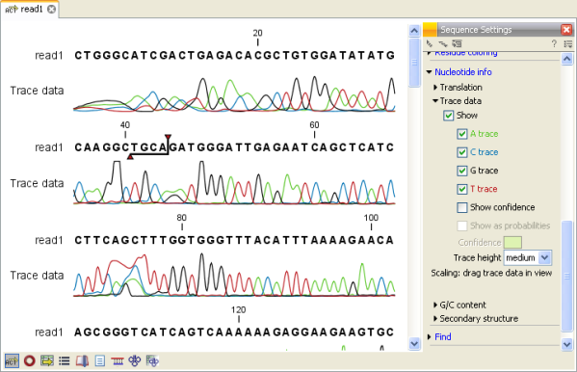
Sequencing data analysis
Management of Sanger and NGS (Illumina, 454, PacBio, etc.) raw sequencing data
This includes visualization, trimming (removal of low quality regions and adapters), demultiplexing an a complex set of advanced downstream analyses
These depend on our target organism (model vs non-model species) and application (genome sequening/RNA-seq/targeted resequencing/bisulfite sequencing etc.

Slide 29
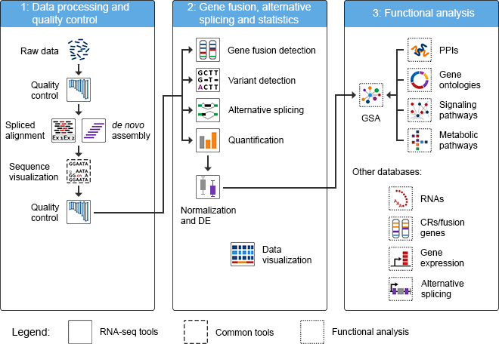
Analysis of high throughput sequencing data

Slide 30
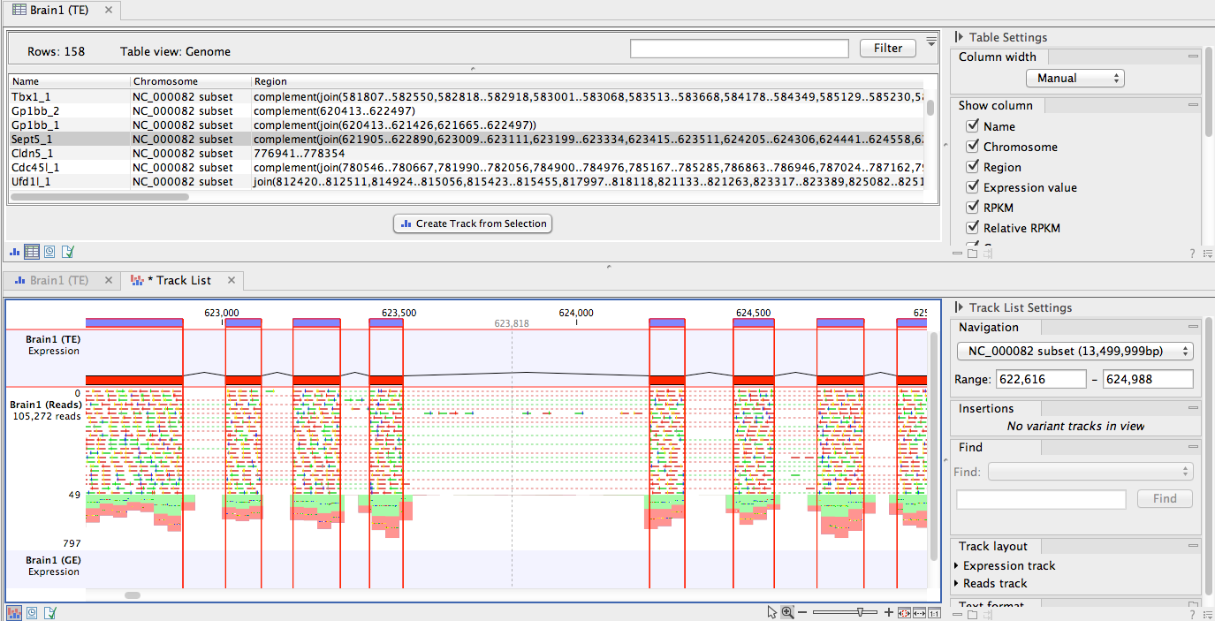
Human studies
Mapping on a reference genome (latest Ensembl release)
Functional analysis: we will use an external software (Ingenuity Pathway Analysis)

Slide 31
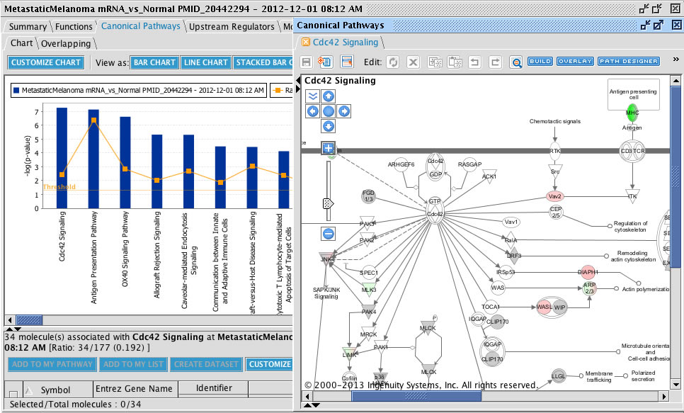
Ingenuity Pathway Analysis
Allows the biological interpretation of gene expression alterations and the prediction of upstream regulators and downstream effects

Slide 32
Settings MobaXterm
https://mobaxterm.mobatek.net per il download
Cliccare su Session -> SSH
Inserire come remote host: «140.105.153.106»
Il vostro username sarà «studenti» e la vostra password «genapp2018», da inserire soltanto al primo login
Il programma si lancia dalla shell con il comando «clcgenomicswb11»
L’account resterà attivo fino a fine gennaio, di modo da permettervi di poter ripetere autonomamente, se lo riterrete necessario, le esperienze viste a lezione

