Slide 1
Interindividual variability in drug response
Treatment outcome
(same dose)
Response
No effect
Adverse effect

























Slide 2
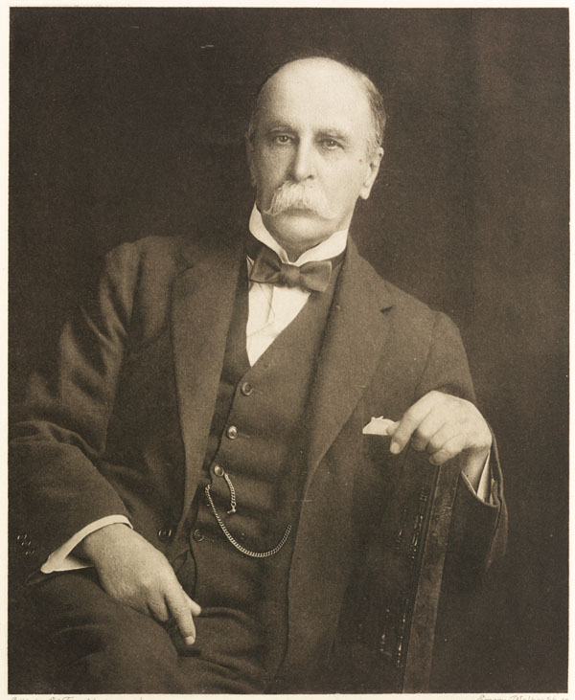
If it were not for the great variability among individuals, medicine might as well be a science and not an art.
Sir William Osler, Physician 1892
Johns Hopkins School of Medicine
The father of modern medicine
Notes:
Da qui

Slide 3
For some diseases the percentage of drug response is still unsatisfactory
US Food and Drug Administration

Slide 4
In US every year 2 million patients are hospitalized for an adverse drug reaction (ADR) to a drug that was correctly prescribed and 100.000 of these cases are fatal (4°cause of death). Lazarou J et al. JAMA 1998, 279, 1200
In UK, hospitalization for an ADR have a prevalence of 6.5%, with an annual cost of $847 millions. Pirmohamed M et al. Br Med J 2004, 329, 15.

Slide 5
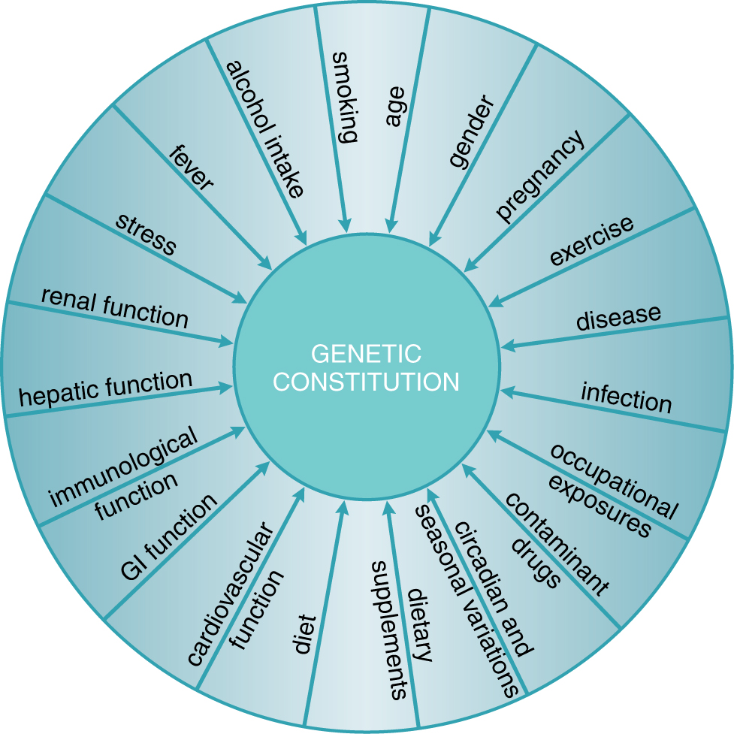
Exogenous and endogenous factors that contribute to interindividual variability in drug response
Physiological
Habits
Pathological
Genetic
Goodman and Gilman, 2011

Slide 6

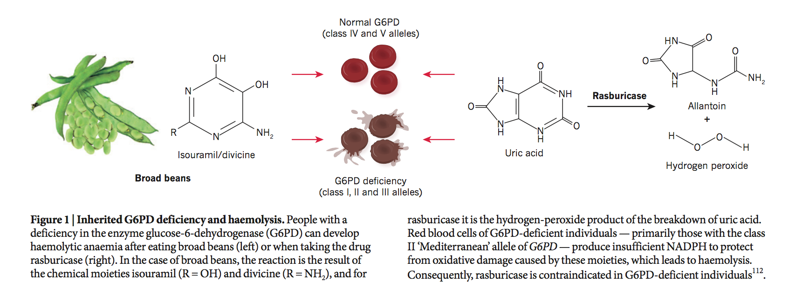
Genetic characteristics predispose to response to drugs and other substances
510 BC
Pitagora forbade his disciples to eat broad beans

Slide 7
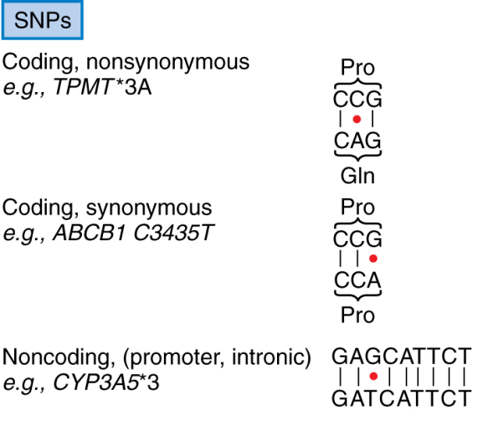

Genetic variants
Single nucleotide polymorphism (SNP)
Transition (pur→pur, pir→pir)
Transversion (pur↔ pir)
~ 1 nucleotide every 300-1000 bp
~ 17.000.000 SNPs
Deletion
Insertion
Sequence repeat
Gene copy number variation
~ 8.000 CNV
Notes:
Polimorfismo:
differenze genetiche ereditate non individuali
Differenze interindividuali e inter-etniche nel metabolismo dei farmaci

Slide 8
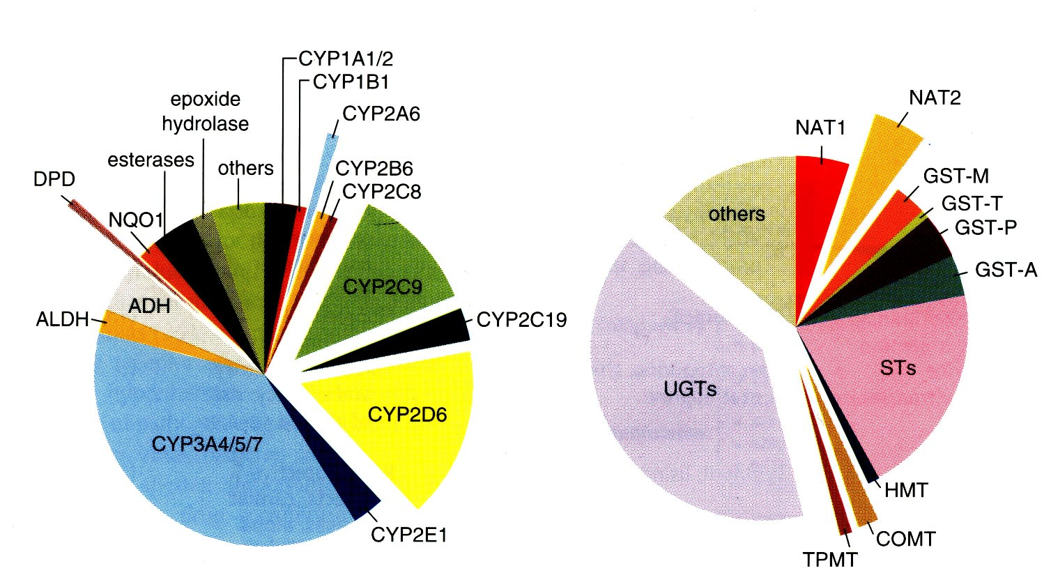
Some of the main enzymes involved in the metabolic inactivation of drugs present polymorphisms of activity that are genetically determined
Phase I
Phase II
Science 1999; 286: 487-491
Notes:
DPD: diidropirimidina deidrogenasi

Slide 9
Personalized therapy
Treatment Outcome (same dose)
Responder
No effect
Adverse event

























Slide 10
Endogenous and exogenous factors contribute to variability in drug effects
physiological
pathological
genetic
Goodman and Gilman, 2011

Slide 11
Variability can be defined as:
pharmacokinetic
pharmacodynamic
idyosyncratic

