Slide 1
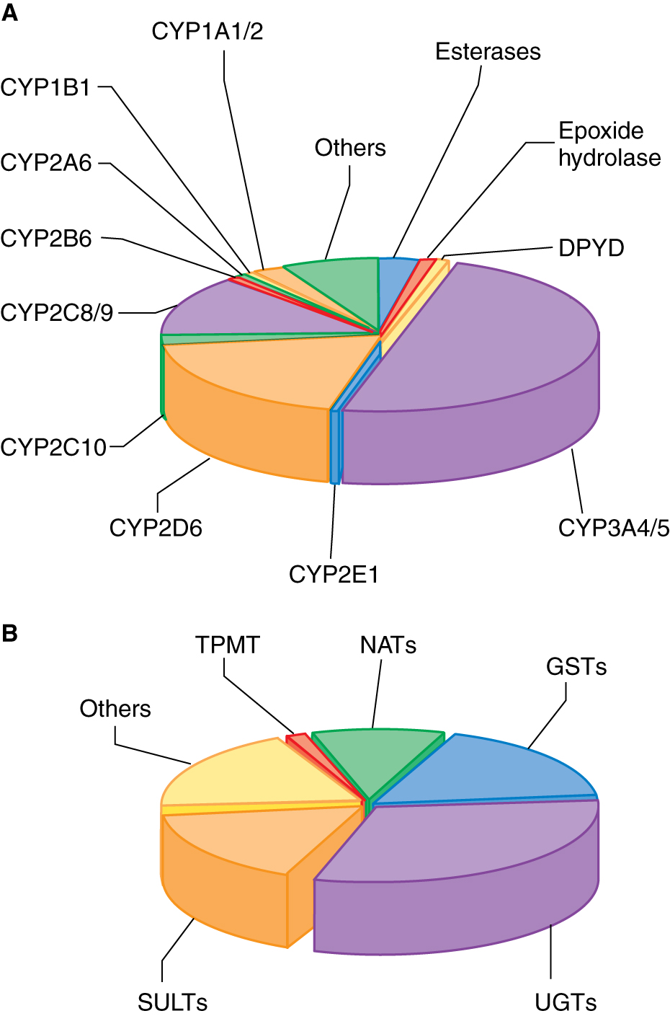
Enzymes involved in drug metabolism
Goodman and Gilman, 2011

Slide 2
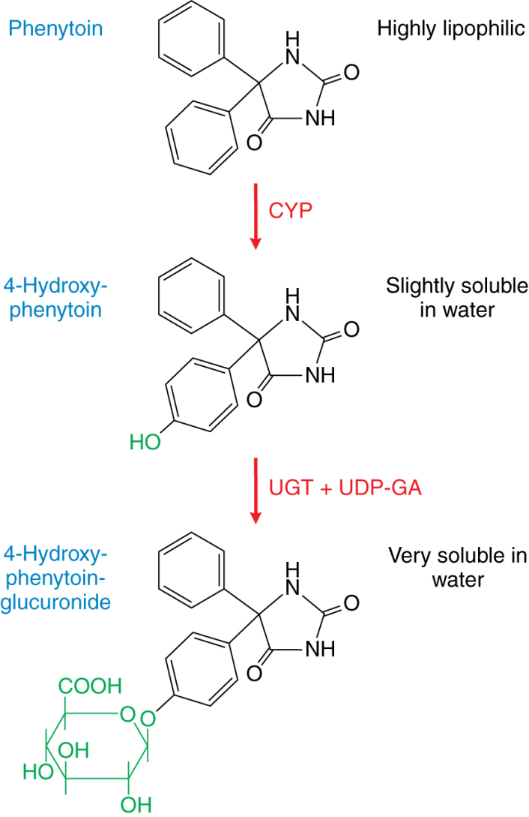
Drug metabolism: phenytoin
Goodman and Gilman, 2011

Slide 3
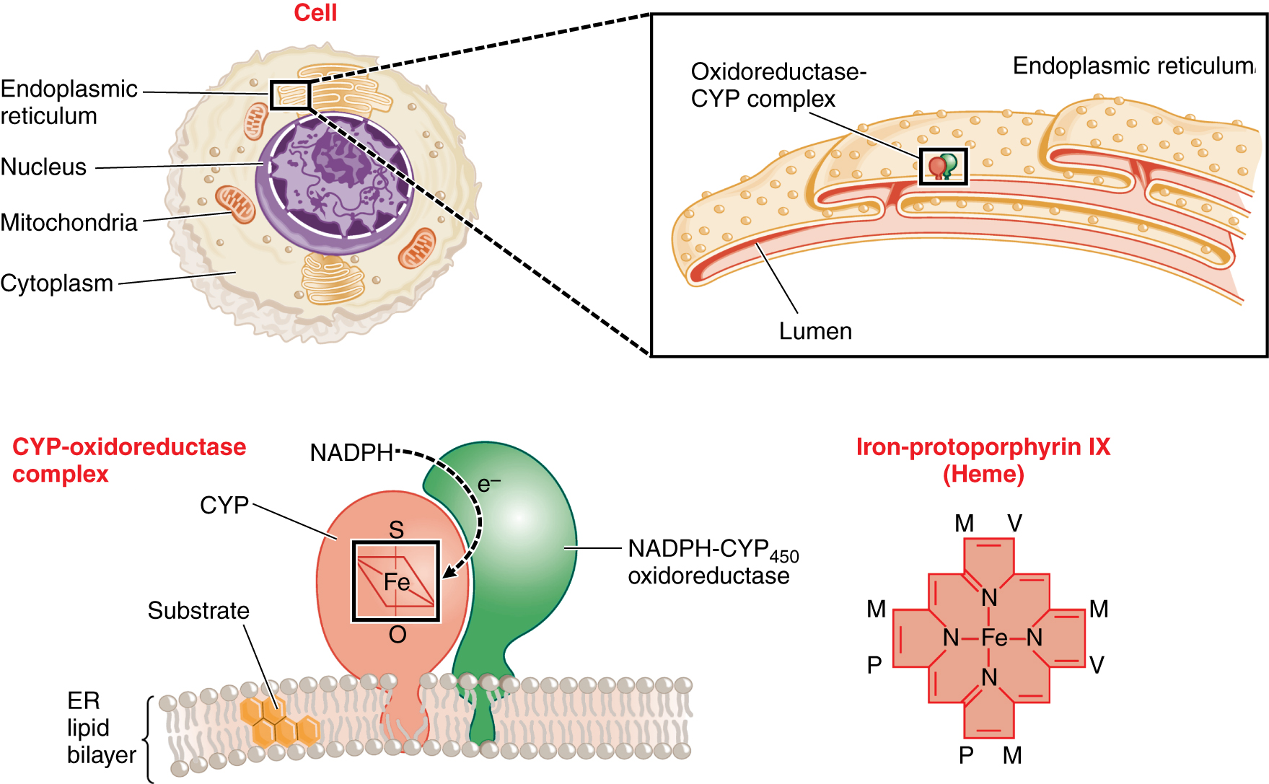
Intracellular localization of drug metabolizing enzymes
Goodman and Gilman, 2011

Slide 4
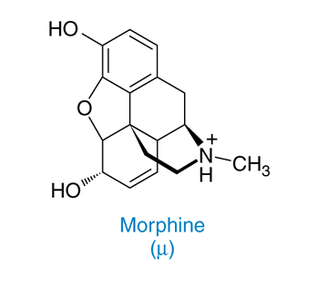
Chemical formula of morphine

Slide 5
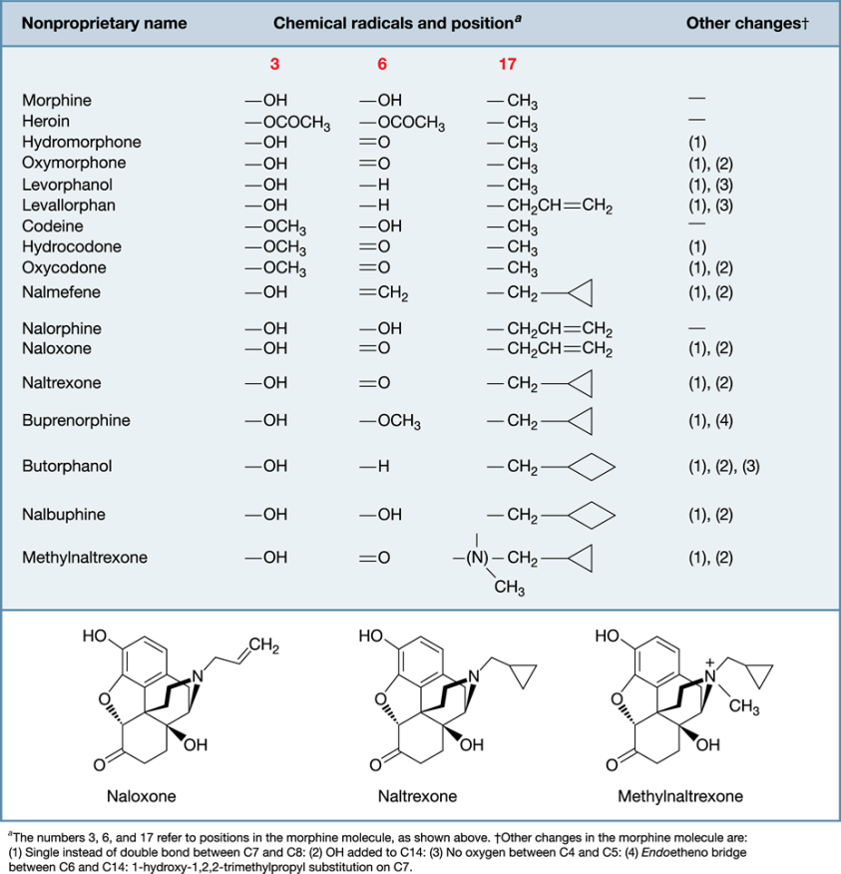
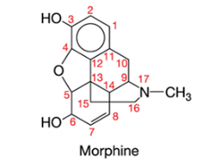
Chemical structures of opioids

Slide 6
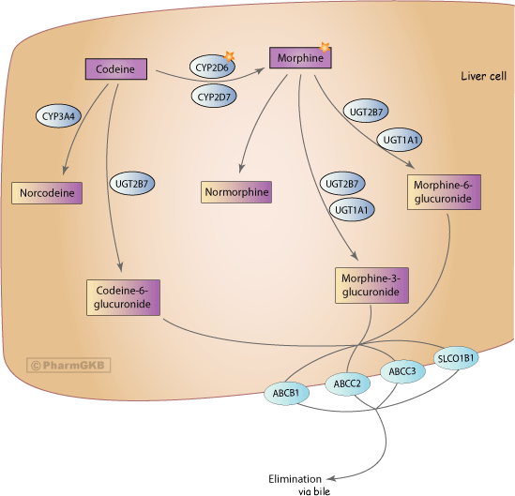
Pharmacokinetics codeine and morphine
Thorn et al., Pharmacogenetics & Genomics 2009

Slide 7
6-glucoronide metabolites of morphine is more active than morphine
Dose from 5 to 37.5 mg morphine every 6 hours
De Gregorti et al., Ther Drug Monit 2014

Slide 8
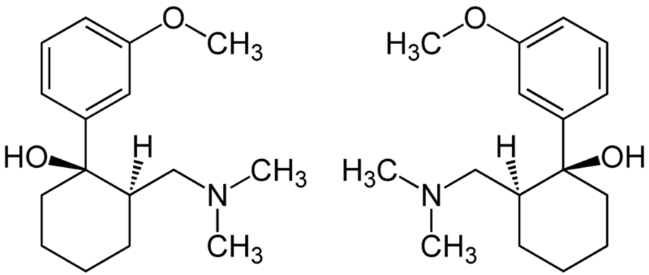
Tramadol
Synthetic opioid of the family of derivatives of amminocycloesanol.
Tramadol acts as an opioid agonist and also as an adreneric and serotoninergic agonist.

Slide 9
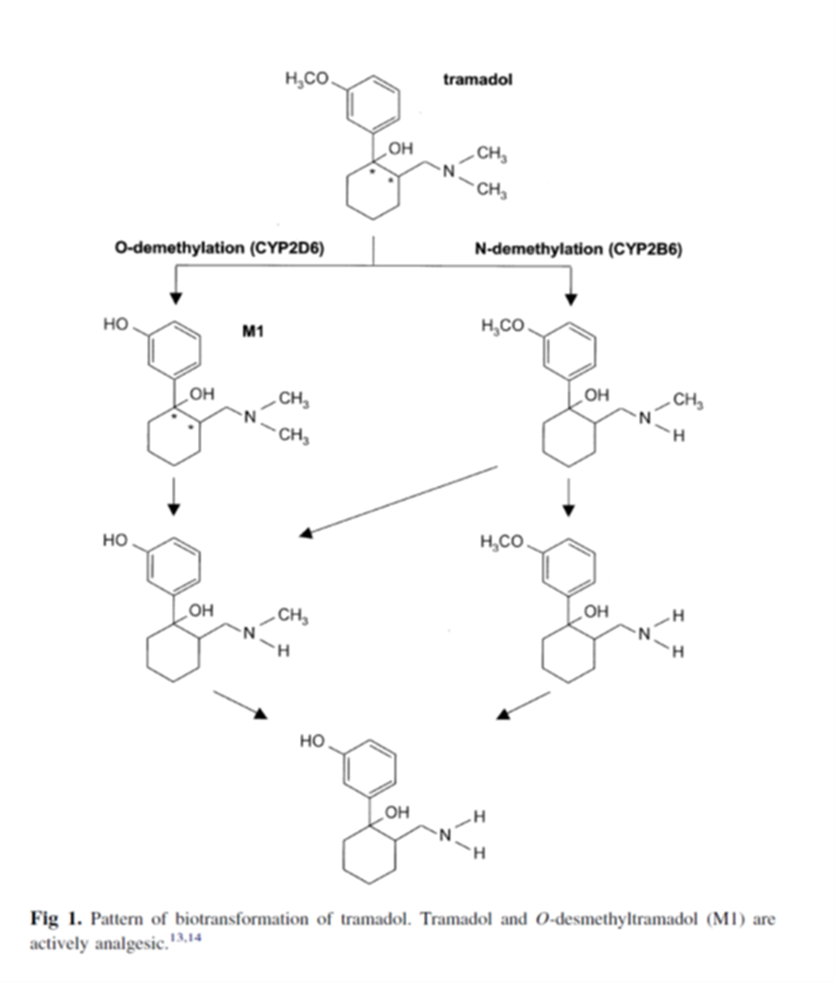
Tramadol biotransformation
(+) - M1: has an activity increased 300-400 for the μ opioid receptor

Slide 10
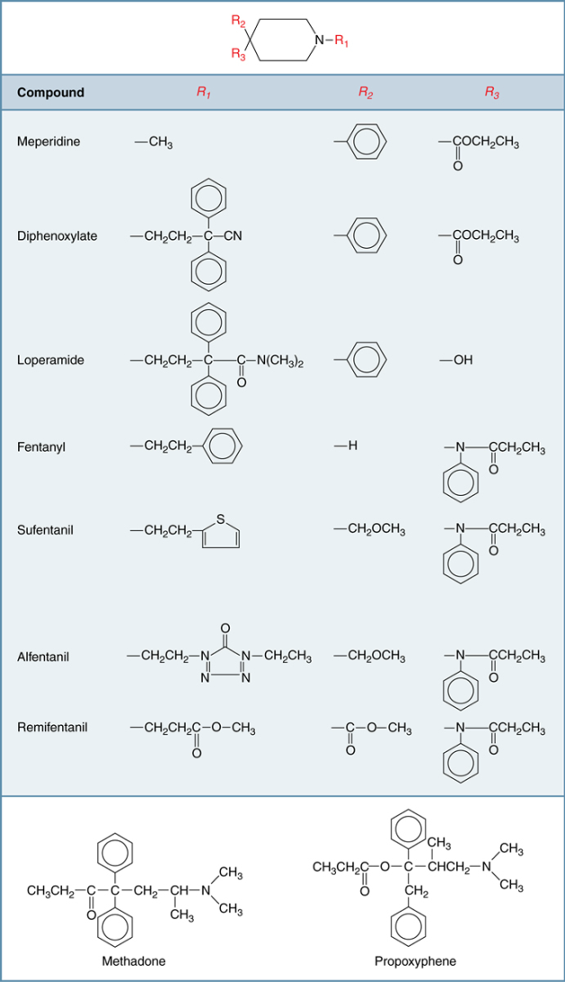
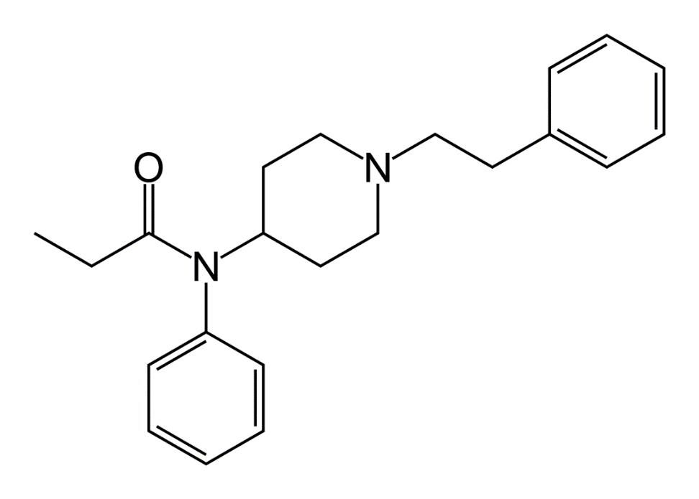
Other opioid agonists
Fentanyl

Slide 11
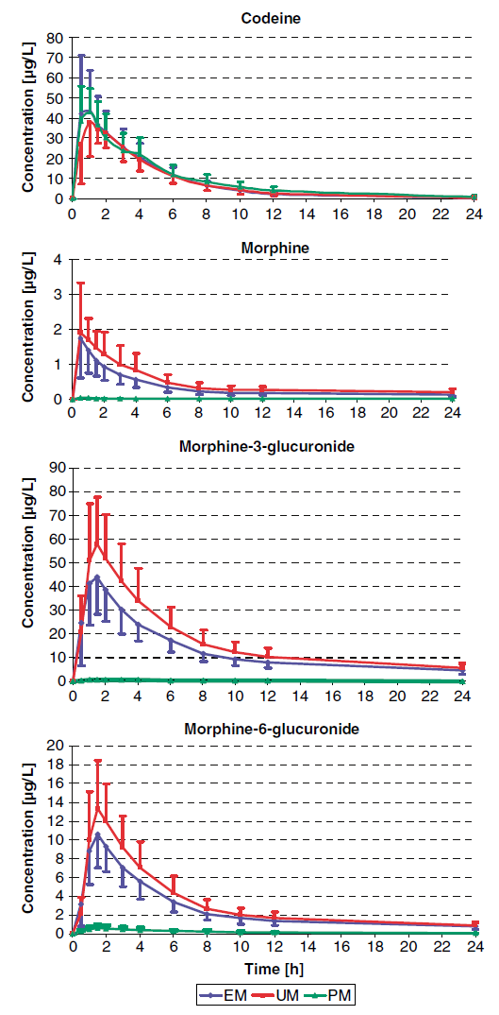
Pharmacokinetics of codeine, morphine and their metabolites and activity of CYP2D6
EM = extensive metabolizer
UM = ultra-rapid metabolizer
PM = poor metabolizer
Kirchheiner et al., Pharmacogenomics J 2007

Slide 12
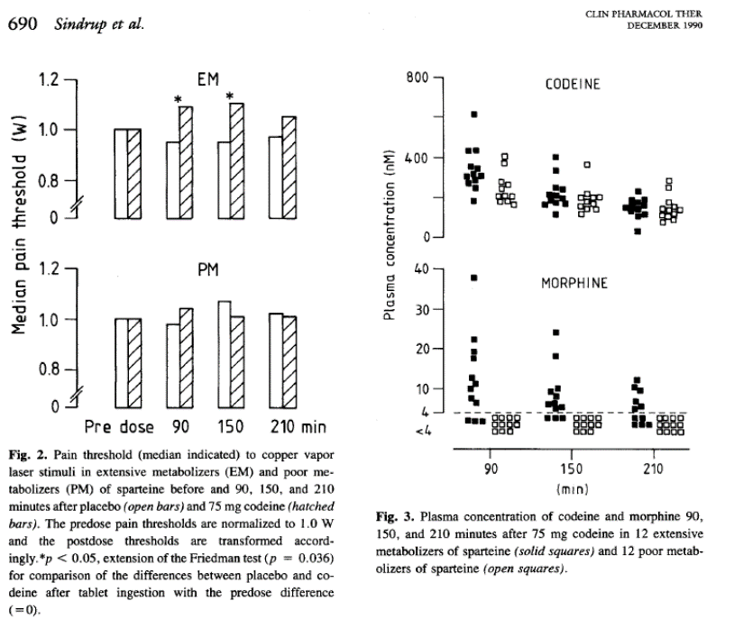
Reduced efficacy of codeine in patients with reduced activity of CYP2D6

Slide 13
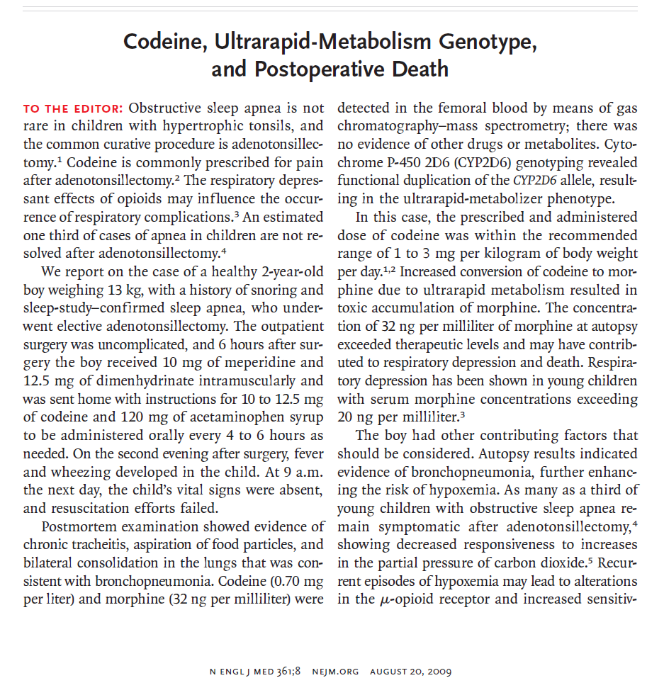

Slide 14
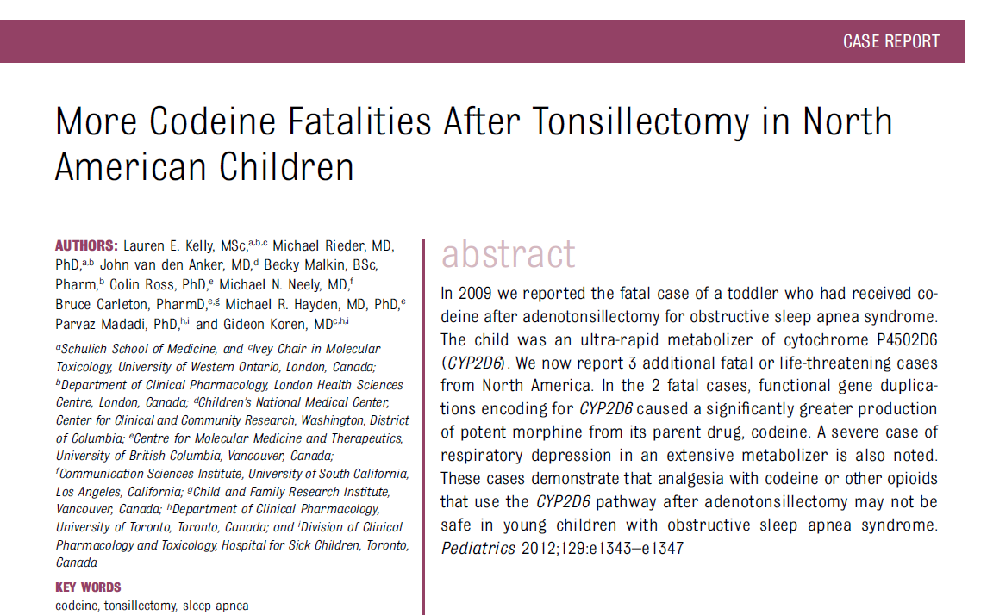
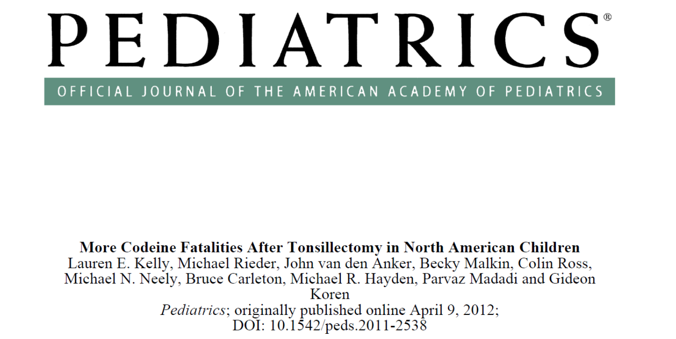

Slide 15
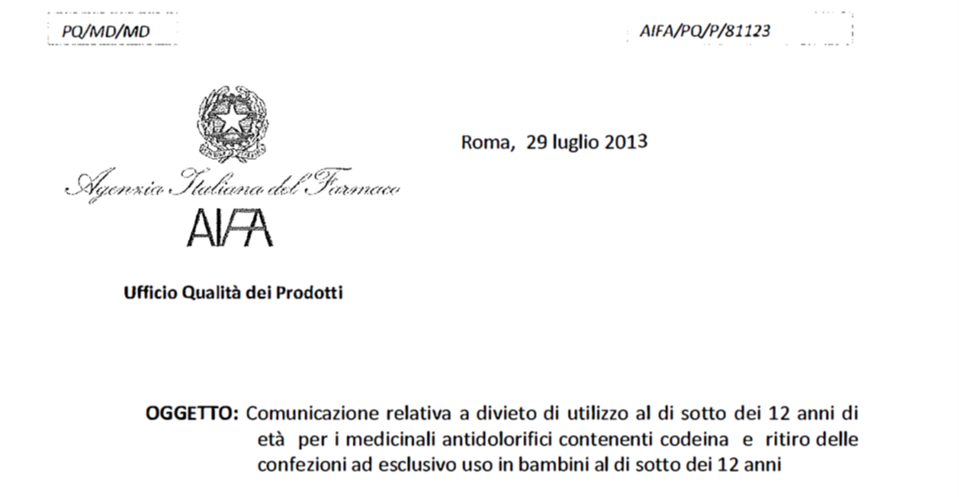

Slide 16
Frazione dei farmaci utilizzati in clinica metabolizzati dai piu’ importanti enzimi di fase 1 e fase 2
Goodman and Gilman, 2011

Slide 17
CYP2D6
DEBRISOCHINA
4-IDROSSIDEBRISOCHINA
Immagine presa da Weinshilboum R. et al., NEJM 348(6), 2006
Weinshilboum R. et al., NEJM 2006

Slide 18
Genetic polymorphisms of CYP2D6
Gene located on chromosome 22
More than 100 variants for this gene have been characterized (https://www.pharmvar.org/gene/CYP2D6).
SNPs and insertions/deletions may reduce the activity of this enzyme (~10% of the population).
Some subjects inherit multiple copies of the gene and display very high activity (2% or more of the population).

Slide 19
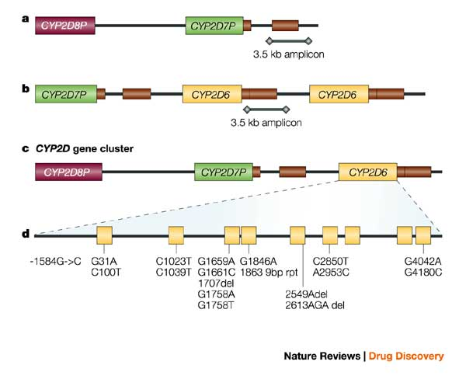
Molecular characteristic of CYP2D6 polymorphisms
- SNP
- deletions
- base repetitions
*4
*6
*3
Deletion of the gene
Amplification of the gene

Slide 20
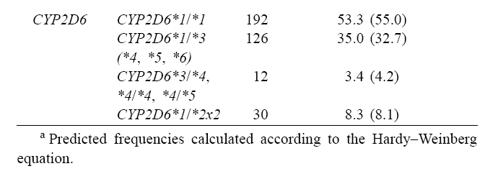
Frequency of CYP2D6 polymorphisms in the Italian population
Scordo et al., Pharm Res 2004

Slide 22
Clinical Guidelines for codeine administration
https://www.pharmgkb.org/chemical/PA449088/guideline/PA166104996

